Slide 1
Streamlined UIP
101
Student Performance Priorities and Targets

Slide 2
Session Outcomes
This video will answer the following questions:
What are Student performance Priorities?
What are Targets and Interim Measures?

Slide 3
Student Performance Priorities in the UIP Process
What are Student Performance Priorities?
Student Performance Priorities (SPPs) identify the student data trends that you want to focus on improving.
SPPs should:
Be limited (e.g., 3 or fewer)
Be at the appropriate magnitude
Include evidence and rationale
Address areas where the school is not meeting expectations (local, state, federal, etc.)

Slide 4
SPPs Role in the UIP Process
Once you have a strong foundation in your current state and the trends you're seeing through current performance and notable trends section of the UIP…
SPPs are the student-focused priorities or data trends you’re prioritizing in your plan.
Your SPPs will inform the root causes you select, the strategies you choose to address your Priorities, and the actions you progress monitor.

Slide 5
Example
Student Performance Priority: Low Student Attendance
“Attendance decreased in 2019 and continues to be below expectations. The attendance rate at the school was tracking about 2% lower in 2020 before the shutdown. Attendance saw a small increase in 2021 but is still a focus.”
Addresses student data trends
Includes rationale
Addresses an area where the school is not meeting expectations (i.e., local, non-assessment data)
Focused and at the appropriate magnitude

Slide 6
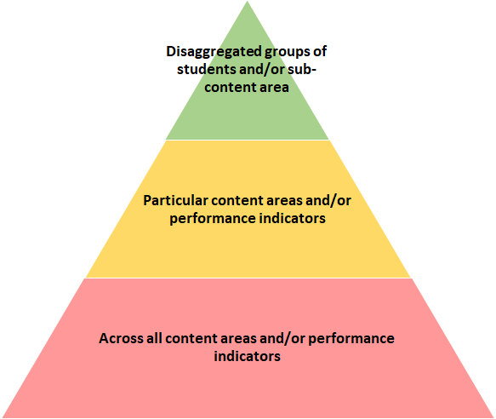
Examples of Levels of Magnitude
For the past three years, students with IEPS have demonstrated declining growth in math that is well below state expectation. Overall, the school’s math achievement is trending upward.
Achievement in mathematics has increased over the last three years but is well below minimum state expectations.
For the past three years, achievement and growth has been flat and well below state expectation across all content areas, subgroups, and grade levels.

Slide 7
Common Misconceptions
SPPs only address areas where the school is not meeting state expectations.
Both state and local data can be used to define performance priorities, including non-assessment data (e.g., attendance).
SPPs address adult actions.
PPCs should be specific statements about student performance. They are not action steps that need to be taken, or concerns about budget, staffing, curriculum, or instruction. Adult actions will be addressed in other areas of the UIP.
SPPs focus on no more than one student data trend.
A single PPC can synthesize multiple concerning trend statements. For instance, both the growth and achievement of students with disabilities in English Language Arts may be combined as a single PPC.

Slide 8
Priorities and Targets in the UIP Process
What is Target Setting?
Target Setting is the process that tells us HOW MUCH we plan to improve each year over time.
Targets are established for each year over two years.
Targets should be directly aligned to the Student Performance Priority.
The targets for associated interim measures should reflect a metric in common with the Student Performance Priority.

Slide 9
The Role of Target Setting in the UIP Process
The Target Setting process allows us to understand the impact of improvement strategies in addressing the identified priority performance priorities(s) over time.
The monitoring of targets with interim measures allows us to determine if major improvement strategies are having a potential impact on priority performance prioritiess by addressing the identified root causes.

Slide 10
Common Misconceptions
The target setting process should be limited to state assessment data
Both state and local data can be used for target setting. This includes non-assessment data (e.g., attendance).
Target setting is limited to the school level
Targets should be established in relation to the groups identified by your priority performance priorities. So, the inclusion of disaggregated targets is encouraged (e.g., FRL, ELL, achievement level).
Using the same target is appropriate for all monitored outcomes.
Improvement strategies impact assessment outcomes differentially with annual results impacted by fidelity of implementation.
Growth on state assessments is incremental
Student growth percentiles on state assessments are determined using a normative approach. So, growth targets are better defined in relation to state defined expectations.

Slide 11
Why Student Performance Priorities & Targets Matter
SPPs focus your improvement efforts on the priorities you’d most like to improve
SPPs frame investigation into root cause analysis
SPPs define clear performance efforts and support strong target setting and interim measures
Targets allow us to determine if our strategy is working for all students and/or certain groups of students.
Interim Measures allow us to measure progress while providing a signal for a need to adjust our strategies.

Slide 12
Email any questions to uiphelp@cde.state.co.us
Thank you for your time!
Notes:
Thank you for your time today. If you have any questions, please email uiphelp@cde.state.co.us

Slide 13
What are interim measures?
Interim Measures
Are measures that allow us to:
look at student outcomes relative to our established targets.
Measure how student performance outcomes are changing.
Tell us whether our strategy is effective.
Notes:
Implementation Benchmarks can sometimes be confused for two other elements of the improvement planning process—Interim Measures and Action Steps—but they differ from each in crucial ways.
Implementation Benchmarks look at adult actions and systems, and they measure how these actions and systems are changing over the course of the year. Interim Measures specifically look at student outcomes, and measure how student performance is changing over the course of the year.
Unlike Implementation Benchmarks and Interim Measures, Action Steps do not “measure” anything; rather, they pace out and detail the specific tasks or actions that will be needed to implement the strategy.

Slide 14
Examples of Targets
Targets define desired student outcomes for two school years and align directly to the priority performance priorities. For instance, if a Student Performance Priority is
CMAS English Growth and Status are below state and district average (25 MGP and mean scale score of 729, respectively).
Then the annual targets might be
 | ELA Growth | ELA Mean Scale Score
Year 1 | CMAS ELA Growth will attain the state expectation for ‘approaching’ which is a MGP of 35 for ELA growth | CMAS ELA Mean Scale Score will increase by 5 points to 734
Year 2 | CMAS ELA Growth will attain the state expectation for ‘approaching’ which is a MGP of 35 for ELA growth | CMAS ELA Mean Scale Score will increase by 5 points to 739

