Slide 1


Ramping up Root Cause Analysis for UIP

Slide 2


Introductions
CDE: Improvement Planning Unit | Center for Transforming Learning and Teaching (UCD)
Erin Loften Lisa Medler | Julie Oxenford O’Brian

Slide 3
Session Purpose
Deepen practices involved in root cause analysis as part unified improvement planning.

Slide 4
Introductions
Share:
Name, Job Title, School/District/Organization
Do a Round Robin to share:
  Your role in Unified Improvement Planning
  Your most important outcome for this session

Slide 5
Materials

Slide 6


The materials used during this session were developed in partnership with the Center for Transforming Learning and Teaching in the School of Education and Human Development at the University of Colorado Denver.

Slide 7
Norms
The standards of behavior by which we agree to operate while we are engaged in learning together.

Slide 8
Session Outcomes
Define and explain the role of root cause analysis in Unified Improvement Planning (UIP).
Describe the critical steps of a root cause analysis as part of improvement planning.
Identify tools available from various sources to collect program and perception data to support root cause analysis.
Plan to use one or more new data collection instrument to support root cause analysis.
Make effectively use of process and perception data as part of facilitating Root Cause Analysis.
Engage in hands-on learning activities and dialogue with colleagues.
Access additional resources.
Complete follow-up activities.

Slide 9
Agenda
Policy Changes for 2015-16 UIP
Root Cause Analysis Basics
Process and Perception Data
Expanding RCA Data Sources
Using Data in Root Cause Analysis

Slide 10
Policy Impacts on UIP for 2015-16
State Transition to new assessment system:
  CMAS Science and Social Studies first administered in the 2013-14 school year.
  CMAS administered by PARCC in English Language Arts and Mathematics first administered in the 2014-15 school year.
2015 Statutory Changes:
  HB 15-1323 – State Assessment Administration and Data Use
  SB 15-056 – Frequency of State Social Studies Assessment
  HB 15-1170 – New Postsecondary and Workforce Readiness Measures for 2017-17
READ Act Requirements to be met by the UIP

Slide 11

2015
2016
Feb | Mar | April | May | June | July | Aug | Sept | Oct | Nov | Dec | Jan | Feb | Mar | April | May
CMAS (PARCC)*
CMAS (PARCC)*
CMAS (PARCC)*:
ELA & Math EOY
Assessment
PBA
EOY
CMAS: Sci & SS
College Entrance
2015 ELA/Math Achievement
Scores
expected
release
2015 ELA/Math Growth Results
MAY be
released
Reporting
Informational SPF/DPF 2.0
Release
Accountability
UIPs
Due
for posting
Optional Submission
PI/T
PI/T UIPs due
for review
UIPs
Due
for posting
UIP
Tools, p. 3
* Additional reporting release includes July: science and social studies; August: college entrance results; and April: ACCESS for ELLs

Slide 12
2015 School and District Accountability
District accreditation ratings will not be assigned in fall 2015 (based on 2014-15 assessments).
School plan types will not be assigned in fall 2015 (based on 2014-15 assessments).
No Request to Reconsider process will occur for 2015-16; Technical assistance for subsequent requests will be available.
Districts and schools will implement the 2014 plan types during the 2015-16 school year.
CDE will provide an update on assessments and accountability to the Joint Education Committee in 2015 to determine if accountability should resume in 2016-17. * Required by HB15-1323
UIP requirements will hold firm during the 2015-16 school year.
Tools, p. 1

Slide 13
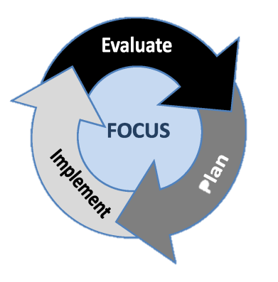
UIP: A framework for Performance Management & Continuous Improvement
Focus on the right things (Performance Indicators)
Evaluate performance (by gathering, analyzing and interpreting data about performance)
Plan (strategies for improvement)
Implement planned strategies
Evaluate (or monitor performance throughout the school year)
Make adjustments to Planned improvement strategies and Implement revised strategies as needed

Slide 14
Unified Improvement Planning Processes
Preparing to Plan
Gather and Organize
Data
Section IV:
Target Setting
Section IV:
Action Planning
Section III: Data Narrative
Review
Current Performance
Describe Notable
Trends
Prioritize Performance Challenges
Identify
Root
Causes
Set
Performance Targets
Identify Major Improvement Strategies
Ongoing:
Progress Monitoring
Identify
Interim Measures
Identify Implementation Benchmarks

Slide 15
Unified Improvement Planning Processes | Types of data used
Review current performance and prior performance targets or goals | State Performance data
Analyze data to identify notable trends | State and Local Performance data
Prioritize performance challenges | State and Local Performance data
Identify root causes of performance challenges | Local Process and Perception data
Establish annual performance targets | State and Local Performance data State and local expectations (comparison points)
Identify measures and monitor the impact of action steps on student performance. | Local Performance data
Identify implementation benchmarks & monitor implementation of action steps. | Local Process and Perception data
Looking Backward
LOOKING FORWARD

Slide 16
Assessment Transition Impact on UIP
Unified Improvement Planning processes remain consistent:
  CDE staff review of priority improvement and turnaround plans remains consistent.
  Deadlines stay the same (including Rural flexibility).
Processes which typically utilize state performance data (metrics and comparison points) will need adjustment for some performance indicator areas:
  Gathering and organizing data
  Reviewing current performance
  Describing notable trends
  Prioritizing performance challenges
  Setting performance target

Slide 17
Unified Improvement Planning Processes
Preparing to Plan
Gather and Organize
Data
Section IV:
Target Setting
Section IV:
Action Planning
Section III: Data Narrative
Review
Current Performance
Describe Notable
Trends
Prioritize Performance Challenges
Identify
Root
Causes
UIP Processes directly affected by the State Assessment Transition and 2015 Policy Changes
Set
Performance Targets
Identify Major Improvement Strategies
Ongoing:
Progress Monitoring
Identify
Interim Measures
Identify Implementation Benchmarks

Slide 18
Opportunities during the state assessment transition. . .
Increase/strengthen use of local assessment resources.
Elementary schools place greater focus on K-3 literacy.
High Schools/districts place a greater focus on post-secondary and workforce readiness.
Schools/districts with English Language Learners place greater focus on their language development.
Put more energy into root cause analysis.
Consider the degree to which improvement efforts are being fully implemented in the school (How do you know?).

Slide 19
Agenda
Policy Changes for 2015-16 UIP
Root Cause Analysis Basics
Process and Perception Data
Expanding RCA Data Sources
Using Data in Root Cause Analysis

Slide 20
Unified Improvement Planning Processes
Gather and Organize
Data
Preparing to Plan
Section IV:
Target Setting
Section IV:
Action Planning
Section III: Data Narrative
Review
Current Performance
Describe Notable
Trends
Prioritize Performance Challenges
Identify
Root
Causes
Set
Performance Targets
Identify Major Improvement Strategies
Ongoing:
Progress Monitoring
Identify
Interim Measures
Identify Implementation Benchmarks

Slide 21
Root Cause Analysis in UIP
Turn to Root Cause Analysis (excerpted from the UIP Handbook) (Tools, p. 7).
As you read this description of Root Cause Analysis for improvement planning, consider the following questions:
  Why is it important to identify root causes?
  What role(s) does root cause analysis play in improvement planning?
When you have finished reading: buzz with a partner with your answers to the above questions.

Slide 22

The Role of Root Cause Analysis
Root Cause Analysis
Action Plan
Priority
Performance Challenges

Slide 23
Non-examples of Root Causes
What is NOT a root cause?
  Student attributes (poverty level)
  Student motivation
  Individual teachers (e.g., Mr. Jones)
Do a whip around with your table group sharing explanations that might appear to be root causes but don’t qualify.

Slide 24
Root Causes are. . .
Statements describing the deepest underlying cause, or causes, of performance challenges.
Causes that, if dissolved, would result in elimination or substantial reduction of the performance challenge(s).
The “why” behind current patterns of performance.
Things that can change and need to change.
The focus of major improvement strategies.
About adult actions.

Slide 25
Steps in Root Cause Analysis
Focus on a performance challenge (or closely related performance challenges).
Consider school/district context (process/perception data).
Generate explanations (brainstorm).
Categorize/classify explanations.
Narrow and prioritize explanations.
Deepen thinking to get to a “root” cause.
Validate with other data (process/perception).
Incorporate external reviews.
Iterative

Slide 26
Steps in Root Cause Analysis
Focus on a performance challenge (or closely related performance challenges).
Consider school/district context (process/perception data).
Generate explanations (brainstorm).
Categorize/classify explanations.
Narrow and prioritize explanations.
Deepen thinking to get to a “root” cause.
Validate with other data (process/perception).
Incorporate external reviews.
Iterative

Slide 27
Agenda
Policy Changes for 2015-16 UIP
Root Cause Analysis Basics
Process and Perception Data
Expanding RCA Data Sources
Using Data in Root Cause Analysis

Slide 28

If you’re only looking at Student Learning, you’re missing 65% of the data.
– Victoria Bernhardt

Slide 29

Multiple measures must be considered and used to understand the multifaceted world of learning from the perspective of everyone involved.
-Victoria Bernhardt

Slide 30

What types of data do we have?
Demographics
Perceptions
School Processes
Student Learning/Performance

Slide 31
Demographics
Enrollment, Attendance,
Race/Ethnicity, Gender,
Drop-Out Rate,
Language Proficiency, Mobility
Victoria Bernhardt

Slide 32
Perceptions
Perceptions of Learning Environment, Perceptions of Teacher Working Conditions, Values and Beliefs, Attitudes, Observations
Victoria Bernhardt

Slide 33
Student Learning (performance)
State-Administered Tests, District Interim Assessments, Cross-classroom assessment, End of unit assessment
Victoria Bernhardt

Slide 34
School Processes
Records of School Programs and Processes, Classroom Records, Classroom Observations
Victoria Bernhardt

Slide 35
Demographics
School Processes
Provides information that allows for the identification of actions, processes, programs that best meet the needs of all students.
Perceptions
Student Learning
(Bernhardt, 2006)

Slide 36
Performance Data | Demographic Data | Process Data | Perception Data
Local (district) summative and interim assessment results Student work samples Classroom assessment results K-3 reading assessment results (required by the READ Act) | School locale and size of student population Student characteristics, including poverty, language proficiency, IEP, migrant, race/ethnicity Student mobility rates Staff characteristics (e.g., experience, attendance, turnover) | External school/district reviews Curriculum documents Instructional materials Observations of Instructional Practice Academic interventions available to students Student attendance Discipline referrals and suspension rates Schedules and class sizes Family/community involvement policies/practices Professional development (structure, participation, focus) Services and/or programs (e.g., Title I, special ed, ESL) MTSS Fidelity of Implementation | Teaching and learning conditions surveys (e.g., TELL Colorado) Perception survey data (e.g., parents, students, teachers, community, school leaders) Self-assessment results
UIP: Trends, PPCs, Targets, Interim Measures
UIP: Root Cause, Action Planning Implementation Benchmarks

Slide 37
What combinations of data types do we need to answer. . .
Is student participation in a reading intervention program associated with increased student learning in reading?
Are teacher perceptions of regarding different aspects of the learning environment associated with different levels of student performance?
Is student participation in our English Language Development program associated with improved student learning results in mathematics?

Slide 38

Activity: Data Questions
Refer to the Data Intersection Questions worksheet (Tools, p. 11).
Consider the questions listed. For each, identify what different types of data would be needed.
Identify 2 additional questions related to the context of your school/district.
With your table group, identify what data would be needed to investigate them.

Slide 39
Agenda
Policy Changes for 2015-16 UIP
Root Cause Analysis Basics
Process and Perception Data
Expanding RCA Data Sources
Using Data in Root Cause Analysis

Slide 40
Process and Perception Data - What do you have? What do you need?
Work in triads to generate a list of process and perception data currently available within your local context.
Work with the same triad to brainstorm answers to these questions (capture on a flip chart page):
  About what aspects of our school/district offerings to students (program/process) would we like to know more?
  About which stakeholder perspectives would we like to know more (e.g., student perceptions of their learning experiences, parent/guardian perceptions of learning opportunities available to their students)?

Slide 41
Measuring Processes and Perceptions
How can stakeholder perceptions be measured?
Self-reported (Surveys, Interviews, Other?)
How can school/district processes/programs be measured?
Self-Reports (surveys/Interviews with participants in processes/programs)
Observation (e.g., walkthroughs, external reviews)
Review of Artifacts (e.g., curriculum resources, policies, meeting minutes)
Other?

Slide 42
Tools to support Data Collection. . .
Survey Instruments
Interview Protocols
Observation Protocols
Criteria
Rubrics/Rating Scales/Checklists
Other?

Slide 43
Rubrics
Rubric: A coherent set of criteria that includes descriptions of different levels of performance quality on the criteria.
Two components:
  Coherent sets of criteria.
  Descriptions of levels of performance.
Why use rubrics?
  Increase accuracy and consistency in measurement.
  Clarify the qualities that are valued.
  Use as the basis for providing feedback for improvement.
(Brookhart, 2013)

Slide 44
Checklists and Rating Scales (Similar to but NOT Rubrics)
Not all evaluation tools are rubrics.
Checklists and Rating Scales include criteria but NO descriptions of levels of performance
Checklists = Lists of criteria that are either met or not.
Two Types of Rating Scales
  Frequency Rating Scales = how often something (criteria) has been done/met
  Quality Rating Scales = judgement of the quality with which criteria were met without specific descriptions of different levels of quality (may involve making a judgement without evidence)
(Brookhart, 2013)

Slide 45
Process and Perception Instruments
Turn to “Process and Perception Measures for UIP,” Tools, p. 13
Work with a partner to process the information in the chart:
  Independently read one row in the chart.
  Turn to your partner and “say something” about what you just read, e.g., a clarifying point, a connection, a summary.
  Continue with each subsequent row in the chart (silently reading and then saying something to your partner).
Once you have read through the entire chart, identify the type of each tool that is described and what kind of data it could be used to capture.

Slide 46
Adding to your Toolbox
Student Engagement
TELL: Educator Perceptions of Teaching and Learning Conditions
Time and Learning
Tools to Measure: Human Capital Systems, Elementary Literacy Programs, PBIS, English Learner Programs, School Effectiveness

Slide 47
Student Engagement Definitions
What is Student Engagement?
Colorado statute defines student engagement as: “a student's sense of belonging, safety, and involvement in school that leads to academic achievement, regular school attendance, and graduation,” (CRS 22-14-102(13)).
Student engagement is visible in the quality of students’ interactions with peers and adults as they engage in learning activities and academic tasks.

Slide 48
Three Dimensions of Student Engagement
Behavioral – involvement in academic, social, and extracurricular activities (positive conduct, absence of disruptive behavior, participation in learning tasks).
Emotional – positive and negative reactions to teachers, classmates and school/school activities (sense of belonging, enjoyment or attachment to school).
Cognitive – mental efforts directed toward learning, use of self-regulated strategies to learn and master complex concepts and difficult skills (investment in learning, perseverance in the face of challenge).
  (Fredricks, Blumenfeld, & Paris, 2004, p. 25)
Note: Cognitive Engagement can be considered evidence of student motivation for learning.

Slide 49
Related Concepts
Grit
Student Motivation for Learning
Student Engagement
Self-Regulation
Growth Mindset

Slide 50
Why does student engagement matter?
Students must engage for learning to occur.
Student engagement correlates with measures of student learning/performance.
Student disengagement has been directly linked to student decisions to drop-out of school.
Student engagement is something educators and schools can influence.

Slide 51
Are you thinking about student engagement as part of planning?
Is student engagement included in your school/district Unified Improvement Plan (UIP)?
How could student engagement be included in your UIP?
  For Alternative Education Campuses (schools): as a priority performance challenge.
  Non-AEC Schools and Districts:
    As a root cause of performance challenges
    As the focus of action steps

Slide 52
Why measure student engagement?
To determine if student engagement is a challenge for our school/district.
If student engagement is a challenge, to determine which dimension(s) need improvement, so we can select associated strategies/actions to increase student engagement.
To determine if student engagement is improving (when we take actions to improve it).

Slide 53
Why formalize measures of student engagement
Educators have a basic sense of which and to what degree students are engaged in learning activity:
  Informal checks -> just-in-time adjustments.
Going beyond informal checks to capture and record data about student engagement, helps . . .
  Identify patterns across students, classrooms, schools or the entire district.
  Reveal presence/absence of different dimensions of student engagement.
  Determine if more systematic action is needed.

Slide 54
Measuring Student Engagement
Determine your purpose(s) and how you will use the student engagement results.
Clarify what you want to measure:
  Which dimension(s) of student engagement: behavioral, emotional, cognitive.
  Remember cognitive engagement is most closely associated with motivation for learning.
Collect data about student engagement:
  Use high quality tools (instruments or measures).
  Verify the quality of the measure/instrument.
Clarify what scores/data points will be generated and how to interpret them.

Slide 55
Using Student Engagement Data
To determine if student engagement is a challenge for our school/district.
If student engagement is a challenge, to determine which dimension(s) of student engagement need improvement, so we can select appropriate strategies/actions to increase student engagement.
To determine if student engagement is improving (when we take actions to improve it).

Slide 56
Clarifying your Purpose
Check-in
What purpose(s) do you have for measuring student engagement?
When would it be most helpful to have student engagement results?

Slide 57
Student Engagement Measures
Student self-report (e.g., student survey)
Teacher Observation/Report
Classroom Observation
Interviews

Slide 58
Student Engagement Dimension(s)
Whatever measurement tool is used. . .
Clarify which dimension(s) are being measured:
  Behavioral (student participation, time on task)
  Emotional (belonging, enjoyment and attachment to school)
  Cognitive (investment in learning, perseverance in the face of challenge, use of deep rather than superficial learning strategies)
The next three slides include examples of questions that are part of a student self-report survey for each dimension.

Slide 59
Questions by Dimension of Student Engagement
Behavioral
How often do you come to class unprepared? (homework unfinished, forget to bring books or materials, etc.) **
How often do you complete homework on time?
How often do you skip classes without permission? **
How often do you actively take part in group (class) discussions?
How often do you work hard to do well in school?
Response categories (Never, Sometimes, Often, Always)
** opposite

Slide 60
Questions by Dimension of Student Engagement
Emotional
I feel part of my school
I care about the school I go to
I am happy to be at my school
I don't find school fun and exciting **
I enjoy the classes I am taking
Response categories (Never, Sometimes, Often, Always)
** Opposite

Slide 61
Questions and Dimensions of Student Engagement
Cognitive
I want to learn as much as I can at school
I think it is important to make good grades
I think the things I learn at school are useful
I think a lot about how to do well in school
School is very important for later success
Response categories (Never, Sometimes, Often, Always)

Slide 62
Tools for Measuring Student Engagement
Free Resource: “Measuring student engagement in upper elementary through high school: A description of 21 instruments”
Regional Educational Laboratory Southeast
Review of student engagement measures, including:
  Purpose and Uses – What instruments are available to measure student engagement?
  Technical Quality – What are the characteristics of each identified measure?
Does not include ratings or recommendations

Slide 63
Summary Table of Student Engagement Measures
Turn to: “Student Engagement Measures,” Tools p. 25
Summary of Student Engagement Measures:
  Developers,
  where to access them, and
  which dimension(s) of student engagement they measure.
Most are available for free.

Slide 64
Using Currently Collected Data
We already collect data that seems like it is related to student engagement, can we use it?
Examples:
  Attendance, Truancy, Student Re-engagement, Returning Students, ICAP completion, discipline information, grades, Some questions included on a school climate/culture/safety survey
Clarify what is being measured (and to what dimension of engagement the data relates).
Consider using as a “flag” or an “early warning” rather than your only student engagement measure.

Slide 65
Checking your Thinking
For which dimension(s) of student engagement could the following metrics be a flag:
    Average Daily Attendance Rate - the total number of full or partial days attended out of the total possible days attended for the most recent three years.
    Truancy Rate - the total number of full or partial days that students were absent without an excuse out of the total possible days attended for the most recent three years.
    Student Re-engagement – of student who had previously dropped out that re-enrolled in the most current year, the percent that remained enrolled through the end of the year.
    Returning Students - Of students who completed the prior year at this school and were eligible to return, the percent who re-enrolled and attended this school for at least 8 weeks during the current year.

Slide 66
Adding to your Toolbox
Student Engagement
TELL: Educator Perceptions of Teaching and Learning Conditions
Time and Learning
Tools to Measure: Human Capital Systems, Elementary Literacy Programs, PBIS, English Learner Programs, School Effectiveness

Slide 67
TELL Survey
TELL = Teaching, Empowering, Leading and Learning.
On-line anonymous survey of public school educators about perceptions of current teaching and learning conditions.
20-30 minute survey - “yes/no” and “Likert scale” ??s
Data available at school, district, and state levels.
Spring 2015 was the fourth administration of this biennial survey first established in 2008 through HB08-1384.

Slide 68
Previous TELL Colorado Initiatives have shown. . .
It’s About Kids: School conditions can constrain or catalyze effective teaching and student learning. Reports in 2009, 2011 and 2013 demonstrate connections to state assessment results.
It’s About Keeping Effective Teachers: Conditions have a strong influence on teacher retention and future employment plans, especially school leadership.
Where You Sit Shapes How You See Things: Conditions are perceived differently within and across schools by role and experience.

Slide 69
What we have learned over time. . .
Overall, Colorado educators are very positive about school conditions!
Time is consistently the biggest challenge.
Sense of efficacy and support from leadership affects teacher attrition more than other factors (e.g., salary).
Effective induction support and mentoring is not systematically available to novice educators.
The construct with the strongest relationship to student performance is community involvement and support.

Slide 70
About the 2015 Respondents
51 percent of Colorado educators participated.
31,849 Educators:
  10,631 (88.9 percent) Teachers
  607 (1.9 percent) Principals
  503 (1.6 percent) Assistant Principals
  2,440 (7.7 percent) other education professionals (school counselors, school psychologists, social workers, etc.)
991 schools met or exceeded the 50 percent participation threshold (55 percent).

Slide 71
2015 TELL Survey State Results
About 85% of respondents agree that overall their school is a good place to work and learn (increase from 83% in 2013).
Colorado educators indicate that Community Support and Involvement in schools remains positive and stable.
Educators view of time for teaching improved slightly, but it remains the least positively viewed teaching condition assessed in the survey.
While nearly all respondents (94%) report teachers use formative assessment to make adjustment to instruction, they reported less use of assessments administered outside of their classroom (declined from 75% to 59%) and fewer indicated state and local assessment data are useful to improve student learning (65% to 49%).
Less than half of participants (44%) in 2015 agree that the teacher evaluation process accurately identifies effectiveness, compared to 62% in 2013.

Slide 72
TELL Survey Basics
Work with a partner, and review the 2015 TELL Survey Basics handout (Tools, p. 29) and Using Your TELL Data (Tools, p. 35).
Answer the following questions:
What is the purpose of the TELL Survey? How should it be used? What are ways it should not be used?
From whom is data collected?
What response rate is required for results to be reported?
Have you accessed your district/school TELL survey results? Did your district/school have a high enough response rate for results to be reported?

Slide 73
TELL Terminology
Consider the “TELL Terminology” – at the end of the 2015 TELL Basics handout (Tools, p. 34).
What is a construct?
What are items?
What does TELL mean by “Teaching Conditions?”

Slide 74
Survey Focus: TELL Constructs
  Time
  Facilities and Resources
  Community Support and Involvement
  Managing Student Conduct
  Teacher Leadership
  School Leadership
  Professional Development
  Instructional Practices and Support
Consider the description of the TELL Survey Focus, discuss the following:
Why would it be important to find out about teachers’ responses related to each of the listed constructs?
How could knowing about teacher perception of these aspects of their working conditions help with root cause analysis?

Slide 75
Using TELL Results in UIP
Root Cause Analysis:
  Setting the stage for root cause analysis by considering the school/district context.
  Validating proposed root causes.
Implementation Benchmarks:
  Measuring the degree to which action steps related to improving the working conditions of teachers have been implemented.

Slide 76
TELL Reports
Tellcolorado.org
Reports/Views:
  Detailed Results for 2015 [PDF]
  Summary Results for 2015 [Excel or PDF]
  Summary Comparison Results 2011, 2013, 2015 [Excel or PDF]
Interactive Tool (New for 2015!)
  Individual School or District HEAT Maps
Additional reports for districts (not public):
  Scatterplot [Excel]
  By School Heat Map for Districts [Excel]

Slide 77
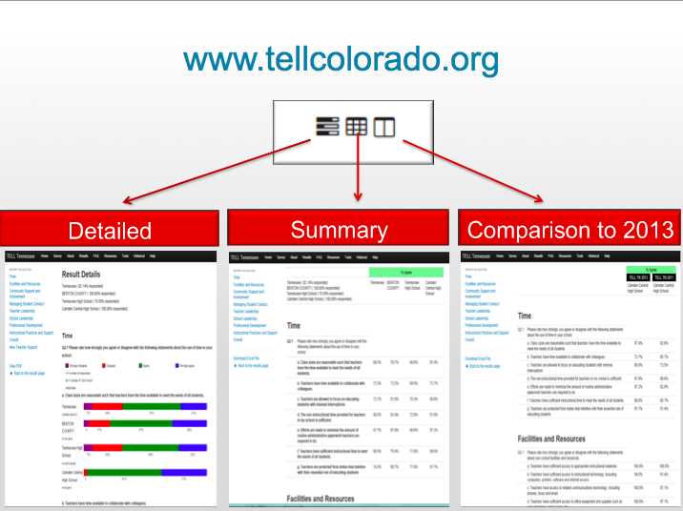

Slide 78
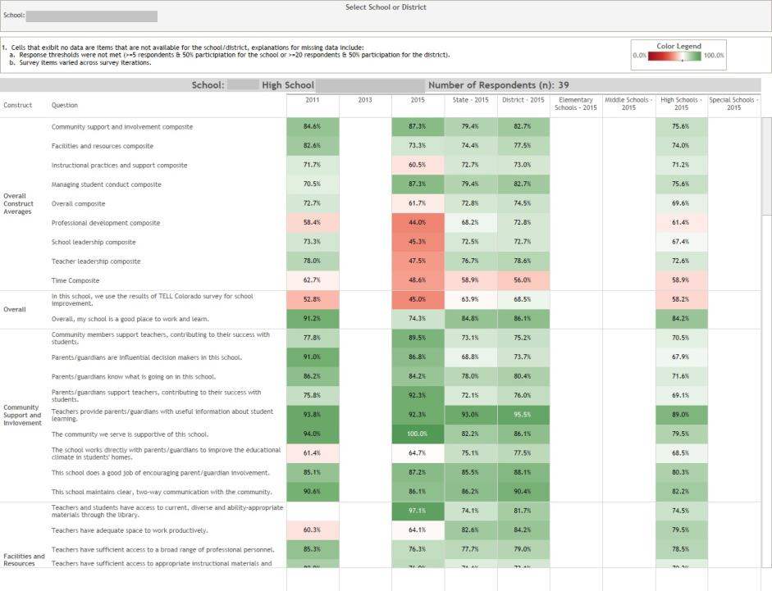
Interactive School/District Heat Map

Slide 79
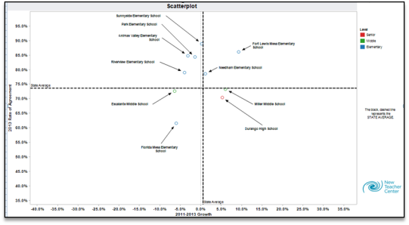
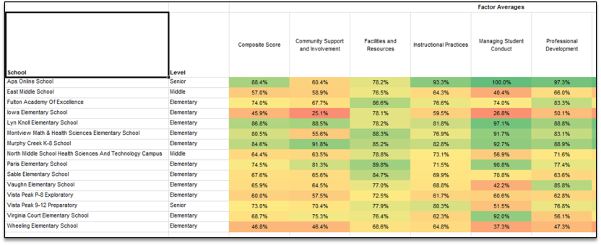
Scatter Plot
By School HEAT Map

Slide 80
A path through the TELL Data
Review Constructs
Examine Items Within the Construct
Determine an Item of Focus
Determine a Construct on which to Focus
Analyze Individual Items

Slide 81
Lots of Data, Where to Start?
Use HEAT Maps to identify a construct to start with:
  For which constructs were our teachers’ responses significantly lower than others? (compared to…)
  Significantly higher? (compared to…)
Consider state-level results by construct:
  Time continues to be the least positively viewed teaching condition assessed in the survey.
  In reporting on their Instructional Practices, educators report high levels of use of classroom assessment, but declining use of state and district administered assessment results.
  In reporting on Supports, less than half of the respondents (44%) in 2015 agree that the teacher evaluation process accurately identifies effectiveness, compared to 62% in 2013.

Slide 82
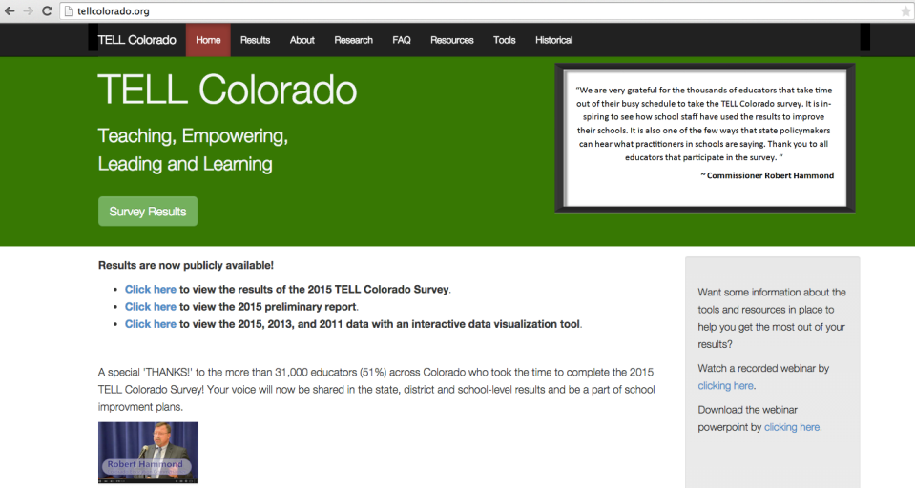
Accessing TELL Results
TELLCOlorado.org
www.tellcolorado.org
All districts and schools with at least a 50% response rate (and a minimum of 5 responses).
Survey Results:
  By District
  By School
Have you accessed your TELL Survey Results?

Slide 83
Practice
Access your school/district TELL Data, either:
  Review your School/District Level HEAT maps (interactive tool), or
  Download the spread sheet of your Summary Results or Summary Comparison Results.
Consider:
  On which construct(s) would you focus first?
  What would be your path through your TELL data?

Slide 84
Relating TELL Results to Root Causes
Common Root Causes | Related TELL Results
Culture of low expectations | “Instructional practices and supports” section on staff beliefs
Not enough time for instruction | Any items in the “Time” section
School does not have a system to address student behavior | Any items in the “Managing student conduct” section
Staff turnover | “Overall” section on future employment plans and reasons for staying
Staff need to strengthen their skills | Any items in the “Professional development,” “Instructional practices and supports,” and “New teacher supports” sections

Slide 85
Adding to your Toolbox
Student Engagement
TELL: Educator Perceptions of Teaching and Learning Conditions
Time and Learning
Tools to Measure: Human Capital Systems, Elementary Literacy Programs, PBIS, English Learner Programs, School Effectiveness

Slide 86
Time and Learning
National Center on Time and Learning
“Redesigning and significantly expanding the school day can give students nearly two additional years of learning time. When done well, expanding learning time raises achievement, enriches education and empowers teachers.”
Tools to support local decision-makers in expanding learning time.

Slide 87
Considering School-Level Tools
Turn to “Process and Perception Measures for UIP: Time Use in Educational Setting”, Tools p. 13.
Tools include:
  Classroom Analysis Tool
  School Time analysis Tool
  Expectations for Effective Teams Comprehensive Analysis
  Framework for Assessing School Community Partnerships
  Framework for Assessing Enrichment Programming
  Framework for Assessing Teacher Collaboration
Which could be useful in your setting?

Slide 88
Adding to your Toolbox
Student Engagement
TELL: Educator Perceptions of Teaching and Learning Conditions
Time and Learning
Tools to Measure: Human Capital Systems, Elementary Literacy Programs, PBIS, English Learner Programs, School Effectiveness

Slide 89
Instrument Descriptions
Turn to “Instrument Description Template” (Tools, p. 23).
What information is provided about each instrument?
Consider:
  What type of tool is it?
  On what does it focus?
  At what level or levels (district, school, classroom) is it intended to be used?
  From whom will data be collected?

Slide 90
Prioritize Instruments to Review
Review your notes about what aspects of the school/district offerings to students you would like to know more. . . (Note Catcher, p. 3).
Utilize Assessment Instrument Descriptions (Tools, p. 39-55).
Identify connections to:
  Human Capital Systems,
  Elementary Literacy Programs,
  PBIS,
  English Learner Programs, and
  School Effectiveness

Slide 91
Reviewing Tools. . .
Select a tool to review (work with a partner if available).
Consider these questions:
  What kind of tool is it?
  About what aspects of our school/district processes can this tool help us collect data? What questions could it help us to answer?
  When could we use it?
  How would we use it?
  How can the results help us better understand root causes of our priority performance challenges?

Slide 92
Adding to your RCA Toolbox
Turn to “Adding to your Root Cause Analysis Toolbox (Note Catcher, p. 6).
Identify additional data collection tools you will use in Root Cause Analysis. Make notes about:
  The focus of the tool
  The questions it can help to answer
  The time frame for using the tool to collect data
  Who will be involved

Slide 93
Agenda
Policy Changes for 2015-16 UIP
Root Cause Analysis Basics
Process and Perception Data
Expanding RCA Data Sources
Using Data in Root Cause Analysis

Slide 94
Steps in Root Cause Analysis
Focus on a performance challenge (or closely related performance challenges).
Consider school/district context (process/perception data).
Generate explanations (brainstorm).
Categorize/classify explanations.
Narrow and prioritize explanations.
Deepen thinking to get to a “root” cause.
Validate with other data (process/perception).
Incorporate external reviews.
Iterative

Slide 95
What
process(es)
did we use?
What context data did we consider?
All possible explanations of performance challenge go in the outer circle
Possible Explanation
Possible Explanation
Performance Challenge
Possible Explanation
Possible Explanation
School Process Data
Perception Data
Circle map used with permission from Thinking Maps, Inc. Specific training required before implementing Thinking Maps.
For more information, visit www.thinkingmaps.com.

Slide 96
Circle Map, part 1: Brainstorm Causes of Performance Challenges
Review Circle Map Directions (Tools, p. 57).
Clarify what will focus your brainstorming (priority performance challenge).
Set up the Circle Map.
Create the frame (identify what data you reviewed in preparation for engaging in root cause analysis).
Brainstorm about the possible causes of your priority performance challenge:
  Individuals capture one idea per sticky note.
  Place sticky notes on the circle map.

Slide 97
Circle Map, Part 2: Categorize your Causes
Sort ideas into natural themes by asking: what ideas are similar?
  Work in silence with each person moving sticky notes around on the circle map. Keep moving notes until a consensus is reached.
  Discuss the groupings.
  If some ideas don’t fit into any theme, leave as a stand alone idea.
  If some fit more than one, create a copy and put in both groups.
Create a short 3-5 word description for each grouping.

Slide 98
Scenario: Priority Performance Challenges
In the performance indicator areas of achievement and growth, performance in all grade levels and in all content areas are below minimum state expectations and have been flat for the last three years.
The MGP for all grade levels and subgroups in all content areas is below the state expectation of 55 and has been flat (35-32-38) for the last three years.

Slide 99
Scenario: Context Information
Group Identified Priorities from TELL results:
  All teachers indicated they have insufficient time for instruction.
  70% indicated they have insufficient access to instructional materials and resources.
  83% indicate teachers do not have an appropriate level of influence in the school, 60% indicated they don’t have effective processes for solving problems.
  65% indicate school leadership does not consistently enforce rules for student conduct.
  65-70% indicate professional development is inadequate.
  65% indicate curriculum taught does not meet the need of students.

Slide 100
How groups “get off track” considering context
Off Track
Getting Back On Track
Group members don’t know how to “make meaning” of context data.
Group spends too much time on context without focusing on how it could impact student performance results.
No “formal” context data/information is available.
Plan in advance how you will have teams interpret their context data. Break it into smaller chunks for interpretation (have sub-groups look at parts of it).
Have team members identify theories about the relationship between the context data and student performance before they look at it (if it isn’t already part of the context data).
Talk about the context in categories (consider using causal theories reading as a guide for categories).

Slide 101
Steps in Root Cause Analysis
Focus on a performance challenge (or closely related performance challenges).
Consider school/district context (process/perception data).
Generate explanations (brainstorm).
Categorize/classify explanations.
Narrow and prioritize explanations.
Deepen thinking to get to a “root” cause.
Validate with other data (process/perception).
Incorporate external reviews.
Iterative

Slide 102
What additional information do we need to validate our “root cause” explanations?

Slide 103
Validate Root Causes (example)
0
Priority Performance Challenge: The % proficient/adv students in reading has been substantially above state expectations in 3rd grade but substantially below and stable (54%, 56%, 52%) in 4th and 5th for the past three years.
Possible Root Causes | Questions to Explore | Data Sources | Validation
K-3 is using new teaching strategies, 4-5 are not. | What strategies are primary vs. intermediate teachers using ? | Curriculum materials and Instructional plans for each grade. | K-3 strategies are different from 4-5.
Less time is given to direct reading instruction in 4-5. | How much time is devoted to reading in primary vs. intermediate grades? | Daily schedule in each grade level. | No evidence that less time is devoted to reading in 4-5.
More ELL students in grades 4 & 5. | Is there a difference between ELL and other students’ scores? | NWEA results disaggregated by ELL status. | ELL student performance in reading is higher.

Slide 104
Validating Root Causes
Typically will require time outside of the rest of the RCA.
Must be explicitly identified in the UIP Data Narrative.
Taps Process and Perception Data.
Could include the same data used in considering the school/district context.
May require additional data collection (e.g., identification of what instructional program is being used in different grade levels).

Slide 105
Give us Feedback!!
Written: Use sticky notes
  + the aspects of this session that you liked or worked for you.
  ⬇The things you will change in your practice or that you would change about this session.
  ? Question that you still have or things we didn’t get to today.
  Ideas, Ah-Has, Innovations.
Oral: Share out one Ah Ha!

Slide 106
References
Bernhardt, V. (2006). Using data to improve student learning in school districts. Larchmont, NY: Eye on Education.
Brookhart, S. (2013). How to create and use rubrics for formative assessment and grading. Alexandria, VA: ASCD.
Fredericks, J., McColskey, W., Meli, J., Mordica, J., Montrosse, B., & Mooney, K. (2011). Measuring student engagement in upper elementary through high school: A description of 21 instruments. National Center for Educational Evaluation and Regional Assistance. 98, 1-80.
Lipton, L., & Wellman, B. M. (2012). Got data? now what?: Creating and leading cultures of inquiry. Bloomington, IN: Solution Tree Press.
Preuss, P. G. (2003). Root cause analysis: School leader’s guide to using data to dissolve problems. Larchmont, NY: Eye on Education.

