Slide 1
The Colorado Growth Model
On Track Growth
Webinar Series, Module 2
Notes:
Welcome to the second module of the on track growth webinar series. The goal of the series is to provide stakeholders with the tools to use and understand the new on track growth measure to support improved student academic outcomes.

Slide 2
On Track Growth Webinar Series: Webinar Topics
Overview
The first webinar provides a brief overview of the on track webinar series along with key content.
Growth Model
The second webinar provides a conceptual overview of the Colorado Growth Model and its relationship to the on track growth measure.
On Track Growth
The third webinar provides a conceptual overview of the on track growth measure.
Accountability
The forth webinar provides a brief overview of on track growth in accountability, performance frameworks, along with an anticipated future rollout plan.
On Track Reporting
The fifth webinar provides a brief overview of data files, tools and reports that are available related to on track growth.
Improvement
The final webinar will focus on the use of the on track growth measure within district and school improvement efforts.
Notes:
This second webinar, of six, provides a brief overview of the Colorado Growth Model to support understanding of the on track growth metric. Subsequent modules will further explore the on track growth metric including its relationship to accountability and school improvement.

Slide 3
Session Outcomes
This video will focus on the following topics:
Provide background information related to the Colorado Growth Model (CGM) and its methodology.
Provide an overview of metrics produced by the CGM, including Student Growth Percentiles (SGPs) and Median Growth Percentiles (MGPs).
On Track Growth Webinar Series, Module 2 – Growth Model
Notes:
The two primary desired outcomes of this module include 1) providing background information related to the Colorado Growth Model and its methodology and 2) providing an overview of metrics produced by the CGM, including student growth percentiles and median growth percentiles.

Slide 4
Colorado Growth Model : Overview
Notes:
In order to understand on track growth one must first understand the Colorado Growth model including what it is and isn’t. First we will want to consider the importance of growth data.

Slide 5


Why is Growth Important?
Growth helps us answer different questions than achievement alone. In addition, growth can be achieved by all students and is not strongly influenced by demographics like achievement scores alone.
Growth is required by statute to be the most heavily weighted of accountability indicators.
Big Idea #1: Growth data helps us answer different questions than achievement data.
The growth data from the Colorado Growth model provides a measure of normative performance relative to other similar scoring students (on prior year assessments). Growth data accounts for student demographics and allows us to see relative change in performance across time.
On Track Growth Webinar Series, Module 2 – Growth Model
Notes:
In the state of Colorado, we can point to three different reasons for the elevated importance of growth. First, growth helps us answer different questions then achievement alone. It gives us information about progress relative to peers which tells us more than just if a particular score or achievement level was achieved. In addition, growth can be shown for all students and is not as tightly connected to student demographics or context such as poverty. Thus, no matter where a student starts, academic growth provides a tool to measure progress. Lastly, in Colorado, due to our belief that all students can show growth it has been incorporated into our educational accountability system as the most heavily weighted indicator of district and school performance. The big idea to recognize, is that growth data helps us answer different questions than achievement data alone.

Slide 6
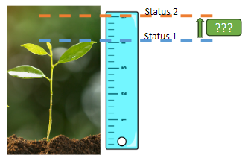

Status & Growth Measures Answer Different Questions
Status (Achievement)
Serves as a good benchmark for setting academic goals and understanding student performance relative to those goals. Focused on a single point in time; less useful for determining how close a student is to reaching the next proficiency level.
Growth
Helps us understand how much progress students are making in comparison to their academic peers. Useful for assessing school/district effectiveness (impact on outcomes) and interpreting the progress of one school/program/group relative to another.
Notes:
Status, such as a student’s performance level on a CMAS assessment, provides a good benchmark for setting academic goals and understanding a student’s performance relative to those goals.
Since a status measurement focuses on a single point in time, it’s less useful for determining how close a student is to reaching the next proficiency level.
However, Growth, as measured by the Colorado Growth Model, helps us understand how much progress students are making in comparison to their academic peers, a group of students in the same grade with similar score histories.
Growth is particularly useful for assessing a school or district’s impact on student outcomes and interpreting how well a school / program did in helping students or a group of students progress relative to others.

Slide 7
Colorado Growth Model :
Methodology and Measures
Notes:
In Colorado, growth is calculated using a normative approach that is based on comparison to academic peers. Let’s briefly explore this methodology and two primary metrics that make up the Colorado Growth Model.

Slide 8
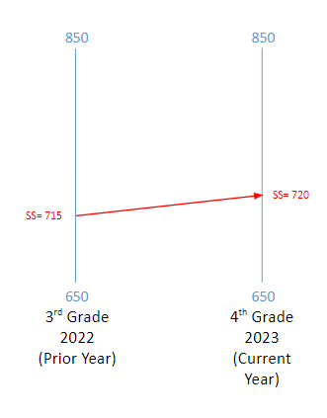
The Colorado Growth Model
The primary metric produced by the Colorado Growth Model is the Student Growth Percentile (SGP).SGP is calculated by comparing each student against an academic peer group with the same score history.
Imagine a student with a prior year CMAS scale score of 715 who scores 720 in the current year.
How do we understand or contextualize their growth? (What does a difference of 5 points really mean?)
  The SGP can help answer this question!
On Track Growth Webinar Series, Module 2 – Growth Model
Notes:
If one was to conceptually describe the Colorado growth model, it is best to begin with its most fundamental measure, the student growth percentile also known as the SGP.. All other Colorado growth model metrics are derived from the student growth percentile, thus making it the single most important concept to understand for those that will be using the related data. Thus, the student growth percentile is considered the primary metric of the system. The SGP is calculated by comparison of an individual students prior year and current year CMAS scores to other students that participated in the same prior year test and had the same previous score history.
Let’s start by imagining a student with a prior year CMAS math score of 715 who scores 720 in the current year. How would we understand or contextualize their growth? We see that the score increased by five points but what does that really mean? The SGP helps to answer this question.

Slide 9
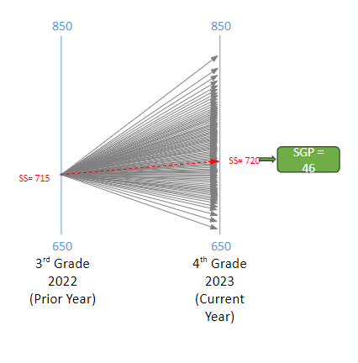
The Colorado Growth Model
To determine the SGP of this example 4th grader, we compare the score trajectories of all students who had the same prior year (3rd grade) score.
This allows us to determine a percentile rank for this student’s growth relative to their “academic peers.”
An SGP of 46 indicates that the student’s growth is greater than 46% of their academic peers.
Big Idea #2: The Student Growth Percentile provides us with a normative measure of growth relative to an academic peer group over time.
This allows us to see how a student is progressing relative to their peers which may not be evident based on achievement scores alone.
On Track Growth Webinar Series, Module 2 – Growth Model
Notes:
To determine the SGP of this student that had a five point scale score increase we would want to compare the change they experienced relative to all the students in the state that had the same prior year scores. This allows us to determine a percentile rank for the student’s growth relative to their ‘academic peers’. The associated percentile in this case is 46 which means the students growth was greater than 46% of their academic peers. This would likely lead us to recognize that while they had a slight increase in the absolute scale score points, they still may be sliding behind their peers given that more than half are growing at a faster rate. Our second big idea is to recognize that the student growth percentile provides us with a normative measure of growth relative to an academic peer group over time. This allows us to see how a student is progressing relative to their peers, which may not be evident based on achievement scores alone.

Slide 10

The Colorado Growth Model: Percentiles
A percentile may be described as the comparison score between an individual score and the scores earned by the rest of a group. It reveals the percentage of scores that a given score surpassed.
So, a Student Growth Percentile represents the percentage of all students within the same academic peer group that had a student growth percentile lower than the student of interest.
Percentiles can also be calculated for larger groups of students to describe their overall performance.
Notes:
Let’s step back for a moment and discuss the concept of percentile specifically and how it relates to the student growth percentile that we just discussed. A percentile may be described as the comparison score between an individual score and the scores earned by the rest of a group. It reveals the percentage of scores that a given score surpassed. So, a Student Growth Percentile represents the percentage of all students within the same academic peer group that had a student growth percentile lower than the student of interest. Percentiles can also be calculated for larger groups of students to describe their overall performance.

Slide 11
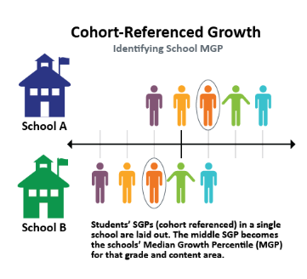
From Student to Median Growth Percentiles
The Median Growth Percentile (MGP) tells us how much a group of students is growing in comparison with other groups.
MGPs represent the summary of student growth percentiles for a given disaggregated group. (The median is used instead of the mean because it is less sensitive to extreme scores).
MGPs are calculated by CDE for the following groups:
  State, districts, and schools (overall and by grade)
  Minority, migrant, gifted, FRL, IEP, multilingual learners, gender, and performance level.
  The state-level cohort MGP will always be about 50.
On Track Growth Webinar Series, Module 2 – Growth Model
Notes:
While the student growth percentile represents growth for a single student, it can be used to help describe the growth of a group of students. The median growth percentile or MGP tells us how much a group of students is growing in comparison to other groups.
The MGP represents a summary of student growth percentiles. The median score or middle score is used to describe the group overall. As can be seen in this illustration, all the students of interest have their SGP laid out from lowest to highest and the score in the middle or median score is selected. It’s worth noting that median is used instead of mean to calculate an average because it is less sensitive to outliers but effectively describes the distribution of scores. This score is known as the MGP and can be used to describe the overall growth of the group of students. CDE calculates MGPs for a number of different groups including at the state, district, and school level. Also, the MGPs of minorities, migrants, gifted, FRL, IEP, multilingual, gender and performance level groups are calculated. These scores can then be used for improvement planning work and accountability determinations.

Slide 12

Summary of Key Points
Growth helps us to answer questions that can’t be answered with achievement scores alone.
The student growth percentile (SGP) provides us with a normative measure of growth relative to an academic peer group.
The median growth percentile (MGP) allows us to compare the normative growth of groups of students, which can then be used for improvement planning and/or accountability purposes.
On Track Growth Webinar Series, Module 2 – Growth Model
Notes:
This module shared three key concepts for your consideration. First, the module described how growth can be used to answer questions that can’t be easily answered with achievement scores alone. Growth provides information that complements status measures. Second, the student growth percentile provides us with a normative measure of individual growth relative to an academic peer group. Lastly, the median growth percentile allows us to compare the normative growth of groups of students, which can then be used for improvement planning or accountability purposes.

Slide 13
Coming Next
The third webinar module will focus on the following topics:
  A conceptual overview of the on track growth measure
including its relationship to achievement, how it’s calculated, and related metrics.
On Track Growth Webinar Series, Module 2 – Growth Model
Notes:
As we move forward, the third webinar module in this series will provide an overview of the on track growth measure This will include its relationship to achievement, its calculation, and related metrics.

Slide 14
Thank you for attending this webinar!
Email any questions to uiphelp@cde.state.co.us
Notes:
Thank you for attending this second module in the on track growth series. Please feel free to email any questions about on track growth or this webinar series to uiphelp@cde.state.co.us.

