Slide 1


Going Beyond TCAP Data for Improvement Planning
Notes:
Peter

Slide 2


Introductions
CDE: Improvement Planning Unit | Center for Transforming Learning and Teaching (UCD)
Darcy Hutchins Christina Larson Alyssa Pearson | Julie Oxenford O’Brian Mary Beth Romke
Notes:
Peter

Slide 3
Session Purpose
Develop background knowledge and provide access to tools to support schools and districts in using a variety of data sources, in addition to TCAP, in unified improvement planning.
Notes:
The purpose for this session is to:
Ensure school planning teams are prepared to identify notable trends and prioritize performance challenges as part of unified improvement planning.

Slide 4
Introductions
Share:
  Name, Job Title, School/District/Organization
  You role in:
    Unified improvement planning
    Your most important outcome for this session

Slide 5
Materials
Notes:
We’ll be using:
UIP Template
UIP Handbook
UIP Tools Packet

Slide 6


The materials used during this session were developed in partnership with the Center for Transforming Learning and Teaching located in the School of Education and Human Development at the University of Colorado Denver.

Slide 7
Norms
The standards of behavior by which we agree to operate while we are engaged in learning together.

Slide 8
Session Outcomes
Turn to “Going Beyond TCAP Data for Improvement Planning: Session Overview” (Tools, p. 1).
Consider: What topics will focus our work together today?
  Is this what you expected to be the focus of the day?
  Do you have questions?
Review Learning Outcomes for Assessment, Data and Education Reform:
  Do they make sense?
  Do you have questions?
Notes:
This session focuses on the following learning outcomes. Participants will:
Describe the major components of the unified improvement planning template
Understand the planning terminology used in the unified improvement planning template.
Recognize how the UIP template supports key planning processes.
Apply the UIP quality criteria.
Describe how local planning teams can represent their work in the template.
Explain which plans the state will review, the timeline and on what criteria the review will be based.

Slide 9
Session Plan
Assessment/Data and Education Reform
English Language Learning
Commonly Used Interim Assessments
Postsecondary and Workforce Readiness
Early Literacy and School Readiness
Equitable Distribution of Teachers
TELL Survey Results
Notes:
This session includes the following topics:
Unified Improvement Planning Basics;
Gathering and Organizing Data
Reviewing Performance Summary
Engaging in Data Analysis;
Developing Action Plans; and
State Review of Plans
If this is your first introduction to unified improvement planning in Colorado you may want to follow the topics in order. Alternatively you can select topics in any order by using the left-hand navigation of this tutorial.

Slide 10
Colorado’s Changing Legislative Context for K-12 Education
HB08-212 – Colorado’s Achievement Plan for Kids (CAP4K)
SB10-191 – Educator Effectiveness Act
HB12-1238 – READ Act
SB09-163 – Educational Accountability Act
Colorado waiver from certain provisions of the Elementary and Secondary Education Act (2012)

Slide 11
Assessment at the core of reform
Colorado education reform initiatives over the last five years require the use of assessment to:
Inform instruction (CAP4K)
Determine students’ readiness for school and if they need a school readiness plan (CAP4K)
Evaluate school and district performance (SB163)
Identify performance trends and prioritize performance challenges (SB163
Measure the progress of school and district improvement efforts (SB163)
Measure principal effectiveness (SB191)
Measure teacher contribution to student learning growth (SB191)
Identify students with significant reading deficiencies (READ Act)
Set performance targets for reducing the number of students with significant reading deficiencies (READ Act)

Slide 12
Colorado Achievement Plan for Kids (CAP4K)
Develop a seamless system of state standards and assessments from preschool through postsecondary and workforce readiness.
Establish early readiness assessments statewide (2013-14) – TS Gold now, others coming.
New assessments in science grades 5, 8 (2013-14) and social studies grades 4, 7 (2013-14) and both grade 12 (2014-15).
PARCC ELA and math grades 3-11 (2014-15).
Use classroom assessment (local) to drive instructional practice.

Slide 13
Educator Effectiveness Act
Educators are evaluated in significant part based on the impact they have on the learning growth of their students.
Required measures of teacher contribution to student learning growth. . .
  When available, state summative assessment results (TCAP).
  When available, Colorado Growth Model results.
  Other local measures (e.g. pre- post- assessment, student learning objectives).

Slide 14
Student Academic Growth Objectives
“A participatory method of setting measurable goals, or objectives, for a specific assignment or class, in a manner aligned with the subject matter taught, and in a manner that allows for the evaluation of the baseline performance of students and the measureable gain in student performance during the course of instruction.”
Also known as Student Learning Objectives.
Assessment results used as:
  Baseline data
  Measures of the gain in student performance at the end of the instructional interval

Slide 15
The READ Act
All districts must assess literacy development K-3 using state approved interim, diagnostic, and summative assessments.
Literacy Development includes: phonemic awareness, phonics, vocabulary development (including oral skills), reading fluency, and reading comprehension.
Use assessment results to identify students with significant reading deficiency.
Use assessment results to monitor the progress of students with significant reading deficiencies.
Use assessment results to establish and evaluate accomplishment of performance targets for UIP.

Slide 16
Educational Accountability Act
School and District Performance Framework:
  TCAP/CSAP Results (CoAlt, Lectura, Escritura)
  Colorado Growth Model Results
  ACCESS
  Early Literacy Assessment Results (by next year)
Developing/Updating Unified Improvement Plans:
  TCAP/CSAP Results
  Colorado Growth Model Results
  ACCESS
  Local assessment data (interim assessment results, early literacy results)
Monitoring UIP Progress (at least quarterly):
  Interim assessment results
  Early Literacy Assessment Results (by next year)

Slide 17
Your plans. . .
How are you thinking about using local assessment resources to meet the requirements of these legislative changes?
Turn to “Assessment at the Core of Reform” (Tools, p. 5).
Identify the assessment resources in your district associated with each of the legislatively mandated uses of assessment.
Compare your list to someone from a different district.
Large group share out. . .

Slide 18
Assessment Transition
Colorado will be transitioning to new state assessments in the next two years, TCAP to CMAS (PARCC).
What we know now. . .
  Colorado Growth Model metrics will continue to be calculated.
  CDE Accountability office will run technical analysis on TCAP to PARCC similar to those regarding the Colorado Growth Model and the transition from CELApro to ACCESS.
  Analysis will focus on ensuring metrics used for accountability accurately and fairly represent school and district performance.
  No adequate growth percentiles will be calculated the first year of the transition from TCAP to PARCC, but will be in subsequent.

Slide 19
Assessment/ Data for Unified Improvement Planning
Preparing to Plan
Gather and Organize
Data
Section IV:
Target Setting
Section IV:
Action Planning
Section III: Data Narrative
Review Performance Summary
Describe Notable
Trends
Prioritize Performance Challenges
Identify
Root
Causes
Set
Performance Targets
Identify Major Improvement Strategies
Ongoing:
Progress Monitoring
Identify
Interim Measures
Identify Implementation Benchmarks
Notes:
The Unified Improvement Planning Template includes several planning processes. In Section I of the template, the primary process in which local planners are engaging is reviewing a summary of the school or district performance.
[Click to highlight Data Analysis]
Section II is designed to support data analysis processes and the development of the school or district data narrative. This includes: gathering and organizing data, describing performance trends, prioritizing performance challenges, and identifying root causes.
Section IV includes two distinct Processes.
[Click to highlight Target Setting.]
The first includes going back to the priority performance challenges identified in section three and setting annual performance targets for two years, for each priority performance challenge. Then for each annual performance target, an interim measure (or measures) should be identified that will be monitored during the year.
[Click to highlight Action Planning.]
The second part of Section IV is action planning. Action planning starts from the root causes that were identified in section three. Major improvement strategies should be identified for each root cause (with some major improvement strategies addressing more than one root cause). Major improvement strategies include action steps, timeline, key personnel, and resources. Then for each action step implementation benchmarks must also be identified. Teams should also indicate the status of action steps that are already in progress.
[Click to highlight progress monitoring.]
The interim measures and implementation benchmarks identified in the unified improvement plan establish two critical components for schools and districts to monitor their progress multiple times during the school year.

Slide 20
Some Key Data Terminology
Work as a table group. Select a recorder.
Discuss the difference between a measure and a metric.
Create a T-Chart with metric on one side and measure on the other and put the following terms under the appropriate heading:
Measure
Metric
  Assessment Instrument
  TELL Survey
  October Count
  DIBELS
  ACCESS
  % proficient or advanced
  Scale Score
  Drop-Out Rate
  % of teachers who agree that the non-instructional time provided for teachers in my school is sufficient
  NWEA Maps
  Acuity
Notes:
Consider the Unified Improvement Planning Terminology (in the Unified Improvement Planning Handbook, Appendix A)
What is the relationship between performance indicators, measures, metrics and targets?
How does root cause identification and target setting depend on appropriate identification of priority performance challenges?
What is the relationship between major improvement strategies and action steps?
How are interim measures and implementation benchmarks similar and different from one another?

Slide 21
Metrics (Levels)
Two levels of metrics:
  Individual
  Group
Examples of groups:
  All students in the school/district
  All students in a grade level
  Students in a disaggregated group
  Students in a classroom
Group metrics are aggregates of individual metrics (e.g.: mean, median, percent, sum).
What metrics do we use for planning?

Slide 22
Levels and Metric Examples (TCAP)
Levels
Example Metrics
Individual
Classroom (formal)/Individual.
Group
Aggregate school/district over-all or grade-level.
Standard/strand (grade-level).
Disaggregated group
(ELL, IEP, FRL, minority).
Individual
individual performance rating, student growth percentile, scale score.
Group
%/number scoring at each performance level, MGP, & AGP, average scale score.
%/number meeting scoring proficient or better by standard.
%/number (within group) scoring at each performance level, MGP, AGP (overall and by grade-level).

Slide 23
Comparison Points
What is a comparison point?
  Data to which school/district performance can be compared.
  Used to determine if our performance is good enough.
Comparison points can be criterion or norm referenced:
  How did we compare to a specific expectation?
  How did we compare to others?
Norm referenced scores often embed the comparison point in the score itself (e.g. percentiles).

Slide 24
Comparison Point Examples
What are examples of comparison points?
Criterion Referenced (State Required Metrics):
  Minimum state expectations, the value that receives a “meets” rating on the SPF/DPF.
  71.65% proficient or advanced on TCAP reading at the elementary level.
  State Mean drop-out Rate (2009-10 baseline year) = 3.6%
Normative:
  For schools, district performance on the same metric.
  For schools or districts, statewide performance on the same metric.

Slide 25
What do we need to know about our assessment results?
What metrics (or scores) will be provided?
  Individual level
  Group level
For what “groups” metrics will be provided?
What comparison points are available?
  As part of the metrics/scores that are provided
  Provided by vendor
  Provided by CDE

Slide 26

If you’re only looking at Student Learning, you’re missing 65% of the data.
– Victoria Bernhardt
Why do we use data other than student assessment results as part of improvement planning?
Notes:
Use as “Handshake quote”

Slide 27
Tools, p. 7
Demographics
Allows for the identification of actions, processes, programs that best meet the needs of all students.
School Processes
Perceptions
Student Learning
Victoria Bernhardt

Slide 28

Activity: Data Questions
Questions help us identify what data is needed and plan analysis.
Refer to the Data Intersection Questions worksheet (Tools, p. 9).
Consider the questions listed.
For each, identify what different types of data would be needed.
Identify 2 additional questions at your table related to school improvement and what data would be needed to answer each.
Notes:
Pull out the “Data Questions Activity” worksheet. This activity is intended to help you think about what data you will need to answer educationally relevant questions. As you work through this worksheet you may find that some of the questions you identify would help you to verify your explanations from the previous session.

Slide 29
For what are different types of data used?
Evaluate current performance to determine accountability status.
Request to reconsider.
Review current performance.
Reflect on prior year’s targets.
Analyze data to identify trends and prioritize performance challenges.
Identify root causes.
Set performance targets.
Identify interim measures and monitor changes in student performance during the year.
Identify implementation benchmarks and monitor implementation of action steps.
Work with a partner:
Turn to “Types of Data Used in Accountability and Planning,” Tools p. 11.
Identify the different types of data (including intersections of more than one type) used for each planning and accountability process.

Slide 30
Unified Improvement Planning | Types of data (intersections) needed
Review current performance and prior performance targets or goals | Performance data intersected with Demographic data
Analyze data to identify notable trends | Performance data intersected with Demographic data
Prioritize performance challenges | Performance data intersected with Demographic data
Identify root causes of performance challenges | Process and Perception data intersected with Demographic data
Establish annual performance targets | Performance data intersected with Demographic data, and state and local expectations
Identify measures and monitor the impact of action steps on student performance. | Performance data intersected with Demographic data
Identify implementation benchmarks & monitor implementation of action steps. | Process and Perception data intersected with demographic data
Looking Backward
LOOKING FORWARD
Notes:
Use the Multiple Measures of Data graphic and the table for matching UIP uses of data to data types.
Consider these uses of data in the UIP:
Reviewing current performance and prior year’s targets
Analyzing data to identify significant trends
Prioritizing performance challenges
Identifying root causes
Identifying interim measures
Identifying implementation benchmarks
What type of data (intersections of data) need to be considered for each use?
Data

Slide 31
Data for Unified Improvement Planning
Preparing to Plan
Gather and Organize
Data
Section IV:
Target Setting
Section IV:
Action Planning
Section III: Data Narrative
Review Performance Summary
Describe Notable
Trends
Prioritize Performance Challenges
Identify
Root
Causes
Set
Performance Targets
Identify Major Improvement Strategies
Ongoing:
Progress Monitoring
Identify
Interim Measures
Identify Implementation Benchmarks
Notes:
The Unified Improvement Planning Template includes several planning processes. In Section I of the template, the primary process in which local planners are engaging is reviewing a summary of the school or district performance.
[Click to highlight Data Analysis]
Section II is designed to support data analysis processes and the development of the school or district data narrative. This includes: gathering and organizing data, describing performance trends, prioritizing performance challenges, and identifying root causes.
Section IV includes two distinct Processes.
[Click to highlight Target Setting.]
The first includes going back to the priority performance challenges identified in section three and setting annual performance targets for two years, for each priority performance challenge. Then for each annual performance target, an interim measure (or measures) should be identified that will be monitored during the year.
[Click to highlight Action Planning.]
The second part of Section IV is action planning. Action planning starts from the root causes that were identified in section three. Major improvement strategies should be identified for each root cause (with some major improvement strategies addressing more than one root cause). Major improvement strategies include action steps, timeline, key personnel, and resources. Then for each action step implementation benchmarks must also be identified. Teams should also indicate the status of action steps that are already in progress.
[Click to highlight progress monitoring.]
The interim measures and implementation benchmarks identified in the unified improvement plan establish two critical components for schools and districts to monitor their progress multiple times during the school year.

Slide 32
Gathering and Organizing Data for Planning
Colorado’s Unified Improvement Planning processes are designed to facilitate and support inquiry into school and district performance and continuous improvement.
Analogous to research process.
Preparing data for analysis takes more time than analysis.
Buzz with a partner: How do you currently prepare for data analysis as part of UIP?
  TCAP and Colorado Growth Model data.
  Other data sources.
Share out.

Slide 33
Gathering Data
Critical but frequently neglected step.
Gathering includes:
  Knowing how to access the data
  Recognizing what reports/views are needed
Consider Required Data (state data sources) and Suggested Data (local data sources) UIP Handbook excerpt (Tools, p. 15).
Discuss: To what degree are the school and district leaders in your district able to access and select appropriate views/reports of required data sources (state)?
  Can they access metrics over-time for at least the last 3 years when available?
  Do they access directly from the state or through a district tool?

Slide 34
Gathering and Organizing Data for Planning
Clarify purpose(s) for which data was collected and alignment to your use(s).
Gather data.
Consider the quality of the data source.
Specify what data is available.
Develop an analysis plan (path through the data).

Slide 35
In which of these steps do you engage?
Turn to “Organizing Data for Planning” (Tools, p. 13).
Work with a partner to review each step.
Answer these questions:
  Do each of these steps make sense? Are any unclear? What questions do you have about this process?
  In which steps do you already engage?
  How are the folks engaging in planning in your district/schools supported in preparing for data analysis?
  What supports/tools are provided beyond data reports/views?

Slide 36
Tools for Organizing Data
Consider the following resources to help get different data sources organized:
  Assessment Instrument Description (Tools, p. 19)
  Inventory of Performance Data Sources (Tools, p. 21)
Buzz with a partner:
  Why might these types of tools be useful?
  Have you used similar organizing tools?
  Are there any components of these tools about which you have questions?

Slide 37
Assessment Instrument Descriptions
ACCESS for ELLs
Interim Assessments (5 most common in Colorado):
  Acuity
  Galileo
  NWEA MAPS
  Scantron Performance Series
  Star Math Enterprise and Reading Enterprise
Early Literacy Assessments:
  DIBELS Next
  DRA2
  PALS
Readiness Assessment: TS Gold

Slide 38
Gathering and Organizing Data Beyond TCAP
Organizing Data for Planning = Organizing Framework for this session.
Performance Data (other than TCAP):
  English Language Learning Assessment (state)
  Local Interim Assessment (local)
  PWR Data: Drop-out data (state)
  Early Literacy Assessment (local, some reported to state)
Process and Perception Data:
  PWR Data: Drop-Out Prevention/ Graduation Support (local)
  Equitable Distribution of Teachers (state)
  TELL Survey Results(state)

Slide 39
Session Plan
Assessment/Data and Education Reform
English Language Learning
Commonly Used Interim Assessments
Postsecondary and Workforce Readiness
Early Literacy and School Readiness
Equitable Distribution of Teachers
TELL Survey Results
Notes:
This session includes the following topics:
Unified Improvement Planning Basics;
Gathering and Organizing Data
Reviewing Performance Summary
Engaging in Data Analysis;
Developing Action Plans; and
State Review of Plans
If this is your first introduction to unified improvement planning in Colorado you may want to follow the topics in order. Alternatively you can select topics in any order by using the left-hand navigation of this tutorial.

Slide 40
Gathering and Organizing ACCESS for ELLs for Planning
Turn to “Organizing ACCESS Results for Planning”, your note catcher for this session.
Steps include:
  Clarify the purpose for which data was collected and the degree to which the purpose aligns with the intended use.
  Gather data.
  Consider the quality of the data source.
  Specify what data is available.
  Develop an analysis plan (path through the data).

Slide 41
ACCESS for ELLs Overview
Assessing Comprehension and Communication in English State-to-State for English Language Learners.
Developed by the Center for Applied Linguistics
Administered annually in WIDA consortium member states.
Purpose: Measure English Language proficiency based on the World-Class Instructional Design and Assessment (WIDA) standards.
New English Language Proficiency assessment first administered statewide during the 2012-13 school year.
Replacing CELApro as Colorado’s required English Language Proficiency assessment.

Slide 42
Uses ACCESS for ELLs Assessment Results
Accountability and UIP Process | ACCESS/CELApro
SPF/DPF: Academic Growth Performance Indicator. District AMAO 1 (Title III). | 2013: Measure of English Language Proficiency growth (CELApro to ACCESS) Median Growth Percentile. 2014: ACCESS Median Growth Percentiles Median Adequate Growth Percentiles.
Data Analysis: Identifying Notable Trends and Prioritizing Performance Challenges. | This year: ACCESS one year performance only. Growth trends from CELApro to ACCESS. Next year: two year ACCESS trends.
Setting Performance Targets. | English Language Proficiency. Growth and Achievement.

Slide 43
Using ACCESS for ELLs: SPF/DPF
Academic Growth, English Language Proficiency sub-indicator.
2013 SPF/DPF:
  Median Growth Percentiles calculated based on 2011-12 CELApro scores and 2012-13 ACCESS results.
  No Median Adequate Growth Percentiles calculated.
  Sub-Indicator ratings based on fixed cut points.
  3-year SPF/DPF includes CELApro growth for years 1 and 2.
2014 SPF/DPF:
  Median Growth Percentiles based on 2012-13 and 2013-14 ACCESS results.
  Median Adequate Growth Percentiles will be calculated and used to determine cut points for sub-indicator ratings.

Slide 44
Gathering ACCESS Results
School and District Summary Reports available on CDE web site:
  Performance
  Growth
Data and reports provided by vendor:
  Student-level record data files
  Standard reports for parents, teachers, school leaders, district leaders
Where do you get your ACCESS data reports?

Slide 45
ACCESS Instrument Description
Turn to “ACCESS Instrument Description” (Tools, p. 25).
Make notes in your “Organizing ACCESS Results for Planning” about:
  For what you will use ACCESS results? Is that use aligned with the purpose of the assessment? (Step 1)
  Where do you retrieve ACCESS assessment results? What reports are available for planning uses? (Step 2)
  The quality of the data source – What learning objectives are assessed by ACCESS? How did administration of ACCESS go at your site this year? (Step 3)

Slide 46
Identify ACCESS Data Reports to use for UIP
Turn to the list of ACCESS Reports provided by the vendor to all districts (Tools, p. 41).
Which of these vendor provided reports would you use for improvement planning? Why?
What additional data can you get from CDE that the vendor does not provide?
Identify what reports you will use for planning.

Slide 47
Specify what Data is Available
Turn to:
  ACCESS for ELLs School Frequency Report and District Frequency Report (Tools, p. 43).
  ACCESS Instrument Description (Tools, p. 25).
What metrics are available on these reports? Which would you use for planning?
What comparison points does the vendor provide?
What metrics and comparison points are available from CDE?

Slide 48
A Path Through the ACCESS Data
A path through the data includes:
  The reports/views that will be used.
  Metrics and comparison points provided in the reports/views.
  The questions that can be answered using each report.
Return to “Organizing ACCESS Results for Planning” (note catcher):
  Decide in what order you will review reports.
  List one report per row.
  Identify the metrics and comparison points included in each report.

Slide 49
Questions to Guide Analysis
Examples:
  Did our school/district English Language proficiency MGP meet minimum state expectations?
  What has been the trend in MGP for English Language proficiency over the last three years?
  What percent of students in each grade level cluster achieved a proficiency level 6? Were there differences across grade levels?
Your turn:
  Identify what questions will guide your school/district analysis of ACCESS for ELL.
  Capture notes on Organizing ACCESS Results for planning.

Slide 50
Session Plan
Assessment/Data and Education Reform
English Language Learning
Commonly Used Interim Assessments
Postsecondary and Workforce Readiness
Early Literacy and School Readiness
Equitable Distribution of Teachers
TELL Survey Results
Notes:
This session includes the following topics:
Unified Improvement Planning Basics;
Gathering and Organizing Data
Reviewing Performance Summary
Engaging in Data Analysis;
Developing Action Plans; and
State Review of Plans
If this is your first introduction to unified improvement planning in Colorado you may want to follow the topics in order. Alternatively you can select topics in any order by using the left-hand navigation of this tutorial.

Slide 51
Gathering and Organizing Interim Assessment Results for Planning
Turn to “Organizing Interim Assessment Results for Planning”, your note catcher for this part of the day.
Steps include:
  Clarify the purpose for which data was collected and the degree to which the purpose aligns with the intended use.
  Gather data.
  Consider the quality of the data source.
  Specify what data is available.
  Develop an analysis plan (path through the data).

Slide 52
Interim Assessments in Colorado
Five most common used in Colorado:
  Acuity
  Gallileo
  NWEA MAPS
  Scantron Performance Series
  Star
What interim assessments are used in your district?
Send someone from your table to get copies of the “Assessment Instrument Description” and report examples for the interim assessment instruments you use.

Slide 53
District/Teacher Created Interim Assessments
Has your district created their own interim assessments?
Assessment Instrument Description Elements (Tools, p. 19):
  Can you fill in this descriptive table for your locally created instrument?
  Which elements would be difficult for you to complete? Why?

Slide 54
Using Interim Assessments in Accountability and UIP
Accountability and UIP Process | Interim Assessments
Request to Reconsider (plan type assignment, accreditation rating). | Provide results from interim assessments as additional data to support request.
Alternative Education Campus School Performance Framework. | Measures for Academic Achievement and Academic Growth.
Data Analysis: Identifying Notable Trends and Prioritizing Performance Challenges. | Identify trends in performance based in interim assessment results within a school year and across multiple years. Consider if the interim assessment results are consistent with or contradict state assessment results.
Progress Monitoring: Identifying Interim Measures, Monitoring Progress towards Performance Targets (at least quarterly). | Identify interim assessments that will be used to measure progress towards each performance target. Monitor interim assessment results throughout the school year.

Slide 55
Using Interim Assessment Results in Requests to Reconsider
“Make a compelling case to change a district’s accreditation category or a school’s plan type based on additional information that the Department does not already have or has not considered.”
Must supplement, not supplant TCAP (i.e. non-tested grades or subjects, or small N).
CDE Guidance: http://www.cde.state.co.us/accountability/requesttoreconsider
Cut points for Common Interim Assessments:
  Set in collaboration with vendors based on the technical qualities of the instrument and scores.
  Included to Reconsider Form.

Slide 56
Using Interim Assessment Results in UIP
Identifying Notable Trends and Prioritizing Performance Challenges:
  Describe Trends within and across school years for interim assessment results.
  To what degree do interim assessment results confirm/disconfirm TCAP results?
Identifying Interim Measures, Monitoring Progress towards Performance Targets:
  Specify what interim measures will be used to track progress during the school year towards each performance target.
  Monitor progress at least quarterly.

Slide 57
Describing Interim Measures in the UIP
Included in the UIP Template.
Review “Interim Measures” (Tools, p. 51; excerpted from the UIP Handbook) to answer the following questions:
  How frequently should data be available from the measure for it to be considered an “interim measure”?
  About what should interim measures provide data?
  What needs to be included about interim measures in the school/district UIP?
  How many interim measures need to be identified?

Slide 58
Organizing Interim Assessment Results for Planning
Turn to/open “Organizing Interim Assessment Results for Planning” and the Assessment Instrument Description for your interim assessment.
Make notes about:
  Step 1: The purpose of your interim assessment, how you plan to use the results of your interim assessment, and the degree to which your use aligns with the purpose of the instrument.
  Step 2: Where you retrieve interim assessment results and what reports/views are available (if you know).
  Step 3: About whom (which students) data is collected and when your district administers the interim assessment, how frequently.

Slide 59
Metrics
Different interim assessments include a variety of metrics and comparison points.
Consider:
  What metrics or scores are available from the interim assessment at the individual student level?
  For which “groups” of students are aggregate scores provided?
  What metrics or scores are available from the interim assessment vendor at the group level?

Slide 60
Comparison Points
Vendor provided comparison point examples:
  % and number of students At Benchmark
  % Advanced, Proficient, Partially Proficient or Unsatisfactory
  % of students in different tiers or performance
CDE has identified points of comparison for requests to reconsider.
What comparison points are available for aggregate metrics for your interim assessment instrument?

Slide 61
Practice: Identifying Metrics and Comparison Points for Interim Assessments
Consider Interim Assessment Report Examples for the assessment used in your district.
Review several reports.
For each report reviewed, identify:
  What metrics are available on the report?
  To what could performance on each metric be compared (comparison points)? How good is good enough?
  What questions could you answer using the report?

Slide 62
Organizing Interim Assessment Results for Planning
Go back to your note catcher “Organizing Interim Assessment Results for Planning.”
Complete at least one row of a path through this data including:
  A report you will review
  Metrics
  Comparison Points
  Questions to Guide Analysis

Slide 63
Session Plan
Assessment/Data and Education Reform
English Language Learning
Commonly Used Interim Assessments
Postsecondary and Workforce Readiness
Early Literacy and School Readiness
Equitable Distribution of Teachers
TELL Survey Results
Notes:
This session includes the following topics:
Unified Improvement Planning Basics;
Gathering and Organizing Data
Reviewing Performance Summary
Engaging in Data Analysis;
Developing Action Plans; and
State Review of Plans
If this is your first introduction to unified improvement planning in Colorado you may want to follow the topics in order. Alternatively you can select topics in any order by using the left-hand navigation of this tutorial.

Slide 64
Postsecondary and Workforce Readiness Data
State Required Metrics:
Measures:
Drop-out Rates
Graduation Rates
Disaggregated Graduation Rates
Average Colorado ACT Composite Score
Student End of Year data collection
Colorado ACT
Challenge: Data Analysis for the “non-assessment” PWR measures.

Slide 65
UIP Processes and PWR Data Sources
UIP Process | PWR Data Source
Data Analysis: Identifying Notable Trends and Prioritizing Performance Challenges | Drop Out Data Analysis Display (DODAD)
Root Cause Analysis | Additional Local PWR Data Sources (most commonly available resources among Colorado districts) Colorado Graduation Pathways research-based framework for drop-out prevention
Setting Performance Targets | Drop-Out Data Analysis Display (DODAD)
Progress Monitoring (Early Warning) | Early Warning Data (Look for more on this at the Progress Monitoring training sessions in November 2013)

Slide 66
Deepening PWR Data Analysis and Root Causes Analysis
Data Sources:
Drop-Out Data Analysis Display
Local PWR Data Sources (related to explaining drop-out and graduation rates)
Colorado Graduation Pathways research-based framework for drop-out prevention
Which of these data sources do your district or do your school(s) currently use in developing UIPs?

Slide 67
What is the drop-out Data Analysis Display?
The DODAD is an analytic tool designed to help administrators at Colorado high schools interpret and investigate the drop-out rates and counts for their school.
The tool allows users to view the drop-out rates, counts and trends for a high school in context by comparing the data for the school against the aggregated data for a group of similar high schools (either Alternative Education Campuses or non-AEC schools).
All data in the DODAD are drawn from the finalized set of student records submitted and approved by Colorado’s school districts via the Student End of Year data collection.
67

Slide 68
Benefits of the DODAD
Easily understandable – graphic display of data makes it easier to identify trends and potential issues and to communicate findings to staff, administrators, and other stakeholders.
Puts the data in context – compares a school’s data to aggregated averages for a similar group of schools.
In-depth – allows users to view drop-out data from multiple “angles”. Several of the metrics used, such as drop-outs by age or by grade level, are not available elsewhere.
Requires no additional data reporting – uses existing data already provided to CDE by schools or districts.
68

Slide 69

Limitations of the DODAD
Information is exclusively quantitative vs. qualitative – findings from the tool can help answer questions regarding who dropped out and when, but not why.
Data are not “real time” – information in the DODAD relates to students who were in attendance 1, 2 or 3 years ago.
The quality and accuracy of the information in the DODAD tool is limited by the quality and accuracy of the student records submitted by the district via the Student End of Year data collection.

Slide 70

Notes and cautions when using the DODAD
Two of the main goals in creating this tool were to make the drop-out data for each high school: 1) legitimately comparable to other high schools and 2) “statistically meaningful.”
To that end …
Grade levels 7 and 8 were excluded from the data:
  The official Colorado drop-out rate calculation includes all students in grades 7-12. The DODAD focuses exclusively on high school grades 9-12.
  While most high schools serve grades 9 – 12, some schools are designated as K-12, 7-12, etc. Since relatively few 7th and 8th grade students drop out, including the numbers from these lower grades for the high schools that serve them would make the comparison data less valid – an “apples to oranges” comparison.

Slide 71

Notes and cautions when using the DODAD(continued)
Certain high schools were removed from the DODAD and from the comparison groups:
To ensure valid comparisons, certain school types were excluded – including detention centers, schools opened or closed within the past three years, and high schools with no reported 12th graders.
Most data were aggregated from the prior three years:
  Aggregation of multiple years of data helps address issues with groups of students that may have a small single-year sample size (e.g. American Indian students or homeless students) or schools with a small population overall. Aggregation also compensates for single year “anomalies” in the data or rates.
For these reasons, drop-out rates and counts from the DODAD should NOT be interpreted or used as equivalent to or interchangeable with other official CDE data sources such as the School Performance Frameworks, End of Year Summary Reports, or SchoolView.

Slide 72
Organizing for Data Analysis with DODAD
Turn to Organizing DODAD for Planning (note catcher)
Talk with a partner to make notes about:
  Step 1: Purpose and alignment with use
  Step 3: Quality of the data source – what could effect the quality of your school’s data in the DODAD?
Turn to: Drop-out Data Analysis Display Description, (Tools, p. 55):
  One row for each view/report available in DODAD (Worksheet/Chart)
  The worksheets/charts used depend on AEC status
  Discuss: What analysis is possible using this tool?

Slide 73
A Path through the drop-out Data
Consider the “Drop-out Data Analysis Display Description” (Tools, p. 55) and turn to “A Quick Path through the DODAD Data” (Tools, p. 61).
Make notes in Organizing for Analysis with DODAD about which views you will use, and the questions that will guide your analysis.
  Take the perspective of a particular high school
  Consider is the school an AEC?

Slide 74
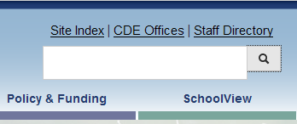
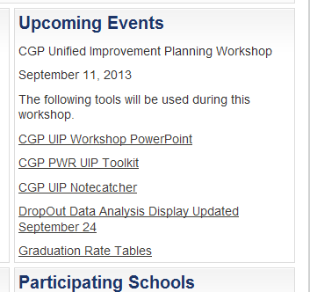
Viewing and Analyzing Your School’s drop-out Data
To download a copy of the DODAD:
Access the CDE website at www.cde.state.co.us
Type “Colorado Graduation Pathways” in the search field near the top right corner of the page
Look under the “Upcoming Events” section and click on the link titled “drop-out Data Analysis Display”

Slide 75
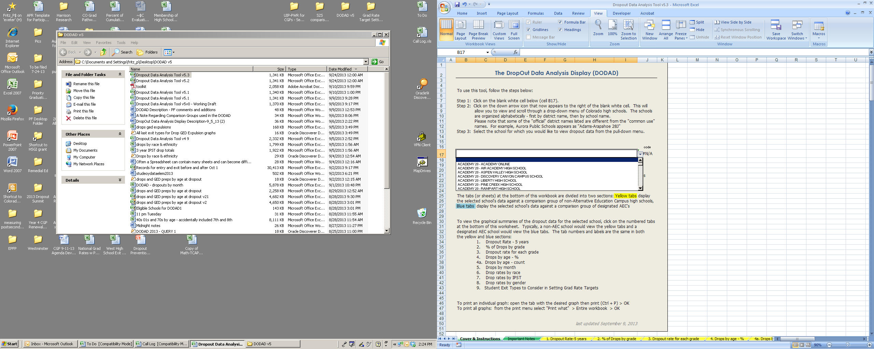
To populate the graphs with your school’s data
1. Click on the worksheet tab titled “Cover & Instructions” at the bottom of the page.
2. After clicking on cell B17, click on the arrow to the right of the blank cell.
3. Select your high school from the pull-down menu. Schools are listed alphabetically by district then school.

Slide 76
Practice drop-out Data Analysis
Consider the DODAD Description, Questions to Guide Analysis for each table.
Open DODAD and access data for your school or a school in your district.
Use your “path through the data” to guide your analysis.
Review data views/reports.
Identify things that “pop out”.
Include both strengths and challenges.
Capture observations!

Slide 77
Root Cause Analysis
Focus on a performance challenge (or closely related performance challenges).
Consider other types of data
Generate explanations (brainstorm).
Categorize/ classify explanations.
Narrow (eliminate explanations over which you have no control) and prioritize.
Deepen thinking to get to a “root” cause.
Validate with other data
Iterative
Notes:
Root cause analysis can be broken down into several different sub-steps.
It is important to note that root cause analysis is focused on a clearly defined performance.
The process of getting to root causes of priority performance challenges (priority needs) can be described as similar to a funnel. It starts broad, like the widest part of the top of a funnel, with brainstorming in a way that brings everyone’s thinking into the process. It is important to start broad for two reasons. First, so that everyone who you want to be part of the solution will have a chance to help define what needs to be fixed. Second, so that the possibility for “out of the box” thinking is present.
Next, the ideas that are generated through the brainstorm should be systematically narrowed, first by categorizing or grouping like causes together, and then by applying criteria. This takes you to the narrow point in the funnel.
Once the list of possible causes has been narrowed, the team needs to intentionally deepen their thinking to get to an actual “root” causes. Several possible processes can help deepen your teams thinking. We’ll introduce a tool called the 5 Why’s.
Once the team believes a root cause has been identified, it will be important to validated with other data.
This may not be the end of the process, however. [Click to animate “iterative”]. This process is iterative rather than linear. Planning teams may get through the deepening process only to realize they had prioritized the wrong cause, or validation may result in the team starting over with a different possible root cause.
First we are going to focus on the first three steps in root cause analysis

Slide 78
What other PWR data should be reviewed?
Student attendance and truancy
Credit accrual (within and across grade levels) and recovery
Student suspension/expulsions
Higher education pursuit (e.g. ICAP participation, college application rates, concurrent enrollment, AP participation)
Student perception surveys (student engagement and social-emotional health)
School process for drop-out prevention (framework for drop-out Prevention)
Multi-Purpose – identifying root causes, interim measures (tracking progress moving forward) /early warning

Slide 79
Example Credit Accrual Metrics
Number and percent of students in grades 9-12 earning a year's worth of credits.
Number and percent of students with the opportunity to be in attendance the entire year who earned a year's worth of credits.
Number and percent of students who earned more than one quarter of the credits necessary to graduate.
Number of students enrolled who started the year 2 or more years behind.

Slide 80
Accessing other PWR Data Resources
What additional data sources should we consider in our root cause analysis?
To what data related to PWR do we have access?
Consider the Other PWR data resources table (Tools, p. 63) and Other PWR Data Resources Checklist (Tools, p. 71).
Identify which data resources are available to schools in your district.
Make notes about data report/view name and how to access each data resource.

Slide 81
Using the Framework for drop-out Prevention
The Framework for drop-out Prevention provides a starting point for identifying school process data that may be important to review for root cause analysis.
Take out Framework for Drop-out Prevention (Tools, p. 73) and Drop-out Prevention Framework Data Sources (Tools, p. 75).
What data sources are available to schools regarding their processes related to each step in the framework?
How could schools use this data in root cause analysis?
Notes:
Judy

Slide 82
The Colorado Graduation Pathways Research-based Framework for drop-out Prevention
Essential Elements
Methods & Tactics
Data Analysis
Early Warning Systems
Tracking Out-of-School Youth
Identification
Assess and Enhance School Climate
Policy and Practices Review
Community Engagement
Institutional Change
Family Involvement
Transition Programs (middle school to high school, high school to postsecondary)
Alternative Pathways to Graduation (expanded curriculum, CTE, concurrent enrollment, etc)
Intervention & Support
Reengagement of Out-of-School Youth
Enhanced Counseling and Mentoring
Credit Recovery Options

Slide 83
Setting PWR Performance Targets
Requirement: Set at least one target for each priority performance challenge.
Targets include: performance indicator (PWR), metric, which students, current performance, comparison point, gain in metric (based on comparison point), and timeframe.
Example: The percentage of students in grades 9-12 who drop out will decrease from 20% in 2012 to 15% in 2013.
Metrics:
  Include state required PWR metrics (drop-out rates, Graduation rates, Disaggregated Graduation rates, and average Colorado ACT Composite score).
  Additional related metrics (defined locally).

Slide 84
Postsecondary and Workforce Readiness Comparison Points
Metrics | Possible Comparison Points
Graduation Rate (4-, 5-, 6-, 7-year) | Minimum state expectation = 80% Exceeds rating: at or above 90%
Disaggregated Graduation Rate (4-, 5-, 6-, 7-year) | Minimum state expectation = 80% Exceeds rating: at or above 90%
Drop-out Rate | Minimum state expectation 3.6% (1-year) or 3.9% (3-year) Exceeds rating: at or below 1%
Average Colorado ACT Composite Score | Minimum state expectation 20.0 (1-year) 20.1 (3-year) Exceeds rating: at or above 22

Slide 85
Setting Postsecondary and Workforce Readiness Targets
What metric(s) will be the focus of your postsecondary and workforce readiness target(s)?
Are you currently below minimum state expectations for that metric? If so, select minimum state expectations as your comparison point.
If not, select the state “exceeds” rate for your comparison point.
Consider: For what other postsecondary and workforce readiness metrics you could set performance targets?

Slide 86
Additional PWR Metrics for Target Setting
4-, 5-, 6- and 7-year completion rates.
Percent of students earning a year’s worth of credits in a year’s time.
Career and Technical Education course completion rate.
Number and percentage of students successfully transitioning into a recognized adult education program (w/out diploma or GED).
Percent/number of students enrolling in a Colorado postsecondary institution within one year after graduation.
Percent of recent graduates attending Colorado public institutions that required remediation.
AP/IB participation.
Percent/number of students scoring high enough on AP/IB tests to receive college credit.
ACT scores by content area.

Slide 87
Target-Setting Advice
Review the number of students that have dropped out over the past four years.
Track the school’s re-engagement outcomes (the percent of students who dropped out, returned and completed school).
Review the GED transfer rate and the number of these students who completed their GED each year.
Consider the change in membership base (rates of mobility, stability, enrollment of students under credit).
Quantify the school’s proposed rate of improvement numerically (what does the rate of improvement in graduation or drop-out mean in terms of the number of students).
Look at the percent of students that accrue a year’s worth of credit or more in a year.
Tools p. 81
Notes:
Peter

Slide 88
Example
Credit Accumulation in 2012-13 SY – Less than 62% of students with the opportunity to be in attendance earned a year’s worth of credits during that year. Consider setting a goal of increasing this rate to at least 70% in two years by offering and promoting aggressive credit recovery options and expanded credit accumulation opportunities.
Student Re-Engagement Outcomes - 26 of the students enrolled at CGP HS in 2012-13 dropped out in a prior school year as indicated by the school’s End of Year records. Of these 26, six graduated or completed and another six were still enrolled as of the end of the year, which results in a 46.2% reengagement outcome rate. The six students that graduated were enrolled in a CTE school. Consider a goal to increase the re-engagement rate to 61.5% by expanding CTE and concurrent enrollment (drop-out recovery) programs.
Notes:
Peter
Student Re-Engagement Outcomes FYI: 46.2% to 61.5% based on an increase of 4 more students graduating, completing or staying in school

Slide 89
Session Plan
Assessment/Data and Education Reform
English Language Learning
Commonly Used Interim Assessments
Postsecondary and Workforce Readiness
Early Literacy and School Readiness
Equitable Distribution of Teachers
TELL Survey Results
Notes:
This session includes the following topics:
Unified Improvement Planning Basics;
Gathering and Organizing Data
Reviewing Performance Summary
Engaging in Data Analysis;
Developing Action Plans; and
State Review of Plans
If this is your first introduction to unified improvement planning in Colorado you may want to follow the topics in order. Alternatively you can select topics in any order by using the left-hand navigation of this tutorial.

Slide 90
Organizing Early Literacy Assessment Results for Planning
Turn to “Organizing Early Literacy Data for Planning”, this will be your note catcher for this session.
Assessment Instrument Descriptions available for:
  DIBELS (Next and 6)
  DRA2
  PALS
Which early literacy assessment is in use in your district?
Send one representative from your table to get copies of the Assessment Instrument Descriptions and report examples for the literacy assessment used in your district.

Slide 91
Approved K-3 Reading Interim Assessments to meet READ Act Requirements
2013-14 School Year:
  DIBELS
  DRA2
  PALS
Beyond 2013-14 School Year:
  RFI Process for identifying additional K-3 reading interim assessments (October 24th).
  Additional information posted early November.
  Districts have until July 2016 to transition to approved interim assessments.

Slide 92
READ Act
Early literacy and SPF/DPF reports:
  Based on achievement (performance level) of 3rd and 4th graders on TCAP/PARCC who were at one time identified as having significant reading deficiency.
  Schools/districts receive “additional credit” toward plan type assignments and accreditation ratings.
  Technical analysis is on-going.
  Decision about inclusion in August 2014 SPF/DPF by spring 2014.
Requires schools and districts to include early literacy in UIPs (2014-15):
  Set performance targets related to reducing the number of students (K-3) who have significant reading deficiencies increasing students achieving grade level expectations in reading.
  Identify associated action steps.

Slide 93
Uses of Early Literacy Assessment Results for UIP
Accountability and UIP Process | Early Literacy Assessment Results
Future SPF/DPF | TCAP/PARCC Results for 3rd and 4th graders at one time identified as having a significant reading deficiency
Data Analysis: Identifying Notable Trends and Prioritizing Performance Challenges | Use aggregate metrics (at the grade level, school, or district level) to identify trends over time in K-3 literacy achievement. Aggregate metrics must include the % or number of students identified with a significant reading deficiency.
Setting Performance Targets | Establish targets related to reducing the number of students identified with a significant reading deficiency.

Slide 94
Clarify purpose and uses
Use your early literacy assessment description table.
Make notes in “Organizing Early Literacy Assessment Results for Planning”:
  For what purpose was data collected as part of the literacy assessment your district uses?
  Did the vendor provide guidance on appropriate uses?
  For what are we proposing to use this data?

Slide 95
READ Act Data reported to CDE
Interim assessment used in determining students’ significant reading deficiency (and administration date).
Students identified as having a significant reading deficiency.
Students’ interim assessment score:
  DIBELS
  DRA2
  PALS
Schools/Districts must use local K-3 reading data for planning.
Some vendor online tools have aggregate reports available.

Slide 96
Early Literacy Assessment Instrument Descriptions
Consider the Assess Instrument Description for your Early Literacy Assessment.
What individual metrics are available?
What aggregate metrics are identified?
What comparison points are provided by the vendor?
What comparison points are provided by CDE?

Slide 97
Practice: Identifying Metrics and Comparison Points for Early Literacy Assessments
Consider Interim Assessment Report Examples for the assessment used in your district.
Review several reports.
For each report reviewed, identify:
  What metrics are available on the report?
  To what could performance on each metric be compared (comparison points)? How good is good enough?
  What questions could you answer using the report?

Slide 98
Organizing Early Literacy Assessment Results for Planning
Go back to your note catcher “Organizing Early Literacy Assessment Results for Planning.”
Complete at least one row of a path through this data including:
  A report you will review
  Metrics
  Comparison Points
  Questions to Guide Analysis

Slide 99
School Readiness Data
Required by CAP4K.
Teaching Strategies Gold (TS GOLD) approved by state.
Turn to Assessment Instrument Description: Teaching Strategies Gold (Tools, p. 83).
Discuss with your table:
  How could the TS Gold Assessment results be used for planning?
  What metrics would you consider?
  What comparison points?
Coming soon: Training for Administrators on TS Gold Reports.

Slide 100
Session Plan
Assessment/Data and Education Reform
English Language Learning
Commonly Used Interim Assessments
Postsecondary and Workforce Readiness
Early Literacy and School Readiness
Equitable Distribution of Teachers
TELL Survey Results
Notes:
This session includes the following topics:
Unified Improvement Planning Basics;
Gathering and Organizing Data
Reviewing Performance Summary
Engaging in Data Analysis;
Developing Action Plans; and
State Review of Plans
If this is your first introduction to unified improvement planning in Colorado you may want to follow the topics in order. Alternatively you can select topics in any order by using the left-hand navigation of this tutorial.

Slide 101
CDE’s History on Equitable Distribution of Teachers Analysis
All districts expected to update Equitable Distribution of Teachers analysis through their UIP.
CDE would prepare reports for districts with higher gaps.
  All required data is now available on SchoolView.org.
Notes:
Added this slide for more context

Slide 102
ESEA Definition of Equitable Distribution of Teachers
ESEA requires that LEAs “ensure…that low -income students and minority students are not taught at higher rates than other students by unqualified, out-of-field, or inexperienced teacher.”
(NCLB, Sec 1112(c)(1)(L))
Notes:
Changed definition to match language in NCLB re: EDT and reworded some of the other text
(L) ensure, through incentives for voluntary transfers, the provision of professional development, recruitment programs, or other effective strategies, that low-income students and minority students are not taught at higher rates than other students by unqualified, out-of-field, or inexperienced teachers
1112c1L
(C) the specific steps the State educational agency will take to ensure that both schoolwide programs and targeted assistance schools provide instruction by highly qualified instructional staff as required by sections 1114(b)(1)(C) and 1115(c)(1)(E), including steps that the State educational agency will take to ensure that poor and minority children are not taught at higher rates than other children by inexperienced, unqualified, or out-of-field teachers, and the measures that the State educational agency will use to evaluate and publicly report the progress of the State educational agency with respect to such steps;
1111b8C

Slide 103
Using EDT data for UIP: Root Cause Analysis
Focus on a performance challenge (or closely related performance challenges).
Consider other types of data
Generate explanations (brainstorm).
Categorize/ classify explanations.
Narrow (eliminate explanations over which you have no control) and prioritize.
Deepen thinking to get to a “root” cause.
Validate with other data
Iterative
Notes:
Root cause analysis can be broken down into several different sub-steps.
It is important to note that root cause analysis is focused on a clearly defined performance.
The process of getting to root causes of priority performance challenges (priority needs) can be described as similar to a funnel. It starts broad, like the widest part of the top of a funnel, with brainstorming in a way that brings everyone’s thinking into the process. It is important to start broad for two reasons. First, so that everyone who you want to be part of the solution will have a chance to help define what needs to be fixed. Second, so that the possibility for “out of the box” thinking is present.
Next, the ideas that are generated through the brainstorm should be systematically narrowed, first by categorizing or grouping like causes together, and then by applying criteria. This takes you to the narrow point in the funnel.
Once the list of possible causes has been narrowed, the team needs to intentionally deepen their thinking to get to an actual “root” causes. Several possible processes can help deepen your teams thinking. We’ll introduce a tool called the 5 Why’s.
Once the team believes a root cause has been identified, it will be important to validated with other data.
This may not be the end of the process, however. [Click to animate “iterative”]. This process is iterative rather than linear. Planning teams may get through the deepening process only to realize they had prioritized the wrong cause, or validation may result in the team starting over with a different possible root cause.
First we are going to focus on the first three steps in root cause analysis

Slide 104
Colorado’s Approach to EDT
Limitations | Colorado’s Enhancements
Required Metrics Highly qualified requirements largely attained (no real gaps) Biased against novice teachers Performance neutral | Add SPF overall growth rating for performance measure
Ease of Analysis Many variables to consider at once. It is confusing. Isolated analysis leads to little action. | Interactive quadrant display in SchoolView. Inclusion in UIP to provide relevance with improvement planning.
Notes:
Changed QTC to state. The districts don’t have much of an understanding of QTC – its through the federal lens that we are approaching this issue.

Slide 105
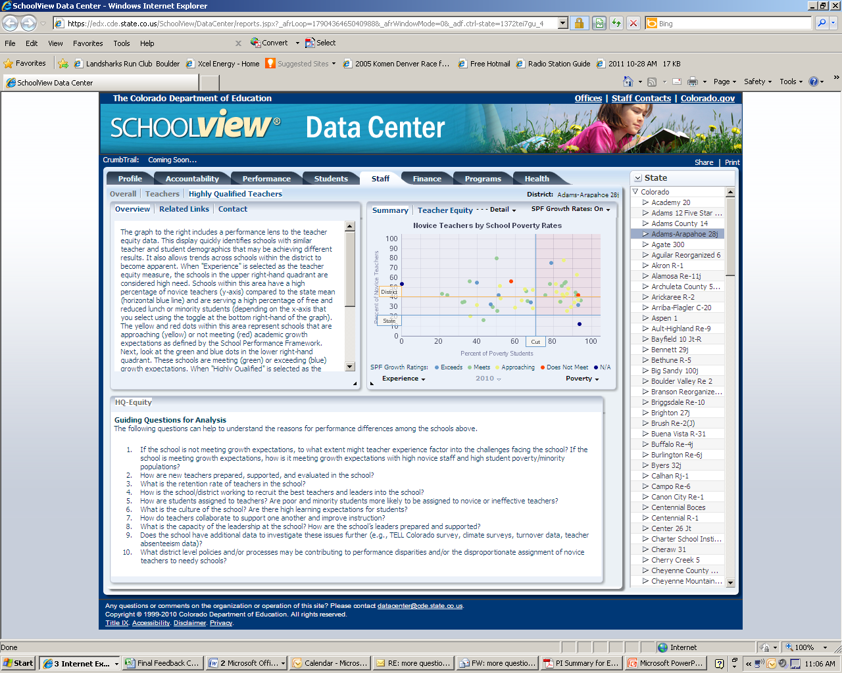
Turn to: EDT Data Job Aide (Tools, p. 89)
www.schoolview.org
Data Center
Staff tab
Teacher Equity Detail

Slide 106
Metrics and Comparison Points
School Level Metrics:
Percent of Novice Teachers
Percent of students qualifying for free/reduced lunch
Percent minority students
School’s SPF Growth Rating
Comparison Points:
State average percent novice teachers for schools
Top quartile of percent poverty for elementary schools
Top quartile of percent minority for schools
State expectations for growth

Slide 107
SchoolView: Understanding the EDT Graph
1
The y-axis represents percentage of novice teachers, those less than three years of total teaching experience.
The horizontal blue line represents the state’s mean percentage of notice teachers.
The horizontal orange line represents the average percentage of novice teachers within your district.
The x-axis represents percentage of free and reduced lunch students, a proxy for poverty.
The vertical blue line represents the top quartile for % poverty or % minority for schools.
The dots represent schools. The colors represent the overall growth rating on SPF.
1
6
5
2
3
3
2
4
4
5
6
Notes:
We used the top quartile for secondary for display purposes. The analysis takes into consideration the top quartile cut points for elementary and secondary schools.

Slide 108
Understanding Each Quadrant
Schools within this quadrant have a high percentage of novice teachers and are serving a high percentage of FRL students. The graph focuses attention on this quadrant.
Schools within this quadrant have a high percentage of novice teachers and are serving lower percentage of FRL students.
4
1
Schools within this quadrant have a low percentage of novice teachers and are serving lower percentage of FRL students.
3
2
Schools within this quadrant have a low percentage of novice teachers and are serving a high percentage of FRL students.
Notes:
Go clockwise

Slide 109
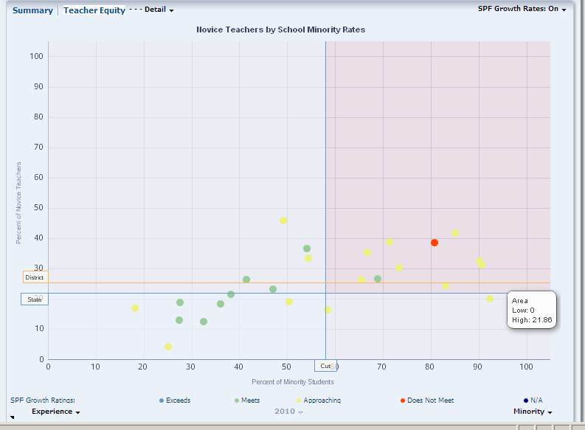

Slide 110
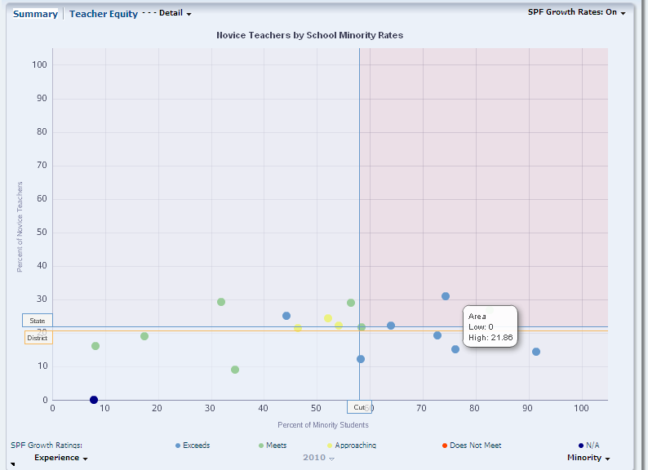

Slide 111
Equitable Distribution of Teachers Practice
Turn to: Equitable Distribution of Teachers Data Job Aide, Practice (Tools, p. 89).
The first two pages are a reminder about how to interpret this data.
Work with a partner to complete the Practice questions.
The graphic will be on the next slide (in color), so wait for it. ☺

Slide 113
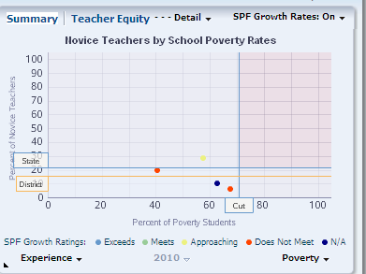
What about small districts?

Slide 114
A Path through the Data for Small Districts
The EDT analysis is still required, but may not always be as enlightening as for larger districts.
Look at the distribution by school level.
Compare average years of staff experience to the state.

Slide 115
What is expected by CDE?
Update of EDT analysis included in UIP Data Narrative each year.
If no problems, just provide a brief summary to indicate that it was considered.
If problems are identified, include:
  Detail in data narrative
  Provide strategies that will address the issue (e.g., using Title IIA funds to strengthen induction program)

Slide 116
Session Plan
Assessment/Data and Education Reform
English Language Learning
Commonly Used Interim Assessments
Postsecondary and Workforce Readiness
Early Literacy and School Readiness
Equitable Distribution of Teachers
TELL Survey Results
Notes:
This session includes the following topics:
Unified Improvement Planning Basics;
Gathering and Organizing Data
Reviewing Performance Summary
Engaging in Data Analysis;
Developing Action Plans; and
State Review of Plans
If this is your first introduction to unified improvement planning in Colorado you may want to follow the topics in order. Alternatively you can select topics in any order by using the left-hand navigation of this tutorial.

Slide 117
TELL Survey Results
TELL = Teaching, Empowering, Learners, and Learning
On-line anonymous survey of public school educators about perceptions of current teaching and learning conditions.
Last administration – Spring 2013
Because teaching conditions. . .
  Matter for students
  Matter for teacher retention
  Are viewed differently by teachers and principals

Slide 118
What We Have Learned from Previous TELL Colorado Initiatives
It’s About Kids: School conditions can constrain or catalyze effective teaching and student learning. Reports in 2009 and 2011 demonstrate connections to CSAP results.
It’s About Keeping Effective Teachers: Conditions have a strong influence on teacher retention and future employment plans, especially school leadership.
Where You Sit Shapes How You See Things: Conditions are perceived differently within and across schools by role and experience.

Slide 119
What we have learned…
Overall, Colorado educators are very positive about school conditions.
Time is consistently the biggest challenge.
Sense of efficacy and support from leadership affects teacher attrition more than other factors (e.g., salary).
Effective induction support and mentoring is not systematically available to novice educators.
The construct with the strongest relationship to student performance is community involvement and support.

Slide 120
TELL Survey Basics
Work with a partner, and review the TELL Survey Basics handout (Tools, p. 93) and Using Your TELL Colorado Survey Results: Data Use Guide (Tools, p. 99).
Answer the following questions:
What is the purpose of the TELL Survey? How should it be used? What are ways it should not be used?
From whom is data collected?
What response rate is required for results to be reported?
Did your district/school have a high enough response rate for results to be reported? Have you accessed your district/school TELL survey results?

Slide 121
Using TELL data for UIP: Root Cause Analysis
Focus on a performance challenge (or closely related performance challenges).
Consider other types of data
Generate explanations (brainstorm).
Categorize/ classify explanations.
Narrow (eliminate explanations over which you have no control) and prioritize.
Deepen thinking to get to a “root” cause.
Validate with other data
Iterative
Notes:
Root cause analysis can be broken down into several different sub-steps.
It is important to note that root cause analysis is focused on a clearly defined performance.
The process of getting to root causes of priority performance challenges (priority needs) can be described as similar to a funnel. It starts broad, like the widest part of the top of a funnel, with brainstorming in a way that brings everyone’s thinking into the process. It is important to start broad for two reasons. First, so that everyone who you want to be part of the solution will have a chance to help define what needs to be fixed. Second, so that the possibility for “out of the box” thinking is present.
Next, the ideas that are generated through the brainstorm should be systematically narrowed, first by categorizing or grouping like causes together, and then by applying criteria. This takes you to the narrow point in the funnel.
Once the list of possible causes has been narrowed, the team needs to intentionally deepen their thinking to get to an actual “root” causes. Several possible processes can help deepen your teams thinking. We’ll introduce a tool called the 5 Why’s.
Once the team believes a root cause has been identified, it will be important to validated with other data.
This may not be the end of the process, however. [Click to animate “iterative”]. This process is iterative rather than linear. Planning teams may get through the deepening process only to realize they had prioritized the wrong cause, or validation may result in the team starting over with a different possible root cause.
First we are going to focus on the first three steps in root cause analysis

Slide 122
Accessing TELL Results
www.tellcolorado.org
All districts and schools with at least a 50% response rate (and a minimum of 5 responses).
Survey Results:
  By District
  By School
Have you accessed your TELL Survey Results?

Slide 123
TELL Terminology
Consider the “TELL Terminology” – at the end of the TELL Basics handout (Tools, p. 98).
What is a construct?
What are items?
What does TELL mean by “Teaching Conditions”?

Slide 124
Survey Focus: TELL Constructs
  Time
  Facilities and Resources
  Community Support and Involvement
  Managing Student Conduct
  Teacher Leadership
  School Leadership
  Professional Development
  Instructional Practices and Support
Consider the description of the TELL Survey Focus, discuss the following:
Why would it be important to find out about teachers’ responses related to each of the listed constructs?
How could knowing about teacher perception of these aspects of their working conditions help with root cause analysis?
p. 94

Slide 125
TELL Reports
Tellcolorado.org
Three Reports/Views:
  Summary Results for 2013 [Excel]
  Detailed Results for 2013 [PDF]
  Summary Comparison Results 2011 to 2013 [Excel]
Additional reports for districts (not public):
  Scatterplot
  Growth Heat Map
  2013 Heat Map

Slide 126
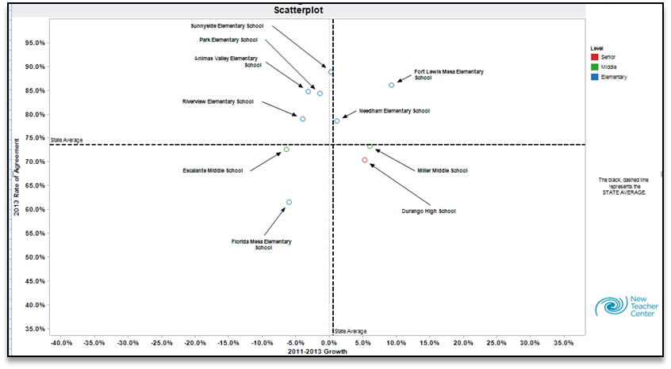
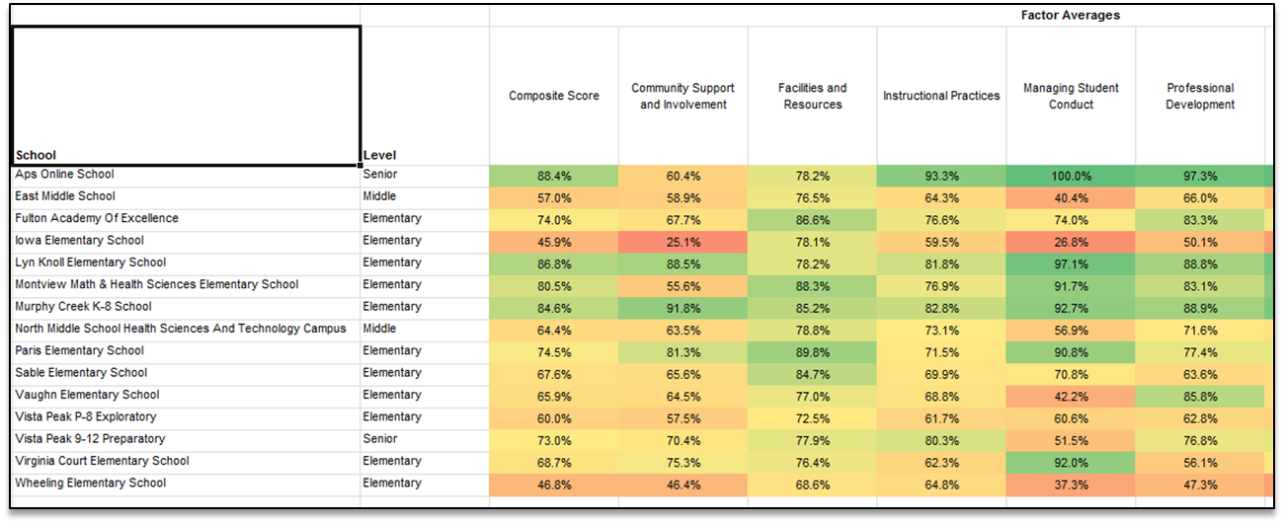

Slide 127
Creating HEAT Maps
Turn to TELL Heat Map Job Aide (Tools, p. 111)
Demonstration

Slide 128
Path Through the TELL Data
Review Constructs
Examine Items Within the Construct
Determine an Item of Focus
Determine a Construct on which to Focus
Analyze Individual Items

Slide 129
Lots of data, where to start?
Use HEAT Maps:
  For which constructs were our teachers’ responses significantly lower than others?
  Compared to what?
Consider state-level results:
  The construct with the strongest relationship to student performance is community involvement and support.
  Time is consistently the biggest challenge.
  Sense of efficacy and support from leadership affects teacher attrition more than other factors (e.g., salary).

Slide 130
Practice
Access your school/district TELL Data. Download the spread sheet of your Summary Results or Summary Comparison Results.
If you have access, consider your HEAT maps.
Follow the job-aide to format your results as a HEAT map.
Consider:
    Which construct(s) would you focus on first?
    What would be your path through your TELL data?

Slide 131
Give us Feedback!!
Written: Use sticky notes
  + the aspects of this session that you liked or worked for you.
  ⬇The things you will change in your practice or that you would change about this session.
  ? Question that you still have or things we didn’t get to today.
  Ideas, ah-has, innovations.
Oral: Share one ah ha!

