Slide 1
Accountability Clock Overview
Brenda Bautsch, Accountability Specialist

Slide 2
Accountability Clock Overview
State Review Panel may review UIPs and conduct site visits
Year 0
Year 1
Year 2
Year 3
Year 4
Year 5
July 1
July 1
July 1
July 1
July 1
July 1
Preliminary SPFs and DPFs are released in August
State Board of Education directs an action to the local board of education
*The clock was paused in 2015-2016 per HB15-1323
Notes:
** Should we add anything about request to reconsider into any of the timelines? Looks like it might come up at the end? lgm

Slide 3
Accountability Clock Process
School/District on Accountability Clock for 5 Years
OR
Turnaround School/District not making progress
State Review Panel Recommendation
School/ District continues to receive ongoing support, monitoring and accountability
State Board of Education Directs Action to Local School Board
Commissioner Recommendation
District Proposal (optional)
Notes:
The law as played out in implementation

Slide 4
Accountability Clock Recommendation Sequence
State Review Panel Report
Commissioner Recommendation
State Board of Education Hearing
Spring 2017
Fall/Winter 2017-2018
District Pathway Plan
February – June 2018
Notes:
District pathway plan (e.g. plan for management, closure, charter, innovation) could be taken into consideration by CDE in the Commissioner's recommendation IF the district shares it with us in advance. They may also share it with the SBE prior to their hearing.
Katy and CDE staff visit schools/districts during commissioner recommendation process.

Slide 5
Statutory Accountability Pathways
The SBE must select a school-level action from these statutory pathways but may go beyond this menu for district-level recommendations
District Actions (C.R.S. § 22-11-210)
School Actions (C.R.S. § 22-11-209)
District Reorganization
Management by a Public/Private Entity
Take over management of one or more schools
Charter school operator or board is replaced
Charter school operator or board be replaced
Conversion to a Charter School
Conversion to a Charter School
Conversion to a Charter School
Innovation
Status
Innovation
Status
Innovation
Status
School
Closure or Revoked Charter
School
Closure or Revoked Charter
School
Closure or Revoked Charter
Notes:
Pathways that are in law
Management partners can fulfill a variety of roles:
May comprehensively manage a school, or
May fill a specific, targeted need within a school (e.g. academic systems or talent management);
May be contracted by the district to manage a school in perpetuity, or
May be contracted for a short term
But, management partners must have some decision-making authority

Slide 6
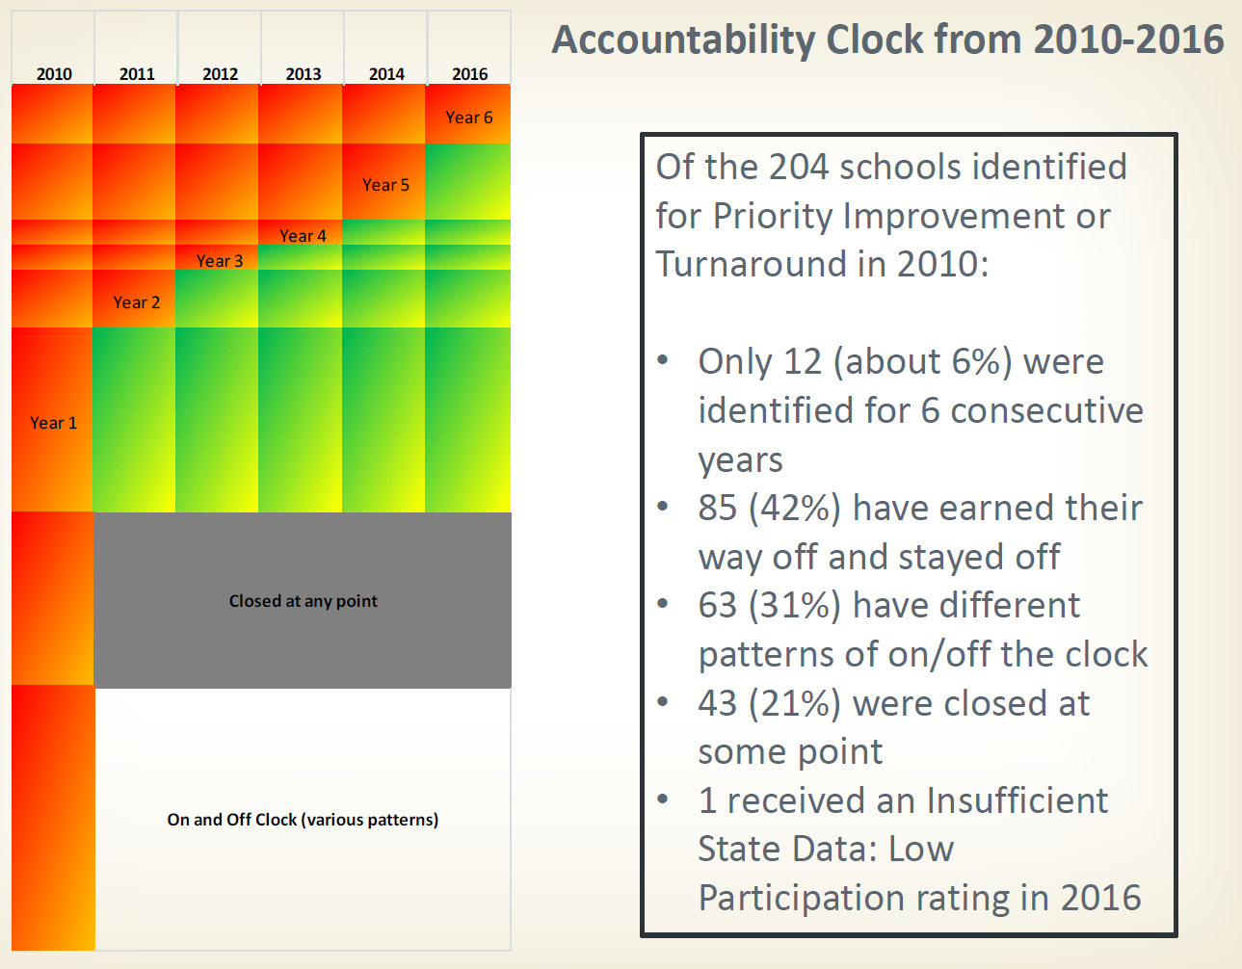
Accountability Clock, 2010-2016: Schools

Slide 7
Accountability Clock from 2010 to 2016: Districts
District Name | 2010 | 2011 | 2012 | 2013 | 2014 | 2016
Adams County 14 | Year 1 | Year 2 | Year 3 | Year 4 | Year 5 | Year 6
Aguilar Reorganized 6 | Year 1 | Year 2 | Year 3 | Year 4 | Year 5 | Year 6
Julesburg Re-1 | Year 1 | Year 2 | Year 3 | Year 4 | Year 5 | Year 6
Westminster 50 | Year 1 | Year 2 | Year 3 | Year 4 | Year 5 | Year 6
Montezuma-Cortez Re-1 | Year 1 | Year 2 | Year 3 | Year 4 | Year 5 | Year 6
Ignacio 11 JT | Year 1 | Year 2 | Year 3 | Year 4 | Year 5
Pueblo City 60 | Year 1 | Year 2 | Year 3 | Year 4 | Year 5
Sheridan 2 | Year 1 | Year 2 | Year 3 | Year 4 | Year 5
Karval Re-23 | Year 2 | Year 3 | Year 4 | Year 5
Vilas Re-5 | Year 2 | Year 3 | Year 4 | Year 5
Rocky Ford R-2 | Year 1 | Year 2 | Year 3 | Year 4
Charter School Institute | Year 1 | Year 2 | Year 3
Denver County 1 | Year 1 | Year 2 | Year 3
Englewood 1 | Year 1 | Year 2 | Year 3
Mountain BOCES | Year 2 | Year 3 | Year 4
Huerfano Re-1 | Year 2 | Year 3 |  |  |  | Year 1
Center 26 JT | Year 2 | Year 3
Lake County R-1 | Year 1 |  | Year 1 | Year 2 |  | Year 1
Branson Reorganized 82 | Year 1 |  | Year 1
De Beque 49JT | Year 1
Fort Morgan Re-3 | Year 1
Las Animas Re-1 | Year 1
Mountain Valley Re 1 | Year 1
South Conejos Re-10 | Year 1
Turnaround
Priority Improvement
District came off clock
Notes:
5 out of 24 stayed on the clock for over 5 consecutive years (20%) of those originally identified in 2010

Slide 8
Summary of Board Actions: Schools
School | District | SBE Directed Action
Destinations Career Academy of CO | Julesburg | Partial Closure
Aurora Central HS | Aurora | Innovation & Management
HOPE Online ES/MS | Douglas County | Management & Reconstitution of Governing Board
Franklin MS | Greeley 6 | Innovation
Prairie Heights MS | Greeley 6 | Innovation
Bessemer ES | Pueblo 60 | Management
Heroes MS | Pueblo 60 | Management
Risley Int’l Academy | Pueblo 60 | Management
Aguilar Jr/Sr HS | Aguilar | Management
Adams City HS | Adams 14 | Management
Peakview School | Huerfano | Management

Slide 9
Summary of Board Actions: Districts
District | SBE Directed Action
Montezuma-Cortez Re-1 School District | Management
Julesburg Re-1 School District | Partial Closure of Destinations Career Academy
Westminster Public Schools | Management
Aguilar Re-6 School District | Management
Adams 14 School District | Management

Slide 10
Feedback Themes from 2017 Cycle
Districts should start planning early in the process
  Pathways Planning Grant
Engage local school boards earlier and in a more meaningful way
Collaborative approach (districts having a voice in the process) has greatest likelihood of producing positive outcomes
Continue clarifying the management pathway
Make all pathway options feasible
Concerns about statute being silent on what happens after the end-of-clock directed action
Notes:
Start early in the process --e.g. Feedback from A14: “The pathways planning grant was particularly helpful. It was important to talk through all possibilities first before putting a plan together. It took a LOT of time to discuss everything to fully understand the process and agree on a plan. Future districts need to be made aware of this and make sure they have enough time set aside.” OR Aguilar: “Make the Pathway Implementation Grant available in Year 3. A funding option would have improved the district’s chances of success had we been able to implement the pathway earlier.” Huerfano – “Change to 4th year process begin date thereby providing a longer time frame to truly find the best pathway for one’s system and plan for its success”
Ways to make all pathways feasible (particularly charters, but also full takeover/EMO, closure) – Have CDE issue a Call for Providers this fall so that there are options lined up in the case that the SBE wants to pursue one of those pathway options next spring
Local board engagement -- Various stakeholders commented on the need to involve local boards earlier in the process – communicate not just about the accountability clock process but about accountability in general and the role of local boards
Collaborative approach worked well -- Districts “owning” their actions and having voice in the direction may have the greatest likelihood of producing positive outcomes
Management pathway – Need to clarify the continuum – Districts expressed concern over the lack of shared understanding between all parties (CDE/SBE/Districts, AG’s office, External Partners).
Concerns about statute being silent on what happens after the end-of-clock directed action -- Expectations for progress monitoring? What if improvements are not seen?
Quasi-judicial hearing structure made the process challenging and led to many frustrations

Slide 11
School Supports
Ongoing Support
Identifying internal and external partnerships and grants
Turnaround Network
Intense 2-3 year grant-funded engagement focused on planning and performance management
Grants
Federal grant opportunities with ongoing Turnaround Support Manager (TSM) and Federal Programs support and accountability
Year 5 Diagnostic Reviews
Bright Spot and Informational Offerings
Point person for support, planning and accountability
1-2 day diagnostic reviews during fall of Year 5 for pathway recommendation and planning support
Provide multiple opportunities annually for PI/T schools to attend best-in-class PD and visit local bright spots
Intensity of Support
Notes:
Varying intensity depending on need and willingness to engage
We don’t have capacity to work with every school intensively, but we work with districts to build their capacity to do so.
Turnaround Network: 2-3 year engagement (see Wendy and others in room)
Grants: various grants including the Pathways Planning Grant for schools in years 3-5 on the clock and an implementation grant for year 6+
Diagnostics: for year 5 and at other times via programs or grants
Point person or contact from different offices to offer guidance and customized support
Bright spot and other events: provide opportunities and exposure using partnerships, school visits, experts…
Ongoing

Slide 12

Questions? Feedback?

Slide 13
Reference Slides

Slide 14

Accountability Clock Hearings: Structure & Procedures

Slide 15
Accountability Hearings for Schools/Districts
Prior to hearing, State Board will receive:
    State Review Panel recommendation
    Commissioner recommendation
    District report (optional)
At the hearing:
  Department will have opportunity to present Commissioner’s Recommendation (30 min)
  District will have opportunity to present (30 min)
  State Board members will have opportunity to ask questions and hold discussion (up to two hours)
Notes:
note that SRP recommendation will be included/shared at the hearing as well.
Proposed admin procedures were written with AG’s office

Slide 16
Accountability Hearings for Schools/Districts
At the conclusion of the hearing:
  State Board may ask for proposed written final determinations from the district and/or the department
Following the hearing:
  State Board will consider proposed written determination(s)
At a subsequent State Board meeting:
  State Board will vote on written final determination (no testimony considered)
Notes:
note that SRP recommendation will be included/shared at the hearing as well.
Proposed admin procedures were written with AG’s office

Slide 17
Accountability Hearings for Schools/Districts
Following adoption of the written final determination:
  Local board and district agree to implement the directed action pursuant to terms to be specified in a revised version of the accreditation contract
  CDE will monitor implementation of the directed action until the district and/or school moves off of the Accountability Clock
Notes:
note that SRP recommendation will be included/shared at the hearing as well.
Proposed admin procedures were written with AG’s office

Slide 18
District Reorganization
Pathway option only for districts on the clock
Involves changing the organization and altering the boundaries of established school districts
Involves a comprehensive negotiation and requires voter approval
Option for districts that desire to merge with another district contiguous to their boundary or deconsolidate into more than one school district

Slide 19
Management
Management partners work in cooperation with state and district staff members, principals, teachers, community partners, and other providers to ensure conditions for success and sustainability in low-performing systems
Providers are expected to have demonstrated expertise in improving low-performing schools and districts
The primary responsibility of management partners is to implement instructional, programmatic, and/or structural supports that result in improved student performance
All supports must serve to increase student achievement no matter the specific focus of the partnership

Slide 20
Management
Management partners can fulfill a variety of roles:
  May comprehensively manage a school, or
  May fill a specific, targeted need within a school (e.g. academic systems or talent management);
  May be contracted by the district to manage a school in perpetuity, or
  May be contracted for a short term
CDE has developed a rubric to evaluate the likelihood and degree to which a Management Plan will result in the significant improvements needed to get the school/district off of the accountability clock
Notes:
Management partners can fulfill a variety of roles in a school’s plan. Partners could comprehensively manage a school or fill a specific, targeted need within a school. Depending on context, management partners may be contracted by the district to manage a school in perpetuity contingent on meeting annual requirements. Alternatively, districts may enter into short-term contracts with partners to support specific capacities within a school or district with the goal of working toward sustainability within the school or district in a set amount of time.
Academic systems: A district may conclude that a school, subset of schools or the entire district would benefit from a partner that would manage all or some academic systems. These systems may include assessment, data, curriculum, intervention, MTSS or any combination therein.
Talent Mgmt:
A district may decide that a school, subset of schools or the entire district would benefit from a partner that would manage all or some of its systems to recruit, grow, and retain high quality staff and leadership. This may include control of the implementation of educator effectiveness model, teacher professional development, and/or the hiring and retention decisions of school leadership, teachers or other staff.
Whole system: A district may decide that it needs to relinquish control of operations for an entire school or number of schools to an outside partner that is better able to serve the needs of that community. This model would constitute the most aggressive form of management. A partnership of this magnitude would require a major overhaul of systems and structures along with a detailed plan of the restructuring as well as contracts for length of time, accountability measures, and consequences.

Slide 21
Charter
A charter school is a semi-autonomous public school operating under a charter contract between the members of the charter school community and the authorizer
In Colorado, charter schools may only be authorized by local districts or by the Charter School Institute
Charter schools may be proposed by individuals or by Charter School Management Organizations (CMOs)
Each district and the Institute have their own unique processes for issuing a call for new schools and considering charter school applicants

Slide 22
Innovation Status
Innovation Schools Act
  Provides path for schools and districts to design and implement innovative practices to better meet student needs
  Innovation schools can obtain waivers from state and local policies and collective bargaining agreements
  Enables flexibilities in the areas of hiring, scheduling, budgeting, and programming
Accountability Pathway
  Schools at the end of the clock may pursue Innovation Status for one or more schools as a “pathway” under SB09-163
  CDE has developed a rubric to evaluate the likelihood and degree to which an Innovation plan will result in the significant improvements needed to get off of the Accountability Clock
Notes:
Innovation Schools Act passed in 2008
For schools seeking Innovation status as an accountability pathway, CDE has developed a rubric to evaluate the likelihood and degree to which an Innovation plan will result in the significant improvements needed to get off of the Accountability Clock. The accountability hearings next year will be the first time the SBE approves Innovation as a “Pathway” (as opposed to granting status per the Innovation School Act)

Slide 23
Comparing State Criteria for Approval of Innovation
Innovation Schools Act of 2008 | Accountability Pathway (Education Accountability Act of 2009)
CDE staff review to ensure the application is meeting all state and federal requirements (see attachment: “Required Components of an Innovation Plan”) | CDE staff use rubric to evaluate innovation plans for PI/T schools to inform the Commissioner’s Recommendation and assess whether the plan will have significant, rapid and positive impact on student learning
State Board shall approve Innovation Plans, unless it concludes that the submitted plan: (i) is likely to result in a decrease in academic achievement in the innovation schools or innovation school zones; or (ii) is not fiscally feasible | State Board considers recommendations from the State Review Panel and from the Commissioner of Education and determines which pathway is best Districts may also present their preferred pathway to the State Board

Slide 24
Closure
Full closure: School closes permanently; there are no longer any students at the school and the school code is “retired”
Partial closure: School no longer serves a particular grade span
  E.g., a junior-senior high school (6-12) no longer serves the middle grades (6-8)
Phase Out: The school is slowly closed over more than one school year; eventually there are no students at the school and the school code is retired
  The phase out timeline for a high school could take four years
  Often combined with the “phase in” of a new school

Slide 25
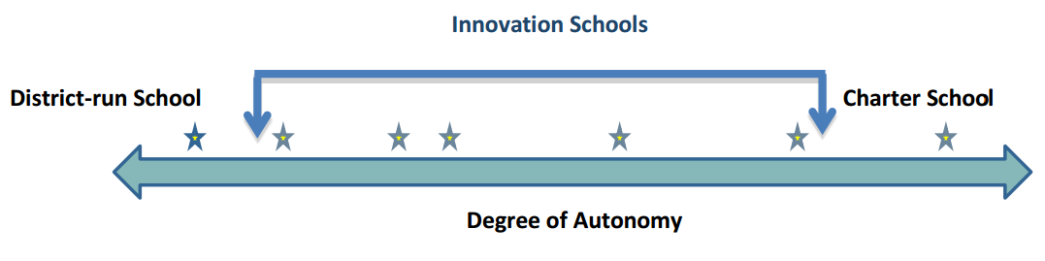
Innovation Status
As of Dec. 8, 2016, 78 schools in 10 different school districts have been granted innovation status in Colorado
  7 Innovation Zones
Allows for a varying degree of autonomies from district-level policies and certain state-level laws and regulations
Notes:
The Innovation Act provides any public school with a formal process to request a varying degree of autonomies from district-level policies and certain state-level laws and regulations.
This slide illustrates the varying degrees of autonomies that innovation schools have and demonstrates that an innovation school can fall anywhere between a traditional, district-run school and a charter school, depending on the school’s specific needs and strategies to increase student achievement. A school may want to waive out of a few district-level policies and state laws and regulations regarding personnel practices, for example, but wish to keep everything else the same. Conversely, a different school may wish to have many decisions made at the school-level about, for example, the school calendar, budget management, curriculum and instructional practices and personnel practices. These schools would fall closer to the charter school end of the spectrum.

Slide 26
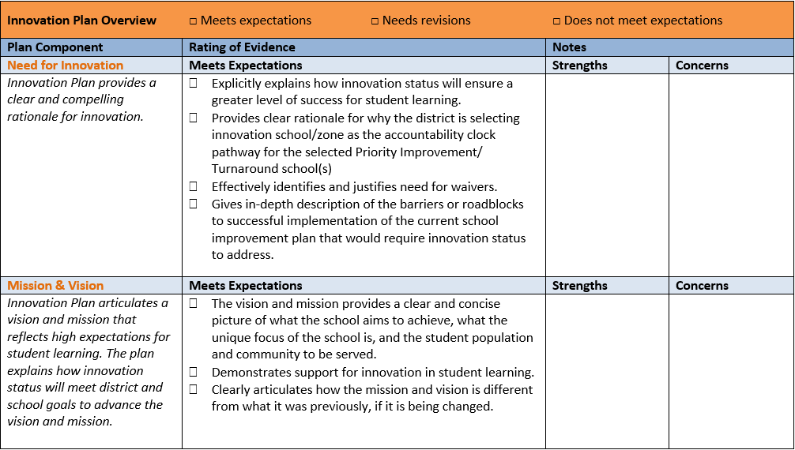
Innovation Accountability Pathway Rubric
See attachment: “Innovation Plan - Accountability Rubric”
Notes:
Have them pull out the rubric for a quick walk-through of the rubric’s components (listed on next slide)

Slide 27
Innovation Accountability Pathway Rubric
Need for Innovation
Student Learning Outcomes
Mission/Vision
Academic Systems (school calendar, curriculum & instruction, assessment & data, special populations)
Talent Management (recruitment/hiring, PD, evaluation, retention, compensation)
Culture of Performance (culture & climate, stakeholder engagement, school leadership/governance)
Budget and Operations
District Systems
Innovation Zone
Notes:
Provide brief overview of the components of the rubric. Emphasize that student learning outcomes –
identifying actionable goals for student academic achievement & describing how the plan will improve student learning and move the school off the Accountability Clock – is at the beginning of the rubric.

Slide 28
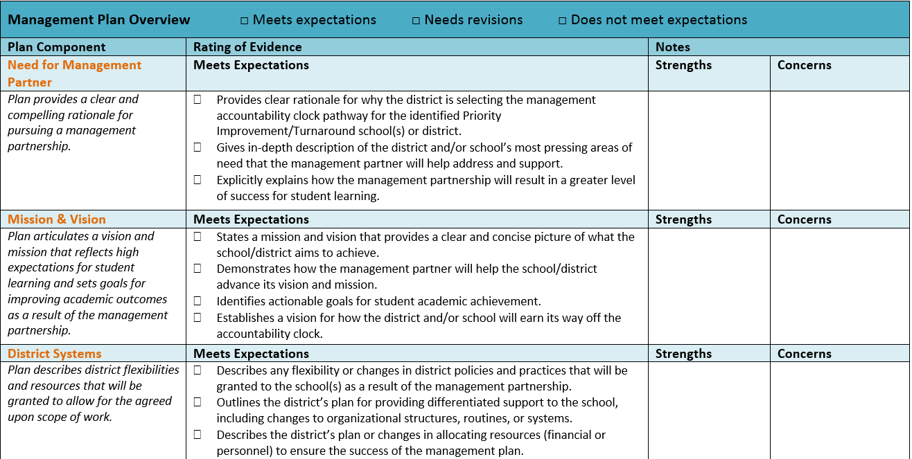
Management Rubric
See attachment: “Innovation Plan - Accountability Rubric”

Slide 29
Innovation Accountability Pathway Rubric
Need for Management Partner
Mission/Vision
Academic Systems (school calendar, curriculum & instruction, assessment & data, special populations)
Culture of Performance (culture & climate, stakeholder engagement, high expectations)
Talent Management (recruitment/hiring, PD, evaluation, retention)
Selection of Partner
Scope of work
Performance contract/MOU
Notes:
Provide brief overview of the components of the rubric. Emphasize that student learning outcomes –
identifying actionable goals for student academic achievement & describing how the plan will improve student learning and move the school off the Accountability Clock – is at the beginning of the rubric.

