Slide 1
School Improvement and Planning
June 12, 2025

Slide 2

Begin Recording

Slide 3
Topics
Overview
Timelines
Key Changes
Resources
New Tool! UIP Element Dashboard

Slide 4
Structural ways that charter schools look different (Red) or similar (Blue) as it relates to our discussion today
Characteristic | District School | Charter School
Governance | School Board🡪 Superintendent🡪Principal | Charter Board🡪Chief Executive
School Accountability Committees | Required | Required
State testing | Required | Required
State content standards | Apply | Apply
State Accountability | Measured by SPF. UIP required | Measured by SPF. UIP required
School Finance Law (C.R.S. 22-54-101, et seq.) | Required | Required

Slide 5
Unified Improvement Planning -Timeline
January- March
April-June
July-September
October-December
ACCESS Testing
State Assessment Window
State Assessment Initial Data Release
State Growth Data and Frameworks Released
Accountability and Assessment
Graduation Data Release
October Count
MOY READ Assessment
EOY READ Assessment
BOY READ Assessment
SBE/Accountability Clock Hearings
Request to Reconsider
Improvement Plan Implementation
January - June
September - December
Implement UIP and Adjust Based on Milestones, Interim Targets
Implement UIP and Adjust Based on Milestones, Interim Targets
April
July
Current Year data analysis, adjust SPPs and targets
Adjust Data Analysis based on State Data
Submit UIP by October 15th
UIP Process
May
August
March
Solidify current year data analysis, SPPs, Root Causes, Strategies (MIS)
Confirm draft plan with growth data and framework. Build out detailed action plan.
Reflect on current year, recent local data. Highlight potential Student Performance Priorities (SPPs)
June
Draft Implementation Milestones and Interim Targets
March
May
June- August
September-December
Related School Leadership Moves
Refine budget and hiring vision to support improvement efforts
Make purchases related to improvement efforts (e.g. curriculum)
Plan teacher induction, including improvement efforts
Closely Monitor Implementation and Keep Stakeholders informed
Stakeholder Engagement
Progress Monitoring
Input on initial data, SPPs and targets
Input on Root Causes and MIS
Input on Finalized UIP
Progress Monitoring
Progress Monitoring

Slide 6
2025-26 State Accountability Timeline
Date | Description
Late Aug 2025 | Preliminary performance frameworks released
Sept 26, 2025 | Accreditation Form due
Oct 15, 2025 | Request to reconsider submissions due UIPs due for public posting and for review for some plans
Nov 12-13, 2025 | State Board approves plan types (sites not participating in R2R) State Board approves 2026 framework targets
Dec 10-11, 2025 | State Board reviews R2R recommendations and finalizes remainder of plan types
End of Dec | Accreditation contracts due
What does this timeline mean for processes with your authorizer? What decision points or communications do you anticipate?
Notes:
Speaker: Lisa Medler

Slide 7
Unified Improvement Plan
The Streamlined Template and Key Changes

Slide 8

Overall Updates
Key changes from Traditional Template:
Use of assurances
Student Performance Priorities follow a “Claim, Evidence and Reasoning” model
Key Terminology Shifts (Student Performance Priority and Implementation Milestones)
One template- all users in the state use the streamlined version
No action needed by districts/Charters to access the template.
CDE has transitioned user roles to “UIP2~School Admin” and accesses the streamlined template.
District users will have one button to access the planning platform: “Access UIP”

Slide 9
Goals of Template Change and Evaluation Focus
01
Adding specificity to collections to ensure users know what to fill out
Reorganize layout to align better with school and district planning processes
Ease of Use
02
Shorten and consolidate sections
Remove components not specified in rule or law
Completion Time Reduction
03
New look and feel to form
Improved final report to increase readability
Improved Visual and Public Reporting

Slide 10

Terminology Changes
Some of the terms have changed to offer more clarity and purpose.
Traditional UIP | Streamlined UIP
Priority Performance Challenges | Student Performance Priorities
Implementation Benchmarks | Implementation Milestones
Interim Measures | Interim Targets

Slide 11
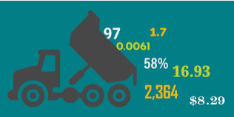
Assurances and Brief Description
In 24/25, the “Brief Description” was removed and many of the expectations of the data narrative were moved to assurances.
Two years ago, assurances were added to the UIP to reduce some of the reporting
Assurances were used for federal and state accountability as well as READ and Math data analysis.
Assurances are customized based on school characteristics- identifications, K-3 serving, etc.

Slide 12
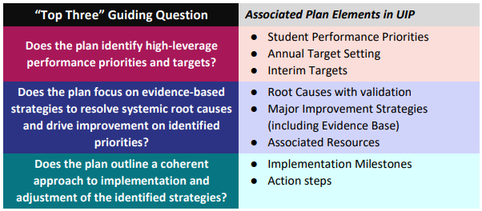
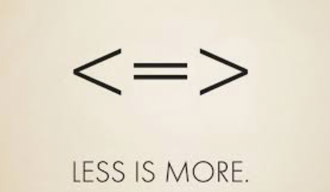
Improved Workflow
The Streamlined UIP Sections

Slide 13
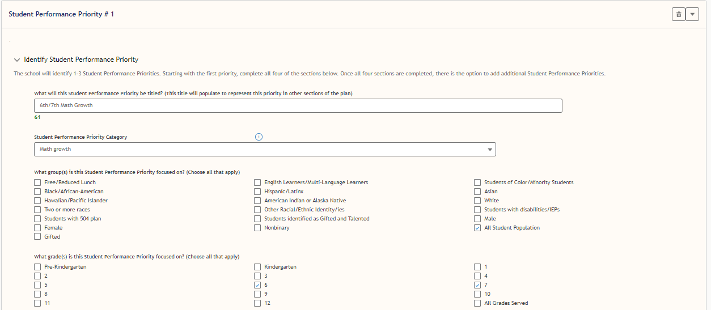
The User Experience: Student Performance Priorities (SPP)

Slide 14
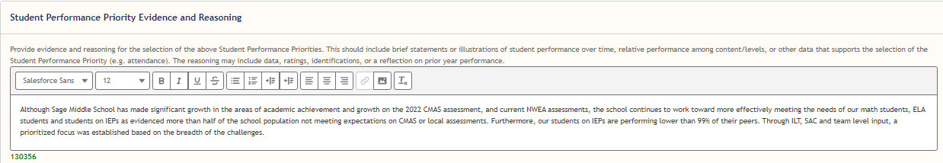
The User Experience: Evidence and Reasoning
The objective of this segment within the Streamlined UIP Process is to convey the evidence and reasoning underlying the selection of Student Performance Priorities.

Slide 15

Factors for Prioritization
Factors that may influence charter school student performance priorities:
Success indicators grounded in charter
Board strategic plan
Renewal performance metrics/timelines
Relative Performance Data (neighboring schools, peer schools, district averages)

Slide 16
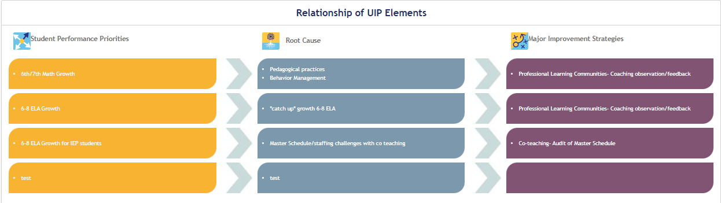
The User Experience: The Throughline

Slide 17

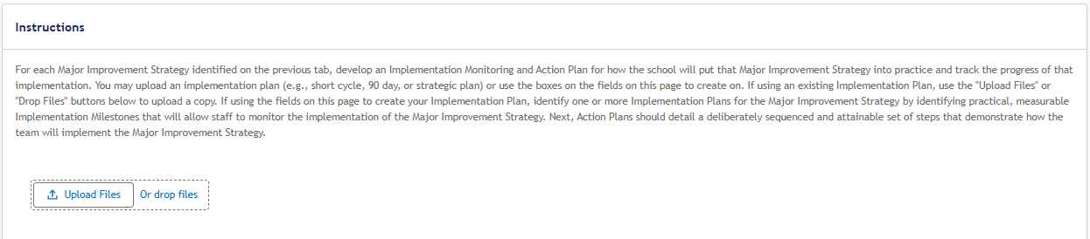
The User Experience: Short Cycle Upload

Slide 18
Overall Updates for the UIP
Pre-populated Data- With rollover, information that is available (e.g. biennial flex submission status, k-3 serving for READ) has been populated in the Requirements section. This data gets updated multiple times over the course of the year when data becomes available.
Sample Statement for Timeline
The district submitted a plan for the 2024-25 school year. Only if the district earns an accredited rating of performance or distinction on the 2025 performance framework will the district be eligible for biennial flexibility. Note: In the case of insufficient state data, the district must submit a 2025-26 plan.

Slide 19
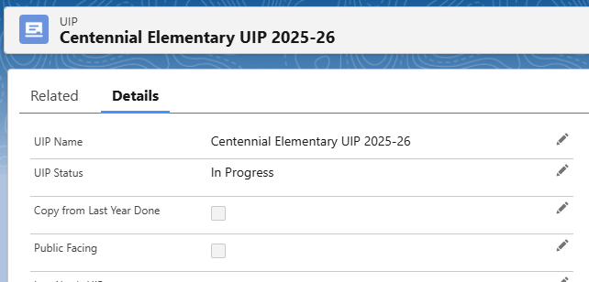
Online System Changes
“Continue Previous Plan” takes the place of copy from last year. Please note, this feature should NOT be used by those going from the traditional to streamlined template.
“Continue Previous Plan” If there is an error, district users can release or “open” the plan so the correct plan can be imported.
If the box is checked, it won’t copy over again.
Click pencil icon to allow editing

Slide 20
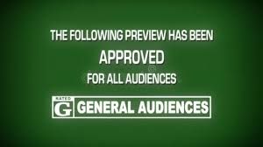
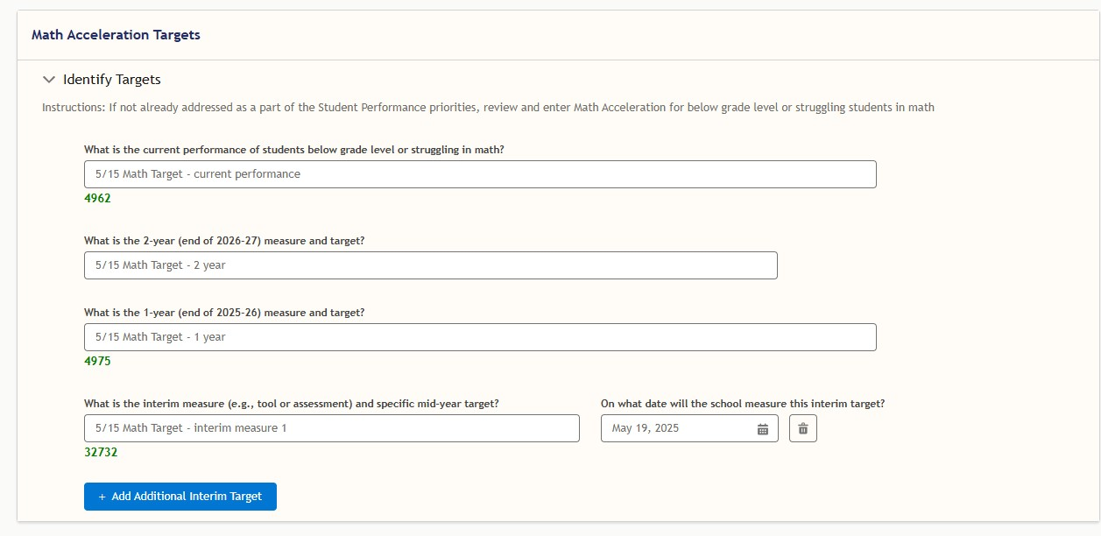
Coming Attractions
Dedicated Target boxes in Plans
READ- K-3 serving schools/districts
Math- fall update as this requirement is dependent on rating (Improvement, Priority Improvement, Turnaround)
Assurances dashboard for districts - allows user to see all assurances across all schools in the district

Slide 21
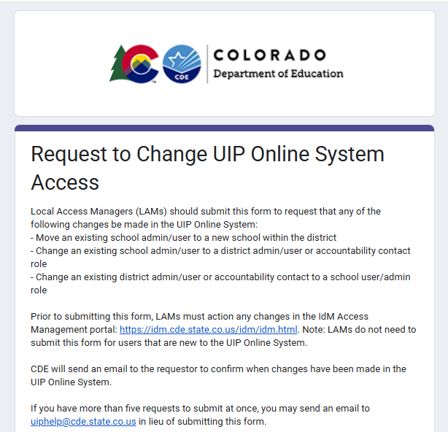
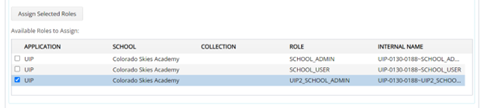
Notes for the school year
Changes for leaders moving buildings
Changes for staff moving
Use the form to notify CDE of these changes, as we need to take additional steps to complete access
New school UIP access: Use UIP2_School_Admin
*Directions in UIP/ACI Online System User Set Up and Management

Slide 22
Resources

Slide 23
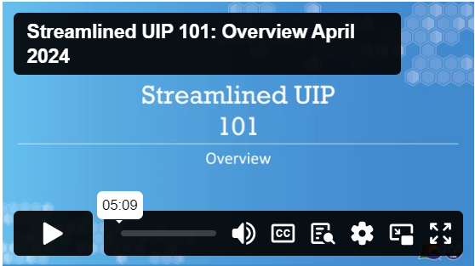
Resources to Get Teams Started
UIP 101 Videos
Quality Criteria
Revised to include both school and district expectations in one document
Programmatic Changes:
Gifted Education
Title I Schoolwide Plan Requirements

Slide 24
Updated Resources
User guides for:
District Admin users
UIP Online System User Guide (school users, district level plans)
LAM ACI Online System User Set Up & Management
Planning Support Resources:
UIP Workbook (DOCX) PDF
Implementation Guide
Priority Claim Evidence Reasoning Sample (in template)
Short Cycle Guidance
Implementation Milestone Guidance
Colorado Educational Accountability: An Overview for Boards of Education
Unified Improvement Plans: The Role of the School Board in Plan Development & Adoption
Accountability and Continuous Improvement
Summary Changes Document
Describes changes in accountability, including improvement planning
Will be updated as policies shift and additional information becomes available

Slide 25
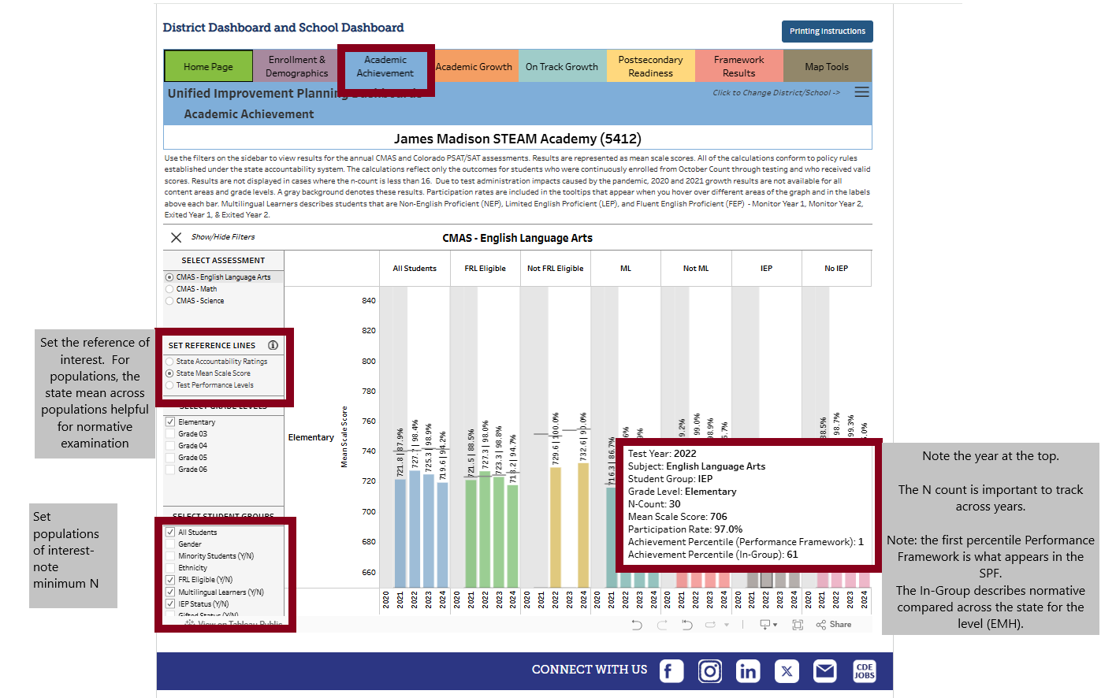
Digging in to Achievement Percentiles for student groups

Slide 26





New Resource- UIP Elements Dashboard
CDE Supports
Strategic Planning
Networking
UIP Process
Identify areas of focus to develop CDE resources and to coordinate technical assistance (e.g., trainings, cohorts).
Inform CDE’s strategic planning process (i.e., monitor trends, track implementation, identify bright spots).
Facilitate cross-district networking (e.g., connect districts that are working on the same strategies).
Districts and schools can use this data to inform improvement planning supports.
Notes:
From a combination of research projects and internal coding, we identified primary categories used by schools and districts for theirUIP’s performance priorities, root causes, and improvement strategies
Beginning with the 2023-24 UIP cycle, schools and districts could self-select from one of the categories above for each of their performance priorities, root causes, and strategies

Slide 27
Participation in Categories
Of the approximate 1,800 plans submitted in 2024-25:
Representative Elements | School UIPs | District UIPs
Number of Schools Represented | 1057 | -
Number of Districts Represented | 76 | 101
Performance Priorities Categorized | 65% | 55%
Root Causes Categorized | 45% | 34%
Strategies Categorized | 61% | 48%

Slide 28
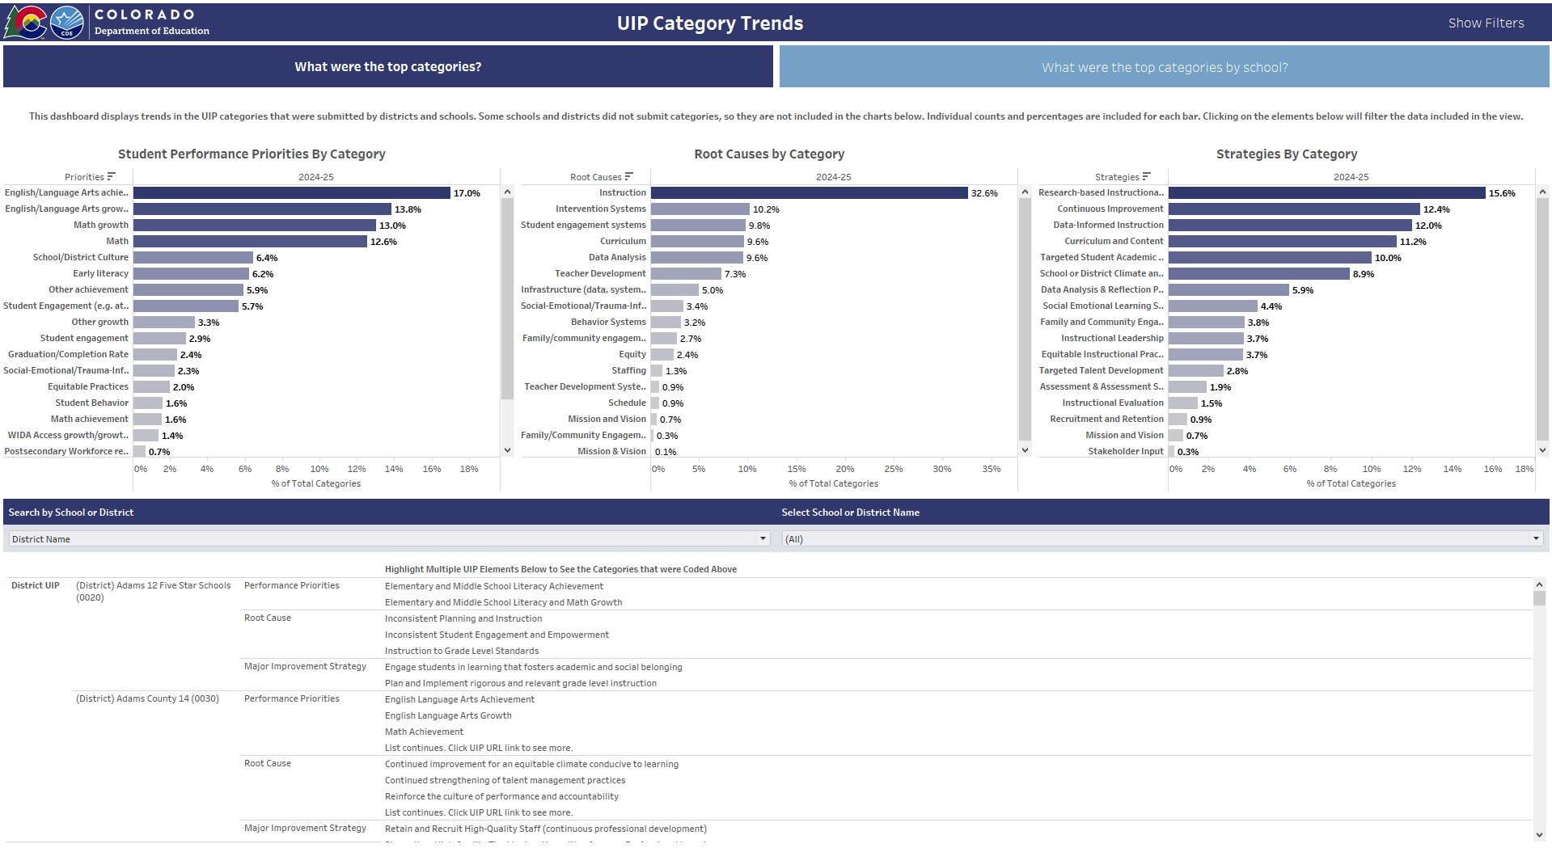
UIP Elements Dashboard
Additional filters are available
Clicking any bar or text will filter the view
Hover overs show N size
Table displays UIP text
Can view trends by District UIPs and School UIPs
Link directs users to UIP

Slide 29
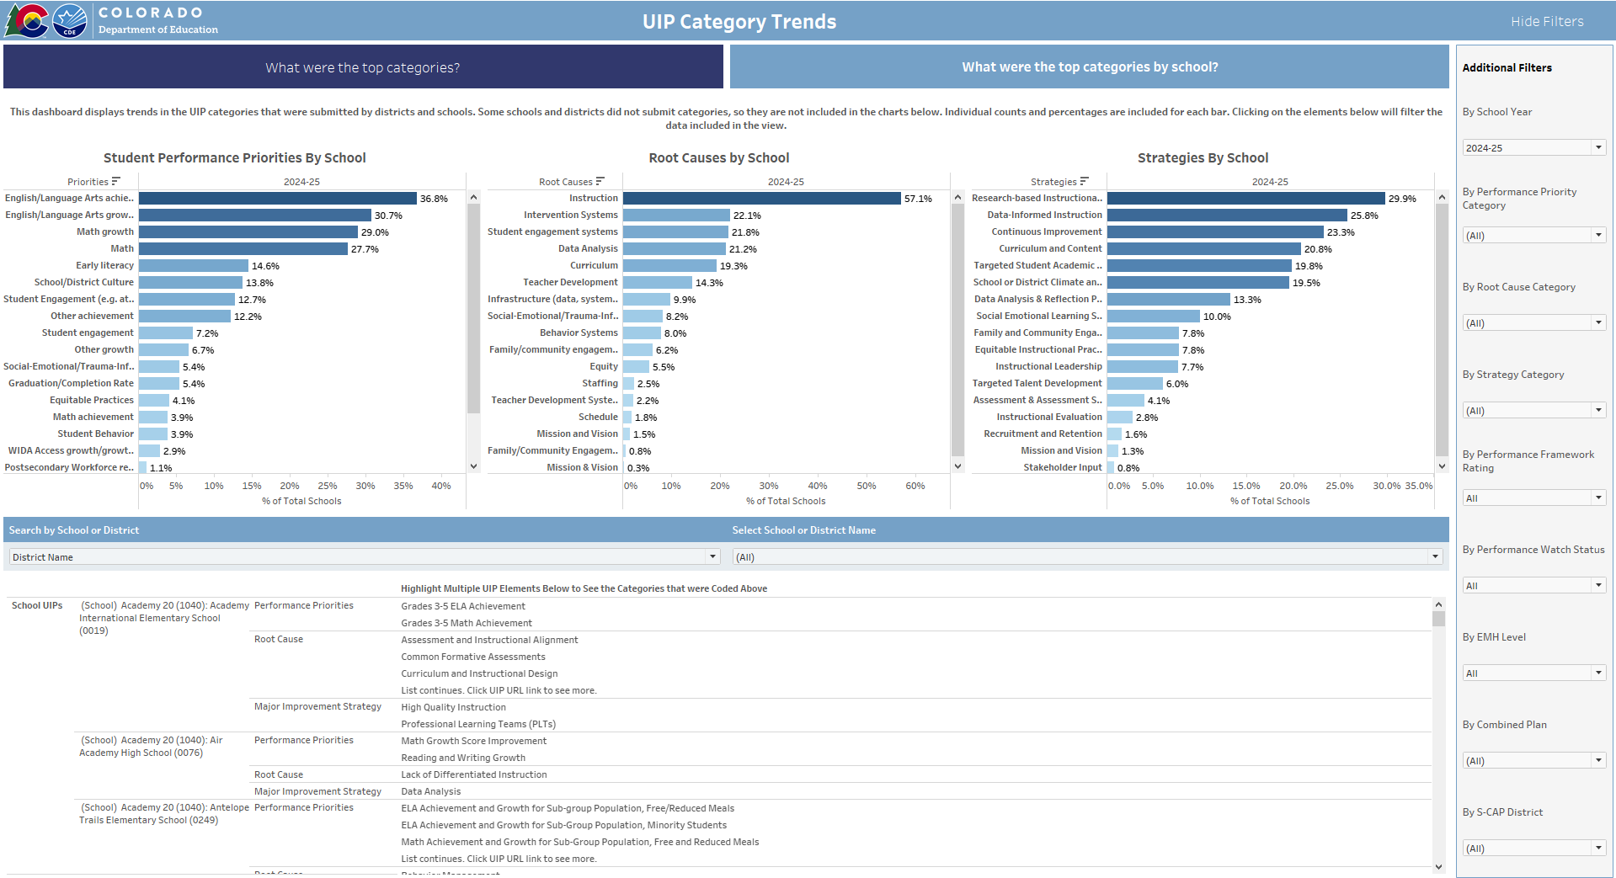
UIP Elements Dashboard
UIP data can be updated automatically each week
Also displays the charts by distinct school count
Can filter by Performance, by EMH level, or UIP type
At any point, data can be downloaded into an Excel file
Notes:
Displaying the data by school helps remove some of the noise in the data from schools selecting multiple categories multiple times

Slide 30
Questions and Answers

Slide 31
Accountability Bill Update
Webinar TODAY
CDE staff will host an informational webinar to discuss the accountability system, including updates on performance frameworks, improvement planning, and new accountability legislation. The webinar will be recorded and publicly posted.
Date/Time: June 12, 2025 12:00-1:00pm
Registration: Registration Link

