Slide 1
Subgrantee Meeting
September 18, 2020

Slide 7
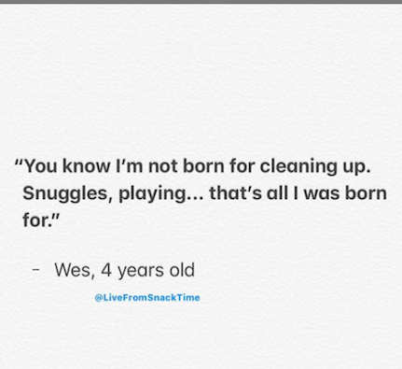

Slide 11
I have a guardian requesting 100% remote learning for a 9th grader who is homeless unaccompanied youth – Student has asthma and takes daily medications. The school is telling me: “We will be happy to take student but in a hybrid schedule (two days in person, 3 days remote). Remote classes are at maximum capacity and we are not taking “any” more students for remote classes. For example, the student needs to take Algebra class and the remote class has already 60 kids enrolled.”

Slide 12
Can we offer our MKV remote learning students RTD passes or gas reimbursement to pick up their school lunches?

Slide 13
Jeffco Food Service Updates

Slide 14
A family who has rented their own apartment and have 5 children residing in one-room (varying ages). A mom and 5 children with boys in one room, girls in one room, and mom sleeping on the couch

Slide 15
Does public housing qualify for McKinney Vento eligibility in that it is a supportive housing program and the family could not afford housing otherwise?

Slide 16
Getting a Pulse…
What is happening/What are you experiencing?
What do you need?

Slide 17
State Coordinator Goals
I will leverage the newly developed Office of Student Support and CDE partnerships to increase outreach, identification, and access to services, supports and resources for students and families in homeless situations. This will be achieved using a 3-pronged approach of professional development, targeted technical assistance, and data-driven evaluation.
Create a McKinney-Vento State Advisory Board to provide unique knowledge, feedback, and strategic advice to the state-level program management.
Submit for EDAC approval the addition of (2) homeless data elements for
SY20-21. These data elements will provide increase insight as to the “causes of
homelessness” to better inform data-driven conversations.

Slide 18
Important Dates for 2020-2021

Slide 19
Recent News Articles
Colorado Newsline
https://coloradonewsline.com/2020/09/10/way-more-students-spike-in-homelessness-feared-in-colorado-school-districts/
Education Week
https://www.edweek.org/ew/issues/reopening-schools/closing-covid-19-equity-gaps-in-schools.html
https://www.edweek.org/ew/articles/2020/09/17/shielding-students-from-the-economic-storm.html

Slide 20
Upcoming Trainings

Slide 21
Upcoming trainings
Throughout the fall CDE will be supporting virtual trainings hosted by national experts that Health & Wellness Department have contracted with to support schools and grantees specifically with various topics such as:
Return to School Support
A Framework for Creating, Sustaining, and Assessing the Trauma-Informed Classroom
Social and Emotional Learning
Transformational Emotional Intelligence for Educators
The Impact of Stress on Learning and Behavior and Creating Developmentally Relevant Strategies
Student Case Presentations and Book Study – The Boy Who Was Raised as a Dog

Slide 22
Next Subgrantee meeting: January 29, 2021

