Slide 1
Educational Stability Grant Pursuant To: Colorado House Bill 18-1306; Colorado Revised Statue 22-32-138
Application Information Webinar March-2025

Slide 2
Program Key Elements

Slide 3

Introduction
In 2018, Colorado passed House Bill 18-1306 “Ensuring Educational Stability for Students in Out-of- Home Placement”. This bill included the creation of the Educational Stability Grant Program, which is intended to support educational stability of highly mobile students.
A highly mobile student is defined as a student who experiences (or is at risk of experiencing) multiple school moves during their K-12 education outside of regular grade promotion. This includes youth in foster care, those experiencing homelessness, and migrant students.
Highly mobile students among these student groups experience low graduation rates, high dropout rates, and tend to be disproportionately represented in disciplinary actions and are above the state average in special education designations.
The statutory definition of “highly mobile students” means children or youth who at any time during the academic year were homeless, as defined in section 22-1-102.5, C.R.S; were in noncertified kinship care, as defined in section 19-1-103, C.R.S; were students in out-of-home placement, as defined in section 22-32- 138(1)(h), C.R.S.; or were migrant children, as defined in section 22-23-103, C.R.S. See Attachment E: Glossary of Terms, for more information.

Slide 4
Introduction [continued 1]
Goals of the Grant Program:
To improve educational experiences and outcomes for students experiencing high mobility in the following populations:
Foster Care (or out-of-home placement)
Migrant
Homeless/Unaccompanied youth
Applicants must focus their proposal on any one, two, or all three of the above highly mobile-eligible categories.

Slide 5
Introduction [continued 2]
“Highly mobile students”, as used in this Request for Applications (RFA), refers to the highly mobile-eligible students who receive the supports and services provided by the grant-funded program efforts.
See Attachment B for a framework for service and supports to provide targeted assistance to highly mobile students. Categories include:
Essential needs
Connectedness (in and out of school)
Innovative solutions to address barriers to learning
Multiple pathways

Slide 6
Intent of the Educational Stability Grant
The intent of the Educational Stability Grant (ESG) is the address reducing educational barriers for students who experience high mobility by providing academic and social emotional services and supports to highly mobile students.
The purpose of this funding opportunity is to support the removal of all educational barriers for children and youth experiencing high mobility with an emphasis on improving school attendance, reducing behavioral and discipline incidents, increasing grade-level promotion, reducing drop-out rates, and increasing graduation and completion rates.

Slide 7
Intent [continued]
To the maximum extent practical, grant-funded services shall be provided through programs and mechanisms that integrate highly mobile individuals and non highly mobile individuals.
Activities undertaken must not isolate or stigmatize highly mobile children and youth. Services provided under this program are not intended to replace the regular academic program.
Funds from this grant can be used to supplement existing services, but they cannot be used to supplant services which LEA/BOCES has been providing through other means.
Collaboration and coordination with other local and state agencies that serve highly mobile children and youth is required (e.g., county child welfare agencies)

Slide 8
Required Professional Development
To support successful implementation and marked progress towards performance measures, awarded grantees will be required to participate in one Colorado Département of Education (CDE) Learning cohorts each year of the grant.
These CDE learning cohorts will be designed specifically for grantees of the Education of Homeless Children and Youth grant and the Educational Stability Grant.

Slide 9
Required Professional Development [continued]
Awarded grantees will be engaged by the District Improvement Strategy Office (DISO) at CDE to determine cohort design and topics. Selected topics of the CDE Learning Cohorts will focus on increasing student engagement and accelerated student outcomes.
Topics may include but are not limited to Chronic Absenteeism, Evidenced Based Social Emotional Learning Strategies, Credit Accrual Strategies and supporting transitions of highly mobile youth, Policy and Practices review, and additional strategies for dropout prevention and student re-engagement.
A required component of the application includes a signed assurance form articulating commitment to participation in these cohorts as a condition of funding. Completion of this assurance form will be scored as part of the rubric.

Slide 10
Eligible Applicants
All Colorado Education Providers are eligible to apply.
"Education provider" means:
a public school district;
a board of Cooperative Educational Services (BOCES);
The Charter School Institute;
A charter school authorized by the charter school institute or a public school district, pursuant to part 5 of article 30.5 of title 22, C.R.S;
a state-licensed day treatment facility;
an approved facility school as defined in section 22-2-402 (1), C.R.S;
a consortia of charter schools

Slide 11
Eligible Applicants [continued 1]
The State Board of Education shall award educational grants to preschool, elementary, and secondary education providers from money appropriated from the Educational Stability Grant Program fund.
Charter Schools:
Pursuant to C.R.S. 22-30.5-104 (11), a charter school may choose to apply apart from their authorizer for a competitive grant program created by a federal or state statute or program. The charter school is considered the LEP only for the purposes of applying and determining eligibility. A charter school’s authorizer will be the fiscal agent, if funded.
A charter school that applies for a grant shall provide to its authorizing district:

Slide 12
Eligible Applicants [continued 2]
The State Board of Education shall award educational grants to preschool, elementary, and secondary education providers from money appropriated from the Educational Stability Grant Program fund.
Charter Schools:
Pursuant to C.R.S. 22-30.5-104 (11), a charter school may choose to apply apart from their authorizer for a competitive grant program created by a federal or state statute or program. The charter school is considered the LEP only for the purposes of applying and determining eligibility. A charter school’s authorizer will be the fiscal agent, if funded.
A charter school that applies for a grant shall provide to its authorizing district:

Slide 13
Eligible Applicants [continued 3]
A copy of the grant application at the time the application is submitted to CDE; and
If the charter school receives the grant moneys, a summary of the grant requirements, a summary of how the charter school is using the grant moneys, and periodic reports on the charter school’s progress in meeting the goals of the grant as stated in its application.
If a charter school intends to apply for a grant that the school’s authorizing school district is also intending to apply for, the charter school shall seek to collaborate with the school district in the application and to submit the application jointly. If the charter school and the school district are unable to agree to collaborate in applying for the grant, the charter school may apply for the grant independently or in collaboration with other charter schools.

Slide 14
Priority Considerations
Priority will be awarded to applicants that meet one or more of the following criteria:
10 points- Propose serving all three populations of highly mobile students;
10 points- Demonstrate through letters of support the engagement and collaboration with the Child Welfare Education Liaison (CWEL), Homeless Liaison, the education provider’s leadership and/or community-based programs that serve highly mobile students;

Slide 15
Priority Considerations [continued 1]
10 points- New programs that have not been funded in the last three years, or programs with high quality past performance (within the past three years) as determined by the following:
All ESG programmatic and fiscal monitoring findings have been resolved
Ongoing formally communicated program or fiscal concerned were resolved
ESG funds were expended in an appropriate manner
Less than 10% ESG funds were returned to CDE at year allowance
ESG grantee attended and participated in all mandatory in person professional developments and trainings

Slide 16
Priority Considerations [continued 2]
10 points- Education providers with over 9% of highly mobile student populations (see Attachment A);
Note: Eligible applicants that do not have data (e.g., facility schools or BOCES) are asked to estimate the number of highly mobile students (as defined in this RFA) for the past three years and explain how counts of students were calculated or determined.

Slide 17
Available Funds and Duration of the Grant
Approximately $825,000 is available for the 2025-2026 school year, with funding contingent on approval of appropriations from the State Legislature.
CDE anticipates awarding approximately 10 grants for a three-year period. Eligible applicants may apply for up to $100,000. Funding in subsequent years for grantees is contingent upon continued appropriations and upon grantees meeting all grant, fiscal and reporting requirements.
Grants will be awarded for a three-year term beginning in the 2025-2026 fiscal year. Additional grant funding for subsequent years will be contingent upon annual appropriations by the State Legislature.
Funded applicants for the 2025-2026 school year are not guaranteed any additional funding beyond the 2025-2026 year at this time. Funds for 2025-2026 school year must be expended by June 30, 2026. There will be no carryover of funds.

Slide 18
Allowable Use of Funds
Eligible activities include the provision of tutoring, supplemental instruction, and enriched educational services that are linked to the achievement of the same challenging State academic standards that the State establishes for other children and youth.
Programs can either expand or improve services provided through a school’s general academic program but cannot replace that program (supplement, not supplant).
To the extent practicable, activities and services should integrate highly mobile and non-highly mobile students.
Applicants may contract with other agencies; however, the local school system assumes responsibility for setting program goals and monitoring program accomplishments. The eligible applicant must serve in the capacity of fiscal agent.
Applicants may use funds to provide services through programs on school grounds, at other facilities, or may use funds to enter into contracts with other agencies to provide services for highly mobile children and youth.

Slide 19
Evaluation and Reporting
Pursuant to C.R.S.22-32-138.5, CDE is responsible for submitting annual reports on the Educational Stability Grant Program to the State Board of Education and the Colorado Legislature. The reports must include a review of the outcomes and effectiveness of services provided as measured by the demonstrated degree of educational stability. The analysis of the degree of educational stability examines:
The improvement in school attendance;
The reduction in behavioral and discipline incidents;
The increase in grade-level promotion;
The reduction in the dropout rate; and
The increase in the graduation and completion rates for the grant recipients’ schools.

Slide 20
Evaluation and Reporting [continued]
To ensure that CDE meets the state-level reporting mandates, evaluation reporting is required of awarded grantees. Grantee reporting includes, at a minimum, the following elements:
End-of-Year Performance Report and Continuation Application when applicable (e.g., including numbers of students served, student outcomes, progress on three performance measure areas, narrative on successes and challenges relevant to serving highly mobile students) during each year of the grant.
State Assigned Student Identifier (SASID) for every student served in the program during the grant period. SASIDs are unique 10-digit student identifiers assigned to each student in the State of Colorado. A SASID spreadsheet will be provided to grantees for annual reporting.
See Attachment D for questions grantees will be asked in the End-of-Year Performance Report and Continuation Application. Education Providers receiving an award through Educational Stability Grant may be selected for a site visit by CDE program staff during the 2025-2026 school year or any of the subsequent years of funding
The information reported to CDE in relation to grant activities is not confidential and is subject to public request. Grantees should ensure reported information does not contain PII or confidential information.

Slide 21
Review Process and Timeline
Applications will be reviewed by CDE staff and peer reviewers to ensure they contain all required components. Applicants will be notified of final award status no later than Friday, June 20, 2025.
Note: This is a competitive process – applicants must score at least 89 points out of the 127 possible points in the scored narrative to be approved for funding. Applications that score below 89 points may be asked to submit revisions that would bring the application up to a fundable level. There is no guarantee that submitting an application will result in funding or funding at the requested level. All award decisions are final. Applicants that do not meet the qualifications may reapply for future grant opportunities.

Slide 22
Submission Process and Deadline
Completed applications must be submitted through the GAINS by Wednesday, April 23, 2025, by 4:00pm.
Application materials and resources are available on CDE’s Education Stability webpage.

Slide 23
Application Elements

Slide 24
Application Format
See below for the required elements of the application. Please Note: Specific word and characters limits will be articulated where applicable.
The Program Assurances Form and CDE Learning Cohort Assurances must include signatures and initials respectively. If a grant application is approved, funding will not be awarded until all signatures are in place.
Each application will need to be approved by the LEA Fiscal Representative and LEA Authorized Representative before it is submitted to CDE.

Slide 25
Required Elements
The format outlined below must be followed in order to assure consistent application of the evaluation criteria. See evaluation rubric for specific selection criteria needed in Part II (pages 12-14).
Part I: Application Information and Assurances
Part IA: Application Information
Part IB: Demonstration of Support
Part IC: Program Assurances Form
Part ID: CDE Learning Cohort Assurances Form
Part II: Application Narrative
Section A: Demographics and Need
Section B: Stakeholders, Collaborations, & Implementation
Section C: Program Design and Implementation
Section D: Performance Measures and Evaluation
Section E: Budget Narrative
Budget

Slide 26
GAINS System Training

Slide 27

Covered in this Section…
How to Login to GAINS
How to Locate and Navigate through the Education Stability Application in GAINS
Live Application Walkthrough

Slide 28

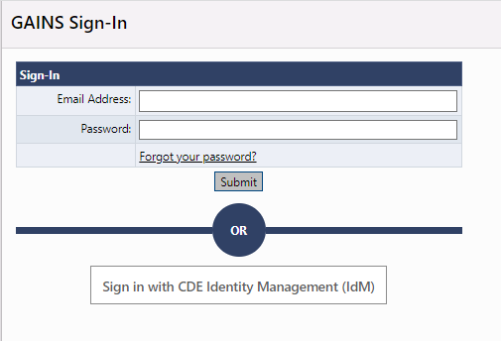
Access GAINS- IdM Users
Step 1 (IdM users): Find the login button on the top right of your screen. Login to the GAINS through the Identity Management System:
Please Note: Facility Schools, Charter Schools, and non district/BOCES users WILL NOT log in through IdM

Slide 29
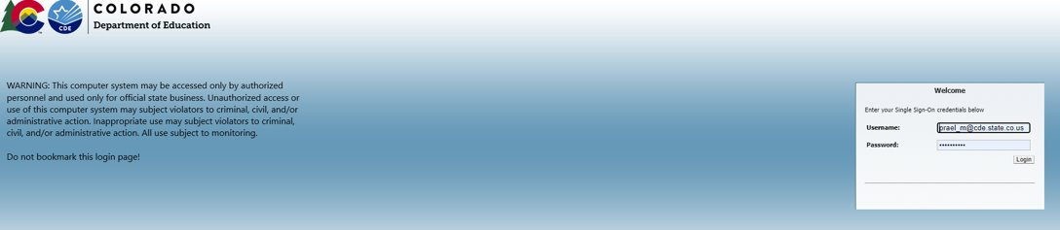
Logging In- IdM
Step 1a: The next page you will see is where you enter your Single Sign-on credentials. The username will be your full email, and the password will align to other CDE logins (i.e. Data Pipeline, the UIP System, etc.)
Please Note: Facility Schools, Charter Schools, and non district/BOCES users WILL NOT log in through IdM
If your IdM login doesn't work
Contact your district Local Access Manager (LAM) to make sure you have access to the Identity Management System (IdM)
Try the CDE IdM Password Reset
Submit a GAINS Help Desk Ticket

Slide 30
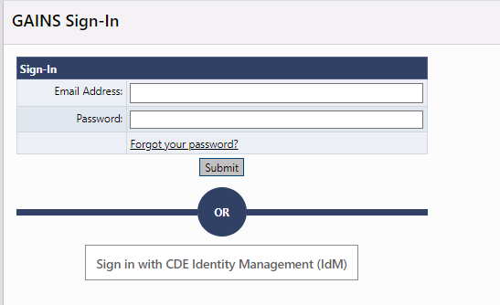
Logging In – Non-IdM Users
Step 1 (Charter Schools, Facility Schools): Once CDE creates the user in GAINS, the applicant will be notified via email to create a password. Once the password is setup, CBO/Library/IHE applicants will access GAINS through the native login.

Slide 31
Access – Non-IdM Users
Charter School Applicants, if you haven’t accessed GAINS before, please fill out the Charter School GAINS Application Access Request Form.
If you have the ALL Funding Applications Director role, you will be able to access the application and complete it.
Facility School Applicants, if you haven’t accessed GAINS before, please fill out the Non-District Organization GAINS Access Request Form.
If you are unsure of your access, you can go to GAINS (without logging in) and search for your organization. Once you click on your organization’s name, the Address Book will appear in the left navigation menu. Click on the Address Book to see who in your organization has access.

Slide 32
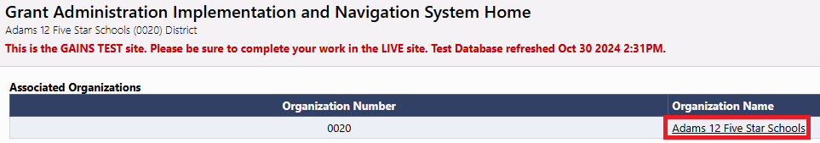
Navigate to Funding Applications
Step 2: Select your Organization's name on the Home page.

Slide 33
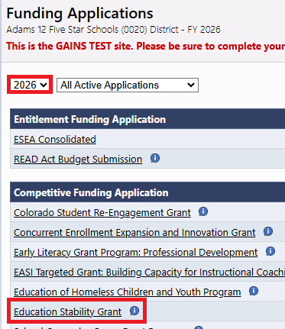
Find the Education Stability Grant
Step 3a: Select 2026
Step 3b: Select “Education Stability Grant”

Slide 34
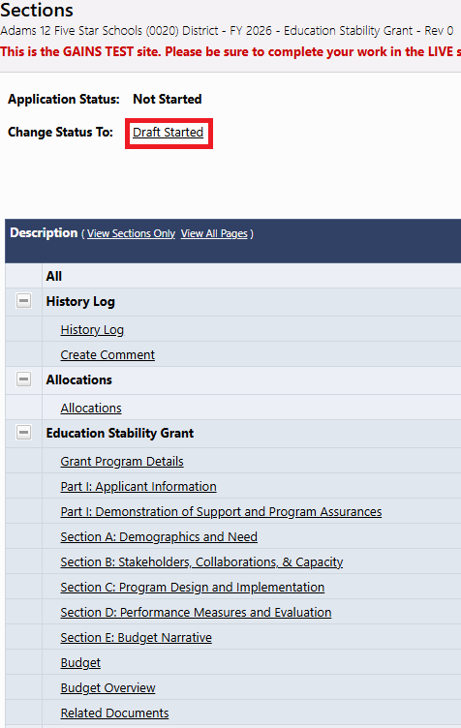
Draft Started
Step 4: Once on the Sections page of the application, be sure to change the application status to “DRAFT STARTED”
Note: Only certain roles can change the application status. You can hover over the "Draft Started" link to see the individuals and roles in your organization with these permissions.
Please note: The pages won't be editable until the status changes to Draft Started!

Slide 35
Navigating Basics - Sections Overview
The Sections page is your Education Stability home page and main navigation center.
From here you can access a number of features related to your application. The following sections are required for submission:
Part I: Applicant Information, Demonstration of Support and Program Assurances
Section A: Demographics and Need
Section B: Stakeholders, Collaborations, & Capacity
Section C: Program Design and Implementation
Section D: Performance Measures and Evaluation
Section E: Budget Narrative
Budget

Slide 36
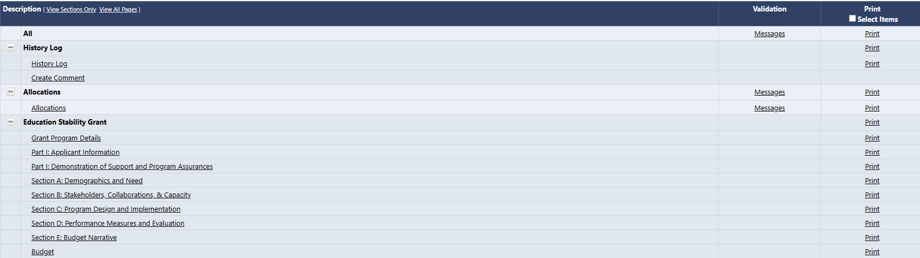
Navigating Basics – Validations
On the Sections page, you will have a Validation column which will let you know when a section has errors that would prevent you from submitting and/or warnings to check before submitting.

Slide 37
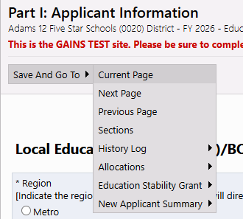
Navigating Basics – Saving your Work
DO NOT USE your browser’s back/forward buttons!
Use the "Go To" feature to move throughout the application.
It will save the data entered on the current page. You can select to remain on the current page (to save your data) or you can move to the selected page. This will also result in the current page saving.
Clicking on "Sections" here will take back to the Home Sections Page
Be mindful of the timer in the top right hand corner. If your time is getting low, use the Go To function to save your progress. This will also reset the timer.

Slide 38
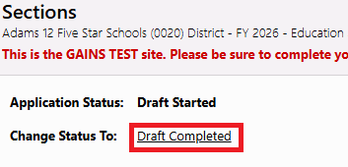
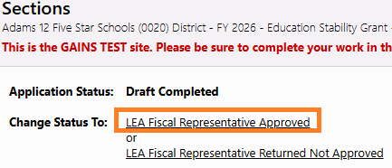
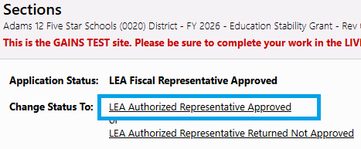
Application Submission
Application are due on April 23, 2025
Application status must be changed to at least “Draft Completed” on April 23 to be considered for funding. Applications are considered fully submitted to CDE when the status is at "LEA Authorized Representative Approved."
We highly recommend keeping the approval workflow in mind. Although the application will be considered submitted in Draft Completed, applicants should continue to work through the approvals, so the application does get fully submitted to CDE.

Slide 39
GAINS Demonstration

Slide 40
Additional Support
Office Hours for the System
Every other Tuesday from 12:30pm to 1:00 pm, hosted by CDE's GAINS Team - Register for Office Hours!
GAINS Small Bites
The Grants Program Administration (GPA) Office has been working on short recordings for various aspects of GAINS called GAINS Small Bites! Feel free to check out the recordings.
One on One Support
Please fill out the Help Desk Ticket for assistance!
In addition, you can always reach out to Michelle Prael at prael_m@cde.state.co.us.
Please note: These support opportunities are specific to the system itself and not the programming. The GPA team will be unable to answer programmatic questions.

Slide 41
Questions

Slide 42
Jamie Burciaga
State Coordinator for Foster Care Education
Burciaga_j@cde.state.co.us
303.518.5938

