Slide 1
The Outcomes-Driven Model
A Model for Data-Based Decision Making

Slide 2
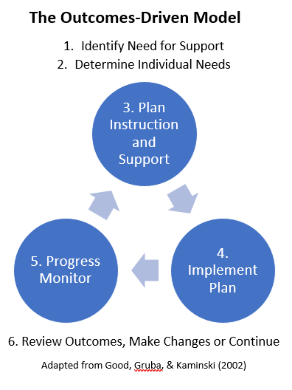
The Outcomes-Driven Model
The Outcomes-Driven Model is a prevention-oriented decision-making system designed to ensure that students are making adequate progress toward outcomes.
The Outcomes-Driven Model provides a step-by-step process to follow that guides educators to analyze the data we gather and plan for changes in our systems and instruction.
Good, Gruba, & Kaminski, (2002)
Notes:
Good, R. H., Gruba, J., & Kaminski, R. A. (2002). Best Practices in Using Dynamic Indicators of Basic Early Literacy Skills (DIBELS) in an Outcomes-Driven Model. In A. Thomas & J. Grimes (Eds.), Best Practices in School Psychology IV (pp. 679-700). Washington, DC: National Association of School Psychologists.

Slide 3
1. Identify Need for Support
Administer the universal assessment to all students. Review the assessment results to determine the need for support.

Slide 4
1. Identify Need for Support
Questions to Consider for Systems:
Are there students who need support?
How many students need support?
Questions to Consider for Students:
Which students need support?

Slide 5
2. Determine Individual Needs
After identifying the need for support, gather additional data to validate the need and administer diagnostic assessments to determine individual needs.

Slide 6
2. Determine Individual Needs
Questions to Consider for Systems:
At what grade level(s)/in what areas is support needed?
Questions to Consider for Students:
What are the student’s skills and needs?

Slide 7
3. Plan Instruction and Support
Determine the instruction and support that the students will receive based on their needs. How do the plans compliment one another?

Slide 8
3. Plan Instruction and Support
Questions to Consider for Systems:
What are our system-wide goals?
What is our system-wide plan for support?
What resources are needed?
How are parents/families involved in this process? Conferences?
Questions to Consider for Students:
What is the plan of support for the student, including goals and plan for progress monitoring?
What resources are needed?
How are parents/families involved in this process? Conferences?

Slide 9
4. Implement Plan
Provide instruction following the plan you have created. How will you ensure that the plan is implemented with fidelity?

Slide 10
4. Implement Plan
Questions to Consider for Systems:
Is there a regular method of collecting data on implementation fidelity?
Are there regular (bi-monthly, monthly) opportunities for teams to meet to discuss plan implementation? (PLCs, RTI, DDI Meetings, etc.)
What mechanisms are in place for staff to communicate needs for support during this time?
Questions to Consider for Students:
Is the plan being implemented with fidelity?

Slide 11
5. Progress Monitor
Collect progress monitoring data to evaluate whether the supports implemented in the plan are leading to increased student outcomes. Are students making progress?

Slide 12
5. Progress Monitor
Questions to Consider for Systems:
Are we making progress toward our system-wide goals?
Is our system of support effective?
When and where do teachers review student progress?
How is student progress communicated to parents?
Questions to Consider for Students:
Is each student making adequate progress?
Is the support effective for individual students?
How is student progress communicated to parents?

Slide 13
6. Review Outcomes, Make Changes or Continue
Administer the universal assessment to all students. Review the assessment results. Do we need to change our instructional plan?

Slide 14
6. Review Outcomes, Make Changes or Continue
Questions to Consider for Systems:
Have we met our system-wide goals?
Is our system of support effective?
Are there students who may need more support? How many students?
How might we share the plans as children transition to the next grade?
Questions to Consider for Students:
Has the support been effective for individual students?
Has the students met their goal(s)?
Which students may need more support?

Slide 15
6. Review Outcomes, Make Changes or Continue
Questions to Consider for Systems:
Have we met our system-wide goals?
Is our system of support effective?
Are there students who may need more support? How many students?
How might we share the plans as children transition to the next grade?

Slide 16
6. Review Outcomes, Make Changes or Continue
Questions to Consider for Students:
Has the support been effective for individual students?
Has the students met their goal(s)?
Which students may need more support?

Slide 17
Resources
Good, R. H., Gruba, J., & Kaminski, R. A. (2002). Best Practices in Using Dynamic Indicators of Basic Early Literacy Skills (DIBELS) in an Outcomes-Driven Model. In A. Thomas & J. Grimes (Eds.), Best Practices in School Psychology IV (pp. 679-700). Washington, DC: National Association of School Psychologists.
Colorado Department of Education. (2016) Outcomes Driven Model Guiding Questions for Use After Each Interim Assessment.

