Slide 1
Kindergarten School Readiness and READ Plans
Preschool – Third Grade Office
December 2020
Notes:
Welcome to the Kindergarten School Readiness and READ Plans Webinar, presented by the Preschool through 3rd Grade Office at the Colorado Dept of Education.
The intended audience for this webinar includes school and district leadership, to support as you develop processes for teachers to use data from the multiple required assessments in Kindergarten to modify instruction based on student needs. We will review the statute that guides the assessment process and the associated requirements, dive into some data, and provide some considerations as you engage in this work.

Slide 2
Introductions
CDE Staff
Megan Prior Rogers
Kindergarten School Readiness Consultant
Preschool through Third Grade Office
Rogers_m@cde.state.co.us
720-326-2880
Andreia Simon
Senior Literacy Consultant
READ Act Communications & District Support
Preschool through Third Grade Office
simon_a@cde.state.co.us
readact@cde.state.co.us
720-402-6049

Slide 3
Agenda & Intended Outcomes
Agenda:
Purpose, legislation and statutory background of assessments
Timeline and connections across assessments in K
Supporting the use of data and individual problem solving
Connecting individual student and trend data
Enabling contexts for data driven decision making
Documenting the process in individual plans
Objectives:
Describe and compare the background of and connection between the required assessments in K.
Review and illustrate how to use the problem-solving process across required assessments.
Review requirements and flexibilities in documenting the DBDM process in individual plans.
Notes:
Talking Points:
We'll start by reviewing the webinar agenda and objectives.
The topics we'll cover include the purpose, legislation, and statutory background of the kindergarten assessments...(continue with agenda)
During the webinar, will....(read objectives)

Slide 4
Ready Child, Ready System
School readiness describes both the preparedness of a child to engage in and benefit from learning experiences, and the ability of a school to meet the needs of all students enrolled in publicly funded preschool or kindergarten. School readiness is enhanced when schools, families, and community service providers work collaboratively to ensure that every child is ready for higher levels of learning in academic content.
~State Board of Education, 2017
Notes:
In this first section we will discuss the purpose, legislation and statutory background of the assessments required in Kindergarten.
Students enter K from a variety of early childhood environments, including child care centers, home care providers, preschool settings such as State-funded preschool programs or Head Start, and the care of family friends or neighbors. These varying settings, in combination with community resources in support of families and young children, may provide high-quality early experiences supportive of child development and school readiness at differing points during any one child's early childhood experience. Thus creating space and need for teachers and school leaders to understand the early childhood resources and programs serving families and young children within their community as well each students skills, abilitites and attitudes at K entry.
It is in the latter of these that purport the purpose of the assessments in K: to assess students' skills abilities and attitudes as well as ongoing progress toward school readiness, so each child is able to fully benefit from learning in Kindergarten, 1st and beyond.
In CO, SR means the preparedness of a child to engage in and benefit from learning experiences and the ability of a school to meet the needs of all students
Additionally, we recognize that SR is enhanced when schools, families, and community service providers work collaboratively
This collaboration ensures that every child, in every community is ready for higher levels of learning and has access to high quality, evidence-based early learning experiences.

Slide 5
Strong Foundations
A strong start is crucial to ensuring student’s ultimate success in school, postsecondary education, in the workforce and in life.
Effective, engaging programming within an aligned system ready for every child will ensure a child’s preparedness to benefit from learning experiences.
(§22-7-1002)
Notes:
Specifically, strong early experiences which provide effective, and engaging programming within an aligned system will prepare each child to benefit in ongoing learning experience and ensure success in school, postsecondary education, in the workforce, and in life.

Slide 6

Strong Foundations - CDE
Colorado has prioritized early learning through its investments in the Colorado preschool program, established in 1988, and full-day kindergarten, and the general assembly recognizes that these investments can be best leveraged by adopting policies that support a continuum of learning from preschool through third grade and beyond.
(§22-7-1202 (b))
Notes:
In Colorado, the general assembly and the colorado department of education have prioritized early learning through its investments in the Colorado preschool program, which was established in 1988, through full-day kindergarten, and the general assembly recognizes that these investments can be best leveraged by adopting policies that support a continuum of learning from preschool through third grade and beyond.

Slide 7

Strong Foundations - Overview
Research-based assessments
Intentional Planning of differentiated, targeted and intensive instruction
Prevention and early identification
Plans to document instructional targets and ongoing progress monitoring
Notes:
This includes the passage of several acts of legislation to support this continuum of learning from preschool through 3rd grade. For the purpose of today's webinar, we will provide an overview of 2 of these acts that directly impact instruction and assessment along this continuum in K, the Preschool to Postsecondary Education Alignment Act, also referred to as Colorado's Achievement Plan for Kids or CAP4K, and the Reading to Ensure Academic Development, the READ Act.
CAP4K and The READ ACT are complementary statutes that support building strong foundations for students in the early years of school. The intent of both CAP4K and the READ Act legislation is to create stronger pathways to success for our youngest students by targeting key practices in schools and classrooms. Both intersect to do this in the following ways:
1. Research-based assessments: The use of research-based assessments provides valid and reliable methods of identifying instructional targets for individual as well as groups of children in Kindergarten classrooms.
2. Prevention and Intervention: Timely assessments and data analysis support the identification of risk factors and create opportunities for prevention or intervention. Both CAP4K and the READ act promote prevention-based models by identifying strengths and needs early and providing high-quality, evidence based instruction and intervention.
3. Intentional planning of differentiated, targeted, and intensive instruction: Data from research-based assessments used to inform intentional planning of differentiated core, targeted, and intensive instruction intentionally improves student outcomes. Clearly identified developmental and academic strengths and needs creates a pathway for teachers to target needs in individualized and small group instruction, as well as clearly outlines the additional, standard supports and interventions needed to supplement core instruction in K.
4. Both include Plans to document instructional targets and progress monitor: The documentation of student targets, instructional supports and interventions, and progress attained create ongoing opportunities for collaboration and communication with families around their child’s strengths, needs, and progress. Additionally, this collaboration creates a support network for each student. Over time, this documentation aids teachers in collaborating and facilitates sharing student data, successful supports, and progress.
These are the two statutes that drive teaching and learning in Kindergarten, with the connected purpose of students progressing toward school readiness and reaching grade level reading expectations by the 3rd grade.

Slide 8
Strong Foundations
“. . . prevention and early intervention are better in both human and practical terms, than waiting until children’s reading difficulties become severe, entrenched and greatly compounded by behavioral or social emotional factors. Although individual children vary widely in the ease with which they learn to read, effective educational practices can make a tremendous difference in children’s reading outcomes.”
-- Louise Spear-Swerling
Notes:
Louise Spear-Swerling summarizes this purpose by saying...
"prevention and early intervention are better in both human and practical terms, than waiting until children’s reading difficulties become severe, entrenched and greatly compounded by behavioral or social emotional factors. Although individual children vary widely in the ease with which they learn to read, effective educational practices can make a tremendous difference in children’s reading outcomes.

Slide 9
CAP4K and READ Act
CAP4K
State Board approved definition and assessments
Administration of assessments for all public K
School readiness plans
§22-7-1004; §22-7-1014
Notes:
CAP4K creates specific requirements for the state of CO to increase intentional alignment of assessment, expectations, and standards from preschool through postsecondary education.
As a part of an aligned system of public education, the school readiness assessment was recognized by the General Assembly as a critical element of aligned assessments continuing from preschool to elementary (§22-7-1002). The State Board of Education has approved four assessment tools to be used in assessing kindergarten school readiness and informing individual readiness plans (§22-7-1014). Each tool assesses physical well-being and motor development, social and emotional development, language and comprehension development, cognition and general knowledge, including literacy and mathematics (§22-7-1004).
In addition, CAP4K requires individual school readiness plans for all publicly funded Kindergarten students to measure progress toward school readiness.

Slide 10
CAP4K and READ Act
READ Act
Teachers assess literacy development of K-3 students using an approved assessment
Teachers develop individual intervention plans (READ plans) for students identified with a Significant Reading Deficiency (SRD)
Schools implement the READ plan by providing targeted, scientifically- and evidence-based reading intervention
§22-7-1205
Notes:
Talking Points:
The Colorado READ Act is legislation that supports early literacy and the overarching goal that all students are reading on grade level by 3rd grade.
Among other requirements, the READ Act requires that:
*Teachers assess the literacy development of k-3 students in the five areas of reading development (PA, phonics, fluency, vocabulary, and comprehension) using an approved assessment.
*Teachers develop individual intervention plans (READ Plans) for students identified with a Significant Reading Deficiency (SRD).
*Schools implement the READ plan by providing targeted, scientifically-based reading intervention addressing the goals indicated on the READ plan.
All of this should occur within an intentionally designed multi-tiered system of supports for all students, which includes scientifically- and evidence-based programming at all tiers of instruction including differentiated core along with tier 2 and tier 3 instructional supports.

Slide 11

Individual Plans in Kindergarten
If a student is identified as having a significant reading deficiency, the local education provider shall include the student's READ plan created as a component of the student's individualized readiness plan created pursuant to §22-7-1014(1)(a)
Notes:
Changes to the READ Act as a result of Senate Bill 19-199 include the following provision.

Slide 12
Assessment
Notes:
We'll spend the next portion of the webinar diving into the assessments that are administered to kindergarten students in Colorado.

Slide 13
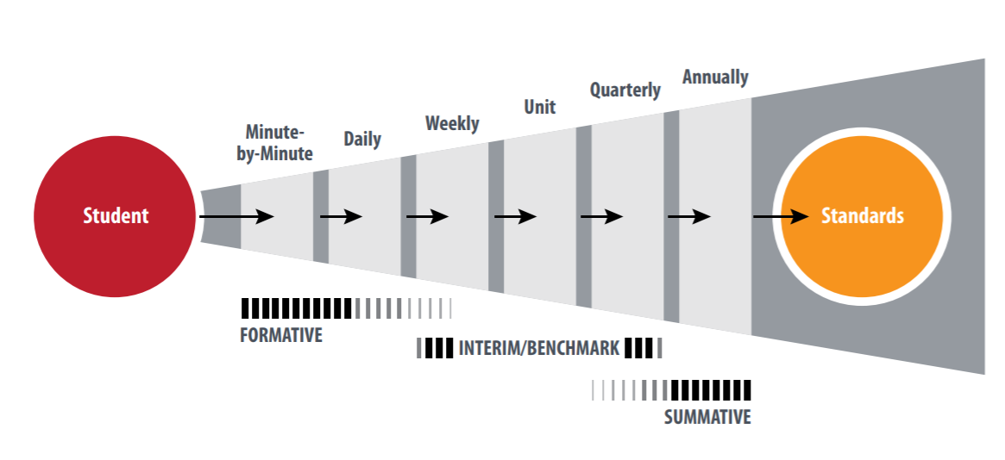
Assessment Continuum
Sigman & Mancuso, 2017
Notes:
We'll use this graphic to frame our assessment discussion. This graphic is intended to illustrate the different kinds of assessments along with their frequency and relationship between students and the learning standards.
Along this assessment continuum published by Sigman and Mancuso (2017), each assessment provides a unique set of information building to a collective understanding of what each child knows and is able to do.
*Click* (blue circle around formative appears)
The State Collaborative on Assessment and Student Standards (SCASS) defines formative assessment as a planned, ongoing process during learning and teaching to elicit and use evidence of student learning to improve student understanding of intended disciplinary learning outcomes and support students to become self-directed learners.
In CO, the Kindergarten School readiness assessments serve 3 primary purposes:
1st: The fundamental purpose of all School Readiness assessment is to provide data to inform instruction.
School Readiness assessment provides a formative measure to authentically assess the skills, knowledge, and behaviors of kindergarteners across learning and developmental domains.
Through daily routines, activities, interactions, and assignments, teachers observe and collect documentation and evidence and analyze this against progressions of learning and development.
This data is then used to inform individual instruction through the creation of School Readiness plans.
2) In addition to informing instruction, the assessment provides a mechanism for engaging and partnering with families around their child's learning as they enter school.
In accordance with the guidance from the assessment tool used, teachers expand their partnership with the child's family by understanding the child and their learning and development in the context of their family.
3) The final purpose is that an aggregate collection of the SR data provides a snapshot of School Readiness across CO to inform state policy
(NIEER, August 2020)
*Click* (blue circle around interim/benchmark appears)
The Interim or Benchmark READ Act Assessments are administered during specific windows of time at the beginning, middle, and end of the school year, are complementary to the KSR assessments, and serve a more focused purpose:
READ Act interim assessments evaluate students' knowledge and skills relative to a specific set of indicators of early literacy acquisition.
The results of these assessments should inform data-based decision making at larger system levels and the individual student level.
These assessments assist in identification of students at risk for reading difficulty, and identify those students who are likely to meet the next grade-level benchmark with high-quality differentiated core instruction.
The content of this webinar will focus on formative and interim assessments in kindergarten. Summative assessments are an additional component of a comprehensive assessment system. It is important to note that all these assessments align to and collect evidence toward student mastery of grade level standards by the end of each school year.
https://www.wested.org/wp-content/uploads/2017/03/resource-designing-a-comprehensive-assessment-system.pdf
https://www.achieve.org/files/TheRoleofInterimAssessments.pdf

Slide 14
Colorado Kindergarten Assessment
KSR
Formative Assessment, measured along a continuum of learning and development
Interim
Screener/Benchmark Assessment: administered to all K-3 students 3 times/year; set of measures used to identify early literacy skills to identify students who may be at risk for reading difficulties, monitor progress, and examine effectiveness of instruction.
Early Literacy Skills: predictive of reading acquisition and later reading achievement, improve outcomes for children if/when we teach them, serve as indicators (like a temperature check)
Diagnostic
Diagnostic Assessment: administered to students identified by the interim as significantly at risk for reading difficulty.
Domains: Physical well-being and motor development, social and emotional development, language and comprehension development, cognition and general knowledge, including literacy and mathematics
Provide specific information about student skills and deficits to target instruction/intervention
Notes:
In Colorado, the Kindergarten School Readiness assessments are administered to all publicly funded Kindergarten students. These assessments are intended to be formative and measure student learning and development. These comprehensive assessments measure 6 domains: Physical well-being and motor development, social and emotional development, language and comprehension development, cognition and general knowledge. The state board further defined general knowledge as literacy and mathematics.
Interim READ Act assessments (also referred to as screeners or benchmark assessments) are administered to all K-3 students. These assessments include a set of measures that are used to identify students who may be at risk for reading difficulties. The information yielded from these assessments also helps teachers monitor progress and examine effectiveness of instruction.
The skills selected for assessment are predictive of reading acquisition and later reading achievement. The skills assessed are part of a continuum of skills that improve outcomes for students when we teach them explicitly. Student progress with these skills serve as indicators of overall reading development, like a temperature check.
Diagnostic assessments provide additional information on student facility with specific reading skills to assist in setting goals and targeting intervention. Local education providers in CO are required to administer an approved diagnostic assessment to students identified with significant risk for reading difficulty on an interim assessment.

Slide 15
Approved Assessments
KSR
DRDP-K
COR-K
Interim
Aimsweb Plus
Acadience Reading (formerly DIBELS Next)
Diagnostic
iReady
PALS
NC KEA
TS GOLD
FastBridge
iReady
ISIP ER (Istation)
PALS
STAR Early Learning
STAR Early Literacy Assessment
Pearson Peabody
Acadience Reading Diagnostic (formerly DIBELS Deep)
Woodcock-Munoz LS
Notes:
This slide includes the State Board Approved Assessments to fulfill the Kindergarten School Readiness and READ Act requirements.

Slide 16
Kindergarten Assessment Timeline
KSR
60 days
All K
READ Interim
90 days
All K
READ Diagnostic
60 days
Students below the benchmark
Mid/End of year
Interim Assessment
KSR, local decision
Remember the purpose of the assessment.
Initial data review for strengths and needs of individual children and class trends.
Use review to intentionally plan for individual and classroom differentiation, support and intervention.
Integrating K assessment data.
Understanding and analyzing each data set.
What is each data source telling us?
Creating individual school readiness plans
Differentiated, core instruction begins on the first day and continues during assessment.
Diagnostic for those who scored below the benchmark on the interim.
Review of Body of Evidence
Identification of SRD
Plan as a component of READ of the KSR Plan
READ assessments may inform the KSR literacy domain, if completed within 60 calendar days.
Notes:
As mentioned previously, each of these approved assessments provides a unique set of information building to a collective understanding of what each child knows and is able to do. In Colorado, the approved assessments also have specific assessment windows. In walking through the assessment timeline in K—it's recognized districts will have other local measures as well. However, we will focus on these two pieces at this time.
Within the first 60 calendar days, teachers administer a State Board of Education approved kindergarten school readiness assessment to all publicly funded Kindergartners---this timeframe is set to capture the skills, knowledge and behaviors of students as they enter K. This early assessment, while formative, provides a snapshot of each child's academic and developmental readiness.
Within the first 90 calendar days, teacher further assess all students reading skills by utilizing an approved interim assessment.
A quick note on the flexibilities between these assessments: the interim assessment can be used to inform the literacy domain. However, it's important to note what each assessment assesses, the purpose, and the information the asesspment provides about students’ literacy development. For example, the interim assessments may not assess concepts of print or emergent writing which may be assessed in the KSR. This will be further explained in the next section
For any student scoring below the benchmark on the interim assessment, a diagnostic assessment is to be given within 60 calendar days of the date of the interim assessment.
For mid-year and end of K: the interim assessments are continued and the KSR as a local decision
This is the specifics of the timeline. However, next, we will unpack how this impacts teaching and learning in classrooms, specifically planning and modifying instruction.
1) Click First, differentiated core instruction begins and continues from the first day of school:
Differentiating is the act of a teacher adjusting instruction to match or respond to an individual student’s needs. This could be adjusting the content by varying how individual students will access new information, or providing multiple ways and opportunities for students to share or express learning.
The student is receiving scientifically-based and evidence-based core instruction from the beginning and throughout the year.
2) Click With KSR:
Teachers begin the initial review of student assessment data. This snapshot of entering Kindergarten students provides information on students academic and developmental readiness to guide adjusting and modifing instruction and providing additional individualized supports and intervention.
For example: In an initial review of assessment data, if a team is finding many students are struggling with retelling the details of a story, shared reading can be adjusted to explicitly demonstration retelling, and then plan meaningful opportunities for students to retell stories and events.
3) Click Interim assessments add additional reading data for each student.
Keeping in mind the purpose of each assessment and what skills and knowledge the assessment is assessing, teachers analyze the data. This comprehensive review of data allows teachers to fully identify, or define, the student's strengths and needs both academically and developmentally. Additionally, at this point, teachers may analyze student data to validate needs and strengths prior to clearly idenifying in the student's individual plan and collaborating with families.
4) Click For those students for whom a diagnostic is administered, teachers have further information on specific skill gaps and how to intentionally address gaps by layering additional standard interventions and supports.
In addition to the interim assessment and the diagnostic assessment results, a body of evidence would then be reviewed to understand a student’s academic performance and determination of a Sig. Reading Deficiency:
A body of evidence would minimally include
scores on formative or interim assessments previously mentioned
work that a student independently produces in a classroom
A body of evidence may include scores on summative assessments
For students who are identified with a SRDeficiency, a READ plan is created as a component of the KSR Plan.
https://www.cde.state.co.us/early/opening2020-21#SRD

Slide 17
Problem Solving Process
Define
Use data to identify individual strengths and needs
Analyze
Gather additional data
Implement
Evaluate
Implementation fidelity
Plan created
Program Monitoring data
What is the concern?
Diagnostic
Does additional evidence validate this concern?
Plan for and implement progress monitoring
What supports and interventions will effectively address this concern and can be implemented with fidelity?
How is this plan impacting the skill gap?
Notes:
This timeline also then guides analyzing individual student data through the problem solving process.
To ensure effective core instruction and intentional supplemental support, teachers analyze data for each child to inform individual strengths and needs. While, this process may also be useful for reviewing trends in student's skills and knowledge across classrooms and grade levels, this section will focus on the individual process. This analysis may be facilitated by reports and views in vendor data systems. However, due to the variety of assessments and vendors, we will speak to the general process and then illustrate a few examples with specific, approved assessment vendors.
Define: Following the 60 day KSR administration window, teachers review the data from the KSR, and potentially the interim read assessment, for individual strengths and needs across all 6 domains. Identify any areas of concern and quantify any gaps between where the child is and the desired skillset. We will look at a specific example of how to do this in the next section. The KSR and, when completed, the interim READ Assessment will help determine the need for support in both academic and developmental areas.
Analyze: Analyze available additional data to determine if areas of concerns and the need for additional support is validated.
Implement: Create a plan that outlines effective supports and interventions and plan for how this will be monitored for progress. Select an effective intervention and support, based on the specific need or needs of that student. Ensure fit, meaning that the selected intervention can be implemented with fidelity, and across learning contexts as needed for continuity this year.
*If a child is below the benchmark on the interim reading assessment, and a diagnostic is administered, this would prompt the return to analyzing data once the diagnostic is complete; this would also prompt a revision of the plan to add the the READ plan as a component of the SR plan further informing specific goals and interventions and the plan for monitoring progress.
Evaluate: Evaluate data gathered on the implementation of the interventions. In addition, evaluate student progress and implementation data to help determine success of the intervention.

Slide 18
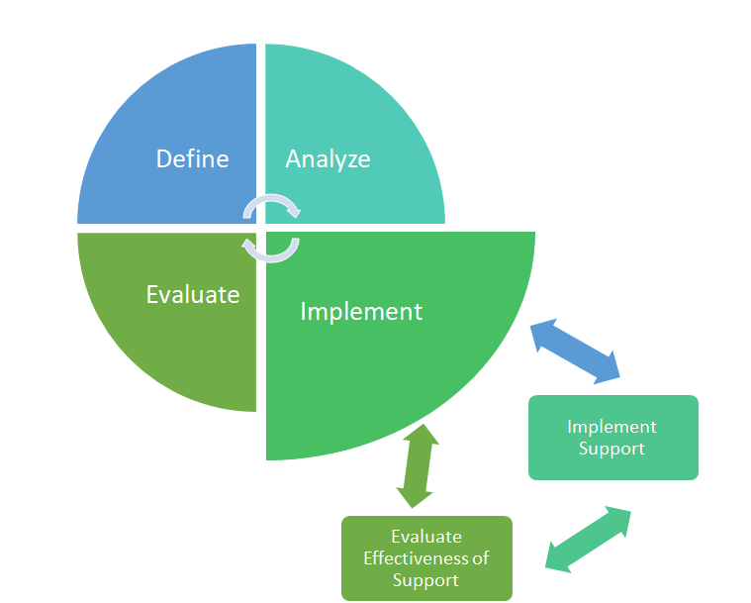
Program Monitoring
Student Data
Program Monitoring
Notes:
As outlined previously, it's important to emphasize this is an iterative process, not sequential.
Additionally, implemention will require continuous evaluation of the effectiveness of the support that is implemented as well as if it was implemented with fidelity. This program monitoring piece is essential to determining the need for a review of data and reanalysis of the selected interventions and supports if the child is not making adequate progress.

Slide 19
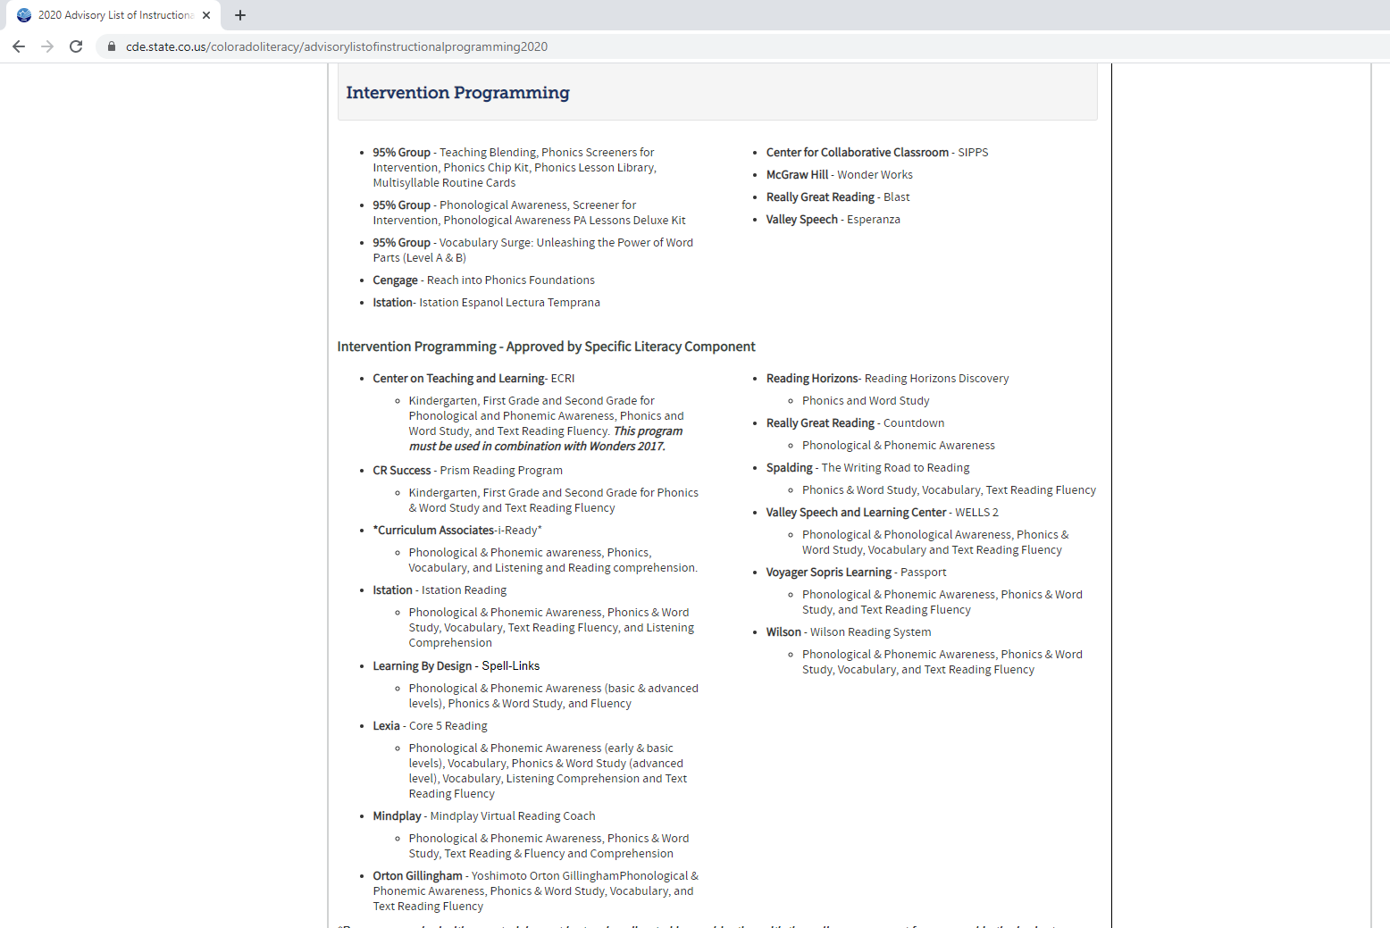
Intervention Programming
Notes:
When selecting intervention programming, specific to reading, it may be helpful to visit the Colorado Department of Educations' website to view the intervention programming reviewed for alignment with scientifically- and evidence-based instructional practices.
As we move into the next section, I'll pause and let Andreia take over.

Slide 20
Data Decision Making Student Profiles
Notes:
Talking Points:
Now we'll transition to a portion of the webinar where we'll dig into kindergarten assessment using three sample student profiles.
We hope to illustrate how a teacher can use data from both a kindergarten readiness assessment and a READ Act interim assessment to make important instructional decisions.
For these examples, we will use DIBELS Next (now published as Acadience Reading) and TS GOLD. However, the same process would apply for any combination of the approved interim and KSR assessments.
We will focus on a few specific measures in order to provide a concrete example of the similarities and differences in the information each assessment provides.

Slide 21
Student Profile 1: Low Risk
Notes:
Talking Points:
The first student profile includes data that indicate low risk for reading difficulty.

Slide 22
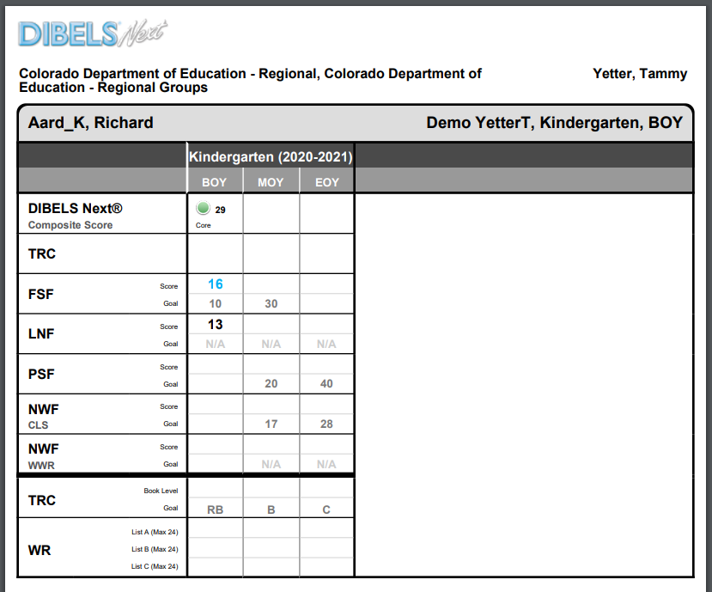
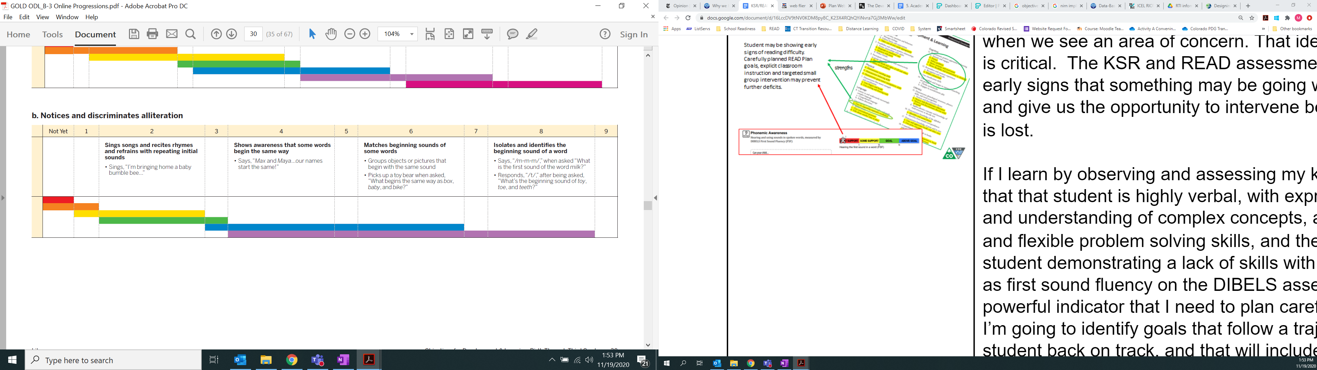
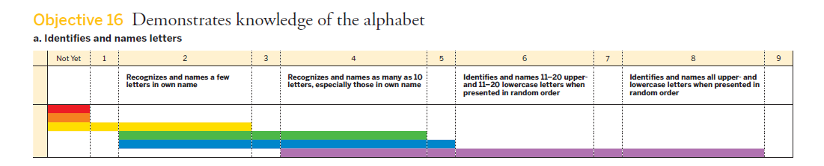
Data Decision Making: Student Profile 1
Notes:
In the example data, the student scores well above the DIBELS Next BOY interim benchmark score of 26, with a composite DIBELS Next score of 29. When a student scores at or above the composite benchmark score, this indicates that the student is likely to meet the next grade level benchmark with high-quality, differentiated core instruction.
*Click 4 Times* (TS Gold data appears) When we analyze the same student's assessment information using TS GOLD, we see the student is scoring within the kindergarten color band, or widely held expectations in both alliteration and letter/name ID.

Slide 23
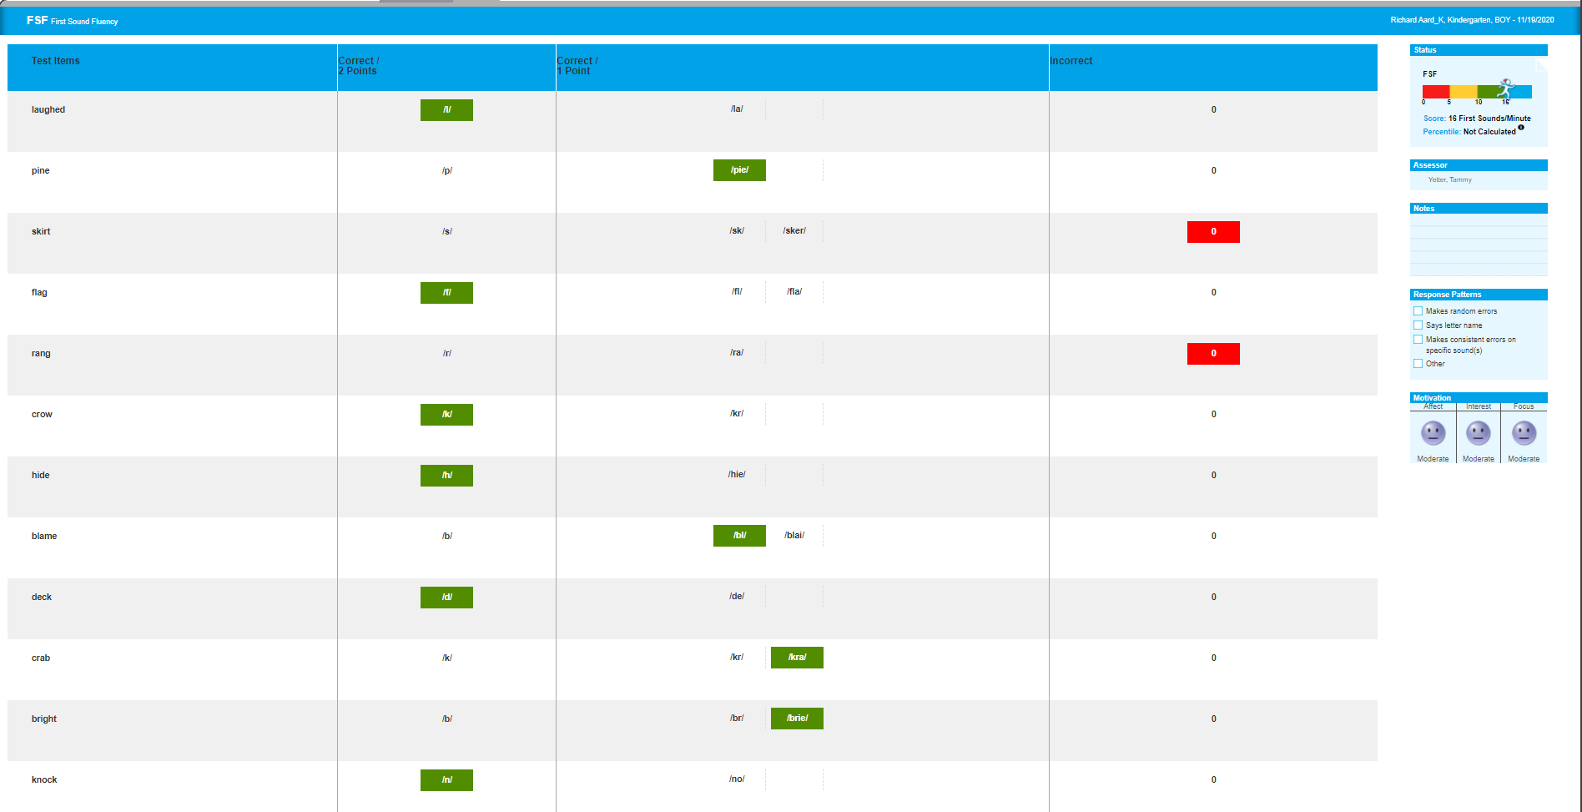
Data Decision Making: Student Profile 1
Notes:
A common mistake in viewing READ Act assessment data is only looking at the composite score.
It is necessary to look at the detail provided by each assessment measure to get a better picture of what the composite score is telling us.
We'll start with the First Sound Fluency Measure in DIBELS Next.
First Sound Fluency is a brief, direct measure of a student's fluency in identifying initial sounds in words, which is an early phonemic awareness skill.
The assessor says a series of words one at a time to a student and asks the student to say the first sound in the word.
The student receives one point for each correctly identified initial sound.
In this measure, students are scored correctly for identifying the initial sound or sounds in each word.
What you see now is a screenshot of the assessor's scoring page.
*Click* The list of words in the column on the left are the words said aloud to the student.
The student responses are highlighted in the columns in the middle and on the right.
*Click* If the student responds with the correct initial phoneme, the assessor highlights the response in green
*Click* If the student responds with the correct cluster of initial sounds, the assessor highlights that response in green.
*Click* If the student does not respond or provides an incorrect response, the assessor highlights the incorrect response in red.
The information from this assessment shows that this student....
Attempted 12 words, correctly identifying the initial sound in 10 out of those 12 words in one minute.
This places the student directly at the BOY benchmark threshold for this skill – 10 initial sounds per minute.
It is important to keep in mind that the middle of the year interim or benchmark assessment includes a Phoneme Segmentation Fluency measure, which measures a more advanced phonemic awareness skill, phoneme segmentation.

Slide 24
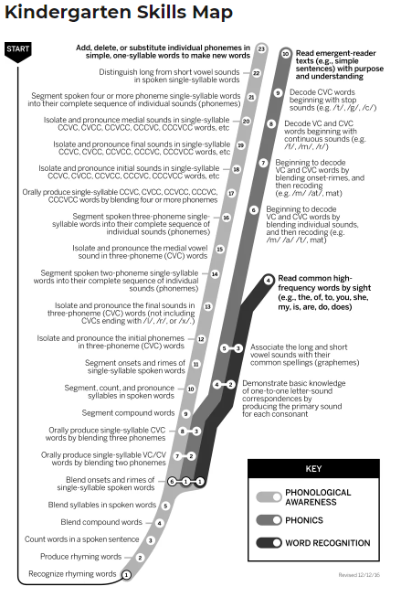
Skills Continuum
Harder
Phoneme Segmentation
Fluency Measure
Kindergarten MOY & EOY
First Sound
Fluency Measure
Kindergarten BOY & MOY
Easier
Notes:
It is critical that teachers understand these assessment measures as indicators along a continuum of discrete and complex skills.
As demonstrated on the kindergarten skills map, you can see that there are several prerequisite skills to the First Sound Fluency Measure, and multiple skills following it on the continuum toward more complex phonemic awareness skills.
Students like the one in this sample profile who score at or above benchmark at the beginning of kindergarten on the First Sound Fluency Measure should continue to receive direct instruction in the more advanced phonemic awareness skills along the continuum.
https://coloradostartstrong.wpcomstaging.com/

Slide 25
Data Decision Making: Student Profile 1
Notes:
Now we'll review the alliteration progression within TS GOLD.
Alliteration is an early phonemic awareness skill, so this information can be used as a complement to the information yielded by the First Sound Fluency measure in DIBELS Next.
This screenshot shows the continuum of discriminating initial sounds from TS GOLD's Objectives for Development and Learning. This is a progression located within the objective: Demonstrates phonological awareness, phonics skills and word recognition.
We see the student's score was finalized at 7, showing the student consistently matched beginning sounds of some words and is beginning to isolate and identify initial sounds in words.
Looking across these two data sets, we see the student is demonstrating a solid foundation of first sound fluency and alliteration with minimal risk of not meeting benchmark during the next assessment window, provided that the student receives high-quality, differentiated core instruction.

Slide 26
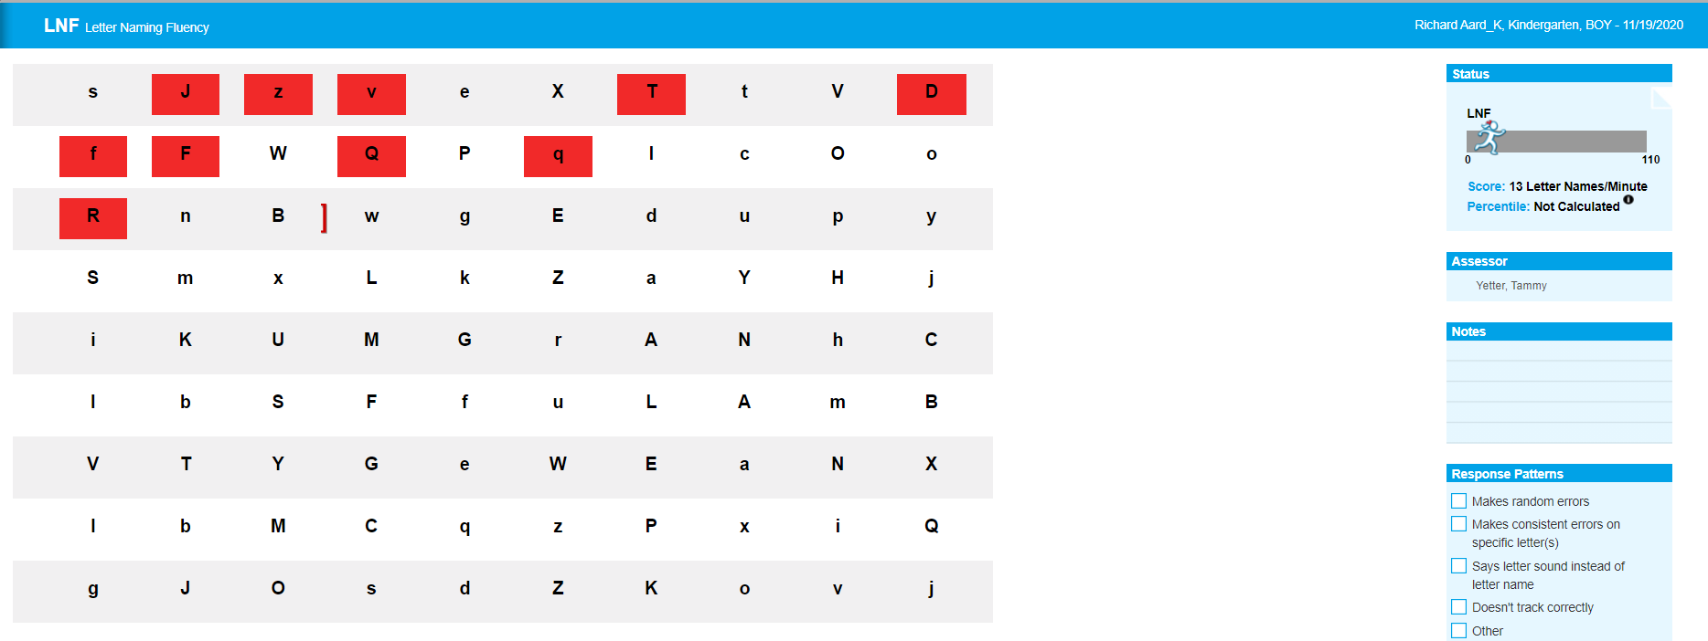
Data Decision Making: Student Profile 1
Notes:
Now we'll use the assessment data we have to get a sense of the students' early alphabetic skills and identify any risk for later reading difficulty.
Letter Naming Fluency is a brief, direct measure of a students' fluency in naming letters.
LNF assesses a student's ability to recognize individual letters and say their names.
This measure is included in the DIBELS Next benchmark assessment because letter naming is a strong and robust predictor of later reading performance.
In this measure,
The assessor shows the student a page of a combination of uppercase and lowercase letters.
The student says the names of the letters.
Each correct letter name is scored with one point.
In this screenshot, you can see the assessor's recording page. Correct responses are not marked. Incorrect responses or omissions are highlighted in red.
The information from this assessment shows that the student:
Correctly identified 13 letter names in one minute.
The Letter Naming Fluency score is used in DIBELS as part of the composite score as an indicator of risk.
There is no DIBELS Next benchmark goal for Letter Naming Fluency, so we can use the end of pre-k standards to determine an appropriate beginning of year Kindergarten expectation.
we would expect a grade-level kindergarten student to name at least 10 letters in one minute at the beginning of the year
This data indicates that the student is in a good position to continue to meet grade-level benchmarks with high-quality, differentiated core instruction.
In kindergarten, it is important to teach both letter sounds and letter names.

Slide 27
Data Decision Making: Student Profile 1
Notes:
Similarly, we see that in TS GOLD, the student consistently identified 10-20 upper and lower letter names.
Using both data sets helps confirm that this student is likely to benefit from differentiated CORE instruction.
The items reviewed here indicate these skills as possible strengths for this student and, this could be indicated on the students' Kindergarten School Readiness Plan
At this point, it's important to note the differences in what these two data sets tell us.
The measures in DIBELS Next are timed fluency measures. They give us information about the student's automaticity with a given skill.
The TS Gold tasks are not timed. Wtihin daily routines and activities, teachers collect evidence about what a child knows and is able to do. An analysis of this evidence, or documentation, is used to determine the child's score during a specific checkpoint or assessment window.

Slide 28
Student Profile 2: At Some Risk
Notes:
Next, we will view a student profile for a student with some risk for reading difficulty.

Slide 29
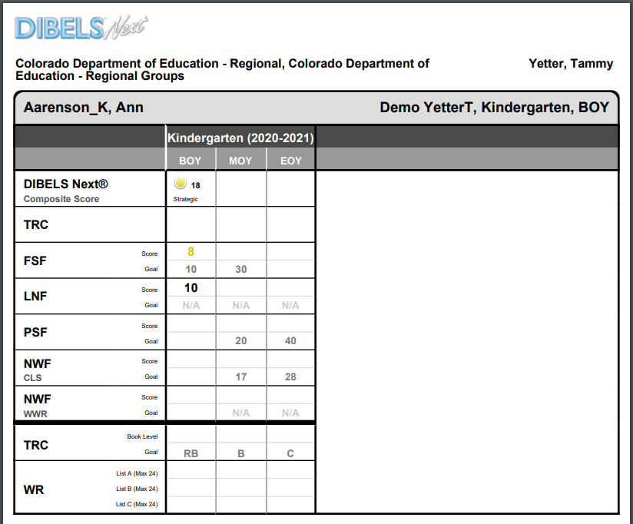
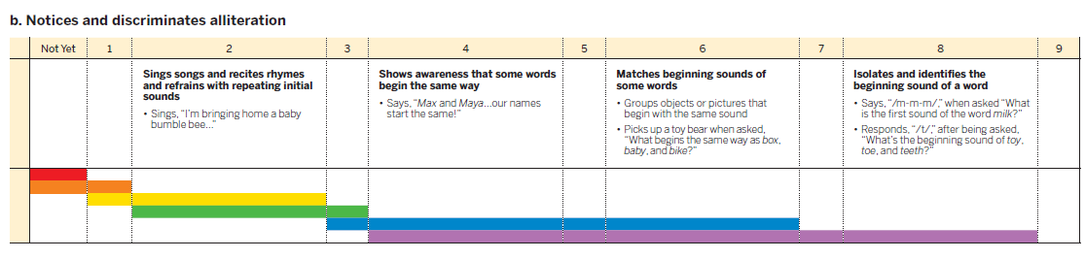
Data Decision Making: Student Profile 2
Notes:
This second student profile includes data that indicate some risk for reading difficulty.
This student's DIBELS Next composite score of 18 is in the yellow category, indicating that the student scored slightly below the benchmark score of 26 and is at a some risk of not meeting the next gradelevel benchmark
The data from TS Gold indicates the student's is scoring within the kindergarten color band, or widely held expectations in both alliteration and letter/name ID.
This student may have need some additional, layered instructional support

Slide 30
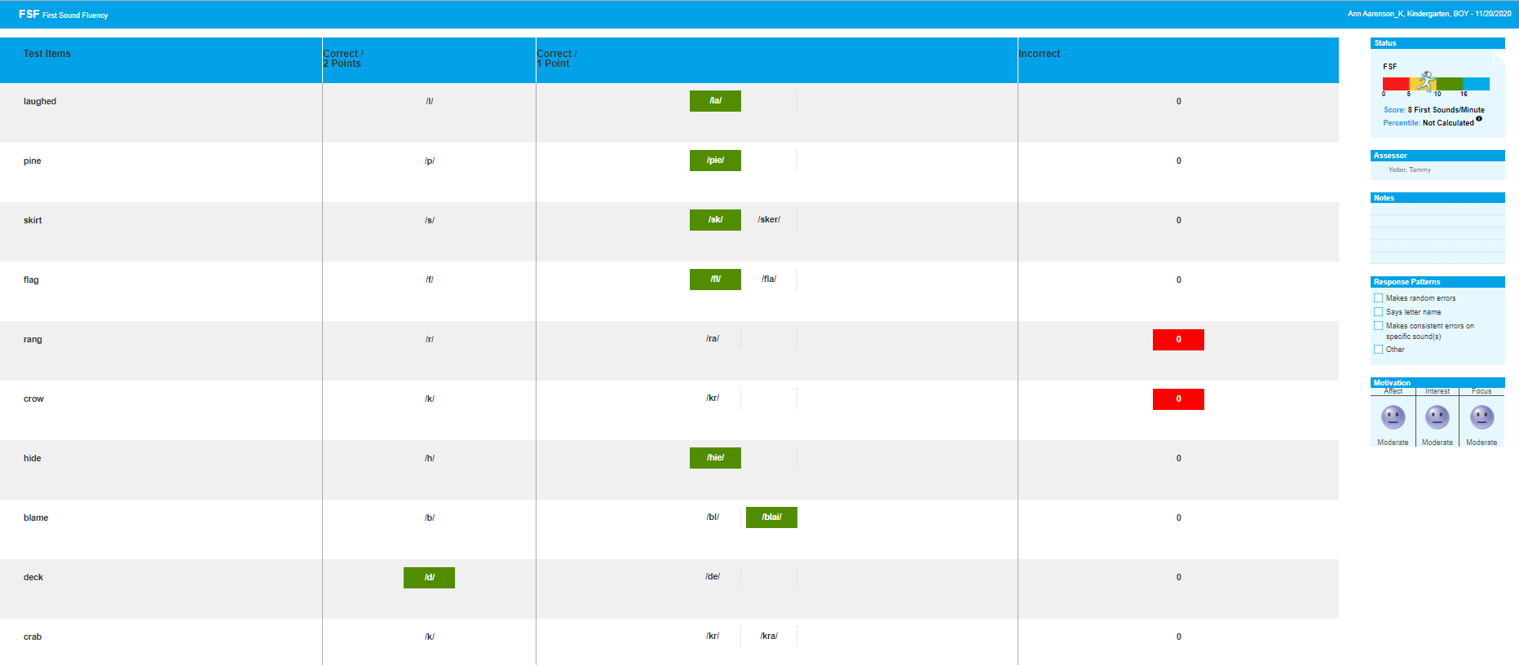
Data Decision Making: Student Profile 2
Notes:
In this screenshot of the assessor's recording page for the First Sound Fluency measure, we can see that the student:
Correctly isolated the initial sounds in 7 words in 1 minute.
This is below the BOY benchmark goal for kindergarten, which is 10 or more initial sounds in one minute, but is not below the cut-point for significant risk or SRD identification, which is 4 correct sounds per minute.
This indicates some level of risk that the student may not reach the next grade level benchmark without targeted intervention in addition to core instruction in phonological and phonemic awareness.
While this student may not be identified with a Significant Reading Deficiency, the READ Act requires that students scoring below benchmark should receive appropriate interventions through the school's multi-tiered system of supports.
1206(2)(a)

Slide 31
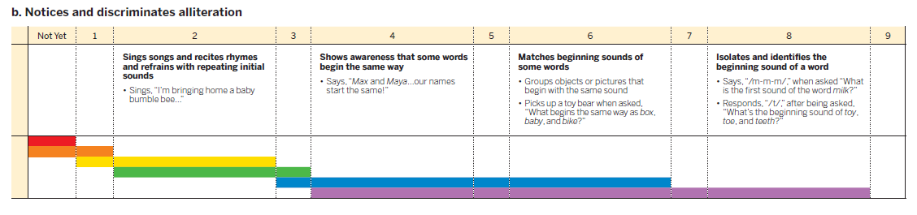
Data Decision Making: Student Profile 2
Notes:
Speaker Notes: Megan Present
Talking Points:
Now dive deeper into the alliteration progression within TS GOLD.
Again, alliteration is an early phonemic awareness skill, so this information can be used as a complement to the information yielded by the First Sound Fluency measure in DIBELS Next.
The student's score was finalized at 6, indicating the student consistently matched beginning sounds of some words.
At this point, let's revisit what and how each of these assessments is measuring first sound fluency. DIBELS Next is timed and assesses a student's fluency of this skill. As a teacher collects evidence of a students understanding and use of this skill, the student may demonstrate this same skill in a variety of ways throughout the daily routine and activities. A review of the documentation leading to the TS Gold score, may provide aditional insight into this student's skills and abilities.
Looking across these two data sets, the student is demonstrating an early understanding of first sound fluency and alliteration, however, this skill may not yet be mastered to a level of automaticity.

Slide 32
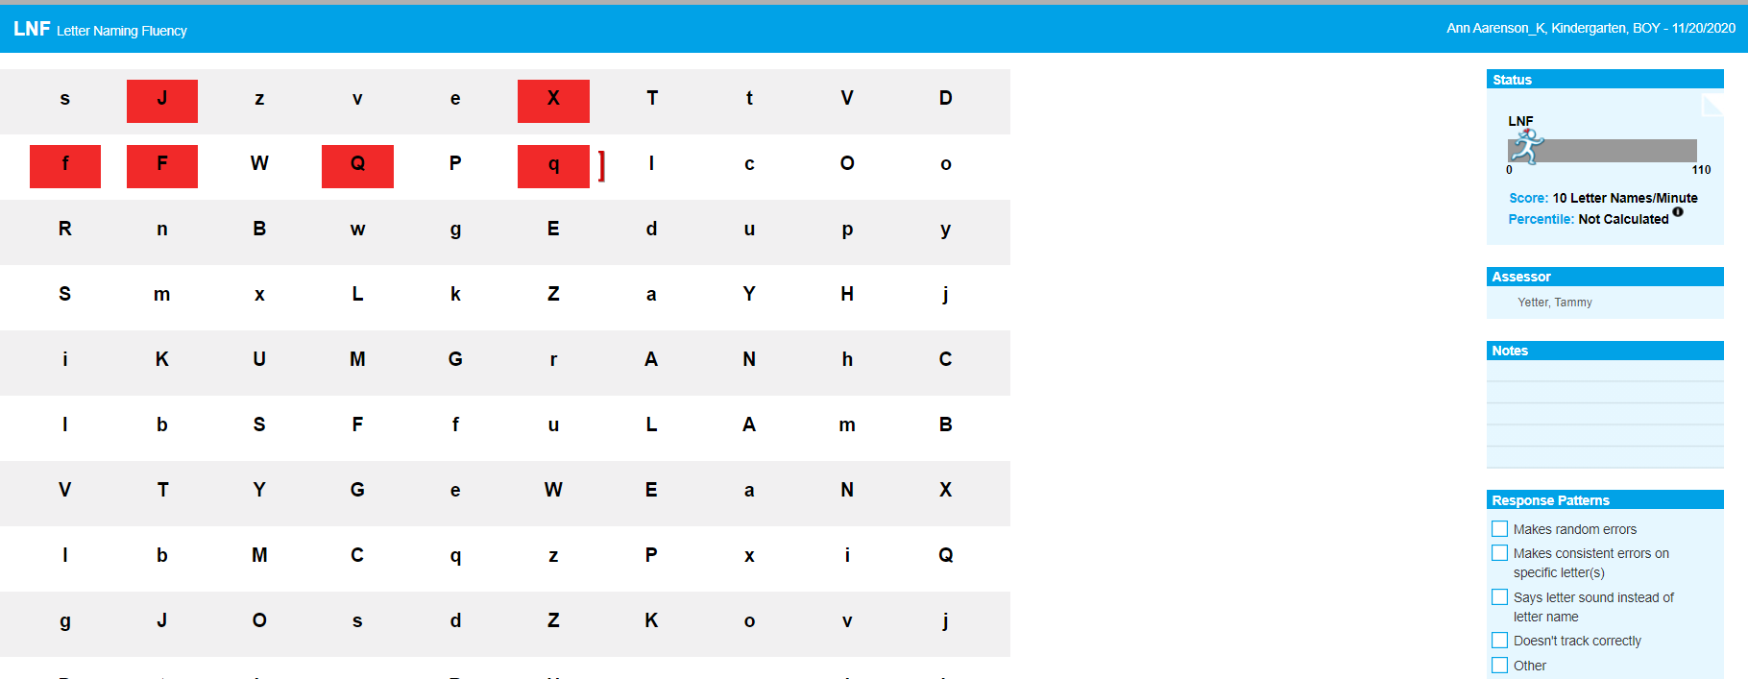
Data Decision Making: Student Profile 2
Notes:
The information from the Letter Naming Fluency benchmark assessment shows that this student:
Correctly identified 10 letter names in one minute.
Although there is no official benchmark for this assessment measure, we would expect a kindergarten student at the beginning of the year to name at least 10 letters in one minute, and this student scored right at that threshold.

Slide 33
Data Decision Making: Student Profile 2
Notes:
Similarly, we see that in TS GOLD the student's score was finalized at 4, indicating the student is consistently identifing 10 letter names.
Looking across both data sets, the student is consistently naming at least 10 letters. A review of the documentation used to score this item in TS GOLD would indicate whether the letters identified are consistent or varied.
Similarly to first sound fluency, this student is demonstrating early abilities within this skill. Again, the measures in DIBELS Next are timed fluency measures. They give us information about the student's automaticity with a given skill; whereas evidence to score TS GOLD is collected across routines, activities, and time.
Looking across both data sets for this skill, the data indicate the student would likely benefit from an additional layer of instructional support in addition to high-quality, differentiate core instruction.
As this student profile is showing some risk, a comprehensive review of the literacy domain would aide in determining the level of support needed to ensure adequate progess in literacy and prevent reading difficulties from developing.
This student would benefit form a stratgic small group in addition to high-quality, differentiated core instruction to support automaticity of early literacy skills, specifically phonological awareness and alphabet knowledge. This strategic small group and the specific instructional support to increase automaticity of early literacy skills would be documented in the student's individual school readiness plan, along with a plan for progress monitoring.

Slide 34
Student Profile 3: At Significant Risk
Notes:
Now we'll move on to our third and last student profile, number three.

Slide 35
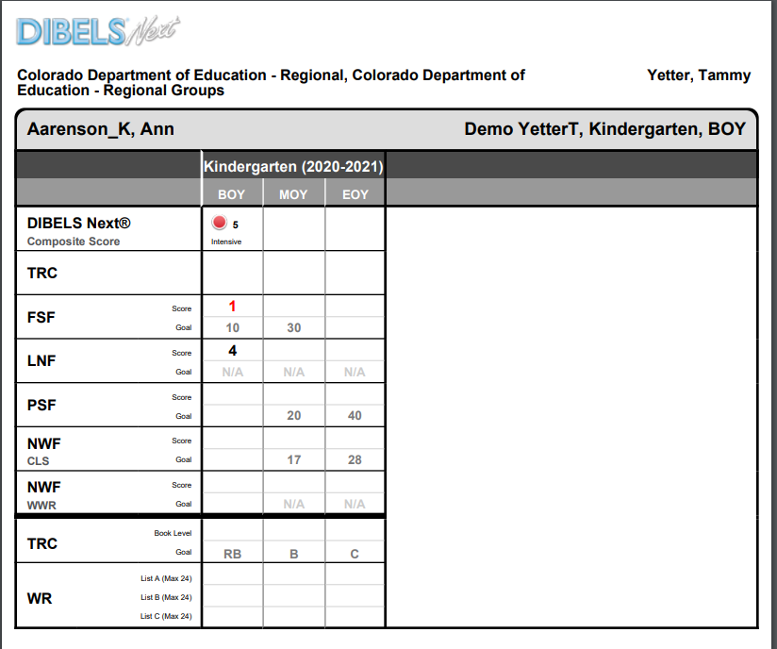
Data Decision Making: Student Profile 3
Notes:
This student profile includes data that indicate clear risk for reading difficulty.
This student's DIBELS Next composite score of 5 is in the red category, indicating that the student scored well below the benchmark score of 26.
The data from TS Gold confirms the student's emergent level skill set.
This student may have a significant reading deficiency.
The teacher will need to begin gathering a body of evidence, including information from an approved diagnostic assessment, to determine SRD and implement a READ Plan if needed.

Slide 36
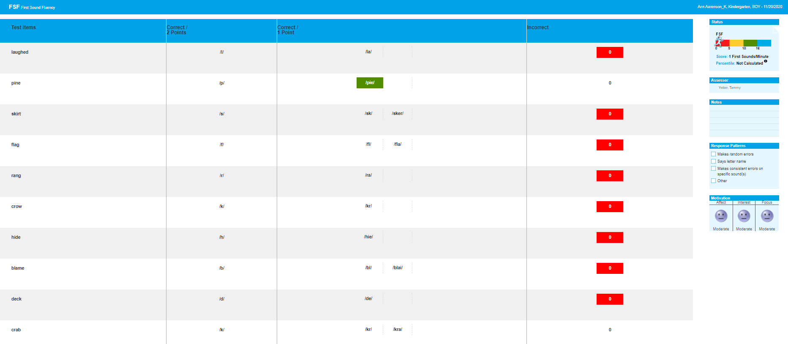
Data Decision Making: Student Profile 3
Notes:
As we dig into the DIBELS Next measure-level detail, the information from this First Sound Fluency Benchmark assessment shows that the student:
Attempted to identify the initial sound in 10 words, but only correctly isolated the initial sound in 1 of those words.
This is well below the BOY benchmark score of 10, and below the cut-score for significant risk, which is 4 correct sounds per minute.
This is a strong indication that this student needs intensive intervention in phonological and phonemic awareness.
More information about this student's specific skills along the continuum of phonological and phonemic awareness is necessary to set goals and plan for intervention, which is the purpose of the diagnostic assessment.

Slide 37
Data Decision Making: Student Profile 3
Notes:
Now, let's review the alliteration progression within TS GOLD.
The student's score was finalized at 3, indicating the student consistently sings and recites rhymes with repeating initial sounds and is beginning to show awareness that some words begin the same way.
This data complements the DIBELS Next data, and confirms the student is not yet demonstrating an early understanding of first sound fluency and alliteration.
Looking across the data sets, this student may have a significant reading deficiency. The documentation used to assess within TS GOLD may be used to begin to gather a body of evidence.

Slide 38
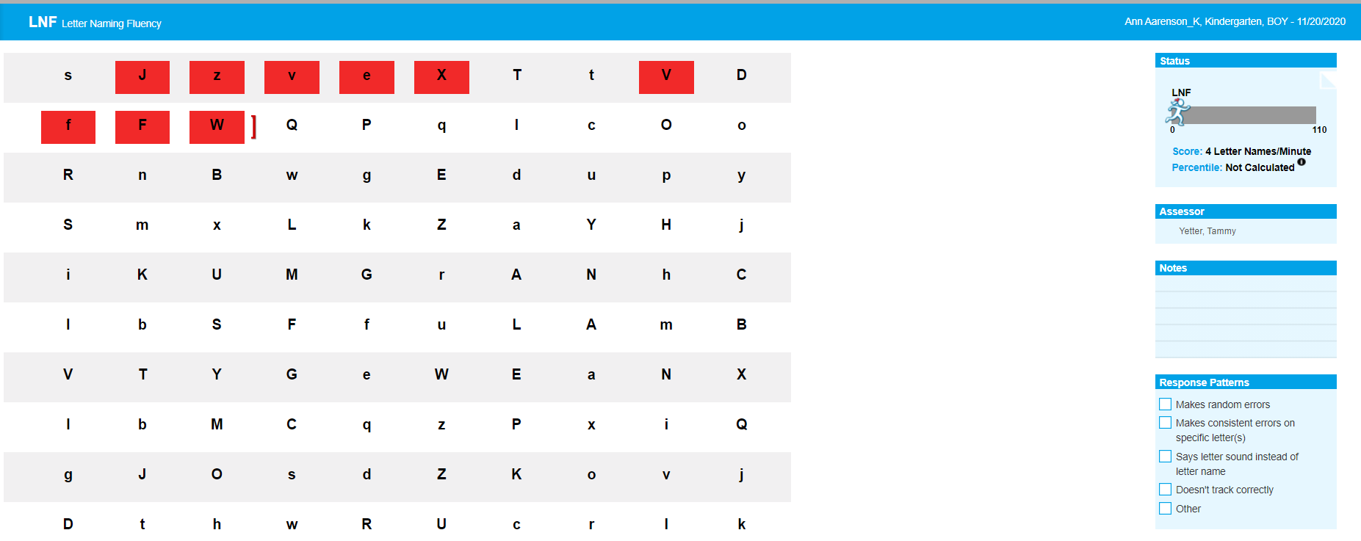
Data Decision Making: Student Profile 3
Notes:
The information from the Letter Naming Fluency assessment measure shows that this student:
Correctly produced the name of 4 letters in one minute.
Although there is not an official benchmark score for this measure, this is well below the 10 letter names per minute that we would expect at the beginning of kindergarten.
While letter naming fluency is a highly predictive measure of a child's later reading ability, the recommendation is not to focus instruction heavily on letter names in isolation. This student would benefit from explicit instruction in letter names AND letter/sound correspondence.

Slide 39
Data Decision Making: Student Profile 3
Notes:
As we look at the TS Gold alphabet knowledge progression, we see this student's score was finalized at a 2, meaning the student is identifying a few letters in his/her name. This indicates the student is demonstrating letter knowledge well below the widely held expectations for Kindergartners.
Information gained from both assessments is similar, and clearly indicates this student would benefit from additional, targeted interventions to support developing early literacy skils. These targeted interventions as well as a plan for
Additionally, this student may have a significant reading deficiency. The documentation used to assess within TS GOLD may be used to begin to gather a body of evidence.
In doing so, a comprehensive review of this student's school readiness data will aid in identifying specific needs to support early literacy.

Slide 40
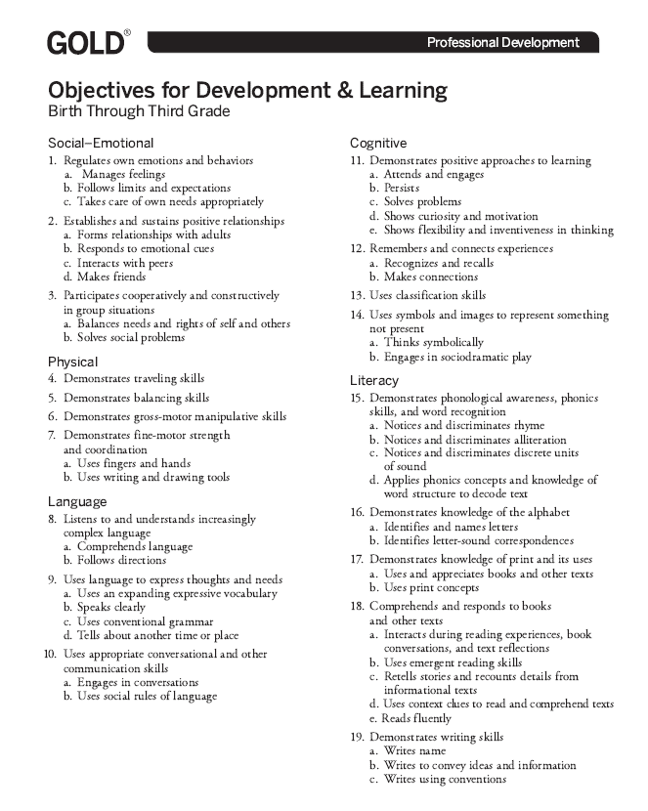
GOLD
Potentially influencing engagement in and benefit from in learning activities.
Notes:
If we zoom out for a moment, additional information may be gained from a broader look at the kindergarten school readiness assessment.
On the screen you see a comprehensive list of the objectives for TS GOLD including each of the domains assessed at K entry
Reviewing the evidence collected to score the progressions in these domains may help identify additional specific supports needed, and the type or grouping of the format in which the instructional supports take place.
CLICK For example, if this student is not yet independently sustaining interest in work or persisting through challenging tasks, this may continue to impact his/her success in responding to additional, layered supports or interventions.
In order to best support this student, the teacher would want to provide additional support for the cognitive skills, as well as target the specific skill deficiencies identified in the diagnostic.
Following the comprehensive analysis of the student data, the identified needs, additional supports and interventions, and the plan for monitoring the progress of the student would be documented in the student's individual plan. Following the adminstration of the diagnostic, a READ Plan would be added as a component of the student's individual school readiness plan.
For additiona information on intervention programming, specific to reading, please visit the Colorado Department of Educations' website to view the intervention programming reviewed as part of the instructional programming review process.

Slide 41
Enabling Contexts for Data Review
School Leaders
Use data to plan for the most optimal school organization strategies, including:
  Screening for potential intervention needs
  Creating school schedules to best meet learning needs
  Channeling resources to support remediation and other supports for individual and small groups of students
Organize professional learning activities
  Focus professional learning on the priority areas flagged by the assessment.
  Find ways to celebrate and capitalize on relative strengths identified.
  Along with other data, use assessment results to support monitoring and program evaluation.
Marion, et al., 2020
Notes:
Creating an enabling context for teachers to flexibilly and intentionally meet individual and group needs is especially important this year.
As published in Restart and recovery: Assessment considerations for fall 2020, school and district leaders can support the intential use of student date to inform planning and instruction in the following ways:
Using data to plan for school organization and strategies which may include additional screening measures for potential intervention needs, creating school schedules to meet learning needs, in both remote and in-person situations.
And, ensuring resources and support for individual and small groups of students. In this case, to prevent future reading difficulties.
Secondly, school and district leaders can organize professional learning that focuses on the priority areas flagged by the asssessments. In supporting teachers in analyzing student data, identify priority areas which may benefit from additional professional learning. Additionally, find ways to celebrate identified strengths. Assessment results can also inform and support monitoring and program evaluation.
https://ccsso.org/sites/default/files/2020-08/CCSSO_RR_Assessment-Fall-v1%28updated%29.pdf

Slide 42
Enabling Contexts for Data Review
School Leaders:
Support teachers in making fluid data-based decisions to adjusting instruction
  Demonstrate when and how teachers can put into practice the findings from the assessments, highlighting just-in-time support for grade-level instruction. Prioritize, support, and provide space for teachers’ pre-assessment and formative assessment practices.
  Provide time and structure to encourage teachers to use flexible, short-term groupings based on student profiles, if appropriate.
  Caution teachers against instructional approaches that exclusively address gaps as a prerequisite to teaching grade-level content.
  Avoid implementing extensive remediation or retention initiatives that delay student exposure to grade-level content.
Marion, et al., 2020
Notes:
Additionally, district and school leaders can support teachers in making fluid data-based decisions to adjust instruction by:
Demonstrating when and how teachers can put findings from assessments into practice.
Create time and structure to support flexible groupings based on student profiles and specific needs
Focus supporting teachers in continuing to provide grade level content, and not exclusively addressing skill and knowledge gaps as a prerequsite to grade-level content.
Similiarly, provide teachers with necessary support to avoid extensive remediation or retention initiatives that delay student grade-level content exposure.

Slide 43
INDIVIDUAL PLANS
Notes:
Previously, we have reviewed the individual problem solving process to 1) analyze data sources,2) clearly identify knowledge and skill gaps, 3) identify targeted instructional supports and intervention and 4) create a plan for monitoring progess and evaluation.
We have also provided 3 student profiles illustrating how the required assessment data in Kindergarten can support the identification of students who need continued high-quality, differentiate core instruction; Students who are at some risk of reading difficulty and would benefit from additional, instructional supports to supplement core instruction; And students who have a clear risk of reading difficulty and need intensive, targeted standard intervention to prevent additional reading difficulty.
Additionally, access to previously reviewed intervention programming is avaialble on the CDE's website.
This process, along with an individualized plan for monitoring student progress, is the process documented within the student's individualized plans.
In the next section, we will discuss the individual school readiness and READ plans required in Kindergarten and the purpose and requirements of each.

Slide 44
SR and READ Plan Comparisons
 | School Readiness Plan | READ Plan
Purpose | Monitor progress toward school readiness for all students | Address identified reading deficiency with entrance & exit criteria for students below benchmark
Foundation | Addresses K standards | Grade level expectations adopted by SBE
Contents | Knowledge and skill areas in need of assistance | Targets specific literacy skill deficits
Timeline | Following completion of fall KSR assessment | Following the completion of diagnostic assessment and review of a body of evidence.
Continuation | Components can remain part of READ plan following end of K | Entrance and exit criteria
Notes:
As described in statute, school readiness plans and READ plans have several similarities and also differences.
First, the purpose. The purpose of the school readiness plan is to monitor porgress toward school readiness for all students in each of the 6 domains. In contrast, the READ plan is created to adress identified reading deficiencies with specific entrance and exit criteria for students below benchmark.
The foundation of both the school readiness plans and the READ plans is grade level expectations, or Kindergarten standards.
The content of the school readiness plan identifies specific knowledge and skill areas in need of assisstance, across the 6 domains. The READ plan's contents, however, target specific literacy skill deficits.
The timeline also varies slightly. The school readiness plan is completed following the fall KSR assessment. The READ plan is added as a component of the school readiness plan following the completion of a diagnostic assessment, a review of a body of evidence, and identification of a significant reading difficiency.
For some students, the school readiness plan may have began in preschool and continued through Kindergarten. Additionally, any compont of a student's school readiness plan that may influence a student's reading skill deficiency may continue to be a part of that student's READ plan as the student enters 1st grade.
The READ plan, however, has specific entrance and exit criteria that identify when the skill deficit no longer exists.

Slide 45
All Kindergarten Students
Individual School Readiness Plan:
Includes student’s strengths and goals
Goals may include those specific to literacy.
Engage families in identifying goals and supporting student
Monitor's progress toward school readiness
Formats may include:
  District designed template
  Vendor reports may inform
Notes:
Teachers are required to create school readiness plans for all kindergarten students.
These plans include:
A student’s strengths and goals taken from the analysis of each student's data.
These goals may include literacy specific goals, as we saw in student profile 2. This plan would document additional the instructional support provided in addition to high-quality, differentiated core instruction
School readiness plans also monitor a student's progress toward school readiness
As teachers complete the analysis of student assessment data, family engagement in creating goals that target specific areas of need is key in communicating with families and ensuring student support.
Formats for the individual school readiness plan may include a district designed template.
In addition, some kindergarten school readiness assessments may have reports that inform the student's individual plan, including monitoring progress toward indentified goals.
Unless a student is significantly below the benchmark on the interim assessment, a READ Plan is not required.
Now, I'll turn it over to Andreia to walk through the specifics of the READ Plan.

Slide 46

Some Kindergarten Students
Student requires a READ plan as a component of the school readiness plan.
Required components of each plan must be addressed
Format may include:
  District designed template
  Vendor created templates
  Designed combined plan
Notes:
If student is significantly below the benchmark on the interim assessment, the READ plan is a required component of the school readiness plan.
The components of both the school readiness plan and the READ plan must be addressed.
CDE does not require a specific format for either plan.
The format a district chooses to use may include:
A district-designed template
Vendor-created templates, or
A designed combined plan

Slide 47
READ Plan
Required Components
Interim/Benchmark assessment results
diagnostic assessment results including specific skill deficiencies
end of year goal
  ongoing objectives to meet the end of year goal
aligned interventions and services (in addition to 90 minutes of evidence-based universal instruction),
progress monitoring,
specific family communication and involvement in supporting the READ Plan,
supplemental services, and
If student has a READ Plan for more than one year:
  Additional, more rigorous strategies and intervention instruction to assist the student in achieving grade level competency
Notes:
The required components of a READ plan are as follows: (Read slide)
https://www.cde.state.co.us/coloradoliteracy/readplans

Slide 48
PURPOSE: Plans to Support Practice
Intentional Planning
Differentiated learning that considers the developmental and academic needs of each child as a prevention strategy.
Early Identification
Timely assessments and data analysis support the identification of risk factors and create opportunities for intervention and prevention.
Documentation of student data, supports, and outcomes creates opportunities for collaboration between a child’s teachers over time.
Family and School Engagement
School Success
Families engaged in the process to build collaboration, communication and support for students.
Notes:
Unfortunately, conversations around school readiness plans and READ plans are often focused on compliance.
It is critical to shift the focus of these conversations beyond compliance by keeping their PURPOSE at the forefront.
The intent of both CAP4K and READ Act legislation, and the requirements of school readiness plans and READ plans is to create stronger pathways to success for our youngest students by targeting key practices in schools and classrooms:
*Click* These plans support improved outcomes through intentional planning. When teachers know their students’ developmental and academic strengths and needs, they can differentiate instruction with those needs in mind.
*Click* These plans promote Early identification: Timely assessments and data analysis support the identification of risk factors and create opportunities for prevention or intervention.
*Click* These plans encourage school/Family Connections: these plans require that parents be included in the process to build collaboration, communication and a support network for students.
*click* Finally, these plans create opportunities for School Success: The documentation of student data, supports and outcomes create opportunities for collaboration between teachers over time, to better know where students are coming from and plan a continuum of learning.

Slide 49

Reflections to Support Success
What internal structures and processes would support the use of kindergarten assessment data to drive instruction and improve student outcomes?
What professional development (training and coaching) is needed to support connecting and using kindergarten assessment data to inform instruction?
How might individual plans support vertical communication about students through transitions?
Notes:
As we conclude this webinar, we encourage you to reflect on a few key questions:
What internal structures and processes would support the use of kindergarten assessment data to drive instruction and improve student outcomes?
Internal structures may include:
Dedicated time for grade level teachers to meet, analyze data, and plan for instruction and intervention together with the support of a coach or administrator.
What professional development (training and coaching) is needed to support connecting and using kindergarten assessment data to inform instruction?
How might individual plans support vertical communication about students through transitions?
Is there dedicated time for cross grade level conversations?
Opportunities for cross grade conversations and collaboration can allow kindergarten teachers to pass timely, accurate, and specific academic and developmental information on to first grade teachers, interventionists, speech pathologists, counselors, and other critical players in a child’s future.
At a time in our state when student's learning is disrupted due to changing contexts, closures, and teacher and staff absences. A deep analysis of student data is critical to clearly identifying skill and knowledge gaps and targeted instructional support and intervention to prevent further challenges in learning and development in Kindergarten, as students transition into 1st grade, and continue their academic carreer. Documenting students strengths, areas of need, and targeted interventions and supports and the progress made toward those goals is cruicial to ensuring communication between teachers, staff, and leadership, particularly in the event of staffing change or longer term absence.
For more information on the topics discussed, please view the references and resouces.

Slide 50
REFERENCES and RESOURCES
Sigman, D., & Mancuso, M. (2017). Designing a comprehensive assessment system. San Francisco, CA: WestEd.
Marion, S., Gong, B., Lorié W., & Kockler, R. (2020). Restart and recovery: Assessment considerations for fall 2020. Washington D.C.: CCSSO.
Perie, M., Marion, S., Gong, G., & Wurtzel, J. (2007). The Role of Interim Assessments in A Comprehensive Assessment System: A Policy Brief. Washington, D.C.: The Aspen Institute
https://www.achieve.org/files/TheRoleofInterimAssessments.pdf
Preschool to Postsecondary Education Alignment Act of 2008, C.R.S. §22-7-1001
Colorado READ Act, C.R.S. §22-7-1201
2020 Advisory List of Instructional Programming
  https://www.cde.state.co.us/coloradoliteracy/advisorylistofinstructionalprogramming2020
Data-Based Individualization Modules:
  https://www.cde.state.co.us/mtss/dbimodules
2020-2021 Reading, Writing, and Communicating Instructional Guidance for Diverse Learning Settings
  https://www.cde.state.co.us/standardsandinstruction/hii_rwc
Notes:
Feel free to contact Andreia Simon or Megan Prior Rogers with questions.
Thank you.

Slide 51
Introductions
CDE Staff
Megan Prior Rogers
Kindergarten School Readiness Consultant
Preschool through Third Grade Office
Rogers_m@cde.state.co.us
720-326-2880
Andreia Simon
Senior Literacy Consultant
READ Act Communications & District Support
Preschool through Third Grade Office
simon_a@cde.state.co.us
readact@cde.state.co.us
720-402-6049

Slide 52
END

