Slide 1
Teacher Recruitment Education and Preparation (TREP) Program
March 8, 2022
Office of Postsecondary and Workforce Readiness (OPWR)

Slide 2
Erica Ryan Postsecondary and Workforce Readiness Specialist ryan_e@cde.state.co.us 720-576-4288

Slide 3
This meeting will be recorded and posted on the TREP webpage.

Slide 4
Agenda
PWR Updates
What is TREP?
Who can participate in TREP?
TREP Pathway (Draft)
Intent to Participate (ITP Process)
Questions

Slide 5
PWR Updates
CE/ASCENT Google Group will become CE/ASCENT/TREP Google Group
Beginning in April, registrations for PWR events will close 2 weeks before the event to allow time provide requested accommodations.

Slide 6
Teacher Recruitment Education and Preparation Program
Created by SB 21-185
First cohort starts in Fall 2022
Intent of the law is to increase and diversify teacher pipeline in Colorado
Prioritizes participation for low-income students and/or students from traditionally underserved populations in order to create a more diverse educator workforce to reflect the ethnic diversity of the state.
Intent of the law is to increase and diversify teacher pipeline in Colorado
Allows for students in an educator pathway to be retained for a 5th/6th year by their LEP
Students in TREP can receive up to two years of free college tuition

Slide 7
Who can participate?
TREP students:
Are enrolled in coursework in the TREP pathway during their 12th grade year.
Are college ready and not in need of developmental education
Complete Individual Career and Academic Plan (ICAP) and declare intent to participate in TREP (educator pathway)
Enter the TREP Program following their 4th year of high school
Are enrolled in a postsecondary program to continue on an approved educator pathway at a qualified Colorado institution of higher education.
Maintain a 2.0 GPA in postsecondary coursework
Cannot be a TREP participant for more than 2 years

Slide 8
TREP Pathway
*The image above shows the full slate of courses that TREP program candidates would complete. The suggested progression for candidates is to complete the courses in red during the 12th grade year to gain experience in education coursework, then continue with all remaining courses in subsequent years before transferring to an educator preparation program at a four-year institution. However, all pathway courses are available to candidates to complete as best fits their situation and course availability through a CCCS partner.

Slide 9
Intent to Participate
Districts will submit an Intent to Participate Form (ITP).
The Intent to Participate is an Alchemer Survey (similar to ASCENT ITP)
Opens March 8th, closes April 11th
TREP allocation results will go out to districts by April 30th

Slide 10
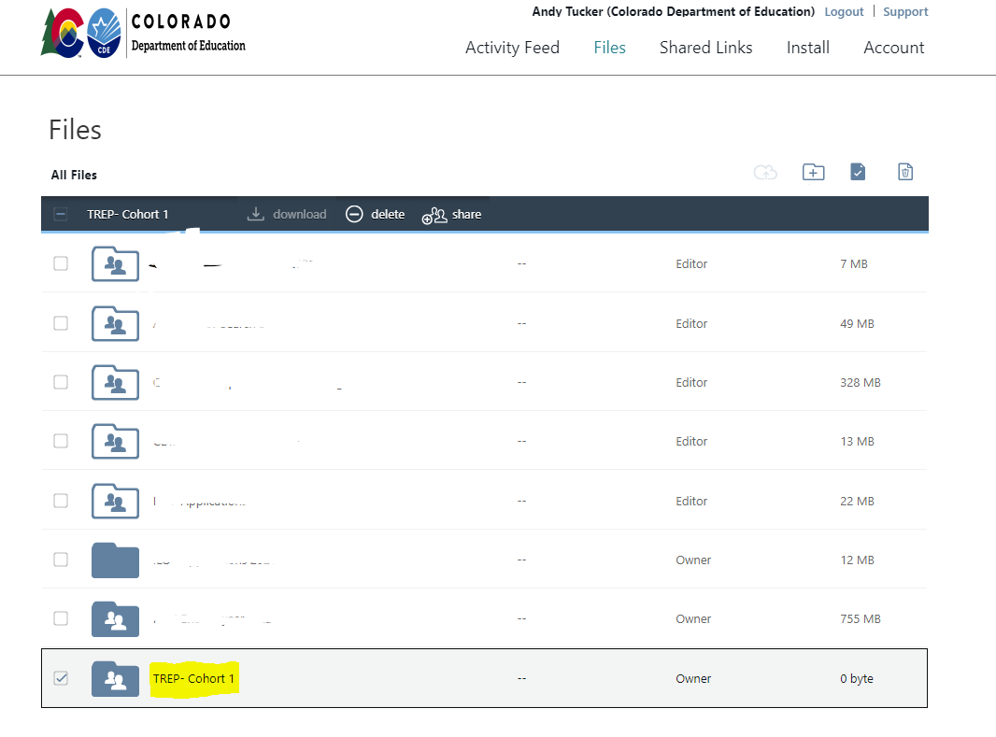
Syncplicity
Following the submission of an ITP, a folder will be created and shared in Syncplicity to collect student level data via Excel spreadsheet.

Slide 11
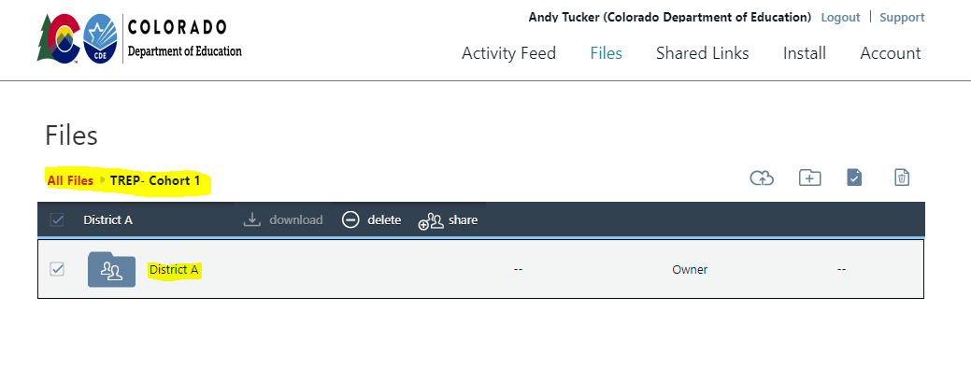
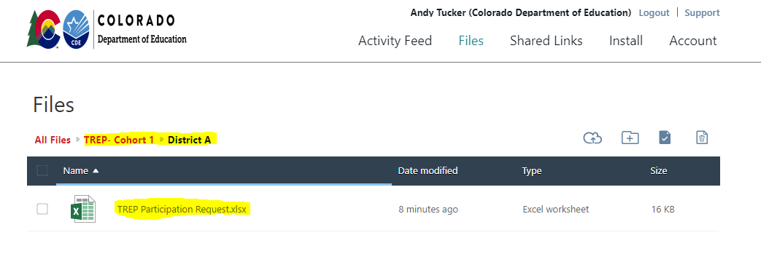
Syncplicity

Slide 12
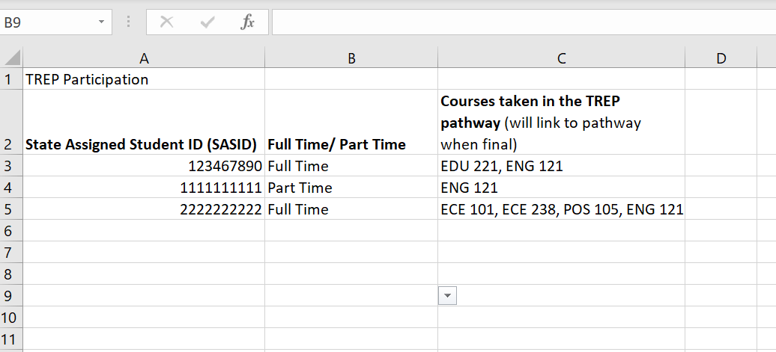
Excel spreadsheet for student info
Student level data will include SASID, full time/part time status, and courses taken in the educator pathway

