Slide 1
The Latest:
Things You Should Know
Office of Postsecondary Pathways

Slide 2
House Bill 17-1041 Inform students of education opportunities leading to jobs
At a minimum, each public school shall ensure that, in developing and maintaining each student's ICAP, the counselor/teacher explains to student/parent/legal guardian, by electronic mail or other written form about:
The requirements for/and benefits of concurrently enrolling in courses with an IHE and assist student in course planning if requested by student/parent
Various career pathways and types of certificates and jobs to which each pathway leads ; and
The skills/educational opportunities available through military enlistment (encourage providing information concerning the military enlistment test)

Slide 3
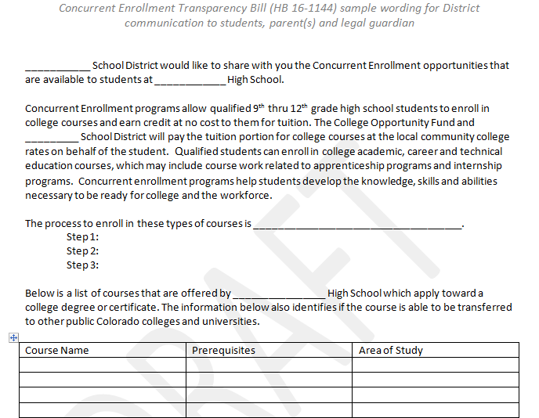
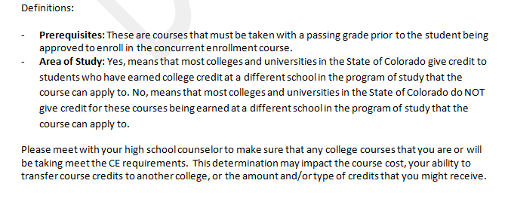
Concurrent Enrollment Transparency Bill (HB 16-1144)
Notes:
Concurrent Enrollment Transparency Act (HB 16-1144)
The Concurrent Enrollment Transparency Act (HB 16-144) was signed into law on 3/31/16 and can be found at https://leg.colorado.gov/bills/hb16-1144. The Act requires Local Education Providers (LEPs) to annually inform their students, parents and legal guardian of which postsecondary courses (including academic courses and career and technical education courses, which may include course work related to apprenticeship programs and internship programs) are available to qualified students at low or no cost, that meet the Concurrent Enrollment requirements, and that apply toward a postsecondary degree or certificate.
The office of Postsecondary Readiness has provided sample wording that LEPs may wish to use to inform their students, parents and legal guardians. The sample wording can also be found in the “Resources” section at http://www.cde.state.co.us/postsecondary/concurrentenrollment.

Slide 4
Advising Students

Slide 5
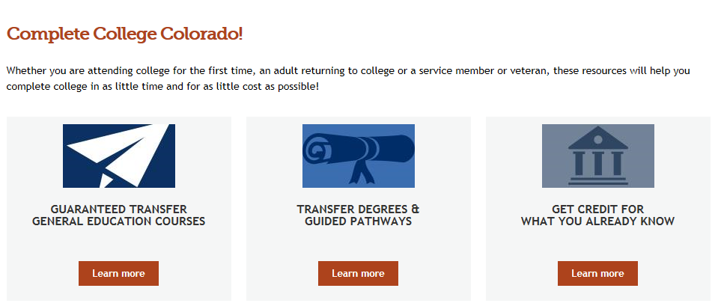
Complete College Colorado

Slide 6
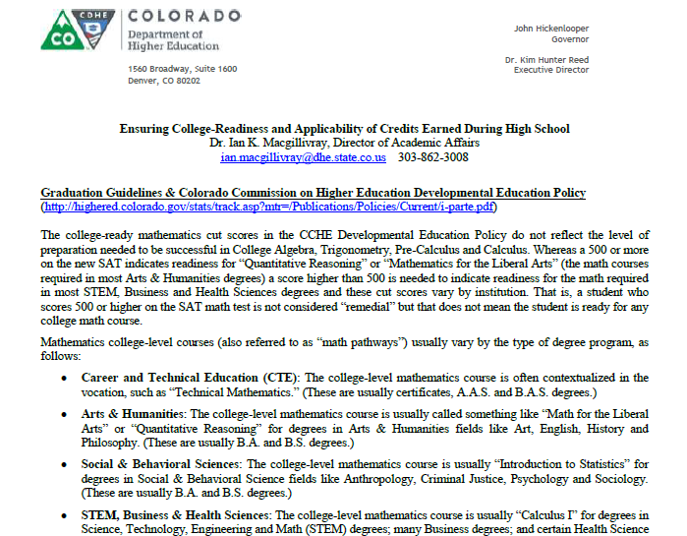
Math Pathways & Transferability
Notes:
Math pathways – vary by type of degree
Grade will be transcripted and factored into official college GPA
Possible academic probation
Financial aid suspension/probation
Transferability
Transfer of credit –vs- application of credit - Whereas just about any course will transfer, that doesn’t mean the credits will apply to degree requirements at the receiving institution.

Slide 7
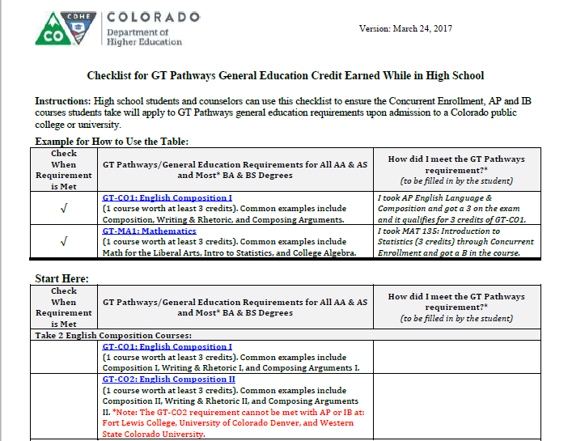
GT Pathways Checklist

Slide 8
Work-Based Learning (WBL)
Education/training systems & business partnerships (public-private)
Ensure that students have skills/career exposure needed to build pathways to meaningful careers
Meet state workforce needs
Colorado is developing industry-led, competency based career pathways
Tools:
Colorado Talent Pipeline
CareerWise Colorado
Skillful
Notes:
Work-Based Learning combines skills training with related employment in real life settings
skilled workforce remains the most important driver for
our state’s future competitiveness. We have laid a strong
foundation for building the Colorado talent pipeline.
Through the Workforce and Education Committee of the Governor’s
Cabinet, we have brought together the relevant government agencies
to work as a single unit, with shared goals, to avoid duplication
of effort, effectively use resources and focus on the needs of business in Colorado.
with apprenticeships, businesses become producers of talent, not just consumers of talent
Education becomes competency-based, not course-based.
Colorado is developing industry-led, competency based, career pathways including work-based learning
opportunities. We have developed tools and programs through public-private partnerships including CareerWise Colorado (more below), Skillful, the work-based learning unit at CDLE, Sector Partnerships, our Workforce Centers and state workforce council and the BEL Commission.
As U.S. Secretary of Labor Thomas Perez noted, “Apprenticeship is the other college — except without the debt. … There are still folks who think about apprenticeship and they think about it in yesterday’s paradigm.

Slide 9
Work-Based Learning Incubator
Collaboration: CDE - Colorado Workforce Development Council – CDHE - Colorado Community College System - Colorado Department of Labor and Employment
Launching October 2017
WHO: Teams of school/district leaders interested in implementing/deepening work-based learning programming
WHAT: Series of webinars/meetings to empower interested districts/schools to create/deepen high quality work-based learning programs.
WHEN: Year-long experience launching fall of 2017

Slide 10
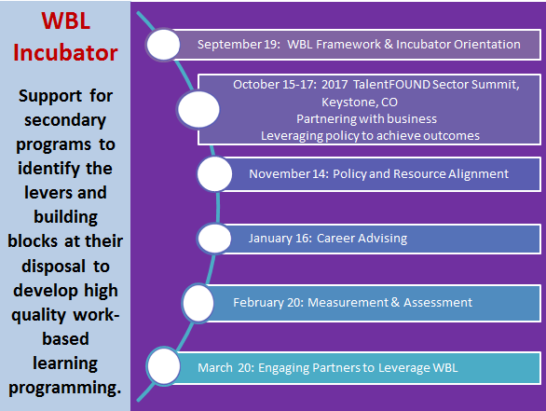
WBL Incubator Summit/Webinar Schedule

Slide 11
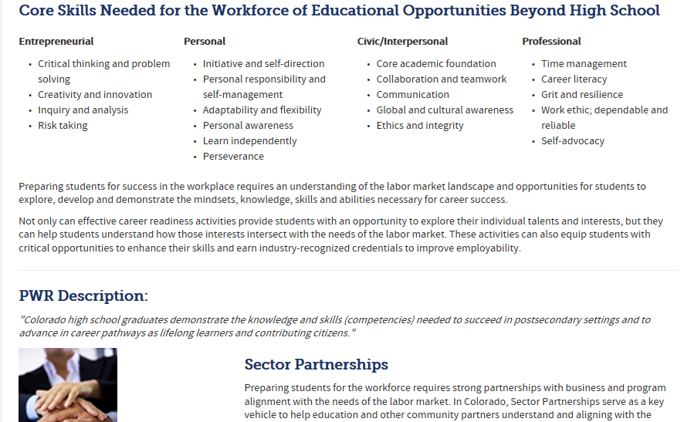
CDE Career Readiness Webpage

Slide 12
Resources
The Colorado Talent Pipeline Report
Industry-Recognized Credentials
Launch My Career Colorado
Colorado Talent Dashboard
Careersincolorado.org

Slide 13
Thank You!
Mary Anne Hunter
Postsecondary Pathways Coordinator
Hunter_Mary@cde.state.co.us
(303) 866-6596

