Slide 1
ICAP
Presenters: Jody Sniff - Las Animas School District
Shauna Hobbs - Mesa County Valley SD 51
Andrea Bolton - Mesa County Valley SD 51

Slide 2
Introductions
Who are we and how did we get here?

Slide 3
How did you know you were ready to graduate high school?

Slide 4
What is ICAP?
ICAP is the foundation for students’ PWR
It IS THE THREAD that links everything together
It is research-based with Quality Indicators that define a process
It CONNECTS research to experiences to reflection to iteration to growth
Experiences
Research
Reflection
Notes:
Share what our district is doing. What does ICAP look like in your district?

Slide 5
ICAP Process | Quality Indicators | PWR Performance Outcomes | Colorado Essential Skills
I Individual Awareness | Self-Awareness Environmental and Cultural Expectations Personal Financial Literacy | Self-Efficacy and Self-Care Communication Adaptability and Reflective Practice Social Responsibility | Personal Self-Awareness Initiative/Self Direction Personal Responsibility Adaptability/Flexibility Perseverance/Resilience Civic/Interpersonal Skills Collaboration/Teamwork Communication Global/Cultural Awareness Civic Engagement Character Entrepreneurial Critical Thinking and Problem Solving Creativity and Innovation Inquiry and Analysis Informed Risk Taking Professional Task/time management Career Awareness Information Literacy Self-Advocacy Leadership
C Career & Postsecondary Planning | Career Awareness Postsecondary Options & Aspirations Environmental and Cultural Expectations | Career Development Credible and Ethical Research Team Building Time and Work Management
A Academic Planning | Academic Planning | Credible and Ethical Research Inquiry and Problem Solving
P Process & PWRful Demonstrations of Learning |  | Educators: Work with teams to develop ICAP Process Use Playbook to choose/adapt Practices Choose Platforms Leverage Portfolio process Create PWRful students

Slide 6
Why at this level?
Important to start career conversations early
Career readiness and career engagement is a dropout prevention tool
Gives kids an understanding of the purpose of school
Notes:
We are all educated so we can have a job someday. In practice of growing good humans. Shauna share about K-5 elementary, Jody share a practice. Then they do a turn and talk, and share out.

Slide 7
What do you do already?
Notes:
What activities or lessons are you already doing with career conversations?

Slide 8
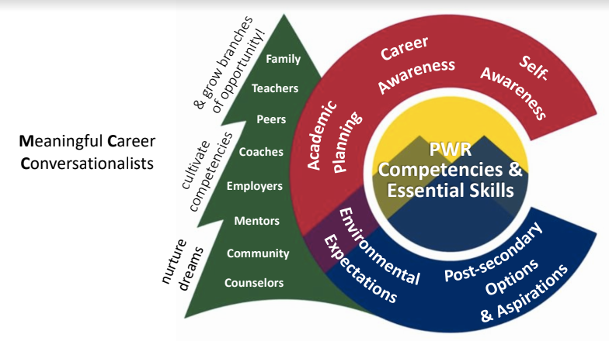
How?
ICAP Playbook!
Need time in classes
Train your community so they can speak the language too
You are not alone!
Includes essential skills
Sharing best practices
Notes:
History: Jody. How would we use the ICAP playbook?

Slide 9
https://docs.google.com/document/d/14gG9AxhxxO5lcD3O0IO2p29sWF17vfvvPeAnK_axgfw/edit

Slide 10
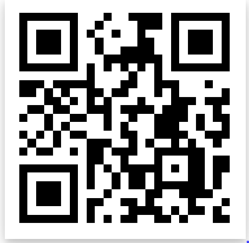
ICAP Playbook Survey
What problem would an ICAP Playbook help you solve?
What do you wish you could find in the ICAP Playbook?
How will you use this guide?
What does it look like, feel like, sound like?

Slide 11
“ICAP is a lifelong process. It’s about meaningful conversations.”
- Lauren Jones Austin

Slide 12
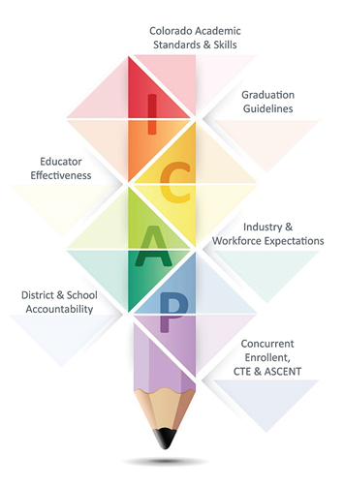
Thanks!
Playbook information:
https://www.cde.state.co.us/
postsecondary/icap
Resources:
CTE Georgia
PBL Works Career Dev. Curriculum
Contact us:
andrea.bolton@d51schools.org
jody.sniff@la-schools.net
shauna.hobbs@d51schools.org

