Slide 1
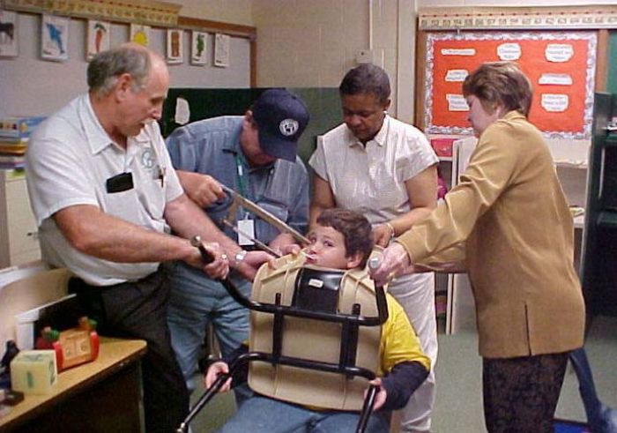
SCCGP

Slide 2
Counselor Corps Goals
Decrease student/counselor ratio
Increase graduation rate
Decrease dropout rate
Decrease remediation rate
Increase postsecondary matriculation rate
Student connections w/ supportive adult
Licensed school counselors
Implement ASCA Model Source: 22-91, C.R.S.

Slide 4
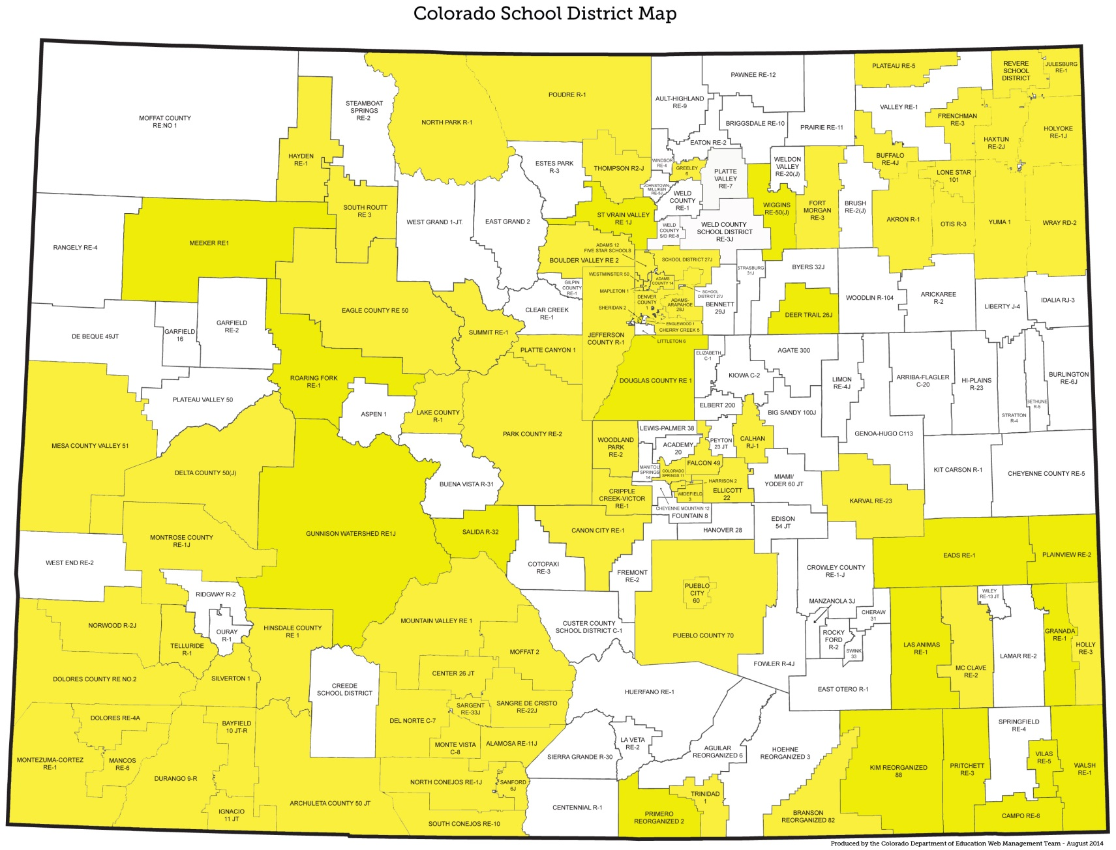
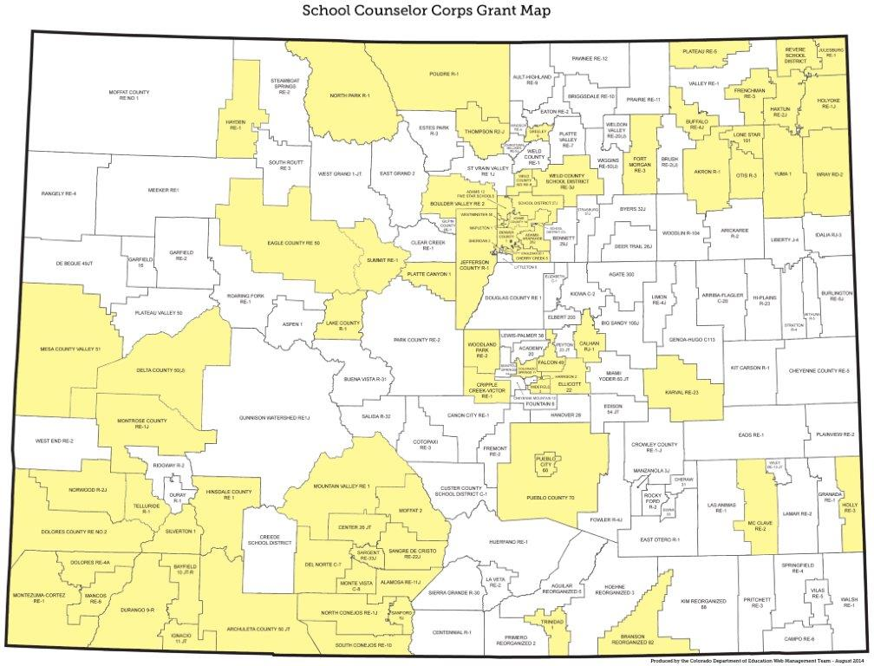
9 Years of funding-Counselor Corps Districts

Slide 5
Award Letter
In addition to the education provider's proposed Professional Development Plan, a team (must include counselors funded under the grant, counseling teams, key leadership staff most closely related to the success of the grant) must attend two one-day grant trainings during each year of the grant cycle (dates for Fall and Spring to be announced.) These trainings will provide professional development consistent with grant expectations for postsecondary preparation counseling. At a minimum, counselors funded under the grant and principals or assistant principals must attend these trainings. The trainings will be held on the Front Range with the possibility of regional sessions being conducted. Costs associated with these training should be included in the School Counselor Corps grantee budget.
• School counseling positions and successful program initiated under the grant shall be sustained by the grant in order to potentially be considered for future Colorado School Counselor grant funding.
All School Counselor Corps funded counselors must participate in the School Counselor Corps mentor program in partnership with the Colorado School Counselor Association. It is anticipated that this commitment will be approximately five (5) hours per month per counselor.
• Grantees are strongly encouraged to participate in the Colorado FAFSA Completion Project https://highered.colorado.gov/fafsa/default.aspx
• No carryover provision for these funds. All unobligated balance as of June 30, 2015 must be returned to the Colorado Department of Education no later than September 30, 2015.

Slide 6
Award Letter
Each Education Provider that receives a grant through the program shall report the following information to the Department each year during the term of the grant:
• 2.01(6)(a) The number of School Counselors hired using grant moneys;
• 2.01(6)(b) Any professional development programs provided using grant moneys;
• 2.01(6)(c) Any other services provided using grant moneys:
• 2.01{6)(d) A comparison of the dropout rates,postsecondary and workforce readiness rates, and the college matriculation and remediation rates, if applicable, at the Recipient Secondary Schools for the years prior to the receipt of the grant and the years for which the Education Provider receives the grant; and
• 2.01(6)(e) Information indicating an increase in the level of postsecondary preparation services provided to secondary students at Recipient Secondary Schools, such as the use of individual career and academic plans or enrollment in pre-collegiate preparation programs or post secondary or vocational preparation programs.

Slide 7
Award Letter
Secondary school counselor salaries and benefits
Postsecondary preparatory services and programs
In-state professional development to include but not limited to the counselors and staff of the funded schools.
Professional development shall align with the goals of the School Counselor Corps grant program.
Out-of-state travel must be pre-approved at least one-month prior to travel.
All computer equipment must be pre- approved and included on budget

Slide 8
Award Letter
All funds identified as unobligated at the close of the grant, June 30, 2018, must be returned to CDE no later than September 30, 2018.

Slide 9
Professional Development
July Training
Front Range
Monthly Webinars (Sept – April, no February webinar)
Development Year requirements and reporting
November Training
All Grantee PD
Partner with CSCA location
February Training (only attend one)
All Grantee PD
Denver Area
Regional

Slide 10
Reporting Timeline
End of Year Report – Due May 7th (Year 1)
End of Year Report – Due June 15th (Years 2-4)
Budget, electronic – Due September 1st
Annual Financial Report – Due September 28th
Interim Financial Reports
Screen Shot of from financial system
First working day of the month
October
January
April

Slide 11
Budget Expenditures
Professional Development
Academic Counseling for Career & College
Tools & Resources
Curriculum
Materials
Counselor Salary & Benefits
Transition Programs
College & Career Exploration
Consultants & Professional Services
Trainers
Change Experts

Slide 12
2017-2018 SCCGP Reporting
CDE Data
- Graduation/Matriculation Rate
- Grades
- Dropout Rate
- Testing info
- Credential Attainment
- Postsecondary Enrollment
- Career
- Remedial Needs
- Concurrent Enrollment & CTE Participation
- FAFSA Completion
- 9th Grade matriculation
District & School Data
- Disaggregated Grad/Matriculation /Dropout
- Admissions Applications
- Scholarship $$
- Attendance
- Counselor/Student Ratio
- College Visits
- Postsecondary Goal
- Parent Engagement
- Assessments
- ASCA Standards Adoption
- ICAP Development/Implementation

Slide 13
End of Year Reporting
The reporting period is July 1, 2017 through June 30, 2018
Reporting
Development Year Report (Year One Grantees complete this report)
Development Year SMART Goals Template
Electronic District Level End of Year Report (Each funded District in years 2, 3, or 4 complete this report)
This electronic survey for the School Level and District Level reports have a save and return feature that will appear at the very top of page 2. Click in the gray band and it will expand for you to put in your email address and verify. When you return to the saved report you MUST use the link that was emailed to you and not return to the link on the SCCG Webpage.
Please print a copy of your report for your records. A print option will be available once you submit your final report(s). Scroll to bottom of final report to find the “Print” option.
Electronic School Level End of Year Report (Each funded school in years 2, 3, or 4 complete this report)
This electronic survey for the School Level and District Level reports have a save and return feature that will appear at the very top of page 2. Click in the gray band and it will expand for you to put in your email address and verify. When you return to the saved report you MUST use the link that was emailed to you and not return to the link on the SCCG Webpage.
Please print a copy of your report for your records. A print option will be available once you submit your final report(s). Scroll to bottom of final report to find the “Print” option.

Slide 14
District Level

Slide 15
District-Level
Page 1
Questions 1 – 9
What year of SCCG funding was 2017-18?
Email me if you do not know – pugh_e@cde.state.co.us
Have staff changes been made using SCCGP funds?
Names are not necessary, just position information
The school counselors hired under the SCCG…are licensed…

Slide 16
SAVE and RETURN
You must complete page 1
This small band is at the top of PAGE 2.
CLICK the band ….

Slide 17
This appears when you click the Save and Return banner, shown on previous slide.
Complete your email, verify and Click SAVE

Slide 18
District Level
Part II: SCCG Performance Goals and Evaluation
You will list your SCCG goals in this part.
There is a separate section for each goal.
Room for five (5) goals
List only the goals developed in Year 1 of the Grant.
If you only have 2 goals – that is ok. That was what was approved and will be reported on for the remainder of the grant.
Part II
Performance Goals and Evaluation

Slide 19
District Level Report Part II
Report Progress
Exceeded goal
Met goal
Making progress
Not making progress
Narrative of progress
Data results
How data collected and/or verified
Special circumstances (positive or negative)
Mark ONE outcome most directly related to this goal.

Slide 20
District Level Part III and IV
PART III – Program Strategies and Services
ASCA Implementation
Special Programing
PART IV – Professional Development
PD Activities –
Room for 5 Activities.
If more than 5, please choose top 5 or most impactful to report here.
-Name of training -Topic Areas
-Number of attendees -Summary
-Number of hours -Implementation Strategies

Slide 21
District Level Part V
Colorado School Counselor Corps Grant Information
How many counselors were hired under the SCC grant by your district?
How you define postsecondary and workforce readiness for students
Provide a brief summary of individual career and academic plans (ICAP) implementation.
List two goals for ICAP implementation/improvement/development for next year.

Slide 22
District Level Part VI
Continuation Plan
What is your district/BOCES/school plan for sustaining counselors hired utilizing SCCGP funds after completion of the grant?

Slide 23
School Level Part I
Part I: Contact and Grant Information
District Name:
School Name:
Name of SCCG School Contact:
School Contact Phone Number:
School Contact Email:
SCCGP Funded Counselor(s):
Have staff changes been made using SCCGP funds during the 2017-18 year?

Slide 24
SAVE and RETURN
You must complete page 1
This small band is at the top of PAGE 2.
CLICK the band ….

Slide 25
This appears when you click the Save and Return banner, shown on previous slide.
Complete your email, verify and Click SAVE

Slide 26
School Level Report Part II
Colorado School Counselor Corps Grant Program School Goals
List goals that were created in your Development Year.
Goals will not change from year to year
Cut and Paste is a wonderful thing!
If your school goals are the same as DISTRICT
Cut and Paste
Room for 5 Goals
The remainder of responses mirror the District Report.

Slide 27
School Level Part III
Program Strategies and Services
Questions 48 – 62
Questions 62 is provided to give you the opportunity to share additional, related information that was not asked in a specific manner.
Questions 62 is not required.

Slide 28
School Level Part IV
Colorado School Counselor Corps Grant
Information
Number of counselors hired under SCCG
Number of counselors in YOUR school prior to SCCG
Counselor to student ratio for 2017-18
66 – 69 will be your best estimate or data collected.
70 – 87 varied questions and number of programs/classes

Slide 29
Contact Information
Eve Pugh, School Counselor Coordinator
pugh_e@cde.state.co.us
303-866-4123
www.cde.state.co.us/postsecondary

