Slide 1
Colorado School Counselor Corps Grant
Drive Your Data
Andy Tucker
CDE Director of Postsecondary Readiness
February, 2018
Notes:
This template can be used as a starter file for presenting training materials in a group setting.
Sections
Right-click on a slide to add sections. Sections can help to organize your slides or facilitate collaboration between multiple authors.
Notes
Use the Notes section for delivery notes or to provide additional details for the audience. View these notes in Presentation View during your presentation.
Keep in mind the font size (important for accessibility, visibility, videotaping, and online production)
Coordinated colors
Pay particular attention to the graphs, charts, and text boxes.
Consider that attendees will print in black and white or grayscale. Run a test print to make sure your colors work when printed in pure black and white and grayscale.
Graphics, tables, and graphs
Keep it simple: If possible, use consistent, non-distracting styles and colors.
Label all graphs and tables.

Slide 2
Workshop Objectives
To help SCC counselors be more effective in their practice
To help SCC counselors be more comfortable looking at and working with data
To help SCC counselors prove their value to all stakeholders
To provide data points that could support sustainability

Slide 3
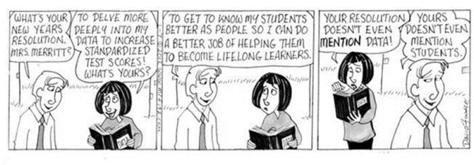
Notes:
This is another option for an Overview slides using transitions.

Slide 4
Self-Score
1 = Never
2 = Not usually
3 = Sometimes
4 = Most of the time
5 = Always

Slide 5
Data Literacy Self-Assessment
1. Do you examine school data regularly to make decisions about your programs and interventions?
2. Are your school counseling interventions aligned with the school mission statement?
3. Do you consider the school improvement plan when making decisions about your program and interventions?
4. Do you understand the difference between process, perception, and results data?

Slide 6
Data Literacy Self-Assessment
5. Do collect pre- and post-test data for all programs and guidance activities you conduct?
6. Do you identify measurable, attainable program goals?
7. Do you share your data results with interested stakeholders?
…………….What is your data literacy score?

Slide 7
Scoring
30-35 You are a data driven school counselor
23-29 You believe that collecting data is important and collect data regularly
17-22 You would like to collect data and sometimes use it when making program decisions
12-16 You are beginning to collect some data
7-11 You are unsure what to do with data
0-6 You are unsure of how to collect and use data

Slide 8
Accurate?
Does this capture where you are?
Would you like to increase your data competency?
Is being a data driven school counselor a goal of yours?

Slide 9
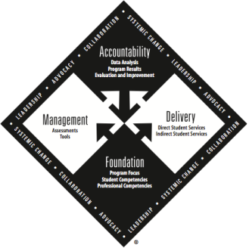
ASCA National Model
Comprehensive in Scope
Preventive in Design
Developmental in Nature
Integral Part of the Total Educational Program
Designs a Delivery System
Conducted in Collaboration
Monitors Student Progress
Driven by Data
Seeks Improvement
Shares Successes
Notes:
Comprehensive in scope – it focuses on what all students from preK through grade 16 should know, understand, and be able to do in the 3 domains of academic, career, and personal/social development.
Preventive in design – counseling program provides specific skills and learning opportunities in a proactive, preventive manner, ensuring ALL students can achieve school success in the 3 domains.
Development in Nature – provides programs and services that meet the needs of students at various growth and developmental stages. It follows student content standards and competencies.
Integral part of the total educational program – as counselors, we are specifically trained to call attention to situations within the school that hinder students’ academic success. We provide leadership to access school needs.
The Delivery System describes activities, lessons, and other areas in which counselors work to deliver the program.
Counselors collaborate with all stakeholders to provide appropriate support services.
National model allows for monitoring student progress and reviewing data to determine if a student or groups of students are meeting program goals and student competencies.
Driven by data – we gather data to show proof that a student competency is not just mastered but has affected course taking patterns, graduation rates, knowledge attainment, attendance, behavior or academic achievement. We can also look at equity issues and needs of various student groups.
Seeks improvement – we continually look at what is working and what is not.
Shares successes – we inform stakeholders of our successes so they know and can promote the value and necessity of school counselors in children’s lives.

Slide 10
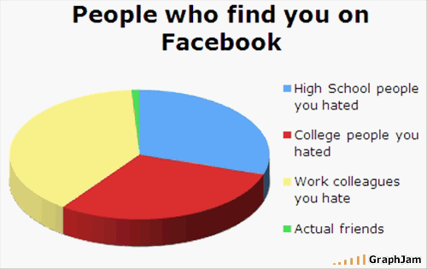

Slide 11
DATA!
“It seems so overwhelming, I have no idea, what DATA I am supposed to be collecting and using!”
“I don’t understand how to use data in school counseling.”
“What kind of data do they want?”
“Data doesn’t measure what we do!”
“When will I have time to collect and analyze data?”
“We collect data, I just don’t know if it is the right stuff.”

Slide 12
Elbow partner discussion
What are data elements that you can collect to show the effectiveness of what you do?
What data elements exist within your student information system?

Slide 13
Data | Data Source | Where I Can Gather data….
Standardized testing CSAP/TCAP Access/CELA | CDE Website - Schoolview | Principal Instructional coach SOARS Infinite campus Naviance
Purchased Curriculum/Testing Explore/PLAN Pre AP/AP | ACT/Collegeboard) | Testing Coordinator Principal SOARS
The school’s yearly goals and plan for achieving the goals | The school’s UIP | Principal
Attendance, Discipline, Grades, Assessment Data, Course Enrollment Patterns | Student Information Systems (Infinite Campus, Powerschool, SASI etc.) System/Administrators | Infinite Campus Assistant Principal Attendance Secretary Special Ed./ILP/ELL
ICAP’s Career pathways First generation Future plans/goals | CIC, Naviance, Paper copy | Naviance

Slide 14
Data | Data Source
Systems analysis | Discipline, Grading Scale Policy, Promotion, Retention, School Safety Surveys | Infinite Campus Surveys Needs assessments Evaluation of school policies and practices
Counselor Interactions | You! (notes, email, phone log) | Microsoft Outlook
Student, Faculty, and Family Needs | Surveys, Needs Assessments | Make your voice heard survey Tell survey
Pre-Post Tests | Given before and after an intervention to determine knowledge gained or to measure a change in perspective
SES info. | Check school, sometimes confidential

Slide 16
Results Data
ULTIMATE GOAL!
“So WHAT” data
Hard data
Application data
Proof your program has (or has not) positively impacted students ability to utilize the knowledge, attitudes and skills to effect behavior

Slide 17
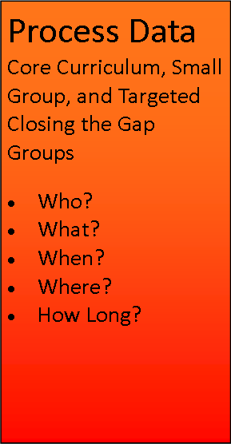
Process Data
What you did for whom
Evidence that event occurred
How activity was conducted
Did the program follow the prescribed practice?
All 8th grade students attended a large group assembly and were trained to use the 4-way test for conflict resolution.

Slide 18
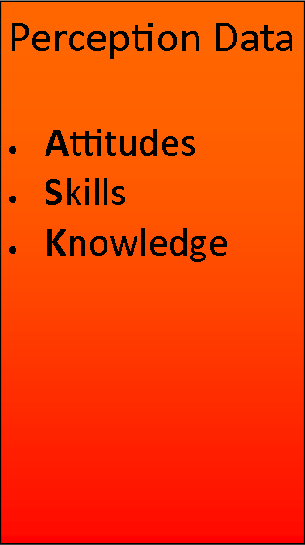
Perception Data
What others think, know or demonstrate
Competency Achievement
Every student in grades 9-12 completed a 4 year plan
Every 10th grade student completed an interest inventory
Knowledge Gained
89% of students demonstrate knowledge of promotion/ retention criteria
92% can identify the difference between tattling and reporting.
Measures pre./post data
Attitudes or Beliefs
74%of students believe fighting is wrong
29% of students feel safe at school

Slide 19
Interventions

Slide 20
Look at current data and break it down by.…
ETHNICITY
GENDER
GRADE LEVEL
FAMILY CONFIGUARTION
MOBILITY
Ex. - What percentage of each racial, ethic, gender, and language group is reading at their grade level?
Notes:
A great deal of data already exists and can provide insight into barriers to student achievement.
Consider the types of data that is available and how this data can be used to understand student achievement issues.
For example Proficiency data can be analyzed by disaggregrating or breaking the data into smaller groups. Looking at this data according to ethnicity, gender or grade level will provide insight into strengths and weaknesses and may help to uncover acheivement gaps.
The same useful analysis can be done for Attendance data, Enrollment data and System Practices. For instance looking at discipline data for according to ethnicity may reveal some issues that need to be better understood. Is there an over or under representation among certain student groups? Are there discipline issues in one particular grade?

Slide 21
Using Data to Uncover Inequities
Ask questions….
What do I want to know about my school’s ability to educate all students?
What questions do I have about my students?, My school community?
What concerns you about your data?
Does an achievement gap exist? Where?
What additional information do you need?
What should you focus on? What data should you collect?

Slide 22
Disaggregation of Data
What is disaggregation?
Disaggregation: To break up or to break apart
http://www.thefreedictionary.com/Disaggregation
What are different ways that we can disaggregate data? We can look at data in so many ways, comparing any given variable (i.e. grade distribution) by different criteria.
Grade
Gender
Race/ethnicity
Attendance rate
IEP/ILP
504

Slide 23
Why disaggregate data?
If we effectively disaggregate data, we can identify trends and/or areas for which intervention is necessary.
Achievement gaps between different populations
Troubling grade distribution patterns by teacher, course, section, etc.
Grade distribution for students with different attendance patterns

Slide 24
Where to get results data
Ad Hoc reports through your student information systems
Talk to your registrar, counseling secretary, IT department, and/or other personnel who consistently work with data to learn how to run reports.
Generally, once you create a report, you only need to tweak it a bit each time new grades are run.
Notes:
Show a real report in IC

Slide 25
What to do with reports once I have run them
Most reporting features allow you to download reports into Microsoft Excel.
Excel has amazing sorting capabilities.
The most amazing of them all are “pivot tables.”

Slide 26
A closer look at real data
Let’s look at an actual report reflecting grades from a specific grading period at a real area high school.
We will look at grade distribution by grade, gender, ethnicity, and attendance rate.
Notes:
Go to spreadsheet and pivot the following:

Slide 27
How to present your data to stakeholders?
Share ideas with a partner

Slide 28
Action Plan

Slide 29
Action Plan

Slide 30
To whom to present your data?
Principals
School boards
Parents
Community members
Anyone who will listen?

Slide 31
What to present?
Process data
How many students did you reach?
What different types of lessons did you provide?
Perception data
What attitudes, knowledge, and/or skills did your students acquire thanks to your work?
Gather this data through pre- and post-tests
Results data
How did your student’s behavior, grades, credit acquisition, etc. change due to your work with them?

Slide 32
Examples of data presentations
Share with your table
What data presentations have you done?
What results did they have?
If you haven’t yet presented data, what data might you present?
To whom?
When?

Slide 33
Action steps to leave with….
What other data do I need, what are my action steps and timeline.
What data will I track (Process, Perception, and Outcome)?
To Whom will I present this data?

Slide 34
Data share goal
Write down:
By the end of this school year, (my team and) I will present _type of_ data to _audience_ at location. We will acquire this data through _process__.

Slide 35
Have Questions, Need More Help? Contact me….
 | Contact information
Andy Tucker | Tucker_a@cde.state.co.us
Notes:
Keep it brief. Make your text as brief as possible to maintain a larger font size.

