Slide 1
Colorado Department of Higher Education and College In Colorado
The New State-Wide Admission and
Transfer Policy
Fall Colorado Counselor Workshops
Carl Einhaus
Director of Student Affairs
Colorado Department of Higher Education
http://highered.colorado.gov/
Carl.Einhaus@dhe.state.co.us

Slide 2
We will discuss…
Admissions Standards Policy
Transfer Policy
New Web-Based Admission Tool

Slide 3
Programs
Counselor Corps (80 schools)
Concurrent Enrollment (25,000 students)
ASCENT (281 students)
ICAP (240,000 students)
FAFSA Completion (30,000 students)
But first…
…the “Honeycomb”
Innovations and Individualized Learning
Graduation Guidelines
ICAP implementation
ASCENT
Academic Guidance
Career Exploration
Partnerships:
CDE, CDHE, CIC, CCCS
ICAP Tutorials
CE Advisory Board
Endorsed Diplomas
Remediation Taskforce
College Admission
Data Sharing
Early College Design
Grad Guidelines Work Groups
Postsecondary and Workforce Readiness
College and Career Preparation
Graduation Guidelines
Concurrent Enrollment (CE)
Career and Technical Education
21st Century Skills
FAFSA Completion
GED
Legislation
Graduation Guidelines
CAP4Kids
Counselor Effectiveness
School Counselor Corps Grant
ICAP
Concurrent Enrollment (CE) Act
Early High School Grads
Dropout Recovery
Results
School Counselor Corps Evaluation
Remediation Rates
ICAP Study
Concurrent Enrollment Reporting
3

Slide 4
Admissions Standards Policy
How it is now…
…how it will be…
…and the timeline.

Slide 5
Admissions Standards Now…
HEAR = Higher Education Admission
Requirements
Admissions Index =
Assessment score (ACT/SAT)
AND
Grade Point Average or class rank

Slide 6
HEAR
English 4 Units
Math 4 Units
Natural Science 3 Units (2 of which lab-based)
Social Studies 3 Units (1 US or World History)
Foreign Language 1 Unit
Academic Electives 2 Units

Slide 7
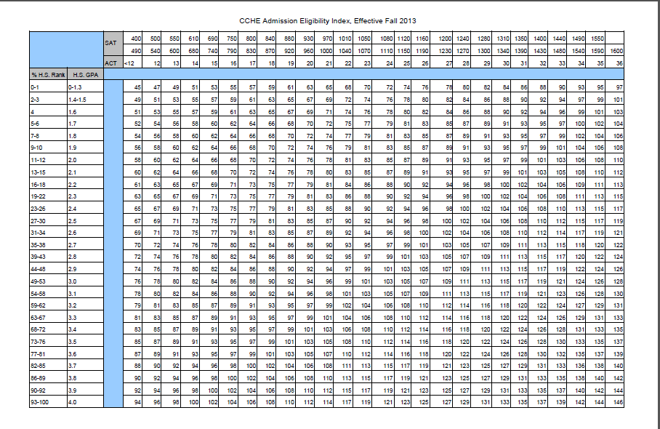
Index

Slide 8
How it WILL be: New Admissions Standards
No more index – new a web-based tool!
Academic performance indicators will include assessment scores, GPA and rigor.
Assessment
ACT, SAT, Compass, Accuplacer, PARCC* (Partnership for Assessing Readiness for College and Career), and Smarter Balanced*
Assessment and GPA mid-50%

Slide 9
New Admissions Standards
Rigor could include:
Completed high school core-content courses;
Sequences of career and technical courses;
Quantity and quality of high school core-content courses completed;
Successful completion of Advanced Placement courses, International Baccalaureate courses or gtPathways concurrent enrollment courses (grades of "C-" or better);
High school senior year coursework; and
High school courses in a chosen career path.

Slide 10
New Admissions Standards
“Transfer student” means a student entering the reporting institution for the first time but known to have previously attended a postsecondary institution at the same level (e.g. undergraduate, graduate) after high school graduation (or passing an equivalency exam). The student may transfer with or without credit. This excludes students who completed remedial coursework and students who completed college-level coursework ONLY as a high school student through Concurrent Enrollment or as their homeschool curriculum.

Slide 11
New Transfer Admissions Standards
The transfer student admission standard applies to all degree-seeking undergraduate transfer applicants with 24 or more college-level semester credit hours completed at the point of application
Guarantee admissions for AA and AS graduates with minimum GPA

Slide 12
Admissions Standards Timeline
Current Admission Policy
Now until Fall 2019
Current AND New Admission Policy
Fall 2016 – Summer 2019
New Admission Policy
Fall 2019

Slide 13
Admissions Web Site
http://highered.colorado.gov/Academics/Admissions/

Slide 14
Your Colorado Resources
College in Colorado
Julia Pirnack Director of Web and Curriculum Development Julia.Pirnack@cic.state.co.us
Dawn Taylor Owens Executive Director
Dawn.TaylorOwens@cic.state.co.us
Colorado Department of Education
Robin Russel Graduation Guidelines Manager
Russel_R@cde.state.co.us
Misti Ruthven Director of Postsecondary Readiness
ruthven_m@cde.state.co.us
Colorado Community College System/CTE
Lauren Jones
CTE Program Director for Career Guidance,
Counseling & ACE
Colorado Community College
System/Career & Technical Education
Lauren.Jones@cccs.edu
Tracy Thompson
ICAP Implementation Specialist
Colorado Community College
System/Career & Technical
Education
Tracy.Thompson@cccs.edu

Slide 15
New Web-Based Admission Tool Discussion
Improving upon this…

Slide 16
Admissions Planning Tool: Focus Group Questions

Slide 17
PURPOSE OF TODAY Get your input regarding what information colleges could provide and that we can we build into this tool, that will help students:
Understand what colleges expect
Improve student chances for admission to certain schools
Help students set goals and monitor their progress toward meeting the requirements of selected school(s)

Slide 18
Please describe how easy is it for students/parents to figure out how close the student is to meeting a college’s expectations. How could we do this effectively within the tool?
Please describe how easy is it to find information about what colleges expect when admitting students.
From your work with students and parents and thinking about admissions criteria used by colleges, what do you think are the most difficult concepts for students and parents to understand?

Slide 19
Should students be able to filter by a college’s selectivity (i.e. Modified open admission , moderately selective, selective and highly selective)? What other filtering or ordering of colleges would be helpful?
How well do you think parents and students understand the basic difference between admissions standards to community colleges, technical schools, and four-year colleges?

Slide 20
What types of institutions do you feel should be included in the tool: public (such as CU and CSU), private (such as DU and Johnson & Wales), technical (such as Delta/Montrose, Emily Griffith)?
What type of institution category filters would you like to see (such as 4 year institutions, 2 year institutions, my region, accreditation status)?
What analytical data from student usage of the tool would you be interested in seeing/should we capture?

Slide 21
How important would it be to enable 8th or 9th graders to use this tool to understand how colleges evaluate students for admissions and play “what if” (i.e. plug in potential GPA, test scores, etc.)?
Do you currently discuss admissions requirements for specific schools with your students? Do students typically “know” which school they want to attend and work toward meeting those requirements during high school? Please describe how interested you would be in using this tool as part of your Individual Career and Academic Plan with students?

