Slide 1
Income Verification Webinar
How to verify information on free and reduced-price meal applications.
This webinar will start at 2:00pm
Notes:
Good afternoon! Welcome to the Verification Webinar for school year 2022-2023! Thank you so much for being here today!
For those of you who don’t know me, I’m Rachael Burnham. I am the principal consultant for benefit issuance areas for the School Nutrition Unit, so that includes free and reduced-price meals, verification and direct certification.
I wanted to provide a webinar to refresh everyone on the Verification process as this starts soon!
We cover this topic during regional training and a lot of you have taken the online training, however, I wanted to give everyone another quick opportunity to understand verification and the numerous steps involved as well as learn of several new updates.
Attending this webinar will count for one hour of continuing education in Administration - Free and Reduced-Price Meal Benefits. An email will be sent to you in the coming day with a link to the evaluation. Please complete the evaluation and then you will be able to download the certificate of completion.

Slide 2
Mute/
unmute
Video
Chat
Closed Captions
Notes:
Before getting started, I want to cover some quick Zoom housekeeping items:
All attendees will enter muted. You will know that you are muted if the microphone button in the lower left corner has a slash across it.
Next to the microphone is a camera icon. Click the camera icon to turn it on which will remove the slash across the icon. It is completely optional to turn on your camera today.
You should see a chat icon in the middle portion of your screen. If you have any questions today, please put them in the chat. We are monitoring the chat and will address questions at the end of the webinar if we have time.
We will insert the PowerPoint slides for today with speaker notes into the chat for you to download.
To the right of the chat icon, is an icon for closed captioning if you needed it. Go ahead and click this button for subtitles.

Slide 3
CDE School Nutrition
Vision
Mission
Nourish young bodies and minds. End childhood hunger.
We support the child nutrition community through innovation, training, and partnerships to ensure all youth have access to healthy meals.
Notes:
We have spent time updating our vision and mission.

Slide 4
Non-Discrimination Statement
In accordance with federal civil rights law and U.S. Department of Agriculture (USDA) civil rights regulations and policies, this institution is prohibited from discriminating on the basis of race, color, national origin, sex (including gender identity and sexual orientation), disability, age, or reprisal or retaliation for prior civil rights activity.
Program information may be made available in languages other than English. Persons with disabilities who require alternative means of communication to obtain program information (e.g., Braille, large print, audiotape, American Sign Language), should contact the responsible state or local agency that administers the program or USDA’s TARGET Center at (202) 720-2600 (voice and TTY) or contact USDA through the Federal Relay Service at (800) 877-8339.
To file a program discrimination complaint, a Complainant should complete a Form AD-3027, USDA Program Discrimination Complaint Form which can be obtained online at: https://www.usda.gov/sites/default/files/documents/USDA-OASCR%20P-Complaint-Form-0508-0002-508-11-28-17Fax2Mail.pdf, from any USDA office, by calling (866) 632-9992, or by writing a letter addressed to USDA. The letter must contain the complainant’s name, address, telephone number, and a written description of the alleged discriminatory action in sufficient detail to inform the Assistant Secretary for Civil Rights (ASCR) about the nature and date of an alleged civil rights violation. The completed AD-3027 form or letter must be submitted to USDA by:
1. mail:
U.S. Department of Agriculture
Office of the Assistant Secretary for Civil Rights
1400 Independence Avenue, SW
Washington, D.C. 20250-9410; or
2. fax:
(833) 256-1655 or (202) 690-7442; or
3. email:
program.intake@usda.gov.
This institution is an equal opportunity provider.
Notes:
We include the nondiscrimination statement in our trainings as a reminder of our responsibilities to ensure all eligible people may participate in our child nutrition programs. As equal opportunity providers, we prohibit discrimination in our programs and provide fair and equitable treatment to every participant.

Slide 5
Conditions for Success
Be present + engaged
Participate in discussion
Actively listen
Mute your microphone when you’re not talking
Bring a positive attitude and be ready to share
Be respectful, inclusive and open minded
Notes:
Here are some other conditions for success to make our time together today as meaningful as possible include.
Are there any other conditions that would help ensure a successful session that you would like to add today?

Slide 6
Learning Objectives
By the end of this training, sponsors will be able to:
Understand and describe program requirements for:
Verification for Cause
Due dates
Calculating sample size
Verification collection report
Accurately process and identify complete income documentation
Utilize the verification tracker to ensure accuracy and compliance
Use customer service skills to help families respond to verification
Professional Standards Learning Objectives and Topic Code:
Free and Reduced-Price Meal Benefits – 3100 (1.5 hours)
Notes:
By the end of this training you will be able to: Leave this training with confidence to conduct verification compliantly while gaining skills to effectively help families respond, keep students on meal benefits and help streamline organizational processes. The more you understand the program requirements the more successful you will be during a review and the more successful you will be in helping families respond.
You will receive 2 hours of training today in Menu Planning, Free and Reduced-Price Meal Benefits, Program Management, and Communications and Marketing.
We will be going through lots of content over the next 1.5 hours but I have built in some breaks and activities. As mentioned in the conditions for success, please be present and I will be sure you get breaks. Additionally, feel free to type questions into the chat throughout the presentation. We will address the questions at two different times throughout the presentations.

Slide 7
Agenda
Verification – The Annual Process
Counting Applications and Calculating Sample Size
Notifying Households and Reviewing Income Documentation
Responses & Results
Best Practices

Slide 8
Verification – the annual process

Slide 9
The Annual Required Process
Annual Requirement: Confirmation of eligibility for free or reduced-price school meals based on an application
If processing free and reduced-price school meal applications, verification must be conducted every year
Ongoing: Conduct verification for cause throughout the school year for questionable applications
Notes:
Verification is the confirmation of eligibility for free or reduced-price meals determined through applications. It’s an annual USDA requirement and involves selecting a 3% sample from all current year approved applications. Households in the sample size are notified that further income or assistance program documentation is required to confirm the information provided on the application.

Slide 10
Verification for Cause
Ability to verify any questionable application at any time during the school year
Must first approve the application at face value
Follow the same process as annual verification
Examples of questionable applications:
Report of fraud
Cannot directly certify a case number application
Outside knowledge/questionable information on the application
Notes:
As mentioned at the beginning of this training, in addition to Verification being required as part of the annual process, it is also required to be conducted for any application that is questionable. Indeed, the SFA has the obligation to verify any questionable application.
When an application is submitted and is questionable, it still must be taken at face value and processed. However, the SFA can then go about verifying the application for cause.
To verify for cause, the SFA will follow the same procedure as the annual process. Verification for cause may be conducted any time during the school year.
Keep in mind that Verification for Cause is conducted separately and in addition to the annual process. Therefore, any applications verified for cause cannot be included as part of the annual sample size.
So, exactly why would an application be considered questionable, thereby making it subject to Verification for cause? There could be several reasons.
There may be questionable information on the application. Do Aunt Sally and Uncle Frederick, both with no income, really live in the household? Does Mom really make just $2.00 per week?
The SFA may also have outside knowledge that conflicts with what is on the application. For example, maybe Dad owns a Fortune 500 company, and he reported receiving only $2,000 per month. Or maybe the household buys a new yacht every other week and therefore likely has a plethora of income incoming, while they listed only $1400 twice per month. Unfortunately, in a small town, it can be true that everyone knows everyone else – and everything about them. Regardless, if the SFA has outside information that conflicts with the application, they are still required to complete Verification for Cause.
An SFA is also required to verify an application for cause if there is any report of fraud made to the SFA. Yes, even if Dad calls up to complain about ex-wife Mom, who is apparently receiving benefits “fraudulently.”
Multiple applications submitted – with varying information – can also be a good reason to verify for cause, as can the fact that a child has an application with a SNAP number – but does not come up on Direct Cert. One note of caution about this, though: If a child is on a SNAP application but does not come up on Direct Cert, this could be because of a data glitch, or it could be a timing issue; it does not necessarily mean that the household is not on SNAP.
Finally, if the verifying official has information on other programs in the district that collect household size/income information, and this information does not match up with the F&R application, the application should be verified for cause.

Slide 11
Verification Timeline
Count all current year approved applications
Count students by required categories (as of 10/31)
All verification activities must be completed
Must complete and submit Verification Collection Report (VCR, FNS-742) in the Portal
October 1
1
Calculate Sample Size
October - November
2
November 15
3
February 1
4
Follow-up attempts
Send adverse action letters
Notes:
Here are the key dates to the verification timeline. October 1 is an important date as this is the day you count all current year applications in order to determine the size of your sample pool.
October 31st or the last operating day in October is important as well. This date you must count the total number of students by specific eligibility. Again, we will cover this in depth later.
November 15th is the closing date of verification. All households need to respond by this date, and all those that have not responded will be sent adverse action letters.
The Verification Collection Report (VCR) records the count of applications you conduct on October 1, the count of students you conduct on October 31 and the results of verification. This must be completed by February 1st.

Slide 12
Verification Process
Count all approved free and reduced applications as of October 1st
Calculate Sample Size
Conduct confirmation reviews
a. Replace applications (if necessary)
Notify households
a. Follow-up attempts
Review submitted documentation
Send results to households and update student statuses
Complete the Verification Collection Report (VCR, FNS-742)
Notes:
It’s best to understand verification as the structured process shown here. These are the steps taken in the following order and will correlate to the dates previously shown.

Slide 13
Counting Applications and Calculating Sample Size

Slide 14
Count of Applications
Count the total number of approved applications on file as of October 1. Keep record of:
# of free categorical applications
# of free income applications
# of reduced applications
Review a complete list of applications not to include in sample pool in the Eligibility Manual
Rolling verification:
Sponsors may start verification activities once they begin the application approval process for the current school year
Conducting verification on a rolling basis (e.g. weekly or monthly)
Notes:
Cover complete list on pages 96-98.
The first step of the annual verification process is the count of applications. This count must be accurate as of the close of business on October 1, and it is to entail the counting of all approved free and reduced-price applications for the current year. This year October 1 will a Saturday, so the official count day will be Oct. 3.
The count does not include paid applications, and if the SFA is still in the carryover period, it does not include applications from the previous year. This count is conducted primarily so that SFAs will know how many applications must be verified. Further, the data from this count will later be reported on the VCR. The SFA’s count must break out the following information:
number of free categorical applications,
number of free income applications,
number of reduced applications
Beginning Verification before Oct. 1 – USDA released Memo SP42-2017 called Beginning Verification before October 1: Guidance to Local Educational Agencies. SFAs can begin verification once they start collecting current year applications and have approved applications on file. You will need to choose how often you would like to conduct the rolling verification. If you choose bi-weekly, you still count approved applications from that timeframe and select a 3% or approved 1.5% sample size and select error-prone first. On October 1 the SFA must still count all approved applications on file to determine an aggregate annual sample size. If the sample size has not been met from the rolling verification, fill the remainder of the sample. If you normally verify 1-2 applications per year, you cannot use rolling verification. If you’re interested in doing rolling verification, please let me know.

Slide 15
Count…or not to Count…
Student is directly certified prior to Oct. 1 and on an application?
Do not count the application
Student is on an application, but his sibling is directly certified prior to Oct. 1?
This student should be extended eligible; do not count the application
Student is on a foster only application?
Unless this student is on a foster list from the county, this application must be counted
What if the application has some students approved based on income and other students are other source categorically eligible?
Count the application
Notes:
School Nutrition frequently receives questions on which applications should be counted and which should not.
If a student is on an application and on Direct Certification, Direct Cert takes precedence, and so the application is not counted.
If a student is on an application along with another student who has been directly certified, this status should extend to him; as such, he is also considered directly certified, and the application is not counted.
If a student is on a foster application, the application is counted. The only exception to this would be if the SFA also receives foster lists from the county, and the student is also on that list. In that case, the application would not be counted.
What if the application has some students approved based on income and other student’s are OSCE? Count the application.

Slide 16
Sample Size Types
3 Types
Standard Sample is 3% of approved applications selected from error-prone first
Alternate 1 is 3% of approved applications selected at random
Alternate 2 is 1% of approved applications selected from error prone first and .5% selected from case number/foster only applications (categorical applications)
When calculating your sample size, ALWAYS ROUND UP
*Must qualify to use Alternate Sample Sizes*
Notes:
We will quickly cover this because selecting the sample size and doing so correctly consistently remains to be an issue every year.
The most important logistical step is to determine the sample pool from which a certain number of applications will be chosen for verification.
The standard sample, a sample that randomly chooses, 3% of the approved applications that have been counted as of October 1. These applications are selected first from error prone applications, which will be covered in the next slide.
SFAs can qualify to use two different sample sizes which help them verify fewer applications. To qualify, a SFA must have had a non-response rate of less than 20% for applications verified in the preceding year. Qualifying SFAs are being notified by CDE School Nutrition and may elect either alternate sample – or stay with the standard sample. If SFA chooses an alternate sample, an assurance must be completed, as well as an Alternate Sample Size Calculation Worksheet, to CDE School Nutrition.
Regardless of which sample size is chosen, SFAs are reminded to check their electronic systems for accuracy, if using a system to pull the sample. Most SFAs with errors in sample size have had these errors because of mistakes in their systems. I would check with your software vendor now that your system is set up to select the correct sample size. I have consistently seen software systems pulling extra applications as a “buffer” for replacement of withdrawn students. Per USDA this is not allowed.

Slide 17
Error Prone
Error prone application: any income application that is close to the thresholds of the income eligibility guidelines (IEGs)
Non-error prone: all other applications, including income and categorical
Frequency | Threshold for Error Prone
Yearly | EP = Apps with income within $1,200 of the yearly IEGs
Monthly | EP = Apps with income within $100 of the monthly IEGs
Twice per Month | EP = Apps with income within $50 of the twice per month IEGs
Every 2 Weeks | EP = Apps with income within $44 of the every 2 weeks IEGs
Weekly | EP = Apps with income within $24 of the weekly IEGs
Notes:
Please reference your error prone chart.
Before we look at the different sample sizes in more detail, we must first have an understanding of what error prone and non-error prone applications are. Error prone applications are simply those applications that fall, depending on frequency, within
$1200 of the yearly Income Eligibility Guidelines (IEGs)
$100 of the monthly IEGs,
$50 of the twice per month IEGs
$44 of the every two weeks IEGs OR
$24 of the weekly IEGs.
A non-error prone application is any other application, including income or categorical applications.
Most electronic free and reduced software systems do flag applications, if they are error prone. However, as with anything with an electronic system, the LEA should always spot check the system for accuracy.

Slide 18
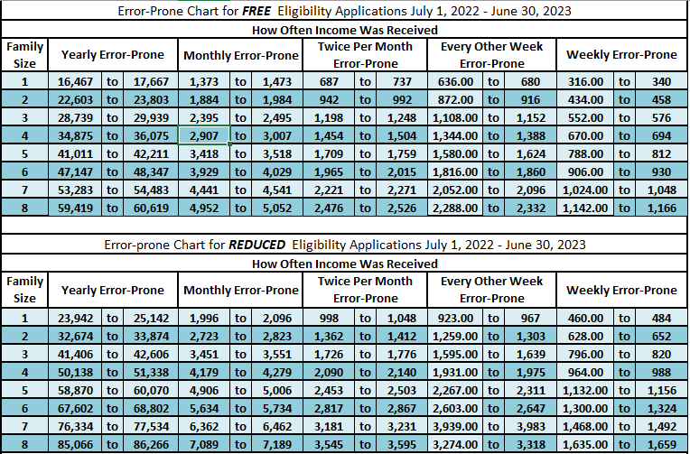
Error Prone Chart
Notes:
Here is the current year error prone chart. While you’re approving current year applications, it will be a good idea to also flag them as error prone (or make sure your software is flagging error prone applications correctly). Please pull out the error prone chart from your top right file share. We will need it for our first poll question.
For example, if we just processed an application for a household of 5 with an annual income of $42,000 we can see this application would qualify for free meals and will also be considered an error prone application.

Slide 19
Poll 1
Notes:
Poll 1:
Household of 6; monthly income of $66,000
Is this Error-Prone? NO

Slide 20
Calculation Example
Standard Sample Size of 3%
On October 1 – counted 123 free income, reduced income and categorical applications
Of these 3 are error prone
Multiply 123 by 3% (.03) = 3.69
ALWAYS ROUND UP = 4 applications must be selected for verification
Select from error prone first to meet the sample size
All 3 error prone will be selected first
Select the remaining 1 application at random from the non-error prone applications
Notes:
To determine the number of applications to verify using the standard sample, the SFA will need to:
Determine the number of applications that were counted as of October 1
Multiply this number by 3%
Round the answer up to the nearest whole number
Begin selecting applications to verify from the error prone applications
If needed, complete the sample size by choosing the remaining needed applications from the non-error prone applications.
SFA has 123 approved applications on file that were counted. Of these, 3 are error prone and the rest are non-error prone.
Multiply 123 by 3%, which is 3.69.
This number must be rounded up, so it becomes 4.
The SFA will first need to select from the error prone applications. So, the LEA will need to include all 3 error prone applications, and to complete the sample size of 4, the SFA will need to choose one additional application from the non-error prone applications.

Slide 21
Recap – Counting Applications
1. Count total approved applications
Will not include any applications where a student has been directly certified
2. Identify error-prone applications
Use the error-prone chart if manually tagging error-prone
3. Calculate sample size
Always round up
Will not include any applications where all listed students have been approved as other source categorically eligible
Is a count of applications not a count of total approved students
Ensure software has accurate error-prone thresholds
Ensure software calculates correct sample size – cannot inflate
Notes:
Please reference your error prone chart.
Before we look at the different sample sizes in more detail, we must first have an understanding of what error prone and non-error prone applications are. Error prone applications are simply those applications that fall, depending on frequency, within
$1200 of the yearly Income Eligibility Guidelines (IEGs)
$100 of the monthly IEGs,
$50 of the twice per month IEGs
$44 of the every two weeks IEGs OR
$24 of the weekly IEGs.
A non-error prone application is any other application, including income or categorical applications.
Most electronic free and reduced software systems do flag applications, if they are error prone. However, as with anything with an electronic system, the LEA should always spot check the system for accuracy.

Slide 22
Poll 2
Notes:
Poll 2:
You count 328 applications on October 1 and are calculating a standard sample size of 3%. How many applications must be selected for verification?
a. 10
b. 9
c. 8
d. 11

Slide 23
Verification Process
Count all approved free and reduced applications as of October 1st
Calculate Sample Size
Conduct confirmation reviews
Replace applications (if necessary)
Notify households
Follow-up attempts
Review submitted documentation
Send results to households and update student statuses
Complete the Verification Collection Report (VCR, FNS-742)
*Document all verification activities on the verification tracker*
Notes:
Let’s review. We’ve defined verification and why we conduct this process annually. We’ve covered which applications to count on October 1 in order to determine our sample size. Lastly, we walked through how to calculate our sample size and identify what an error prone application is.
Next, we will look at steps 3, 4, 5 and 6 and how to use the verification tracker!

Slide 24
Notifying Households and Reviewing Income Documentation

Slide 25
Steps Prior to Notification
Replace Applications
1
Confirmation Reviews
2
Limited English Proficiency Services
3
Notes:
One lesser known provision of verification is that applications selected to be verified can be replaced, on a case-by-case basis. If you know the household cannot respond or has been selected year after year, you can replace up to 5% of applications. If an SFA replaces an application with another, the replacement application must be selected on the same basis. For example, if the original application was error prone, the replacement application must also be error prone (assuming there are still enough error prone applications remaining in the pool). Often, it is found that students have left the district or moved. If this is known, you must replace the application. If it is found that the household has become directly certified you do not have to replace the application. You can send the direct certification notification and the verification for that household is considered complete.
Once the SFA has determined which applications are to be verified, they must conduct confirmation reviews on the applications that were selected for verification. A confirmation review means that an individual, other than the individual making the initial eligibility determination, checks the application to ensure that it was approved correctly.
It is critical that the confirmation review must be documented – i.e., the confirming official must sign off – and date – that the review took place. The best place to document this is on the Verification Tracker.
It is extremely important that services are provided for households that do not speak English. If you have a high population of non-English speakers, I highly recommend sending verification notices in English and a translated version in the language that is prominent in your community.

Slide 26
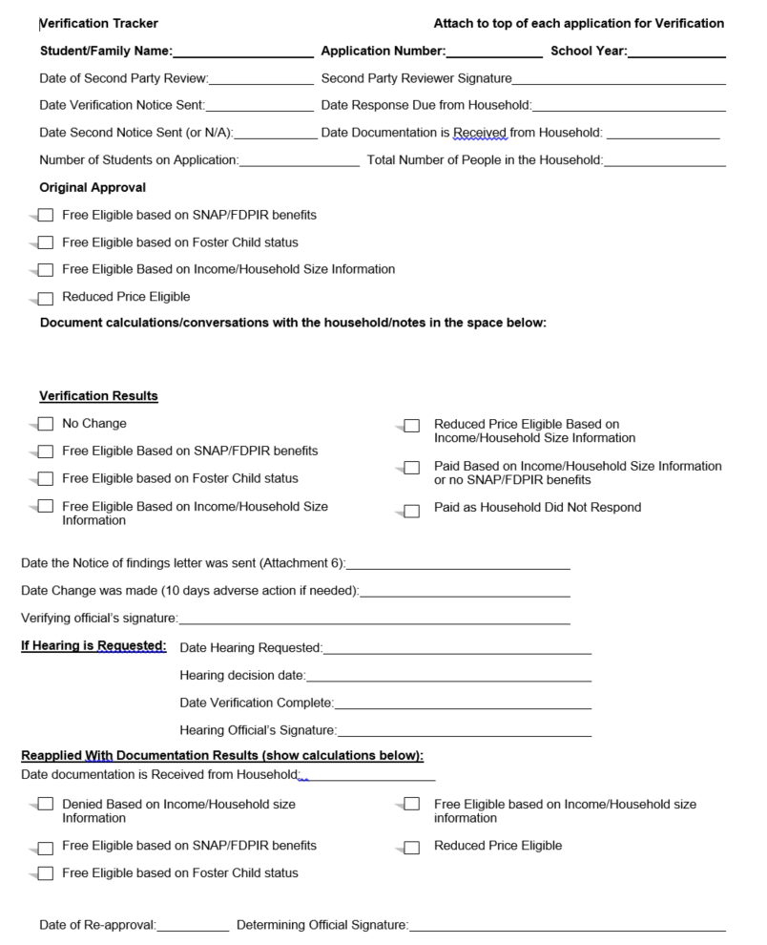
Thank you!
Document Confirmation Review
Record Date Verification Notice was Sent
Document Follow-Up Attempts
Record Submitted Documentation Calculations
Document Verification Results and Date Results Letter was Sent
Notes:
Here is the verification tracker. This resource will be a huge help during verification season to stay organized. It’s posted on the verification webpage. Use this as a cover page for each application that you have selected for verification and you can track your process, income calculations, communication with households and any pertinent notes needing to be documented.
Conducting verification this way will also help for review season. If you document everything on your tracker for each application, you can keep each year in a binder and you will have all required documentation needed for an administrative review!

Slide 27
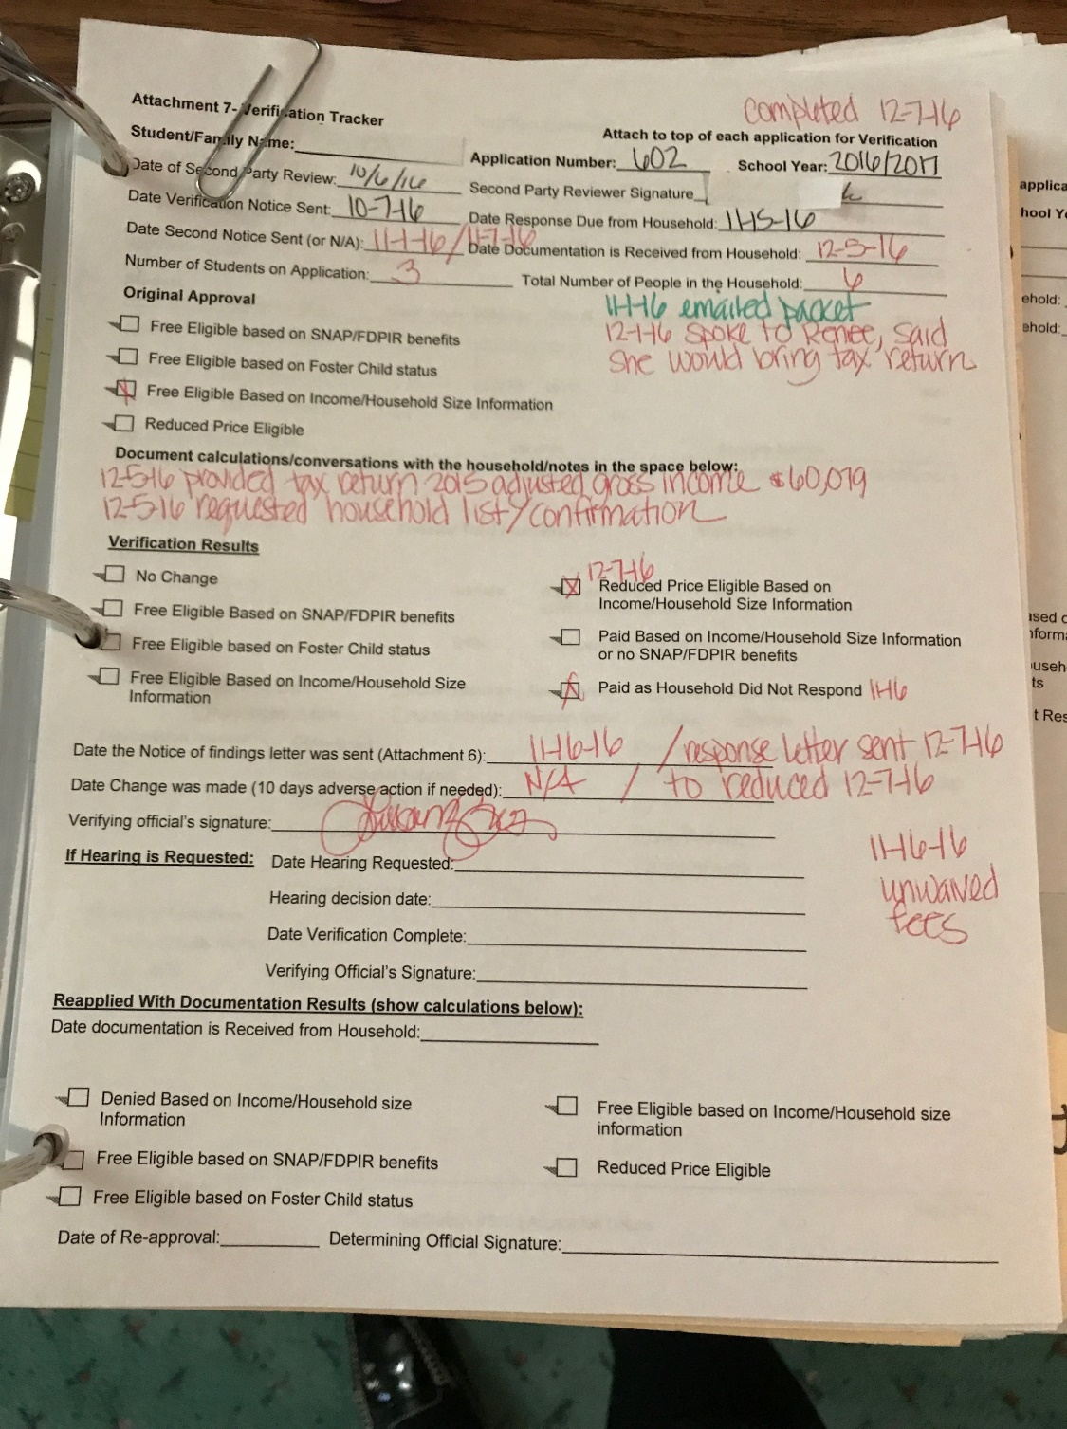
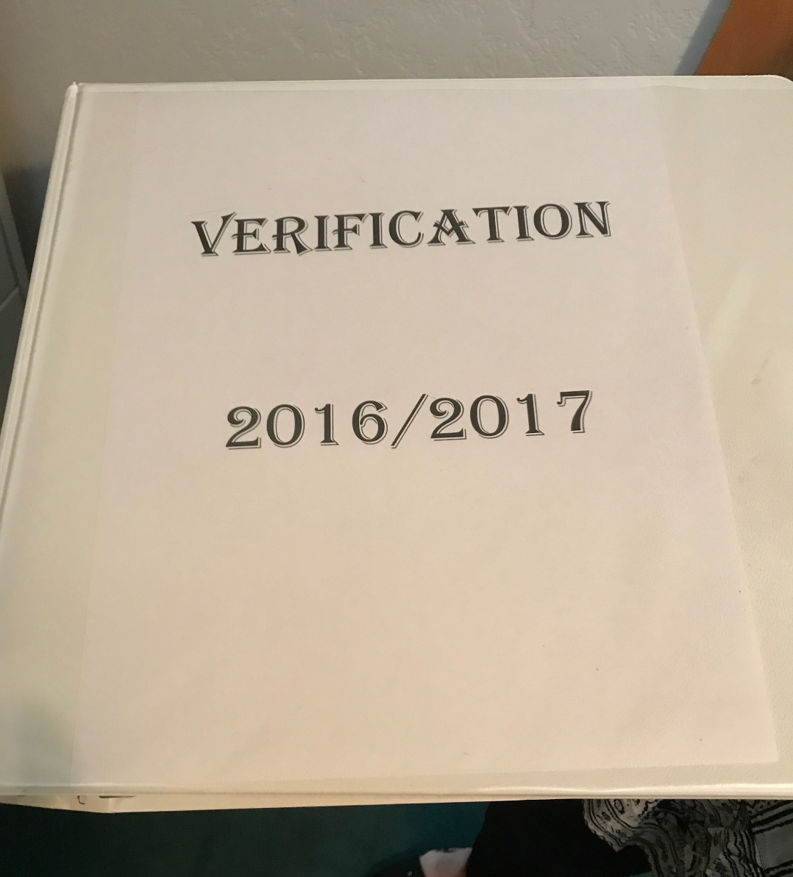
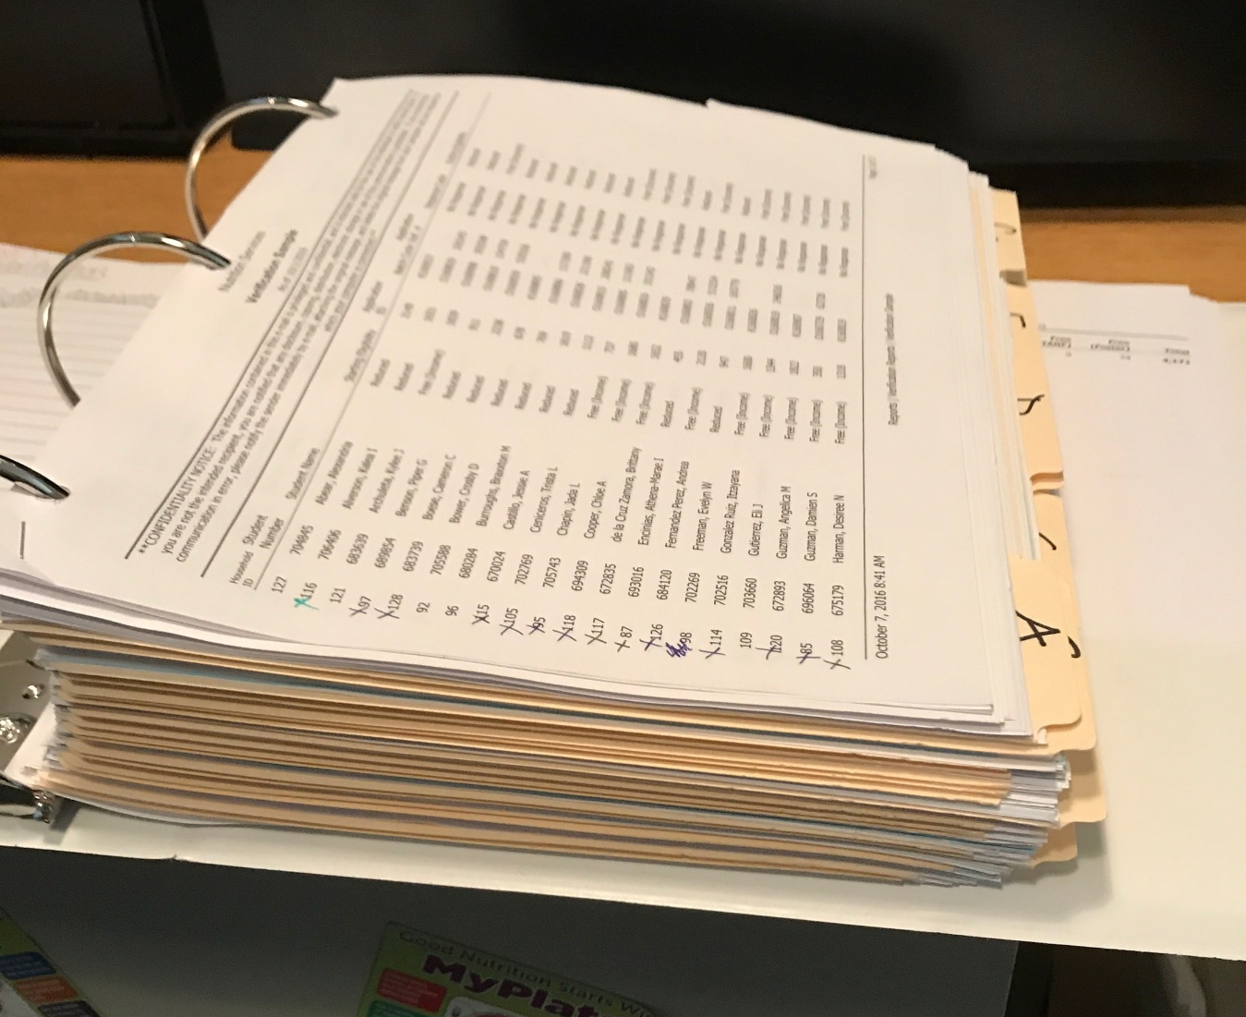
Fueling Kids
School Nutrition Unit
Notes:
Example of organizing verification documentation in a binder and using the tracker.

Slide 28
Household Notifications
Use School Nutrition and/or USDA templates
Make notifications bright, easy to read and welcoming
Clarify what is required and acceptable documentation
Emphasize it is a required process and households are chosen at random
Send notifications early
Send initial notifications in English and Spanish if appropriate
Run a direct certification upload of selected households prior to sending notifications
Postal mail or email
Notes:
Once households have been selected, the SFA must send out the notification they have been selected for verification. This letter should be sent out in early October and must contain the following information:
That the household was selected for Verification
The types of acceptable information that may be provided to confirm current income
Paystubs, benefit award letters, support payment decrees from courts
Information on the receipt of benefits under SNAP, FDPIR, or TANF
Proof that a child is homeless/migrant/runaway/foster/Head Start
That current income means any time between the month prior to application and the time the household is being verified
The household members form
That information must be provided by a certain date & that failure to do so will result in termination of benefits
Name of LEA contact & no-cost telephone number
Modified Use of Information Statement & Non-discrimination Statement

Slide 29
Notification of Selection of Verification Letter Template
Notes:
To summarize, we have counted applications, determined sample pool, selected appropriate applications (error prone/non error prone), reviewed applications needing to be replaced and conducted confirmation reviews. Now, we can send notifications to families that have been selected for verification!

Slide 30
Follow-up Attempts
Before November 15th, at least one additional attempt to obtain necessary verification information is required
Follow-up if household does not respond or submits insufficient documentation
May be via phone, mail, text, or email
Recommend follow-up is done by phone
Must be documented on the verification tracker
Notes:
Once households have been notified that they must submit documentation for verification, the SFA will need to track of households that are not responding. The SFA must make a follow-up attempt before the verification deadline of November 15th. It is recommended initially giving households one month to submit documentation – and providing the follow-up notice two weeks before that deadline. This still gives the households adequate time to respond before their documents are due.
A follow-up must also be given if the household has responded but has not given sufficient written evidence. For example, maybe a household sent in proof of one income but not another, or perhaps the frequency was missing on the paystub. If this is the case, the LEA must follow up.
Follow-ups must especially be sent to Limited English Proficient households, to ensure they have the resources needed to complete the request.
Follow-ups may be conducted via phone, mail, or email, but they must always be documented – on the Verification Tracker. Phone calls are highly recommended as this can provide better customer service to households and give you an idea of what the household is confused about and/or if they are going to respond.

Slide 31
Submitted Documentation
Ensure all required documents are submitted
Household members form
Proof of income or enrollment in qualifying assistance programs
Ensure information is current
Month prior to submission of application and up until time of verification
Documentation must include:
Name of household member
Gross income received and/or assistance program documentation
Acceptable date range
Notes:
Households will start submitting documentation in October. When the SFA receives this information, they must ensure that all required documents have, in fact, been submitted. This includes the household members form and proof either of income or of enrollment in Assistance Programs (like SNAP or TANF) or in OSCE programs (like homeless, migrant or foster).
Once it has been determined that all of the paperwork has been submitted, the next question is, “Is the information current?” For purposes of verification, current refers to the month prior to the time of application, the month in which the application was submitted, or any month after that, up until the time the application is being verified.
Next, the SFA will need to ensure that the documentation includes the name of the person for whom it was submitted. For example, does the paystub have the name of the employee who lives in the household, or does the SNAP letter have the name of someone in the household who is receiving the benefits?

Slide 32
Household Members Form

Slide 33
Household Members Form
Helps provide a clear picture of current household composition
Acceptable if household composition is different than initial application
Will need to clarify with household and document all communication
If a member has lost employment, a written letter from household or employer documentation of loss of employment should be provided or verbally confirmed by household
Must be submitted for each household with income documentation
Notes:
The last piece of information to note, which must be submitted as part of the household’s documentation, is the Household Members Form, which was briefly mentioned previously. This form gives the SFA a clear picture of who lives in the household – and whether they have income.
This form can be particularly helpful if, for example, both Mom and Dad had income listed when the application was submitted, but now Mom has lost her job, and only Dad sends in proof of income. By Mom marking the no income box on the Household Members form, the SFA will know that it was not just an oversight; Mom really did not have any income documentation to submit.
Also, it could be helpful if the household has chosen to report on their current circumstances, which have changed since the time of the app. If Aunt Sally and Uncle George have since moved in, the household can simply note them on the Household Members form, and the SFA will not need to wonder why the household suddenly has two extra people living there.

Slide 34
Employment
Pay stubs, letter from employer or statement of earnings signed by employer
Must include name, date, frequency, gross amount and pay date
Self-employed or farming income is calculated as net income
Determine eligibility status as if processing an application
Compare household income and size to the IEGs
Document calculations on verification tracker and any changes in status
Notes:
Let’s now look through the different types of documentation that must be submitted, depending on the household’s circumstances – and at how the Sponsor will need to process it.
If a household receives income from employment, they must send in a pay stub or signed letter from the employer. Again, the documentation must include the person’s name and the date, frequency, and amount. The frequency must be indicated by the employer on the paystub or in the letter; the household cannot self-indicate this.
If income documentation is submitted, it must also have the frequency and the amount, for one month’s worth of income. (If a weekly pay stub, for example, is representative of what the household normally receives each week, though, one pay stub is sufficient). Self employed and farming income is reported as net income (income – business expenses).
The Sponsor will need to calculate the total income the same as if they were processing an application. If there is just one income, or if all income is received at the same frequency, the income must be determined at that specific frequency. If income is received at different frequencies, it must be annualized.
Once the Sponsor knows the total amount of the income, the SFA will compare it to the IEG chart, determine the eligibility status, and document all calculations on the Verification Tracker.

Slide 35
Income to Report
Salary/Wages
Tips/Commissions
Self-Employment Income
Basic Pay/Drill Pay
Military Cash Bonuses
Off-Base Housing Allowances
Allowances for Food/Clothing
Alimony and Child Support
Earnings from Work
Supplemental Security Income
Cash Assistance from State/Local Government
Housing Subsidies
Public Assistance
Retirement Income
Social Security Retirement or Survivor’s Benefits
Railroad Retirement or Black Lung Benefits
Pension Income/Retirement Income
Earnings from U.S. Military
Un-employment and Disability
Unemployment Benefits
Worker’s Compensation
Strike Benefits
Social Security Disability Insurance
Veteran’s Benefits
All Other Income
Child Income
Regularly Received Monies
Rental Income
Interest/Investment Income/Annuities
Any regularly received monies that can be used to pay for school meals
Full/Part Time Job
SSI/Disability Income
SSI of disabled, retired or deceased parent
Regularly Received Monies
Pension, Annuity or Trust

Slide 36
Income Documentation
Calculate average total for multiple paystubs
Average will be associated to the frequency received
Can accept one paystub if confirmed the average gross amount is regularly received
Tax return documentation can be used
Calculate gross income received for the year (net income for self-employed)
*All regularly received income MUST be reported, whether it is federally recognized or not.*
Notes:
Income documentation must be current, show who it belongs to and show gross income. This will come in a variety of forms and it’s important to remember the intent of the verification request is to prove the household’s income is within the free and reduced guidelines. Here are some basic requirements as well as good reminders when evaluating income documentation.

Slide 37
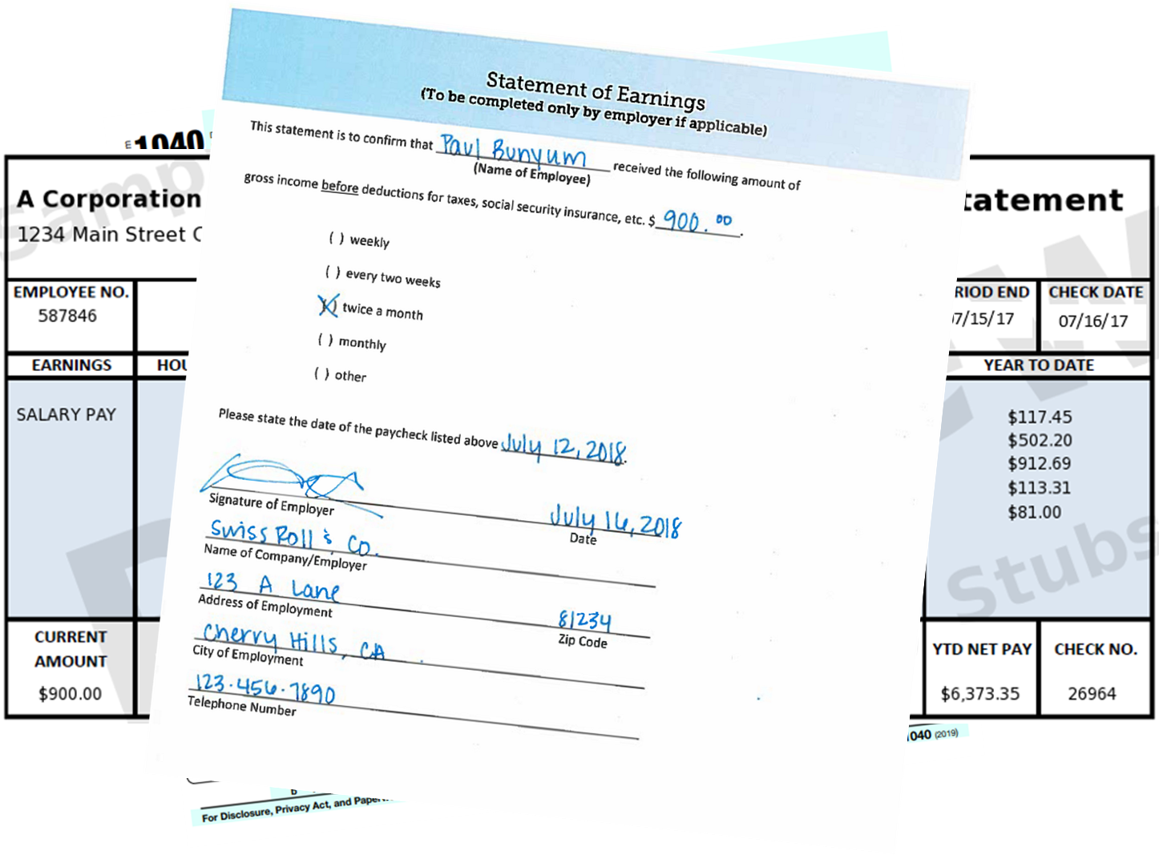
Notes:
Here are examples of types of income documentation you may receive. What you will want to remember is ensuring the documentation contains all the requirements:
Name of household member
Date
Gross income and/or net income for self-employment
Frequency or date range
Current date ranges
In this first example of a pay stub you can see the date range is current and indicates a pay range of the 1st through the 15th. More than likely this household member is paid on a bi-monthly schedule versus a bi-weekly schedule. If you only receive one paystub please contact the household to confirm their pay schedule and if the amount sent is the amount that is normally received. If you received more than one paystub you will be able to confirm the pay frequency and should take an average of gross pay if they differ.
These other examples are also acceptable forms of income documentation. The statement of earnings form can be signed by an employer as documentation. If you feel the household may be forging this document ask for a business card or company letter head to be submitted with this form.
With all income documentation you will be making a new determination based on the income documentation submitted and what is reported on the household members form.

Slide 38
Assistance Program Records
Benefit programs:
Letter from appropriate agency
Assistance Programs (SNAP/TANF/FDPIR)
Certification notice showing current dates
Foster
Documentation verifying the child is under the legal custody of the agency, state or court
Other OSCE (Homeless/migrant/runaway/Head Start)
District liaisons can provide documentation
Notes:
During Verification, many SFAs come across households receiving benefits. This includes benefits from Social Security, pensions, retirement, unemployment, disability, worker’s comp, and welfare payments. Appropriate documentation that the households may submit includes notices of eligibility, benefit letters, statements of benefits received, or check stubs.
The SFA will need to ensure that a household member’s name is listed on this documentation, and that it is current. If the household does not have current documentation, they will need to contact the appropriate agency to obtain a letter for the amount (and frequency) they are receiving.
Another main type of documentation that may be submitted is proof of enrollment in Assistance Programs or in OSCE. If a SFA chooses one the of the alternate sample sizes, this increases the chances that one of these types of applications will be verified.
If an application being verified was determined eligible based on SNAP, TANF or FDPIR benefits, the household must submit either a certification notice or a letter showing that benefits are being received by someone in the household. It must also show that the benefits are current.
If an application being verified was determined based on foster status, the household will need to submit either written documentation or the name and contact information of a person at the agency or court. The documentation or this person must be able to verify that the child is in the custody of the county – during the current timeframe.
Finally, if a household is being verified and has a student who may qualify based on OSCE, such as homeless, migrant, runaway, or Head Start, households should be encouraged to contact the district. Then the appropriate liaison can provide food services with the information (e.g., a homeless list) needed to show that the child has been identified under these programs. This documentation will serve as proof of the student’s status and is sufficient for satisfying the requirements of verification.
It is important to note that just because a household applies based on an Assistance Program or OSCE, that does not mean that they cannot provide documentation for verification showing that they also qualify for free based on income. Income documentation should still be provided with a new income application.

Slide 39
Special Situations and Other Forms of Income
Seasonal workers: use annual income
Zero income: provide signed statement explaining how food, clothing, and housing is provided and when family expects to receive income
Child support: court decree, child support registry, copies of checks received
Military Housing Privatization Initiative: letter or rental contract showing housing is part of the Military Housing Privatization Initiative
Collateral Contacts
Notes:
As with determining income during the F&R application process, the verification process also includes a number of special circumstances. These include income for seasonal workers, those who have no income, child support, and military housing.
A seasonal worker’s current income may distort his actual income circumstances. Accordingly, the Eligibility Manual allows for annual income to be used for seasonal workers, including prior year, if it is still current. Therefore, 1040 tax forms would be an allowable form of documentation.
Sometimes, households may not currently be receiving any income at all. If this is the case, they must submit a signed, written notice stating how basic needs, such as food, clothing, and shelter, are being met. There should also be an indication of when the individual expects to start receiving income again. Such a letter is considered sufficient evidence for verification.
Child support can be very tricky, in that the amounts stipulated to be paid are not always received – or are not always received consistently. The best documentation for child support includes a court degree, child support registry, or copies of checks received.
Households in the military do not have to include their housing allowances as income, if they are part of the Military Privatization Initiative. A letter or rental contract can be submitted to show participation in this program.
One final method of documenting eligibility for free or reduced benefits is for the household to designate a collateral contact. A collateral contact is a person outside of the household who is knowledgeable about the household’s circumstances, including household size and income information. Examples include employers, social services, migrant workers’ agencies, and religious or civic organizations.
A collateral contact may be used only when there is no adequate written evidence that may be submitted by the household. This person may not be contacted by the LEA unless the household has provided prior consent. The information received from the collateral contact may be written or oral, but if oral, the conversation must also be documented, including the date and the initials of the verifying official.

Slide 40
Chat
How do you ensure all required documentation has been sent by each family? For example: Highlighting name, date range and gross income on paystubs.

Slide 41
Recap – Processes after Sample is Selected
1. Sample Size Selected
Replace applications if applicable
2. Complete Follow-Up Attempts
Contact households that have not responded before the Nov. 15th deadline
3. Review Responses
Process provided documentation
Conduct confirmation reviews (unless approved for waiver)
Send notification of selection for verification
Provide timeline for responses
Send results letter
Notes:
Please reference your error prone chart.
Before we look at the different sample sizes in more detail, we must first have an understanding of what error prone and non-error prone applications are. Error prone applications are simply those applications that fall, depending on frequency, within
$1200 of the yearly Income Eligibility Guidelines (IEGs)
$100 of the monthly IEGs,
$50 of the twice per month IEGs
$44 of the every two weeks IEGs OR
$24 of the weekly IEGs.
A non-error prone application is any other application, including income or categorical applications.
Most electronic free and reduced software systems do flag applications, if they are error prone. However, as with anything with an electronic system, the LEA should always spot check the system for accuracy.

Slide 42
Responses and Results

Slide 43
Complete Verification Responses
Submitted documentation supports, increases or does not support eligibility, and results letter is sent
1
Household becomes directly certified and notification is sent
2
Household indicates verbally, or in writing, that they no longer wish to receive benefits, and letter of adverse action is sent
3
Household does not respond by November 15, and letter of adverse action is sent
4
Households can reapply at any time during year but must provide income documentation
Notes:
Questions often come up on when verification is considered complete.
Verification is considered complete when the SFA sends the results letter. This may be once:
The household submits documentation that supports, increases or does not support the benefit level, and the SFA sends the results letter
The household becomes directly certified
The household indicates verbally or in writing that they no longer wish to receive benefits, and the SFA sends the results letter/adverse action
The household does not respond by the November 15 deadline, and the SFA sends the results letter/adverse action

Slide 44
Update Benefits and Send Results
Increase in benefit implemented within 3 operating days
Decrease in benefits must be implemented after 10 calendar days
Letters of adverse action must be sent to households that did not properly respond, had a reduction in benefits or did not respond at all by November 15
10 calendar days’ benefits are decreasing
Reason for the change
Instructions on how to appeal
Household can reapply at any time during the school year
Notes:
Once the SFA has verified all the documentation that has been submitted – and has made a determination on all of the applications, the SFA will need to send results to the households.
The Results Letter should include the following information:
The results of Verification (i.e., no change in status, or a change to a different status)
The effective date of the change (if any)
The cost of meals (if change in status).
Once determinations have been made and letters have been sent, the SFA will need to update the benefits of any student whose application changed status. If the student is moving from reduced to free, this change must be implemented within 3 operating days, but preferably as soon as possible.
If the student is moving from free to reduced or paid - or from reduced to paid, this change must be made within 10 calendar days from the date the letter of adverse action is sent. During the 10 days, the household does have the right to appeal. If this is the case, the SFA’s hearing procedure must be followed, and the household’s benefits must stay the same during the time of the appeal.
If a household has been changed to reduced or denied, they may re-apply at any time. Households that had changed to reduced must submit documentation and update their application, in order to re-apply. Households that had changed to denied must submit documentation but also must submit a new application. Documentation must always be submitted by these households because they are considered to be in Verification for the whole year.
Record the date the letter was sent on your verification tracker.

Slide 45
Verification Collection Report (VCR)
Completed in the CO Child Nutrition Hub
Contains data from the application count, student count, and verification results
Due February 1, 2023
Any corrections must be completed by this date
Detailed instructions will be provided along with a live webinar
Notes:
The VCR must be completed in some aspect by all SFAs in some aspect whether they conducted verification or not. The VCR captures verification activities and directly certified students. The report is due annually by February 1.
The VCR must be submitted and completed (meaning all errors have been corrected) no later than February 1.
Please note the following critical information about the VCR:
Detailed instructions will be provided with the VCR. Following these will answer most questions and will help ensure that the form is filled out correctly.
Errors on the VCR do lead to a finding on the Administrative Review

Slide 46
Verification Process
Count all approved free and reduced applications as of October 1st
Calculate Sample Size
Conduct confirmation reviews
Replace applications (if necessary)
Notify households
Follow-up attempts
Review submitted documentation
Send results to households and update student statuses
Complete the Verification Collection Report (VCR, FNS-742)
Notes:
Now that we have reviewed the verification process, let’s summarize one more time to have this all come full circle.
We counted our applications and properly calculated our sample size. Prior to notifying families we reviewed applications needing to be replaced, we conducted our confirmation reviews and we translated materials appropriately to help service our community. We sent notifications to our selected households. All of these steps were recorded on our verification tracker.
When households begin to respond via mail, in-person, email, etc. we are evaluating if what they submitted is acceptable. We ensure the household members form is completed and submitted with proper income or assistance program documentation. Once a new eligibility is determined we are notifying the households of their results of verification. All our efforts are recorded on the tracker and all activities for verification are completed by November 15th.
We have until March-ish to submit our verification results, student count and other required information within the Verification Collection Report. Then we are done with verification until the next year!!

Slide 47
Best Practices

Slide 48
Verification Tracker
Income Calculation for Multiple Frequencies

Slide 49
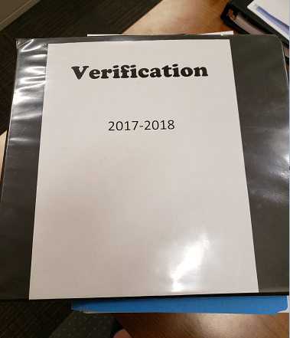
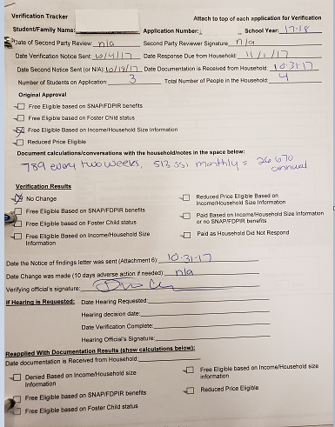

Slide 50
Increase Response Rate
Send 2nd and 3rd follow up notices
Follow up by telephone
Use family engagement staff to help Spanish speaking families
Explain process to families (i.e. selected at random, annual process, specific examples of acceptable documentation)
Accept appointments for families to complete the process in person
Keeps meticulous notes and documentation with the Verification Tracker
Notes:
It’s important to see yourself as the liaison to help households complete this process. If they are scared to respond due to immigration/migrant/refugee status and “reporting” of their information, it’s up to you to communicate this. Their private information is not reported and most importantly applying for school meals/responding to verification is not considered a public charge and will not affect their visa or green card status.

Slide 51
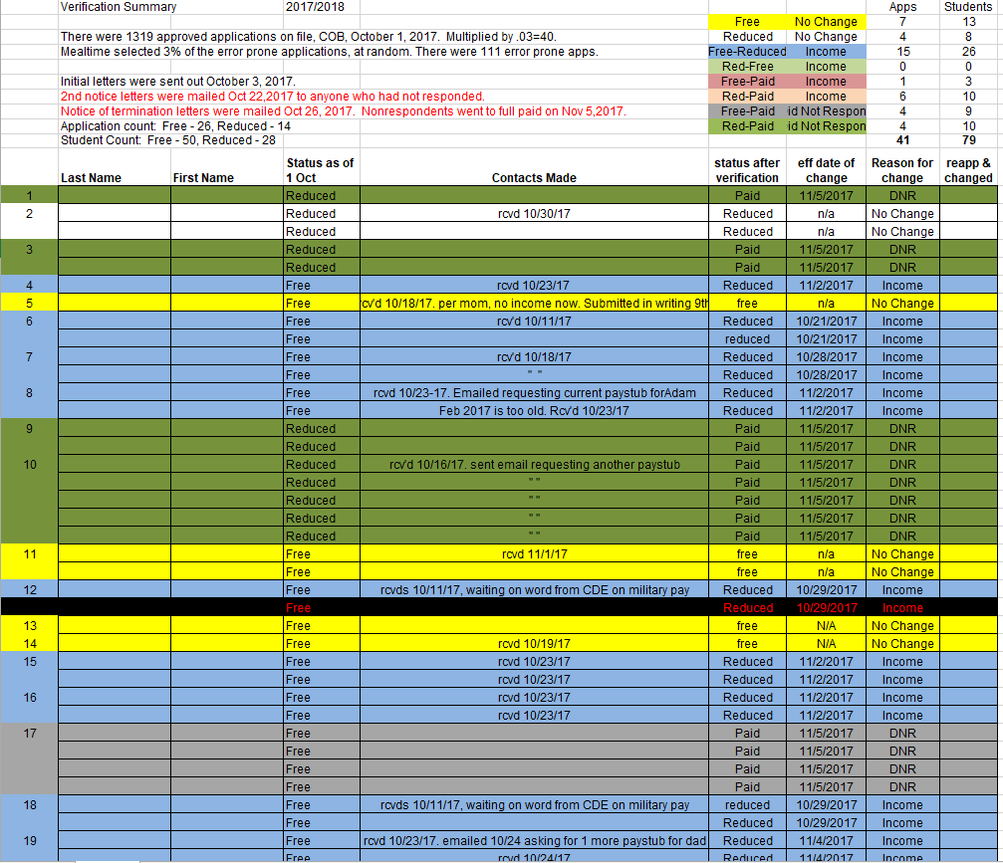
Verification Organization
Income Calculation for Multiple Frequencies

Slide 52
Verification Organization
Mark error prone applications with sticky notes
Use the same sticky note to document income and change in status
Contact verification household to explain notice being sent and the process
Use School Nutrition templates
Incorporate humor when appropriate (i.e. Congratulations! You have been selected…)
Use sticky notes for follow up reminders and track due dates
Keep verification tracker and associated documentation in a folder/binder

Slide 53
Register for Online Training
School Nutrition moved all of its online trainings to a new platform.
To access online trainings and receive professional standards credit, register for a FREE Moodle account
https://app.smartsheet.com/b/form/c22b69634b4e4a8596306d45ac107c2f
Notes:
School Nutrition has moved all of its online trainings to a new platform. To access the online trainings and receive professional standards credit, you need to register for a FREE Moodle account. Registration only takes a few seconds to complete. Once you have submitted your registration, our office will create your account. You will receive an email to confirm your Moodle account and then you will be able to access the trainings. If you have any questions, please contact Alicia Grove at grove_a@cde.state.co.us or 720-795-2038.

Slide 54
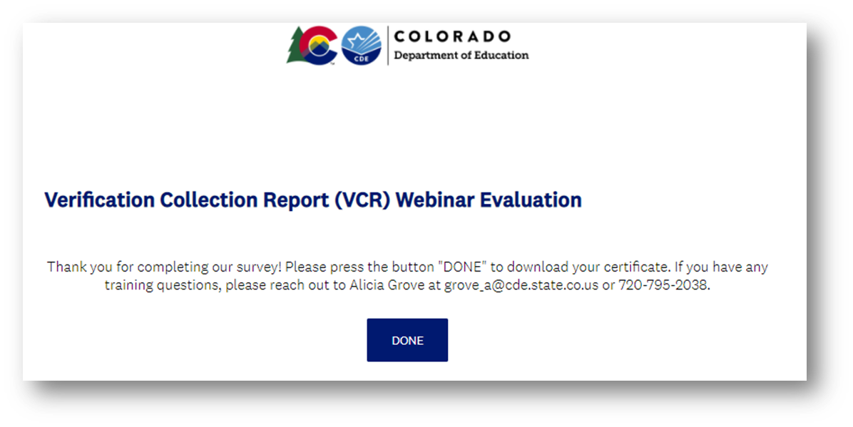
Training Evaluation & Certificate
Click this link to complete a quick training evaluation
https://www.surveymonkey.com/r/T65DLKY
When you submit the evaluation click “DONE” on the survey thank you page to download your certificate
Notes:
This link will be emailed out to all training attendees. This information is included for those watching this training at a later date as a recording.
Thank you so much for your feedback - we are always looking for ways to improve our trainings to better support you.

Slide 55
Thank you!
Rachael Burnham
Burnham_R@cde.state.co.us
Nell Dochez
Dochez_N@cde.state.co.us
https://www.cde.state.co.us/nutrition

