Slide 1
Pandemic-EBT (P-EBT) Updates
Town Hall
July 15, 2021
Join us at 2:00 p.m. to hear the latest updates about P-EBT!

Slide 2
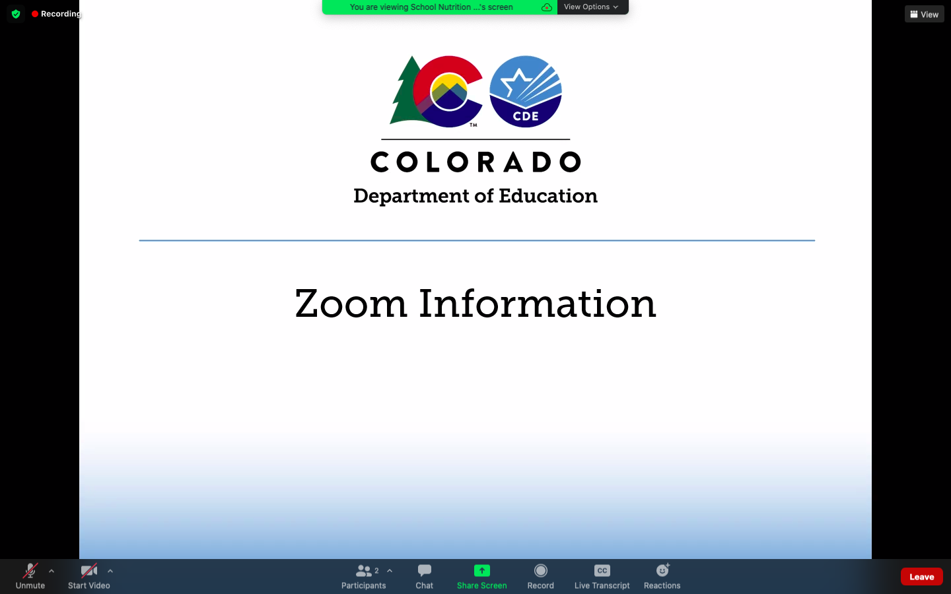
Mute/
unmute
Video
Chat
Closed Captions
Notes:
First, I will cover some quick Zoom housekeeping items before we jump into the content
All attendees will enter muted. You will know that you are muted if the microphone button in the lower left corner has a slash across it. Next to the microphone is a camera icon. Click the camera icon to turn it on which will remove the slash across the icon. It is completely optional to turn on your camera today. During the question and answer section of this townhall you can unmute your microphone to ask questions or feel free to type them in the chat.
If you keep moving across the bottom portion of your screen you will see a chat icon in the middle. If you have any questions today, please insert them into the chat-we will monitor the chat and compile a list of questions to address at the end of the webinar if we have time.
We will insert the PowerPoint slides for today with speaker notes into the chat for you to download.
To the right of the chat icon, is an icon for closed captioning if you needed it. Go ahead and click this button for subtitles.

Slide 3
Contact Information
If you experience audio or technical difficulties, please contact Alicia Grove at:
  720-795-2038 OR
  Grove_a@cde.state.co.us

Slide 4
CDE School Nutrition Unit Vision
Nourish young bodies and minds. End childhood hunger.
CDE School Nutrition Unit Mission
We support the child nutrition community through innovation, training, and partnerships to ensure all youth have access to healthy meals.
Notes:
We have recently updated our vision and mission

Slide 5
Non-Discrimination Statement
In accordance with Federal civil rights law and U.S. Department of Agriculture (USDA) civil rights regulations and policies, the USDA, its Agencies, offices, and employees, and institutions participating in or administering USDA programs are prohibited from discriminating based on race, color, national origin, sex, disability, age, or reprisal or retaliation for prior civil rights activity in any program or activity conducted or funded by USDA. Persons with disabilities who require alternative means of communication for program information (e.g. Braille, large print, audiotape, American Sign Language, etc.), should contact the Agency (State or local) where they applied for benefits. Individuals who are deaf, hard of hearing or have speech disabilities may contact USDA through the Federal Relay Service at (800) 877-8339. Additionally, program information may be made available in languages other than English.
  To file a program complaint of discrimination, complete the USDA Program Discrimination Complaint Form, (AD-3027) found online at: https://www.usda.gov/oascr/how-to-file-a-program-discrimination-complaint, and at any USDA office, or write a letter addressed to USDA and provide in the letter all of the information requested in the form.
  To request a copy of the complaint form, call (866) 632-9992. Submit your completed form or letter to USDA by: (1) mail: U.S. Department of Agriculture Office of the Assistant Secretary for Civil Rights; 1400 Independence Avenue, SW Washington, D.C. 20250-9410;
  (2) fax: (202) 690-7442; or (3) email: program.intake@usda.gov.
This institution is an equal opportunity provider.

Slide 6





Conditions for Success
Be respectful, inclusive, and open minded
Bring a positive attitude
Be present and engaged
Put your cell phone out of arms reach
Close out email or other tabs
Avoid multi-tasking or doing other work
Actively listen
Notes:
This townhall will provide an open space to ask questions, discuss and share. On the slide we’ve listed some conditions for a successful townhall. If you haven’t already please use the chat box to share your name and district/school you are with.

Slide 7



What We Will Cover
P-EBT Mini Grants
Summer P-EBT Updates
Dispute Resolution/Escalations
Notes:
Today I will go over the P-EBT Mini Grant process, my name is Erica Boyd, I am a senior nutrition consultant in the office who is overseeing the P-EBT Mini Grant process and then Rachael will go over P-EBT Summer Updates and new information regarding dispute resolution and escalation processes with the P-EBT Support Center.

Slide 8
P-EBT Mini Grants
Mini Grant vs. Simplified Funding
Both reimburse School Food Authorities (SFAs)/Districts for allowable administrative costs incurred for P-EBT
Mini Grant: application process, with reimbursement to match administrative costs incurred
Simplified Funding: automatic tiered based funding
Notes:
There are two options for SFA’s to receive reimbursement for the administration of Pandemic-EBT, sponsors can either elect to apply for the P-EBT Mini Grants or automatically receive reimbursement through the simplified funding process.
The purpose of the mini grants is to reimburse SFA’s for administrative costs associated with the fiscal year 2021 P-EBT program.
There are 2 application periods. The first application period, covered P-EBT related costs from October 2020 to March 2021. The second application period opened June 28th and covers expenses from April 2021 to September 2021. Reimbursements will be distributed once all supporting documentation have been submitted and approved by CDE.
Additionally for SFA’s that do not wish to apply for the P-EBT mini grant the USDA is providing additional tiered funding via the Simplified Tiered Funding process for those districts the provided P-EBT data during the submissions period. Districts that did not submit needed student data may submit data during the fall submission periods in order to be eligible for the grant funding or the tiered funding.
We will go over both the Mini Grant process and the Simplified Funding in more detail in the subsequent slides.

Slide 9
P-EBT Mini Grants
Mini-Grant application now open
July 2021 application:
  Opened June 28th
  Closes July 30th
  Covers expenses from April 2021-September 2021
Applications must be submitted through the online form: http://www.cde.state.co.us/p-ebt-minigrant-applications
  Please submit only one application per sponsor
  Submit a detailed budget outlining reimbursable costs
Notes:
P-EBT Mini grants are now open. The purpose of the mini grants is to reimburse SFA’s for administrative costs associated with the fiscal year 2021 P-EBT program. This is a non-competitive grant administered through the USDA.
Applications will close Friday July 30th this is the Second of two application periods and covers expenses from April 2021 to September 2021. Applications can be accessed through the online form shown here on the screen. Only one application per sponsor and each sponsor must submit a detailed budget outlining the reimbursable costs requested. The budget template can be found within the application.

Slide 10
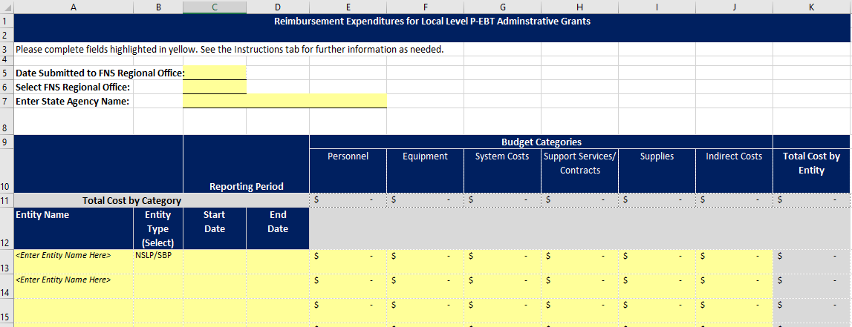
P-EBT Mini Grants
P-EBT Mini Grants Town Hall 5.11.21 Recording
P-EBT Mini Grant Application Instructions and FAQ (PDF)
Budget template overview
Notes:
Detailed instructions on the P-EBT Mini Grant application can be found within the P-EBT Mini Grant townhall from 5/11 or within the application instructions PDF, both linked within this slide and within the chat.
Here is a screenshot of the budget template. As you can see there is a section for personnel, equipment, systems cost, support services/contracts, supplies and indirect costs. It is important to ensure budget categories are clear and align with approvable costs outlined within the grant. This budget template is a required component and must be attached within the application, applications without a detailed budget or an incomplete budget will not be able to be approved.

Slide 11
P-EBT Mini Grants
Allowable Costs:
Reporting student-level P-EBT Data Pipeline Collection or school-level Monthly Learning Modality to CDE
Designated staff to respond to requests and questions about eligibility and student/school schedules
Collecting and processing school meal applications specifically to establish eligibility for P-EBT
Salaries of personnel, supplies and support services
Unallowable Costs:
Are not necessary or reasonable for the administration for the FY 2021 P-EBT Program
Expenses already reimbursed under another Federal award
Notes:
The funds will reimburse SFAs for allowable administrative costs incurred during the delivery of the P-EBT benefits.
Allowable costs include salaries of personnel, supplies and support services, such as reporting the student-level P-EBT data pipeline collection, school-level monthly learning modalities to CDE, staffing hours to respond to p-ebt benefit questions and time related to school meal application collection and process. Please note these funds may also be used to staff the office when school is not in session to process applications, be available for family questions.
Unallowable costs are any cost not necessary or associated with the administration of the P-EBT program or expenses already reimbursed under another federal award

Slide 12
P-EBT Mini Grants
Simplified Funding
Sponsors who do not apply through the application process are eligible for simplified tiered funding
Districts that provided P-EBT data are eligible to automatically receive tiered funding
Number of P-EBT Eligible Students in Local Entity | Funding Amount
Less than 1,000 students | $614
1,001- 5,000 students | $3,063
5,0001- 1,000,000 students | $5,814
http://www.cde.state.co.us/nutrition/tieredfundinglist
Notes:
The second option for districts to receive reimbursement is through the Simplified Funding process. Sponsors who do not apply through the application process are eligible for simplified tiered funding. Districts that provided P-EBT data are eligible to automatically receive tiered funding based on the number of P-EBT eligible students in the district. Supporting documentation is not needed. This option will have one allotment payout in September 2021. Children eligible for P-EBT are defined as those eligible for free or reduced-price school meals and/or enrolled in a special provision school. The table within the slide shows the funding amount for each category. To see which tier your district is eligible for visit the hyperlink listed below the table.
Districts are eligible for either the mini grant or the simplified funding and cannot receive both.
For any additional question on either the Mini-Grant or the Simplified Funding you can contact the free and reduced price email which will be listed on the last slide of this presentation.

Slide 13
Recap
Spring 2020 Issuance
Reached approximately 180,000 students
Nearly $50,000,000
School Year 2020-21
Projected to reach 306,000 children
Issued approx. $239,000,000
Application process
Data submission and direct issuance process
Summer P-EBT is coming!
Notes:
Just to recap, the Pandemic Electronic Benefits Program or P-EBT was created as part of the Families First Coronavirus Response Act. This was, and is, a brand new program that provides a cash like benefit to students that otherwise would have received a free or reduced-price meal school meal.
To implement P-EBT last spring of 2020 our unit, and other CDE departments, partnered with the Colorado Department of Human Services (CDHS). Due to the lack of access to student level data Colorado opted to create a P-EBT application last spring and families eligibility was assessed during the application process. This process was a great start to issuing P-EBT benefits but did have it’s challenges. We were able to reach 180,000 students and disseminate nearly $50 million in benefits.
The P-EBT program was extended for the 2020-21 school year and using lessons learned as well as garnering district staff feedback Colorado devised a plan to collect student level data through the CDE data pipeline in order to direct issue to eligible students. As you can see the new approach has reached a much greater amount of students almost 306,000! The issuance amount to date is near $239 million dollars that has gone out the door to support our CO families. This again could not have been done without all of you. This is a huge accomplishment!
But, the fun doesn’t stop here. USDA has extended P-EBT into the summer months and that’s what I will jump to now.

Slide 14
Summer P-EBT Benefits
Colorado is awaiting approval for Summer P-EBT plan
Who qualifies:
  Students identified as eligible for free or reduced-price school meals and who were enrolled at an NSLP school during May 2021, are eligible for summer P-EBT regardless of school year learning modality
  Approved free or reduced-price meal applications for SY2020-21 or SY2021-22 will qualify for Summer P-EBT
    Specific application “cutoff” dates for SY2021-22 and Summer P-EBT qualification is forthcoming
Online and paper applications must be available for households to complete
Notes:
We did submit a Summer P-EBT plan and are currently waiting for approval from USDA.
Students can qualify for Summer P-EBT if they were eligible for free or reduced-price meals and were enrolled in a school that participated in the National School Lunch Program (NSLP) as of May 2021 and this is regardless of their school or districts learning modality during the school year. This of course will include any schools/districts that normally operate NSLP but opted to operate the Summer Food Service Program (SFSP) last school year. Students free or reduced-price meal eligibility for Summer P-EBT can be determined from school year 2020-21 or as of today from school year 2021-22. There will be a specific application or eligibility date cutoff for Summer P-EBT qualification but we are waiting for plan approval before announcing.
Due to the availability of Summer P-EBT it will be imperative that paper or online applications are widely available for families to complete. Funding is available to support those efforts and staff time, which I will talk about shortly.

Slide 15
Proposed Submissions
PROPOSED Submission Timeframes
  August P-EBT data collection: capture 2020-21 updates or students not previously provided
  September P-EBT data collection: capture any updates after July 1
    Specific dates to be announced after plan approval
No expected changes to the file layout or upload process
  Proposed certification process upon submission to ensure data being submitted is accurate and reflective of the criteria established
Notes:
These are the proposed submission timeframes we have written into the Summer P-EBT plan. So, please preface this slide knowing that these may change based on USDA feedback. We will not release specific dates or more detailed information until we obtain USDA approval of our plan.
We plan an August submission timeframe to capture any newly eligible students, updates to student information or students that were missed in the April or May submission. This submission period will be for students who were enrolled in the 2020-21 school year only.
We then plan to have a second submission period during the month of September to capture newly eligible students only for the 2021-22 school year only. Again, more specific cutoff dates for P-EBT eligibility will be announced after plan approval.
At this time there are no expected changes to the file layout specifications of the upload process itself. We do, however, plan to add a certification process upon submission to ensure the data being submitted is accurate and reflective of the school year criteria I mentioned previously.

Slide 16
P-EBT Support Center
P-EBT Support Call Center is open!!
Households can call 1-800-536-5298, Monday – Friday 8 am – 7:30 pm, Saturday 8am – noon
Households can also email cdhs_pebtcolorado@state.co.us
Support Center will answer questions about P-EBT eligibility, benefits, and P-EBT card activation, issuance or replacements
Remind households to keep P-EBT card for future issuances!
Notes:
That P-EBT Support Center is open and the contact information is listed here. Please refer families to the call center if they have questions about
P-EBT eligibility, benefits,
card activation, issuance or replacements
This is kind of an aside of the call center but wanted to put in a reminder when you’re interacting with families about P-EBT to remind households to keep the P-EBT cards for future issuances! Thanks in advance for your help with communicating this.
Let’s move on to some updates about the Support Center and how we may need your help!

Slide 17
P-EBT Support Center cont.
Students not identified as free and reduced-price meal eligible will be referred to the district to apply
Households can update mailing addresses directly with the support center
Dispute resolution/escalation process for:
  Households indicating their learning modality differed from school/district
  Households needing to change the parent/guardian contact
  Instances where it appears a student was not included in the data submission
For school/district specific questions please contact p-ebt.datapipeline.support@cde.state.co.us
Notes:
Any students not identified as free and reduced-price meal eligible will be referred back to the district to complete a free and reduced-price meal application.
Households can update mailing addresses directly with the Support Center for accurate mailing of P-EBT cards. Previously the Support Center was also recommending families update their address with the school and that is no longer happening as it was increasing the number of families reaching out to schools. Families can update their address with the Support Center to receive their card.
There will be a dispute resolution/escalation process for households with situations where their learning modality may have differed from their school or district which will require additional information from districts. Instances where a parent/guardian needs to changed or the Support Center cannot locate a student will be escalated for further investigation by our team. I’ll get into those details next.
If you ever have school or district specific questions you can always contact us or if you have any questions about how to help a family we are always happy to help. Please reach out.

Slide 18
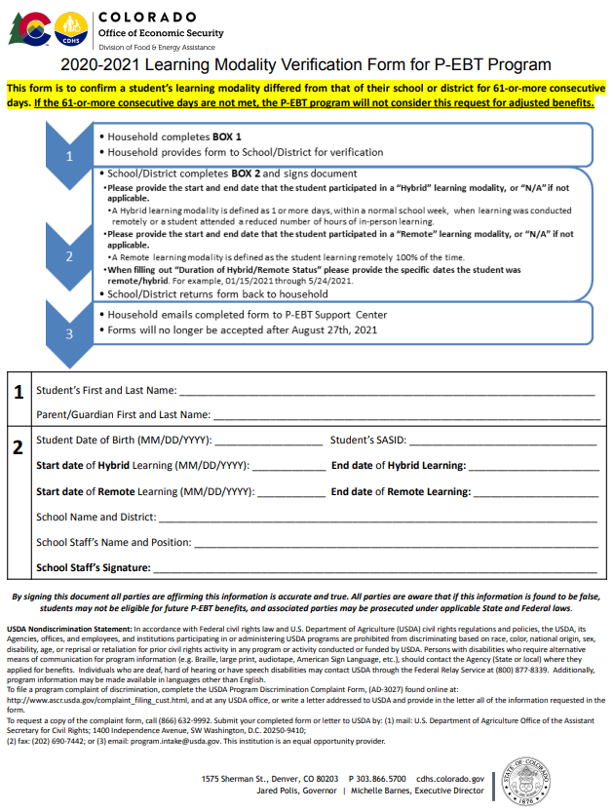
Dispute Resolutions/Escalations
Disputes regarding Learning Modality:
Support Center will create an escalation ticket for household
Household is provided a formal Learning Modality Verification form to be completed by school/district
Once signed and completed household returns to the Support Center
Notes:
Disputes regarding Learning Modality:
Support Center will create an escalation ticket for household
Household is provided a formal Learning Modality Verification form to be completed by school/district
Once signed and completed household returns to the Support Center
Because we could not collect individual student learning modality, this process will help ensure families are getting the correct benefit amounts if they were remote or hybrid for 61 or more consecutive days.
Here is an example of that formal form that is to be completed by school or district staff. This can be completed by any staff member. The form asks for student information and the time periods for learning modalities for that specific student that may have been different from the school or district. Once the form is completed and signed by a staff member the household is responsible for returning it to the Support Center.
One very important thing to note is that these forms will only be provided to households by the Support Center. At no time should these be copied for mass distribution at the school or district level.

Slide 19
Dispute Resolution/Escalations
Escalations for change of parent/guardian contact:
  Support Center will create and escalation ticket for household
  CDE staff will contact school/district to verify the parent/guardian change
Escalations for missing student data:
  Support Center will create an escalation ticket for household
  CDE staff will contact school/district to verify student was included in the data submission
  Missing student data can be provided during August submission
Notes:
Escalations for change of parent/guardian contact:
Support Center will create and escalation ticket for household
CDE staff will contact school/district to verify the parent/guardian change
Escalations for missing student data:
Support Center will create an escalation ticket for household
CDE staff will contact school/district to verify student was included in the data submission
Missing student data can be provided during August submission

Slide 20
Q&A

Slide 21
Resources and Training
P-EBT data collection resources:
  https://www.cde.state.co.us/datapipeline/p-ebtdatacollection
  Support or questions, email: P-EBT.datapipeline.support@cde.state.co.us
P-EBT mini grant:
  http://www.cde.state.co.us/p-ebt-minigrant-applications
  Support or questions, email: free&reducedpriceschoolmeals@cde.state.co.us
P-EBT information:
  https://cdhs.colorado.gov/p-ebt
  https://www.cde.state.co.us/nutrition/schoolmealeligibility

