Slide 1
P-EBT Data Collection

Slide 2
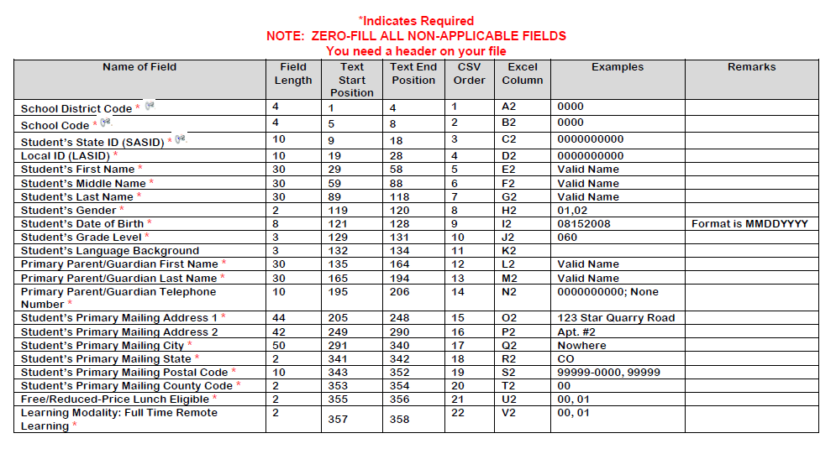
Student Enrollment Data
The Identity Management (IDM) role is PIPELINE-####-PBT~LEAAPPROVER where #### is the district code.
Contact: P-EBT.datapipeline.support@cde.state.co.us
Notes:
Full file specifications. The PDF resource will also have more detailed definitions for each data field.

Slide 3
Anticipated Timeline
First upload timeframe due by April 23rd
Second upload timeframe due by May 31st
Possible opportunity to provide any updated information or missed information sometime in August 2021
Contact: P-EBT.datapipeline.support@cde.state.co.us
Notes:
First upload timeframe due by April 23rd
Second upload timeframe due by May 31st
Possible opportunity to provide any updated information or missed information sometime in August 2021

Slide 4
School Level Month Over Month Learning Modality
Definitions:
Remote: The majority (more than 50%) of students in the District participated in 100% remote learning for the majority (more than 50%) of the month.
Hybrid: If the standard for Remote benefits (defined above) is not met, but the majority of students in the District followed a hybrid schedule (at least one virtual day per week) OR between 25% and 50% of students in the District participated in 100% remote learning for the majority of the month.
In-Person: If the Remote or Hybrid standards (defined above) are not met, the District will be considered In-Person for that month. This means no Hybrid schedule was in effect and less than 25% of students in the District participated in 100% remote learning for the majority of the month.
Contact: P-EBT.datapipeline.support@cde.state.co.us
Notes:
First upload timeframe due by April 23rd
Second upload timeframe due by May 31st
Possible opportunity to provide any updated information or missed information sometime in August 2021

Slide 5
School Level Month Over Month Learning Modality
Example 1: The majority of Elementary students in District A attended schools that operated a Hybrid schedule (e.g. 3 days virtual, 2 days in-person) from October 5 through November 10. For the rest of November, students participated in 100% Remote learning. District A should list October as “Hybrid” and November as “Remote.”
Example 2: In District B, the majority of Elementary students in the District attended school in-person for the entire month of February. Several individual classrooms switched to virtual learning for 2 weeks during the month due to COVID-19 exposures, but the District estimates that less than 15% of students in the District were impacted by this switch. District B should list February as “In-Person.”
Example 3: For the month of December, the majority of Middle/High Schools in District C operated a Remote Schedule. In the same month, all District C Elementary Schools remained open for In-Person learning, but approximately 40% of Elementary students opted for Virtual Learning during that month. District C should list Middle/High Schools as “Remote” and Elementary Schools as “Hybrid” for the month of December.
Contact: P-EBT.datapipeline.support@cde.state.co.us
Notes:
First upload timeframe due by April 23rd
Second upload timeframe due by May 31st
Possible opportunity to provide any updated information or missed information sometime in August 2021

Slide 6
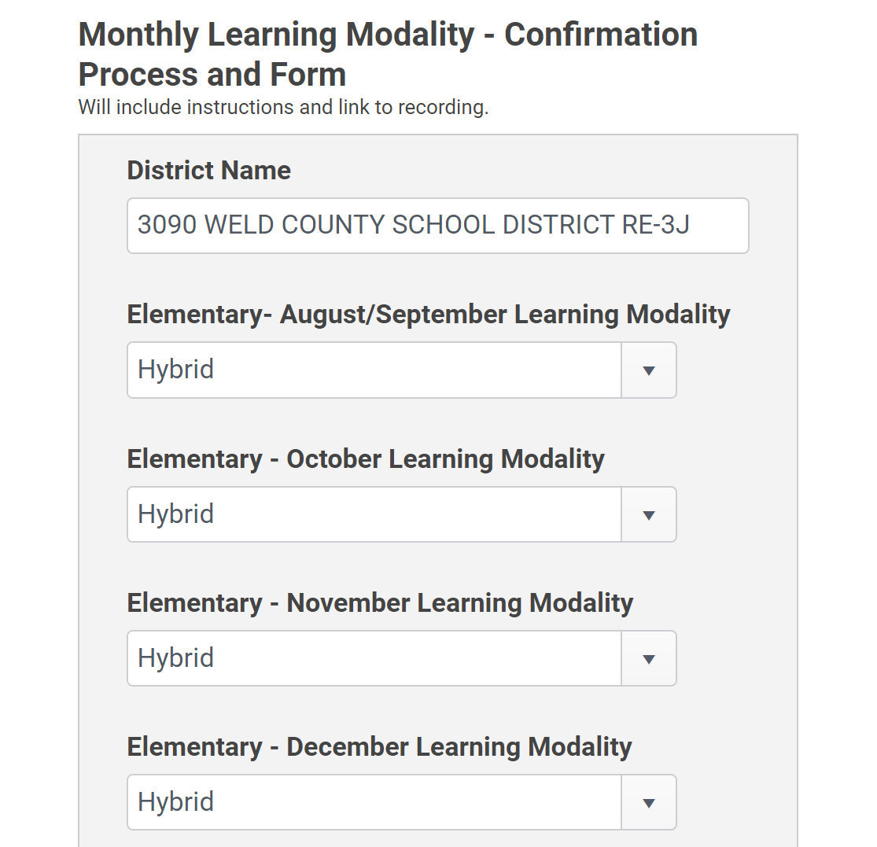
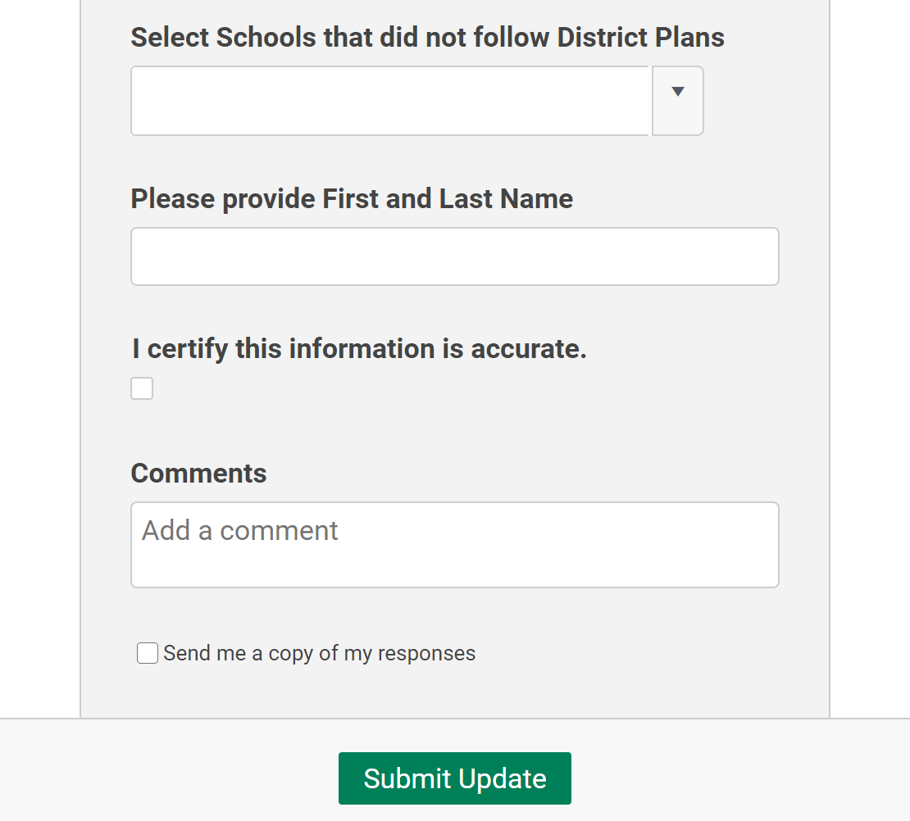
School Level Month Over Month Learning Modality
Contact: P-EBT.datapipeline.support@cde.state.co.us
Notes:
First upload timeframe due by April 23rd
Second upload timeframe due by May 31st
Possible opportunity to provide any updated information or missed information sometime in August 2021

Slide 7
FAQ’s
Can we submit only students who are eligible for free or reduced-price lunch?
What if we were in-person all year and did not offer a remote learning option for students?
What if the school is a school who does not participate in the National School Lunch Program (NSLP)?
What if the school is a full time on-line remote school?
What if the student was in-person all year?
What if the student left the district and came back?
What if the school has been providing meals to remote/hybrid learners for the entire year (i.e., grab and go meals)?
Contact: P-EBT.datapipeline.support@cde.state.co.us
Notes:
First upload timeframe due by April 23rd
Second upload timeframe due by May 31st
Possible opportunity to provide any updated information or missed information sometime in August 2021

Slide 8
FAQ’s
We are asking that the data submission includes ALL students at your district for a variety of reasons:
We are tracking the data across several different sources (i.e., October Count, Direct Certification, Child Care data, and this District data collection) over the course of the year to ensure we are determining the maximum benefit amount allowable to students
A current school of enrollment may have the most up to date address information but enrollment at a previous school may deem the student eligible for benefits for part of the school year
More students may be eligible for benefits for the summer and we need the data to help make that determination
Contact: P-EBT.datapipeline.support@cde.state.co.us
Notes:
First upload timeframe due by April 23rd
Second upload timeframe due by May 31st
Possible opportunity to provide any updated information or missed information sometime in August 2021

Slide 9
FAQ’s
The CBMS call center will encourage parents/families who may be eligible to apply for FRPL and we need to have the data for those students if their data changes
We want to provide the CBMS call center with as much data as possible to respond to parent questions and concerns so if a student is not eligible, we want the call center to be able to look up the student’s information to explain WHY the student is not eligible, i.e., the school offered In-Person learning for the school year
Even if a student is at a school where meals were provided during any remote learning (i.e., grab and go meals), the student is not automatically disqualified from receiving P-EBT benefits
Contact: P-EBT.datapipeline.support@cde.state.co.us
Notes:
First upload timeframe due by April 23rd
Second upload timeframe due by May 31st
Possible opportunity to provide any updated information or missed information sometime in August 2021

Slide 10
FAQ’s
Do districts have to report changes to free and reduced-price lunch eligibility over time?
What if our district had different learning modalities over the course of the year? How do we report that in this data collection?
How do we report students who enrolled in remote learning after October 1st?
How do we report students who moved between remote, hybrid and in-person learning throughout the course of the year?
What if the student was only remote learning for the first semester of school and returned to in-person learning for the second semester?
What if we didn't track the learning modality of students or time when a student may have been quarantined?
What if the school of enrollment is a school that operates CEP or Provision 2?
Contact: P-EBT.datapipeline.support@cde.state.co.us
Notes:
First upload timeframe due by April 23rd
Second upload timeframe due by May 31st
Possible opportunity to provide any updated information or missed information sometime in August 2021

Slide 11
FAQ’s
The learning modality question in the P-EBT Data Collection through the Data Pipeline is specifically asking about student level learning modality. We are asking districts to provide information to the best of their knowledge, the best feasibly available data.
If the student was or planned to be engaged in a remote learning option for the months of October 2020 through March 2021 the response should be YES. The student will receive benefits for the month of August/September as well if the student meets the rest of the criteria.
If the student opted to engage in remote learning after October 1st, the student is not considered a full year remote student and the response should be NO.
If a student was a remote learning for part of the year, the parent/family will have the opportunity to dispute the allocation of benefits by contacting the CBMS Call Center.
Contact: P-EBT.datapipeline.support@cde.state.co.us
Notes:
First upload timeframe due by April 23rd
Second upload timeframe due by May 31st
Possible opportunity to provide any updated information or missed information sometime in August 2021

Slide 12
FAQ’s
We have created a visual eligibility decision flow attempting to provide more clarification around the distinction between student level learning modality and school level month over month learning modality.
There has been reference to 5 or more consecutive days to help determine the learning modality. The 5 consecutive day criteria is in reference to the school level learning modality only and is not relevant to the P-EBT Data Collection through the Data Pipeline.
For student level learning modality, we are not asking for districts to report transition from one learning modality to another over the course of the school year or time when a student has been quarantined. For student level learning modality, reported through this data collection, we are asking if the student was enrolled in remote learning by October 1st with the intention of remaining in remote learning through at least March. Again, this is data to the best of the district’s knowledge and with the intent of erring on the side of providing students with more benefit than less.
Contact: P-EBT.datapipeline.support@cde.state.co.us
Notes:
First upload timeframe due by April 23rd
Second upload timeframe due by May 31st
Possible opportunity to provide any updated information or missed information sometime in August 2021

Slide 13
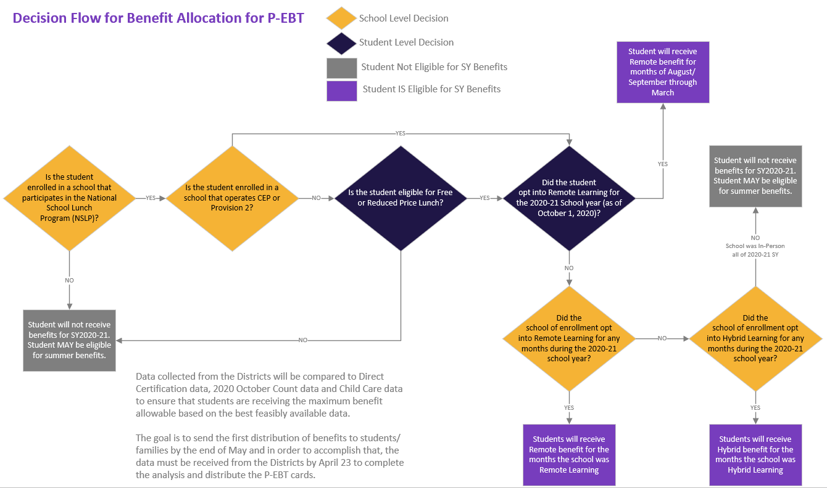
Eligibility Decision Flow
Contact: P-EBT.datapipeline.support@cde.state.co.us
Notes:
First upload timeframe due by April 23rd
Second upload timeframe due by May 31st
Possible opportunity to provide any updated information or missed information sometime in August 2021

Slide 14
FAQ’s
How do we determine what address to use if there is more than one address in the SIS for the student?
What if the student is in a joint custody situation and both parents/guardians are involved in the student’s education?
What if the student is a McKinney-Vento student or does not have an address in the SIS?
The school should provide the mailing address typically used to send communication to the family in regards to the student. The district should provide the best feasible data available. The card for the student can only be sent to one address and the school will likely have the best feasible knowledge of which address it should be sent to.
In the case where a student does not have any address on record in the Districts SIS, we are waiting to receive guidance and will update districts as soon as that guidance is available.
Contact: P-EBT.datapipeline.support@cde.state.co.us
Notes:
First upload timeframe due by April 23rd
Second upload timeframe due by May 31st
Possible opportunity to provide any updated information or missed information sometime in August 2021

Slide 15
FAQ’s
What are the ramifications if a district chooses not to submit the information?
This submission contains parent and student personally identifiable data not previously provided in state required data collections. What authority allows this data to be provided?
Do we need to have parents’ permission to send in this information?
What is a parent does not want their information shared?
Contact: P-EBT.datapipeline.support@cde.state.co.us
Notes:
First upload timeframe due by April 23rd
Second upload timeframe due by May 31st
Possible opportunity to provide any updated information or missed information sometime in August 2021

Slide 16
FAQ’s
Both CDE and CDHS executives support the requirement of this data collection for purposes of implementing the USDA P-EBT program. EDAC has approved this data collection.
The P-EBT program has federal legislation allowing for the release of student information (specifically student eligibility information) without the need for parental consent.
All CDE and CDHS 3rd party agreement processes were followed to allow vendors to have access to student data for the purposes of supporting the P-EBT allocation process. All data privacy and data protection practices are being followed.
Families can request to not receive benefits by contacting the CBMS Call Center.
There is no process in place to prohibit the sharing of data needed to determine eligibility and enable disbursement. Student data can be shared for the purposes of state and federal education and nutrition programs and P-EBT qualifies as a federal nutrition program.
Contact: P-EBT.datapipeline.support@cde.state.co.us
Notes:
First upload timeframe due by April 23rd
Second upload timeframe due by May 31st
Possible opportunity to provide any updated information or missed information sometime in August 2021

Slide 17
FAQ’s
Some students could be reported by two or more districts. How will you know what is the most recent contact information?
Is Direct Certification information being collected?
Do we need to submit pre-school students (students under 6)?
Once the data is received from the districts, it will be compared and analyzed with other available data sources such as the 2020 October Count data, Direct Certification data, Child Care data, etc.
This data will be used to determine the maximum allowable benefit available for the student, the current enrollment and address information, identification of students/families receiving SNAP benefits and students who are eligible under the childcare criteria.
Additional data sources are being used minimize the burden on the districts to the greatest extent possible while still providing maximum benefits to students.
Contact: P-EBT.datapipeline.support@cde.state.co.us
Notes:
First upload timeframe due by April 23rd
Second upload timeframe due by May 31st
Possible opportunity to provide any updated information or missed information sometime in August 2021

Slide 18
FAQ’s
Are vendors such as PowerSchool or Infinite Campus included on this process and are they constructing data extraction reports for their clients?
Has this information been provided to SIS vendors?
We are currently working with vendors who responded to our outreach efforts and are working to finalize the requirements for the data pull.
All major vendors have been contacted but not all have responded.
If you have a vendor who has not communicated about assisting with this effort, please reach out to your contact person and encourage them to contact us.
Contact: P-EBT.datapipeline.support@cde.state.co.us
Notes:
First upload timeframe due by April 23rd
Second upload timeframe due by May 31st
Possible opportunity to provide any updated information or missed information sometime in August 2021

Slide 19
FAQ’s
Are we supposed to submit data for one of the submission dates or for both?
What's the back-up plan for distributing these cards if Districts cannot get this done?
Optimally districts will submit both data submissions. The first data submission will ideally include all students as of April 23rd (or the date of submission). The second submission will be a full snapshot as of the that submission date and should include any newly enrolled students, changes to FRPL status, address updates, etc. The targeted distribution date for data submitted by April 23rd is mid-May.
If Districts are not able to submit by the April 23rd deadline, the distribution of benefits to those students not submitted will be delayed. Districts are able to provide full submissions for the May 31st deadline as well. The expected date of benefit issuance for the May 31st data submission is targeted for mid-June
Contact: P-EBT.datapipeline.support@cde.state.co.us
Notes:
First upload timeframe due by April 23rd
Second upload timeframe due by May 31st
Possible opportunity to provide any updated information or missed information sometime in August 2021

Slide 20
Support for Data Collection
Will continue to attend upcoming Town Hall Meetings
Dedicated P-EBT data collection webpage https://www.cde.state.co.us/datapipeline/p-ebtdatacollection
Questions to P-EBT.datapipeline.support@cde.state.co.us
Contact: P-EBT.datapipeline.support@cde.state.co.us
Notes:
Detailed training and overview on April 6th from 2 – 3:00 p.m.
Ensure relevant staff are aware of training and available support
Start planning now
1:1 support -> contacts and resources coming soon!

