Slide 1
On the Menu Supply Chain Challenges
November 18, 2021
Notes:
Hi Everyone, welcome to our November On the Menu call. This month, we’ll be focusing on sharing solutions to the current supply chain challenges.
As a reminder, On the Menu is a monthly series that CDE School Nutrition facilitates to share program updates and related supports for child nutrition sponsors. These calls are usually scheduled for the last Thursday of each month, but this month the call was moved due to the upcoming holiday. You can register to join future calls through the Dish, our bimonthly newsletter, or on the CDE School Nutrition website.
This session is being recorded and ppt slides will be shared.

Slide 2
Mute/
unmute
Video
Chat
Closed Captions
Notes:
First, I will cover some quick Zoom housekeeping items before we jump into the content
All attendees will enter muted. You will know that you are muted if the microphone button in the lower left corner has a slash across it. Next to the microphone is a camera icon. Click the camera icon to turn it on which will remove the slash across the icon. It is completely optional to turn on your camera today.
If you keep moving across the bottom portion of your screen you will see a chat icon in the middle. If you have any questions today, please insert them into the chat-we will monitor the chat and address questions throughout the webinar.
We will insert the PowerPoint slides for today with speaker notes into the chat for you to download.
To the right of the chat icon, is an icon for closed captioning if you needed it. Go ahead and click this button for subtitles.

Slide 3
Reactions
Notes:
Reactions allow participants to communicate with the host and other participants without disrupting the flow of the meeting. For example, selecting the Slow down icon places the icon in your video panel and beside your name to indicate you would like the host or presenter to go slower.

Slide 4
View
Notes:
Advanced Zoom Features-
If you select View in the top right hand corner, you will see two options- speaker view and gallery view
Speaker view will switch the large video window between who is speaking with 3 or more participants in the meeting.
Gallery view lets you see thumbnail displays of participants, in a grid pattern, which expands and contracts as participants join and leave the meeting.

Slide 5
CDE School Nutrition Unit Vision
Nourish young bodies and minds. End childhood hunger.
CDE School Nutrition Unit Mission
We support the child nutrition community through innovation, training, and partnerships to ensure all youth have access to healthy meals.
Notes:
We have spent time updating our vision and mission.

Slide 6
Non-Discrimination Statement
In accordance with Federal civil rights law and U.S. Department of Agriculture (USDA) civil rights regulations and policies, the USDA, its Agencies, offices, and employees, and institutions participating in or administering USDA programs are prohibited from discriminating based on race, color, national origin, sex, disability, age, or reprisal or retaliation for prior civil rights activity in any program or activity conducted or funded by USDA. Persons with disabilities who require alternative means of communication for program information (e.g. Braille, large print, audiotape, American Sign Language, etc.), should contact the Agency (State or local) where they applied for benefits. Individuals who are deaf, hard of hearing or have speech disabilities may contact USDA through the Federal Relay Service at (800) 877-8339. Additionally, program information may be made available in languages other than English.
To file a program complaint of discrimination, complete the USDA Program Discrimination Complaint Form, (AD-3027) found online at: https://www.usda.gov/oascr/how-to-file-a-program-discrimination-complaint, and at any USDA office, or write a letter addressed to USDA and provide in the letter all of the information requested in the form.
To request a copy of the complaint form, call (866) 632-9992. Submit your completed form or letter to USDA by: (1) mail: U.S. Department of Agriculture Office of the Assistant Secretary for Civil Rights; 1400 Independence Avenue, SW Washington, D.C. 20250-9410;
(2) fax: (202) 690-7442; or (3) email: program.intake@usda.gov.
This institution is an equal opportunity provider.
Notes:
We include the nondiscrimination statement in our trainings as a reminder of our responsibilities to ensure all eligible people may participate in our child nutrition programs. As equal opportunity providers, we prohibit discrimination in our programs and provide fair and equitable treatment to every participant. For the full disclosure statement, visit the School Nutrition civil rights webpage.

Slide 7
Conditions for Success
Be present and engaged
Put your cell phone out of arms reach
Close out email or other tabs
Avoid multi-tasking or doing other work
Participate in discussion
Actively listen
Mute your microphone when you’re not talking
Bring a positive attitude and be ready to share
Be respectful, inclusive, and open minded
Notes:
Here are some other conditions for success to make our time together today as meaningful as possible. Today we’ll be heading into small group discussions, and our goal is for these discussions to be a place where you feel safe sharing best practices you’ve developed this year, as well as sharing challenges so your peers can help generate solutions.
Are there any other conditions that would help ensure a successful session that you would like to add today?

Slide 8
Learning Objectives
By the end of this training, sponsors will be able to:
Describe best practices other sponsors have developed to address the current supply chain challenges
Determine relevant solutions to your own child nutrition program
Professional Standards – 1 hour of training
2430 – Purchase food, supplies, and equipment through vendors, meeting school district specifications in compliance with Federal, State, and local procurement regulations and availability of USDA Foods
Notes:
By the end of this training, you will be able to: describe best practices other sponsors have developed to address the current supply chain challenges and apply relevant solutions to your own child nutrition program.
You will receive 1 hour of training for your participation in today’s call. The training certificate is accessible after you complete the evaluation survey, which will be shared at the end of this session.

Slide 9
School Nutrition Support
Providing resources and templates
Guidance documents
Communication templates
Consistently communicating with USDA and partners
Increased flexibilities
Meal pattern waivers
Procurement
Non-competitive allowed in emergency situations for 1 year
No procurement reviews
No fiscal action
Notes:
We know that you all are experiencing supply chain challenges this year, and I want to start by giving you a quick overview of how CDE is supporting sponsors through these challenges. On the resource front, we have created a new supply chain section of our online back to school resources where we’re posting new guidance documents and communication templates you can use in your district and are also using this space to highlight resources from the USDA, SNA, and other partners. This section of our website will continue to be updated as new materials are released or webinars are announced, so make sure to check back often.
Quick plug for attending the webinars listed here or watching the recording afterwards – School nutrition directors from across the country have been sharing really innovative ways they are adjusting to the challenges this year. Some highlights I’ve heard from joining these recently include planning an no utensil menu day each week focused on finger foods, or using the packaging a product comes in already to make the rest of the meal (ie, walking nachos or corn chip pie)
We’re also consistently communicating with the USDA as well as partners in Colorado to share feedback we are hearing from sponsors. Being able to elevate your voices and the challenges you’ve shared has been really helpful for multiple reasons – it allows us to share real-time shortages to keep these groups up to date on the challenges you’re experiencing, and also allows us to identify new resources that are most useful to our sponsors at this time. Please continue to share your feedback with us so we can continue to advocate for you and your programs.
USDA has released a number of flexibilities this year to support sponsors through these challenging times. These include:
Meal pattern waivers, which we’ll talk about more in a moment
Procurement flexibilities to allow non-competitive purchases and contracts, and the decision not to conduct procurement reviews this year; both of which can hopefully reduce some of the administrative burden with operating your program this year
And last but not least, USDA is waiving the requirement that fiscal action be applied for missing components, missing production records, and repeated violations involving milk type and vegetable subgroups when due to COVID-related supply chain disruptions.
I’ll now pass it over to my colleague Erin who will review the meal pattern waivers available this year.

Slide 10
Meal Pattern Waivers
USDA is allowing meal pattern waiver requests for the following:
Sodium requirements
Whole grain-rich requirements
Vegetable subgroup requirements
Milk variety requirements
Low-fat flavored milk
Age/grade group (pre-K-12)
Sponsors may apply for these flexibilities using the Meal Pattern Waiver Request form
Short-term shortages – document on production records
For questions, contact Erin Opgenorth at Opgenorth_e@cde.state.co.us or 720-822-1883.
Notes:
As mentioned on the previous slide, USDA has released a number of meal pattern waivers that can be requested to waive certain aspects of the meal pattern – the current waivers available are listed on this slide. If the issue is systemic (lasting more than 2 weeks) please request a waiver using our Meal Pattern Request Waiver form, which is linked on this slide. If you anticipate the shortage to last less than two weeks, please document missed components and justification on production records or somewhere for your records. In cases of emergencies not covered with the meal pattern waivers, document the situation, including the product shorted or missing, the product served in its place, and keep all product information. Notify Erin Opgenorth of the situation.
Before we move on, are there any questions on meal pattern waivers or other flexibilities?

Slide 11
Instructions for Breakout Groups
~20 minutes to discuss the prompts
School Nutrition staff will serve as notetakers
Decide who in your group will report back to the larger group
Notes will be collected in Jamboard, anyone can contribute!
1- We know that districts across the state (and country) have had to adjust their approach to feeding children based on the supply chain and labor challenges they are facing. What solutions has your team developed to help mitigate these issues? (Think about: menu planning, recipe substitutions, vendor relationships, recruiting/retaining staff, distribution, changes to meal service, creative supply uses, communication approach to your school community)
2- What are the current pain points that you’re working through? Can your colleagues help to brainstorm solutions based on their foodservice operation?
Notes:
Before we disperse into our breakout groups for discussion, I want to quickly review how this will work. You will be automatically assigned to a breakout room. Your breakout room will consist of sponsors from across the state as well as a CDE School Nutrition representative, who will serve as a notetaker and will be able to clarify instructions as needed.
We have two discussion questions for you today:
1- We know that districts across the state (and country) have had to adjust their approach to feeding children based on the supply chain and labor challenges they are facing. What solutions has your team developed to help mitigate these issues? (Think about: menu planning, recipe substitutions, vendor relationships, recruiting and retaining staff, distribution, changes to meal service, communication approach to your school community)
2- What are the current pain points that you’re working through? Can your colleagues help to brainstorm solutions based on their foodservice operation?
You will have a little over 20 minutes to discuss in your small group. Notes will be taken using jamboard, with each breakout room getting their own page to take notes. At the end of the breakout time, you will automatically be brought back to the main meeting room, and we’ll ask someone from each group to share highlights from your discussion. Please choose who in your group will share back at the beginning of your discussion so they can be prepared.
For those of you who haven’t used jamboard before I wanted to provide a quick orientation to the tool:
Jamboard is a collaborative tool where anyone can contribute virtual sticky notes. As mentioned, a CDE representative will be available to take notes, but we welcome you to also add to the jamboard if you’d like.
You can navigate to different boards using the arrows at the top of the screen – if you decide to add stickies for your group make sure you scroll to the correct board
Sticky notes can be moved/grouped and edited as needed once they are created
Are there any questions on this process before we head into the breakout rooms?

Slide 12
Register for an Online Training Account
School Nutrition moved all of its online trainings to a new platform.
To access online trainings and receive professional standards credit, register for a FREE Moodle account
https://app.smartsheet.com/b/form/c22b69634b4e4a8596306d45ac107c2f
Notes:
School Nutrition has moved all of its online trainings to a new platform. To access the online trainings and receive professional standards credit, you need to register for a FREE Moodle account. Registration only takes a few seconds to complete. Once you have submitted your registration, our office will create your account. You will receive an email to confirm your Moodle account and then you will be able to access the trainings. If you have any questions, please contact Alicia Grove at grove_a@cde.state.co.us or 720-795-2038.

Slide 13
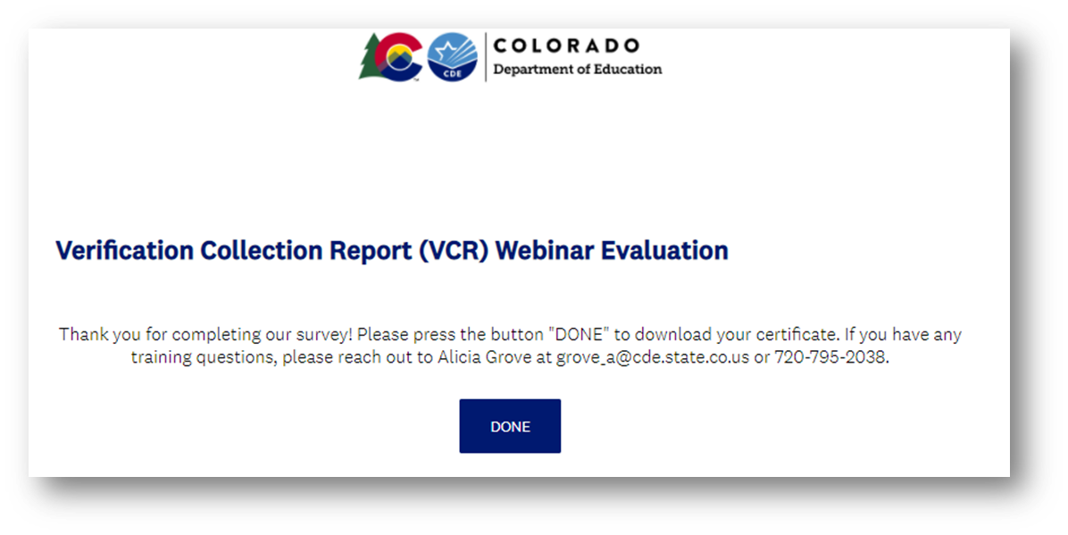
Training Evaluation and Certificate
Click this link to complete a quick training evaluation
https://www.surveymonkey.com/r/XHWHNM6
When you submit the evaluation click “DONE” on the survey thank you page to download your certificate
Notes:
This link will be emailed out to all training attendees. This information is included for those watching this training at a later date as a recording.
Thank you so much for your feedback- we are always looking for ways to improve our trainings to better support you.

Slide 14
Thank you!

