Slide 1
Free and Reduced-Price School Meal Program 201
School Nutrition Unit
Every Meal Matters. Even just one.
Notes:
Welcome, Welcome!
I have a couple of housekeeping items for today’s virtual training:
All attendees will be in listen only mode to reduce background noise.
If you experience audio or technical difficulties, please contact Alicia Grove. Her information is available in the Chat.
Please use the chat pod to enter any questions you have throughout the training.
Just below the chat you will see a pod titled “Files” we have provided today’s 201 Handout packet and PowerPoint slides for you to download.
Below the “Files” pod, you will see “weblinks” which are important websites that are hyperlinked. We will refer to these resources during the presentation.
Today you will see the importance of the work you do in providing free and reduced-price meals to your students. Proper nutrition positively supports students behavioral health and academic performance. We hope to provide guidance on how to successfully operate the free and reduced program in the most efficient way possible. This is our first 201 course and will focus on process improvement, common software issues/capabilities, share marketing strategies, share some of our knowledge!

Slide 2
Together We Can
Colorado Department of Education Vision
All students graduate ready for college and careers and are prepared to be productive citizens of Colorado.
CDE School Nutrition Unit Mission
The School Nutrition Unit is committed to ensuring all school-aged children have equal access to healthy meals by supporting, training, and connecting Colorado’s child nutrition community.
Notes:
Our office takes great pride in our Mission statement specifically supporting, training and connecting Colorado’s child nutrition community. You are our community!
Ask questions in the chat, & share ideas

Slide 3
Learning Objectives
Evaluate current free and reduced software systems and/or manual process for improved efficiencies
Use the Eligibility Manual to formulate solutions for common free and reduced-price process questions
Maximize opportunities for families to apply for free or reduced-price school meals
Ensure free and reduced-price school meal data is being used to its fullest potential
Notes:
Cover learning objectives and Agenda. Notate the orange words on slides (key words – also a handout in the resources section of the packet).

Slide 4
Introductions
Notes:
Introduce team members for F&R Team. Thank Alicia again for technical help.
We’ve covered why we are here and what we plan to learn today. Let’s hit the ground running with our first activity which is a poll, so we can get to know other school districts which are similar to yours.
Then explain what the eligibility manual is and where located on the webpage and refer to Key terms handout for future reference.
Poll: school size
2,499 or less
2,500-9,000
10,000 or more

Slide 5
The Big Picture
Notes:
Let’s start with the big picture of the free and reduced-price school meal program and how eligibility is determined.

Slide 6
The Eligibility Process
Application
Student determined free, reduced-price, or paid based on household size and income
Direct Certification
Student determined free based on participation in an approved assistance program
Income
Other Source Categorical Eligible (OSCE)
SNAP/TANF/Migrant
Notes:
If you’re operating the breakfast or lunch program, you’re required to provide free or reduced-price school meals. How do you do that, and how do you know when a household is eligible for free or reduced-price school meals?
Hopefully, you all know a free, reduced-price or denied/paid status is determined by either an application or direct certification.

Slide 7
More than a Meal
At-Risk Funding
October 1 Count Data
Grant Qualifications
Nutrition Program Qualification – Snack, Summer, FFVP, BAB, Severe Need
Provisional Programs
Notes:
Determining eligibility for free or reduced-price meals means so much more than approving applications. You’re helping provide healthy meals to your students! Providing nutritious food for kiddos is correlated to improved test scores, improved behavior and has shown a decrease in missed school days.
Eligibility is also tied to these items listed here. Does anyone have anything they would like to add?? Go ahead and type it in the chat box.
1. Any student reported in October 1 count as free lunch eligible receives additional funding per reported pupil. This is called At-Risk funding. For some districts, this can amount to millions of dollars in extra funds for their district. This is a HUGE deal!
2. Annually CDE requires all districts to submit total student enrollment with required fields (free and reduced eligibility being one) as of October 1 (or close to this date). This is literally called October 1 Count data, or you may hear it referred to as data pipeline submission or pupil membership. The free and reduced data reported here is used A TON!! It is collected from October to mid-November then finalized and posted to CDE website.
3. Many grant applications (even School Nutrition equipment grant application) ask for site or district level free and reduced %. This can be pulled from the local level or often this data is pulled from what is reported in October count.
4. Afterschool Snack, SFSP, FFVP, BAB, Severe Need reimbursement require specific free and reduced percentages to qualify for participation. Our office uses October count data to confirm qualifying percentages.
5. CEP participation requires a direct certification rate of at least 40% and Provision 2 programs benefit greatly from high free and reduced %.
*Communication Plan – Reach out to your district staff this summer to ensure clear concise information is known by all who need to know (superintendents, directors, I.T. and October count coordinators). Also, ensure all your district school sites are reporting free and reduced eligibility!

Slide 8
Maximize Eligibility
Strong communication plan – Administrators, October count coordinator, district liaisons
Implement edit checks to ensure data accuracy
Work with district to report eligibility for ALL school sites
Notes:
*Communication Plan – Reach out to your district staff this summer to ensure clear concise information is known by all who need to know (superintendents, directors, I.T., district liaisons and October count coordinators).
*Also, ensure all your district school sites are reporting free and reduced eligibility! You can do this by working with your district on getting ALL enrollment data for direct certification uploads, even for non-participating sites and ensuring non-participating sites know they can use a FEDS form to capture and report eligibility data.
*It’s always good to remember that your district may contain sites that do not participate in School Nutrition Programs. It is still important that you collect their eligibility data so you can report it during the annual October Count that determines general school state funding.

Slide 9
Food For Thought
Notes:
This resource will be used throughout the training for any notes you’d like to take but please use this for inspiration and to jot down important take aways.
Action Items:
1. Do you know the right school administration to contact for -> helping in ensuring data accuracy in October count, getting enrollment data for ALL students, creating a communication plan to provide information on nutrition programs and the importance of eligibility data.

Slide 10
The Details – Application and Supporting Materials

Slide 11
Start of Year
Policy Statement
Outlines requirements of the program
Public Release
Published by School Nutrition for all participating districts/sites
Update templates and Income Eligibility Guidelines
Distribute application, instructions and letter to households
Notes:
*Eligibility Manual**All requirements for any template is listed in the Eligibility Manual. Refer to the templates on the School Meal Eligibility webpage.
The policy statement is part of the annual renewal policy. New statements must be signed only when changes are made. The policy statement outlines the requirements for the free and reduced-price meal program. If you want specific language on what is required to be in the policy statement review the Eligibility Manual. If changes are made, the policy has always been part of the renewal application process and will be addressed/signed during that process.
The public release provides information about the free and reduced program to households about FAQs on applying and also what the income guidelines are for qualifying.
School Nutrition publishes the public release annually for all participating districts/sites, so the requirement to publish the public release is fulfilled for all SFAs. School nutrition highly encourages you still publish your own public release (and we have a SFA template for use) specific to your school district. The School Nutrition public release has very general information and it would be a great service to your community to publish information specific to your nutrition program and how households can complete an application.
The updated school year templates are released in later April early May after USDA releases any updates. School Nutrition provides templates for all free and reduced-price, direct certification and verification notices on the Free and reduced-price Webpage.
The information letter to households is one piece of the supporting materials provided with the F&R application. The Eligibility Manual outlines the requirements for the letter to households and you will want to ensure the templates you’re using are compliant if you’re not using School Nutrition templates. One large piece I’d like to point out is the income guidelines chart. This chart must only ever contain the guidelines for reduced-price. I also recommend not spelling out they are reduced-price guidelines as it eludes to being able to report less and qualify for free school meals (for our untruthful households).
The letter to households can be provided in a variety to ways to meet compliance of every household receiving it. You can provide in back to school materials, email to households, mail to households, etc. If you choose to not provide the application and instructions with the letter to households you must provide an easily accessible way for families to apply (either link to online applications or widely available paper applications. However, your families can apply you must provide that information in a clear manner within your letter to households.

Slide 12
Application and Letter Distribution
July 1 of new school year
Send updated information letter to household, application and application instructions (postal mail or email)
Ensure translated copies are available
Market your program!
Notes:
Quickly following the publication of the public release comes the distribution of all updated and current year materials. Each year parent letters must be sent to all households of the children attending participating schools. This lets the family know which school nutrition program is available at their child’s school and that the meals available may be at a free or reduced cost to them. Additionally, all schools must provide each household an application. New year applications and supporting materials cannot be distributed before July 1 for the federally-defined school year on a traditional school schedule, or as early as June for year round.
The letters and applications can be distributed in multiple ways: At school registration or electronically via email. It is important to provide a paper-copy if requested, and to have several different translations available. We highly recommend you’re distributing these materials throughout the school year to reach as many households as possible.
Work with local community champions and/or district liaisons to identify what translations you need. School Nutrition has all templates in English and Spanish. If additional languages are needed USDA has 27 translations of the application and instructions.
Important to mention: service models in 2020-21 will be very different for schools. Talk through this and be sure they know to market/inform families of differences.
*take a break from lecture style and start a conversation about marketing the program and innovative ways to help households apply.* What are you currently doing to market your program, or do you have any ideas on what you’d like to try this school year?* Add comments in the chat box
Go to next slide for other district examples.

Slide 13
Get Creative!
Notes:
HungerFree Colorado is also working of free and reduced-price application marketing materials. They are gathering district feedback and I hope to see materials released for the new school year. Stay tuned!

Slide 14
Online Applications
Must be approved by School Nutrition during the renewal application process
Use the checklist to ensure application compliance
Check all software templates for compliance
Reference the Eligibility Manual for helpful edit checks
Notes:
*Reference the software checklist in handout packet*
*Page 81 of the Eligibility Manual – Electronic application requirements* Have participants read out what surprised them or what they took away from the requirements.*
All online applications must be approved by School Nutrition. Currently the following vendors online applications have been approved by our office:
Infinite Campus
Payschools
Nutricloud/Nutrilink
MCS/Heartland
PrimeroEdge
Horizon
EZMealApp
Titan
Regardless of state approval it’s crucial you utilize the F&R software system checklist every year! Updates are needed regularly for systems and online applications to be compliant.

Slide 15
Start of Year Checklist
Notes:
This checklist will be extremely helpful to use each and every year after your software has been rolled over for the new year. A great place to start is ensuring your data is rolled over for the new school year and ready to start!
Then, you can use this checklist to make sure you’re ready to start processing applications and conducting direct certification. I would encourage you go through this checklist, but you can also provide this checklist to your vendor to ensure you’re on the same page and nothing has been overlooked.

Slide 16
Food For Thought
Notes:
This resource will be used throughout the training for any notes you’d like to take but please use this for inspiration and to jot down important take aways.
Action Items:
1. What do you need to do to ensure your system is ready to go?! Is there anything you missed? Do you need to touch base with your vendor?

Slide 17
Eligibility based on Application
Notes:
*Pull up the Information Letter to Households template, application and instructions from the F&R webpage.*

Slide 18
Application Types
Income Applications
Categorical Eligibility
Provides income and household size in order to establish free, reduced-price, or paid eligibility for all students in the household
Provides free eligibility based on a child’s (or any household member) participation in an Assistance Program, or designation as OSCE
Notes:
Income Applications: Applications that provide income information in order to establish free or reduced-price eligibility for all children in the household.
Categorical Eligibility: Automatic eligibility for free meals or free milk due to a child’s (or any household member’s) receipt of benefits under an Assistance Program (SNAP, TANF or FDPIR), or a child’s designation as Other Source Categorically Eligible (Homeless, Runaway, Foster, Head Start, Migrant).
Other Source Categorically Eligible will be reviewed more thoroughly later on.

Slide 19
Income Applications
Eligibility determined by comparing household size and income to the annual Income Eligibility Guidelines (IEGs)
Free eligibility = at or below 130% federal poverty level
Reduced-price eligibility = at or below 185% federal poverty level
Updated annually and published by USDA
Notes:
Students are determined eligible based on household size and income provided on the application. The number of household members and gross income provided are compared to applicable IEG thresholds.

Slide 20
Special Household Situations “Do I report this household member?”
Notes:
Page 23-24. Mark these pages. You will reference these often!
We know that families have many unique types of household situations and now we will review a few examples.

Slide 21
Special Household Situations
An adopted child for whom a household has accepted legal responsibility
Child living with one parent, relative or friend
Child away at school (boarding school or college)
Foster child
Families with joint custody
A child living alone or emancipated
Notes:
Go through a few situations verbally then use polling questions
1. An adopted child for whom a household has accepted legal responsibility is considered to be a member of that household. Any assistance or subsidy payments are income.
2. Child living with one parent, relative or friend are a member of the household where they reside.
3. Child away at school (boarding school or college) can still be considered part of the household.
4. A foster child is considered to be a member of the foster parents’ household and not a separate economic unit. Cannot require households to submit separate applications for foster and non-foster children.
*Polling Questions*
5. Families with joint custody - the child is considered part of the household where he or she resides. If both parents apply for benefits in the same LEA for the child, and different eligibility statuses result, the greater benefit level is used. Where one parent applies for benefits and the other parent does not want benefits, guidance to implement wishes of custodial parent.
Q: Families with joint custody
Only one household can apply for benefits
Child is part of the household where they reside
6. A child living alone or emancipated - is considered to be a household of one.
Q: A child living alone or emancipated
Child is considered a household of one
Child is automatically eligible for free meals

Slide 22
Categorical Applications
Free meal eligibility determined by household participation in an Assistance Program, or designation as OSCE
OSCE = Migrant, Homeless, Runaway, Head Start or Foster
Assistance Program = SNAP, TANF or FDPIR
Notes:
Categorical applications are those that have provided an assistance program case number, or have indicated they participate in an OSCE program (Migrant, Homeless, Runaway, Head Start) or are a Foster Child.

Slide 23
Case Number Applications
Applications with SNAP, TANF or FDPIR case number
Extends to all students in the household
Can be accepted at face-value and approved for free school meals
Attempt to directly certify SNAP and TANF case numbers
SNAP
7 alpha numeric characters starting with 1B
TANF
7 alpha numeric characters starting with 1B
FDPIR
9 numeric digits
Notes:
Case number applications can be accepted at face-value if they are complete and the case number is in the correct format as listed in the slide.
SNAP and/or TANF applications should attempt to be directly certified by looking the case number up in the direct certification system. Sometimes a family receiving these benefits aren’t in our match system yet, and that is okay. We will touch more on this later.
Once approved these benefits can be extended to all students in the household.

Slide 24
OSCE Eligibility
Applications for students classified as foster, Head Start, runaway, homeless, or migrant
Must verify the student’s participation by district liaison prior to approving for free school meals
Exception: Foster applications accepted at face-value and approved for free school meals
Eligibility does not extend to other students in household
Notes:
Key Terms - ***OSCE***
Students’ may be categorically eligible due to OSCE status through the application when their participation is confirmed through the appropriate liaison or school official.
Under this designation, an appropriate box must be marked on the application indicating the child’s status. OSCE must be determined individually for each child listed as such prior to providing free meal benefits;
Homeless students must be verified by your local McKinney Vento liaison. The list must be signed and kept on file with other eligibility documentation.
this eligibility cannot extend to other children in the household.

Slide 25
Income and Categorical Applications
Students marked as OSCE on application must be confirmed by liaison prior to free eligibility
Non-OSCE are determined based on income
All students can be determined eligible based on income in the interim of OSCE participation confirmation
Notes:
If an application lists students and some are marked OSCE while others are not and income information is provided, you must recognize this. I recommend processing the application based on income to issue benefits as soon as possible while following up with the liaisons for the correct OSCE program marked.
For example, if a household submits an application with 4 students and 2 are marked as homeless and income is also provided, process the application based on income for all students to issue benefits while checking with the homeless liaison for the 2 marked students.

Slide 26
Foster Applications
Students marked as foster on application are automatically approved for free school meals/milk
Remain free no matter the determination for non-foster students on the same application
Are considered part of the household
Cannot require separate applications for foster and non-foster students in the same household
Accepted at face-value
Notes:
Foster student applications are accepted at face-value and approved for free school meals. If non-foster students are on the same application the eligibility is determined as normal and no matter the outcome for the household, the foster students remain eligible for free meals.
For example, if a household of 5 apply with income over the IEGs and mark 2 students as foster, the application would be determined as paid but the 2 foster students would still remain eligible for free school meals.
*Reference the F&R start of year checklist – it is important to ensure your online applications and software are processing categorical applications. For example, if a household submits an application that is denied based on income, but there are foster students marked, the foster students must still remain eligible. Similarly, ensuring OSCE applications are not automatically processed as free. This should be queued for manual approval by district liaisons.**

Slide 27
Application Activity
Notes:
Following 3 slides: 3 applications. Participants will determine 1) is the application complete and 2) determine an eligibility status. Multiple choice polling question for each application.
Application #1: George Pena – TANF case number is in correct format and application is signed. Household members do not match. Should you approve at face value for one student? What is the best option?
Application #2: John and Jerry – Application is well over income guidelines but both students are marked as foster and application is signed. Approve both students for free school meals.
Application #3: Tawny and Tilly – No household members listed in total, indicated only receive student income sometimes. How should you proceed? Would they qualify anyways if you included? Yes, they would qualify regardless. I would approve based on information provided.

Slide 28
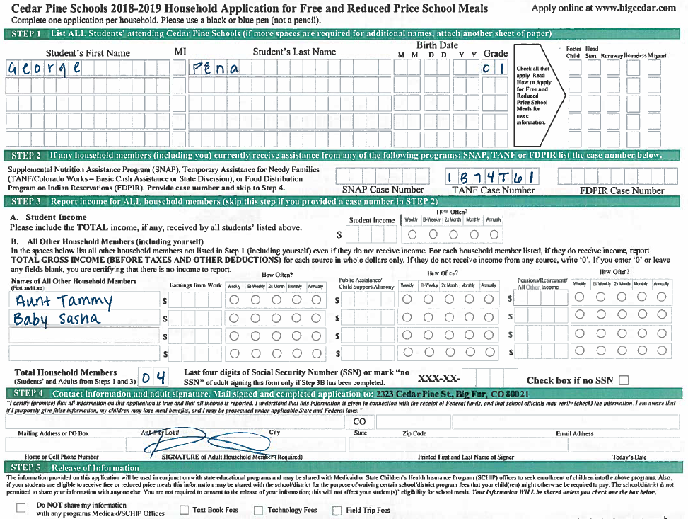
2020-2021
Notes:
Application #1: George Pena – Based on this application which answer would you choose?
(TANF case number is in correct format and application is signed. Household members do not match. Should you approve at face value for one student? What is the best option?)
Polling Question – How do you proceed with this application?
Approve student for free meals based on TANF case number
Verify TANF case number then approve student for free meals
TANF case number is correct and application is signed, but household number does not match – follow up with household
Application is incomplete – follow up with household

Slide 29
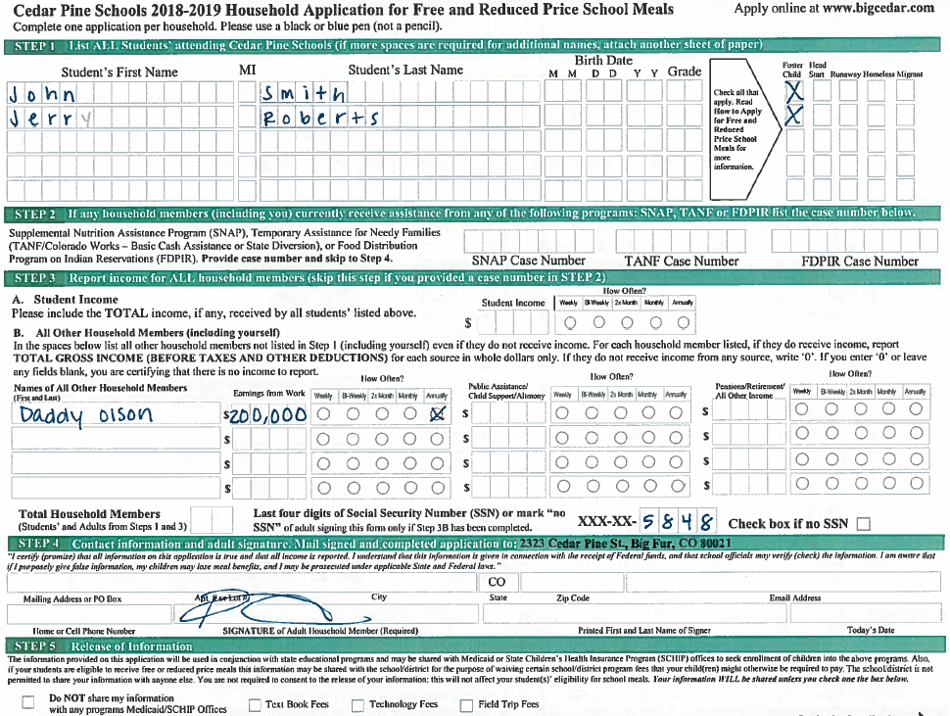
2020-2021
Notes:
Application #2: John and Jerry – Based on this application which answer would you choose?
(Application is well over income guidelines but both students are marked as foster and application is signed. Approve both students for free school meals.)
Polling question:
Application is complete, but benefits should be denied for all students based on income
Approve both students for free meals based on foster status
Verify foster status for both students before approving for free meals
Foster children are not part of the household – deny benefits

Slide 30
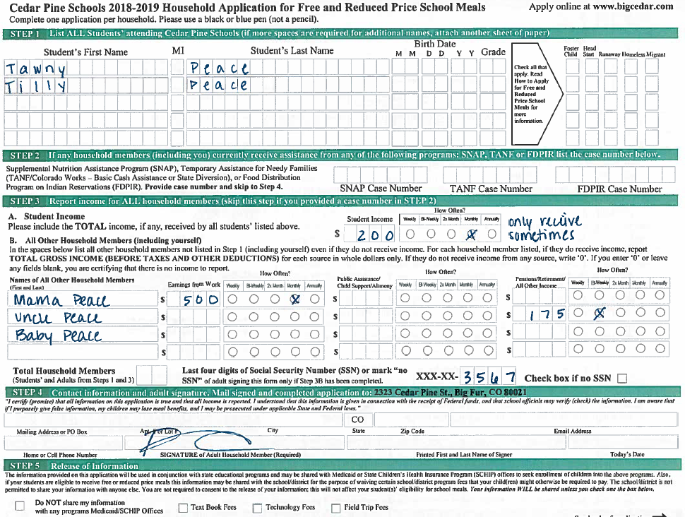
2020-2021
Notes:
Application #3: Tawny and Tilly – Based on this application which answer would you choose?
(No household members listed in total, indicated only receive student income sometimes. How should you proceed? Would they qualify anyways if you included? Yes, they would qualify regardless. I would approve based on information provided.)
Polling question:
Total household members not completed – follow up with household before processing application
Follow up on household members and student income before processing application
Process application as is – both students qualify for free meals
Process application as is – both students qualify for reduced-price meals

Slide 31
Food For Thought
Notes:
1. What is 1 process you’re going to check your software for compliance? Foster applications, OSCE applications? How will you do this?

Slide 32
Processing and Notifications

Slide 33
Application Processing Timeframe
10 operating days to process, notify and update student status
Flexibility of effective date
Missing required information, contains inconsistent information, or is unclear cannot be processed
Make reasonable effort to contact household and clarify/obtain needed information prior to denying
Notes:
Applications must be reviewed in a timely manner. Expedite eligibility determinations for children who do not have approved status on file from the previous school year. An eligibility determination must be made and implemented within 10 operating days of the receipt of the application.
When possible, applications should be processed immediately.
Households should be notified immediately if benefits are denied or reduced from the level of the previous year in order to provide adequate time for the family to make appropriate arrangements for payment to prevent the household from accumulating meal charges.
The SFA may not delay the approval of an application if the household fails to provide any information that is not required (i.e., Birth date, street address, etc.)
Required information that is missing or unclear must be obtained before approval. Every reasonable effort should be made to obtain missing information prior to denying the application. If information is not obtained with the 10 operating days of receipt you must deny the application and cite the reason as incomplete application on the denial notice.
All missing required information (except a missing original signature) may be obtained by contacting the household by phone or in writing - document all of the details of the contact and then date and initial the entry. When obtaining information from the household, document:
Whom the SFA spoke with
What information was obtained
Date information was obtained
Initials or signature of SFA representative

Slide 34
Changes in Eligibility
Households not required to report changes in income, household size or assistance program participation
If households voluntarily report changes:
Increase in benefits must be put into effect within 3 operating days
Decrease or termination of benefits, change does not go into effect unless the household requests the change in writing (i.e. submitting a new application)
Must provide notice of adverse action
Notes:
Because applications are approved for year-long duration, households are not required to report changes in income, household size, or changes with regard to participation in a program that makes the children categorically eligible.
If the family reports a change that will increase the household’s benefits, the SFA must put that change into effect within 3 operating days.
If the change will decrease benefits, the SFA must explain to the household that the student has the benefit status for the entire year. If the household requests that the lower benefits go into effect, the household would then be provided a notice of adverse action showing the changes in benefits status.
Adverse action is only applicable to current year change in status. An appeal must be filed within the 10 day grace period.

Slide 35
Transferring Eligibility
Within the same SFA
Eligibility status must transfer
To another SFA
Encouraged to share eligibility
To Provision 2: New application or DC is required unless during the base year (allow 30-day grace period)
To Community Eligibility Provision: New application or DC is required (allow 30 day grace period)
Application should be reviewed for errors
To Provisional SFA: New application or DC is required unless during the base year (allow 30-day grace period)
Notes:
Eligibility Manual pages 48-49. Refer to the tables.
If a child transfers to another school in the same LEA the status must transfer.
CEP or Provision 2 to non-Provision school - new F&R application or DC is required. Can provide free meals for up to 10 operating days until a new eligibility determination is made.
Non-Provision to CEP or Provision 2 school – Federal Economic data Form (Feds form). Can allow 30 operating day grace period – like carry over
(Feds form not required in Prov 2 base year). Allow 30 operating day grace period – like carry over
If a student transfers to different SFA, it is optional but encouraged to share eligibility information. When transferring to another SFA, if a copy of the application is received from the original SFA, the accepting SFA should review the application for math errors and compare the income and household size to the IEGs to assure that the correct level of benefits was assigned. If the accepting SFA determines that the benefit level was determined incorrectly, the SFA must notify the household that it must file a new application in order to receive benefits.

Slide 36
Notification Scenario
A family with two children transfers into your district
You receive their application from their old district, which shows that they have been receiving reduced-price meals
You review the application and determine they should actually be receiving free meals
You notify the family and increase the students’ benefits the following operating day
Notes:
Read through scenario and bring up polling question
Polling question: Was this scenario handled correctly?
Yes
No - If the accepting SFA determines that the benefit level was determined incorrectly, the SFA must notify the household that it must file a new application in order to receive benefits.
I’m not sure

Slide 37
Direct Certification

Slide 38
Overview
Direct Certification
Determining children eligible for free school meal benefits based on documentation obtained directly from appropriate state or local agencies or other authorized individuals.
Notes:
Direct Certification is a simplified process that helps to eliminate paperwork and labor for both the household and the SFA. It also reduces the number of total applications for Verification. And it helps to extend free meal benefits to more children!

Slide 39
Benefits
Reduces paperwork for SFAs and households
Lessens verification sample size
Helps meet required 95% match rate
Higher school meal participation
Mitigate unpaid meal charges
Most importantly: Qualifies children for free meals
Notes:
Direct Cert is a federal and state requirement, it reduces the paperwork burden for households and parents (by not having to fill out, process, or verify meal benefit applications). Direct Cert efforts also continue to help our state maintain and improve our match rate. Finally, most importantly, Direct Cert helps qualify eligible children for the free school meals to which they are entitled, which, in turn, also leads to higher participation rates in the district.
Last year, our office achieved a 102.65% DC match rate! That is because school districts matched often and to the best extent possible. Thank you!

Slide 40
Direct Certification System
Notes:
Remember SFA are required to complete 4 dc upload s per year, the first being Between July 1 and first day of school. Encourage weekly uploads at beginning of year.
Refer to DC Uploading Instructions in handout. School Meal Eligibility web page has link to online training module.
SNAP, TANF and Migrant data is sent to the direct certification system one time per month. SFAs upload their enrollment into the DC system. Students are matched based on their participation in the above programs. Any student on a DC list is eligible for free school meals.
School Nutrition is able to receive SNAP, TANF and Migrant student data to import into the direct certification system. This data is received monthly and lies in the background of the DC system. Each SFA uploads its entire district enrollment; the system will generate a match list between the district file and the SNAP/TANF and Migrant data, and any child who matches will be directly certified.
The Direct Certification dashboard will display three options: Direct Certification List, Uploading a Student Enrollment File and looking up a student on the Individual Student Lookup.
Upload student data – system identifies any records that are formatted incorrectly and display a list of errors and rejects the students line of data. Take a screen shot or print the error list. Once you click finish you cannot return to the list.
Try to fix the errors on SIS file, rename the text file and re-upload. If you cannot fix the file, contact School Nutrition for help.
When a match is found, date the application, extend benefits to all students in the household and file separately from approved applications. These students will now all be updated to a direct certification status, not eligible based off an application.

Slide 41
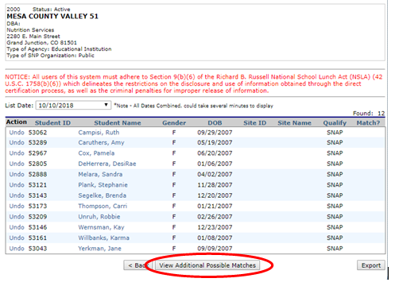
View Additional Matches
Notes:
Possible matches are students who are likely matches but have a slight variation (such as a hyphen or space in their last name). ALL names on the list must be reviewed, all the way down to the 37% likelihood.
You now have a full list of all matched students from this upload. Most free and reduced software allows you to export the list from the portal and upload into your software.
You can either print your match list for proof of uploading, however saving electronic versions of match lists is also allowable for audit purposes.

Slide 42
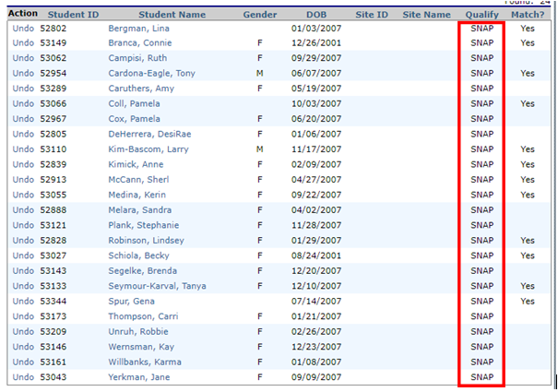
Qualify Type
Notes:
Lastly, ensure you’re aware of the qualify type and are coding students correctly.
All students matched in the direct certification system must have a status as free – directly certified. It’s also important to note the “Qualify” type from your match lists as shown. Students coded as SNAP, BOTH or SNAP/MIGRANT must be coded as free – directly certified SNAP. Students coded as TANF only or MIGRANT only must be coded as free – directly certified TANF or free – directly certified MIGRANT respectively. MIGRANT only statuses do not extend eligibility.

Slide 43
Maximize Eligibility
Strong communication plan – Administrators, October count coordinator, district liaisons
Upload as much as possible prior to October 1 Count date – extend eligibility
Upload ALL enrolled students – whether at participating site or not
Notes:
As a reminder…..
*Communication Plan – Reach out to your district staff this summer to ensure clear concise information is known by all who need to know (superintendents, directors, I.T., district liaisons and October count coordinators).
*Be an advocate for your district to maximize funding!
Encourage departments work together to ensure ALL enrolled students can be incorporated into a direct certification upload and those matched students are then reported back to the appropriate school sites.
ANY matched student can be reported as free lunch eligible in October 1 Count reporting which directly results in your district receiving MORE funding.
It is an allowable practice, and we encourage nutrition services, to charge a flat rate on time spent uploading students and reporting match students back to school sites.

Slide 44
Food For Thought
Notes:
Action Items:
1. How will you reach out to other district staff to upload ALL Enrolled students and get that information back to appropriate school sites? 2. What resource might you need?

Slide 45
Direct Certification Types
Direct Certification with Assistance Programs
SNAP
TANF
Direct Certification with OSCE Programs
Homeless/McKinney Vento
Migrant
Foster
Runaway
Head Start
FDPIR
Administrator apps
Notes:
There are two types of Direct Certification:
1. DC for Assistance Programs (SNAP, TANF and FDPIR)
Supplemental Nutrition Assistance Program (SNAP): SNAP offers nutrition assistance to millions of eligible, low-income individuals and families and provides economic benefits to communities. Children from households that receive benefits under SNAP are deemed categorically eligible for free school meals.
Temporary Assistance for Needy Families (TANF): A Federal designation for a State-funded program under Part A of Title IV of the Social Security Act. Each State has its own name and acronym for the program. In Colorado, this program is called CO Works.
Food Distribution Program on Indian Reservations (FDPIR): FDPIR is a Federal program that provides United States Department of Agriculture foods to low-income households living on Indian reservations, and to Native American families residing in designated areas near reservations. Children from households that receive benefits from FDPIR are deemed categorically eligible for free school meals.
Certification through assistance programs must be extended to members of the entire household. This is done through extended eligibility which we will cover in greater detail later.
2. Direct Certification for Other Source Categorical Eligibility (OSCE) programs (homeless, migrant, foster, runaway, administrator apps or head start) require liaison confirmation via lists. This type of eligibility is student specific and does not extend to other children in the household.
Local school officials may complete an application for a child known to be eligible if the household fails to apply. When exercising this option, the school official must complete an application on behalf of the child based on the best household size and income information. Refer p 42 of Eligibility Manual.
The source of the information must be noted on the application. Names of household members, the last four digits of the social security number, and signature of an adult household member is not required, and the household must be notified the child has been certified. There are extreme cases when the child’s well being may be jeopardized by sending notification and School Nutrition is happy to work with you in these situations. Please call us for guidance.

Slide 46
Case Number and Migrant Applications
Should attempt to directly certify the student using the Individual Student Lookup
When a match is found
Eligibility must be extended to all students in the household and change status to DC
When a match is not found
Contact the household for clarification
Verify the application for cause
File application separately
Notes:
Case Number and Migrant Applications - The DC module has an individual student lookup feature which you can use to look up specific students.
Show next slide to locate within Portal, then return to this page.
This module is also where you can attempt to directly certify SNAP, TANF and Migrant applications. You can search by case number and it will show you whether the number is valid or not. You can search for Migrant students by entering first name, last name and DOB. If you cannot match based on case number or student information, SFA can choose to follow up with the household or verify the application for cause.
When a match is found, date the application, extend benefits to all students in the household and file separately from approved applications. These students will now all be updated to a direct certification status, not eligible based off an application.

Slide 47
Individual Student Information
Notes:
The Individual Student Lookup feature allows you to look up students one at a time. This can be useful for new students throughout the year, validating case numbers and/or validating Migrant eligibility without needing to upload an entire enrollment file.

Slide 48
Extended Eligibility
Extended Eligibility: free eligibility is extended to all students in a household based on SNAP, TANF or FDPIR participation (via application or direct certification)
Must document:
Originally directly certified student
Basis of extension (add siblings form/same address/application)
Date of extension
Notes:
Extended eligibility: A child or other household member’s receipt of benefits from an Assistance Program automatically extends eligibility for free benefits to all children who are members of the household. Applies to applications and the Direct Certification process.
If one student is matched on Direct Certification (as SNAP or TANF only, does not apply to MIGRANT only status) but other students are not matched but live in the same household, free meal benefits must be extended to all children in household.
SFAs must ensure that children in a household that lists an assistance program (SNAP, TANF, FDPIR) case number on an application for any household member are provided free meal benefits.
SFA must keep documentation of the names of students with extended eligibility, the date benefits were issued, and the signature/initials of the official.
Something great to remember is to try and obtain an incoming kindergarten list before school starts so you are able to extend benefits to those kiddos, too.
Your software most likely has reports that will automatically extend eligibility based on household address. It’s imperative you’re system is tracking this and/or you’re manually tracking this. Documentation for extended eligibility is a requirement and requested during ARs.
Reference the USDA Extended Eligibility Q&A in handout packet – will use for polling questions on next 3 slides.

Slide 49
Extended Eligibility Scenario 1
During a school year, an LEA may learn (for example, from the household) that, although one child in the family was directly certified, additional children in the family are not receiving free meal benefits.
When would free meal benefits begin for the additional children who were not identified through the direct certification process?
Notes:
(Question 3 from USDA memo – Q&A on Extending Categorical Eligibility; in handout packet under resources)
*Read scenario and question, then pull up poll question
Poll question: When would free meal benefits begin for the additional children who were not identified through the direct certification process?
On the date these children are certified as eligible**
Backdate meal benefits to the date the first child was certified as eligible
Eligibility starts the date the benefits are extended - benefits cannot be back-dated for extended eligible students.
(Memo answer: Benefits would begin on the date these children are certified as eligible. The children are not eligible for retroactive benefits, and the LEA cannot claim free meals for these children retroactively. This also applies to children who become eligible for SNAP, FDPIR or TANF benefits or who submit an application with a case number during the school year.)

Slide 50
Extended Eligibility Scenario 2
If a child is categorically eligible for free meals based on enrollment in Head Start, or certification as a homeless, runaway, or migrant child, is eligibility extended to other children in the household?
Notes:
(Question 4 from USDA memo – Q&A on Extending Categorical Eligibility; in handout packet under resources)
*Read scenario and question, then pull up poll question
Poll question: Is eligibility extended to other children in the household?
Yes
No**
benefits do not extend to OSCE types (Migrant, Head Start, Runaway, Foster and Homeless)
(Memo answer: No. This policy applies only to children receiving SNAP, FDPIR, or TANF benefits.)

Slide 51
Extended Eligibility Scenario 3
A child’s parents have shared physical custody during the certification period. How does this policy apply if only one parent’s household receives SNAP, FDPIR or TANF benefits?
Notes:
(Question 16 from USDA memo – Q&A on Extending Categorical Eligibility; in handout packet under resources)
*Read scenario and question, then pull up poll question
Poll question: Can eligibility be extended to children in both households?
Yes**
No
DC kiddos in split households can extend eligibility to both households.
(Memo answer: If a child is determined eligible for free meals because he/she receives SNAP, FDPIR or TANF benefits in one parent’s household, he/she retains eligibility for free meals regardless of where the child is living for the remainder of the certification period. When that child is residing in the second parent’s household, the child is a member of that household and because he/she was determined eligible for free meals based on receipt of SNAP, FDPIR or TANF benefits, eligibility extends to other children in that household.
If a child is not determined eligible for free meals based on his/her own receipt of SNAP, FDPIR, or TANF benefits, but on the extended eligibility from another family member in the first parent’s household, eligibility is not extended to other members of the second parent’s household.

Slide 52
Other Requirements N’ Such
Notes:
Brain Break

Slide 53
Carryover
Carryover: Students prior year eligibility remains in effect until a new eligibility determination is made or, if no determination is made, for the first 30 operating days of the new school year.
Must honor individual student start dates
Applies to all types of eligibility determinations
Notes:
Carryover of Eligibility: A child’s prior year’s eligibility remains in effect until a new eligibility determination is made or, if no determination is made, for the first 30 operating days.
The carryover status is for the first 30 operating days into the current school year, beginning with the first operating day of school. An operating day is defined as a day a reimbursable meal is served (SY20-21 first operating day is first day of instruction time); if the first day/operating day varies by school site and/or grade, the SFA must provide carryover based on each unique start date. We recommend working with your software vendor to make sure this is working correctly.
Once a new eligibility determination has been made for the school year, it will supersede the carryover eligibility effective immediately. The carryover period is not intended to allow schools to delay the processing of applications.
If a household does not submit an application, or if children are not directly certified by the end of the carryover period, the SFA CANNOT send the household a denial notice (AKA adverse action). For example, if carryover ends October 2nd, those that did not re-apply or become DC change to paid on October 3rd.
List of incoming kindergarten students. Add to last years application to provide carryover.

Slide 54
Carryover – Drop off date
30 operating days – Begins on 1st day of school!
Help families re-apply before the carryover drop off date and/or before October Count
Run direct certification as much as possible before the drop off date and/or October Count
Promote re-applying at back to school nights, send out email reminders or robo-calls
Notes:
Help families re-apply before they drop off. This will help with:
Mitigating un-paid meal charges for those who do not re-apply and drop off
Help maximize the amount of at-risk funding for those you can capture as free eligible for October Count.
Lessen the amount of students that drop off of eligibility.
Operating days begin on first day of instruction time.

Slide 55
Food For Thought
Notes:
Let’s switch gears here for a second…Carryover is a large burden every year for every sponsor. During this time we see hundreds, even thousands sometimes, of households not re-apply. Then, drop-off comes, students rack up meal charges before families get the hint they have to re-apply. So, I’d like to talk about:
What are you doing in your district to encourage families to apply?
What are barriers in your district?
What are you hearing from your families?
Testimonials on increased application submissions – how this positively affects students and district $$, eligible for other CNP, eligible for CEP and/or advantageous to implement Provision 2.
Re-visit your food for thought…how can you be a champion in your district to ensure you’re increasing application access, reporting FRL correctly and collaborating with the right liaisons.
**Reference back to more than a meal**Keeping in mind the big picture of our WHY is meal eligibility important.**

Slide 56
Disclosure
Disclosure: Revealing or using individual children’s program eligibility information for a purpose other than the purpose for which the information was obtained.
Applies to all types of eligibility determinations
Can release to approved programs
Non-approved programs require written parental consent
Aggregate data can be provided (avoid overt identification)
Notes:
*Reference the F&R webpage and the Disclosure Agreement Template and the Disclosure for Federal and State Programs resource.*
Disclosure means revealing or using individual children’s Program eligibility information obtained through the eligibility process for a purpose other than the purpose for which the information was obtained. Disclosure includes but is not limited to access, release, or transfer of personal data about children by means of print, tape, microfilm, microfiche, electronic communication, or any other means. It includes eligibility information obtained through the application or through direct certification.

Slide 57
Disclosure – Guiding Questions
What is the intended use of the data?
Does it involve school improvement, accountability and/or investigation of performance gaps?
Does it support interventions that positively benefit students?
Are there safeguards in place to limit access to only approved programs/purposes and designated school officials?
Is this program a required federal or state education program/reporting requirement?
Notes:
*Reference the F&R webpage and the Disclosure Agreement Template, Disclosure for Federal and State Programs resource and Consent Release Form.*
You will be contacted more than once (most likely) for free and reduced-price meal eligibility. Your first question should always be…can this information be provided at an aggregate level? If not, and individual student status is asked for your next step should be to review your Disclosure Resource and ask these questions? This will help you determine if you can release the information to the requestor without parental consent. If you release the information, School Nutrition recommends the district staff receiving the information sign a disclosure agreement.
What are some programs have you encountered requesting this data?
If parental consent is required, you always have the option of providing households with a separate consent form for the specific program, or you can request households provide their eligibility letters to the program directly.

Slide 58
Provisional Programs and Non-Participating Sites
Provisional Programs – USDA programs which allow all meals to be served at no cost to students (Community Eligibility Provision and Provision 2 options)
Non-participating sites – school sites not operating NSLP
Cannot use the free and reduced application for at-risk funding documentation
At-risk funding documentation is based on households completing the Family Economic Data Survey (FEDS form) or direct certification
FEDS forms can be found on the At-Risk/Free Lunch Count webpage
Notes:
The most important item to take away here is your role in helping non-participating sites understand what a FEDS form is and helping them directly certify their students.
All for the purpose of reporting as many free lunch eligible students during October count.

Slide 59
Verification

Slide 60
Verification Overview
Verification
Confirmation of eligibility for free and reduced-price school meals based on applications
Required for…
Annual Verification Process
Verification for Cause
Reporting tool: Verification Collection Report (VCR)
*Provisional districts follow different verification procedures*
Information on Verification virtual training to come!
Notes:
Verification: The confirmation of eligibility for free and reduced-price meals under the National School Lunch Program (NSLP) and the School Breakfast Program (SBP). All SFAs collecting free and reduced-price meal applications must complete Verification, both as an annual process and if cause warrants additional verification efforts throughout the year (i.e., Verification for Cause).
Verification is accomplished by SFAs requesting and checking written documentation from households that have been selected. All data relative to this process is reported to the School Nutrition Unit via a report known as the Verification Collection Report or FNS-742.

Slide 61
Back to School Guidance
Notes:
As you all know, 2020-21 is going to look a little different than other years as back to school efforts are going to be determined by the severity of the COVID-19 crisis. Here we are going to go through a few potential ways back to school could look.

Slide 62
What do we know?
Schools will be operating different teaching models across the state for the 2020-2021 school year
Remote learning: no in-person contact or students on site
In-person learning
Physically distanced approach: small, in-person learning with remote learning rotations
Rolling starts and stops to in-person learning: move between in-person, or modified in-person and remote learning
Sponsors need to provide consistent and clear communication on how families can apply and why they should apply
Notes:
Even though school is right around the corner, there are still a lot of unknowns surrounding what a return to school will look like. Here are some different models.
Once you know what your district or school will be operating like, it is extremely important that you provide your families with information on how to apply. Also, you will want to explain the benefits of applying for free and reduced-price meals such as increased state funding.

Slide 63
Considerations
Communication
Modified letter to household
Applications
Online
Assistance
Fielding questions
Email and phone assistance hours
Instructions on how to apply and where
Marketing materials
Paper
Kiosks
Application assistance
Hold office hours
In-person protocols
Set up appointments
Notes:
Promote online application as component in online registration
Mail paper applications with pre-paid return envelopes or designate a drop-off point
Hold office hours for in-person application assistance
Directly certify and extend eligibility to greatest extent possible
Attach application and returning instructions to grab-n-go’s
Use Marketing materials to incentivize applying
For all learning models: Families still need to apply!

Slide 64
Summary
Notes:
All the processes covered today are outlined in the school meal eligibility important dates resource. Provided in your handouts, this you’ll want to print-out and hang somewhere you can reference often.

Slide 65
More than a Meal
At-Risk Funding
October 1 Count Data
Grant Qualifications
Nutrition Program Qualification – Snack, Summer, FFVP, BAB, Severe Need
Provisional Programs
Notes:
Determining eligibility for free or reduced-price meals means so much more than approving applications. You’re helping provide healthy meals to your students! Providing nutritious food for kiddos is correlated to improved test scores, improved behavior and has shown a decrease in missed school days.
Eligibility is also tied to these items listed here. Does anyone have anything they would like to add??
1. Any student reported in October 1 count as free lunch eligible receives additional funding per reported pupil. This is called At-Risk funding. For some districts, this can amount to millions of dollars in extra funds for their district. This is a HUGE deal!
2. Annually CDE requires all districts to submit total student enrollment with required fields (free and reduced eligibility being one) as of October 1 (or close to this date). This is literally called October 1 Count data, or you may hear it referred to as data pipeline submission or pupil membership. The free and reduced data reported here is used A TON!! It is collected from October to mid-November then finalized and posted to CDE website.
3. Many grant applications (even School Nutrition equipment grant application) ask for site or district level free and reduced %. This can be pulled from the local level or often this data is pulled from what is reported in October count.
4. Afterschool Snack, SFSP, FFVP, BAB, Severe Need reimbursement require specific free and reduced percentages to qualify for participation. Our office uses October count data to confirm qualifying percentages.
5. CEP participation requires a direct certification rate of at least 40% and Provision 2 programs benefit greatly from high free and reduced %.
*Communication Plan – Reach out to your district staff this summer to ensure clear concise information is known by all who need to know (superintendents, directors, I.T. and October count coordinators). Also, ensure all your district school sites are reporting free and reduced eligibility!

Slide 66
Maximize Eligibility
Strong communication plan – Administrators, October count coordinator, district liaisons
Implement edit checks to ensure data accuracy
Work with district to report eligibility for ALL school sites
Notes:
I truly hope this training has provided high level and detailed information on the entire process of the free and reduced-price meal program. We have online trainings you can reference throughout the school year and we will also be holding in-person trainings in the fall for verification. I highly encourage all of you to attend that as Verification is a tough subject!

Slide 67
Questions?
Notes:
We are now going to open up the floor for questions and comments.

Slide 68
Free and Reduced Team Contact Info: free&reducedpriceschoolmeals@cde.state.co.us School Meal Eligibility 303-866-6661 Evaluation survey will be emailed. Certificate of participation will generate once survey is completed. If reviewing this training at a later date use this link to complete the evaluation survey and receive certificate of completion: https://www.surveymonkey.com/r/9SFZKM5
Thank you for coming!

