Slide 1
Together We Can
CDE Vision
All students in Colorado will become educated and productive citizens capable of succeeding in society, the workforce, and life.
CDE Office of School Nutrition Mission
The Office of School Nutrition is committed to ensuring all school-aged children have equal access to healthy meals by supporting, training, and connecting Colorado’s child nutrition community.

Slide 2
USDA Nondiscrimination Statement
In accordance with Federal civil rights law and U.S. Department of Agriculture (USDA) civil rights regulations and policies, the USDA, its Agencies, offices, and employees, and institutions participating in or administering USDA programs are prohibited from discriminating based on race, color, national origin, sex, disability, age, or reprisal or retaliation for prior civil rights activity in any program or activity conducted or funded by USDA.
Persons with disabilities who require alternative means of communication for program information (e.g. Braille, large print, audiotape, American Sign Language, etc.), should contact the Agency (State or local) where they applied for benefits. Individuals who are deaf, hard of hearing or have speech disabilities may contact USDA through the Federal Relay Service at (800) 877-8339. Additionally, program information may be made available in languages other than English.
To file a program complaint of discrimination, complete the USDA Program Discrimination Complaint Form, (AD-3027) found online at: How to File a Complaint http://www.ascr.usda.gov/complaint_filing_cust.html, and at any USDA office, or write a letter addressed to USDA and provide in the letter all of the information requested in the form. To request a copy of the complaint form, call (866) 632-9992. Submit your completed form or letter to USDA by:
(1) mail: U.S. Department of Agriculture
Office of the Assistant Secretary for Civil Rights
1400 Independence Avenue, SW
Washington, D.C. 20250-9410;
(2) fax: (202) 690-7442; or
(3) email: program.intake@usda.gov
This institution is an equal opportunity provider.

Slide 3
Offer vs. Serve School Breakfast Program
Notes:
Welcome to the Colorado Department of Education School Nutrition Unit’s training on Offer vs. Serve School Breakfast Program.
This training will take approximately X minutes to complete with quiz questions throughout the training.
Let’s take a minute to review the navigation controls. In the top right corner, there is a resources tab. This is where you’ll find resources related to this training. On the left side, you’ll see a menu panel with notes. You can follow along using the notes if you like. Please refrain from navigating back and forth using the menu. Instead, use the next and previous arrows in the bottom right corner. In the bottom left corner there is an audio control button for you to adjust the volume to your needs, as well as a pause and play button.
Click Next to get started!

Slide 4
Learning Objectives
Recall meal pattern requirements by age grade group for the School Breakfast Program.
Select Offer versus Serve scenarios that show a reimbursable meal.
Professional Standards
30 minutes of training
Key Area: 2000
Topic: 2220
Notes:
By the end of this training, you will be able to recall meal pattern requirements by age grade group for the School Breakfast Program and select Offer versus Serve scenarios that show a reimbursable meal.
You will earn X minutes of training in the key area of X under the topic X. The certificate will be obtained by successful (80%) completion of the quiz questions throughout the training.

Slide 5
School Breakfast Program Meal Pattern Requirements
Notes:
Before we dive into Offer vs. Serve (OVS) we will provide a brief review of the meal pattern requirements. This is important to note all of the requirements that the student must be offered regardless of implementation of OVS. We will discuss the meal patterns so we will know all of the components and items we will be referencing when using OVS.

Slide 6
Breakfast Meal Pattern
Meal Pattern | Amount of Food Per Week (Minimum per Day)
5-day Week | Grades K - 5 | Grades 6 – 8 | Grades 9 - 12
Fruit (cup) | 5 (1) | 5 (1) | 5 (1)
Grains (oz. eq.) | 7-10 (1) | 8-10 (1) | 9-10 (1)
Fluid Milk (cup) | 5 (1) | 5 (1) | 5(1)
4-day Week | Grades K - 5 | Grades 6 – 8 | Grades 9 - 12
Fruit (cup) | 4 (1) | 4 (1) | 4 (1)
Grains (oz. eq.) | 5.5-8 (1) | 6.5-8 (1) | 7-8 (1)
Fluid Milk (cup) | 4 (1) | 4 (1) | 4 (1)
All 3 grade groups overlap
Can use one menu for K-12 (use 9-12 grade range for grains)
Notes:
This chart details breakfast meal pattern requirements. Note that there are both daily and weekly minimums that must be met. In Colorado, we follow a food based menu planning system, meaning you are required to meet the meal pattern daily and weekly offerings rather than conduct a nutrient analysis. In this table, the number in the parenthesis is the daily requirement while the number outside of the parenthesis is the weekly requirement. Looking at grains for the K-5 age grade group, we see that 1 oz. eq. is required per day and 7-10 oz. eq. is required over the course of a week which means on more day than one, you will need to serve more than the daily minimum.
As you will see in the chart, there is no vegetable or meat/meat alternate requirement at breakfast.
The kindergarten through 12 age grade groups overlap so it is possible to have a K-12 menu.
Some of the main issues we see on reviews are not meeting the weekly grain minimum and not offering enough daily fruit.
Articulate: Click in the upper right hand corner for resources including the Breakfast Meal Pattern, meal pattern requirements for short and long weeks and an Offer versus Serve resource sheet.

Slide 7
Age/Grade Calorie Ranges
Grade: K-5
Age: 5-10
Range: 350-500
Grade: 6-8
Age: 11-13
Range: 400-550
Grade: 9-12
Age: 14-18
Range: 450-600
Overlap: 400-500
Overlap:
450-550
Overlap: 450-500
Notes:
The age/grade groups in the school breakfast program were established to provide age-appropriate meals. Schools are allowed to use the same breakfast meal pattern for students in grades K-12 because food quantity requirements for all age/grade groups are comparable and the calorie ranges overlap as shown.
On any given day, the calorie level for an offered breakfast may fall outside the minimum or maximum levels, this is allowable as long as the average number of calories for the week is within the required range. The intent of these requirements is not to reduce the amount of food offered but to avoid excessive calories.
The meal patterns provide more fruits, vegetables and whole grains and should result in nutrient-dense meals. The required maximum calorie levels are expected to drive menu planners to select nutrient dense foods and ingredients to prepare meals, and avoid products that are high in fats and added sugars.
Keep in mind that nutrient analysis is conducted on planned servings. If seconds are served free, the seconds must be counted towards the calorie requirements.

Slide 8
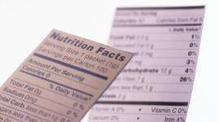
Dietary Specifications
Zero grams of trans fat per portion
Saturated Fat ≤10%
Grade Group | K – 5 | 6 – 8 | 9 - 12
Calories | 350 – 500 | 400 – 550 | 450 - 600
Sodium | ≤540 mg | ≤600 mg | ≤640 mg
Notes:
This slide details the breakfast dietary specifications.
The sodium limits for Target One are shown in this chart. Due to the recent USDA menu planning flexibilities, SFAs can continue to implement target one goals.
Other dietary specifications that schools must meet include: zero grams trans fat per portion and total saturated fat must be less than or equal to 10% of total calories. Check all labels for trans fat.
Concentrate first on meeting meal pattern requirements. A nutrient analysis is not required.

Slide 9
Offer vs. Serve School Breakfast Program
Notes:
Now we will discuss Offer versus Serve in the School Breakfast Program.

Slide 10
What is Offer versus Serve (OVS)?
Concept that applies to menu planning and the determination of reimbursable meals
Allows students to decline a certain number of food components in the meal
Notes:
Offer versus Serve or OVS, is a concept that applies to menu planning and the determination of reimbursable school meals in the USDA National School Lunch Program and School Breakfast Program.
OVS allows students to decline a certain number of food components in the meal, reducing food waste and food cost, and allowing students to select the foods they prefer to eat.
When student select the foods they prefer to eat they are more likely to eat the foods and less likely to throw them out, reducing plate waste.
OVS is optional for all grade levels at breakfast. OVS is optional for middle schools, and elementary schools for lunch. OVS must be implemented in senior high schools for lunch.

Slide 11
OVS Breakfast Signage
Notes:
Schools must identify what constitutes a reimbursable meal at or toward the beginning of the meal service line.
Signage is required to assist students in identifying and selecting what is a reimbursable meal.
Most effective signage is signage that is tailored to the school menu. Here is an example of a breakfast signage template available on our website and in the resources tab.

Slide 12
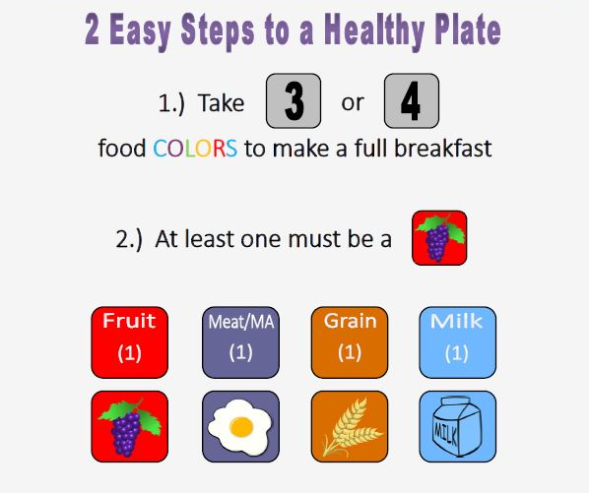
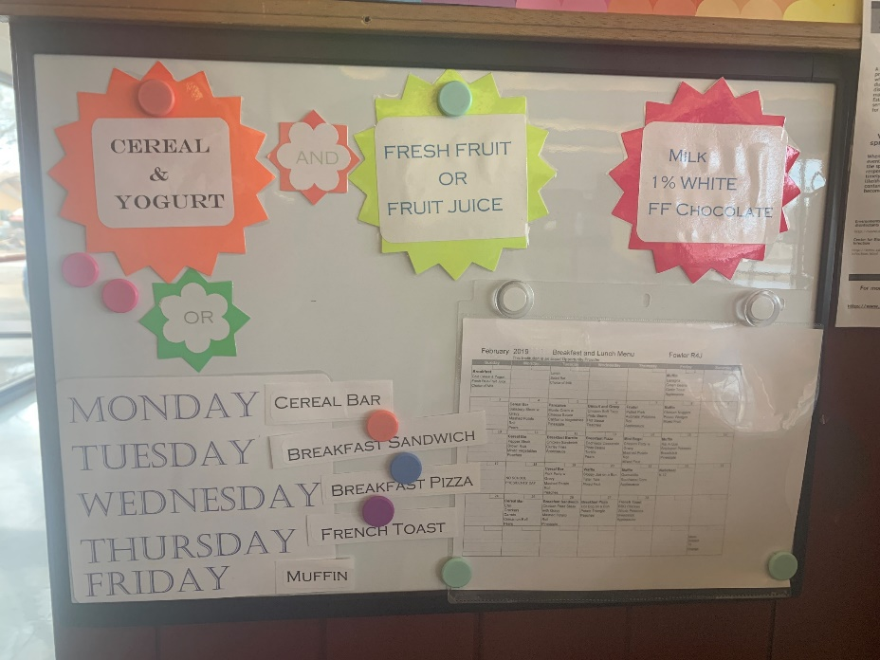
OVS Breakfast Signage
Notes:
Here are a few examples of OVS breakfast signage. The example on the left uses a color coding system instructing students to take a certain amount of colors while the sign on the right uses specific language for the menu served. Best practice is to use whatever works well for you and your site.

Slide 13
OVS at Breakfast
Always offer all three components in at least the required amounts
For OVS, must offer at least four food items at breakfast
Students must select at least 3 items (if more than 4 items are offered, they may decline more than one)
For purposes of OVS, an item is the daily required minimum amount of each food component that a child can take
1 cup of milk
1 oz. eq. of grains
1 cup of fruit (or veg)
Notes:
At breakfast we must think in terms of food items and food components.
Food components at breakfast are grain with optional meat/meat alternate allowed, fruit or alternate vegetable, and milk.
Food items are a specific food offered within the 3 food components. For example, an orange is a food item within the fruit component.
To implement OVS at breakfast a school must offer at least 4 food items from the three components in the required amounts.
For the purposes of OVS at breakfast a student must select at least 3 items, one of which must be a ½ cup fruit/vegetable.

Slide 14
OVS at Breakfast
Cereal: 1.0 oz eq grain
Toast: 1.0 oz eq. grain
Milk: 1 cup
Banana: 1
Notes:
This slide shows an acceptable offering for breakfast under OVS.
Note there are four items offered (cereal, toast, milk and banana) from the three components (grain, milk, fruit).

Slide 15
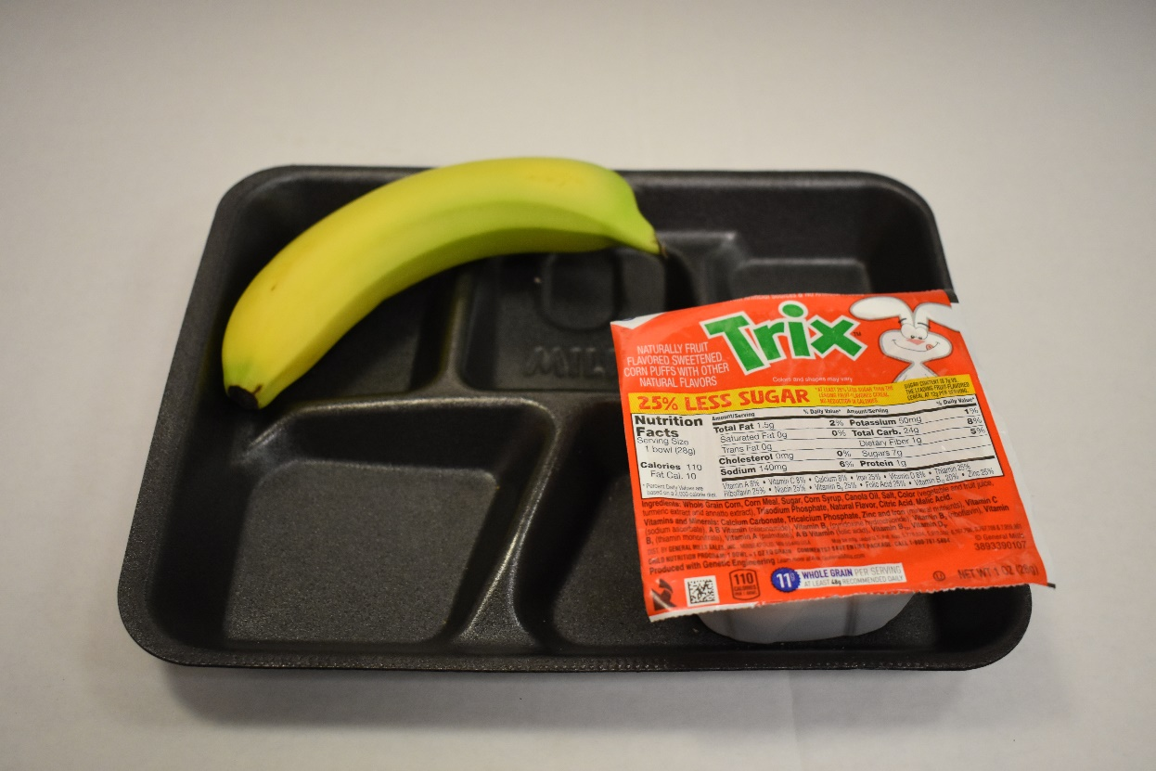
Reimbursable Breakfast?
NO
Offered
Cereal: 1 oz. eq. grain
Banana: 1
Notes:
A student has selected this tray, is this meal reimbursable? No
This meal is not reimbursable because there are only two food items on the tray, regardless of having the minimum requirement of fruit.
A different quiz question-What would make this meal reimbursable? Eggs, Milk, Yogurt, Apple

Slide 16
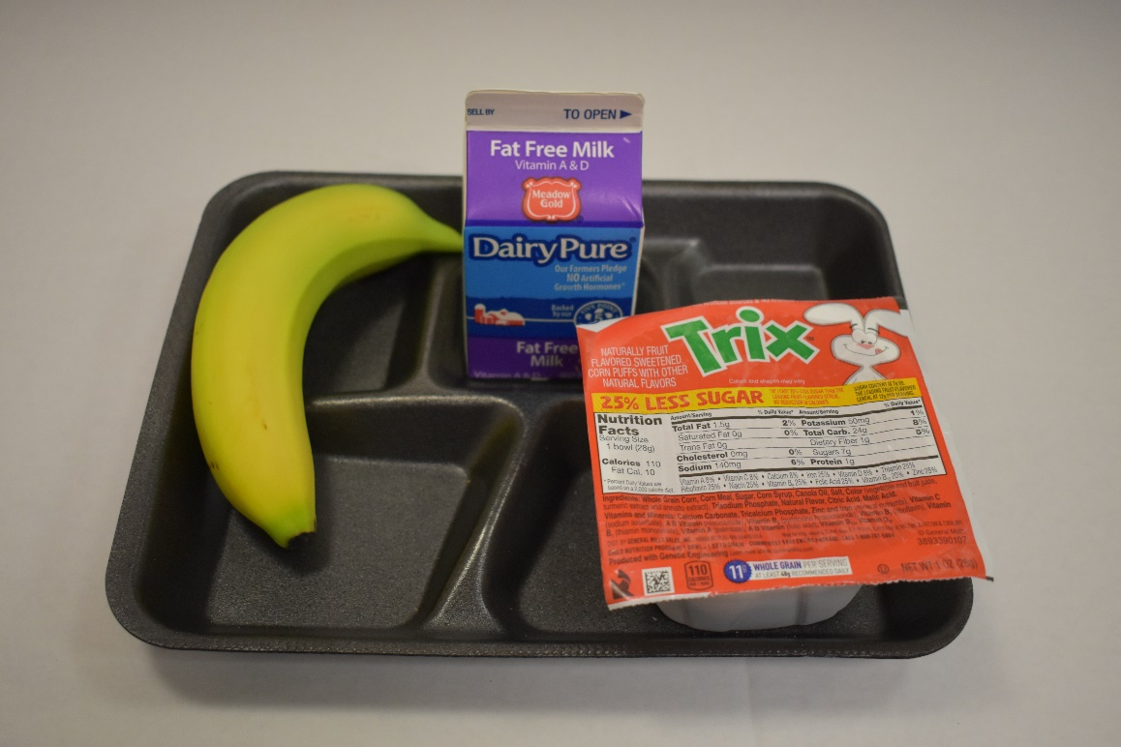
Reimbursable Breakfast?
YES
Offered
Cereal: 1.0 oz. eq. grain
Milk: 1 cup
Banana: 1
Notes:
In this example milk has been added.
This breakfast is now reimbursable because it contains 3 different food items, one of which meets the ½ cup fruit requirement.

Slide 17
Optional Meat/Meat Alternates
Breakfast meal pattern does not require a meat/meat alternate
SFAs that wish to offer a meat/meat alternate at breakfast have two options
Credit the meat/meat alternate as a grain item
Offer the meat/meat alternate as an extra item
Common breakfast M/MA:
Cheese | Yogurt | Sausage | Egg | Ham
Notes:
Meat/meat alternates contain many important nutrients, especially protein, which is important for children as they begin the school day.
Menu planners have discretion to offer meat/meat alternates and either 1) count these items as a grain and credit them toward the grains component (once the daily grain component has been met) or 2) count these items as extras, and choose to not credit them toward the grains component. If MMA is an extra item, you can’t count this as an item for a reimbursable meal.

Slide 18
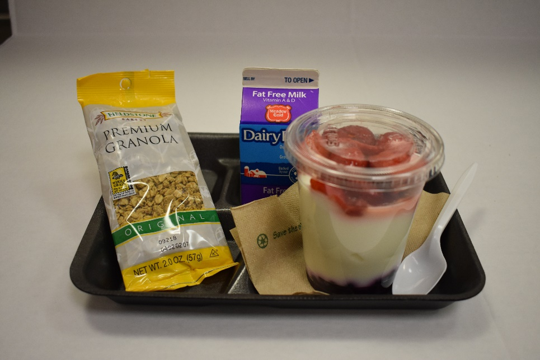
Meat/Meat Alternate In Place of Grains
Granola: 2 oz. eq. grain
Yogurt: ½ cup
Strawberries: ½ cup
Blueberries: ½ cup
Milk: 1 cup
Offered
Notes:
In the first option, schools have flexibility to credit the meat/meat alternate as a grain item, provided they also offer 1 ounce equivalent of grains daily.
This is intended to safeguard planning flexibility while promoting the consumption of whole grain-rich foods consistent with the recommendations of the Dietary Guidelines for Americans.
In this example, the menu planner is offering 2 oz. eq. grain with the granola and 1 MMA with yogurt, which credits as 3 oz. equivalent grains and 2 food items under offer vs. serve.
Keep in mind that meat/meat alternates counted as grains at breakfast contribute toward the weekly grains range, the dietary specifications and as an “item” under OVS.

Slide 19
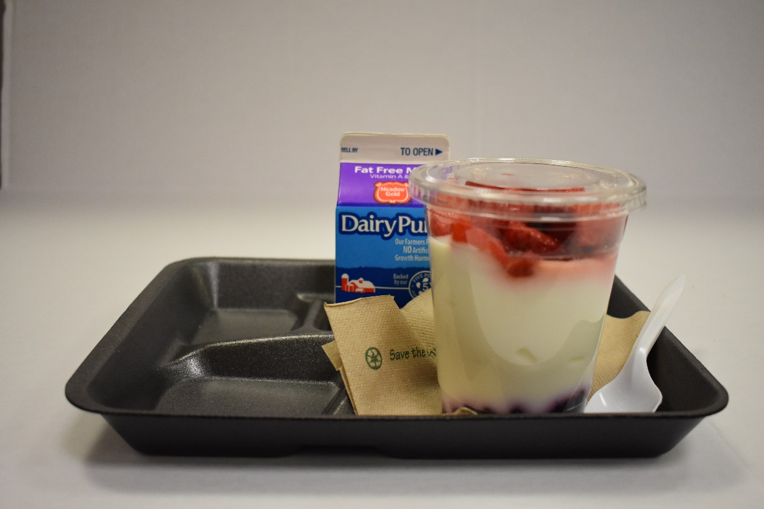
Allowable Offering?
NO
Offered
Milk: 1 cup
Yogurt: ½ cup
Strawberries: ¼ cup
Blueberries: ¼ cup
Notes:
Here we have a school offering a yogurt parfait containing ½ cup of yogurt, ½ total fruit and 1 cup milk
Is this an allowable offering under OVS?
Keep in mind that the amount offered must contain the grain. Seeing this come through the line would only be allowable if the student had the option to take a grain (it was offered).

Slide 20
Large Grains at Breakfast
Component
Item
Grains
2oz eq Muffin (2)
A large grain can count as more than one food item for purposes of OVS in breakfast
e.g. 2 oz. eq. muffin = 2 food items
Notes:
Let’s talk about the grains component under OVS.
First, a large grain (In this specific example, a 2 oz eq. muffin) counts as more than one item for purposes of OVS in breakfast.
Since 1oz eq of grain is the minimum required amount a child can take daily, for all age/grade groups. If the 2 oz is offered, the menu planner counts this as 2 items.

Slide 21
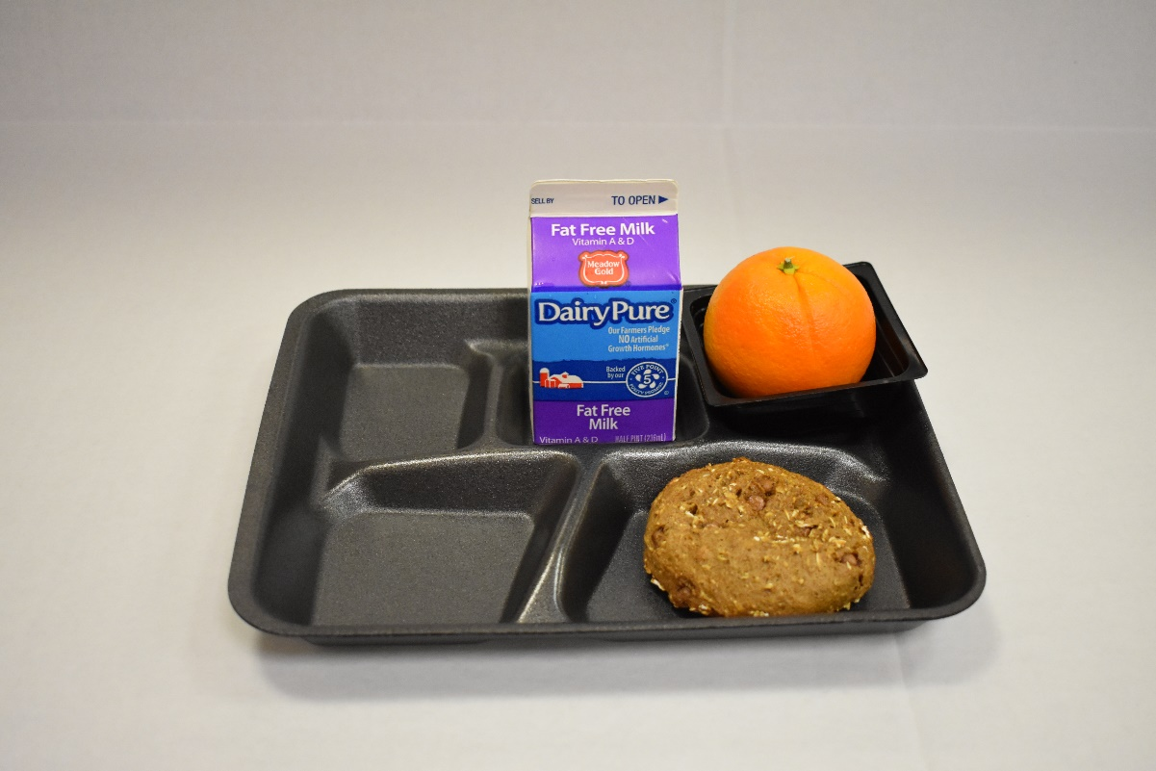
Allowable Offering?
YES
Offered
Breakfast Bar: 2 oz. eq.
Orange: ½ cup
Milk: 1 Cup
Notes:
Here, a school is offering a 2oz. Eq. breakfast bar, an orange and 1 cup milk. Is this an allowable offering?
Yes, remember the breakfast bar counts as two food items under OVS. Only 2 other food items (a fruit and milk variety) must also be offered to have OVS, to make the total of 4 food items needed for OVS.

Slide 22
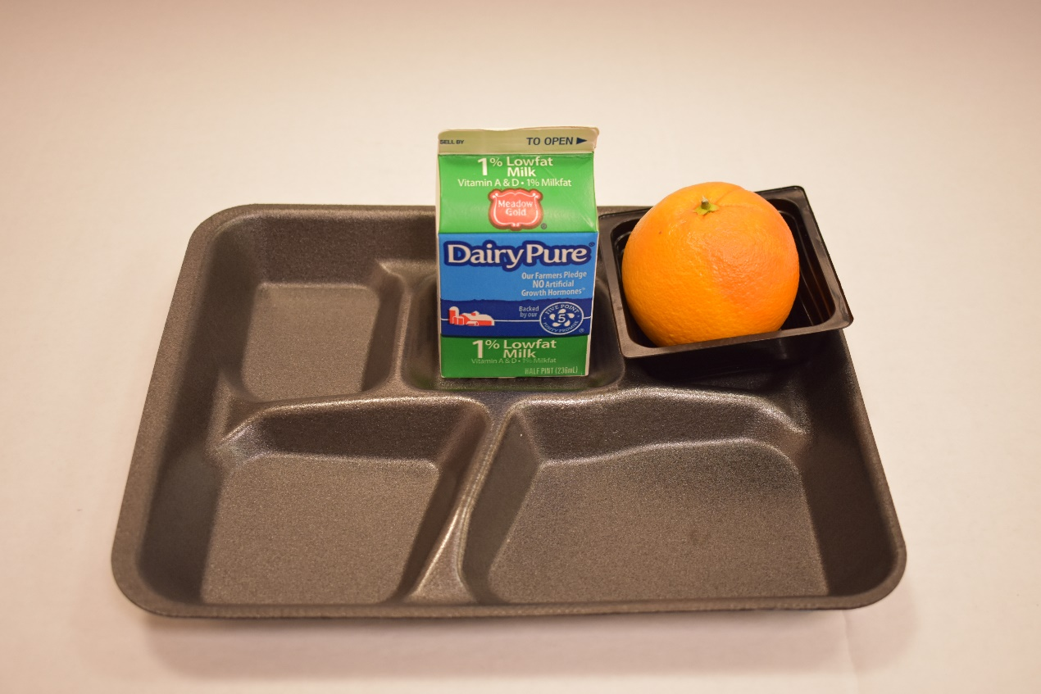
Reimbursable Breakfast?
NO
Offered
Milk: 1 cup
Orange: ½ cup
Notes:
Here we see the tray if the large grain item is refused. Is this a reimbursable breakfast?
No, only two items have been selected.
Keep in mind that because the 2oz grain counts as 2 items, it cannot be declined.
For OVS at breakfast, students may only decline one item. This is a limited menu.

Slide 23
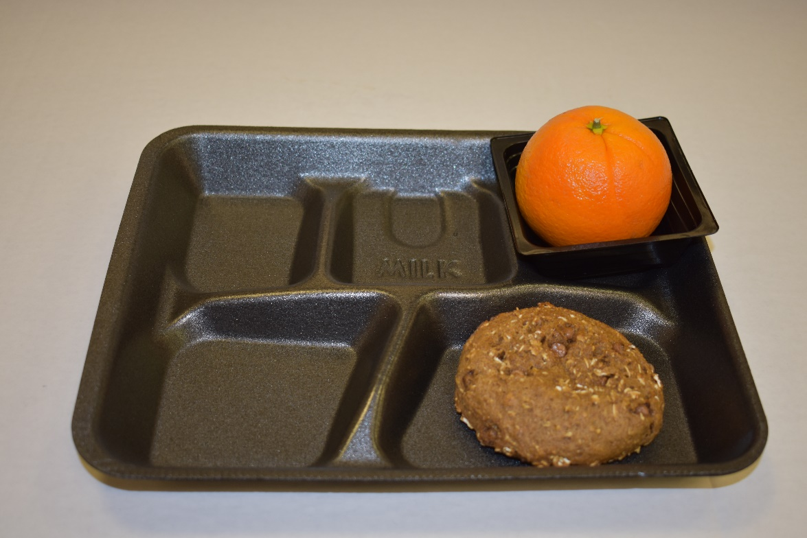
Reimbursable Breakfast?
YES
Offered
Breakfast Bar: 2 oz. eq.
Orange: ½ cup
Notes:
Is this breakfast reimbursable? Yes, the meal has three items.
The breakfast bar counts as two items, only one more item is needed and the orange satisfies the ½ cup of fruit requirement

Slide 24
Grains-Meat/Meat Alternate Combination Items
When counting the meat/meat alternate as grains, the combination item may count as two food items
Example: Egg/Cheese Sandwich:
1 oz. eq. of grains and 1 oz. eq. of MMA counting as grains = 2 food items
Notes:
The second part of OVS as it relates to grains has to do with grain-meat/meat alternate combination items. The breakfast sandwich pictured above is an example.
Menu planners have a couple of options related to how to count a meat/meat alternate-grains combination. One option is to count the combination as two items for purposes of OVS.
In this example, a menu planner may choose to credit the egg and cheese (meat/meat alternate) toward the grains component and count the sandwich as two grain items (a total of 2 oz eq of grains).
This is similar to the prior slide, when we discussed the 2 oz eq muffin counting as 2 items.
The menu planner must also always offer the full required amount of fruit (or vegetable) and milk.
Again in this case, the student may not decline the combination sandwich under OVS if only four items are offered as it would exceed the maximum number of items that may be declined.

Slide 25
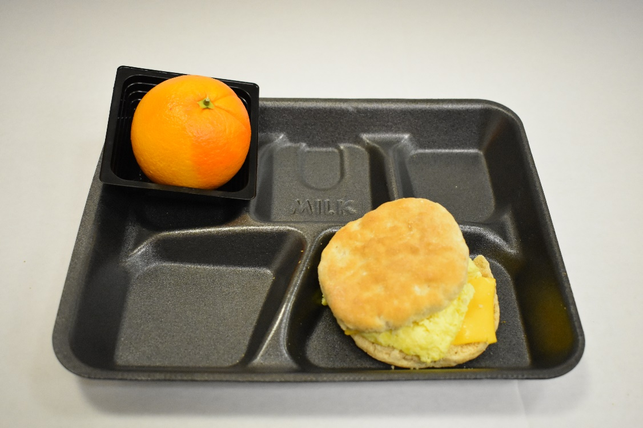
Reimbursable Breakfast?
YES
Offered
Breakfast Sandwich 1oz eq. grain, 1MMA
Orange: ½ cup
Notes:
If a student selected the breakfast above would it be reimbursable? Yes.
Why? Three items have been selected one of which is ½ cup fruit.

Slide 26
Allowing Students to Take Two of the Same Grain Item
If a menu planner offers two different 1 oz. eq. grain items at breakfast, a student may be allowed to take two of the same grain and count as two items
Notes:
When a menu planner offers two different 1 oz eq grain items at breakfast, a student may be allowed to take two of the same grain item and count this as two grain items for purposes of OVS.
In this example, the school is offering two grains: cereal (1 oz. eq.) and toast (1 oz. eq.) plus milk and fruit.
This is acceptable if the menu planner chooses to do so.

Slide 27
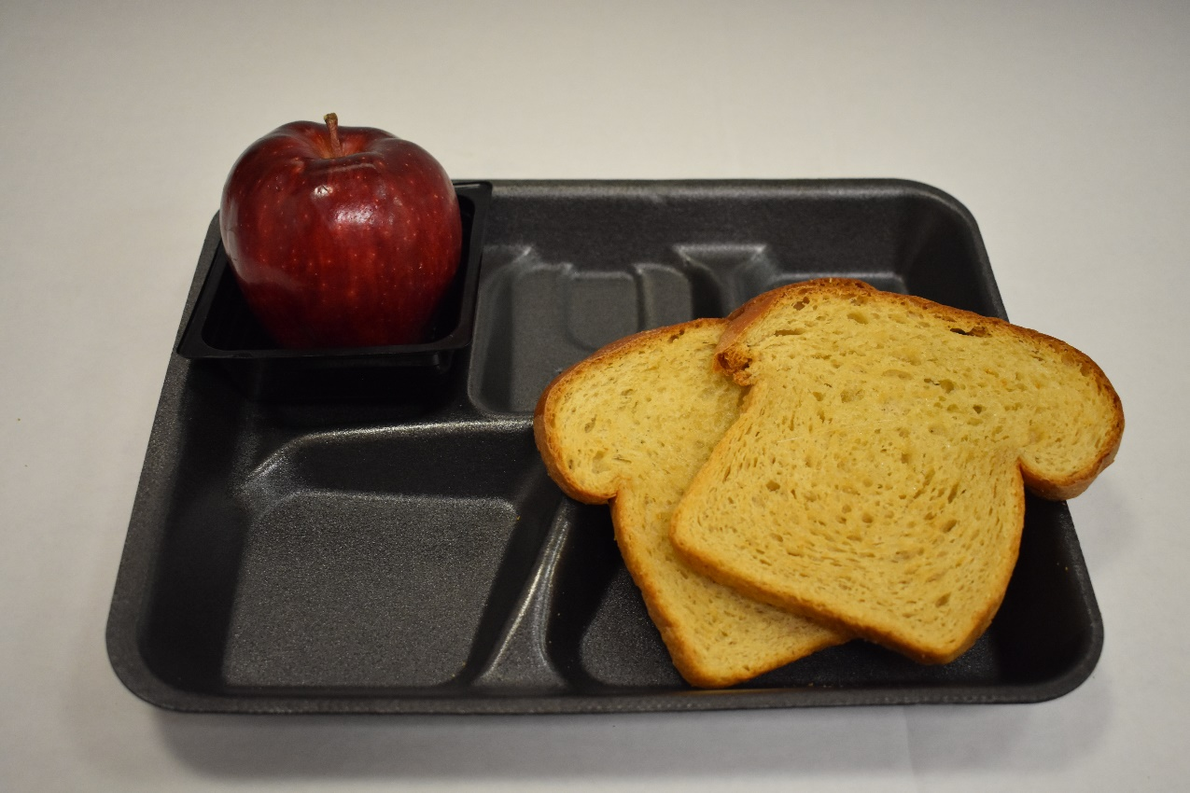
Allowing Students to Take Two of the Same Grain Item
Selected
Two Slices of Toast: 1 oz. eq. each
Apple: 1 cup
Notes:
The student could select the fruit and two pieces of toast. The 2nd piece of toast would be selected in place of the cereal, the other grain offered.
This would be a reimbursable breakfast under OVS. Only the milk (1 item) is declined.
The menu planner has discretion whether or not to allow students to select duplicate grain items. In this example, will you allow the students to take two toasts or two cereals or would it be just one cereal and one slice of toast combined? All of these decisions are allowed and up to the menu planner’s discretion.

Slide 28
Quiz Question
Under OVS it is __________ to count a large grain item (for example a 2oz muffin) as two items at breakfast.
Allowable
B) Unallowable
Notes:
Time to check your knowledge!
Under OVS it is __________ to count a large grain item (for example a 2oz muffin) as two items at breakfast.
A) Allowable
B) Unallowable
The answer is A, allowable.
Under SBP large grain items can be counted as two items.
What do you need to watch out for? That if only four items are offered that students may not refuse large grain item or they will not have the required three items.

Slide 29
Contacts and Resources
Meal Pattern or Offer versus Serve questions: call 303-866-6661 or email the School Nutrition staff member who oversees Meal Patterns https://www.cde.state.co.us/nutrition/nutristaff
Further Resources:
Meal Planning webpage
Offer Versus Serve webpage
Notes:
This training is one of two trainings on Offer versus Serve. If you haven’t already, take the Offer versus Serve National School Lunch Program training as well.
Please feel free to contact our office for questions or clarification.
Thank you for tuning in to the training and also thank you for the work you do everyday in providing students healthy school meals!

