Slide 1
Summer 2022 & School Year 2022-23 Updates
April 2022
School Nutrition Unit
Notes:
19.04.2022
Good afternoon, and welcome to the April on the menu call. I’m Megan Johnson, the Nutrition Programs Manager for the CDE School Nutrition Unit.
*Click record*
‹#›

Slide 2
Mute/
Unmute
Video
On/Off
Chat
Closed Caption
Notes:
19.04.2022
First, I will cover some quick Zoom housekeeping items before we jump into the content.
All attendees will enter muted. You will know that you are muted if the microphone button in the lower left corner has a slash across it. Next to the microphone is a camera icon. Click the camera icon to turn it on which will remove the slash across the icon. It is completely optional to turn on your camera today.
If you keep moving across the bottom portion of your screen you will see a chat icon in the middle. If you have any questions today, please insert them into the chat-we will monitor the chat and compile a list of questions to address at the end of the webinar if we have time.
We will insert the PowerPoint slides for today with speaker notes into the chat for you to download.
To the right of the chat icon, is an icon for closed captioning if you needed it. Go ahead and click this button for subtitles.
‹#›

Slide 3
CDE School Nutrition
Vision
Mission
Nourish young bodies and minds. End childhood hunger.
We support the child nutrition community through innovation, training, and partnerships to ensure all youth have access to healthy meals.
Notes:
19.04.2022
Here are the CDE School Nutrition Unit’s Vision and Mission. We have spent time updating our vision and mission to reflect our team’s desire to support our child nutrition community and end childhood hunger in Colorado.
‹#›

Slide 4
Non-Discrimination Statement
In accordance with Federal civil rights law and U.S. Department of Agriculture (USDA) civil rights regulations and policies, the USDA, its Agencies, offices, and employees, and institutions participating in or administering USDA programs are prohibited from discriminating based on race, color, national origin, sex, disability, age, or reprisal or retaliation for prior civil rights activity in any program or activity conducted or funded by USDA. Persons with disabilities who require alternative means of communication for program information (e.g. Braille, large print, audiotape, American Sign Language, etc.), should contact the Agency (State or local) where they applied for benefits. Individuals who are deaf, hard of hearing or have speech disabilities may contact USDA through the Federal Relay Service at (800) 877-8339. Additionally, program information may be made available in languages other than English.
To file a program complaint of discrimination, complete the USDA Program Discrimination Complaint Form, (AD-3027) found online at: https://www.usda.gov/oascr/how-to-file-a-program-discrimination-complaint, and at any USDA office, or write a letter addressed to USDA and provide in the letter all of the information requested in the form.
To request a copy of the complaint form, call (866) 632-9992. Submit your completed form or letter to USDA by: (1) mail: U.S. Department of Agriculture Office of the Assistant Secretary for Civil Rights; 1400 Independence Avenue, SW Washington, D.C. 20250-9410; (2) fax: (202) 690-7442; or (3) email: program.intake@usda.gov.
This institution is an equal opportunity provider.
Notes:
19.04.2022
We include the nondiscrimination statement in our trainings as a reminder of our responsibilities to ensure all eligible people may participate in our child nutrition programs. As equal opportunity providers, we prohibit discrimination in our programs and provide fair and equitable treatment to every participant. For the full disclosure statement, visit the School Nutrition civil rights webpage.
‹#›

Slide 5
Be present and engaged
Participate in discussion
Mute your microphone when you’re not talking
Bring a positive attitude and be ready to share
Be respectful, inclusive and open minded
Conditions for Success
Notes:
19.04.2022
Here are some other conditions for success to make our time together today as meaningful as possible.
Are there any other conditions that would help ensure a successful session that you would like to add today?
‹#›

Slide 6
Learning Objectives
By the end of this training, you will be able to:
Identify flexibilities available for summer 2022 and SY 2022-23
Describe sponsor training requirements
Locate and utilize SFSP outreach materials
Professional Standards
1 hour in Operations (2000), Administration (3000)
Notes:
19.04.2022
By the end of this training, you will be able to:
Identify flexibilities available for summer 2022 and SY 2022-23
Describe sponsor training requirements
Locate and utilize SFSP outreach materials
You will also receive 1 hour of training that can be applied to professional standards requirements. The areas covered by this training are operations and administration.
‹#›

Slide 7
Waiver Updates for Summer and SY22-23
Program Operation reminders and updates
Agenda
Notes:
19.04.2022
Here is the agenda for today’s training. If questions come up during the training, please feel free to type them in the chat and we will have time for questions throughout the training and at the end.
I also want to note that resources are linked on the slides throughout this presentation. You won’t be able to click on your screen for the links, but you can download the slides and access the links that way. Links will also be dropped in the chat throughout the presentation.
Before we get going, let’s do a quick warm up. I am so excited that the weather is getting warmer and it feels like summer is almost here! I want to know what your favorite thing to do in the summer is. Please type in the chat or unmute yourself.
‹#›

Slide 8
Waiver Updates
Notes:
19.04.2022
That was fun, thank you for sharing. Now let’s get into the content for today. We’re going to start off with recent waiver updates.
‹#›

Slide 9
Waiver Updates
Current nationwide waivers are not extended
State agencies can apply for specific waivers for this summer and next school year
Notes:
19.04.2022
For the past couple of years, the USDA has been able to grant nationwide waivers related to the covid-19 pandemic that have provided a tremendous amount of flexibility for child nutrition program requirements. As a reminder, the USDA no longer has the authority to extend these nationwide waivers. In addition, USDA cannot waive certain requirements, including:
Nutritional content of meals served
Federal reimbursement rates
Provision of free and reduced-price meals
However, USDA has identified options to support sponsors during this summer and next school year while transitioning back to traditional operations.
‹#›

Slide 10
Expansion of area eligibility
Operation of SSO during the school year
Offering the SFSP reimbursement rate for SSO meals
Waiver of meal pattern requirements
Expiring Waivers
Notes:
19.04.2022
Let’s start by talking about the nationwide waivers that will not be extended or available for states to apply for moving forward. The waivers that are expiring include:
Allowing non-area eligible sites in the Summer Food Service Program, Afterschool Snack Program, and Seamless Summer Option
Operating the SSO during this school year
Offering the SFSP reimbursement rate instead of the SSO reimbursement rate when operating the SSO during the school year
And waiver of meal pattern requirements
‹#›

Slide 11
Available Waivers
Summer 2022
Waiver Updates: Summer Food Service Program
Non-congregate meal service
Parent/guardian meal pick-up
Off-site monitoring
SFSP Comparison Chart
Notes:
19.04.2022
USDA announced last week that states can apply for a variety of waivers for the SFSP and for next school year. I’m happy to report that through the hard work of our team Colorado has already applied for all of the waivers that I am going to talk about today. I also want to point out up front that sponsors will need to seek approval from CDE in order to use the waivers for summer 2022, and we will discuss the approval process on the next slide.
For this summer, the waivers available are:
Non-congregate meal service
Parent pick-up of meals and
Off-site monitoring
When the non-congregate meal service waiver is being used, sites can serve multiple days’ worth of meals at one time
There will also be flexibilities for area eligibility that are not part of these waivers, and we will discuss these options when we talk about program operations later on.
We have created a comparison chart that describes the differences between traditional summer operations and flexibilities that are allowed for this year. The resource is linked on this slide and in the chat.
If approved, the summer waivers will expire on September 30th, 2022.
‹#›

Slide 12
Waiver Process
Summer 2022
Waivers may be utilized when operations are impacted by COVID
Sponsors must apply and be approved to use waiver
Smart sheet form and examples coming soon!
Notes:
19.04.2022
Waivers are allowable to be used when the sponsor, county and/or operations are impacted by COVID-19. We are currently working with USDA and the Colorado Department of Public Health and Environment to better define what qualifies as “impacted by COVID” and we will follow up with criteria and examples soon.
If waivers are approved for Colorado, sponsors will also need to receive approval from CDE to implement the flexibilities. This process will likely be a smart sheet form with drop downs to define the waiver you want to implement and justification. Look for updates via the DISH soon!
‹#›

Slide 13
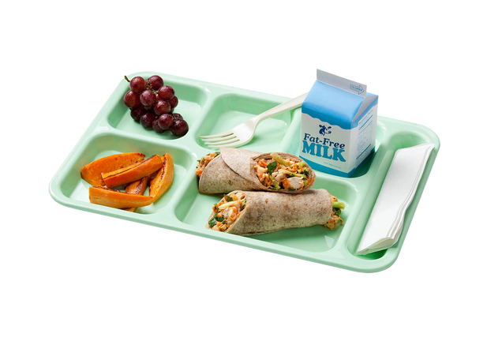
Waiver Update:
National School Lunch & School Breakfast Programs
Non-congregate meals
Meal times
Parent/guardian meal pick-up
Offer versus serve
Local wellness policy assessment
Food Service Management Company contract duration
Off-site monitoring
Notes:
19.04.2022
By the end of this training, you will be able to:
Identify flexibilities available for summer 2022 and SY 2022-23
Describe sponsor training requirements
Locate and utilize SFSP outreach materials
You will also receive 1 hour of training that can be applied to professional standards requirements. The areas covered by this training are operations and administration.
‹#›

Slide 14
Available Waivers
School Year 2022-23
Waiver Updates:
Special Milk Program
Non-congregate milk service
Parent/guardian pick-up
Notes:
19.04.2022
We have also applied for waivers for non-congregate feeding and parent pick up for the Special Milk Program.
‹#›

Slide 15
Available Waivers
School Year 2022-23
Waiver Updates:
Fresh Fruit & Vegetable Program
Parent/guardian pick-up
Alternate sites
Notes:
19.04.2022
For the FFVP, state agencies can submit a waiver request for parent/guardian pickup and the use of alternate FFVP serving sites when an approved site is closed.
If approved, expire June 30th, 2023.
‹#›

Slide 16
Waiver Process
School Year 2022-23
Waivers may be utilized when operations are impacted by COVID
Sponsors must apply and be approved to use waiver
Smartsheet form and examples coming soon!
Notes:
19.04.2022
Similar to Summer Food Service Program flexibilities, certain waivers are allowable to be used when the district is impacted by COVID-19; such as non-congregate feeding, meal times and parent pick up.. We are currently working with USDA and the Colorado Department of Public Health and Environment to better define what qualifies as “impacted by COVID” and we will follow up with criteria and examples soon.
If waivers are approved for Colorado, sponsors will also need to receive approval from CDE to implement non-congregate feeding, meal times and parent pick up flexibilities. This process will likely be a smart sheet form with drop downs to define the waiver you want to implement and justification. Look for updates via the DISH soon!
Other waivers for school meals, such as offer vs. serve at the high school level, local wellness policy assessment, food service management company contract duration and off-site do not need justification of being impacted by COVID-19 or a form completion.
CDE is working on a comparison chart, similar to summer, for school year operations to ensure operation requirements are clear. We will also be holding a Back to School pre-con session at the Colorado School Nutrition Association in June; and will have additional training over the summer. Look for training information and updates in the DISH.
‹#›

Slide 17
Waiver Questions?
Notes:
19.04.2022
I know that this is a big transition from how programs have been operating for the last couple of years, and I want to make sure I answer any questions specific to the waivers. I will also note that we are in the process of creating an FAQ for summer 2022 and School Year 2022-23 operations, so if there are not questions we can answer today we will be sure to include those in the FAQ.
Are there any questions you can think of at this time? Please feel free to type in the chat or un-mute yourself.
Open up to other waiver questions- limit to 10 min
‹#›

Slide 18
Program Operations
Notes:
19.04.2022
Thank you for bringing up your questions around the waivers. If you think of any other questions, feel free to put them in the chat and we can answer them at the end of this training.
Now we’re going to dig in to some more detailed information on program operations.
‹#›

Slide 19
Area Eligibility Options
Summer Food Service Program
Seamless Summer Option
NSLP Afterschool Snack Program
Notes:
19.04.2022
First, we will talk about options for establishing site area eligibility. These options will apply to the Summer Food Service Program, Seamless Summer Option, and NSLP Afterschool Snack Program, and do not require a waiver request.
Also applies to CACFP at-risk afterschool and family daycare homes
‹#›

Slide 20
Area Eligibility Options
Traditional: Use the most recent school or census data
Option 1: Use School Year 2019-2020 Oct. 1 count school data
Option 2: Use Community Eligibility Provision data
Notes:
19.04.2022
With the area-eligibility waiver no longer in place, all sites must meet site eligibility requirements. However, the USDA is allowing two additional options to establish area eligibility in the event that sites do not qualify using traditional methods.
As a reminder, the traditional method to establish site eligibility is to use current school or census data. This is still your go-to option when establishing site eligibility for SFSP, SSO, and ASP. Once established, sites are area eligible for five years.
If the site is not eligible using the traditional method, then sponsors may work with their CDE point of contact to determine if option 1 or option 2 will work.
With option 1, sites may use the October 1 school free and reduced price lunch count data from school year 2019-20. Sites that qualify using option 1 will be eligible through the summer of 2024.
With option 2, sites may use their CEP Identified Student Percentage, or ISP, to qualify. The ISP is multiplied by the factor of 1.6, and if the resulting percentage is over 50% then the site would qualify. (ISP of 31.25 x 1.6 = 50%).
Sponsors can use a combination of options 1 and 2, but each site will only use one option to establish area eligibility. These options are only available during the summer 2022 and SY 2022-23.
‹#›

Slide 21
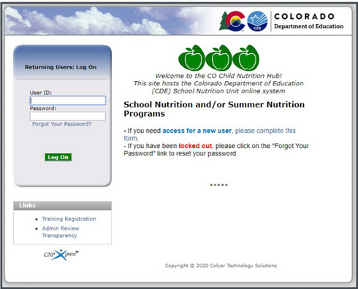
SFSP Program Year 2022 Applications
Applications are due May 1, 2022
Sites can be added at any time
Training available on the How to Apply web page
Notes:
19.04.2022
We understand that this new information about site area eligibility options is coming close to the SFSP application deadline of May 1st. Applications are still due May 1st, but sites may be added after this date.
Please work with your CDE point person on application questions, as well as applying for sites using the area eligibility options 1 and 2.
‹#›

Slide 22
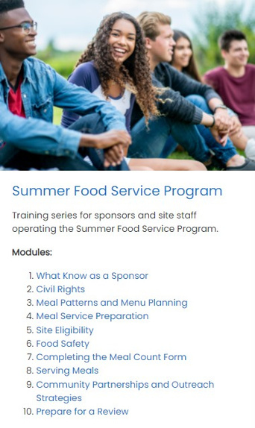
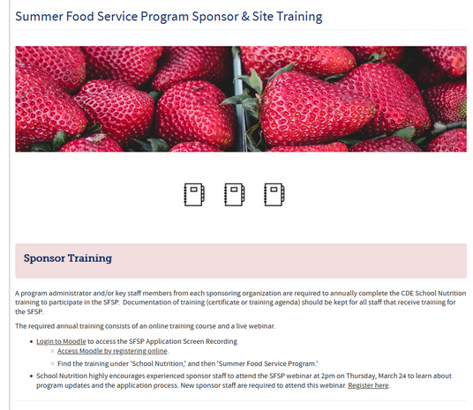
Training Requirements - Sponsors
SFSP Training Page
Register for a Moodle account
Notes:
As a reminder, sponsors are required to complete sponsor training prior to the start of SFSP operations. This year, we have a new video series with required and optional videos, as well as the recording from last month’s On The Menu webinar.
To access the videos, visit our summer training web page. You will need to log in to our new training platform called Moodle to access the videos, and if you don’t have a Moodle account you can fill out a quick form that is also linked on the training page to create a new account.
You will need to complete the training evaluation for the videos and recorded webinar in order to access your training certificate. If you have any trouble accessing the evaluation links, please reach out to me.

Slide 23
Community Eligibility Provision
Provides free meals to all students
Used for a group of schools or whole district
CEP Web Page
wetherbee_b@cde.state.co.us
Notes:
19.04.2022
We also wanted to highlight the Community Eligibility Provision as an option to provide free meals to all school students.
The CEP is a provisional program that uses information about student direct certification to qualify a group of schools, or an entire district to provide universal free meals. It can also streamline the administrative burden of collecting income applications.
The implementation timeline of CEP has been extended this year, so there is still time to decide if this is an option for your schools. If you are interested in the CEP and would like to know more, please visit CDE’s CEP web page or contact Benjamin Wetherbee.
‹#›

Slide 24
Renewal Applications
NSLP/SBP/ASP applications opening in May
Application training May 26th
Notes:
19.04.2022
It’s hard to believe we’re here already, but renewal application for NSLP and SBP are just around the corner.
Applications will be opening in May, and we will be offering application training on Thursday, May 26th. We will also record this training for those that are not able to attend.
Be on the lookout for training registration and more information coming soon in the Dish!
‹#›

Slide 25
Breakouts
What are the top 3 things you learned?
What questions do you still have about program operations?
What resources or support is needed?
Notes:
19.04.2022
Now that we have covered waivers and program requirements, we’re going to have a short breakout activity to process the information we have learned today.
Questions:
What are the top 3 things you learned?
What questions do you still have about program operations?
What resources or support is needed?
We will get into these breakout rooms shortly, and you will have 10 minutes for discussion before we return to the larger group to share out at least one additional question or idea for resources/support.
10 minutes
will someone from group 1 share a question or topic you discussed
‹#›

Slide 26
Marketing & Outreach
Notes:
19.04.2022
For the last section of this training, we will cover marketing and outreach strategies to help increase participation in your programs
‹#›

Slide 27
Outreach Materials
New! Free Outreach Toolkits
Order Form
Notes:
19.04.2022
School Nutrition is excited to share that outreach toolkits are available for FREE to all sponsors for all summer and school year meal sites. Complete this order form to order your summer and/or school toolkits. Toolkits will be shipped this summer.
‹#›

Slide 28
Wrap Up & Questions!
Notes:
19.04.2022
We’re at the end of this training, so let’s wrap up and get to your questions.
‹#›

Slide 29
Training Evaluation & Certificate
Click this link to complete a quick training evaluation:
https://www.surveymonkey.com/r/YYDDCWS
When you submit the evaluation, click “DONE” on the survey thank you page to download your certificate
Notes:
19.04.2022
Linked on this page is an evaluation survey that you can take to access your training certificate for today.
This link will also be emailed out to all training attendees. The information on this slide is included for those watching this training at a later date as a recording.
Thank you so much for your feedback - we are always looking for ways to improve our trainings to better support you.
‹#›

Slide 30
CDE Point Person
Thank you!
Summer Meal Program Email
SFSP Web Page
Notes:
19.04.2022
Thank you for your time today. Here are some helpful links for you to reach out to CDE with additional questions.
‹#›

Slide 31
Questions?
Notes:
19.04.2022
With the time we have left, I would like to answer some of your remaining questions.
If you have additional questions, please continue to add them to the chat.
If we do not have time to get to all of the questions, I will follow up via email to answer the questions that we aren't able to get to today.
‹#›

