Slide 1
Resources needed for this presentation (Keep this slide hidden) | 1
A way to project the PowerPoint
Note for presenters: For accessibility, you must read the words on the slides. The words bolded in the notes are the words from the slide.
Adequate audio for playing videos (test audio and video before presentation)
Video 1, slide 12: Scarborough’s Reading Rope (initiate closed captions for accessibility)
Video 2: slide 23: Comprehension Lesson | Primary Grades
Video 3: slide 24: Comprehension Lesson | Intermediate Grades
Video 4: slide 27: Build Language Comprehension
Video 5: slide 28: Talking While You Read (closed captions automatically show in video)
Blank paper and writing utensils for participants to take notes for discussion

Slide 2
Resources needed for this presentation (Keep this slide hidden) | 2
Review facilitator directions for Practice 2:
Practice 2: Talking While You Read Tri-fold 1 p. 2|1|3-2|1|11
If in a virtual setting, prepare to make breakout rooms for partners to talk.
Printed copies of these documents:
Slide 12: Note-taking handout The 5 Strands of Language Comprehension
Practice 2 materials:
Talking While You Read Tri-fold 1 p. 2|1|6
Print out this document with QR codes for audio books for parents if they prefer.
Language Comprehension and Reading Comprehension for Parents Handout
A variety of picture books for the practice section
Estimated time of presentation:
40 minutes of content, 20 minutes of practice activities

Slide 3


The Colorado READ Act and the Science of Reading for Families
Language Comprehension & Reading Comprehension
Notes:
Welcome and thank you all for being here today.
This is a presentation within the Colorado READ Act and the Science of Reading for Families. A series developed to support parents with ways to help their children build reading skills in partnership with their school. ​
During this presentation, we will be focusing on Language Comprehension and Reading Comprehension
For more information or additional resources, please visit the READ Act Parent Resources page found within the CDE website. (QR Code on the slide)
Background information for presenters:
The READ Act encourages local education providers to provide parent opportunities to participate in parent reading workshops throughout the school year to assist parents in developing their own reading skills and in developing the skills necessary to assist their children in reading. We hope this series will be helpful to you as parents (CRS 22-7-1208 (4)).
The Colorado READ Act statute defines the term “parent’ as a student’s biological or adoptive parent, stepparent, foster parent, or legal guardian(CRS 22-7-1203 (8)(a)).
For brevity purposes, we have adopted this definition throughout the presentation. When we use “Parent” during the presentation we mean family or caregiver aligned with the language of the law.

Slide 4
Welcome | Language Comprehension & Reading Comprehension
First Name Last Name, Title
Office
Email | Phone
Notes:
Welcome, we are glad you are here.
Share your name, title and contact details
If time, share a bit about your journey as an educator and/or parent that would be relevant to this session.
Logistics: Share the following points that match your circumstance:
This presentation includes active captions.
Presenters will be using a microphone.
We ask that audience members use a microphone when asking questions.
Presenters will be reading the content on each slide to ensure that it is accessible for ALL participants.
Note for presenters: For accessibility, you must read the words on the slides. The words bolded in the notes are the words from the slide.

Slide 5
Outcomes | Language Comprehension & Reading Comprehension
What are language comprehension and reading comprehension?
Why are language comprehension and reading comprehension important?
What do language comprehension and reading comprehension look like at school?
How can I support language comprehension and reading comprehension at home?
Notes:
By the end of this presentation the outcomes are for you to be able to answer these questions.
What are language comprehension and reading comprehension?
Why are language comprehension and reading comprehension important?
What does language comprehension and reading comprehension look like at school?
How can I support language comprehension and reading comprehension at home?
Take a moment to think about which question(s) you are very interested in learning about in our time together (Give 1-2 minutes of think time).
We have provided writing utensils and paper at each table. (If presenting virtually, start here) Please feel free to take notes. Later in the session, we will be talking in partners about what we have heard and learned around these questions.

Slide 6
Norms | Language Comprehension & Reading Comprehension
Active listening is appreciated
Active participation is welcomed
Take care of your own needs
Silence your cell phone as a courtesy to all
Notes:
We hope this will be an engaging and informative time for everyone here tonight. Please work to follow these norms:
Active listening is appreciated
Active participation is welcomed
Please take care of your own needs
If in-person, share where the restrooms and water stations are located, as needed.
If presenting virtually, you might consider asking participants to leave cameras on as they are able.
Silence your cell phone as a courtesy to all
Are there any other items you think we should add to this list that will support all of us?

Slide 7

Warm-Up | Language Comprehension & Reading Comprehension
Like Me
Move chairs back from the table so it is easy for you to stand up
A category will be named
Stand if you match the category
Look around to see who else is also in the category
Introduce yourself
Notes:
We are going to start with a Warm-up activity called (click) Like Me (Adjust the mobility section of the activity according to the abilities of the participants in the room).
We are doing this activity because:
This activity focuses the energy into this room and out of your day or previous activities, so you feel ready to participate
You will begin to understand who you are in relation to others in the group and have a chance to introduce yourself
Here is how this activity will work. I will read all of the steps, ask for questions and then we will begin to activity. (If presenting in a series, consider if reviewing the directions is needed for the group)
(click) Move chairs back from the table so it is easy for you to stand up. (Adjust the mobility section of the activity according to the abilities of the participants in the room. If presenting virtually, ask participants to stand in front of their camera or use the thumb's up reaction button).
(click) A category will be named.
(click) Stand if you match the category.
(click) Look around to see who else is also in the category.
(click) At the end, you will have a chance to Introduce yourself
Check for understanding -Does anyone have any questions?
Then, start the activity at step 1.
Name some of the following categories (or create your own to match your community) and give time for people to stand: (facilitators should also participate by standing or staying seated)
I am a parent
My child has a favorite topic they love learning about, (Ask for examples, if time).
My child changes topics they want to learn about frequently.
My child prefers to gain knowledge through listening.
My child prefers to gain knowledge through reading.
My child loves being an expert and will correct you if you are not specific or exact enough on your information sharing.
Have the parents go around the room and share: (if group is large, make small groups for this activity)
Name
Grade of Child(ren)

Slide 8
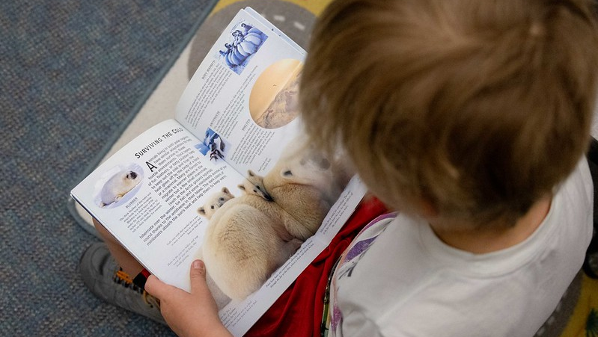

What are Language Comprehension & Reading Comprehension?
Notes:
What are Language Comprehension and Reading Comprehension?

Slide 9


Language Comprehension & Reading Comprehension
Language Comprehension
Gaining or making meaning from speech
Reading Comprehension
Gaining or making meaning from print
(Brown & Stollar, 2025; Kemeny, 2023)
Notes:
(click) Language comprehension involves gaining or making meaning from speech. Children begin developing language comprehension skills, or an understanding of spoken language, from birth. Listening and speaking are naturally occurring processes that children acquire as they grow and are exposed to vocabulary, language structures, and knowledge of the world around them.
Early exposure to texts being read aloud helps students gain an awareness of the language used in print, including how stories are structured, and exposure to more complex sentence structure than is often used in oral language.
(click) Reading comprehension involves the reader gaining or making meaning from print. Reading comprehension relies on the ability to accurately and fluently read the words on the page and use knowledge of language to make meaning from the text.
(Brown & Stollar, 2025; Kemeny, 2023).

Slide 10
Simple View of Reading (SVR)
Word
Recognition
Language
Comprehension
=
Reading
Comprehension
X
(Gough & Tunmer, 1986)
Notes:
Several decades of reading research have given us a clear understanding of how students best learn to read. One way to conceptualize reading is through the Simple View of Reading (SVR) model. This model, developed by Gough and Tunmer, organizes the skills needed to become a proficient and successful reader into two categories: (click) word recognition and (click) language comprehension. The Simple View of Reading is a basic formula for (click) reading comprehension.
It says this: reading comprehension is the product of word recognition skills and language comprehension skills.
We need both sides of the equation for students to become skilled, proficient readers.
(click) Students need efficient word recognition or decoding skills where they are accurately and automatically reading the words on the page without the aid of context clues or pictures.
(click) They also need fully developed language comprehension skills which references the ability to understand language or gain and make meaning from speech.
In order for a student to understand text or achieve Reading Comprehension, they need to decode the words on the page and then make meaning of the words, sentences, and overall text.
(https://www.cde.state.co.us/coloradoliteracy/scienceofreadingresources).

Slide 11
Simple View of Reading (SVR) | The 5 Components of Reading
Word
Recognition
Language
Comprehension
=
Reading
Comprehension
X
Phonological Awareness
Phonics
Vocabulary
Language- based skills and strategies
Literacy knowledge and skills
Fluency
Oral Language
(Gough & Tunmer, 1986; NRP, 2000)
Notes:
We can use the Simple View of Reading to organize the Five Essential Components of Reading.
(CLICK) Word recognition skills require phonological awareness (attention to the sounds in our language) and phonics (the ability to connect sounds to the letters that represent them).
(CLICK) Language comprehension is supported by vocabulary knowledge (knowing and understanding the meanings of words). In addition, vocabulary knowledge can also support word recognition, particularly as students encounter more complex or irregular words that require familiarity with word parts (morphemes) or context to decode and understand.
Readers also need a variety of language-based skills and strategies such as inferencing, understanding syntax and sentence structure, and utilizing background knowledge. To comprehend text, we must also acquire literacy knowledge and skills, such as understanding text structure and literary genres or different types of print.
(CLICK) Reading Fluency acts like a bridge that connects word recognition and language comprehension to support understanding when reading.
(CLICK) Oral language is the foundation for skilled reading and literacy development and needs to be integrated throughout all components.
As we become better readers, our reading skills, in turn, help us develop more complex thinking, communication, and language skills (Kamhi & Catts, 1989; Lonigan & Shanahan, 2012).
Each component acts as a piece of the larger whole, similar to a puzzle. Effective reading instruction is not complete without ensuring that all five components, and oral language, are taught.

Slide 12
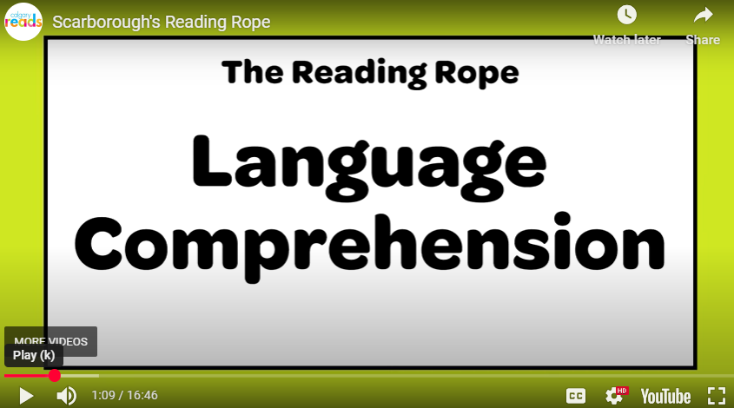
Components of Language Comprehension Explained
Key points about the video:
Parents can help build literacy by supporting a child’s oral language skills
Language comprehension is made up of five individual strands of oral language skills
Each of the five strands are explained in detail within the video
(Reading Rockets, 2025)
Notes:
Note to Presenter:
When you begin the video, please initiate the Close Captions, by clicking CC, for accessibility needs.
The Language Comprehension section concludes at 10:23. You may stop the video then or watch to the end to review Word Recognition, if time allows.
We will watch this video to hear the Components of Language Comprehension Explained.
Please watch for these Key Points about the Video:
Parents can help build literacy by supporting a child’s oral language skills
Language comprehension is made up of five individual strands of oral language skills
Each of the five strands are explained in detail within the video
Please feel free to use the provided note-taking handout (The 5 Strands of Language Comprehension) to write down ideas about each strand as you watch the video. After the video, you will have the opportunity to turn and talk with a neighbor about what you saw and heard.
Upon completion of the video,
Please think about the key points in the video and the notes you may have taken (give them 1-2 minutes).
Please turn to a neighbor at your table or near your seat.
Discuss the key points and anything you may have written down. (Give 2-3 minutes for this discussion. Ask for ideas from participants, if time).

Slide 13

Reading Comprehension
“Reading Comprehension is an outcome, not a skill to be taught.”
(Kemeny, 2023)
(Gough & Tunmer, 1986)
Notes:
We can see from these different models that “Reading Comprehension is an outcome, not a skill to be taught” (Kemeny, 2023, p. 130).
Knowing that reading comprehension is the product of word recognition and language comprehension is important.
If a student is having difficulty with reading comprehension, it is important to find out if the difficulty is because of Word Recognition skills, Language Comprehension skills, or both (Brown & Stollar, 2025).

Slide 14
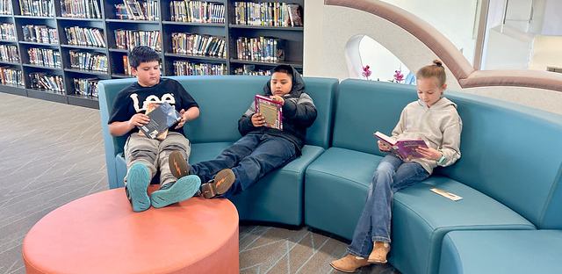
Why are Language Comprehension & Reading Comprehension Important?
Notes:
Why are Language Comprehension and Reading Comprehension Important?

Slide 15
Reading in Action John stood on the bank, patiently waiting for a tug on the line. With a little luck, he might have a tasty dinner tonight.
Notes:
As we have discussed, the outcome of reading comprehension is dependent upon not only being able to read the words on the page but making sense of them using all the components of language comprehension. Let’s consider a simple example to demonstrate how all the pieces fit together to comprehend the text we have read.
John stood on the bank, patiently waiting for a tug on the line. With a little luck, he might have a tasty dinner tonight.
What might we have to know and be able to do to comprehend these two sentences?
You can write down your ideas on paper at the tables or think to yourself. (give 1-2 minutes of wait time and ask for ideas, if time allows).
First, the reader needs to be able to read the individual words using Word Recognition Skills. This is the red box in the Simple View of Reading.
The reader must have the skills to decode words using what we know about sound-symbol correspondences, so that we can read words quickly and accurately. In this sentence, there are a variety of vowel spelling patterns that students must understand in order to read the words, such as the vowel team oo in the word “stood,” or the ‘igh’ spelling for the long /i/ sound in the words “might” and tonight”.
The reader must also have practice with basic syllable types and reading multisyllabic words (patiently, waiting, little, dinner, tonight) and must have in their sight word bank a few irregularly spelled words (the, have).
Accurately reading the words on the page is only the first step. We also need Language Comprehension Skills to understand what the author means by the words she used. This is the blue box in the Simple View of Reading.
The reader must activate the correct meaning, in this context, for the words “bank” and “line.” This is vocabulary. They must understand that this meaning of “bank” means the land beside a river, and this meaning of “line” means the thin string used for fishing.
These sentences also require specific background knowledge to make sense. It is imperative that the reader has a basic understanding of how fishing works for these sentences to make sense, and that fishing requires a little bit of luck and patience to catch a fish.
The reader must rely heavily on inferential information in this example. Because it is not clearly stated, the reader must make an inference (verbal reasoning) that John is fishing in a river or a stream, since he is standing on the bank, and that he has used his fishing pole to cast his line into the water and is waiting for a fish to bite. The reader also must infer that John intends to eat any fish he catches later in the day, but that it is not guaranteed that he will catch a fish.
As this simple example demonstrates, reading comprehension requires more than just accurately reading the words on the page. Each component of language comprehension is equally essential for the outcome of strong reading comprehension to occur.
Adapted from: “Ending the Reading Wars: Reading Acquisition From Novice to Expert” (Castles et al., 2018).

Slide 16
Skilled Readers
Accurate, fluent word reading
A broad vocabulary
Robust background knowledge
An awareness of sentence, paragraph, and text structure
Monitoring of comprehension
Application of strategies when appropriate
Word Recognition
Language
Comprehension
(Carlisle & Rice, 2002)
Notes:
Research is clear that the primary factors of a skilled reader’s comprehension of text include (Carlisle & Rice, 2002):
(click) Accurate, fluent word reading
(click) A broad vocabulary
(click) Access to robust background knowledge
(click) An awareness of sentence, paragraph, and text structure
(click) Ongoing monitoring of comprehension
(click) And the Application of strategies when appropriate
The first component includes (click) Word Recognition Skills.
The final 5 components lie within (click) Language Comprehension Skills.
Language Comprehension is important to Reading Comprehension because, as you can see on this slide, once we “crack the code” of English and can read the words, the rest of the components we need come from our Language Comprehension skills! These skills continue to develop throughout our lives.
Background knowledge for the presenter:
The skills needed for reading comprehension come into play as students progress in school. In the early grades, for example, reading comprehension depends heavily on growing word recognition skills. As children accomplish the ability to read printed words, language comprehension begins to contribute more to individual differences in reading comprehension. ((LARRC, 2015 as cited in Castles et al, 2018; Lonigan & Shanahan, 2012; Oakhill et al., 2015 as cited by Hennessy, 2021).
This is because, as students progress in school, the books they are reading become increasingly complex requiring more academic knowledge, sophisticated vocabulary, and understanding of the complexity of our language structures (Cardenas-Hagan, 2021; Catts et al., 2006 as cited in Wexler, 2025).
We cannot wait to begin Language Comprehension instruction (Birsh & Carreker, 2018; Brown & Stollar, 2025; Gillis, 2020).
Skilled reading, and thus reading comprehension, is not possible without language comprehension — the ability to understand spoken language — and, of course, word recognition (Reading Rockets, 2025).

Slide 17
Paired Verbal Fluency | Language & Reading Comprehension
What are language comprehension and reading comprehension?
Why are they important?
Write down thoughts and ideas you could shared with a partner (1-2 minutes).
We will create partners A and B and take turns talking about the questions above.
At a signal, one will speak, and one will listen.
At a signal, the other will speak while the first speaker listens.
Each time, no one is allowed to repeat anything that was said by the other.
Notes:
We are going to do an activity called Paired Verbal Fluency
We want to give you time to think about the information presented and share your understanding with a partner about what language comprehension and reading comprehension are and why they are important for literacy. (If presenting virtually, say that you will be creating breakout rooms for this discussion to take place).
Here is how this activity will work:
First, you will think about these two questions:
What are language comprehension and reading comprehension?
Why are they important?
Next, we will follow these steps:
Write down thoughts and ideas you could share with a partner (1-2 minutes).
We will create partners A and B and take turns talking about the questions above.
At a signal, one will speak, and one will listen.
At a signal, the other will speak while the first speaker listens.
Each time, no one is allowed to repeat anything that was said by the other.
Does anyone have any questions? (Clarify as needed).
Note to Presenter:
Start at #1 (1-2 minutes to write down ideas or think about notes taken)
Create partners:
Same kind of shoes, sitting next to each other, child in same grade, etc…
Have partners decide or assign A and B
First round (60 seconds)
A speaks, B listens
Second round (40 seconds)
B speaks, A listens
If time, Third Round (20 seconds)
A speaks, B listens
*If presenting virtually, read all the directions and have participants discuss on their own in breakout rooms. Create breakout rooms ahead of time.
Ask if anyone has any questions or comments to share before moving on.

Slide 18
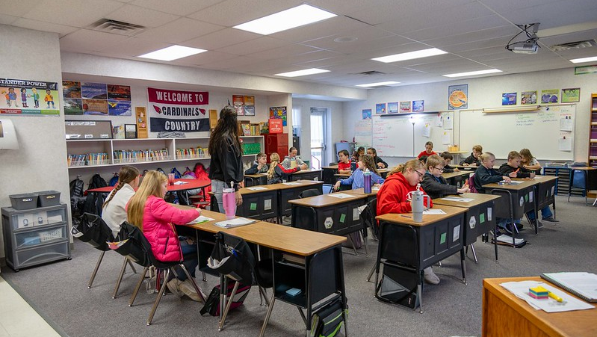
What Does Language Comprehension & Reading Comprehension Look Like at School?
Notes:
What Does Language Comprehension and Reading Comprehension Look Like at School?

Slide 19


Colorado Academic Standards (CAS) Language Comprehension & Reading Comprehension
You May Find Kindergarten – 3rd Grade Students:
K: Asking and answering questions about main ideas and details in readings
1st: Identifying similarities and differences between two texts on the same topic
2nd: Discussing the author’s word choices and use of images in a story, poem, or book
3rd: Exploring the connections between words, illustrations, charts, photos and captions
(CDE, 2020)
Notes:
The Colorado Academic Standards (CAS) provide a grade-by-grade road map to help ensure students are successful in college, careers, and life.
Each grade level contains standards around Comprehension: gaining and making meaning from text. You can use the QR code to access the Family and Community Guides to the Colorado Academic Standards to see standards for each grade level and content area.
Here are examples of what You May Find Kindergarten through 3rd Grade Students doing.
K: Asking and answering questions about main ideas and details in readings
1st: Identifying similarities and differences between two texts on the same topic
2nd: Discussing the author’s word choices and use of images in a story, poem, or book
3rd: Exploring the connections between words, illustrations, charts, photos and captions
Before students can demonstrate their comprehension or understanding of text, schools are working to develop Language Proficiency levels and build Language Comprehension Skills that create Strategic Readers.
Background for presenters:
Created by Coloradans for Colorado students, the Colorado Academic Standards (CAS) provide a grade-by-grade road map to help ensure students are successful in college, careers, and life. The standards aim to improve what students learn and how they learn in 12 content areas while emphasizing critical thinking, creativity, problem solving, collaboration, and communication as essential skills for life in the 21st century.
To support families, communities, and teachers in realizing the goals of the Colorado Academic Standards (CAS), the Colorado Family and Community Guides provide overviews of the learning expectations for students.
These guides offer some learning experiences students may engage in at school that may also be supported at home.
As always, the best place to know about what your child is learning is from your child's teacher.

Slide 20
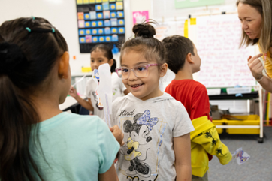
Develop Language Proficiency | How language works
Support students to examine language
Collaborative talk and discussions
Explore stories and informational text structures
Home-School language connections
Benefits ALL learners
(Public Consulting Group, 2025; Reading Rockets, 2025)
Notes:
Schools help children develop their language proficiency at the word, sentence, paragraph, and text levels (Reading Rockets, 2025).
For strong language comprehension skills, children need to understand how language works.
Teachers help develop language proficiency by:
(click) Supporting students to examine language (vocabulary, sentences, and structure) and apply their knowledge and skills in reading, writing, speaking, listening, and/or signing.
(click) Teachers plan time for students to engage in structured collaborative talk and discussions throughout the lesson about the text that builds knowledge, oral language skills, and language proficiency.
(click) Teachers provide multiple opportunities to listen to and explore stories and informational texts and engage in discussions about the meaning of texts to develop oral language.
(click) Teachers create opportunities for Home and School language connections that support language development for Multilingual Learners (MLs). This focus on English language development, through oral or spoken language, is essential for Multilingual Learners (MLs) (Stollar, 2025).
(click) However, developing language proficiency benefits ALL learners by growing academic language skills for everyone. Academic language is the language found in books and assessments.
(-Adapted for classroom use from Public Consulting Group’s “Example Literacy Walk-Through Science of Literacy: Reading Comprehension" in CDEM6_Admin-20 Module 6: Increasing Reading Comprehension for Administrators-20)
Background for presenter:
Reading and writing depend on language proficiency (Moats & Tolman, 2019, Vol. 2 Unit 7).
Verbal reasoning, literacy knowledge, and knowledge of language structure are all part of language comprehension.

Slide 21

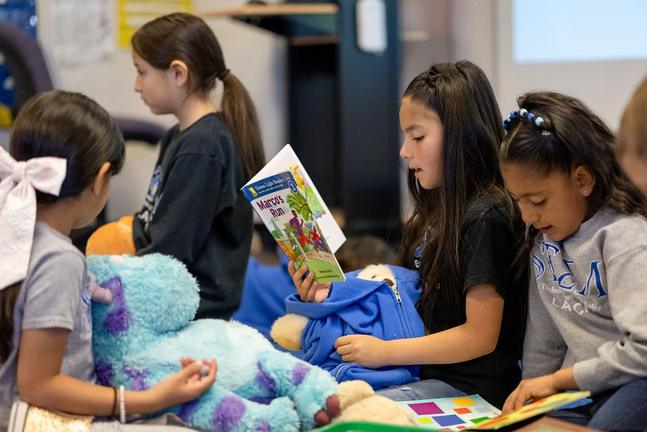
Develop Text Comprehension Skills
Primary Grades
Intermediate Grades
Reading Comprehension
Listening Comprehension
Notes:
According to Dr. Louisa Moats (2020), “A focus on language comprehension can -and should- begin long before children can read text on their own. Reading aloud to children from well-written text serves to develop their vocabularies and knowledge, their familiarity with academic language, and their appreciation for the pleasures of the written word” (p.16).
In primary grades, kindergarten and 1st grade, as students are acquiring word recognition skills, comprehension instruction primarily occurs through listening to text read aloud. This allows students access to much more complex text than they can read on their own, exposes them to advanced vocabulary, and allows for rich discussion and interactions with the text.
In intermediate grades and beyond, once students can read grade-level text on their own, the focus of instruction shifts to reading comprehension with language comprehension skills providing the foundation (Brown & Stollar, 2025, p.14).

Slide 22
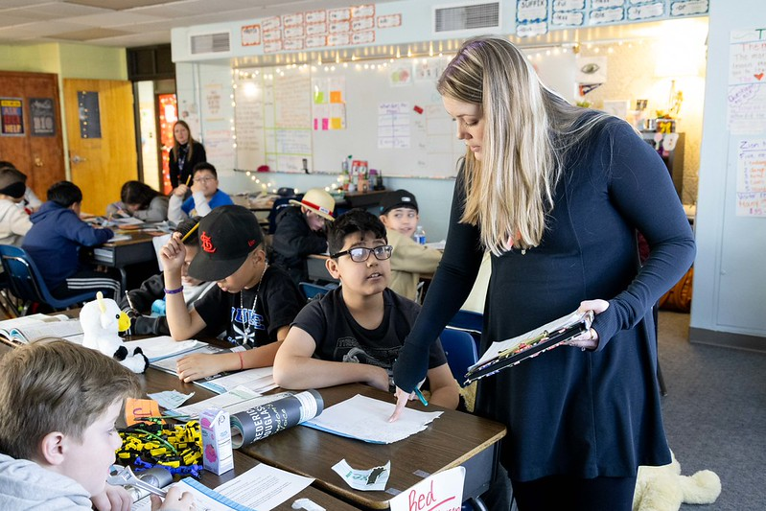
Create Strategic Readers
Six researched-based strategies:
Activating Prior Knowledge
Asking Questions
Visualizing
Monitoring
Drawing inferences
Summarizing
(Shanahan et al., 2010)
Notes:
Effective reading instruction includes the teaching of reading strategies, that are used individually or in combination, to support the reader’s comprehension and Create Strategic Readers (Birsh & Carreker, 2018; Cardenas-Hagan, 2021; Hennessy, 2021; Honig et al., 2018; NRP, 2000; Shanahan et al., 2010).
The six research-based strategies are:
Activating Prior Knowledge, or connecting to what students already know,
Asking Questions before, during, or after reading,
Visualizing, or creating a visual image in your mind,
Monitoring, checking for understanding while reading,
Drawing inferences, using clues inside and outside of the text to draw a conclusion that is not clearly stated in the text, and
Summarizing, retelling or recalling the key information from the text.
Background for presenter:
Research has identified six strategies that improve a reader’s comprehension (Shanahan et al., 2010).
These strategies are not taught in isolation but used with text as a way to enhance understanding of the content (Moats, 2020).
They are modeled explicitly by the teacher and practiced by the students, as needed, to understand the text (Hennessy, 2021; Moats, 2020; Public Consulting Group, 2025).
Comprehension strategies help readers focus on the most important parts of the text. However, this instruction should be short, and these strategies should not take the place of evidence-based word recognition instruction or language comprehension instruction such as vocabulary development, and the building of background knowledge (Kemeny, 2023; Willingham, 2006 as cited in Buckingham, 2020).

Slide 23
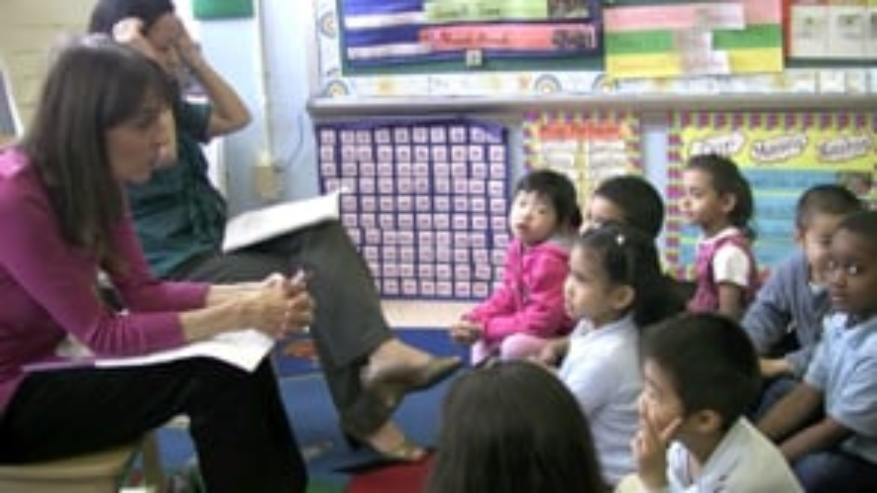
Comprehension Lesson| Primary Grades (K-2)
Key Points About the Video:
Background knowledge about butterflies was built and then used in the lesson
The lesson focused on one sentence to develop the children’s language proficiency
The children act out actions from the sentence to grow their understanding
The children are learning to speak, read, and write while learning content about butterflies
(CGCS Video Maker, 2012)
Notes:
Note for presenter: This is an optional video if time allows. Video length: 7:51
Keep slide hidden if unused.
This video is one example of how teachers might teach a Comprehension Lesson in the Primary Grades.
In Kindergarten through 2nd grade, children may be gaining and making meaning through spoken language and listening (Birsh & Carreker, 2018; Brown & Stollar, 2025; Gillis, 2020).
These kindergartners have been in a unit studying butterflies where background knowledge, language proficiency (including academic vocabulary and language structure), and strategies to unlocking the meaning of complex text have been deeply embedded into their daily learning.
Please watch for these Key Points about the Video:
Background knowledge about butterflies was built and then used in the lesson
The lesson focused on one sentence to develop the children’s language proficiency
The children act out actions from the sentence to grow their understanding of vocabulary
The children are learning to speak, read, and write while learning content about butterflies
(Play the video-Click the CC to start subtitles for accessibility)
Would anyone like to share something they noticed or thought about during the video? Discuss as appropriate.

Slide 24
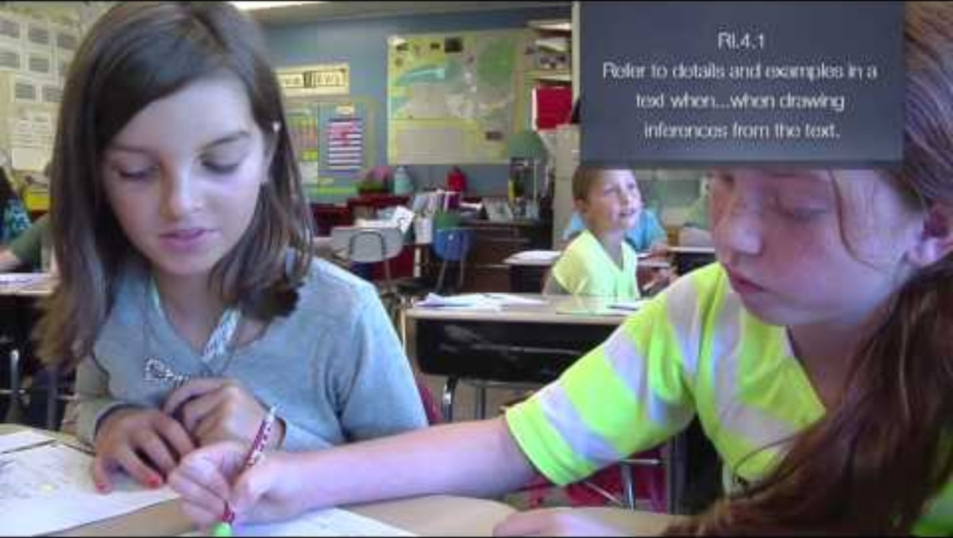
Comprehension Lesson| Intermediate Grades (3-5)
Key Points About the Video:
Students read the text on their own and wrote details about the text
Students work in pairs to use the details and their background knowledge to make inferences about the text
Making inferences and building a mental model is a life-long skill
(EngageNY, 2014)
Notes:
Note for presenter: This is an optional video if time allows. Video length: 6:36
Keep slide hidden if unused.
This video is one example of how a teacher might teach a Comprehension Lesson in the Intermediate Grades.
In 3rd through 5th grade, once students can read grade-level text on their own, the focus of instruction shifts to reading comprehension (Brown & Stollar, 2025).
These 4th grade students are learning a reading strategy, Drawing Inferences, to help them create a mental model of the text they have read.
Please watch for these Key Points about the Video:
Students read the text on their own and wrote details about the text
Students work in pairs to use the details and their background knowledge to make inferences about the text
Making inferences and building a mental model is a life-long skill
(Play the video-Click the CC to start subtitles for accessibility)
Would anyone like to share something they noticed or thought about during the video? Discuss as appropriate.

Slide 25

How Can You Support Language Comprehension & Reading Comprehension at Home?
Notes:
Now that you know what language comprehension and reading comprehension are, why they are important and how your child’s school is supporting their development, let’s discuss: How Can You Support Language Comprehension & Reading Comprehension at Home?

Slide 26
How Can You Support Language & Reading Comprehension at Home?
Practice 1: Ways to Build Language Comprehension Skills
Practice 2: Talking While You Read Using CROWD
Notes:
We will consider two practices around How you can support language comprehension and reading comprehension at home.
Practice 1: Ways to Build Language Comprehension Skills
Practice 2: Talking While You Read Using CROWD
These practices mirror or align with how language comprehension and reading comprehension are developed in the classroom.
Note to presenter: Please use the activities most applicable to your audience and hide the unused slides.

Slide 27
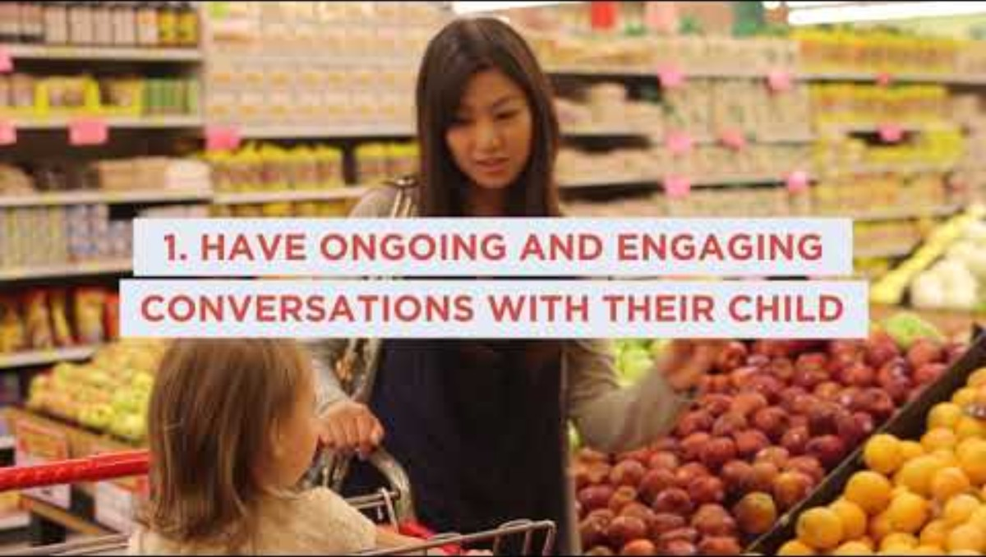
Practice 1: Ways to Build Language Comprehension Skills
Key Points About the Video:
Have Ongoing, Engaging Conversations
Literacy-Friendly Environment
Make Reading Enjoyable
Hold High Expectations
Communicate with Your Child’s Teacher
Use Home Languages
Visit the Library
(Ready Rosie, 2025)
Notes:
Practice 1 is Ways to Build Language Comprehension Skills (This activity takes 7-8 minutes)
Good readers have a strong knowledge base, a rich vocabulary, and thinking strategies to use when needed (Marzola as cited by Birsh & Carreker, 2018). These develop early on, at home, as children interact with their families and community.
We are going to watch a video and then set a goal around 1-2 activities that you might do at home to build language comprehension skills as you spend time with your children.
Please watch for these key points in the video (video length 1:20):
Have Ongoing, Engaging Conversations
Create a Literacy-Friendly Environment
Make Reading Enjoyable
Hold High Expectations
Communicate with your child’s teacher
Use Home Languages
Visit the Library
(When you play the video-click CC to turn on the closed caption for accessibility).
After the video: Would anyone like to share something they noticed or thought about during the video? Discuss as appropriate.
Activity:
Let’s think back on the 7 key points from the video that are showing on this slide.
First, give yourself a pat on the back for things you noticed you already do with your child!
Next, on the paper at your tables, please list 1-2 activities you could add to time spent with your child.
You might want to write some notes about scheduling, materials or when you might do the activities. We will share our ideas with someone else in a few minutes.
(Give participants 1-2 minutes to think and write. Answer questions as you walk around as needed).
Now, I would like you to talk with a partner about one of these activities you think you could try at home with your children.
If in-person: Please find one of the partners you met from the Paired Verbal Fluency activity to work with.
If in a virtual setting: I will place you into a breakout room with a partner to discuss.
Give 2-3 minutes for discussion
After participants return to their seats, ask:
Would anyone like to share an activity they are planning to try? (Take 1-3 answers as time allows).

Slide 28
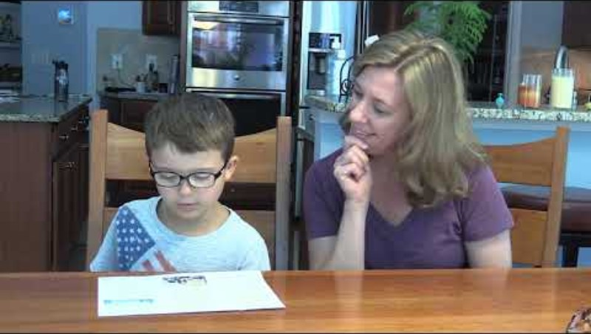
Practice 2: Talking While You Read | CROWD
Key Points About the Video:
Parent encourages child to point to the words as he reads.
Parent asks different types of questions using the CROWD handout.
Parent encourages child to look back at the text to find answers to the questions.
Talking While You Read | CROWD
(Kosanovich et al., 2021)
Notes:
Practice 2 is Talking While You Read using a strategy called CROWD. (This activity takes 10-15 minutes)
“Talking while you read is simply having conversations about what you are reading. Having conversations about books will help your child become a better reader because it will develop your child’s vocabulary and knowledge about the topics of those books” (Kosanovich et al., 2021, p. 2|1|3).
Each letter in CROWD stands for a type of question you might ask while reading.
We are going to watch a video and then practice the CROWD strategy.
Please watch for these key points in the video:
Parent encourages child to point to the words as he reads because she knows that his accuracy is better when he points to the words. He needs to use his Word Recognition skills accurately and fluently read the text.
Parent asks different types of questions using the CROWD handout. She is supporting his understanding of the text and modeling how to monitor comprehension.
Parent encourages child to look back at the text to find answers to the questions.
(Play the video-subtitles are included within the video, length 3:54)
Would anyone like to share something they noticed or thought about during the video? Discuss as appropriate.
Let’s look at this handout, Talking While You Read using CROWD. This is something you can have next to you while you read with your child.
I am going to go through each steps for using this strategy found on the handout. (These steps follow with what is written on the trifold. Point this out to parents as needed).
Take turns reading or listening to your child read the whole book.
Read the book again, stopping regularly to have a conversation or Talk While You Read.
Ask your child to explain the information from the book. Use CROWD to ask different types of questions to prompt a discussion about the book. Examples of the types of questions to ask:
Completion: Ask your child to complete a sentence or a phrase from a book you are reading. “The four stages of the life cycle of a butterfly are egg, caterpillar, _________, and butterfly.”
Recall: Ask about details of what you read. “Can you describe how the caterpillar builds a chrysalis?”
Open-ended: Ask about details of what you read. “Can you describe how the caterpillar builds a chrysalis?”
W: Ask WH questions that begin with Who, What, Where, When, or Why. “What does a caterpillar do a lot of after it hatches from the egg?”
Distancing: Ask questions that relate something in the text to your child’s life. “Remember when we saw that butterfly on our walk yesterday? Which picture of the butterflies in this book look most like then one we saw? What type of butterfly was it that we saw?”
You can use CROWD, to Talk While you Read, with any book!
At each of your tables, I have placed a number of books you could read aloud to your child or they might read to you. I also have papers with QR codes where you can access audio books if you prefer to read in this way with your child. If presenting in a virtual setting, say “We will review The Fog example on the trifold together).
On your own or with a partner, choose a book from your table (printed or audio) to read and think about question you might ask, use the CROWD tri-fold to help you. I will walk around to answer questions as you try this out.
Give 7-8 minutes
Would anyone like to share a question they could ask about a book? (Take 1-3 answers).
“Remember to enjoy the conversations with your child! Provide a lot of positive praise about how your child is learning about both the topic from the book and specific new words. If you are enjoying yourself while reading and talking, so will your child” (Kosanovich et al., 2021, p. 2|1|5).
Background for presenter:
“Vocabulary and Background knowledge are especially critical for reading comprehension” (Kemeny, 2023, p. 130).
This strategy works well with informational texts, which are books that share information. Informational books are a great way to build knowledge and vocabulary.
(Consult the IES Facilitator Guide Grade 2: Talking While You Read (p. 2|1|3 – 2|1|11) for additional directions or ideas)

Slide 29
Reminder: Support Word Recognition Skills at Home
Word
Recognition
“There is no comprehension strategy powerful enough to compensate for the fact that you can’t read the words.”
Phonological Awareness
Phonics
(Archer & Hughes, 2011)
Fluency
Notes:
As a Reminder: Please also Support Word Recognition Skills at home. “There is no comprehension strategy powerful enough to compensate for the fact that you can’t read the words” -a famous quote by Dr. Anita Archer (Archer & Hughes, 2011) meaning a reader might have strong oral language skills or extensive background knowledge on a topic, but if she can’t read the words on the page, it may affect her ability to understand or to learn from a book on that topic (Archer & Hughes, 2011; Reading Rockets, 2025).
A way to move your child towards reading comprehension is by supporting your school’s efforts by practicing Phonological Awareness, Phonics, and Fluency at home.
Background for presenter:
In this series on the Colorado READ Act and the Science of Reading for Families, there are presentations on each of these Word recognition Components on the CDE Parent Resource Website.
If time allows, give parents 5-7 minutes to access the website, look at resources and make a plan to view Word Recognition skill recordings using the QR code on Slide 34.
Optional: If you have missed any presentations in this series, we:
Encourage you to view the recordings of the Word Recognition presentations related to Phonological Awareness, Phonics, and Fluency to see the practices you can support at home.
We also encourage you to reach out to your child’s teacher to find out how you can support their growing Word Recognition skills and match classroom instruction.

Slide 30
Summary of Key Points | Language & Reading Comprehension
Reading comprehension is an outcome, the product of word recognition and language comprehension.
Language comprehension skills are the oral language foundation for reading comprehension skills.
Once a child can independently read the words on the page, the strength of their language comprehension skills will determine overall reading ability.
Comprehension continues to grow throughout a child’s life.
Notes:
Here is a summary of key points about Language Comprehension and Reading Comprehension:
Reading comprehension is an outcome, the product of word recognition and language comprehension (Gough & Tunmer, 1986).
Language comprehension skills are the oral language foundation for reading comprehension skills.
Once a child can independently read the words on the page, the strength of their language comprehension skills will determine overall reading ability (Hogan et al., 2011; Oakhill et al., 2015 as cited by Hennessy, 2021).
Comprehension continues to grow throughout a child’s life.
Handout Language Comprehension and Reading Comprehension For Parents Handout

Slide 31

Learning to Read Transforms Lives
“Learning to read transforms lives. Reading is the basis for the acquisition of knowledge, for cultural engagement, for democracy, and for success in the workplace.”
(Castles et al, 2018)
Notes:
In closing, “Learning to read transforms lives. Reading is the basis for the acquisition of knowledge, for cultural engagement, for democracy, and for success in the workplace (Castles et al., 2018, p.5).
—Helping children learn to read and then providing opportunities for varied, extensive, and successful reading experience is fundamental to their success” (Castles et al., 2018, p. 38).

Slide 32
Do You Want to Learn More?
Visit the CDE Parent Resources Website
Notes:
There are more resources for parents on the CDE Parent Resources Website including videos of activities you can do at home and links to get additional books.
You can also look up your local library for the resources they have to share!

Slide 33
References Slide 1
Archer, A. L., & Hughes, C. A. (2011). Explicit instruction: Effective and efficient teaching. Guilford Publications.
Birsh, J. R. & Carreker, S. (2018). Multisensory teaching of basic language skills (4th ed.). Baltimore, MD: Brookes.
Brown, S. E., & Stollar, S. (2025). MTSS for reading improvement: A leader's tool kit for schoolwide success. Solution Tree.
Buckingham, J. (2020). Six reasons to use the science of reading in schools. The Reading League Journal, 1(1), 13–17.
CGCS Video Maker. (2012, August 10). Classroom example of teaching complex text: Butterfly [Video]. Vimeo.
https://vimeo.com/47315992?fl=pl&fe=vl
Cardenas-Hagan, E. (2020). Literacy foundations for English learners: A comprehensive guide to evidence-based instruction. Paul H Brookes Publishing.
Carlisle, J.F., & Rice, M.S. (2002). Improving reading comprehension. Timonium, MD: York Press.
Castles, A., Rastle, K., & Nation, K. (2018). Ending the reading wars: Reading acquisition from novice to expert. Psychological Science in the Public Interest, 19, 5–51. doi:10.1177/1529100618772271
Colorado Department of Education. (2020). Family and community guides to the Colorado academic standards.
https://www.cde.state.co.us/standardsandinstruction/guidestostandards
EngageNY. (2014, September 29). Grade 4 ELA: Making inferences using details and the main idea RI.4.1 [Video]. Vimeo.
https://vimeo.com/47315992?fl=pl&fe=vl

Slide 34
References Slide 2
Gillis, M. (2020). Comprehension. Literacy How. https://literacyhow.org/comprehension/
Gough, P. B. & Tunmer, W.E. (1986). Decoding, reading, and reading disability. Remedial and Special Education, 7(1).
Hennessy, N. L. (2021). The reading comprehension blueprint: Helping students make meaning from text. Paul H Brookes Publishing.
Hogan, Tiffany; Bridges, Mindy Sittner; Justice, Laura M.; and Cain, Kate, "Increasing Higher Level Language Skills to Improve Reading Comprehension" (2011). Special Education and Communication Disorders Faculty Publications. 79. https://digitalcommons.unl.edu/specedfacpub/79
Honig, B., Diamond, L., & Gutlohn, L. (2018). Teaching reading sourcebook. Academic Therapy Publications.
Kahmi, A.G., & Catts, H.W. (1989). Language and reading: Convergences, divergences and development. In A.G. Kamhi & H.W. Catts (Eds.), Language and reading disabilities (3rd ed.) Boston, MA: Pearson.
Kemeny, L. (2023). 7 mighty moves: Research-backed, classroom-tested strategies to ensure K-to-3 reading success. Scholastic Professional.
Kosanovich, M., Lee, L. & Foorman, B. (2021). A Second-Grade Teacher’s Guide to Supporting Family Involvement in Foundational Reading Skills (REL 2021-053). Washington, DC: U.S. Department of Education, Institute of Education Sciences, National Center for Education Evaluation and Regional Assistance, Regional Educational Laboratory Southeast. Retrieved from http://ies.ed.gov/ncee/edlabs.
Lonigan, C. & Shanahan, T. (2012, October 9). The role of early oral language in literacy development. Language Magazine. https://languagemagazine.com/5100-2/

Slide 35
References Slide 3
Moats, L. C. (2020). Teaching reading is rocket science: What expert teachers of reading should know and be able to do. Washington, DC: American Federation of Teachers
Moats. L.C.& Tolman, C. A. (2019). LETRS (3rd edition). Voyager Sopris Learning.
National Reading Panel. (2000). Teaching children to read-An evidence-based assessment of the scientific research literature on reading and its implications for reading instruction (NIH Publications No. 00-4769) Washington, DC: National Institutes of Child Health and Human Development
Public Consulting Group LLC 2025, (Building a Strong Foundation for Lifelong Literacy Success (6), Increasing Reading Comprehension for Administrators, Playbook, https://playbook.educatored.com/Playbook/ViewPlay?playId=5807&instanceId=90657
Reading Rockets. (2025). Comprehension Module. https://www.readingrockets.org/reading-101/reading-101-learning-modules/course-modules/comprehension
Ready Rosie. (2018, November 16). Seven Research Based Ways Families Promote Early Literacy [Video]. YouTube. https://www.youtube.com/watch?v=J0zFbcsd4Vg
Scarborough, H. S. (2001). Connecting early language and literacy to later reading (dis)abilities: Evidence, theory, and practice. In S. Neuman & D. Dickinson (Eds.), Handbook for research in early literacy (pp. 97–110). New York, NY: Guilford Press.​
Shanahan, T., Callison, K., Carriere, C., Duke, N. K., Pearson, P. D., Schatschneider, C., & Torgesen, J. (2010). Improving reading comprehension in kindergarten through 3rd grade: A practice guide (NCEE 2010-4038). Washington, DC: National Center for Education Evaluation and Regional Assistance, Institute of Education Sciences, U.S. Department of Education. Retrieved from whatworks.ed.gov/publications/practiceguides. Video link: https://www.youtube.com/watch?v=De2rveNA_XQ&t=6s

Slide 36
References Slide 4
Stollar, S. (2025). The simple view of reading: Implications for assessment and instruction. https://vsl.widen.net/s/svshgrrwlj/stollar-language-comprehension
Wexler, N. (2025). Beyond the science of reading: Connecting literacy instruction to the science of reading. ASCD.

