Slide 1
Resources needed for this presentation (Keep this slide hidden)
A way to project the PowerPoint
  Note for presenters: For accessibility, you must read the words on the slides. The words bolded in the notes are the words from the slide.
Adequate audio for playing videos (test audio and video before presentation)​
  Video 1: The Reading Brain – How We Learn to Read
Writing utensils and blank paper for participants to take notes for discussions
Please print this handout:
  Handout: The Science of Reading for Parents handout

Slide 2


The Science of Reading
The Colorado READ Act and
the Science of Reading for Families
Notes:
Welcome and thank you all for joining us today.
This is a presentation within the Colorado READ Act and the Science of Reading for Families series developed to support parents with ways to help their children build reading skills in partnership with their child’s school. ​
During this presentation, we will be focusing on The Science of Reading
For more information or additional resources, please visit the READ Act Parent Resources page found within the CDE website. (QR Code on the slide)
Background for presenters:
The READ Act encourages local education providers to provide parent opportunities to participate in parent reading workshops throughout the school year to assist parents in developing their own reading skills and in developing the skills necessary to assist their children in reading. We hope this series will be helpful to you as parents (CRS 22-7-1208 (4)).
The Colorado READ Act statute defines the term “parent’ as a student’s biological or adoptive parent, stepparent, foster parent, or legal guardian(CRS 22-7-1203 (8)(a)).
For brevity purposes, we have adopted this definition throughout the presentation. When we use “Parent” during the presentation we mean family or caregiver aligned with the language of the law.

Slide 3
Welcome | Science of Reading
First Name Last Name, Title
Organization
Contact Information
Notes:
Welcome, we are glad you are here.
Share your name, title and contact details
If time, share a bit about your journey as an educator and/or parent that would be relevant to this session.
Logistics: Share the following points that match your circumstance
This presentation includes active captions.
Presenters will be using a microphone.
We ask that audience members use a microphone when asking questions.
Presenters will be reading the content on each slide to ensure that it is accessible for ALL participants.
Note for presenters: For accessibility, you must read the words on the slides. The words bolded in the notes are the words from the slide.

Slide 4
Outcomes | Science of Reading
What is the science of reading?
Why is the science of reading important?
What does the science of reading look like at school?
How can you support reading at home?
Notes:
By the end of this presentation the outcomes are for you to be able to answer these questions.
What is the science of reading?
Why is the science of reading important?
What does the science of reading look like at school?
How can you support reading at home?
​Take a moment to think about which agenda question(s) you are interested in know more about today. (Provide 1-2 minutes of think time).
Note to presenter: Let the participants know that their will be an activity between questions 2-3 in which they will discuss the first to questions with another participant. Paper and pens are provided for optional notetaking.

Slide 5
Norms | Science of Reading
Active listening is appreciated
Active participation is welcomed
Take care of your own needs
Silence your cell phone as a courtesy to all
Notes:
We hope this will be an engaging and informative time for everyone here. Please work to follow these norms:
Active listening is appreciated
Active participation is welcomed
Please take care of your own needs
If in-person, share where the restrooms and water stations are located, as needed.
If presenting virtually, you might consider asking participants to leave cameras on as they are able.
Silence your cell phone as a courtesy to all
Are there any other items you think we should add to this list that will support all of us?

Slide 6

Warm-Up | Science of Reading
Like Me
Move chairs back from the table so it is easy for you to stand up.
A category will be named.
Stand if you match the category.
Look around to see who else is also in the category.
Introduce yourself.
Notes:
We are going to start with a Warm-up activity called (CLICK) Like Me (Adjust the mobility section of the activity according to the abilities of the participants in the room).
We are doing this activity because:
We want to begin to turn this room of individuals into a group that works together
This activity focuses the energy into this room and out of your day or previous activities, so you feel ready to participate
You will begin to understand who you are in relation to others in the group and have a chance to introduce yourself
Here is how this activity will work. I will read all the steps, ask for questions, and then we will begin to activity. (If presenting in a series, consider if reviewing the directions is needed for the group)
(CLICK) Move chairs back from the table so it is easy for you to stand up. (Adjust the mobility section of the activity according to the abilities of the participants in the room. If presenting virtually, ask participants to stand in front of their camera or use the thumb's up reaction button.)
(CLICK) A category will be named.
(CLICK) Stand if you match the category.
(CLICK) Look around to see who else is also in the category.
(CLICK) At the end, you will have a chance to introduce yourself
FACILITATOR NOTES:
Read the activity steps.
Ask if participants have questions.
Start the activity at step 1.
Name some (5-10) of the following categories (or create your own to match your community) and give time for people to stand: (facilitators should also participate by standing or staying seated):
I am a parent
I have a child in kindergarten, 1st, 2nd, or 3rd grade.
I have more than one child in elementary school.
I have a middle or high schooler in addition to my elementary student or students.
I live within walking distance of the school.
I work in this community.
I attended this school (or another school in this district).
I grew up in this town/city.
I am new to this community within the last 2 years.
I speak more than one language at home.
I enjoy attending school or community events with my family.
I share family stories, traditions, or sayings with my child or children.
My child or children enjoy playing word games or singing silly songs.
I have noticed my child sounding out letters or words.
I have listened to my child or children read the same book more than once.
I believe reading will help my child or children in future.
Have the parents go around the room and share: (if group is large, make small groups for this activity)
Name
Grade of Child(ren)

Slide 7
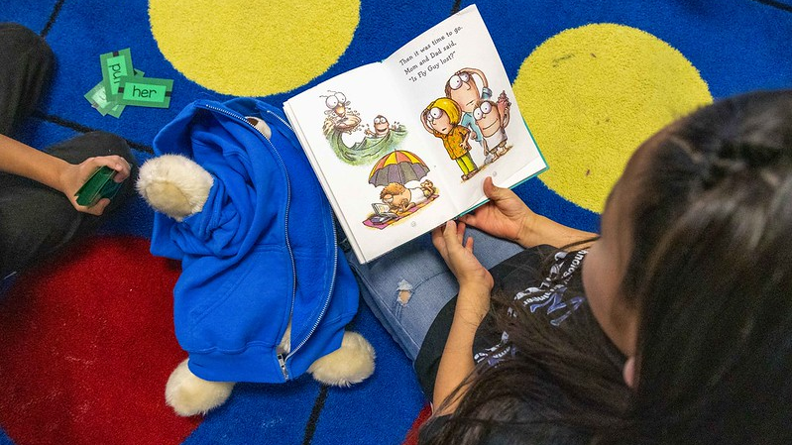

What is the Science of Reading?
What is the Science of Reading?
Notes:
What is the Science of Reading?
Although the scientific evidence supporting effective reading instruction has existed for decades, the term “the science of reading” has become more popular in recent years. Since we are talking about the science of reading, it is important for us to have a common definition of the term.

Slide 8
The Science of Reading Definition
The science of reading is a vast, interdisciplinary body of scientifically-based research about reading and issues related to reading and writing:
Conducted over the last five decades
Derived from thousands of studies in multiple languages
Across multiple fields of study
(TRL, 2022)
Notes:
This Science of Reading Definition was adopted by The Reading League in 2022:
The science of reading is a vast, interdisciplinary body of scientifically-based research about reading and issues related to reading and writing.
This research has been conducted over the last five decades across the world, and it is derived from thousands of studies conducted in multiple languages.
The interdisciplinary body means that these studies were conducted across multiple fields of study, not just in education.

Slide 9

The Science of Reading Definition I Evidence
The science of reading evidence tells us:
how proficient reading and writing develop
why some have difficulty
how we can most effectively assess and teach
...and therefore, improve student outcomes through prevention of and intervention for reading difficulties.
(TRL, 2022)
Notes:
The science of reading tells us:
(CLICK) how proficient reading and writing develop;
(CLICK) why some have difficulty;
and how we can most effectively assess and teach;
(CLICK) And therefore, improve student outcomes through prevention of and intervention for reading difficulties.
The science of reading:
Helps us understand the skills and processes needed to read
And proves how to teach these skills effectively.

Slide 10
1.The Science of Reading
The Science of Reading IS:
The Science of Reading is NOT:
A body of scientifically-based research
A curriculum
Word recognition & language comprehension skills
Only phonics
Good for all students
A one-size fits all approach
(TRL, 2022)
Notes:
To understand a little more about the term “The Science of Reading,” it helps to understand what the Science of Reading is and what it is not.
The science of reading IS a body of scientifically-based research. The Science of Reading is NOT a program or a curriculum that can be purchased and implemented.
The science of reading confirms that both word recognition (reading the words) and language comprehension skills (understanding the words read) are required for proficient reading. It is NOT only phonics. Reading is a complex cognitive process, and phonics is only part of that process.
The science of reading provides evidence about what is good for all students.
It is NOT a trend or fad, and scientists are not debating on if it works or not.
Scientists know how the brain works and how we learn to read.
The science of reading is NOT a one-size-fits-all approach. By focusing first on meeting the needs of the vast majority of children through effective core instruction, more intensive resources are available to support students with complex reading needs.

Slide 11

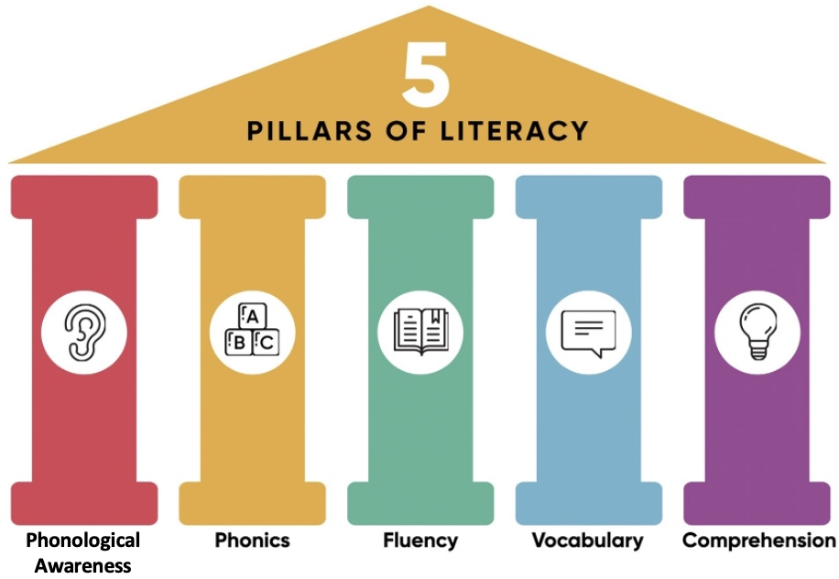
The Five Essential Components of Reading
(The Science of Reading. LD & ADHD Network Calgary, 2022)
Notes:
We are going to explore 2 well-known theoretical models as ANCHORS to ground us in what the research says about learning to read.
The first anchor we are going to explore is The Five Essential Components of Reading.
In 1997, the U.S. Congress convened a national panel to assess the status of research-based knowledge, including the effectiveness of various approaches for teaching children to read (NICHD, 2000).
In 2000, the National Reading Panel released their report into what became known as the five essential components of reading, or the five pillars of literacy:
Phonological Awareness, and more specifically Phonemic Awareness
Phonics
Fluency
Vocabulary
Comprehension

Slide 12
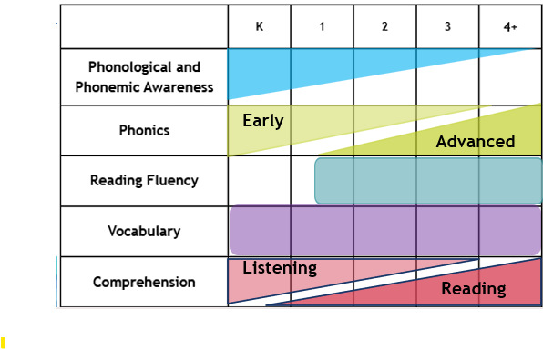
The 5 Components Across the Grades
Notes:
While all of the 5 components of reading should be addressed across the grades when learning to read, the level of focus in each area progresses over time.
(CLICK)In kindergarten and first grades, there is a strong emphasis on phonological and phonemic awareness skills, most importantly being able to blend and segment phonemes, or individual speech sounds. While instruction continues to address more advanced phonemic awareness skills in second and third grades, much less time is focused on these skills unless a student is struggling.
(CLICK) The focus of phonics instruction in kindergarten through second grade is on early phonics skills, which begins to shift to more advanced phonics concepts in the later grades
(CLICK) While students practice fluency with letter naming, word parts, and word reading early on, a focus on reading fluency does not typically begin until the middle of first grade, when students have enough skills to read chunks of text.
(CLICK) Vocabulary (and oral language) should have a prominent place in instruction from the beginning of kindergarten through all grade levels.
(CLICK) As does Comprehension. However, text comprehension is primarily addressed through listening to text read aloud in the early grades as students learn the basics of decoding. This gradually shifts to a focus on comprehension of texts students read themselves as their reading skills improve.
While children are building foundational word-reading skills, instruction should also build oral language and reading comprehension, background knowledge, and vocabulary.
Facilitator Note: Long-form caption for The 5 Components Across the Grades image included in Appendix B on slide 49

Slide 13
1.The Simple View of Reading
Word
Recognition
Language
Comprehension
=
Reading
Comprehension
X
(Gough & Tunmer, 1986)
Notes:
The second anchor we are going to explore is the Simple View of Reading.
This model developed by Gough and Tunmer organizes the skills needed to become a proficient and successful reader into two categories: (CLICK) word recognition and (CLICK) language comprehension. The Simple View of Reading is a basic formula for (CLICK) reading comprehension. ​
​It says this: reading comprehension is the product of word recognition skills and language comprehension skills. ​
​
Notice that it is a multiplication equation: We need both sides of the equation for students to become skilled, proficient readers. ​
​
(CLICK) Students need efficient word recognition or decoding skills where they are accurately and automatically reading the words on the page without aid of context clues or pictures. ​
​
(CLICK) They also need fully developed language comprehension skills, or the ability to understand spoken language. ​
Deficits in either component will impact reading comprehension.
​​
Background knowledge for the presenter: It is important to note that the Simple View of Reading uses multiplication instead of addition. By defining reading comprehension as the product rather than the sum of its two component capacities, it claims that both components are necessary; neither is sufficient for skilled reading. No amount of skill in one can compensate for a lack of skill in the other. If one of the components (either word reading or language comprehension) is zero, overall reading ability will be zero. If a child cannot decode any words OR does not have any language comprehension skills, he or she cannot read.
For children to become proficient readers, they have to be strong in both word recognition and language comprehension.
(https://www.cde.state.co.us/coloradoliteracy/scienceofreadingresources)​

Slide 14
2.The Simple View of Reading
Word
Recognition
Language
Comprehension
Reading
Comprehension
=
X
Strong
Word Recognition
Weak
Language Comprehension
Weak
Reading Comprehension
(Gough & Tunmer, 1986)
Notes:
Facilitator Note: This slide is animated. Do not click to advance. The animations will run automatically while you are reading the notes.
If a child has strong word recognition skills, but weak language comprehension skills, their reading comprehension will be weak.
Readers with this skill profile may show characteristics of hyperlexia and need additional support in language-based skills, vocabulary, and background knowledge.
Background knowledge for presenter:
Children in this profile read words accurately and fluently, at expected grade level, but struggle to answer questions after listening to a passage, or when given other language comprehension tasks (e.g., following directions, categorizing, sequencing). This profile may show characteristics related what is referred to as hyperlexia. Often these difficulties coincide with other types of difficulties but specifically found in children with social-linguistic disabilities (e.g., autism spectrum disorder), vocabulary weakness, generalized language learning disorders, and learning difficulties that affect abstract reasoning and logical thinking.

Slide 15
3.The Simple View of Reading
Word
Recognition
Language
Comprehension
Reading
Comprehension
=
X
Weak
Word Recognition
Strong
Language Comprehension
Weak
Reading Comprehension
(Gough & Tunmer, 1986)
Notes:
Facilitator Note: This slide is animated. Do not click to advance. The animations will run automatically while you are reading the notes.
Similarly, if a child has strong language comprehension skills but has weak word recognition skills, then reading comprehension will still be weak.
Readers with this skill profile may show characteristics of dyslexia and need additional support in word recognition skills such as phonological awareness, phonics, and word reading.
Background knowledge for presenter:
Children with this profile tend to have strong oral language skills and robust vocabularies and understand and engage with text easily when it is read aloud. Many children in this profile may show characteristics related to dyslexia. Because they have strong language skills, these children may use compensatory strategies in the early grades but may begin to experience difficulties around Grade 3 or 4, when expected to decode more complex, multisyllabic words.

Slide 16
4.The Simple View of Reading
Word
Recognition
Language
Comprehension
Reading
Comprehension
=
X
Weak
Word Recognition
Weak
Language Comprehension
Weak
Reading Comprehension
(Gough & Tunmer, 1986)
Notes:
Facilitator Note: This slide is animated. Do not click to advance. The animations will run automatically while you are reading the notes.
If a child is struggling with weak word recognition skills and also has weak language comprehension skills, we will, predictably, still see a weakness in their overall reading comprehension ability. These students will need support with developing both their word recognition and language comprehension skills.
Background knowledge for presenters:
Children in this profile are often referred to as “garden variety” poor readers.
About 50% of children who show characteristics of dyslexia, also have a language comprehension deficit, and vice versa (Hogan, 2023).

Slide 17
5.The Simple View of Reading
Word
Recognition
Language
Comprehension
Reading
Comprehension
=
X
Strong
Word Recognition
Strong
Language Comprehension
Strong
Reading Comprehension
(Gough & Tunmer, 1986)
Notes:
Facilitator Note: This slide is animated. Do not click to advance. The animations will run automatically while you are reading the notes.
For a student to be a proficient reader, word recognition skills must be accurate, automatic, and fluent, and language comprehension must be strong, including comprehension of text read aloud. Both skills together are necessary for strong reading comprehension skills.

Slide 18
Simple View of Reading (SVR) | The 5 Components of Reading
Word
Recognition
Language
Comprehension
=
Reading
Comprehension
X
Phonological Awareness
Phonics
Vocabulary
Language- based skills and strategies
Literacy knowledge and skills
Fluency
Oral Language
(Gough & Tunmer, 1986; NRP, 2000)
Notes:
We can use the Simple View of Reading to organize the Five Essential Components of Reading.
(CLICK) Word recognition skills require phonological awareness (attention to the sounds in our language) and phonics (the ability to connect sounds to the letters that represent them).
(CLICK) Language comprehension is supported by vocabulary knowledge (knowing and understanding the meanings of words). In addition, vocabulary knowledge can also support word recognition, particularly as students encounter more complex or irregular words that require familiarity with word parts (morphemes) or context to decode and understand.
Readers also need a variety of language-based skills and strategies such as inferencing, understanding syntax and sentence structure, and utilizing background knowledge. To comprehend text, we must also acquire literacy knowledge and skills, such as understanding text structure and literary genres.
(CLICK) Reading Fluency acts like a bridge that connects word recognition and language comprehension to support understanding when reading (Sedita, 2019).
(CLICK) Oral language is the foundation for skilled reading and literacy development and needs to be integrated throughout all components.
As we become better readers, our reading skills, in turn, help us develop more complex thinking, communication, and language skills (Kamhi & Catts, 1989; Lonigan & Shanahan, 2012).
Each component acts as a piece of the larger whole, similar to a puzzle. Effective reading instruction is not complete without ensuring that all five components, and oral language, are taught.

Slide 19
The Science of Reading Supports Instruction That Is:
Systematic
& Sequential
Simple →
Complex
Explicit
& Direct
I do it
We do it
You do it
Multi-
Modal
See it
Say it
Write it
Cumulative
Brick-by-Brick
Diagnostic
Progress
Monitoring
Notes:
The science of reading supports instruction that is:
(CLICK) Explicit and direct
The teacher models the skill first (I do it),
Then the teacher and students practice the skill together (We do it),
And finally, the students practice and apply the skills independently (You do it).
Although explicit instruction works for all students, it is particularly critical for students who are struggling readers.
(CLICK)Instruction that is Systematic and sequential means that concepts are presented within a defined scope and sequence in which more complex ideas or patterns build up from more simple skills to more complex skills.
(CLICK) Cumulative means that review of previously learned material is frequent, and each new concept builds on earlier learning, brick by brick.
(CLICK) Multi-modal is an instructional approach combining listening, speaking, reading, and a tactile or kinesthetic activity.
For example, if students are learning letters, they see the letter, say both the name of the letter and the sound the letter makes, and write the letter at the same time.
(CLICK) Diagnostic means students’ progress is continuously being monitored so teachers can adjust their instruction accordingly.
Background knowledge for presenter:
Explicit and direct means that the teacher explains and illustrates a new concept directly, without relying on students to discover it themselves or pick it up from some incidental examples. Children do not learn that print represents speech simply from exposure to books or print.
Instruction includes planned practice and application to meaningful reading and writing using a gradual release of responsibility. This is an instructional model in which:
The teacher models the skill first (I do it),
Then the teacher and students practice the skill together (We do it),
and finally, the students practice and apply the skills independently (You do it).
Although explicit instruction works for all students, it is particularly critical for students who are struggling readers.
Systematic and sequential means that concepts are presented within a defined scope and sequence in which more complex ideas or patterns build up from more simple skills to more complex skills.
Cumulative means that review of previously learned material is frequent, and each new concept builds on earlier learning. This can be compared to building a foundation wall, brick by brick.
Multi-modal is an instructional approach that helps children get new knowledge into their long-term memory by combining listening, speaking, reading, and a tactile or kinesthetic activity. Phonics instruction lends itself to multi-modal teaching because these techniques can be used to focus children’s attention on the sequence of letters in printed words.
For example, if students are learning letters, they see the letter, say both the name of the letter and the sound the letter makes, and write the letter at the same time.
Diagnostic means students’ progress is continuously being monitored so teachers can adjust their instruction accordingly.

Slide 20

Why is the Science of Reading Important?
Notes:
Why is the Science of Reading Important?

Slide 21
Reflection | How Did You Learn to Read?
Effortless? Did you learn before formal schooling?
Relatively easy? Perhaps you picked it up with little instruction.
Somewhat challenging? Maybe you learned with additional instruction and hard work.
Very difficult? Did it take intense instruction and lots of practice?
Notes:
Let’s take a moment of Reflection | How Did you Learn to Read?
Was your reading:
Effortless? Did you learn before formal schooling?
Relatively easy? Perhaps you picked it up with light instruction.
Somewhat challenging? Maybe you learned with additional instruction and hard work.
Very difficult? Did it take intense instruction and lots of practice?

Slide 22
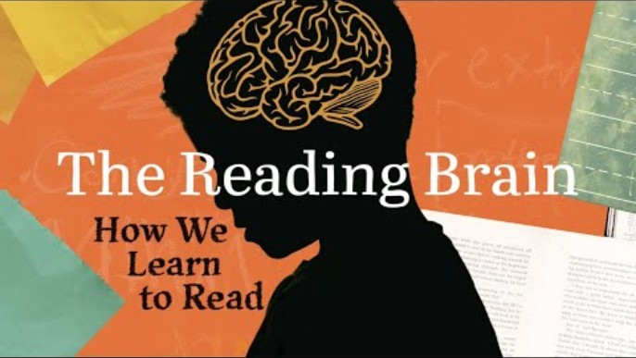
The Reading Brain I How We Learn to Read
Key Points About the Video:
Reading is not innate
The brain must be trained to read
Reading activates specific brain areas
Learning to read changes brain processing
Letter-sound instruction is essential
(Hill Center Learning)
Notes:
FACILITATOR NOTES:
Before watching the video, read the Key Points About the Video so participants know what to focus on.
After reviewing key points, watch Video (4:10): How We Learn to Read (Closed captioning is available. Enable by clicking on the black CC box at the bottom of the video.)
We are born with our brains hard-wired for speech. We do not need to be taught explicitly to connect sound with meaning. Babies are born automatically attuned to sound, especially speech sounds and they develop the ability to understand language simply by being immersed in it.
However, we are not born with our brain hard-wired for reading and writing. Reading is a skill that requires explicit instruction and opportunities to practice for a person to become proficient. We are going to watch a short video from Hill Center Learning called The Reading Brain | How we Learn to Read to understand this more.
Please watch for these key points about the video:
Reading is not innate-we are not born with the skills for reading and writing
The brain must be trained to read
Reading activates specific brain areas
Learning to read changes brain processing
Letter-sound instruction is essential
Background for presenters:
The brain must be trained to read
To learn to read, our brains must be trained to connect our visual system with our spoken language system. This actually changes the way our brain codes phonemes and connects those sounds to meaning.
Reading activates specific brain areas
The occipital lobe analyzes the visual features of the word. The visual word form area, or "letterbox," stores our knowledge of letters, letter combinations, whole words, and written language patterns. This area only activates in people who have learned to read and only for known letters in direct proportion to reading scores.
Learning to read changes brain processing
Learning an alphabetic language changes the way our brain codes the sounds of speech. This literally changes the neurological processing that happens in the visual cortex.
Letter-sound instruction is essential
Reading and comprehension is achieved most efficiently by first teaching letter-sound correspondences. Once a child can recognize the letter-sound correspondences, the anatomy of the brain changes.
Two routes support reading
One route connects letters to speech sounds and then to meaning. A second route develops: going from vision to meaning. The idea that there are two routes of reading is a critical piece of all models of the process of reading.

Slide 23
Stanislas Dehaene Quote
“It is simply not true that there are hundreds of ways to learn to read… when it comes to reading, we all have roughly the same brain that imposes the same constraints and the same learning sequence.”
(Dehaene, 2009)
Notes:
The Science of Reading is important because:
It is simply not true that there are hundreds of ways to learn to read... when it comes to reading, we all have roughly the same brain that imposes the same constraints and the same learning sequence" (Dehaene, 2009).
The reading circuit looks the same in the brains of all readers, regardless of the language in which a person learns to read. But individuals who struggle with reading are missing these strong connections. What is taught and how it is taught can either create and support these brain connections or leave children without the connections to read for meaning.

Slide 24
Paired Verbal Fluency I Science of Reading
What is the Science of Reading?
Why is it important for reading development?
Write down thoughts and ideas you could shared with a partner.
We will create partners A and B and take turns talking about the questions above.
At a signal, one will speak, and one will listen.
At a signal, the other will speak while the first speaker listens.
Each time, no one is allowed to repeat anything that was said by the other.
Notes:
To help us think about the information presented, we are going to use a conversation protocol called Paired Verbal Fluency to share with your partner about what the science of reading is and why it is important for reading development.
Write down thoughts and ideas you could share with a partner.
We will create partners A and B and take turns talking about the questions above.
At a signal, one will speak, and one will listen.
At a signal, the other will speak while the first speaker listens.
Each time, no one is allowed to repeat anything that was said by the other.
FACILITATOR NOTES:
Read all of the protocol directions.
Ask if participants have questions.
Start at #1: Give participants 2-3 minutes to write down thoughts and ideas they could share with a partner.
Create partners
Determine who’s A and B.
Round 1: 60 seconds
Partner A speaks, Partner B listens
Round 2: 40 seconds
Partner B speaks, Partner A listens
Round 3: 20 seconds (Time permitting)
Partner A speaks, Partner B listens
Ask participants if there are any questions or comments before continuing presentation.

Slide 25
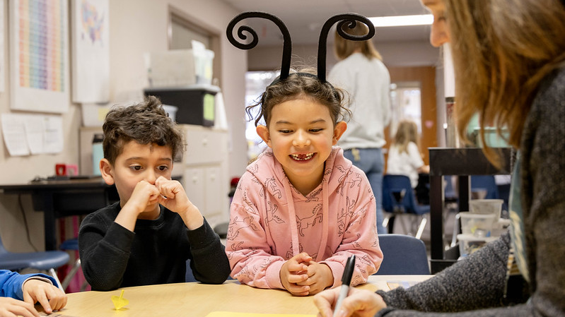
What does the Science of Reading
Look Like at School?
Notes:
What Does the Science of Reading Look Like at School?

Slide 26
Explicit, Systematic, Sequential Instruction
Explicitly teaches skills in the areas of phonological awareness, phonics, fluency and oral language, vocabulary, and comprehension.
Predictable routines so that students know what to expect. Lessons follow an “I do, we do, you do” progression.
Logical order to teaching skills needed for proficient reading that move from simple to complex.
Skills build over time.
Notes:
Explicit, Systematic, Sequential Instruction:
(CLICK) Explicitly teaches skills in the areas of phonological awareness, phonics, fluency and oral language, vocabulary, and comprehension.
(CLICK) includes Predictable routines so that students know what to expect. Lessons follow an “I do, we do, you do” progression.
(CLICK) There is a logical order to teaching skills needed for proficient reading that move from simple to complex. Teachers follow a predictable scope and sequence of skill instruction.
(CLICK) Skills build over time. Previously taught skills are regularly reviewed to practice to mastery.

Slide 27
2.The 5 Components Across the Grades
Notes:
The 5 Components should be addressed, every day, Across the Grades; however, we will see the focus shift at different grade levels as students progress through school.
Background knowledge for presenters:
As we discussed earlier in this presentation, while the five components of reading should be addressed every day, the focus in each component looks different at each grade level. There is a strong focus on phonological and phonemic awareness and phonics in the early grades to ensure students are learning proficient word-reading skills, while much of the instruction in vocabulary and comprehension is done through oral language and text read aloud. As students become more independent readers, they learn more advanced phonics and word study skills for reading and spelling, while shifting more focus on vocabulary and comprehension skills to the text they are reading independently.
This shift in focus can be seen in how classrooms at different grade levels approach literacy instruction.
Facilitator Note: Long-form caption for The 5 Components Across the Grades image included in Appendix B on slide 50

Slide 28

Literacy Instruction During the School Day
90-minute literacy block (minimum)
Whole group and small group instruction
Explicit instruction with corrective feedback
Working with a variety of texts
Reading AND writing opportunities
Additional time for intervention when needed
Reinforced throughout the day across content areas (math, science, etc.)
Notes:
Literacy Instruction During the School Day should include:
A 90-minute literacy block (at a minimum)
Both Whole group and small group instruction
Explicit instruction with corrective feedback
Students Working with a variety of texts
Both Reading AND writing opportunities are provided
With Additional time for intervention when needed
Concepts from literacy instruction are Reinforced throughout the day across content areas, like math or science, and possibly by multiple educators.

Slide 29
Texts for Literacy Throughout the Day
Decodable Texts
Authentic Texts
Audiobooks
Skill-based
Practice in phonics concepts being taught
Ideal text for independent phonics decoding practice
Written for enjoyment, information, etc.
Contain rich vocabulary, complex sentences, and language structures
Supports development of literacy knowledge
Model fluency and prosody
Support comprehension and vocabulary development
Provide access to grade-level content
Note: Despite the popularity and prevalence of leveled reading systems, there is scant evidence in the research to support either the accuracy of leveling systems or the effective use of leveling systems within classroom instruction (Adams, 2001; Stahl, 2003).
Notes:
A variety of texts for literacy instruction are used for different purposes throughout the day. Understanding the different types and their uses can be helpful information for parents.
(CLICK) -The first type of text we should see in an early literacy classroom is decodable text.
This is also sometimes called controlled text.
Decodable text is text that is written with a focus on the phonetic code.
It is skill-based and is used to allow students to practice the phonics concepts they are being taught, along with patterns they have already learned.
Decodable text is the ideal text to use for independent phonics decoding practice in the early grades, as it promotes accurate decoding and eliminates inefficient strategies like guessing or relying on pictures.
(CLICK) – The next text type you will see regularly in a literacy block is authentic texts.
These are what we would consider “real” books – books written to provide enjoyment, information, etc.
These texts contain rich vocabulary, and complex sentence and language structures that students often do not hear in everyday conversation.
Authentic text supports the development of literacy knowledge initially through read-alouds.
The goal is to get all children reading authentic texts independently.
(CLICK) – Finally, the third text type you may see used in classrooms is audiobooks.
Listening to stories provides students a model of fluency and prosody,
and supports comprehension and vocabulary development, as well as background knowledge.
Audiobooks are a great supplement to provide access to grade-level content before students are able to read texts themselves.
Despite the popularity and prevalence of leveled reading systems, there is scant evidence in the research to support either the accuracy of leveling systems or the effective use of leveling systems within classroom instruction (Adams, 2001; Stahl, 2003).
Notes for the presenter about leveled text:
It is important to understand that since text levels are determined by factors other than decodability, such as sentence length, number of words, and complexity, it is difficult to determine how appropriate an individual text will be for a student. Further, because leveled text is not focused on patterns of decodability in a predictable scope and sequence, students must rely on strategies that encourage them to guess, rely heavily on picture clues, rely on sentence patterns that do not require them to attend to each word, or focus on what makes sense, rather than identifying the actual words on the page. Incredibly, despite the popularity and prevalence of leveled reading systems, there is scant evidence in the research to support either the accuracy of leveling systems or the effective use of leveling systems within classroom instruction (Adams, 2001; Stahl, 2003).
For more detailed information: https://www.cde.state.co.us/coloradoliteracy/decodable_leveled_text

Slide 30

Supporting the Science of Reading
Evidence-based and scientifically based curriculum and programming
Literacy Curriculum Transparency Act
Evidence-based training requirements for teachers, interventionists, principals, and administrators
Literacy Curriculum Transparency Icon
Notes:
The Colorado React Acts helps support the science of reading by:
Outlining evidence-based and scientifically curriculum and programming for all students in kindergarten through third grade by.
These programs must focus on developing reading competency, focused on the 5 essential components of reading we examined earlier: phonemic awareness, phonics, vocabulary development, reading fluency (including oral skills), and reading comprehension (CRS 22-7-1204).
The Colorado General Assembly passed the Literacy Curriculum Transparency Act which requires each school and district to submit information around the targeted, evidence-based or scientifically based reading instructional programs used at each of their schools.
The Literacy Curriculum Transparency icon is an easily identifiable image representing student literacy and the Colorado READ Act.
Your child’s school must include this icon and a link to the Literacy Curriculum Transparency webpage on their website.
The READ Act also outlines evidence-based training requirements for teachers, interventionists, principals, and administrators
All schools that receive per-pupil funding ensure their K-3 reading teachers and 4th-12th grade reading interventionists have successfully completed evidence-based training in teaching reading.
K-3 principals and administrators complete training that assists them in coaching and evaluating educators and implementing schoolwide literacy programming that is scientifically based and evidence-based.

Slide 31

How Can You Support Reading at Home?
Notes:
How Can You Support Reading at Home?

Slide 32

1How Can You Support Reading at Home?
Read with your child every day
Have conversations together
Expand your child’s vocabulary
Develop your child’s background knowledge
Support your child with homework
Ask questions of your child’s teacher to understand your child’s strengths and challenges with learning to read
Notes:
You are likely already doing many things on this list of How Can You Support Reading at Home. Our hope is that you get one or two new ideas to try!
(Click) Read with your child every day.
Set aside time to enjoy books together, but also engage with print throughout the day, by reading signs in your environment, reading a recipe together, sharing an interesting article, or reading directions for a game or project. Model how reading intersects with life throughout the day.
(Click) Have conversations together.
Conversations about books and engaging in back-and-forth conversation around other topics builds knowledge, vocabulary, and understanding of our language.
(Click) Expand your child’s vocabulary.
Talk about new words, in books and in daily life. Answer questions about words students are curious about and make connections to the knowledge they already have.
(Click) Develop your child’s background knowledge through experiences and a variety of books.
Background knowledge about the world plays an important role in comprehension. Expose your child to life experiences around you and use books to access a variety of topics.
(Click) Support your child with homework.
Pay attention to what your child is learning at school and reinforce it at home.
Such as alphabet knowledge and letter formation.
(Click) Ask questions of your child’s teacher to understand your child’s strengths and challenges with learning to read.

Slide 33

What Books Should We Be Reading at Home?
Books your child’s teacher sends home from school
Books your child is interested in
Books you are interested in sharing with your child
Notes:
A question frequently asked is “What books should we be reading at home?”
Read the books your child’s teacher sends home from school.
These are designed to reinforce the reading instruction at school and are typically decodable texts in the early grades.
Read books your child is interested in
Let them pick out books and titles that are interesting to them
If they can not read the book themselves, you can read it to them or find an audio book version
It is common and okay to read a book over and over again!
Read books you are interested in sharing with your child about topics you find interesting
Most importantly, have fun reading together!

Slide 34
Key Takeaways | Science of Reading
The science of reading is based on 50+ years of scientifically based research
The Five Essential Components and The Simple View of Reading are anchors that can help organize our understanding
We are not born with our brain hard-wired for reading and writing
Nearly all children can learn to read with the right instruction
The science of reading is ever-changing, with new research and evidence all the time
Notes:
Let’s wrap up the presentation by revisiting some Key Takeaways about the Science of Reading.
(CLICK) The science of reading is based on 50+ years of scientifically based research
(CLICK) The Five Essential Components and The Simple View of Reading are anchors that can help organize our understanding
(CLICK) We are not born with our brain hard-wired for reading and writing
Evolutionarily speaking, reading and writing are recent behaviors.
We need to “re-arrange” our brains to learn to read.
(CLICK) All children deserve to learn to read. Nearly all children can learn to read with the right instruction
(CLICK) The science of reading is ever-changing, with new research and evidence all the time. As populations, communities, and approaches evolve, so should practices.
Share The Science of Reading for Parents handout

Slide 35
National Council on Teacher Quality Quote
“With the scientific discoveries that began over a half-century ago, we now have the good fortune of holding the keys to the locks that bar far too many children from having full access to society. It is time to put the keys in the locks and start turning them.”
(National Council on Teacher Quality, 2007, p. 17)
Notes:
The good news is we know how to improve reading achievement!
"With the scientific discoveries that began over a half-century ago, we now have the good fortune of holding the keys to the locks that bar far too many children from having full access to society. It is time to put the keys in the locks and start turning them" (National Council on Teacher Quality, 2007, p. 17).

Slide 36
Do You Want to Learn More?
Visit the CDE Parent Resources Website
Notes:
Do You Want to Learn More?
There are more resources for parents on the CDE Parent Resources Website including videos of activities you can do at home.

Slide 37
References 1
Adams, M. J., Foorman, B. R., Lundberg, I., & Beeler, T. (1998). Phonemic awareness in young children: A classroom curriculum. Brookes Publishing.
Adams, N. J. (2001). On the lexile framework. In National Center for Education Statistics (Ed.), Assessing the lexile framework. Results on a panel meeting NCES 2001-08 (pp. 15–21). Washington, DC: National Center for Education Statistics
Birsh, J. R. & Carreker, S. (2018). Multisensory teaching of basic language skills (4th ed.). Brookes Publishing.
Boulton, D. (2003). Children of the code [Documentary series]. Learning Stewards.
Cassar, M., Treiman, R., Moats, L., Pollo, T. C., & Kessler, B. (2005). How do the spellings of children with dyslexia compare with those of nondyslexic children? Reading and Writing, 18(1), 27–49.
Dehaene, Stanislas. (2009). Reading in the Brain. Penguin Books.
D’Orio, W. (2020, February 3). Reading levels unfairly label learners, say critics. School Library Journal.
Ehri, L. C., Nunes, S. R., Stahl, S. A., & Willows, D. M. (2001). Systematic phonics instruction helps children learn to read: Evidence from the National Reading Panel's meta-analysis. Review of Educational Research, 71(3), 393–447.
Gillon, G. T. (2004). Phonological awareness: From research to practice. Guilford Press.
Gough, P. B. & Tunmer, W.E. (1986). Decoding, reading, and reading disability. Remedial and Special Education, 7(1).
Hanna, P. R., Hanna, J. S., Hodges, R. E., & Rudorf, E. H. (1966). Phoneme–grapheme correspondences as cues to spelling improvement. Washington, DC: U.S. Department of Health, Education, and Welfare.
Hasbrouck, J. (2020). An update to the National Reading Panel Report: What we know about fluency in 2020. The Reading League Journal, 1(3), 29-31.
Hill Learning Center. (2022, September 22). The reading brain: how we learn to read [Video]. https://www.youtube.com/watch?v=A2HHrKpjlYM

Slide 38
References 2
Hoffman, J. V. (2017). What if “just right” is just wrong? The unintended consequences of leveling readers. The Reading Teacher, 71(3), 265–273.
Hogan, T. [Speech and Language Literacy Lab]. (2023, March 5). The quadrant model of reading comprehension difficulties [Video]. YouTube.
Institute of Education Sciences. (n.d.). [YouTube channel]. YouTube. https://www.youtube.com/@InstituteofEducationSciences
Kamhi, A. G., & Catts, H. W. (1989). Reading disabilities: A developmental language perspective. Allyn & Bacon.
Kemeny, L. (2023). 7 mighty moves: Research-backed, classroom-tested strategies to ensure K-to-3 reading success. Scholastic Professional.
Kilpatrick, D. A. (2015). Essentials of assessing, preventing, and overcoming reading difficulties. Wiley.
Kozloff, M. A. (2002). Sufficient Scaffolding, Organizing and Activating Knowledge, and Sustaining High Engaged Time.
Kuhn, M. R., Schwanenflugel, P. J., Meisinger, E. B., & Levy, B. A., & Rasinski, T. V. (Eds.). (2010). Aligning theory and assessment of reading fluency: Automaticity, prosody, and definitions of fluency. Reading Research Quarterly, 45(2), 230–251.
Lane, H. B., & Pullen, P. C. (2004). Phonological awareness assessment and instruction: A sound beginning. Allyn & Bacon.
Lonigan, C. J., & Shanahan, T. (2008). Executive summary of the report of the National Early Literacy Panel. Developing early literacy: Report of the National Early Literacy Panel, 1–8. National Center for Family Literacy.
National Early Literacy Panel. (2008). Developing early literacy: Report of the National Early Literacy Panel. National Center for Family Literacy.
Lyon, R.G. (1998). Reading is not a natural process. Educational Leadership, 55, 6 pp 14-18. ​
Lyon, G. R. (2002). Reading development, reading difficulties, and reading instruction: Educational and public health issues. Journal of School Psychology, 40, 3-6.​
Moats, L. C. (2020). Speech to print: Language essentials for teachers (3rd ed.). Brookes Publishing.

Slide 39
References 3
Moats, L. C. (2020). Teaching reading is rocket science (2nd ed.). In L. Diamond & L. Thorsnes (Eds.), Teaching reading sourcebook (3rd ed., pp. 9–30). Arena Press.
National Center for Education Statistics., National Assessment of Educational Progress (Project), Educational Testing Service., & United States. (2019). NAEP ... reading report card for the nation and the states. Washington, D.C: National Center for Education Statistics, Office of Educational Research and Improvement, U.S. Dept. of Education.​
National Reading Panel. (2000). Teaching children to read: An evidence-based assessment of the scientific research literature on reading and its implications for reading instruction (NIH Publications No. 00-4769) Washington, DC: National Institutes of Child Health and Human Development.
National Institute of Child Health and Human Development (NICHD). (2000). Report of the National Reading Panel. Teaching children to read : An evidence-based assessment of the scientific research literature on reading and its implications for reading instruction. (NIH Publication No. 00-4769). Washington, DC: U.S. Government Printing Office.
Parrott, K. (2017, October 12). Fountas and Pinnell say librarians should guide readers by interest, not level. School Library Journal.
Reading Rockets. (n.d.). Reading 101: A guide for parents. https://www.readingrockets.org/literacy-home/reading-101-guide-parents.
Reading Universe. (n.d.). Word recognition. Reading Universe. https://readinguniverse.org/explore-teaching-topics/word-recognition
Reitsma, P. (1983a). Printed word learning in beginning readers. Journal of Experimental Child Psychology, 36, 321-339.
Reitsma, P. (1983b). Word-specific knowledge in beginning reading. Journal of Research in Reading, 6, 41-56.
Rules for the Administration of the Colorado Reading to Ensure Academic Development Act, 1 Colo. Code Regs. 301-92, (2017).
Sedita, J. (2021). The keys to beginning reading [Professional development materials]. Keys to Literacy.

Slide 40
References 4
Scarborough, H. S. (2001). Connecting early language and literacy to later reading (dis)abilities: Evidence, theory, and practice. In S. Neuman & D. Dickinson (Eds.), Handbook for research in early literacy. New York: Guilford Press.
Stahl, S.A. (2003). Vocabulary and readability: How knowing word meanings affects comprehension. Topics in Language Disorders., 23(3), 241–247.
The Reading League. (2022). Science of Reading: Defining guide (2nd ed.). The Reading League.
Torgesen, J. K. (1998). Catch them before they fall: Identifying and helping children with reading difficulties in early grades. American Educator, 22(1–2), 32–39.
Torgesen, J. K. (2004). Lessons learned from research on interventions for children who have difficulty learning to read. In P. McCardle & V. Chhabra (Eds.), The voice of evidence in reading research (pp. 355–382). Brookes Publishing.
Uhry, J. K. (2011). Phonemic awareness and letter-sound knowledge: Their impact on spelling. In R. L. Treiman & B. E. Berninger (Eds.), Spelling development and disability: Theoretical, empirical, and practical perspectives (pp. 147–164). Routledge.
Wolf, M. & Katzir-Cohen, T. (2001). Reading fluency and its interventions, Scientific Studies of Reading, 5, 211-239.
Yopp, H. K., & Yopp, R. H. (2009). Phonological awareness is child's play! Young Children, 64(1), 12–17.
Young, N., & Hasbrouck, J. (2024). Climbing the ladder of reading & writing: Meeting the needs of all learners. Benchmark Education.

Slide 41
Appendix B: The 5 Components Across the Grades
The image is a grid chart illustrating different stages and components of literacy development across educational levels labeled K, 1, 2, 3, and 4+. It consists of five rows, each representing a different literacy component: "Phonological and Phonemic Awareness," "Phonics," "Reading Fluency," "Vocabulary," and "Comprehension."
    The "Phonological and Phonemic Awareness" row is shaded in light blue, with a triangle spanning K to 2.
    The "Phonics" row transitions from light green labeled "Early" at K to a slightly darker green labeled "Advanced" at 2.
    The "Reading Fluency" row shows a light blue rectangle covering grades 2 to 4+.
    The "Vocabulary" row is filled with a light purple rectangle stretching from K to 4+.
    The "Comprehension" row has a pink rectangle labeled "Listening" from K to 2, transitioning to a red gradient labeled "Reading" from 1 to 4+.
The grid is bordered in black, with vertical and horizontal lines separating each section.
Notes:
Long-form caption for image included on slides 12 and 33

