Slide 1


Welcome to Ascend
Colorado Department of Education’s
Data Management System (DMS)
1

Slide 2
Topics Included
System Requirements
System Features
Roles in DMS
Login
Welcome Page
Documents – Secure File Sharing
Help – Professional Learning System
Role Specific Modules
  Administrative Unit (AU) Tasks
  Corrections
  Fiscal
  Facilitated Assessment
  Gifted
  Reports
2

Slide 3
Ascend DMS System Requirements
System Requirements:
Most current versions of Google Chrome*, Apple Safari, Firefox, & Microsoft Edge. Check that your browser is updated to the latest version.
Your pop-up blocker must be disabled.
*You may experience better functionality with Google Chrome.
Use the links below to check if you have your browsers latest version:
  Chrome
  Safari
  Firefox
  Microsoft Edge
3

Slide 4
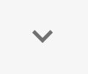


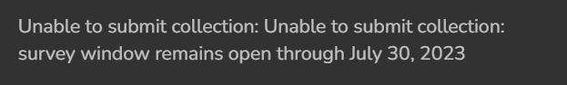
Ascend DMS Features
Caret: an open or filled arrowhead. Click once to reveal additional information. Click again to hide.
Quick Access Menu: 3 short stacked horizontal lines. Click to reveal additional information/options.
Modals, pop-ups, and new tabs: Messages that appear on the screen to indicate success or failure on an action.
4

Slide 5
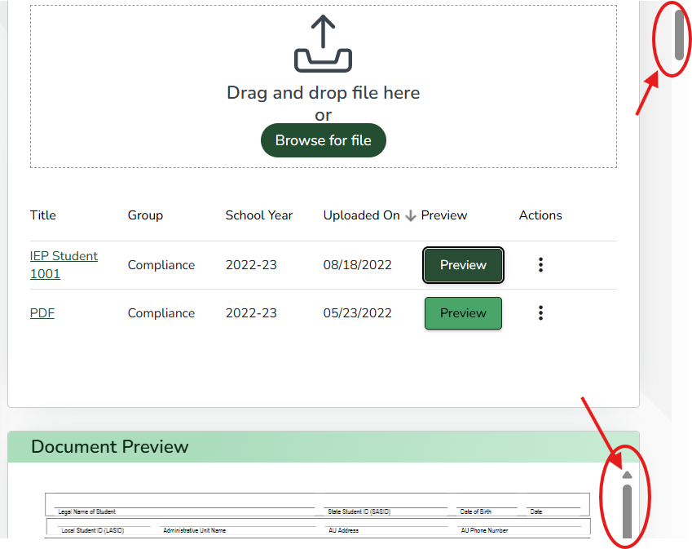
Ascend DMS Features Cont.
Vertical and Horizontal Scroll Bars: Be sure to check if the sides and top and bottom of the page, or if any sections or pop-up boxes have these scroll bars used to reveal more information.
# of items per page and page over arrows: may exist at the bottom of the page. You can change the # of items displayed or page over to reveal more information.
Auto-save: Ascend DMS automatically saves when you are working in the system.
5

Slide 6
Assigning Roles in Ascend DMS
Roles are assigned by your AU’s Local Access Manager (LAM). If you do not know who your LAM is, use the LAM Request For Assistance form.
Your LAM will assign one (1) role per user for the ASCDMS application in Identity Management. Having more than one role will prevent the user from logging into the DMS.
Review the Role Descriptions in slides 7-12 to decide which role is best for you or your staff members. If you are still unsure which role to add, contact
Josh Fails (fails_j@cde.state.co.us)
6

Slide 7

SpEd Monitoring Director and
Gifted Director Roles
7

Slide 8
Role Descriptions - Director Level
SpEd Monitoring Director (MD):
  View, complete, and submit IEP Record Reviews
  View, complete, and submit Post School Outcomes (PSO) Interviews
  Export student list and survey data for Parent Surveys
  Upload documents for Dispute Resolution
  View and upload Fiscal documents
  View and download Indicator Summary Data in Reports
  View, respond to, and submit Corrections
  View, edit, and submit Facilitated Assessment
  Upload and download files in Documents
8

Slide 9
Role Descriptions - Director Level Roles Cont.
Gifted Director (GD):
  Gifted Dashboard: View
  Monitoring: View, enter checklist responses, and enter student responses
  Monitoring Schedule: View, add new day, edit
  Annual Plan: View, interview entry, edit interview content, and edit student samples
  Gifted Fiscal: Enter survey responses and view survey data
  Upload and download files in Documents
  Gifted Rollup in Reports
Gifted and SpEd Monitoring Director (GDnMD):
  This role is for those who act as both Monitoring Director and Gifted Director, and combines access of the two roles.
9

Slide 10

Non-Director Roles in DMS
10

Slide 11
Role Descriptions – SpEd Monitoring
Monitoring Post School Interviewer (MPSI):
  View, complete, and submit PSO Interviews
  View, respond to, and submit Corrections
  Upload and download files in Documents
  View Report tab
Fiscal (FP):
  View and upload Fiscal documents
  View and download Indicator Summary Data
  View, respond to, and submit Corrections
  Upload and download files in Documents
  View Report tab
Monitoring Record Reviewer (MRR):
  Includes the same access as the MPSI and FP roles, and in addition can:
  View, complete, and submit IEP Record Reviews
  Export student list and survey data for Parent Surveys
  View and edit Facilitated Assessments
11

Slide 12
Role Descriptions – Gifted
Gifted Fiscal Director (GF):
  View, complete, and submit Post School Outcomes Interviews
  View, respond to, and submit Corrections
  Upload and download files in Documents
  View Report tab
Gifted Regional Consultant (GGRC):
  View and Upload Fiscal documents
  View and download Indicator Summary Data
  View, respond to, and submit Corrections
  Upload and download files in Documents
  View Report tab
12

Slide 13

Logging in to DMS
13

Slide 14
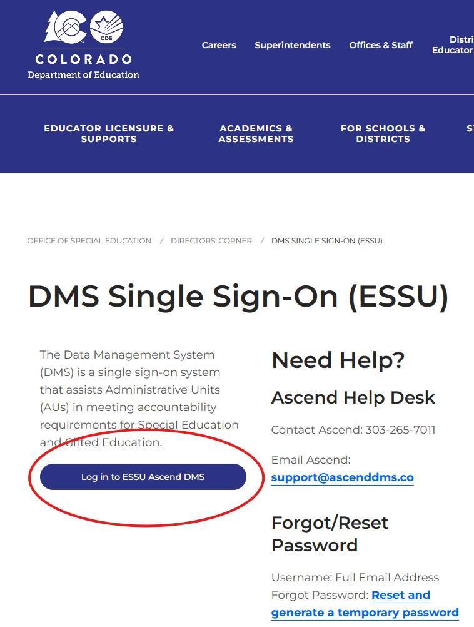
Ascend DMS Login
Go to CDE’s webpage at:
DMS Single Sign-On (ESSU) – CDE
Bookmark this link to sign in!
Click on the blue “Log in to ESSU Ascend DMS” button on the left side of the webpage to be taken to the Single Sign on page.
14

Slide 15
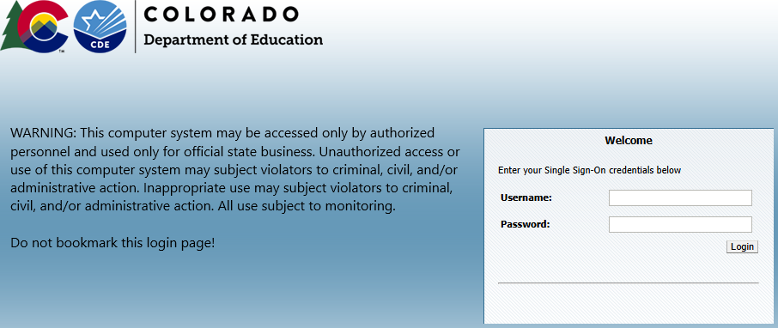
Single Sign-On through Identity Management
Enter your Username (full email address) and Password.
Do not initiate login attempts from this page.
Always use the CDE DMS login page (previous slide) to begin a new session.
15

Slide 16
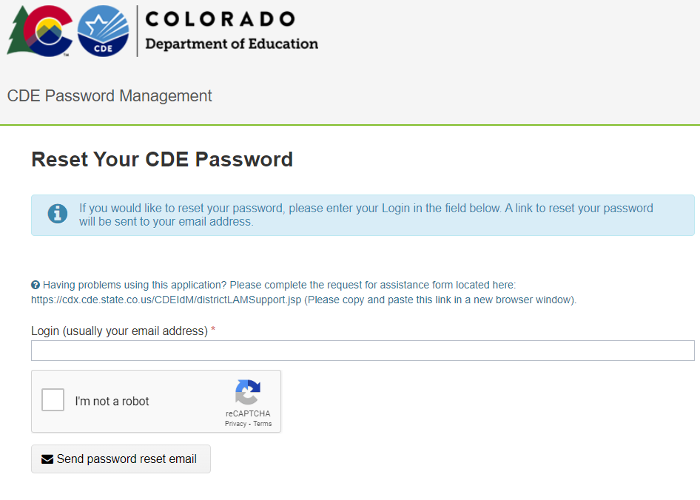
Single Sign-On Password Reset
Forgot your Password? Go to:
Reset and generate temporary password
This link is also available on the DMS Single Sign-On (ESSU) – CDE Webpage
If you continue to have difficulties logging on to the DMS, please contact your AU Local Access Manager (LAM).
16

Slide 17

Important DMS Sections for All Roles
17

Slide 18
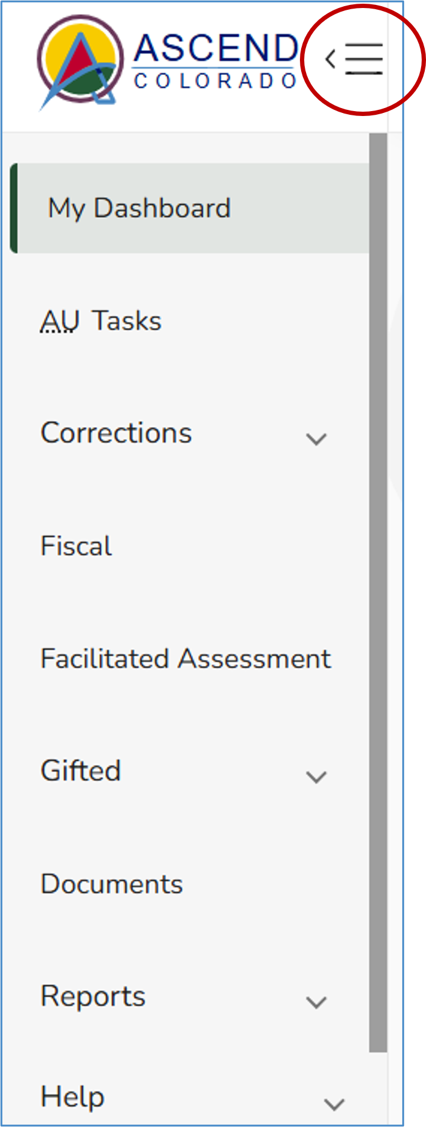
Left Pane Navigation
Ascend DMS will open to the My Dashboard page. To expand the left navigation pane, use the Quick Access menu button to open the panel. The pane contains the links to the various module pages such as AU Tasks, Corrections, Documents, Help, and more.
Each module listed in the panel will be outlined in the following slides.
*Note, Documents is the most accessed module in DMS.
18

Slide 19
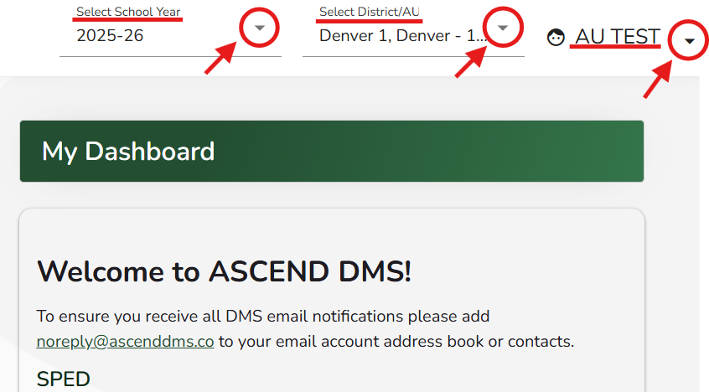
Ascend DMS Dashboard
Upon logging into Ascend DMS, you will land on the “My Dashboard” page. Along the top right side of the screen, you will see 3 drop-down fields:
Select School Year (default is current school year)
District/AU (only shows your AU)
Username
Clicking on the shaded caret to the right of these fields will reveal options to:
Select the school year; Show your District/AU; Adjust your settings or sign out of the system.
19

Slide 20
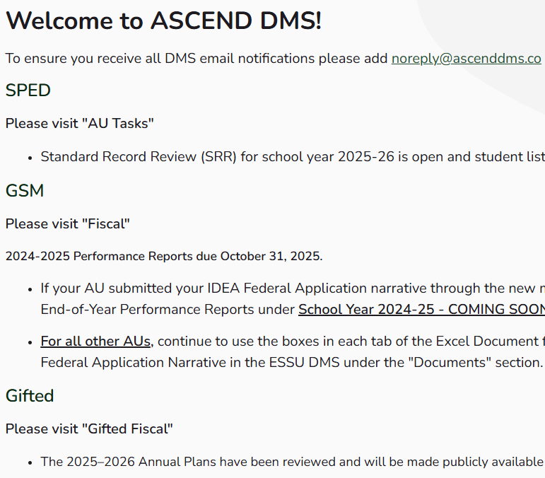
Welcome Section
This section will have important dates and reminders for:
SpEd Collections
General Supervision and Monitoring (GSM) tasks, and
Gifted collections and tasks.
Review this page often to stay up to date!
20

Slide 21
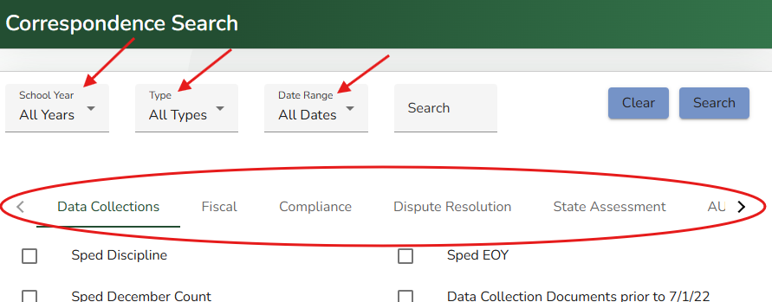
Documents – Correspondence Search
Documents is the most used module in DMS. It is a secure file transfer module for sending files with sensitive information between AUs and CDE. All DMS Roles have access to this module.
Search using the filter fields School Year, Type, and Date Range.
You can also search by Tags in the Categories of Data Collections, Fiscal, Compliance, and more.
21

Slide 22
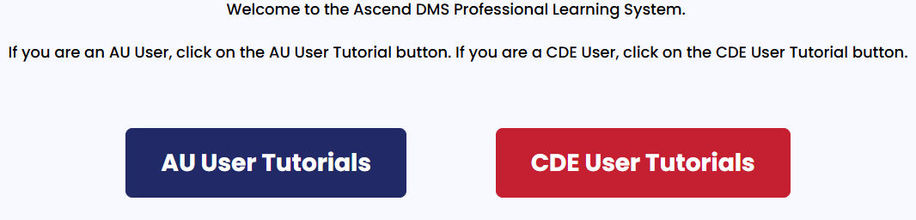
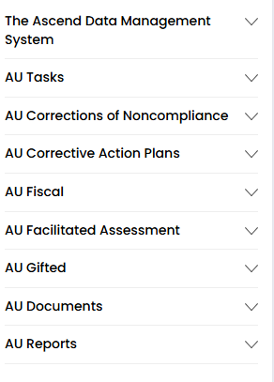
Help – “How To” Information
Click the Help tab at the bottom of the left navigation, then the Professional Learning System (PLS), and AU User Tutorials
Use the tutorial list provided to find the task you are working on. You will be given very detailed steps to assist in your work.
The PLS is an extremely valuable tool for self teaching.
22

Slide 23

Role Specific Modules –
Descriptions and CDE Resource Links
23

Slide 24
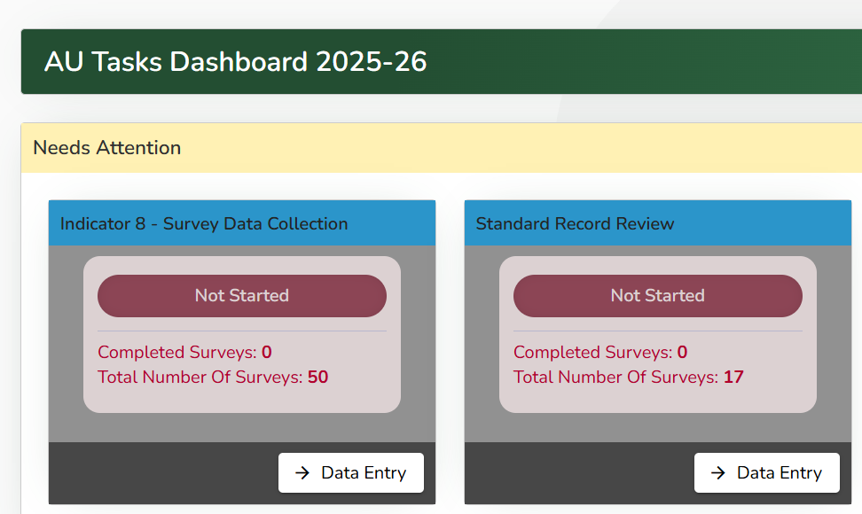
AU Tasks
The AU Tasks Dashboard houses three major SpEd collections:
Standard Record Review (Indicator 13)
Parent Survey (Indicator 8)
Post School Outcomes Interview (Indicator 14)
24

Slide 25
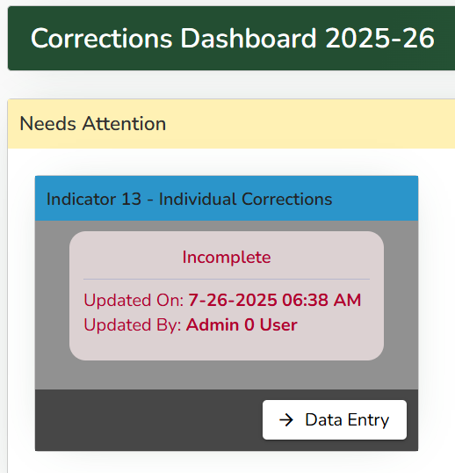
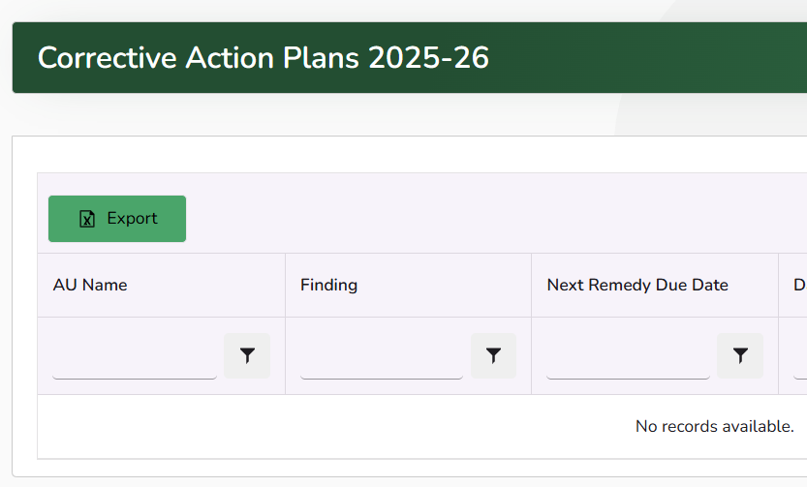
Corrections
The Correction tab has two options.
Corrections Dashboard
  Here you will work on Corrections for Indicators 11, 12 and 13.
    Indicator 11
    Indicator 12
    Indicator 13
CAPs
  GSM CAPs can be worked on through this Dashboard.
  GSM Contacts
25

Slide 26
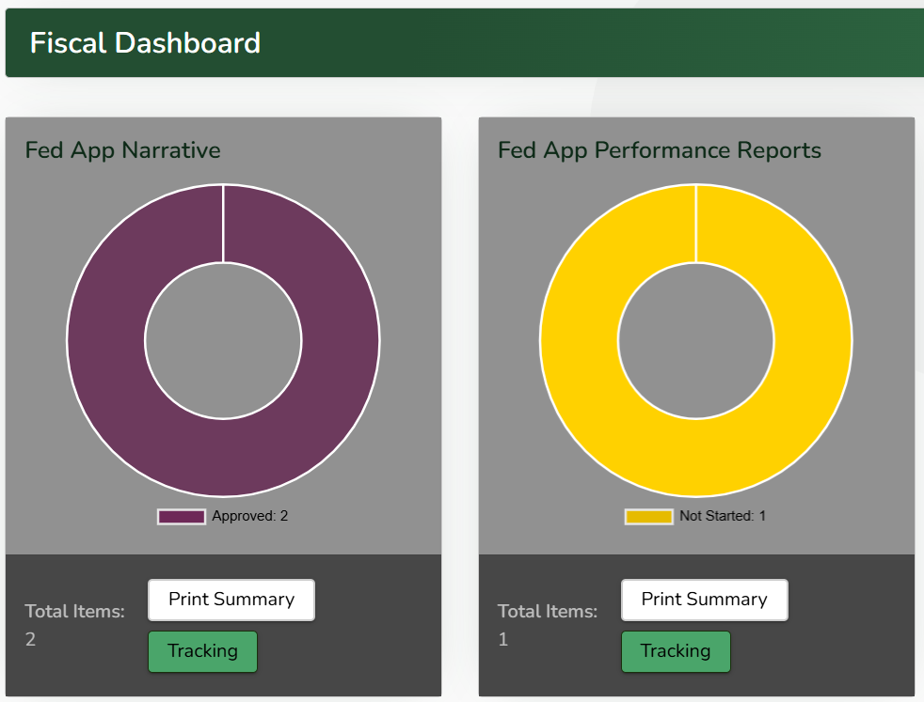
Fiscal
The Fiscal Dashboard is where you can complete your Fed App Narrative and Performance Reports.
IDEA Part B Fiscal Resources
26

Slide 27
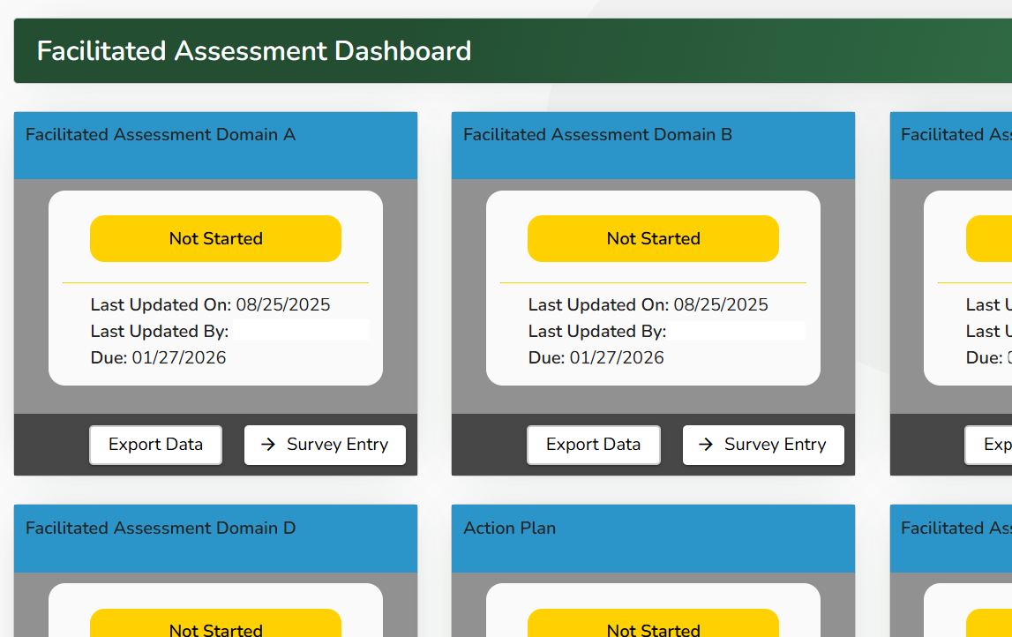
Facilitated Assessment
If you are working on a Facilitated Assessment (FA) this year, you can export and enter data using the FA Dashboard.
Integrated Monitoring & Facilitated Assessment
GSM Contacts
27

Slide 28
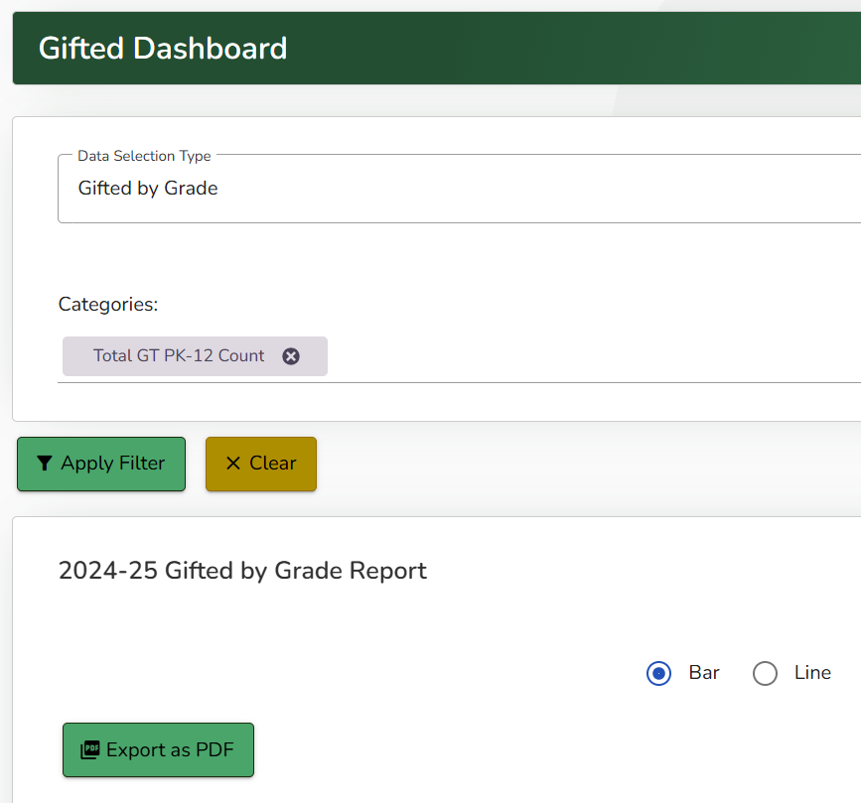
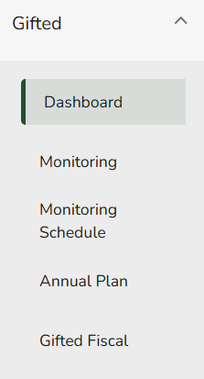
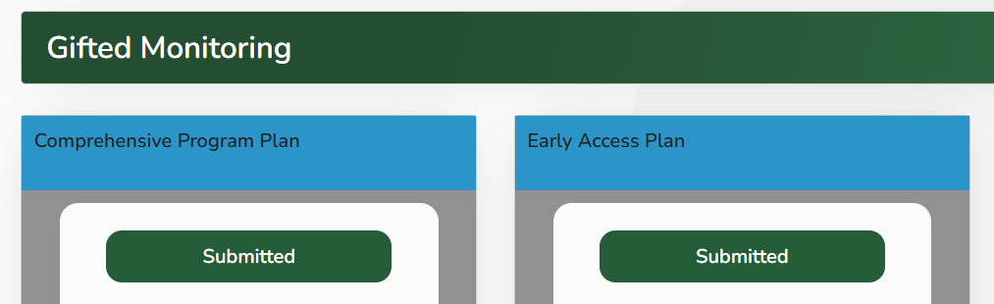
Gifted
The Gifted Module has 5 components. The Dashboard, Monitoring, Monitoring Schedule, Annual Plan, and Gifted Fiscal.
Dashboard - The Gifted Dashboard provides multi-year AU data (in graph, line, and spreadsheet form) for gifted identification demographics.
Monitoring - Includes plans and reports assigned to an AU before, during, and after their Gifted Education Monitoring visit.
28

Slide 29
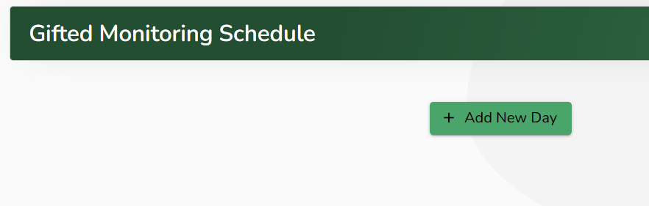
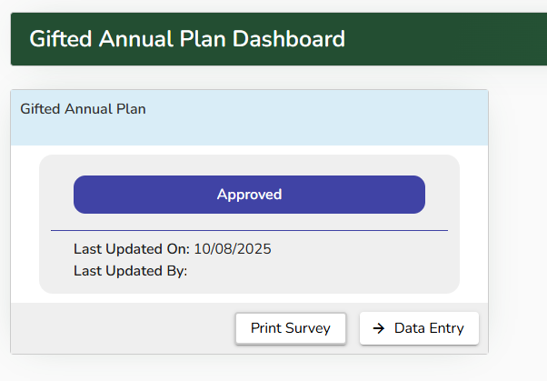
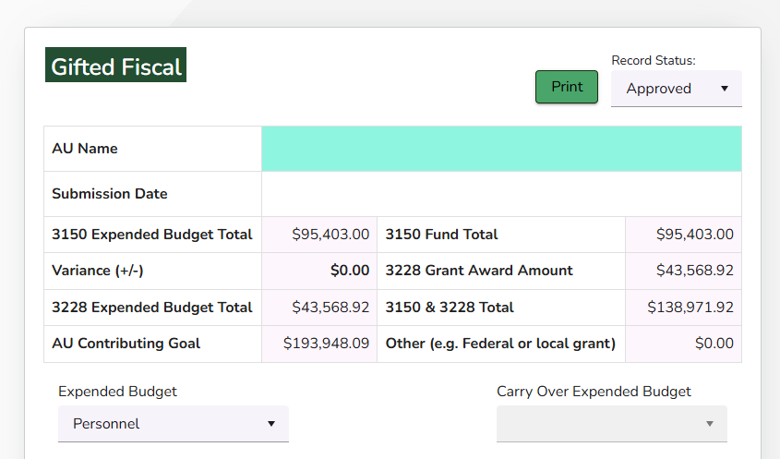
Gifted Cont.
Monitoring Schedule - An AU can use this section to build the schedule used during their Gifted Education Monitoring visit.
Annual Plan - This section houses the yearly plan/goals an AU writes.
Gifted Fiscal - The 3150 Categorical Gifted funds are reported as an expended budget in this section.
29

Slide 30
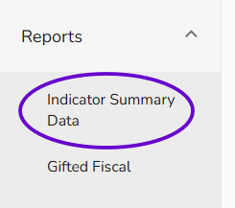
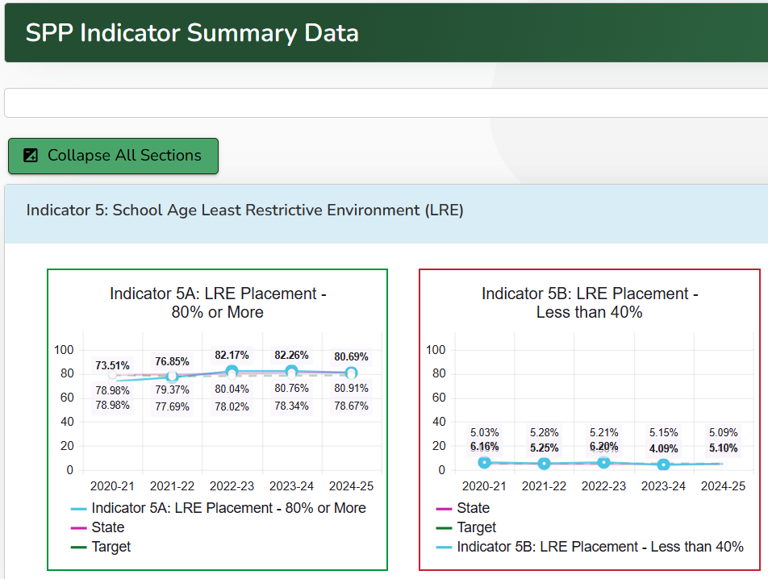
Reports – Indicator Summary Data
The Indicator Summary Data tab provides trend graphs of data from the previous 5 years of collections for most of the Indicators reported in the State Performance Plan/Annual Performance Report and Determinations.
Each Indicator graph has a trend line for your AU’s Indicator results, the state results, and the targets.
30

Slide 31
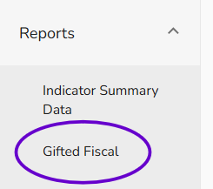
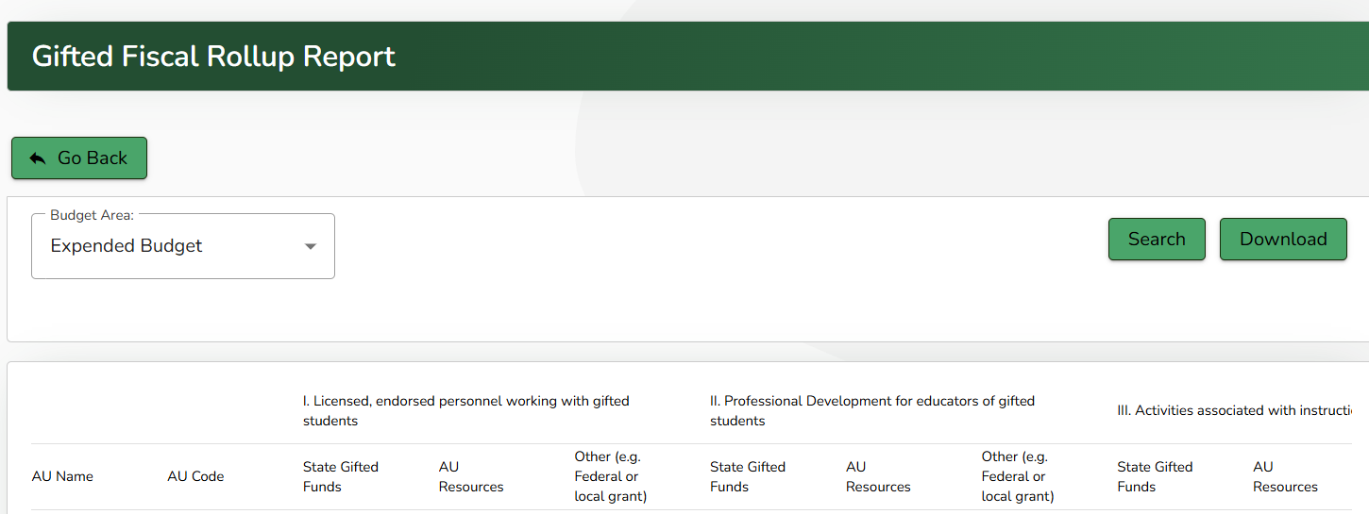
Reports – Gifted Fiscal Rollup
In Gifted Fiscal, the Gifted Fiscal Rollup Report provides a way for CDE to look at the way 3150 funds are being spent across the state.
31

Slide 32
Contact CDE for DMS Help
For general help with the DMS please contact:
Josh Fails
Online Project Coordinator & Data Consultant
Fails_J@cde.state.co.us
720-618-0538
32

