Slide 1
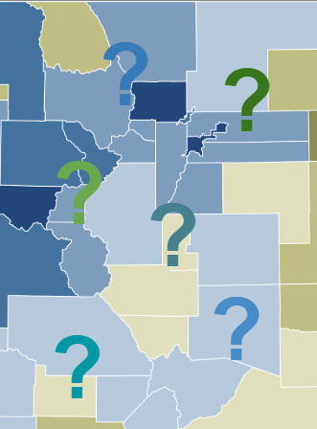
Mill Levy Calculation & Submission: 100% Fully Locally Funded Districts
November 19, 2025
Presenter: Tim Kahle

Slide 2
Agenda
Important Dates
Total Program Basics
Funding Scenarios
CDE’s Mill Levy Submission Process
Contacts
Questions?

Slide 3
Mill Levy: Important Dates

Slide 4
Important Dates
On or before December 10, 2025:
County assessor will provide final Certifications of Valuation to district/CDE
Contact your county assessor to find out when they will provide certifications
On or before December 15, 2025:
District’s Board of Education must certify mill levies and provide to County Commissioner (be sure to find out what your County Commisioner requires well before this deadline, as county procedures may vary)
District must submit certification information to CDE using online system

Slide 5
Total Program Funding Basics

Slide 6
Total Program Basics
Total Program is calculated utilizing the state’s funding formula
Total Program is then made up of two pieces
Local Share
State Share
Calculated Total Program less Local Share equals State Share
State Share is a backfill of the difference between Total Program and Local Share
Districts that receive enough in Local Share to fund the calculated Total Program, are consider Fully Locally Funded
These districts may also be required to repay a portion of Categorical Program funding, up to the full amount of categorical funds paid on the district’s behalf (Ex: ECEA Special Education though paid to AU)

Slide 7
District Funding Scenarios

Slide 8
Scenario #1 (continued)
District has an Assessed Valuation of $412,104,020
Total Program Mills are 24.545 which generates $10,115,093 in revenue
Total Program Funding equals $9,251,080
Therefore, only 21.504 needed to fully fund Total Program, leaving 3.041 mills
Property Taxes for Total Program = $8,861,884
SOT = $389,002
Total Local Share applied to formula funding is $9,250,886
State Share equals $256
District’s total categorical programs equals $358,355 (only 0.870 mills out of the excess 3.041)
Remaining 2.171 mills goes into Total Program Excess
Payback amount from district will be credited the $256 from state share

Slide 9
Scenario #2 (continued)
District has an Assessed Valuation of $3,951,710,493
Total Program Mills are 5.624 which generates $22,224,420 in revenue
Total Program Funding equals $12,134,854
Therefore, only 2.939 needed to fully fund Total Program, leaving 2.685 mills
Property Taxes for Total Program = $11,613,359
SOT = $521,495.75
Total Local Share applied to formula funding is $12,134,854
State Share equals $544
District’s total categorical programs equals $607,593 (only 0.154 mills out of the excess 2.685)
Remaining 2.531 mills goes into Total Program Excess
Payback amount from district will be credited the $544 from state share

Slide 10
Scenario #3 (continued)
District has an Assessed Valuation of $515,992,429
Total Program Mills are 12.173 which generates $6,281,176 in revenue
Total Program Funding equals $6,710,600
Therefore, only 11.799 needed to fully fund Total Program, leaving 0.374 mills
Property Taxes for Total Program = $6,088,195
SOT = $622,288
Total Local Share applied to formula funding is $6,710,483
State Share equals $117
District’s total categorical programs equals $532,449 (remaining 0.374 mill generates $192,981)
District required to only repay state funding in the amount of $192,864 ($192,981 from excess total program mill revenue less $117 state share credit)

Slide 11
CDE’s Mill Levy Submission Process

Slide 12
CDE Mill Levy Certification Submission Process
CDE has a web-based application for reporting mill levies
Access is through the State Equal System (we no longer accepts submissions through physical mail or fax)
https://idm.cde.state.co.us/equal/
Each district’s Local Access Manager (LAM) will have to grant permission to the district individual responsible for submission of mill levy data
REQUIRED to upload/email form copy and County Certification of Valuation
OPTIONAL to upload/email district worksheet
Submission must be completed on or before end of day, December 15, 2025
Early submission gives us more time to correct any issues you encounter

Slide 13
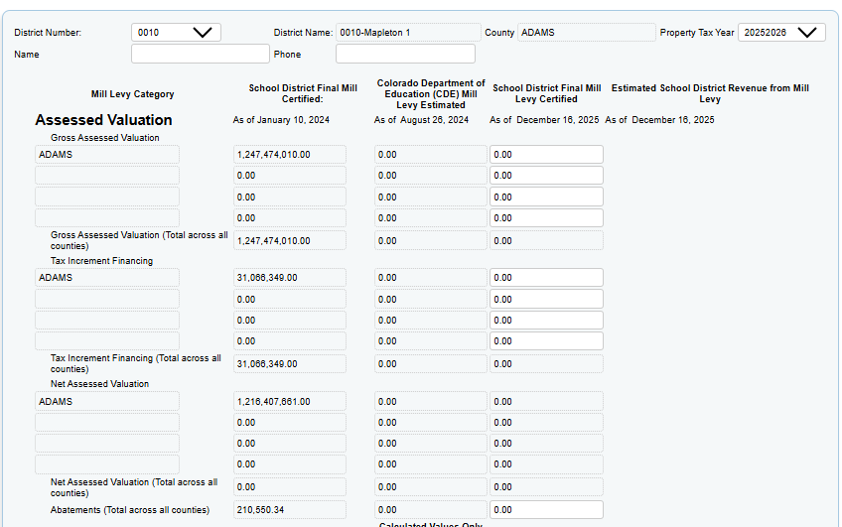
CDE Mill Levy Submission: Entering Your Data (1 of 4)

Slide 14
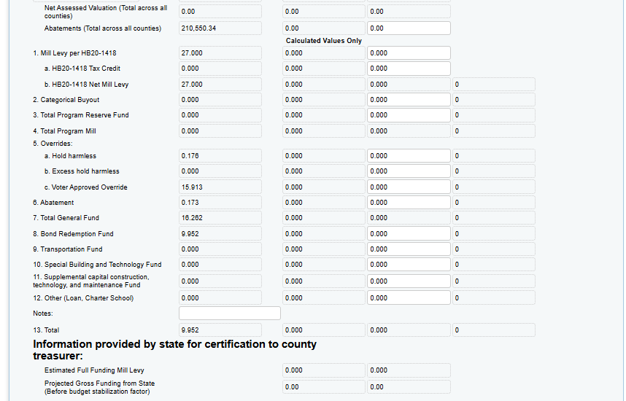
CDE Mill Levy Submission: Entering Your Data (2 of 4)

Slide 15
CDE Mill Levy Submission: Entering Your Data (3 of 4)
Step One: select your District LEA number from the drop-down box (this will populate your counties on the form; verify that all your counties appear)
Step Two: Enter the name and phone number of the person submitting the data
Step Three: Enter the data from Column E of your Mill Levy Certification Form into the appropriate fields on State Equal
Prior year and August columns will be pre-populated.
Estimated revenue generated from Mills will automatically compute once you enter your data
Be sure to double-check that you have entered the correct data in each field

Slide 16
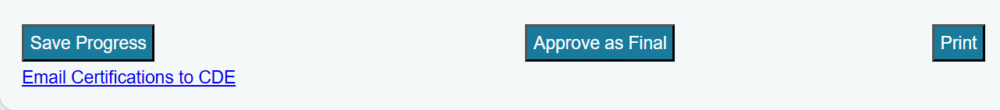
CDE Mill Levy Submission: Entering Your Data (4 of 4)
Step Four: Scroll to the bottom of the form; save your progress or approve as final, and print
after clicking Save or Approve, scroll back and look at the top left of the form; there will be a confirmation message in red text)
The “Print” button is currently a print screen shortcut; we recommend you print a copy of your online submission
Step Five: Send your form copy and Certifications of Valuation to CDE using either Syncplicity or email
Via Syncplicity: Upload
Via email: the “Email Certifications to CDE” link on the form is just a mailto: If your browser does not allow the mail pop-up, you can email directly to schoolfinance@cde.state.co.us
You may include a copy of your calculation worksheet (optional)

Slide 17
CDE Mill Levy Submission: What happens after I submit my data?
After you click “Approve as Final,” your entries will be locked.
If you need to correct an entry, CDE will need to unlock your submission
Please contact schoolfinance@cde.state.co.us to request an unlock

Slide 18
Contacts

Slide 19
School Funding Contacts
Tim Kahle - School Finance Program Director
303-335-6991
kahle_t@cde.state.co.us
Kim Reeves - Government Finance Analyst
720-795-5749
reeves_k@cde.state.co.us
Tabitha Tyree - School Finance Senior Analyst
720-391-3575
tyree_t@cde.state.co.us
Not sure whom to contact?
schoolfinance@cde.state.co.us

Slide 20

Questions?

