Slide 1
Financial Policies and Procedures
Advisory Committee Meeting
Thursday November 13th, 2025
Meeting Facilitator
Sheila Summers, Northwest BOCES

Slide 2
Agenda Items
Call to order
Approval of agenda
Approval of prior meeting minutes
Special Education Fiscal Advisory Committee (SEFAC) Vacancy
Office of the State Auditor
Legislative Process and Dates
Mill Levy Certification
Governor’s State Share of Total Program Budget Request
Governor’s Categorical Budget Request
CDE/CSI/CSDB Budget Requests
School Finance Modernization Budget Request and RFP Status
Election Update
Federal Shutdown Update
Rule Update
Training Updates
Financial Reporting: Chart of Accounts
Financial Reporting: Finance December
Other Topics of Interest
Upcoming Meetings
Adjourn

Slide 3
Approval of the prior meeting minutes
Request a motion for approval
Request for a secondary approval
Any objections from the remaining members?

Slide 4
Approval of agenda
Request a motion for approval
Request for a secondary approval
Any objections from the remaining members?

Slide 5
Special Education Fiscal Advisory Committee (SEFAC) Vacancy
SEFAC is a statewide advisory group that was established through statute in 2006. The SEFAC reviews annual applications for reimbursement of special ed high cost students and creates an annual legislative report.
SEFAC membership includes special education representatives from Administrative Units (AUs) and BOCES from the 8 regions across the state. Additional fiscal representation comes from a BOCES, a small rural AU, and a large urban or suburban AU. The final member is the State Director of Special Education from the Colorado Department of Education, currently Paul Foster. There are a total of 12 members and 2 non-voting CDE liaisons. Members bring diverse fiscal expertise and a shared commitment to improving outcomes for students with disabilities.

Slide 6
SEFAC Vacancy (continued)
Frequency of meetings / obligations / experience:
SEFAC meets approximately 4 times a year, generally 2 in-person and 2 virtual with occasional ad hoc virtual meetings as needed.
Members oversee the process to distribute $4 million in State funding for high cost students.
Members contribute to the development of an annual legislative report which makes recommendations on special education funding to the Colorado Legislature.
There is currently a vacancy for a large urban fiscal representative.
If your district fits this profile and you're ready to make an impact, we encourage you to apply!
If interested, please contact:
Vicki Graham — graham_v@cde.state.co.us
720-237-7541

Slide 7

FPP
OSA Update
November 13, 2025
Crystal Dorsey, CPA
Local Government Audit Manager

Slide 8

Audit Law Deadlines
School Districts – June 30 year end
  Audit shall be completed within 5 months
    Submit to the OSA within 30 days of receipt of audit report
  December 31st – Deadline to file an extension
    Extension may be granted for 60 days
      March 1

Slide 9
Audit Law Deadlines continued
Extension applies only to the audited financial statement report – not the single audit
Compliance supplement delay
Auditors may issue separate reports
Auditing SEFA
  In relation to the financial statements as a whole
Data Collection Form due 3/31/2026

Slide 10
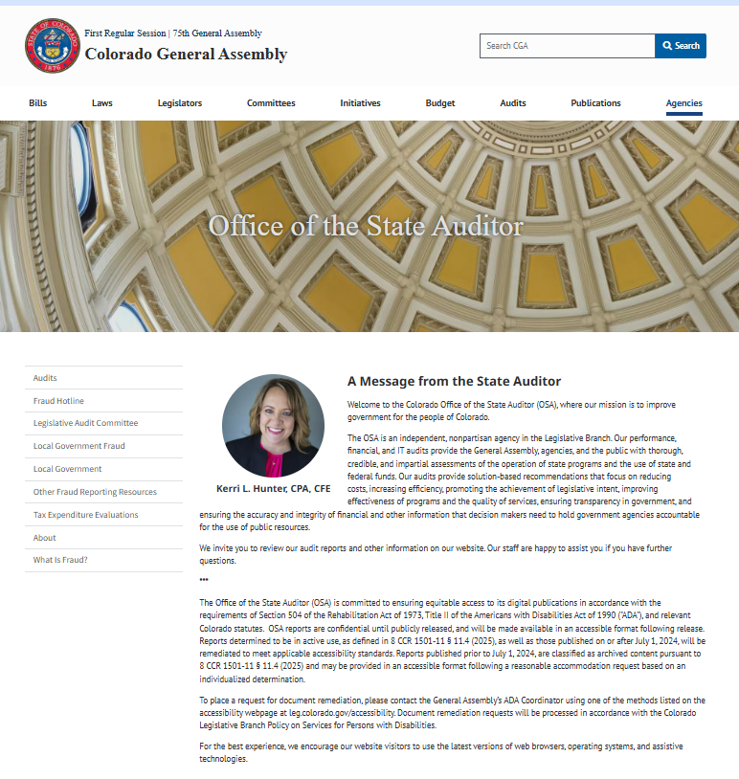
How do I request an extension of time?
New Website! Live 11/9/2025

Slide 11
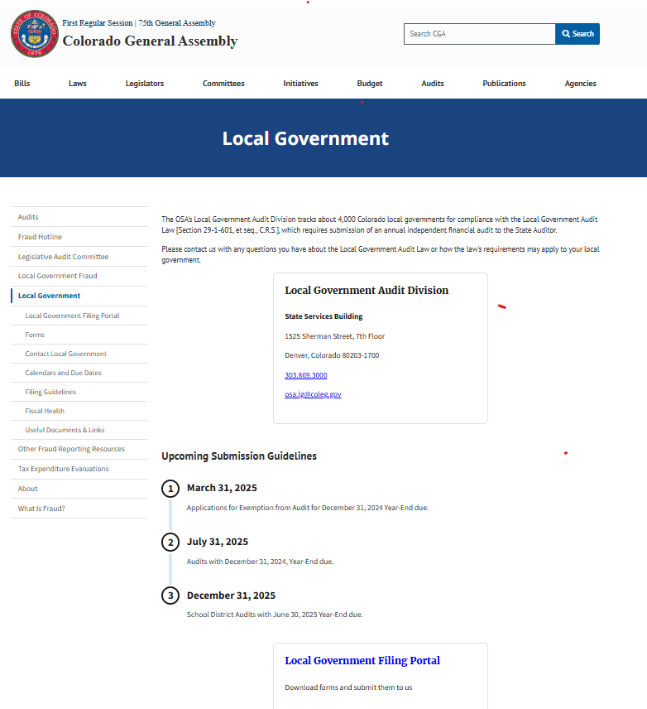
Click on Local Government Portal

Slide 12
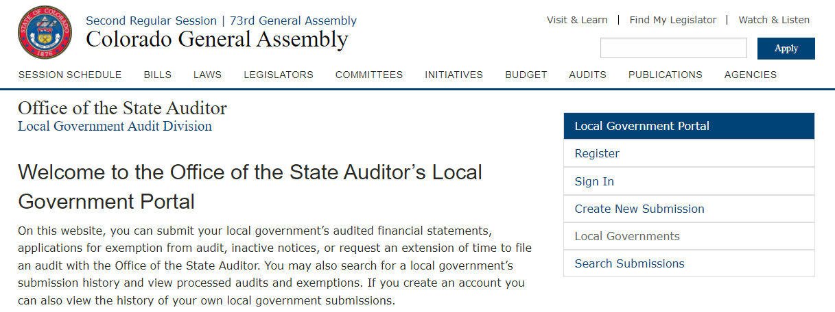
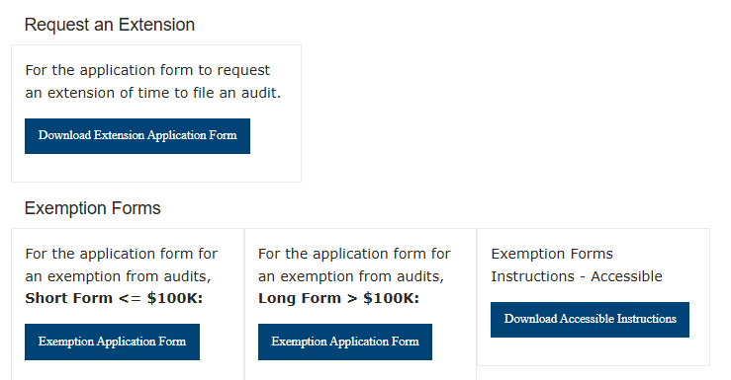
Scroll to the bottom of the portal page to find the form to request for an extension

Slide 13
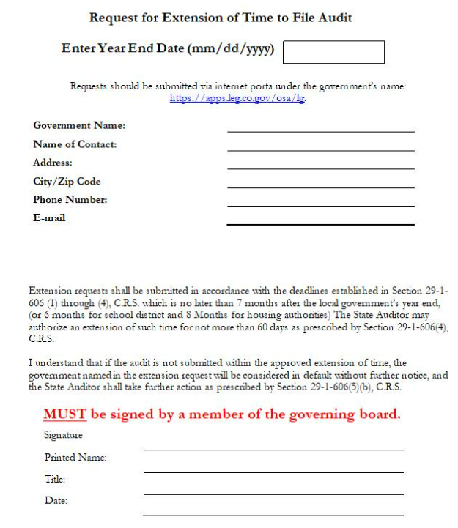
Print and have a board member sign.
Submit through the OSA Local Government Portal.

Slide 14
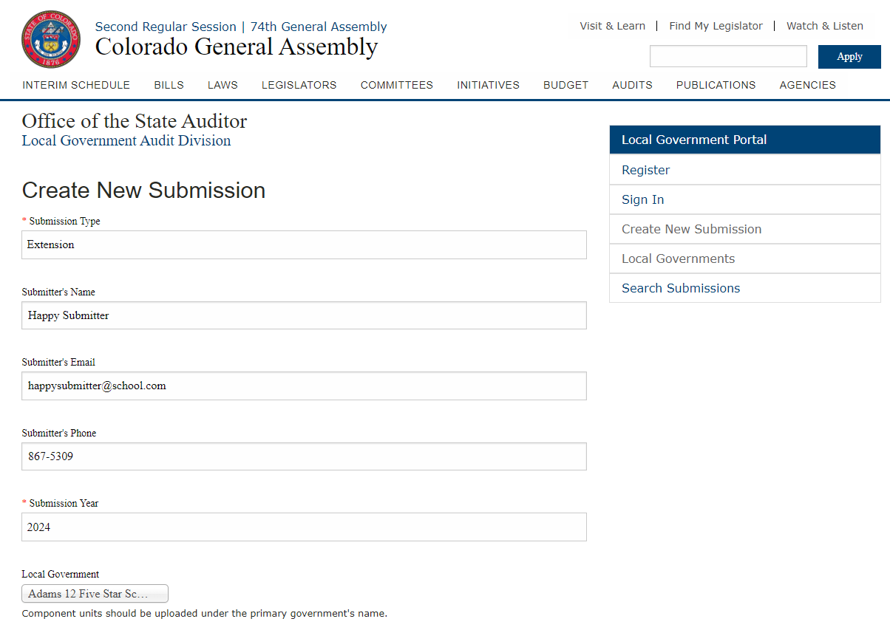
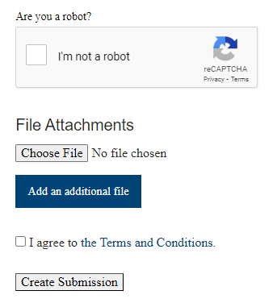
Start with “Create New Submission”
Submission Type: Extension
Complete all other fields
Use the drop down for Local Government, enter part of the district’s name to search.
Make sure you select your school district’s name and not the county by mistake.

Slide 15
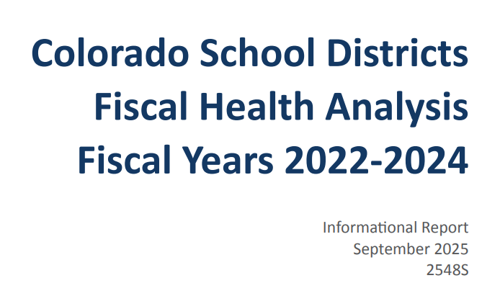
School District Fiscal Health

Slide 16
School District Fiscal Health Analysis
October 20, 2025
  Legislative Audit Committee
178 School Districts
Reviewed trends over Fiscal Years ended 2022, 2023, 2024

Slide 17
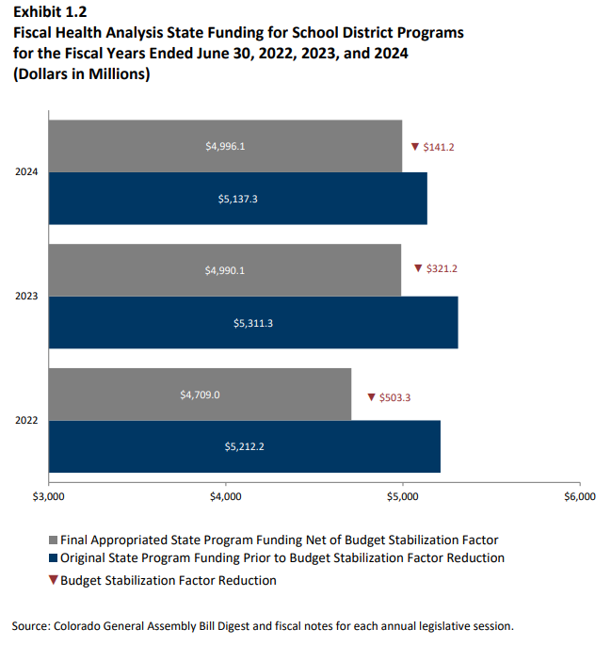
School District Fiscal Health Analysis continued

Slide 18
School District Fiscal Health Ratios
Asset Sufficiency
  General Fund Assets / Liabilities
Debt Burden
  Revenue paying debt / debt payments
Operating Reserve
  GF fund balance / GF expenditures
Operating Margin
  GF revenues-expenditures / GF revenues
Deficit Fund Balance
  Total deficit fund balance(s) – fund balance of the general fund (if positive)/Total revenues in deficit fund balance(s)
Change in Fund Balance
  Current year GF fund balance-prior year / GF prior year fund balance

Slide 19
School District Fiscal Health Analysis
- 1 or more missed benchmarks
35 school districts with one or more missed benchmarks
  23 districts with one
  10 districts with two
  1 districts with three
    Elizabeth (Elbert)
  1 district with five
    Ellicott (El Paso)

Slide 20
School District Fiscal Health Analysis
- two missed benchmarks
  10 districts with two
    Alamosa (Alamosa)
    Bayfield (La Plata/Archuleta)
    Clear Creek RE-1 (Clear Cree)
    Hanover (El Paso)
    McClave (Bent)

Slide 21
School District Fiscal Health Analysis
- two missed benchmarks (continued)
  10 districts with two (continued)
    Moffat County RE-1 (Moffat)
    Pawnee (Weld)
    Roaring Fork (Garfield/Eagle/Pitkin)
    Strasburg (Adams/Arapahoe)
    Summit RE-1 (Summit)

Slide 22
School District Fiscal Health Analysis
- continued
Missed benchmarks do not always mean there is a problem
  Salaries/benefits to remain competitive
  Capital needs and maintenance
  Fluctuating student count
However: the more missed benchmarks, the greater the risk
  Identify potential problems early

Slide 23
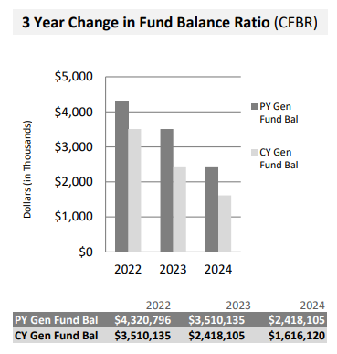
Change in Fund Balance Ratio

Slide 24
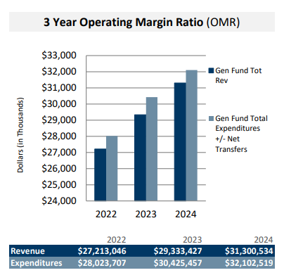
Operating Margin Ratio

Slide 25

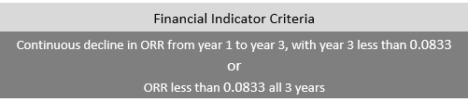

Operating Reserve Ratio

Slide 26
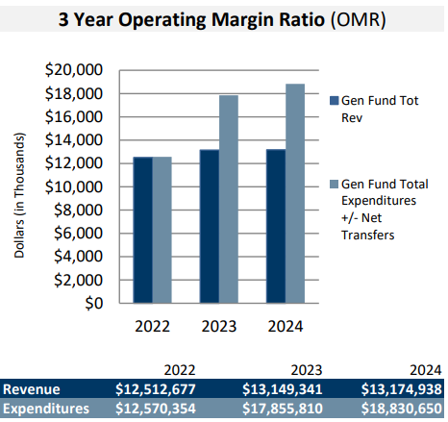
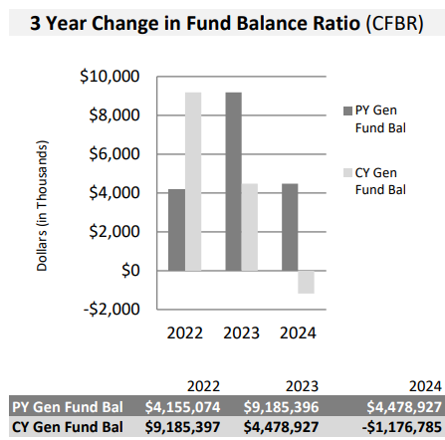
OMR and CFBR

Slide 27
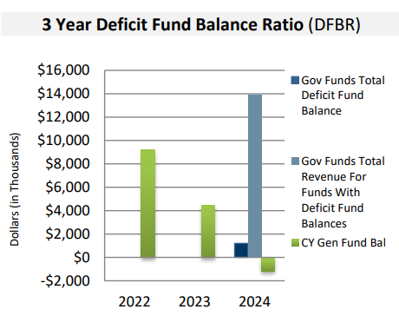
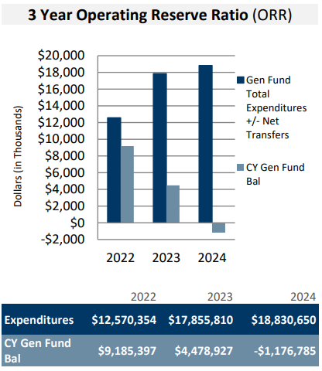
DFBR and ORR

Slide 28
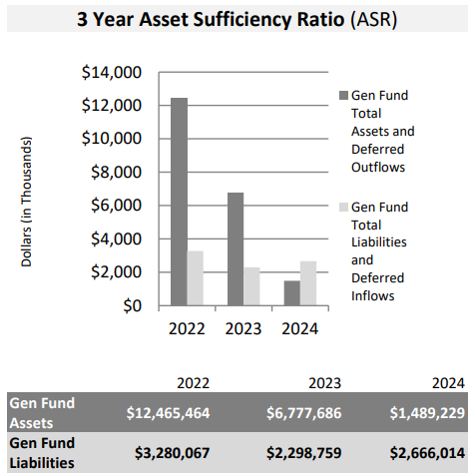
Asset Sufficiency Ratio

Slide 29

Operating Reserve Ratio

Slide 30
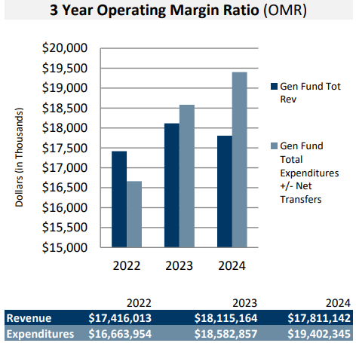
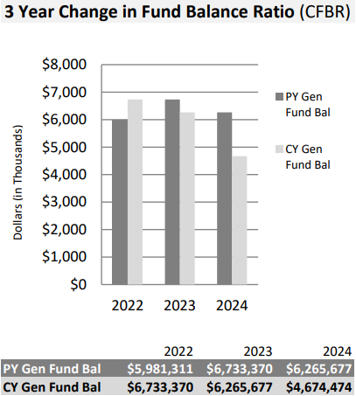
OMR and CFBR (ratios)

Slide 31

ORR – Another Example

Slide 32
WE HAVE MOVED!
As of October 27, 2025
Our new address is:
1375 Sherman Street, 5th Floor, Denver, Colorado 80203

Slide 33
Colorado Office of the State Auditor
1375 Sherman Street, 5th Floor, Denver, Colorado 80203
303.869.3000 http://www.colorado.gov/auditor/
Crystal Dorsey: crystal.dorsey@coleg.gov (303) 869-3002 osa.lg@coleg.gov
All OSA Email addresses have changed to “@coleg.gov”

Slide 34
Legislative Process and Dates
JBC Staff Briefing
  November 19th from 9:00 am – 12:00 pm – CDE Grants and Operations
  December 2nd from 1:30 – 5:00 pm – CDE School Finance and Categoricals
JBC Hearing
December 9th - Time TBD
Mid-Year Supplemental True Up Request Submitted
January 15th
Notes:
Remind FPP members that the Nov 1st request is just the starting point.

Slide 35
2026-27 Governor’s State Share Budget Request
Governor’s State Share of Total Program Request
Incremental funding request of + $166,990,163
Assumes a 2.6% inflation rate
Increases statewide average per pupil by $413 to $12,272 in FY26-27
Assumes lower local share revenue for Total Program
Includes the 30% phase-in of the new formula funding per HB25-1320
Changes to 3 year pupil count averaging per HB25-1320

Slide 36
Annual Total Program True-Up
October count data locked down at end of day on December 5th following duplicate count process and cleanup
Updates with counts and available final AV information run in formula and posted by end of day on December 9th
October count data reopened on December 8th for districts to continue to correct errors
Counties must provide final AV information to districts by December 10th
Districts must certify mills to counties and CDE by December 15th
All data is locked down permanently in early January
Final true-up of Total Program calculations are completed, tied out with legislative staff and posted by January 15th

Slide 37
Mill Levy Certification Important Dates
On or before December 10, 2025:
  County assessor will provide final Certifications of Valuation to district/CDE
  Contact your county assessor to find out when they will provide certifications
On or before December 15, 2025:
  District’s Board of Education must certify mill levies and provide to County Commissioner (be sure to find out what your County Commissioner requires well before this deadline, as county procedures may vary)
  District must submit certification information to CDE using online system
Notes:
RBC has been discussing some of the potential difficulties in mill levy certification this year as it relates to the growth cap and associated levies
This may be more cumbersome for Districts (especially smaller ones) relative to prior years

Slide 38
Mill Levy Certification Forms - Tools to Assist
Both versions available at: https://ed.cde.state.co.us/cdefinance/december-2024-mill-levy-certification-files
Version 1: “Traditional” Mill Levy Certification Form without Calculation Worksheet
Not recommended for most users
All December values must be entered/calculated by District
Column E data is entered into CDE online submission form

Slide 39
Mill Levy Certification Forms - Tools to Assist
Version 2: Mill Levy Certification Form WITH Calculation Worksheet
Highly recommended
Manual input cells for data, then it does the calculation and auto populates everything for you across multiple tabs
Includes BOE packet cover sheet and resolution, calculation worksheet, and CDE Mill Levy Certification Form (needed to enter data into CDE online submission form

Slide 40
2026-27 Governor’s Categorical Budget Requests
Governor’s Categorical Programs Request
Incremental funding request of $14,539,542
Assumes a 2.6% inflation rate
Funds required inflationary increase for Special Education per SB22-127 = $10,106,065
Remaining funds allocated based upon standardized formula (aka gap analysis) = $4,433,476
Request for Information Response

Slide 41
2026-27 CDE/CSI/CSDB Budget Requests
CSI Mill Levy Equalization
BEST Assessment IT System
READ Act Awareness Campaign and Evaluation Reductions
Restructuring of Statewide Social Studies Assessment
Local Accountability Grant Program Reduction
CDE Administrative Reduction
CSDB Teacher Salary Increase

Slide 42
School Finance Modernization Budget Request and RFP Status
School Finance Modernization Request
CDE has received $3 Million for Phase I of this project in FY 2025-26
CDE has requested $3.15 Million for FY 2026-27 for Phase II of this project
Another $3.15 Million is anticipated for FY 2026-27, pending awarded bid
CDE has received 8 bids
CDE anticipates contract award in mid-December
Notes:
Anticipate contract in place by March

Slide 43
Election Update
Proposition LL: Allow the state to keep $12.4 million in excess revenue and interest from reduced state income tax deductions under Proposition FF (2022) to provide funding for the Healthy School Meals for All Program - Passed
Proposition MM: Reduce state income tax deductions for taxpayers earning $300,000 or more to generate additional revenue for the Healthy School Meals for All Program and, once the program is funded with reserves, for SNAP - Passed
No program changes this school year - Communications templates are available

Slide 44
Federal Shutdown Update - School Meals
USDA Reimbursements for School Meals:
Q4 of FFY 24-25 (August - September) - Fully Funded
Claim Submissions/Payments made November 1 to December 30
Q1 of FFY 25-26 (October - December) - Received 75% of Requested Amount
Claim Submissions/Payments made January 1 to February 28
Claim due dates are still in effect, so districts should claim as they normally would

Slide 45
Federal Shutdown Update - Cash Flow
CDE has had a preliminary discussion with RBC Capital Markets related to the use of the Interest Free Loan Program to support districts with cash flow issues resulting from the federal shutdown.
This program is designed to help school districts with cash flow deficits that typically occur during the first eight months of the school year when property tax collections are low. Statute stipulates that the repayment of the principal portion of these Notes is secured by a pledge of each participating district’s general fund property taxes.
The Federal shutdown may result in General Fund cash flow issues in some districts. Therefore, it may be possible for districts to be eligible for this program during this year. Federal grant reimbursements must be unrestricted. Districts may only use the program IF they spend all available General Fund.
If your district believes you may be eligible due to General Fund cash flow issues and are interested in potential participation in the program, please email Dan O’Connell at dan.oconnell@rbccm.com and Anthony Singh at anthony.singh@rbccm.com.
Notes:
There are more steps to borrowing than just the spreadsheet and that may be prohibitive for Districts, especially coming up on the holidays where boards meet less frequently, etc.

Slide 46
Federal Shutdown Update - Impact Examples
CDE is working with national organizations to compile information about the impact of the shutdown on LEAs, schools, families, and school communities.
Please share your experience or hardships with CDE so that we can share those with national organizations.
The more concrete and specific examples we can share the better.
Send impact examples to mohajeri-nelson_n@cde.state.co.us.

Slide 47
Rule Update
The State Board of Education approved proposed rules for 1 CCR 301-11: Rules for Accounting and Reporting and 1 CCR 301-29 Administration of the Public School Transportation Fund at the October SBE meeting.
The new rules will become effective on December 1, 2025.
For transportation reimbursements, districts can implement the flexibilities for reimbursable expense in FY 25-26 if they would like. Full implementation of the rules will be in effective for FY 26-27.

Slide 48
School Audit - Old Liabilities
CDE processes did not provide districts with timely reminders on outstanding audit liabilities for some time now. We have recently updated our processes. As a result, several historical outstanding audit liabilities have come to our attention.
It is in the best interest of the state to facilitate the payment of this outstanding liability. Because the Department’s processes did not provide the district with timely reminders on the outstanding audit liability from prior audits, it would not be appropriate to penalize districts willing to commit to timely repayment.
Thus, CDE is able to waive the accrued interest on prior audit liabilities if the district pays in full within 30 business days or submits an Audit Repayment Plan which results in full payment within 365 days. Failure to make payment in full within 365 days will result no interest being waived.
We apologize for the inconvenience that our broken processes have caused for the impacted districts.
Notes:
We have been trying to fix this. Unfortunately, we didn’t get any real traction on it until recently.

Slide 49
Training Updates: Office Hours
Upcoming Trainings:
Certifying District Mills 11/12/25 9:00am - 10:30am
Cert Dist Mills - Fully Funded Districts 11/19/25 2:00pm - 3:30pm
Budget Planning 12/11/25 9:00am - 10:30am
Financial Policies Review 1/27/26 9:00am - 10:30am
Fund Balance Training 2/19/26 9:00am - 10:30am
Budget Training Pt II 3/12/26 9:00am - 10:30am

Slide 50
Training Updates: CDE/CSFP Strategic School Finance Training
New updated training with different topics than prior years
State Budget Update
Revenue Optimization
Expenditure Optimization
Fund Balance Strategies
Grants Update
Performance Excellence & Key Performance Indicators (KPIs)

Slide 51
Training Updates: CDE/CSFP Strategic School Finance Training - Dates
2026 Training Schedule (details to be confirmed)
  1/29/26 - 1/30/26 - Greeley, Co
  4/23/26 - 4/24/26 - Pueblo, Co
  5/14/26 - 5/15/26 - Durango, Co
  6/4/26 - 6/5/26 - Frisco, Co
  8/6/26 - 8/7/26 - Grand Junction, Co
  10/1/26 - 10/2/26 - Loveland, Co

Slide 52
Chart of Accounts Requests
Summary of Votes
There are 24 voting members; a majority is 13 votes.
Summary of Votes
Proposed Item | Yes | No
Revise Fund 07, Total Program Reserve Fund (optional) | 21 | 0
Add Object 0639 Local Food (non-bold; rolls to 0630) | 21 | 0
Add Object 0170 - Compensated Absences (non-Bold; rolls to 0100) | 21 | 0

Slide 53
Chart of Accounts Requests
Update Fund 07 - Total Program Reserve Fund (optional)
Element: Revise Fund 07, Total Program Reserve Fund (optional)
Purpose: To clarify that this is an optional fund and is no longer required to be reported. If this fund is used the district may expend money from the total program reserve fund only to offset the amount of a reduction in the district’s state share caused by application of the budget stabilization factor in fiscal years when the district’s total program mill plus specific ownership tax revenue is insufficient to cover the district’s total program.
Revised Description: (optional) The revenue from a tax levied pursuant to § 22-54-107(5), C.R.S., may be deposited into this fund. The district may expend money from the total program reserve fund as they see fit. Total program reserve fund was repealed as of July 1, 2025. Therefore, this fund may be used at the district's discretion.
Additional Information: Total program reserve fund was repealed as of July 1, 2025. Going forward data pipeline will not have edits or restrictions related to the use of Fund 07 since it is now an optional fund. District’s may use it if they want to track that additional funding separately for their own purposes. There is no longer any limits on how/when the funds may be utilized. They now work as additional general fund monies.

Slide 54
Chart of Accounts Requests
Add Object 0639 - Local Food (non-bold; rolls to 0630)
Element: Add Object 0639 Local Food (non-bold; rolls to 0630)
Purpose: To distinguish local food purchases. HSMA includes grant funding for local food purchases with a requirement to report expenditures. Bolding 0639 would allow easy extraction of this data for reporting. A Local Food Program grant code can be added to 0639 to further isolate these program expenditures. Local food purchase data is frequently requested and used for various purposes.
Proposed Title & Description: Local Food. For the purchase of local agricultural products. This will include raw, unprocessed, minimally processed, and value-added products. Food purchased will meet local definition as defined by the USDA or state grant requirements. This code does not include Fresh Fruit and Vegetable Program (FFVP) or USDA foods/commodities (see also objects 0630 and 0633).

Slide 55
Chart of Accounts Requests
Add Salary Object Code - for Compensated Absences (GASB 101)
Element: Add Object 0170 - Compensated Absences (Non-Bold; rolls to 0100)
Purpose: To record payouts of compensated absences in accordance with GASB 101.
Proposed Title & Description: Salaries - Compensated Absences. To record payout of compensated absences in accordance with GASB 101.

Slide 56
Financial Reporting
Financial Transparency
Financial Transparency for Colorado Schools
FY 2023-24 Final data set loaded to the live site (in-progress)
  FY2024-25 data will be loaded by July 1, 2026, in accordance with statute
HB24-1448, Section 5 reporting requirements
  The PPR/PPF figures in sub-sections (g) and (h) will not be loaded to the FT site (as originally proposed/communicated via the School Finance Listserv)
  CDE will submit a report to the legislature to meet all requirements

Slide 57
Financial Reporting
Financial Transparency continued
Local Financial Transparency pages - a few reminders:
Please remember to add the FY24-25 files to your local FT page:
  Audit
  Financial Data Files (districts/BOCES only) -
    please post excel versions of the file, not a pdf
  Any other files that need to be updated
FPP-approved (FY25) templates (there are different requirements - see templates):
  District/BOCES template
  Charter School template

Slide 58
Financial Reporting
Finance December
FY 2024-25 Data Submission
Soft Open was available on August 1st
Official Open was on September 2nd
Submissions are Due December 31st
  Extensions may be granted for 60 days, from OSA
  CDE honors the extension approved by OSA
Office Hours, Overview of Data Pipeline
Part I Submission Process - (8/14/25)
Part II Cognos Reports - (8/21/25)
Part III Website Resources - (8/28/25)

Slide 59
Financial Reporting
Finance December - Continued Audit Work
Business Manager Year-Round Monthly Calendar - Audit Work
September
Continue completing Auditor's Prepared by Client list
Continue submitting data to pipeline to clear Tier I & II Errors and warnings & Grant Revenue Reconciliation Report
Depending on Auditor Schedule, Provide Trial Balance to auditor. Best Practice is after clearing Tier I, II, & Grant Rev Recon Report.
October
Continue completing Audit Work.
November
Audit complete-Submit Data to Office of State Auditor
Submit Audit with the signed accreditation checklist to CDE along and response to Tier I & II warnings and Grant Revenue Reconciliation Report
IF Audit not completed, Request Extension via the Office of State of Auditor.

Slide 60
Financial Reporting
Finance December - Where to Submit CDE
School Finance Division, submit electronically to schoolfinance@cde.state.co.us.
What to send
FY 2024-2025 Financial Audits
Assurances for Financial Accreditation
Single Audit, if issued separately (Uniform Guidance/2CFR 200) – Districts that expend $750,000 or more in Federal Awards (increased to $1,000,000 on 10/1/2024).
Charter School Audits, if applicable
Reconciliation Reports and Other Supporting Documentation
  Tier I & II warnings and Grant Revenue Reconciliation Report

Slide 61
Financial Reporting
Finance December - Where to Submit OSA
Local Government Division, Website Submission: https://apps.leg.co.gov/osa/lg
Audit, exemptions (meeting electronic signature policy) and extension can be submitted to the OSA via our online portal at: https://apps.leg.co.gov/osa/lg. Registration is not required but recommended if someone will be making multiple submissions. When submitted through the portal the sender will receive an automated reply that the OSA has received the submission.
What to send
FY 2024-2025 Financial Audit
Charter School Audits, if applicable
Single Audit

Slide 62

Other Topics of Interest - CASBO
Save the Date! CASBO 2026 Spring Conference
Get ready — Spring Conference registration opens in early January!
Join us April 22–24, 2026, in Pueblo for an unforgettable experience.
Theme: Super Heroes!
Celebrate the everyday heroes in school business and beyond.
Professional Growth:
Earn Continuing Education credit for your national SFO certification while connecting with colleagues and industry experts.
Stay tuned for more details coming soon — you won’t want to miss it!

Slide 63
Other Topics of Interest
CASB
CASE-DBO
CGFOA
COCPA

Slide 64
Upcoming Meetings
February 12th, 2026 - Meeting Facilitator: Mayra Ramirez, School District 27J
April 16th, 2026 - Meeting Facilitator: Brian Gustafson, Poudre R-1
June 18th, 2026 - Meeting Facilitator: Cathy Watts, Academy 20

Slide 65
Adjourn
Thank you for attending!

