Slide 1
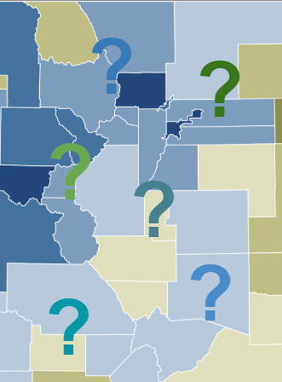
Mill Levy Calculation & Submission
November 12, 2025
Presenters: Kim Reeves & Tim Kahle

Slide 2
Agenda
What is a “Mill”?
What is Mill Levy Certification (and where does CDE fit in)?
Important Dates
CDE’s Mill Levy Certification Form
CDE’s Mill Levy Submission Process
Contacts
Questions?

Slide 3
What is a Mill?

Slide 4
What is a “Mill”?
Mills are what we use to calculate the percentage of net assessed property value a district receives in a given budget year.
One mill = one dollar per $1,000 of assessed property value
Net assessed value (NAV) multiplied by mills divided by 1,000 equals the dollar amount generated by those mills (the amount levied)
TABOR limitations still apply to tax revenue generated by mills for school districts
  A district can’t levy infinite mills (but voters can override TABOR)
  Most districts do not levy enough mills to fully fund the “Total Program Funding” amount set by the state

Slide 5
What are the different types of mill? (1 of 3)
Total Program Mills (General Fund)
Where most of your local funding comes from
HB20-1418 requires mills to be set for each district (targeted mills)
Some districts also have a temporary tax credit mill
  Mills left to increase to get to the required Total Program Mills
  Tax credits are reduced by 1 mill each year until zero, as a phase-in
  You may or may not have tax credits
Targeted Mills minus Tax Credit = Net Total Program Mills
  These are the actual mills multiplied by NAV to calculate the district’s local portion of Total Program

Slide 6
What are the different types of mill? (2 of 3)
General Fund - Non-Voter-Approved
Not applicable to every district every year
Abatements
  Dollar amount on Line 11 of each Certification of Values
  Must certify in order to collect the taxes that were abated in prior years
1995 Hold Harmless
General Fund - Voter Approved Mill Levy Overrides (MLOs)
Voters must approve these additional mills at referendum elections
Ballot must indicate if fixed dollar or a fixed mill levy amount
Ballot must indicate what the money can be spent on

Slide 7
What are the different types of mill? (3 of 3)
Bond Fund (31): Collects money to make the annual principal and interest payments on long term debt
Transportation (25): Collects “excess” transportation costs (typically for capital purchases such as school buses)
Special Building and Tech Fund (42):
Maximum 3 years and 10 mills
Doesn’t apply to many districts
Supplemental Capital Construction, Technology, and Maintenance Fund (46)
No sunset requirement and no mill maximum
Not applicable to many districts

Slide 8
What is Mill Levy Certification?

Slide 9
What is Mill Levy Certification?
Each year, the district must calculate their total mills and the amount to be levied. Then they certify this information to their county or counties, and submit the information to the state. The overall process is:
County tax assessors provide Certifications of Valuation to districts and CDE
The district calculates their total mills and the amount to be levied by their county/counties (Remember: Net assessed value (NAV) multiplied by mills divided by 1,000 equals the dollar amount to be generated by those mills)
The district obtains local school board approval of those numbers
The district reports or “certifies” the approved numbers to their county/counties
The district submits those numbers to CDE using the online system
CDE uses the numbers to calculate the state’s share of Total Program Funding

Slide 10
Mill Levy Certification – Things to Keep in Mind
A district may fall in one or multiple counties (and one county may include multiple districts)
Each county tax assessor provides separate Certifications of Valuation related only to the portion of the district that falls within their county
  Make sure you know the certification requirements for each of your ocunties, as they may differ
A county may provide one or multiple Certifications of Valuation to a district
  Some assessors provide a separate valuation document for each type of mill; some combine the information into one document. You may have one or both situations for your district, depending on your counties.
  If you get multiple valuations from one county, look at line 11 for each one; the “abatement” amounts will differ (if they aren’t zero), and will need to be added as part of the calculation we’re about to go over.
The county tax assessors are required to send all districts’ Certifications of Valuation to CDE; you must also submit the Certifications of Valuation along with your Mill Levy Certification Form.

Slide 11
Important Dates

Slide 12
Important Dates
On or before December 10, 2025:
  County assessor will provide final Certifications of Valuation to district/CDE
  Contact your county assessor to find out when they will provide certifications
On or before December 15, 2025:
  District’s Board of Education must certify mill levies and provide to County Commissioner (be sure to find out what your County Commisioner requires well before this deadline, as county procedures may vary)
  District must submit certification information to CDE using online system

Slide 13
Get ready to type your answer choices in the chat (on 3)!

Slide 14
What is a mill?
A. $1,000 in net assessed property value
B. $1 per $1,000 in net assessed property value
C. $1,000,000 in gross assessed property value

Slide 15
What do we call the full amount the state calculates is necessary for a district to fund its public and charter school education for one budget year?
A. Total Program Funding
B. Total Per-Pupil Funding
C. State Share Funding

Slide 16
Who must provide Certifications of Value to CDE?
A. County Tax Assessors
B. School Districts
C. Both A & B

Slide 17
CDE’s Mill Levy Certification Form

Slide 18
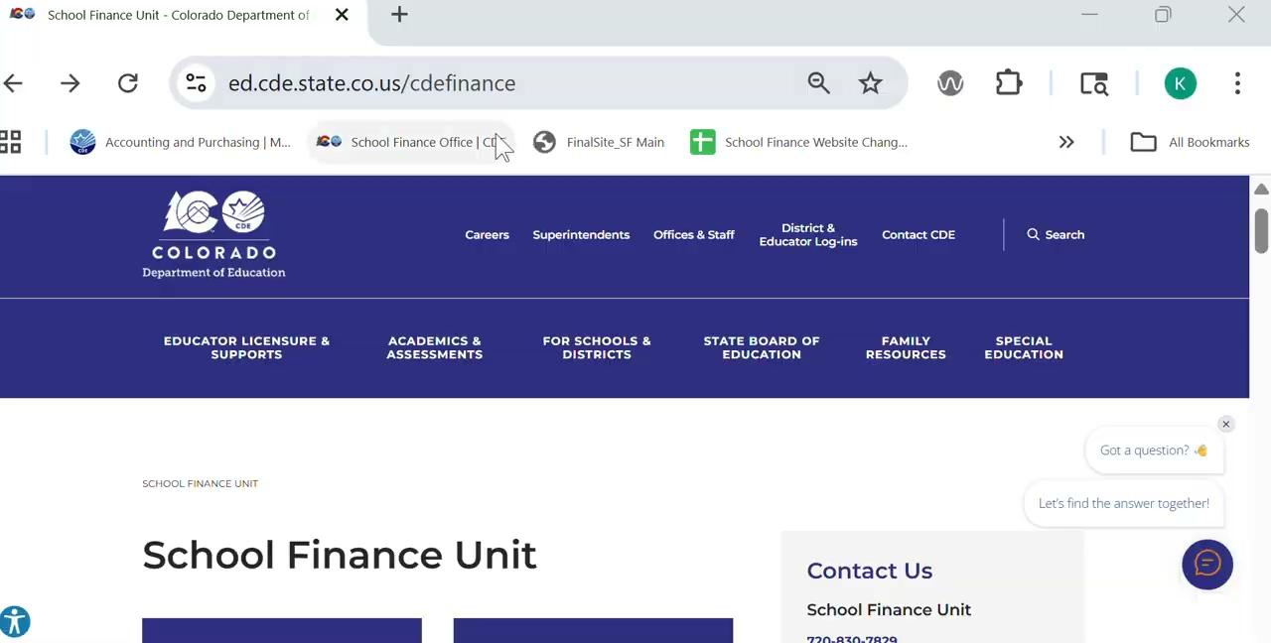
CDE’ss Mill Levy Certification Form and Worksheet
Where to find the CDE Mill Levy Certification Form and Worksheet:

Slide 19
Mill Levy Certification Form: 2 versions
Both versions available at: https://ed.cde.state.co.us/cdefinance/december-2024-mill-levy-certification-files
Version 1: “Traditional” Mill Levy Certification Form without Calculation Worksheet
Not recommended for most users
All December values must be entered/calculated by District
Column E data is entered into CDE online submission form
Version 2: Mill Levy Certification Form WITH Calculation Worksheet
Highly recommended
Manual input cells for data, then it does the calculation and autopopulates everything for you across multiple tabs
Includes BOE packet cover sheet and resolution, calculation worksheet, and CDE Mill Levy Certification Form (needed to enter data into CDE online submission form

Slide 20
Mill Levy Certification Form: What’s in it
Both form versions contain these locked values (these values won’t change between August valuations and December certification):
December 2024 submitted data & August 2025 assessed valuations
FY25 HB20-1418 values (gross, credit, & net)
Estimated full funding mill levy
Projected gross funding from state

Slide 21
Mill Levy Certification Worksheet Tabs
Instruction (also available on the same web page as a pdf)
Explains how to use the worksheet / breaks it into 12 sections
Cover (customizable BOE meeting packet cover sheet)
BOE Resolution (includes signature line for BOE president)
Auto-populates from worksheet with:
  Total district mills
  Total net assessed valuation
  Dollars and mills by fund
  Estimated full funding mill levy
  Projected gross funding from state
Calculation Worksheet (where you’ll enter your data)
CDE Mill Levy Certify Form (what you’ll need to complete your online submission to CDE)

Slide 22
Mill Levy Calculation Worksheet Mechanics (1st steps)
Only input into the yellow cells (everything else is locked)
Before you do anything else:
Step one: input 4-digit district code into cell C1 to pull locked information into worksheet.
Step two: review and verify locked information from previous and current years (make sure you’re starting with the correct numbers and all your counties listed; contact us right away if you think a correction is needed)
This year the worksheet tab has a new, more user-friendly layout;
no more scrolling over to the right to input data!

Slide 23
Mill Levy Calculation Worksheet Mechanics, Section 1
Only input into the yellow cells (everything in gray is locked)
Section 1: Assessed Valuation and Abatement (establishing Net Assessed Valuation, on which all your dollar and mill calculations will be based)
Input Gross Assessed Valuation per county in cells C10-F10
Input Tax Increment Financing per county in cells C11-F11
  Enter TIF as a negative number, regardless of how it appears on your valuation forms
Net Assessed Value will auto-calculate in cells C12-E12
Totals will populate cells D29-D31
Input Abatement amounts per county (per specific levy sources from each Certification of Valuation) in cells C16-F22
  Total of all Certification of Valuation abatement amounts (General, Bond, MLO, etc.) from all counties for all funds populates cell D35

Slide 24
Mill Levy Calculation Worksheet Mechanics, Section 2
Only input into the yellow cells (everything else is locked)
Section 2: General Fund Total Program Mill Calculation (and comparison of previous year to current year)
Rows 43-48 are all calculations pulled from the "CDE Mill Levy Certify Form" tab.
Cells F46 and F47 are for fully locally funded districts only
  if this applies to your district, enter Categorical Buyout and Total Program Excess Mills.
  There will be an additional training later in the month for fully locally funded districts.

Slide 25
Mill Levy Calculation Worksheet Mechanics, Section 3
Only input into the yellow cells (everything else is locked)
Section 3: General Fund Non-Total Program Mill Calculation (Voter Approved Mill Levy Overrides)
Best Practice: have a copy of every ballot question to check language/amounts; you need to know if the override is a fixed mill levy or fixed dollar amount
Cells A61 - A65; enter Voter Approved Override date and whether it is a fixed mill or dollar amount (this area is the one exception to the yellow-cell rule)
If dollar amount, enter into Column C
If fixed mill amount, enter into Column D
Calculated result appears in Column E
Note the abatement amount is pulled from Cell D35 in Section 1
(The 3 digit mill will produce a value over or under the voter approved dollar amount when rounded to 2 digits. It’s okay to be over due to rounding)

Slide 26
Mill Levy Calculation Worksheet Mechanics, Section 4
Only input into the yellow cells (everything else is locked)
Section 4: Bond Fund Principal and Interest Amount Certification
Best Practice: have a copy of every ballot question to check language/amounts
Cell C98: From your Bond Schedule, add the dollar amount to certify to pay for interest & principal payments (do not certify more than the maximum amount your ballot question allows)
Cell B98 is your dollar amount from Cell C98 divided by your Net AV from Section 1, times 1,000 (this is your calculated mill amount)
Cell D98: Enter the number from Cell B98, rounded to 3 decimal places (or enter a fixed mill amount if your ballot question specifies a fixed mill).
(The 3 digit mill will produce a value over or under the voter approved dollar amount when rounded to 2 digits. It’s okay to be over due to rounding)

Slide 27
Mill Levy Calculation Worksheet Mechanics, Sections 5-8
Only input into the yellow cells (everything else is locked)
Sections 5 through 8
Follow the same process as for Section 4 to enter amounts for the following funds:
Section 5: Transportation Fund
Section 6: Special Building and Tech Fund (NOT Debt-Free-Schools)
Section 7: Debt Free Schools (AKA Supplemental Capital Construction, Technology, and Maintenance Fund)
Section 8: Other Funds (Loan, Library, Charter School)

Slide 28
Mill Levy Calculation Worksheet Mechanics, Sections 9-12
Only input into the yellow cells (everything else is locked)
Sections 9 through 12
These are largely auto-calculated, with the exception of Cell F181 in Section 10.
Section 9: Total Mill Levy (summary and year over year comparison)
Section 10: Estimated Specific Ownership Taxes (uses prior year SOT from data pipeline submission to calculate estimated portion of SOT to be applied to current year’s Total Program)
Section 11: Calculation of County Tax Collection Rate
Section 12: provides a summary of the tax impact on $100,000 of both residential and commercial assets (for informational purposes only)

Slide 29
CDE Mill Levy Certify Form
This is the form required for your online submission to CDE
  Pulls from your entered data / all the calculations on the Calculation Worksheet as well as from hidden tabs containing your historical data
  Provides FY26 mills and dollar amounts
  Column B (“August column comments”) clarifies what values are shown in Column D - Aug 25, 2025
  Column G provides links to the Calculation Worksheet
Column E contains the information you will use for your submission to CDE using the online system
  All submissions are made using the online State Equal system or through either email or Syncplicity as specified by School Finance staff
  Submissions/documents are no longer accepted via physical mail or fax

Slide 30
“Help! I’ve forgotten everything from the Mill Levy training! I’m staring at this monster spreadsheet and I’m not sure what to do!”
That’s okay, because the worksheet comes with _______?

Slide 31
In the chat, type one place to find the instructions for the mill levy calculation worksheet

Slide 32
CDE’s Mill Levy Submission Process

Slide 33
CDE Mill Levy Submission: Overview
Each district must submit to CDE:
Mill Levy Certification data (online submission via State Equal system)
Copies of the county Certifications of Valuation for all counties from which the district gets revenue (email or Syncplicity upload)
  Optional: copy of your calculation worksheet and form. You aren’t required to include these, but it can help us clarify any issues that may arise with your submission
Submitting your supporting documents:
  Once your online form is submitted, you must upload your CDE Mill Levy Certification Form (Mandatory Form PSF-119) and all Certifications of Valuation to your Syncplicity “Mill Levy” folder
  There may be an option to upload directly on State Equal; if this feature is available by the submission period, we will notify districts via the listserv
Submission must be completed on or before end of day, December 15, 2025
  Early submission gives us more time to correct any issues you encounter

Slide 34
CDE Mill Levy Submission: Using State Equal
State Equal: https://idm.cde.state.co.us/equal/
CDE uses the “State Equal” online system for mill levy reporting
  You will use the information from Column E on your CDE Mill Levy Certify Form to complete the online form
  Please double-check your entries to make sure you’re entering the right information into the right field
  We no longer accept submissions via physical mail or fax
Your Local Access Manager (LAM) must grant access/permission to the person at your district who will submit your mill levy data
  LAM assigns permission under State Equal, not Data Pipeline / Transportation or Audit
  CDE cannot grant access or view your access; only your LAM can manage these permissions

Slide 35
CDE Mill Levy Submission: Entering Your Data (1 of 4)
Step One: select your District LEA number from the drop-down box (this will populate your counties on the form; verify that all your counties appear)
Step Two: Enter the name and phone number of the person submitting the data
Step Three: Enter the data from Column E of your Mill Levy Certification Form into the appropriate fields on State Equal
Prior year and August columns will be pre-populated.
Estimated revenue generated from Mills will automatically compute once you enter your data
Be sure to double-check that you have entered the correct data in each field

Slide 36
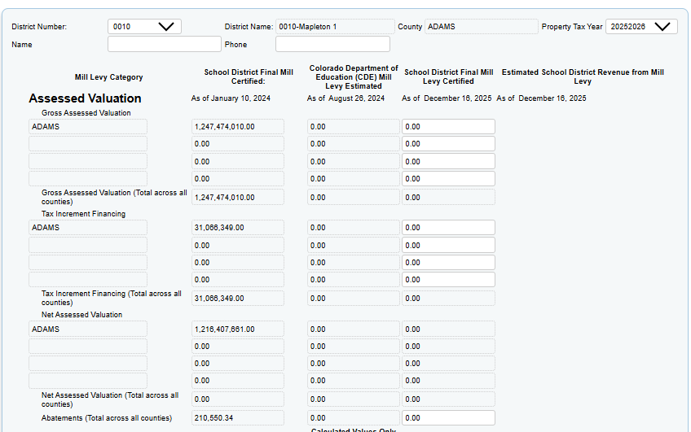
CDE Mill Levy Submission: Entering Your Data (2 of 4)

Slide 37
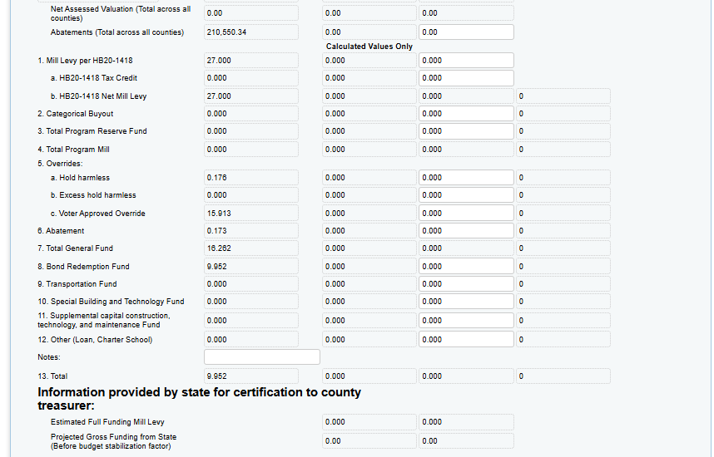
CDE Mill Levy Submission: Entering Your Data (3 of 4)

Slide 38
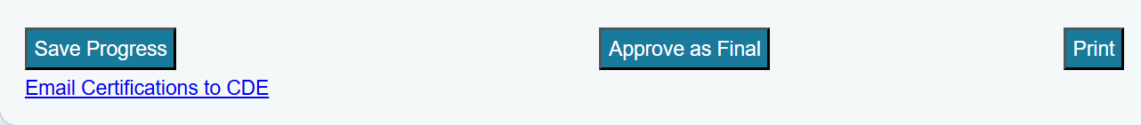
CDE Mill Levy Submission: Entering Your Data (4 of 4)
Step Four: Scroll to the bottom of the form; save your progress or approve as final, and print
after clicking Save or Approve, scroll back and look at the top left of the form; there will be a confirmation message in red text)
The “Print” button is currently a print screen shortcut; we recommend you print a copy of your online submission
Step Five: Send your Certifications of Valuation to CDE using either Syncplicity or email
Via Syncplicity: Upload
Via email: the “Email Certifications to CDE” link on the form is just a mailto: If your browser does not allow the mail pop-up, you can email directly to schoolfinance@cde.state.co.us
You may include a copy of your form and calculation worksheet

Slide 39
CDE Mill Levy Submission: What happens after I submit my data?
After you click “Approve as Final,” your entries will be locked.
If you need to correct an entry, CDE will need to unlock your submission
Please contact schoolfinance@cde.state.co.us to request an unlock

Slide 40
Contacts

Slide 41
Contacts
Tim Kahle - School Finance Program Director
303-335-6991
kahle_t@cde.state.co.us
Kim Reeves - Government Finance Analyst
720-795-5749
reeves_k@cde.state.co.us
Tabitha Tyree - School Finance Senior Analyst
720-391-3575
tyree_t@cde.state.co.us
Not sure whom to contact?
schoolfinance@cde.state.co.us

Slide 42

Questions?

