Slide 1
Grants Management 101 Training
Grants Fiscal Management Unit
Colorado Department of Education
10/30/25

Slide 2
Grant Life Cycle
Finance involvement at the Pre-Award is crucial part to best practices grant management
Pre-Award
Request for Application (RFA), Planning and development of program, budget, final approval
Award
Award
Grant Award Letter (GAL), Terms and Conditions
Post Award
Grant Management,
Monitoring, Reporting, Closeout
This process is a collaboration across several units at CDE and is not the focus of this training.
These items are the focus of this training.

Slide 3
Key Differences Between Federal and State Grants
Note: CDE does not allow subawarding beyond the LEA or BOCES for any awards passed through CDE
Federal awards
Created and appropriated through an act of U.S. Congress.
Codified in federal law.
Governed by:
  2 CFR 200 - Uniform Administrative Requirements, Cost Principles, and Audit Requirements for Federal Awards
  Education Department General Administrative Regulations (EDGAR)
Funded via reimbursement (funds provided after expenditures incurred-Only Grant Receivable 8142).
Indirect Cost Recovery is allowed dependent upon an approved Indirect Cost Rate and possible CAP by federal awarding agency (e.g., training grants).
Subject to monitoring from CDE as required by the UGG.
State awards
Created and appropriated through an act of state legislation.
Codified in Colorado Revised Statutes (C.R.S.).
Governed by state fiscal rules, State Board of Ed Rules (if applicable), Program Rules, etc.
For LEAs and BOCES only, Typically funded in advance (forward funded-Only Unearned Revenue 7482).
Typically does not allow Indirect Cost Recovery (MAY require an admin cap).
May be subject to monitoring from CDE in the future.
Best Practice - ALWAYS treat your state as you would federal awards (internal process, policy, requirements, etc).
For both State and Federal awards from CDE, CDE has the authority to be more restrictive if it does not impede the delivery of services or intent and if it does not conflict with any other rule or statute.

Slide 4
FEDERAL Applicable Requirements and Order of Precedence
Authorizing Statute - The federal statute authorizing the grant program and any other federal statute directly affecting performance of the award.
Program Regulations - Federal program specific guidance related to the specific program under which the funds were awarded.
National Policy Requirements - additional requirements, i.e., FAR, FFATA
Administrative Regulations - cost principles, and audit requirements, e.g., agency implementation of the Uniform Grant Guidance (UGG - 2 CFR 200)
Pass-through Requirements – Pass through entity's applicable laws and/or regulations that are not in conflict with federal law.
Note, the awardee's internal policies or procedures cannot conflict with the guidance above and must be followed even if they are MORE restrictive than that guidance. During monitoring, activity and internal controls are tested against Federal Regulation AND the awardee’s internal policy.
Authorizing Statute
Program Regulations
ALWAYS follow what is MOST restrictive, even if that is State Fiscal Policy or Awardee Internal Policy
National policy requirements
Administrative regulations
Pass-through entities laws, regulations, and policies
Notes:
FAR - Federal Acquisition Reporting
FFATA - Federal Funding Accountability and Transparency Act

Slide 5
STATE Applicable Requirements and Order of Precedence
Authorizing Statute/Bill - The state statute or bill authorizing the grant program and any other statute directly affecting performance of the award.
Program Rule - Rule as approved by program or SBE, program rules as defined in the RFA.
GAAP/GASB Requirements - requirements related to standard accounting and internal control practices.
GAL- Terms and Conditions of the CDE Grant Award Letter.
Pass-through Requirements – Pass through entity's applicable laws and/or regulations that are not in conflict with federal law.
Note, the awardee's internal policies or procedures cannot conflict with the guidance above and must be followed even if they are MORE restrictive than that guidance. During monitoring, activity and internal controls are tested against program rules and requirements AND the awardee’s internal policy.
Authorizing Statute/Bill
Program Rules
ALWAYS follow what is MOST restrictive, even if that is State Fiscal Policy or Awardee Internal Policy
GAAP/GASB
GAL Terms and Conditions
Pass-through entities laws, regulations, and policies/procedures
Notes:
SBE-state board of education
GAL-grant award letter
GAAP/GASB: generally accepted accounting principles or governmental accounting standards board
BEst Practice - treat state as you would federal - be safe

Slide 6
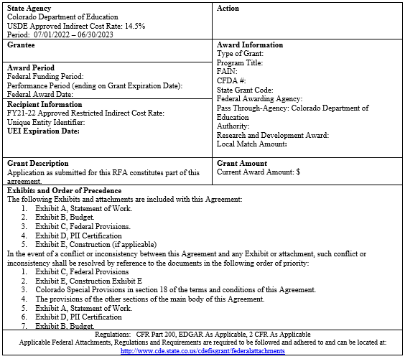
Federal Grant Award Letter (GAL) - What does it mean?
State Agency (typically known as the pass through entity)
  CDE indirect cost rate; this is not the rate your organization uses if you are claiming indirect costs. Your organization should have its own rate (see Recipient Information below).
Action
  Initial or supplemental or amendment to award (if the statement of work changes or funding changes)
Award Information
  CRS/State Award Name, Federal Program/Grant name
  Federal SEFA information (ALN, FAIN, etc)
  The 4-digit code and name of your organization as registered for your Unique Entity Identifier (UEI)
  Funding Period (period of time in which funds can be expended / drawn down by PTE)
  Performance Period (Period of expenditure and obligation allowed)
  Performance period does not commit funding beyond the current approved budget period.
Recipient Information:
  The approved indirect cost rate for your
organization
  Your organization’s UEI
PAY ATTENTION AND READ THIS - awardees are bound to these requirements.
Notes:
Federal award period - GAN to us
Performance period - GAL spending terms within the performance period - allocability discussed on the other slide
Unique Entity Identifier & its expiration

Slide 7
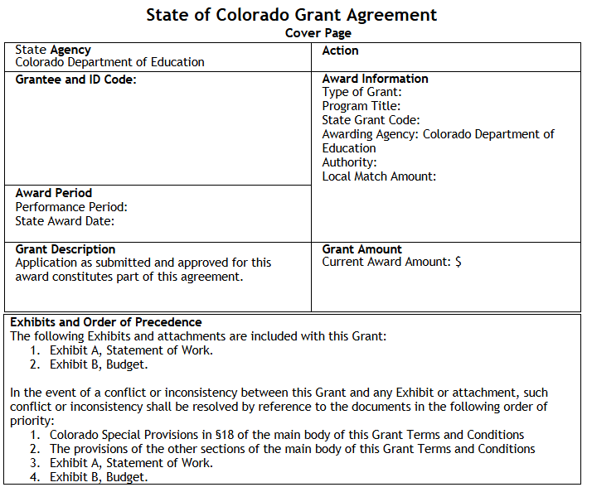
State Grant Award Letter (GAL) - What does it mean?
A lot of the same information (State Agency, Award Information, Award Period etc..)
PAY ATTENTION AND READ THIS - awardees are bound to these requirements.

Slide 8
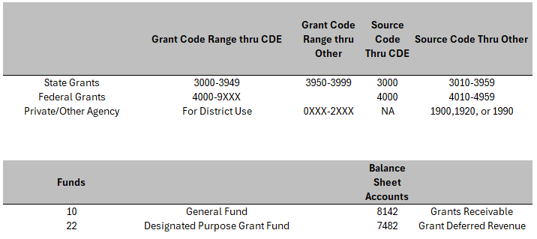
Chart of Accounts – Deciphering Grant Codes
Notes:
The coding for grants is important because if there is a problem in the coding it will flag on the data pipeline. State grants passed through CDE will have a project code in the range of 3000 to 3949. Any state funding that is received must have a corresponding source code of 3000, which is state revenue from CDE. 3950-3999 are state grants codes that are available for district use. These codes would be for state grants outside of CDE and must be used with a corresponding source code of 3010. The charter school will need to utilize flow through coding and the corresponding source codes for the charters. Federal grant codes must be assigned by CDE to stay in compliance with Uniform Grant Guidance (UGG). Federal grants from CDE must be used with the corresponding source code 4000, which is federal revenue from CDE. Federal source code 4010 is for federal revenue outside of CDE.

Slide 9
Obligations
§ 76.707 When obligations are made.
The following table shows when a State or a subgrantee makes obligations for various kinds of property and services.
If the obligation is for - | The obligation is made -
(a) Acquisition of real or personal property | On the date on which the State or subgrantee makes a binding written commitment to acquire the property.
(b) Personal services by an employee of the State or subgrantee | When the services are performed.
(c) Personal services by a contractor who is not an employee of the State or subgrantee | On the date on which the State or subgrantee makes a binding written commitment to obtain the services.
(d) Performance of work other than personal services | On the date on which the State or subgrantee makes a binding written commitment to obtain the work.
(e) Public utility services | When the State or subgrantee receives the services.
(f) Travel | When the travel is taken.
(g) Rental of real or personal property | When the State or subgrantee uses the property.
(h) A pre-agreement cost that was properly approved by the Secretary under the cost principles in 2 CFR part 200, Subpart E - Cost Principles | On the first day of the grant or subgrant performance period.
Notes:
Note things like travel and related costs can have different obligation measures. The actual travel (airline, hotel, etc) which are obligated when the travel takes place and things like conference fees which are obligated at the time of the purchase.

Slide 10
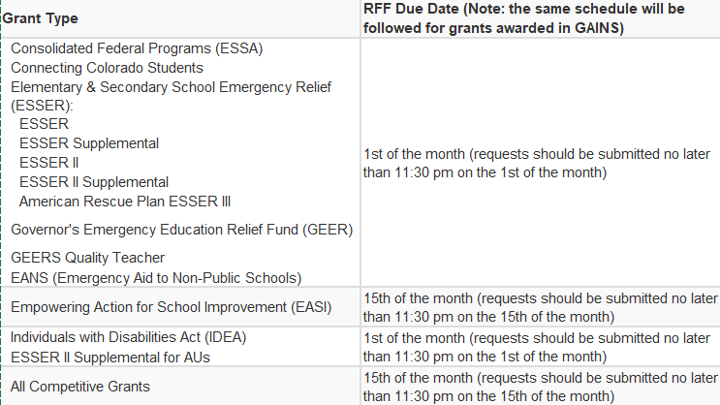
Requesting Federal Funds Once Spending Begins
Grant Requests for Funds - 1st or 15th of every month (award specific)
Fund Request (FR) through GAINS
  Scroll to bottom of the link for additional trainings
Request for Funds (RFF) through Formsite
What is it?
Requesting reimbursement from CDE for expenditures in your federal funds (Title, IDEA, etc.)
What do you need to get it done?
Must submit a General Ledger detailing the expenditures being requested
Expectation that supporting documentation is retained by the entity for all of those expenditures
Contact: GFMU - grants_fiscal@cde.state.co.us

Slide 11
Forward Funded (State) vs Reimbursement Based (Federal)
Advanced Revenue - State Categorical Grants & Competitives for LEAs and BOCES only
  Book all of the related/allowable Expenses
  Most grants should have more Expenses than revenue
  Revenues need to equal expenses at a minimum
    If needed, book Unearned Revenue (7482)
Request For Funds/Fund Requests - Federal
  Revenues must equal Expenses to the penny
  Only request funds after expenses are recorded
  Only Grant Receivable should be recorded, not Unearned Revenue
    There should never be Unearned Revenue (cash on hand)
    Best practice to periodically monitor 7481/7482 for anything federal

Slide 12
Fund Request Support - Upfront vs When Requested
Strongly encourage use of a fund request “packet” or “road map”
GL(s) must be submitted with FR
Supporting documentation should be maintained in easily retrievable manner
Tie expenditures to GL
Can use as a guide to all the charges being requested
LEA maintains digital copies in an internal folder​ as an example
Links or paths to supporting documents
Makes data gathering more efficient when requested down the road
Especially helpful during personnel transitions
More detail in the following slides for expectations/guidance on what is considered proper supporting documentation from a federal perspective
Notes:
The ONLY support required as part of the FR submission is the GL. However, we encourage the use of some form of “packet” or “road map” to make sure all the other WHEN REQUESTED items are easily retrievable when needed

Slide 13

Maintaining Compliant Supporting Documentation

Slide 14
Proper Grant Management Begins with a Documented Process
The Two-Pronged Approach
Policy
A guiding principle used to set direction in an organization.
Changes infrequently
States generally who, what, when, or why
Is broad and general
Procedure
A series of steps to be followed as a consistent and repetitive approach to accomplish a result.
Continuously changes and improves
States specifically who, what, when, and how
  CDE recommends using titles rather than names when documenting the “Who”
Offers a detailed description of activities

Slide 15
Creating or Refining a Process
Start with a defined (and documented) process - How do I …?
To ensure compliance with the federal rules around documenting internal processes, CDE recommends LEAs begin by documenting their current process at a level of detail that would describe all the steps needed from start to finish to accomplish a task (e.g. – make a purchase, document time and effort, receive and track capital assets, etc.).
Once developed, an LEA should then identify what internal controls or compliance requirements may be missing and adjust the process and/or procedure accordingly.
An LEA should develop their process to ensure it works at their entity and may choose to have more controls or be more restrictive than the federal guidance. However, an LEA must follow their internal process, so they should avoid adding steps to a process unless they are prepared to follow them.
To help facilitate this internal process documentation, CDE has compiled some rules and guidance an LEA should incorporate. An LEA will need to determine how best to fit these required elements into their documented processes.

Slide 16
What Are the Federally Required Internal Processes and Procedures?
Must (required in UGG)
Time and effort (200.430)
Employee benefits (200.431)
Procurement (200.318-320)
Equipment management (200.313)
Cost Allowability (200.403-405)
Cash management & Internal Controls (200.302, 303 and 200.305)
Fraud Waste and Abuse (200.113)
Travel (200.475)
Conflicts of interest (200.318(c)), (200.112)
Accounting Policies (200.400(a)), (200.302, 303)
Should (best practice)
Record retention (200.334)
Internal monitoring (e.g., risk assessments, subrecipient review, etc.)
Program specific requirements (e.g., eligibility, matching, etc.)

Slide 17
Employee Compensation - What’s Required?
Compensation for all employees paid even partially with federal funds must be supported by time and effort
Documentation standards outlined at 2 CFR 200.430(g)
  Compensation must be based on actual work performed. These records must:
    Be accurate, allowable, and properly allocated,
    Be incorporated into the official records of the non-Federal entity,
    Reasonably reflect the total activity (federal and non-federal) for which the employee is compensated,
    Comply with the established accounting policies and practices of the non-Federal entity; and
    Support the distribution of the employee's salary or wages among specific activities or cost objectives

Slide 18
Employee Compensation - How to Document?
Historically, two main types of time and effort reporting:
  Semi-annual Certifications - used when an employee works solely on a single Federal award or cost objective
  Personnel Activity Reports - most commonly called timesheets. These are used when an employee works on multiple activities or cost objectives.
Both types must comply with the documentation standards on the previous slide. The main difference is how often they are required to be completed.
An employee’s activity on the award should be represented in their job description/contract. (Effort)
Extra duty pay should be reflective of additional hours ABOVE regular duties
  Must be documented and handled consistent with LEA process for non federally funded positions

Slide 19
Employee Compensation - Semi-annual Certification
The main criteria for this report is an employee can only work on a single award or cost objective
  Must be prepared at least semiannually;
  Typically includes signatures (employee and/or supervisory official with direct knowledge of work performed);
  Must account for total work activity; and
  Must reflect after-the-fact distribution of actual activity
Note, a single cost objective does not necessarily mean a single funding source
  Is the person not being fully funded because there is not enough in the award? OR
  Is the person not being fully funded because they are doing other duties that cannot be charged to the award?
Notes:
Note, “allocability” is discussed in more detail in later slides.

Slide 20
Employee Compensation - Personnel Activity Report (PAR)
The main criteria for this report is when an employee works on multiple activities or cost objectives
  Prepared typically monthly but must coincide with one or more pay periods;
  Appropriate approvals (e.g., signatures by employee, supervisor, etc.);
  Must account for total work activity; and
  Must reflect after-the-fact distribution of actual activity
Note, a PAR can be used in lieu of a semi-annual certification but not the other way around

Slide 21
Employee Compensation - Semi-annual Certification (continued)
Example:
An LEA supports a supplemental math teacher to serve low-achieving students with 50 percent Title I, Part A funds and 50 percent State compensatory education funds.
  Teaching math to low-achieving students is a single cost objective because it can be fully supported (allocable) under Title I, Part A. Only a semiannual certification, therefore, is required even though the employee’s salary is funded by a Federal award and a non-Federal award.

Slide 22
Procurement - What’s Required?
Documented Procedures – purchase cycle
  Federal guidance has specific requirements (e.g., purchase thresholds, segregation of duties, approvals, etc.)
Typical support for transactions (specific to school)
  Should follow the school’s internal policy/procedures. Some typical items may include:
    Purchase Orders – based on dollar amounts
    Approvals – departments, dollar levels
    Invoices – approvals to pay, specific cost objective(s)
    Receiving documents – any tagging required
  Supported by strong internal controls
  Document any allowed exceptions to internal rules

Slide 23
Capital Property and Equipment - What’s Required?
Documented Procedures – receiving and inventory cycle
  Federal guidance has specific requirements (e.g., capital threshold defined, receiving and inventory process, any required tagging, adjustment to records, etc.)
  Federal equipment threshold is $10K but entities may have lower thresholds - make sure this is defined in your policy
Physical inventory conducted at least every two years
  Results reconciled to property records
Specific items required by federal guidance for tracking
  Description and serial number or other identification number
  Source of funding for the property, including FAIN# (Federal Award Identification Number); and ALN#
  Title owner/holder, acquisition date & cost, % for federal program
  Location, use and condition of property
  Disposition data including the date of disposal and sale price of the property, federal release of title/approval to dispose

Slide 24
What Happens When Property and Equipment Are No Longer Needed?
Equipment must be used by the program or project for which it was acquired as long as needed, whether or not the project or program continues to be supported by the Federal award.
  Includes the requirement to track mentioned previously
  If equipment is being replaced for the same award, the proceeds from any sale or trade-in may be used to offset the cost of the replacement
When the item is no longer needed by that program, first look to other activities that might use it
Any disposition rules apply when the Fair Market Value of the equipment at the time of disposition exceeds $10K
Step by step analysis detailed on the CDE website
Note, records retention rules kick in upon final disposition (3 years minimum)

Slide 25
Projects/Construction - What’s Required
Best to avoid funding projects with federal funds so as to avoid the large number of additional requirements as highlighted on the next few slides.
Not common in USDE grants until ESSER but compliance requirements have lasting effects
Really tied in closely with Procurement process
  Some projects meet the definition of construction found at 34 CFR 77.1(c), which will trigger additional compliance requirements at 34 CFR 75.600-75.618
  Start with Appendix II in UGG for potential clauses - this dictates which rules come into play (e.g. Davis-Bacon and Related Acts) throughout the funded activity starting with the contract/purchasing document
Davis-Bacon and Related Acts (DBRA) typically takes center stage. This means ensuring laborers are paid prevailing wages (possibly higher project costs)
  Rules apply if contract:
    Exceeds $2,000
    Is federally financed (in whole or in part)
    Is for the construction, alteration, or repair (including painting and decorating) of public buildings and public works
    Involves the employment of mechanics or laborers
  Cannot split-fund different phases or purchases of a project in an attempt to avoid DBRA.

Slide 26
Projects/Construction - Common Pitfalls
CDE has noted significant noncompliance with Davis-Bacon requirements
  LEAs must:
    Collect and review weekly certified payrolls - looking for assurance of prevailing wage being paid
    Conduct on-site reviews for required wage notifications and Davis-Bacon poster
Contract Clauses
  Ensure applicable Appendix II clauses are included
  Always review the rules prior to drafting any contracts, purchase orders, etc.
    Issuing addendums inherently becomes a much higher obstacle to overcome
Notice of Federal Interest
  An administrative filing that is commonly overlooked
  County departments may have standard forms/language
  See additional guidance for sample language
Notes:
USDE established a $1M threshold for ESSER funded activities but CDE does not anticipate a similar threshold moving forward.
Link currently does not work

Slide 27
Summing Up - Typical Examples of Source Documentation
Employee Compensation (aka - time and effort)
  Timesheets
  Semi-annual certifications
  Personnel Contracts
  Extra Pay Timesheets
  Stipend Memos
Purchase Orders/Receiving
Contracts
Pcard Statements
Invoices
Travel Reimbursement Forms
  For indicating the purpose for travel
  Per Diem Rates
  Hotel Confirmations
  MapQuest or Google Maps for Mileage
  Uber Receipts
  Car Rental Receipts

Slide 28
But … For How Long?
Most federal awards must comply with the requirement of retaining supporting documentation for a minimum of 3 years beyond the final financial report.
Entities receiving SLFRF funds must comply with the US Treasury rules requiring records to be retained for a minimum of 5 years after all funds have been expended or returned.
If there is any litigation or audit at the expiration of the record retention time period, those records must be retained until final resolution.
A good best practice is to utilize the longest period applicable to avoid potential confusion down the road.

Slide 29
Indirect Costs, Allowability & Resources

Slide 30
Indirect Cost Guidance
The indirect cost rate (ICR) is calculated by CDE based on financial data pipeline.
  Every entity receives Restricted Rate and Unrestricted Rate
  Allowable rate depends on award (ESSER allowed unrestricted, training caps at 8%)
Indirect costs (IDC) represent the expenses of doing business that are not readily identified with a particular grant, contract, project function or activity, but are necessary for the general operation of the entity
  Designed to offset expenditures already incurred by the entity
Must have direct expenditures incurred and posted to the grant PRIOR to applying the ICR
Extraordinary or distorting items such as equipment or capital expenditures must be removed before applying the ICR
Certain contracted services are distorting in nature and the ICR must only be applied against the first $50K of costs associated with these contracts
  Use Independent Contractor vs Employee rules for guidance
Not allowed on any state award administered through CDE.
ICR loses its ‘strings’ when reimbursed. Once the LEA receives reimbursement for its indirect costs, those funds can be used for any purpose; they do not have to be spent on the award on which they were earned.
Best practice to review and reconcile at least quarterly (Rev=Exp)
Notes:
CDE currently only has Educator Licensing as a fee based state award

Slide 31
The Mathematics of Allowability
Allowable = reasonable + necessary + allocable
Necessary
Required for the proper performance of the award
Reasonable (200.404)
Would a prudent person consider the cost and nature of the item to be ordinary and necessary?
Allocable (200.405)
Cost assignable in accordance with relative benefit received

Slide 32
Determination of Allowable Costs
Applies to State AND Federal Awards
    ANY dollar of federal funds MUST meet the following requirements (best practice for state):
Is it Allowable (200.403)
  Necessary and reasonable for the performance of the award.
  Conform to specific exclusions or limitations (award specific as well).
  Consistent treatment in process (federal and nonfederal) and application (direct or indirect).
  Conform to GAAP/GASB.
  Not used as cost share or match for another federal award OR duplication of reimbursement (no double dipping).
  Adequately documented.
  Incurred during approved budget period (obligation).
Is it Reasonable AND Necessary (200.404)
  The cost does NOT exceed that which the entity would NORMALLY pay for the service/product.
  Is necessary for the delivery of services under the specific project.
  Complies with requirements and restraints of the award, state law, and INTERNAL POLICY!
Is it Allocable (200.405)
  Example - Labor Costs! (puts the “effort” in time and effort)
  Incurred for the particular project and is necessary to carry out the project.
  Expense is NOT part of the indirect cost base being claimed.
ALL EXPENSES CHARGED TO A STATE OR FEDERAL AWARD MUST BE NET OF ANY CREDITS.
These requirements are applicable to Cost Share/Matching expenses as well!
Notes:
Every expenditure must meet these three pillars of allowability however, the expenditures must NOT conflict with an entity’s internal rules and requirements either. And most especially it must comply with the GRANT agreement, intent or rules.

Slide 33
Compliance - Common Issues Related to Allowable Costs
Food - very specific scenarios in which ED sees food as an allowable use of federal funds
Taxes - make use of available tax exemptions (200.470)
Personal benefit - be careful with perceived benefits (e.g., incentives/gifts)
Conflict with internal policies (e.g., travel normally charged to non federal funds?)

Slide 34
Additional Grant Resources
Chart of Accounts: http://www.cde.state.co.us/cdefinance/sfcoa
Grants Fiscal: https://www.cde.state.co.us/cdefisgrant
Indirect Rates: https://www.cde.state.co.us/cdefinance/icrc
Request for Funds: https://www.cde.state.co.us/cdefisgrant/requestforfundsforms (Formsite submissions)
Federal Regulation 2 CFR 200: https://www.ecfr.gov/current/title-2/subtitle-A/chapter-II/part-200?toc=1
EDGAR Regulation: https://www.ecfr.gov/current/title-34
Related School Finance Trainings: http://www.cde.state.co.us/cdefinance/upcomingschoolfinancetownhallsandtrainings
Colorado Revised Statutes: https://leg.colorado.gov/agencies/office-legislative-legal-services/colorado-revised-statutes
Colorado Office of the State Controller Fiscal Rules: https://osc.colorado.gov/financial-operations/fiscal-rules-procedures/fiscal-rules
CDE Grants Fiscal Resources: https://www.cde.state.co.us/cdefisgrant/webinarstrainingsguidance
GAINS: https://www.cde.state.co.us/idm/gains
Indirect Cost Guidance: https://www.cde.state.co.us/cdefisgrant/idcusesrequirements and 2 CFR 200.1 Modified Total Direct Cost (MTDC)
Federal GAL Additional Regulations to review: http://www.cde.state.co.us/cdefisgrant/federalattachments

Slide 35
Grants Fiscal Contacts
Jennifer Austin
Grants Fiscal Management Director
Office of Grants Fiscal Management
EMAIL: Austin_J@cde.state.co.us
Bill Parsley
Fiscal Monitoring Supervisor
Office of Grants Fiscal Management
EMAIL: Parsley_B@cde.state.co.us
Hilery Morris
Fiscal Monitoring Specialist
Office of Grants Fiscal Management
Email: Morris_H@cde.state.co.us
Rich Hull
School Finance Analyst and Auditor
Office of Grants Fiscal Management
Email: Hull_r@cde.state.co.us
Robert Hawkins
Lead Grants Fiscal Analyst
Office of Grants Fiscal Management
EMAIL: Hawkins_R@cde.state.co.us
Steven Kaleda
Grants Fiscal Analyst
Office of Grants Fiscal Management
EMAIL: Kaleda_S@cde.state.co.us
Tricia Miller
Fiscal Grants Supervisor
Office of Grants Fiscal Management
Email: Miller_T@cde.state.co.us
Evan Davis
Fiscal Grants Supervisor
Office of Grants Fiscal Management
Email: Davis_E@cde.state.co.us

Slide 36


Question
Are there any questions?

