Slide 1
READ Act Regional Meeting Office of Elementary Literacy and School Readiness and the Office of Learning Supports
January 17, 2025
9:00 – 10:00
Notes:
Thank you for joining us for the Elementary Literacy and School Readiness READ Act Regional Meeting.

Slide 2
Introductions
Lindsey Beveridge, Senior Literacy Consultant
Office of Elementary Literacy and School Readiness
Beveridge_L@cde.state.co.us
Caitlin Fickling, Senior Literacy Consultant
Office of Elementary Literacy and School Readiness
Fickling_C@cde.state.co.us
Jamie Olson, Senior Literacy Consultant
Office of Elementary Literacy and School Readiness
Olson_J@cde.state.co.us
Christina Kirchhof, Multi-Tiered Systems of Support (MTSS) Specialist
Office of Learning Supports
Kirchhof_C@cde.state.co.us
Evan Daldegan, Multi-Tiered Systems of Support (MTSS) Specialist
Office of Learning Supports
Daldegan_E@cde.state.co.us
Notes:
Good morning, everyone. I am Caitlin Fickling, one of the Senior Literacy Consultants from the Elementary Literacy and School Readiness office. I am joined by Jamie Olson and Lindsey Beveridge for this presentation and the rest of our team is in the audience as well. We are so excited to have Christina Kirchhof, Evan Daldegan, and Dr. Arlisha Lawson-Watford here from the Office of Learning Supports to facilitate this presentation about COMTSS and the READ Act. Before I turn this presentation over to them, I will briefly review our objectives and zoom features for this meeting on the next two slides.

Slide 3
Objectives
-
Understand how effective implementation of the READ Act is supported by a strong MTSS framework.
-
Understand how the process of identifying students with an SRD and initiating a READ Plan fits within the MTSS framework.
-
Identify decision rules using data to ensure students receive needed supports.
Notes:
Our objectives for this meeting are to understand how effective implementation of the READ Act is supported by a strong MTSS framework, understand how the process of identifying students with an SRD and initiating a READ Plan fits within the MTSS framework, and to identify decision rules using data to ensure students receive needed supports.

Slide 4
Today’s Meeting
Please utilize the Zoom Q&A feature for questions during the meeting
Some questions may be answered live by CDE or later in the meeting
Individual district questions may be answered over email or later follow-up with your consultant or specialist
Notes:
For today’s meeting, please utilize the Zoom Q&A feature for questions. Some questions may be answered live or later in the meeting based on our pacing through the content in this first hour. Individual district questions may be answered over email or later follow-up with your consultant or specialist.
With that out of the way, I will go ahead and turn this presentation over to Christina. Thank you so much for sharing your expertise with us today.

Slide 5
Colorado Multi-tiered System of Supports
Colorado Multi-Tiered System of Supports (COMTSS) is a prevention-based framework using team-driven leadership and data-based problem solving to improve the outcomes of every student through family, school, and community partnerships, comprehensive assessment, and a layered continuum of supports. Implementation science and universal design for learning are employed to create one integrated system that focuses on increasing academic and behavioral outcomes to equitably support the varying needs of all students.
Notes:
Colorado Multi-tiered System of Supports or COMTSS is the name for the MTSS framework used in the state of Colorado.
Today we are going to explore what COMTSS is, what components it is comprised of, and how each component of COMTSS is called for in the READ Act.
The framework is comprised of five components: team-driven leadership, data-based problem solving and decision-making, family, school, and community partnerships, comprehensive screening and assessment, and a layered continuum of supports.
Identifying these common elements shows us that through implementing COMTSS well, we will meet legislative requirements and support the creation and implementation of effective, individualized, READ plans.

Slide 6
What is MTSS?
MTSS is a systems framework that supports the use of educational innovations.
An innovation is an intervention or a solution that helps solve a problem.
Innovations in education are the evidence-based practices used to support students and staff in all domains.
Notes:
MTSS is a systems framework that supports the use of educational innovations.
An innovation is an intervention or a solution that helps solve a problem.
Innovations in education are the evidence-based practices used to support students and staff in all domains.

Slide 7
What is MTSS?
RtI
PBIS
READ Act
SEL
UDL
RP
MTSS
Notes:
We can think of MTSS as the framework of a building. It is providing support and allowing all of the other parts of the building to work they way they are supposed to.
On the framework of MTSS, we can implement social-emotional learning, universal design for learning, restorative practices, response to intervention, positive behavioral interventions and supports and the READ act.
The READ Act is a legislative requirement in Colorado also focused on prevention. The legislation requires universal literacy assessment and identification of students at risk for reading difficulty so that appropriate interventions can be put in place. It also focuses on high-quality, evidence based programming and instructional practices. The READ Act is considered an educational innovation that fits within the framework of MTSS.
Acronyms
SEL – Social-emotional Learning
UDL – Universal Design for Learning
RP – Restorative Practices
RtI – Response to Intervention
PBIS – Positive Behavioral Interventions and Supports
READ Act - Reading to Ensure Academic Development Act

Slide 8
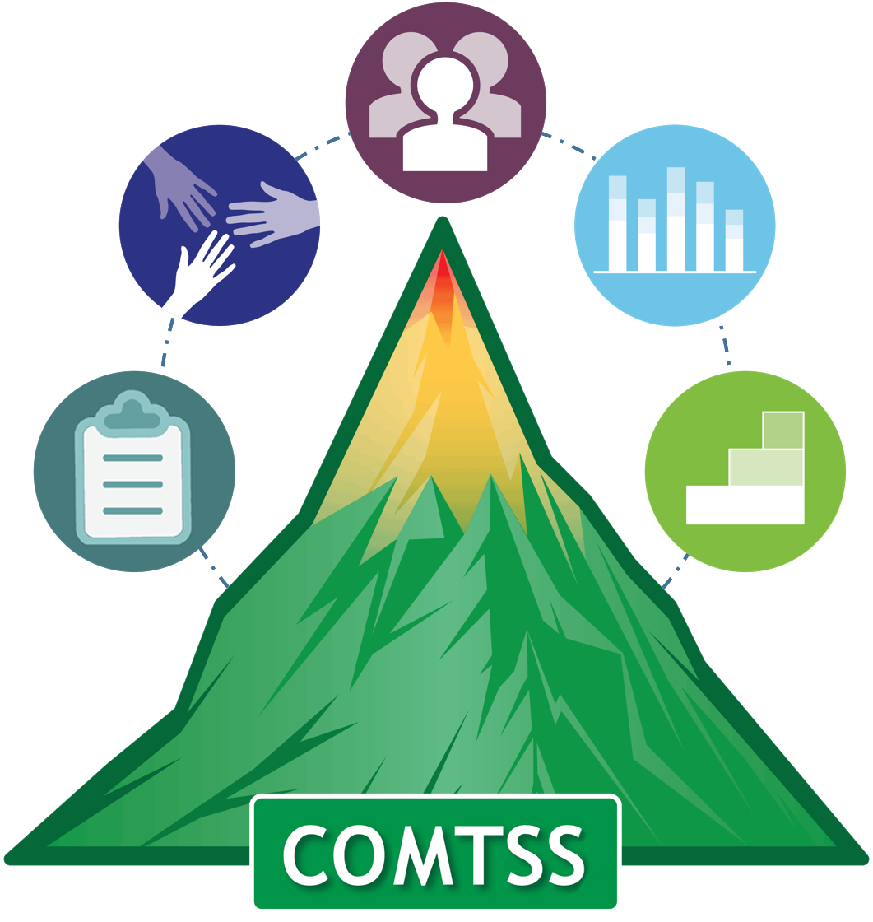
Colorado Multi-Tiered System of Supports
So……what is this actually?
MTSS is a SYSTEMIC IMPROVEMENT framework that ensures that the components that are needed to implement an innovation (RtI, PBIS, READ plans, etc.). It ensures that we have the right people, the right information to identify needs, the right interventions to support those needs, clear processes to evaluate needs, progress, and fidelity, and a holistic approach that considers the whole child.
Notes:
In practice, COMTSS is a structured framework for driving systemic improvement, ensuring the essential elements are in place to support innovations.
It emphasizes assembling the right team, gathering reliable data to understand needs, implementing appropriate strategies to address those needs, establishing clear methods to monitor progress and effectiveness, and adopting a whole-child perspective throughout the process.

Slide 9
MTSS is the framework that aligns the initiatives in use. It ensures that the initiatives are used to compliment one another, not to compete.
Notes:
Often, these innovations may feel like they are in competition with each other. When this occurs, staff may be unclear what interventions to use, when, and how.
MTSS is the framework that aligns the initiatives in use. It ensures that the initiatives are used to compliment one another, not to compete.
When an MTSS framework is used with fidelity, that ambiguity is resolved as each innovation is operating in the framework to address similar, but different problems.
For example, if you work in a school that uses a PBIS system it may cause confusion if you introduce restorative practices as the innovations are both addressing behavior.
However, when we implement each through the MTSS framework, the components help us to understand how each innovation operates across the tiers and we can use PBIS and Restorative practices to compliment one another and provide more comprehensive, needs aligned, supports.

Slide 10
IT IS “HOW”
It uses implementation science to create systemic change by improving:
Colorado Multi-Tiered System of Supports
how we conduct meetings,
how we make decisions,
how we train staff,
how we communicate (internally and externally),
how we integrate our systems,
how we action plan,
how we consider data and use data
Notes:
COMTSS is HOW we work
It uses implementation science to create effective systemic change by improving :
How we conduct meetings to ensure that they are purpose-driven, and promote collaboration, respect, and engagement from all participants.
How we make decisions collaboratively, using a data-informed approach
how we train staff to integrate research-based practices and apply them in their schools
How we ensure that communication is clear, consistent, and that feedback is received
how we integrate our systems to ensure that initiatives, resources, and practices are consistent across teams, that resources are used well, and that work is not duplicated.
We action plan to break down goals into actionable steps, assign responsibilities, review and adapt.
How we use data to drive resource allocation, decision-making, and intervention strategies.
If we use each of these elements with fidelity we will be implementing MTSS and therefore support schools and districts to implement the READ Act and READ plans effectively and with fidelity.

Slide 11
Why use COMTSS to support systems change:
Colorado Multi-Tiered System of Supports
Why use COMTSS to support systems change:
Increase academic, behavioral, and social emotional outcomes for students through equipping the adults within your system
Increase prevention efforts
Decrease staff stress: usability + clarity = competence
Increase staff competency to use ANY Effective Innovation
Teachers’ sense of self-efficacy is a significant predictor of productive teaching practices.
Notes:
COMTSS is an evidence-based practice that has proven to be a valid and reliable framework.
The COMTSS framework was influenced by the work of Kent Mcintosh and Steve Goodman, both of whom are experts in the field of systems change.
At CDE, COMTSS is a partnership with our national advisors, the National Implementation Research Network (NIRN), and the State Implementation and Scaling-up of –based Practices (SISEP). Through these partnerships, the COMTSS framework is continuously improved.
Through research we know that when implemented with fidelity,
COMTSS increases academic, behavioral, and social-emotional outcomes for students by equipping the adults within the system
It increases prevention efforts and provides needed supports before students fall behind.
It decreases staff stress by ensuring that innovations are usable – by making sure that everyone has the knowledge and skills necessary - and clear – making sure that everyone knows how each tier operates and their role within the systems.
Once the framework is established with fidelity it ensures staff have the competence to use any innovation.
This is important because we know that teachers' confidence in their own abilities is a key factor in fostering effective teaching practices.

Slide 12
COMTSS is NOT
A new version of Response to Intervention (RTI) or Positive Behavioral Interventions and Supports (PBIS)
A framework that should be used only when skill deficits are apparent
The job of one person or department
A supplant of core instruction
Only used for students in general education
Only used to move students into special education
Notes:
There can be a lot of confusion and misinformation about MTSS. This often stems from the rapid transition of systems and inconsistent messaging between states, districts, school, and staff.
In Colorado, COMTSS is a systems framework used to support innovations.
What COMTSS is not is equally important.
Response to intervention and positive behavioral interventions and supports pre-date the MTSS framework. Each are tiered systems that support students in different ways. In the past, these systems were in competition with one another causing one or both to be implemented incorrectly.
MTSS stems from the need to make systems complimentary and gives us a framework to use innovations as intended. It is not a new or modified version of these initiatives.
MTSS is not only used for students who display the need for additional support. It is a preventative framework that should be used to support students before they fall behind not as a means of remediation.
MTSS cannot be the role of one person or department. All stakeholders, teachers, administrators, support staff, families, etc. have an important role in MTSS and must be included to ensure that the framework is implemented with fidelity.
MTSS should supplement core instruction, not replace it.
MTSS is not a general education framework. It should be used to support all students across each tier as their needs warrant.
And finally, because the MTSS framework is used to prevent students from falling behind and is used to support all students, it is not intended to be used solely as a pathway to special education services.

Slide 13
5 COMTSS Components Supporting Innovations
Team-driven Shared Leadership
Family, School, and
Community Partnering
READ
Data-based
Problem Solving
When implementing or improving practices, we want to look at it through the lens of each of the five components and make sure we are addressing all of them.
Comprehensive Screening and Assessment System
Layered Continuum
of Supports
Notes:
When we are implementing or improving practices, we want to look at our work through the lens of each of the five components of COMTSS to ensure that we are using each to inform and improve our practice.

Slide 14
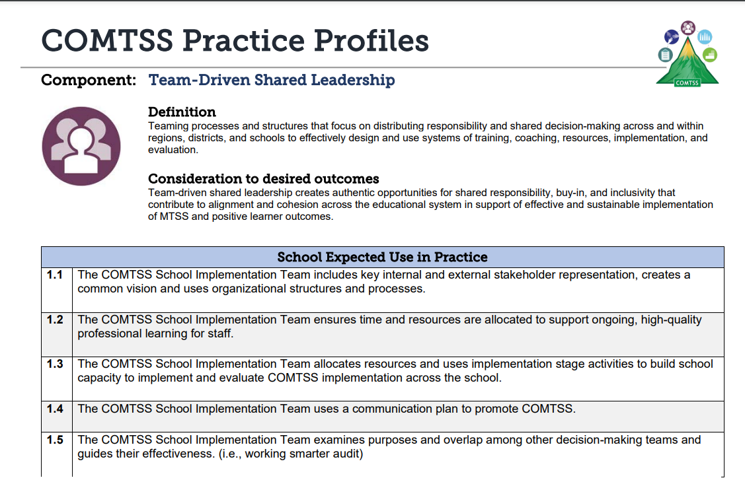
COMTSS Five Components Practice Profiles
Notes:
We’re going to look at each of the five components and what actionable steps are used to implement each. We do this through the use of practice profiles.
The COMTSS Practice Profiles were developed to specify exemplary strategies that teams can use to support effective and sustainable use of the COMTSS framework as intended.
Each row in the profiles offer examples of activities undertaken by teams to implement and ‘do’ the work of COMTSS.
Practice profiles are available for region, district, and school level teams to highlight the similarities and differences in the work of the MTSS team at each level.
A link to the practice profiles is included at the end of the presentation.
We are going to switch gears to review each component and how the READ Act legislation mandates are addressed through the use of the framework.

Slide 15
Team-Driven Shared Leadership
Teaming processes and structures that focus on distributing responsibility and shared decision-making across and within regions, districts, and schools to effectively design and use systems of training, coaching, resources, implementation, and evaluation.
Notes:
Evan- add time stamp 9:17
The first component we wanted to explore with you all is Team-driven shared leadership and it is defined as Teaming processes and structures that focus on distributing responsibility and shared decision-making across and within regions, districts, and schools to effectively design and use systems of training, coaching, resources, implementation, and evaluation.
Team-driven shared leadership creates authentic opportunities for shared responsibility, buy-in, and inclusivity that contribute to alignment and cohesion across the educational system in support of effective and sustainable implementation of MTSS and positive learner outcomes. This is best practice as we consider how to systematize Read Act processes, protocols, and procedures
This component is essential as without an effective team communication breaks down, necessary steps are left incomplete, and there is no common understanding of the plan to achieve desired outcomes. The team is needed to ensure that all of the other components can function. This component is incredibly important when one considers how to use the COMTSS framework to implement the Read Act in school and districts- implementation of the Read Act should include the input from all stakeholder and this can be accomplished using the tenants of Team driven shared leadership

Slide 16
Key Aspects of Team Driven Shared Leadership
Includes the perspectives of those who will be impacted by decisions and the professionals who support them (Administrators, teachers, other staff, families, students)
Determines roles and responsibilities based on skills and interests.
Effective communication including: sharing agendas beforehand and meeting minutes afterwards.
Creates safety for team members to equally participate
Notes:
Systems focus is emphasized
Here are some practical – key aspects of what team driven shared leadership actually looks like in practice:
Include the perspectives of those who will be impacted by decisions and the professionals who support them (Administrators, teachers, other staff, families, students)
Determine roles and responsibilities based on skills and interests
Effective communication including sharing agendas beforehand and meeting minutes afterwards.
Create safety for team members to equally participate

Slide 17
Team-Driven Shared Leadership in our Student-Service Innovations
READ Act
Throughout the READ plan implementation process, decisions should be made collaboratively between school personnel and parents.
Local education providers (LEPs) are responsible for developing procedures to support effective READ Act implementation.
Is process-focused: identifying, selecting, developing, implementing, and monitoring effectiveness of student level reading proficiency.
Teachers and administrators are trained in the Science of Reading to ensure system-wide improvements to literacy instruction.
Notes:
In preparing this presentation, our team went through the READ Act, and we were able to pull out specific content from the read act that directly falls under Team Driven Shared Leadership in the COMTSS Framework, and all the other components embedded in the COMTSS Framework so that you all can see how you could use the COMTSS Framework to successful use and systematize READ Act principals both at the district and school levels
The READ plan implementation process emphasizes collaboration between school personnel and parents in decision-making.
Local education providers (LEPs) are tasked with establishing procedures to ensure effective implementation of the READ Act.
This process focuses on identifying, selecting, developing, implementing, and monitoring strategies to improve student reading proficiency.
To support system-wide literacy improvement, teachers and administrators are trained in the Science of Reading.

Slide 18
Comprehensive Screening and Assessment System
Comprehensive Screening and Assessment System is the coordinated effort of gathering information across multiple measures to support decision making at the system and student level for the whole child.
Key: A comprehensive assessment system contributes to an outcomes-driven approach that includes structured monitoring and evaluation with a commitment to continuous improvement.
Notes:
Identifying and administering the right assessment at the right time for both the student and system levels.
Comprehensive Screening and Assessment System is the coordinated effort of gathering information across multiple measures to support decision making at the system and student level for the whole child.
Key: A comprehensive assessment system contributes to an outcomes-driven approach that includes structured monitoring and evaluation with a commitment to continuous improvement. This component is essential for implementation of Read Act principals at the district and school level

Slide 19
Key Aspects of a Comprehensive Screening and Assessment System
Intentionally use of universal screeners, progress monitoring, diagnostics, and summative assessments to identify student and/or systemic academic and behavioral needs.
Intentional planning about how to respond to screening and assessment data results to maximize positive outcomes.
Notes:
Key aspects of comprehensive screen and assessment system include Intentional use of universal screeners, progress monitoring, diagnostics, and summative assessments to identify student and/or systemic academic and behavioral needs for all students and Intentional planning about how to respond to screening and assessment data results to maximize positive outcomes

Slide 20
Comprehensive Screening and Assessment System in the READ Act
READ Act
Literacy development is assessed in the areas of phonemic awareness; phonics; vocabulary development; and reading fluency, including mastery of oral skills, and reading comprehension.
An interim assessment is used throughout the year to measure reading competency. The assessment is administered to all students to identify those who may experience lower than expected reading outcomes who may be at risk for reading challenges.
A diagnostic assessment is used if a student scores below the cut-score on the interim assessment to identify specific needs.
Regular progress monitoring is provided for students identified with an SRD to determine the efficacy of intervention programming.
Notes:
The READ Act calls for literacy development to be evaluated in areas such as phonemic awareness, phonics, vocabulary, reading fluency (including oral proficiency), and comprehension.
Interim assessments to be conducted throughout the year for all students to assess reading skills and identify those at risk for challenges.
And for students who perform below the cut-score on the interim assessment undergo diagnostic evaluations to determine their specific needs.
For those identified with a significant reading deficiency (SRD), progress is monitored regularly to assess the impact of intervention strategies.

Slide 21
Data-Based Problem-Solving & Decision-Making
A continuous improvement process used by teams to collect, analyze, and evaluate information to inform decision making at the system and student levels.
Notes:
DBPSDM is the next component of COMTSS. It is defined as a continuous improvement process used by teams to collect, analyze, and evaluate information to inform decision making at the system and student levels.
This component is essential because it ensures that we have the right information to make decisions and that the data is used to meaningfully inform instruction.

Slide 22
Four-step Problem Solving Process
Step 1: Problem Identification
Step 4:
Plan
Evaluation
Step 2: Problem Analysis
Step 3: Plan Identification and
Implementation
Notes:
Data-Based Problem-Solving and Decision-Making involves a 4-step process in which data are used to identify and understand a problem.
A possible solution is generated, an action plan to achieve that solution is created with timelines for monitoring fidelity and outcomes, and additional data is gathered to monitor fidelity and the impact of the solution.
Fidelity and outcome data are continuously analyzed and used to evaluate efforts throughout the organizational system to determine the necessary course of action for continuous improvement at the system level.

Slide 23
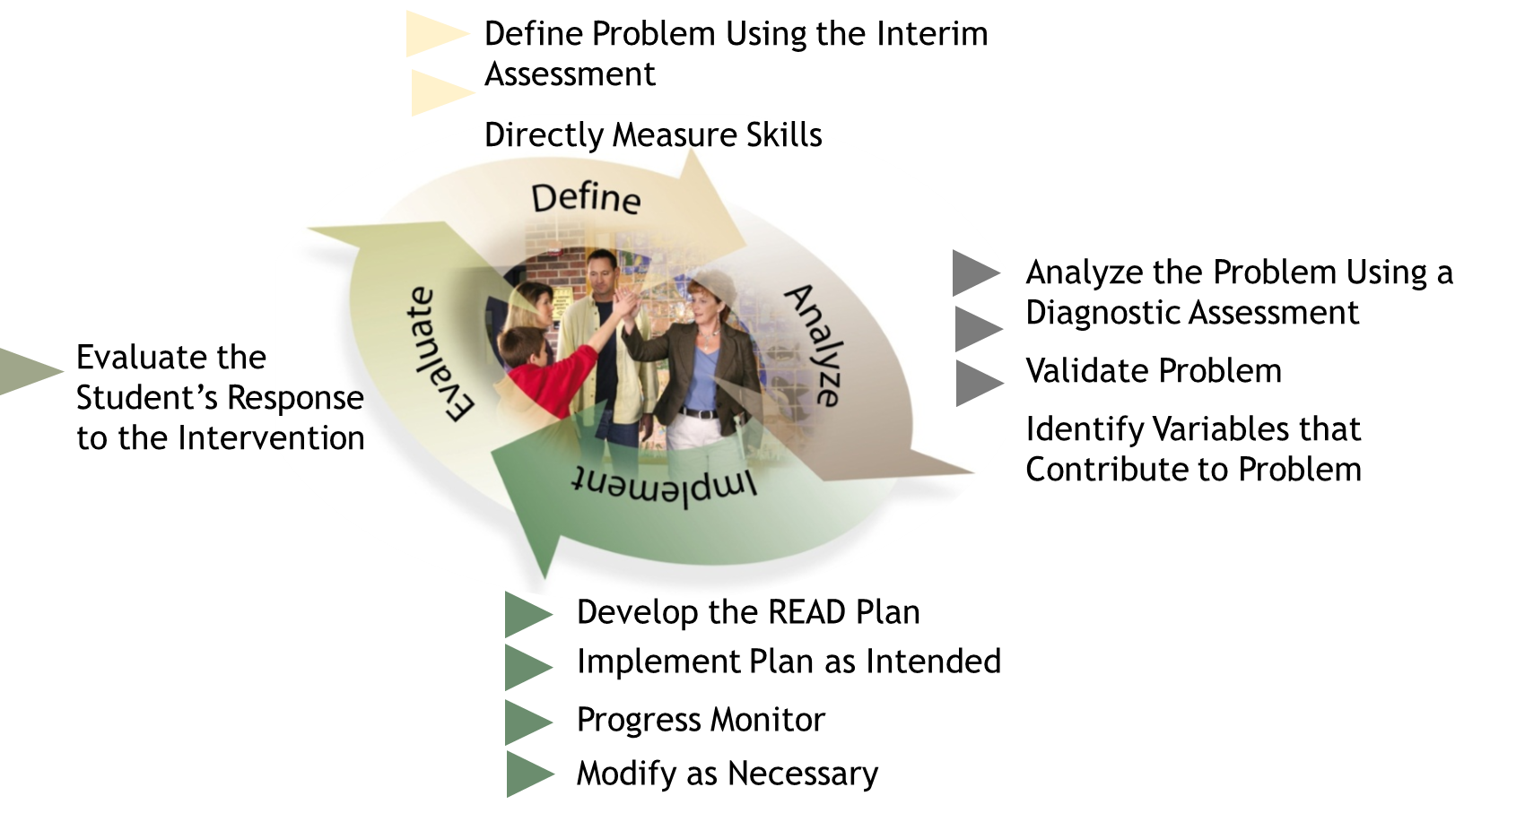
Problem-Solving Process and the READ Plan
Notes:
Here is an example of where READ Plan components can be used within the 4 step problem solving process as apart of Data based problem solving and decision making. It is a great example of how the COMTSS framework can be directly used as a multi-disciplinary teaming process to address student level needs

Slide 24
Key Aspects of Data-Based Problem Solving and Decision-Making
Make decisions based on data and evidence and not assumptions.
Don’t jump to solution without understanding what the root problem is and why it’s happening.
Develop an action plan (who will do what by when? how will we know it was done and that it worked?)
Spend time determining if your plan worked. How do you know?
Notes:
Key aspects of data-based problem solving and decision making include:
Making decisions based on data and evidence and not assumptions, Don’t jump to solution without understanding what the root problem is and why it’s happening, Develop an action plan (who will do what by when? how will we know it was done and that it worked?), Spend time determining if your plan worked. How do you know?

Slide 25
Data-Based Problem-Solving & Decision-Making in the READ Act
READ Act
Data-based problem solving and decision making occurs at the student level to build, implement, and evaluate student-level support.
Analysis of data drives decision making, is ongoing, responsive, and systematic.
Universal screening data is analyzed to determine the efficacy of core instruction.
Results from the interim assessment, diagnostic assessment, and other data are compiled to form a complete body of evidence in determining a significant reading deficiency (SRD).
Notes:
In the READ Act, data-driven problem-solving and decision-making are focused on building, implementing, and evaluating supports at the student level.
Through ongoing and systematic analysis, data informs responsive decisions.
Universal screening results are used to evaluate the effectiveness of core instruction, while interim and diagnostic assessments, along with other data, provide a comprehensive body of evidence to identify significant reading deficiencies (SRD).

Slide 26
Layered Continuum of Supports
Ensuring that every student receives equitable whole child supports that are evidence based, culturally responsive, matched to need, and developmentally appropriate through layered supports.
Notes:
Our next component in the COMTSS Framework is Layered Continuum of Support. The purpose of a Layered continuum of supports is to ensure that every student receives equitable whole child supports that are evidence based, culturally responsive, matched to need, and developmentally appropriate through layered supports.

Slide 27
Key Aspects of a Layered Continuum of Supports
Tier 1 Health-if many students need tier II supports, it may mean you need to change what you offer universally.
Establish clear guidelines for intensifying and fading tier II and III supports.
Ensure tiered supports for students, staff, and families.
Notes:
Key Aspects of Layered continuum of supports include
Examining Tier 1 Health-in other words, if many students need tier II supports, it may mean you need to change what you offer universally.
Establish clear guidelines for intensifying and fading tier II and III supports.
Ensure tiered supports for students, staff, and families.

Slide 28
Why use a Layered Continuum?
Educators are better able to respond effectively and efficiently to each students’ individual needs
When students receive support based on need, they are more likely to succeed
When students make sufficient progress
regularly, teacher efficacy increases
Leads to higher morale of interventionist
and increased student motivation
Notes:
We know from research that when a layered continuum of supports is in place, educators are better able to respond to the needs of students
When these students receive support based on their needs, they are more likely to succeed academically and behaviorally
As students make sufficient progress at regular intervals, it actually leads to increased teacher efficacy
Which is correlated with higher morale and increased student motivation
All of these aspects are integral in making sure that Read Plans are implemented and used with a high level efficacy to ensure positive student outcomes

Slide 29
Layered Continuum of Supports
Ensuring that every student receives equitable whole-child supports that are evidenced based, culturally responsive, matched to need, and developmentally appropriate through layered supports.
Every student = Universal
Some = Universal + Targeted
Few = Universal + Targeted + Intensive
Notes:
In the COMTSS Framework layered continuum of supports is
A Prevention based framework- and is proactive as opposed to reactive
used for students but also adults- how to teacher’s needs differ? Parent needs? Admin needs? What additional supports do these groups need?
students at all levels, continue to receive high quality and evidence-based tier 1 universal supports regardless of their level of intervention

Slide 30
Layered Continuum of Supports: Student Level
Students may receive supports in different areas across different tiers.
Notes:
Here is an example the layered continuum of supports as it may play out for a typical students who attends as school that uses the COMTSS Framework to address student need. This student is receiving high quality tier one instruction in these areas but is also receiving targeted intervention in emotional regulation and intensive support in addition based on the student’s specific needs. Notice how the targeted support for emotional regulation and intensive support for addition doesn’t cancel out the on-going high-quality tier 1 instruction that they are also receiving in these areas. Ongoing high-quality tier 1 instruction in all areas is important to maximizing positive student outcomes regardless of their intervention level for specific needs.

Slide 31
Student Supports in Literacy
Decoding Accuracy
Decoding accuracy
Phonological/phonemic awareness
Phonics fluency vocabulary
Oral language skills comprehension
written language
Notes:
When considering how the tiers of instruction function when focused specifically on literacy, it is important to ensure that all students receive scientifically based and evidence-based universal instruction in each of the components of literacy. When a student is identified with an SRD, the specific skill deficit is identified and an intervention initiated to address the student’s needs in addition to Tier 1 instruction.
For example, (CLICK)
A student’s diagnostic assessment data pinpoints decoding accuracy as the skill in need of support, and the team decides that the student will participate in a targeted small group intervention, 30 minutes/day focused on improving decoding accuracy.
If this approach does not result in adequate progress, a decision may be made to intensify the intervention (CLICK). This may mean increased time, frequency, or duration and a decreased group size or one-on-on instruction.

Slide 32
Layered Continuum of Supports in the READ Act
READ Act
• The purpose of the legislation is prevention.
• All students receive high quality Tier 1 instruction using evidence-based instructional programming.
• Students significantly below grade level in reading receive a READ plan of intervention.
• Supports are layered on top of core instruction and supplement rather than supplant.
• Fluid student-level interventions are emphasized.
• A data-driven and systematic selection of evidence-based instruction and interventions is utilized.
• READ plans will continue into the subsequent school year for students on an existing READ plan who do not reach grade level reading competency by the End-Of-Year assessment. The Beginning-Of-Year READ plan for students who continue to have an SRD includes more rigorous strategies and interventions, including increased daily time in school for reading instruction, than were provided in the previous year.
Notes:
The legislation aims to prioritize prevention by ensuring all students receive high-quality, evidence-based Tier 1 instruction.
Students significantly below grade level in reading are provided with a READ plan, which offers targeted interventions that supplement, rather than replace, core instruction.
Emphasis is placed on fluid, student-specific interventions selected through a systematic, data-driven approach.
For students who remain on a READ plan due to not achieving grade-level reading competency by the End-of-Year assessment, the plan continues into the next school year. These Beginning-of-Year plans incorporate more rigorous strategies, increased instructional time, and intensified interventions to address persistent reading deficiencies.

Slide 33
Moving Between the Tiers
Decision rules: Clear, predetermined guidelines or criteria that teams use to determine when a student requires additional support, when to adjust existing interventions, or when to consider reducing or discontinuing support. These rules ensure decisions are consistent, data-driven, and equitable.
What supports are available at each tier?
What data are used to intensify or fade supports?​
When are supports intensified?
When are supports faded?
Notes:
To use a layered continuum with fidelity, it is imperative that a determination of how movement between the tiers of support will be determined.
We use decision rules to ensure the use of data to identify clear criteria to determine when to adjust or change student supports. Decision rules will vary in different settings to ensure they are appropriate for our population and that all student needs are being addressed.
To create or change decision rules we ask these four questions.
What supports are available at each tier?
At tier 1 universal supports provided to all students, including high-quality instruction and proactive classroom strategies. An effective tier one will ensure that the majority of students are making gains.
An effective tier two uses targeted interventions that are tailored to individual student needs and are intended to improve student progress over shorter periods of time such as 10-12 week intervals.
An effective tier three uses targeted interventions and precise goals tailored to the individual student to provide specialized instruction and services.
What data are used to intensify or fade supports?
Data from various sources, such as progress monitoring and screening assessments are critical. These data help determine whether students are responding to current interventions or require adjustments.
When are supports intensified?
Supports are intensified when data indicate insufficient progress despite existing interventions. Intensification could involve increasing the frequency, duration, or intensity of the intervention or providing more targeted support.
When are supports faded?
Supports are reduced or faded when data show that a student has met their goals and is maintaining progress without additional assistance. The aim is to promote independence while ensuring continued success.

Slide 34
Family, School, and Community Partnerships
Families, early childhood programs, schools, and communities actively partnering to develop, implement, and evaluate effective and equitable practices to improve educational outcomes for children and youth.
Notes:
Our last component is FSCP which states: Families, early childhood programs, schools, and communities actively partnering to develop, implement, and evaluate effective and equitable practices to improve educational outcomes for children and youth.
This component is important because research shows that with high levels of engagement from families and the community, students earn higher grades, graduate from high school and attend post-secondary education at a higher rate, develop self-confidence and motivation in the classroom, have better social skills and classroom behavior.

Slide 35
Key Aspects of Family School Community Partnerships
Creating Safety is vital! Remember that some family members had difficult experiences at school and have emotional resistance to going to a school building.
Build trusting relationships that enable families and programs/schools to partner about the educational outcomes for students.
Partnering doesn’t mean only letting families know what is going on or what you need them to do.
Support staff in gaining the skills and confidence to have hard conversations with families.
Notes:
Key aspects of this component include:
Ensuring that families feel safe and welcome in school settings,
That trust is built with families,
Involving families in decision making,
And having challenging conversations through a lens of growth.

Slide 36
Family, School, and Community Partnerships in the READ Act
READ Act
• Promotes family involvement and shared responsibility in the data-based problem-solving and decision-making process at the student level.
• Requires that parents receive regular, ongoing updates from the student’s teacher concerning results of the intervention instruction and the student’s progress in achieving reading competency.
• Parents are strongly encouraged to work with the student's teacher in implementing the READ plan, and to supplement the intervention instruction the student receives in school.
• An end-of-year parent meeting is held to ensure that sound educational decisions are made as the student transitions.
Notes:
The READ Act promotes family school and community partnerships by emphasizing shared responsibility in data-driven problem-solving and decision-making for individual students.
Parents are kept informed through regular updates from teachers about intervention outcomes and their child’s progress toward reading proficiency.
Collaboration is strongly encouraged, with parents actively participating in the implementation of the READ plan and supporting intervention efforts at home.
At the end of the year, a parent meeting is held to ensure informed and effective educational decisions are made as the student transitions to the next stage of their learning journey.

Slide 37
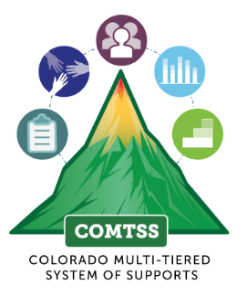
What components of MTSS does the READ Act support?
Colorado READ Act
READ plans for students identified with an SRD based on interim and diagnostic data and a body of evidence
Responsibilities outlined for CDE, local districts, school leaders and teachers
Approved core, intervention and supplemental programs and assessments; Required plan of intervention for students with an SRD
READ plans designed with family support
Continuous progress updates; end of year parent meeting
Approved interim literacy assessments required for all K-3 students; diagnostic assessments for students at risk
Team Driven Shared Leadership
Comprehensive Screening and Assessment Systems
Data-Based Problem Solving and Decision Making
Layered Continuum of Supports
Family, School, and Community Partnerships
Notes:
What components of MTSS does the READ Act support?
This slide provides an overall summary of what has been discussed in this presentation: how the READ Act addresses each of the components of MTSS to support a strong framework for success in reading.

Slide 38
How does the READ Act support Tier 1 Literacy Instruction in an MTSS Framework?
Interim literacy assessment given to ALL K-3 Students
Scientifically and Evidence-based core literacy programming
Minimum competencies for K-3 literacy outlined in READ Act Rule
Training for teachers/administrators in SOR
Establishes attributes of universal instruction for literacy

Slide 39
How does the READ Act support Tiers 2 and 3 Literacy Instruction in an MTSS Framework?
Approved diagnostic assessment for all students at risk of having an SRD
Requires a Plan of intervention (READ Plan) is initiated and services implemented for students identified with an SRD
Establishes attributes of intervention instruction for literacy
Approved SB/EB intervention programming
Ongoing progress monitoring requirement
Parent involvement and communication requirement
Increased support in second year if still SRD
Requires students below grade level but not SRD to be supported through MTSS

Slide 40
Resources and Contact Information
Christina Kirchhof, COMTSS Specialist - Kirchhof_c@cde.state.co.us
Office of Learning Supports – COMTSS@cde.state.co.us
COMTSS homepage and Practice Profiles
COMTSS Resources
Online Academy

