Slide 1
Oral Language
CDE Science of Reading Literacy Series
Turn and Talk Routine
Notes:
Speaker Notes:
Welcome to the Science of Reading professional development series brought to you by the Colorado Department of Education Elementary Literacy and School Readiness office. This lab session focused on implementing a turn and talk routine to support oral language development.

Slide 2
Preparing for this Session
For this session, participants will need:
Writing utensils
Additional Support Materials (optional):
Leader Look-Fors - Oral Language
Features of Effective Instruction Checklist

Slide 3
Introduction
Notes:
This lab session is designed to provide teachers and administrators with foundational knowledge in implementing a turn and talk routine to support oral language development. This session is designed as a turnkey presentation that a teacher leader or administrator can present to staff and then follow up with the implementation progress in subsequent observations and meetings.

Slide 4
Objectives
Understand the foundational knowledge for high-impact oral language instruction
Engage in academic discourse on evidence-based instructional considerations
Incorporate a turn and talk routine through modeling and practice
Determine personalized next steps for implementation
Notes:
During this session, participants will
Understand the foundational knowledge for high-impact oral language instruction
Engage in academic discourse on evidence-based instructional considerations
Incorporate a turn and talk routine through modeling and practice
Determine personalized next steps for implementation

Slide 5
Key Terminology
Oral Language
The ability to produce and comprehend spoken language, including vocabulary and grammar (CCR 301-92, 2.23).
Interpretive or Receptive Communication
This type of communication includes listening, reading, and viewing (WIDA, 2020).
Expressive Communication
This type of communication includes speaking (or signing), writing, and representing (WIDA, 2020).
Recasting
Recasting is a strategy that is used to provide corrective feedback. It supports language development by clearly modeling language for a child or student by expanding upon what the child or student has said (e.g., Student says: crayon / Recast: You want the red crayon.)
Notes:
References
Birsh, J. R. & Carreker, S. (2018). Multisensory teaching of basic language skills (4th ed.). Baltimore, MD: Brookes Publishing Co.
Cleave, P. L., Becker, S. D., Curran, M. K., Van Horne, A. J., & Fey, M. E. (2015). The efficacy of recasts in Language intervention: A systematic review and meta-analysis. American Journal of Speech-Language Pathology, 24(2), 237–255. https://doi.org/10.1044/2015_ajslp-14-0105
Colorado State Board of Education. Rules for the Administration of the Colorado Reading to Ensure Academic Development Act (READ act). 1 CCR 301-92, March, 2020.
Ehri, Linnea C. (2014) “Orthographic mapping in the acquisition of sight word reading, spelling memory, and vocabulary learning.” Scientific Studies of Reading, 18:1, 5-21.
International Dyslexia Association. https://dyslexiaida.org/definition-of-dyslexia/
Kilpatrick, D. A. (2015). Essentials of assessing, preventing and overcoming reading difficulties. Hoboken, NJ: Wiley.
Sedita, Joan. (2019). Keys to beginning reading teacher training manual. Rowley, MA: Keys to Literacy.
Roth FP, Speece DL, Cooper DH, De La Paz S (1996) Unresolved Mysteries: How do Metalinguistic and Narrative Skills Connect with Early Reading? The Journal of Special Education 30: 257–277. [Google Scholar]
Moats, L.C. (2020). Speech to Print Workbook: Language Exercises for Teachers (3rd ed.). Baltimore, MD: Brookes Publishing Co.
WIDA. (2020). WIDA English language development standards framework, 2020 edition: Kindergarten–grade 12. Board of Regents of the University of Wisconsin System.
“What Is the Science of Reading.” The Reading League, 8 Apr. 2022, https://www.thereadingleague.org/what-is-the-science-of-reading/.
* Definitions obtained from READ act rules from the State Board of Education

Slide 6
Scientifically Based & Evidence-Based
Scarborough’s Reading Rope
Language Comprehension
Reading Comprehension
Word
Recognition
Notes:
In what should now be a familiar model, Scarborough’s Reading Rope (2001) demonstrates how the subskills that comprise word recognition and language comprehension work in tandem and allow students to read fluently and coordinate automatic word recognition with text comprehension.
Notice that vocabulary knowledge is one of the five strands of language comprehension. Language comprehension skills begin to develop from the moment a child is born and continue to develop while a child acquires the skills needed for automatic word recognition.

Slide 7
Warm Up
What structures do you currently use to facilitate oral language development?
Notes:
Discussion –
What structures do you currently use to facilitate oral language development?

Slide 8
Setting the Foundation
Notes:
This is a review of essential elements necessary for providing quality explicit oral language instruction.

Slide 9
Neurolinguistic Development
Oral language is the foundation from which literacy skills emerge. The progression of oral language can be sorted into four fixed, overlapping, sequential phases (Locke, 1997).
Phase I:
Prelinguistic Stage
Birth – 6 months
Phase II:
Utterance Acquisition and Storage- Holophrases
5 months – 20 months
Phase III:
Syntax, Morphology, Phonology, and Pragmatics
18 – 20 months
Phase IV:
Integration & Elaboration
Begins during the first 5 years of life, progressively
building in complexity
Notes:
Oral language is the foundation from which literacy skills emerge. Reading, writing, listening, and speaking are integral parts of language development.
Phase I
Infants are learning the sounds of speech and vocal characteristics of caregivers. In return, infants learn to mimic prosody, communicate through expression and gestures, and attempt a variety of phonetic patterns.
Phase II
Beginning as early as 5 months, babies begin storing single words and 2-3 word holophrases, such as “shoesnsocks” or “gotabed” in their prosodic memory. These utterances that are being stored provide a bank of material that infants later learn to parse into syllables and phonemes. This phase is critical for utterance acquisition and storage. During this phase, the right hemisphere of the brain is very active and is being primed for children to transition to metalinguistic processing.
Phase III
At this stage, children begin discovering some regular patterns in our language. This phase builds upon phase II and we see more involvement of the left hemisphere of the brain. Children begin to learn how to build phrases with word parts and how to divide phrases into words. Typical growth estimates that children acquire about 400 expressive words during this phase and are able to apply meaning to these words. Children become more aware of phonemes that carry meaning, such as a plural –s or –es. They begin to play and experiment with our sound system, including rhymes, jargon, and word strings. These basic understandings continually develop into more complex application of language awareness.
Phase IV
This phase of language development gradually builds from the previous three to children being able to structurally analyze spoken and written words in our language. This is the phase where the child’s lexicon increases substantially and where word memory is not the only method in which children acquire and use new language. We see more complex development with all layers of oral language, which prepares children for the more difficult writing phase in the language continuum.
Oral language continues to develop in tandem with each component of the five components of reading: phonemic awareness, phonics, fluency, vocabulary, and comprehension. Skill progression of oral language is specific to each of these literacy components. It is important for educators to understand how oral language develops through “well-integrated knowledge of the form, content, and use of the language” (Soifer, 2022).

Slide 10
Oral Language
“There is no hierarchy among languages, only context. All language is equally valid and vital to the human experience” (Medina, 2023).
Social Language
Informal
Language heard when students are working together (e.g., What’s that?)
Situational
Academic Language
Formal
Tends to sound like how we write
Not situational
Cavazos (2022)
Notes:
Oral language includes both the social language we hear students using throughout the day as well as the academic language used during different content areas. Since language is used for “different purposes in different situations” (Bloom & Lahey, 1978) there is no hierarchy of language. Both social and academic language serve distinct purposes based on the audience (listener) and the speaker.
When we think about social language, it’s more informal and can be situational. For example, you might hear a group of students who are working together say things like: What’s that? It’s not necessarily clear what the students are talking about unless you are present and understand what’s happening in the situation.
Oftentimes the expressive language students use when interacting socially is incomplete…
Conversely, academic language is more formal, and it often sounds like the language we use to write. It isn’t situational, meaning you don’t have to be listening into someone's conversation to understand what they are talking about. For example, you might overhear a student saying something like “A prefix is placed at the beginning of a base word or root.” You can understand what the student is talking about without having to be present during the actual conversation.
To support language development at school, we can create lesson plans that focus on content and language. To learn new content, students need access to the academic language being used both within and across subject areas. For Multilingual Learners this also includes making specific cross-linguistic connections that promote the transfer of language.

Slide 11
It is important to limit unnecessary teacher talk, facilitate a classroom environment that supports classroom discussion, and ensure that students are engaged, included, and appropriately challenged throughout the school day.
“Whoever is doing the talking is doing the learning.” – Jen York-Barr
Teachers talk for
70 – 80% of class time on average.
(Hattie, 2012)
John Hattie conducted a meta-analysis and discovered that classroom discussions are a powerful way to improve instruction with an effect size of 0.82. (Fisher, Frey & Hattie, 2016).
Notes:
“Whoever is doing the talking is doing the learning.” This quote by Jen York-Barr is notable for this focus on oral language development. John Hattie did a meta-analysis for educational practices and discovered that, on average, teachers talk for 70-80% of class time. He also found that classroom discussions have an effect size of .82 and an effect size greater than .4 has been found to accelerate student learning (Hattie, 2012).
It is important to limit unnecessary teacher talk, facilitate a classroom environment that supports classroom discussion, and ensure that students are engaged, included, and appropriately challenged throughout the school day.
This may require a mindset shift for teachers to move away from unnecessary narratives, asking questions that limit conversation, and compliance statements to being more of a facilitator that asks open ended questions, allows think time, and provides space for students to communicate effectively throughout the learning process.

Slide 12
Turn and Talk Routine
The turn and talk routine incorporates the use of a short prompt to discuss a topic or practice a skill.
Students are directed to have a brief conversation with a partner using appropriate roles and turn-taking.
The turn and talk routine is an effective, high-utility instructional routine that can be used at any grade level and within any content area.
Notes:
The turn and talk routine incorporates the use of a short prompt to discuss a topic or practice a skill. Students are directed to have a brief conversation with a partner using appropriate roles and turn-taking. The turn and talk routine is an effective, high-utility routine that can be used at any grade level and within any content area.

Slide 13
Preparing for Instruction
Notes:
In this section, we will break down the components of the Turn and Talk Routine and provide tips for preparation and implementation.

Slide 14
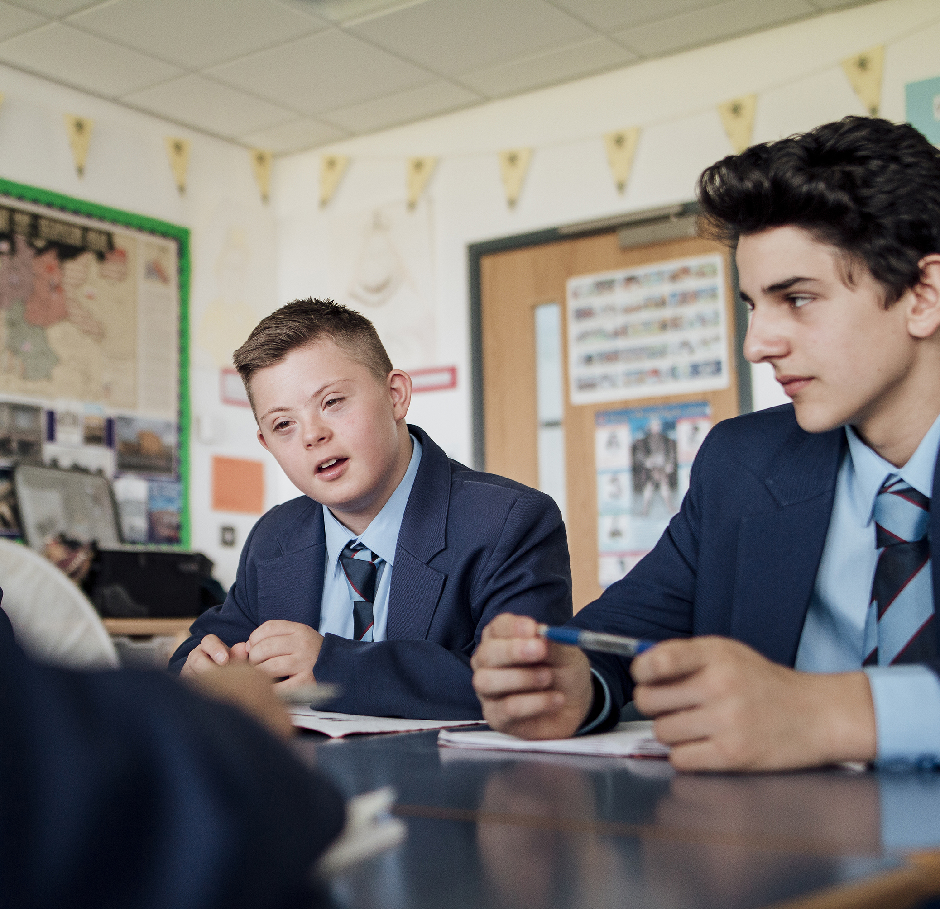
Setting Expectations
When you turn and talk to a partner:
• Tell your partner your response to the prompt in one to two sentences.
• Listen without interrupting while your partner shares their response.
• Be kind and supportive so everyone feels comfortable sharing their responses.
Notes:
Instruction should start with modeling to show students what the turn and talk routine looks and sounds like.
When you turn and talk to a partner, remember to…
• Tell your partner your response to the prompt in one to two sentences.
• Listen without interrupting while your partner shares their response.
• Be kind and supportive so everyone feels comfortable sharing their responses.
After teacher modeling, students will be able to use the turn and talk routine with a small amount of teacher support.
Eventually, the teacher can prompt students to complete the turn-and-talk routine independently.
Work Cited:
Stewart, A. A., & Swanson, E. (2019). Turn and talk: An evidence-based practice. Teacher’s guide. Austin, TX: The Meadows Center for Preventing Educational Risk.

Slide 15
Pairing Students
Consider partnerships that will be respectful and mutually beneficial.
Pair struggling learners with students who are supportive.
Pair less proficient English language learners with more proficient English language learners.
Notes:
When pairing students, it is important to consider partnerships that will be respectful and mutually beneficial.
Pair struggling learners next to students who are supportive and pair less proficient English language learners next to more proficient English language learners.
Work Cited:
Stewart, A. A., & Swanson, E. (2019). Turn and talk: An evidence-based practice. Teacher’s guide. Austin, TX: The Meadows Center for Preventing Educational Risk.

Slide 16
Plan Explicitly
When implementing a turn and talk routine, it is important to model procedures, especially for young students.
Plan for implementation by considering the following:
How to sit and face partner
Who will be partner 1 and partner 2
Navigating talk time
Active listening protocols
Notes:
When implementing a turn and talk routine, it is important to model procedures, especially for young students.
Plan for implementation by considering the following:
how to sit and face partner (e.g. sit side by side and turn your face to talk and listen, sit crisscross on the floor facing each other with knees touching, sit at desks next to each other and turn to face your partner)
who will be partner 1 and partner 2 (e.g. pairing cards, partner chart, number off procedure)
navigating talk time (e.g. setting a timer, consider limiting or challenging students with the number of sentences for each partner, and check in to review expectations prior to the practice with students who tend to dominate the conversation)
active listening protocols (e.g. call on partners to share what their partner said with permission, check in with a few pairs during the practice, have students fill out an exit ticket sharing what was discussed)

Slide 17
Features of Effective Instruction
Turn and Talk Routine
Explicit – clear explanations, teacher modeling, student practice
Engaging – motivating, multisensory, and snappy pace to keep interest
Repetition - Ensure students have many opportunities to think, speak and engage with each other in meaningful contexts
Notes:
Here are the features of effective instruction as it relates to oral language and vocabulary instruction.
Instruction should be explicit with clear explanations, teacher modeling, and ample opportunities for student practice.
Instruction should be engaging, motivating the students with multisensory supports, and snappy pace to keep interest.
The duration of oral language instruction should ensure that students have many opportunities to think, speak, and engage with each other in meaningful contexts.

Slide 18
Turn and Talk Instructional Routine
1. Provide a Prompt
2. First Partner Responds
3. Second Partner Responds
4. Share and Extend
Notes:
The turn and talk routine consists of four basic steps.
1. The teacher provides students with a brief prompt or question.
2. The first student verbally answers the prompt while the second student listens.
3. The roles are reversed, and the second student answers the prompt while the first student listens.
4. Students participate in a whole class discussion where the teacher facilitates clarifying responses and extending the conversation.

Slide 19
Step 1: Provide a Prompt
Turn and Talk Routine
What is your favorite ________?
Begin with simple, concise prompts and build into more complex prompts as students progress.
We have been learning about _________________.
We know that it means ______________________.
Now let’s think of examples ______________ in your life.
Turn to your partner and answer this question:
What is one example of _______________?
Notes:
Prompts can have a variety of purposes, including the following:
• Applying content to students’ lives, creating meaningful connections
• Practicing a discrete skill, such as explaining text evidence to support an argument
• Brainstorming to access background knowledge
• Answering a question related to key content
Begin with simple prompts and build into more complex prompts as students become comfortable with the procedures and flow of the routine. The turn and talk routine can be used in combination with the explicit vocabulary routine to maximize this time.
As we go through this presentation, we will start by modeling with this simple prompt to support with initial implementation and then we will walk through the more complex prompt shown on this slide.
In the classroom, the teacher would be explicit in the partner pairing process and clearly state who is partner 1 and who is partner 2 in each pairing. This can be done by strategically providing pairing cards or by asking partner 1 to raise their hand, then partner 2 to confirm after you have set up partners.
Share examples
Sample Simple Prompt: What is your favorite _________?
Sample Complex Prompt: We have been learning about ___________________. We know that it means _____________________. Now let’s think of examples ______________ in your life. Turn to your partner and answer this question: What is one example of _______________?

Slide 20
Step 2: First Partner Responds
Turn and Talk Routine
Sample Introductory Prompt:
What is your favorite animal?
Sentence Stem:
My favorite animal is _______ because ___________.
My favorite animal is a panda bear because it is black and white, funny, and eats a lot.
Partner 1 will respond while Partner 2 listens without interrupting.
Incorporate sentence stems to build oral language development and strengthen discussion skills.
Notes:
Partner 1 will respond while Partner 2 listens without interrupting.
Incorporate sentence stems to build oral language development and strengthen discussion skills.

Slide 21
Step 3: Second Partner Responds
Turn and Talk Routine
My favorite animal is a clownfish. I like it because it is orange and lives in a coral reef.
After the first partner has responded to the prompt, the second partner can respond.
Once the second partner responds to the prompt, the students can engage in further conversation about the prompt by asking more questions and providing additional details.
Notes:
After the first partner has responded to the prompt, the second partner can respond.
Once they respond to the prompt, the students can engage in further conversation about the prompt by asking more questions and providing additional details.

Slide 22
Step 4: Share and Extend
Turn and Talk Routine
Ask a few pairs to share what they discussed during this time.
Provide feedback by naming one or two things that you noticed students did well.
Take the opportunity to share and extend the discussion and vocabulary usage.
Notes:
Ask a few pairs to share what they discussed during this time. Provide feedback by naming one or two things that you noticed students did well. This is an opportunity to recast what students are saying and expand their oral language development. Take the opportunity to share and extend the discussion and vocabulary usage.

Slide 23
Instructional Routine Look Fors
The teacher models use of academic language and elevated “teacher talk.”
The time the teacher talks is minimized to allow for student response/conversation within a lesson.
The teacher asks questions throughout instruction that allow students opportunities for oral response.
The teacher provides opportunities for students to engage in discussions that include multiple exchanges (teacher/student, student/student).
The teacher encourages students to speak in complete sentences and explain or elaborate their thinking.
The teacher provides opportunities for students to utilize “talk moves” to extend, expand, or make connections during discussions.
The teacher models recasting, rephrasing, or repeating what students say to enrich oral language exchanges.
The teacher provides sentence stems for scaffolding oral language.
The teacher pairs or groups students appropriately for discussions.
Notes:
Here is a checklist to keep in mind when providing or observing oral language instruction. This list is also located in the oral language leader look fors tool. This list can be used to guide grade level meetings to track implementation progress. This list can also be used to support coaching conversations and corrective feedback after administrator walkthroughs.

Slide 24
Modeling Instruction
Notes:
In this section, we will model each component of the turn and talk routine and provide support for scaffolding and differentiation.

Slide 25
Step 1: Provide a Prompt
“We have been learning about habitats.
We know that it means the natural home or environment of an animal, plant, or another living thing.
Now let’s think of examples of habitats.
Turn to your partner and answer this question:
What is an example of a habitat?”
Possible Sentence Stem:
“An example of a habitat for a __________ is ____________.”
Notes:
Now we will practice together.
We have been learning about ___________________. We know that it means _____________________.
Now let’s think of examples ______________ in your life. Turn to your partner and answer this question: What is one example of _______________?

Slide 26
Step 2 & 3 : Partner Responses
“Partner 1, you will respond first. Then, Partner 2, you can answer”.
Partner 1 Sample Response:
“An example of a habitat for a clownfish is in a coral reef. The reef has anemones where the clownfish can live and hide from predators.”
Partner 2 Sample Response:
“Thank you for sharing! An example of a habitat for a panda bear is a forest with lots of bamboo to eat. Pandas can’t live without bamboo! ”
Notes:
Restate the procedure after providing the prompt.
“Partner 1, you will respond first. Then, Partner 2, you can answer”.
Provide sentence stem again to scaffold.
Once both students have a chance to respond to the prompt, students can take additional time to ask clarifying questions or extend the conversation about the topics presented.

Slide 27
Step 4: Share and Extend
“When you shared about the panda’s habitat, it was so interesting that you explained that the panda would not be able to live in a habitat without bamboo.
Pandas do rely on bamboo to survive. Bamboo makes up 99% of their diet!”
Notes:
Ask a few pairs to share what they discussed. I liked several things about your discussions. Name one or two things that you noticed students did well.
Extend the learning by expanding understanding of what was shared and providing modeling of new vocabulary.

Slide 28
Scaffolding and Differentiation
Visual supports
Prepare in advance and provide sentence stems
Add on to sentence stems to extend conversations
Provide closed questions for more simple responses when introducing this routine
Encourage elaboration as students progress
Model additional procedures to support active listening and turn-taking
Notes:
The turn and talk routine contains a variety of scaffolds that naturally support all learners. When providing differentiation for your students, consider how the inclusion or exclusion of specific scaffolds may impact learners.
Scaffolding and differentiation can include:
Visual supports
Prepare in advance and provide sentence stems
Add on to sentence stems to extend conversations (ex: What is your favorite color and what is something that is that color?)
Provide closed questions for more simple responses when introducing this routine, then encouraging open questions and elaboration as students progress
Model additional procedures to support active listening and turn-taking

Slide 29
Practice
Notes:
In this section, we will provide time for you to plan and practice the turn and talk routine.

Slide 30
Interactive Activity
Partner Practice
Plan with your grade level teams or colleagues
Practice the routine with adjustments for your classroom
1. Provide a Prompt
2. First Partner Responds
3. Second Partner Responds
Clear up any misconceptions
Create a plan for implementation
Share feedback based on materials and practice
4. Share and Extend
Notes:
Facilitator Notes:
This is your opportunity to facilitate the practice with your participants.
Depending on whether you are presenting this session in person or virtually, it is important to provide time to practice.
During this time, participants can create or adjust their current lesson plans to ensure that they are teaching oral language appropriately with their existing curriculum materials.
The time can also be used to practice the turn and talk routine with colleagues.

Slide 31
Implementation Considerations
Let’s take a few minutes to discuss how you will implement this routine in your classroom.
Consider:
Existing oral language and vocabulary routines
Cross-curricular application
Corrective feedback
Opportunities for review
Extensions and connection
Notes:
Let’s take a few minutes to discuss how you will implement this routine in your classroom.
Consider:
Existing oral language and vocabulary routines
Cross-curricular application
Corrective feedback
Opportunities for review
Extensions and connection
Facilitator Notes:
This is the time to review expectations and discuss any roadblocks or plans for implementation. As a READ lead or administrator, you will want to tailor this discussion to include what is expected during walkthroughs and on lesson plans.

Slide 32
Debrief
After practicing this turn and talk routine,
what questions do you still have?
Notes:
After practicing this routine, what questions do you still have?

Slide 33
Next Steps
Notes:
Now, let’s discuss next steps for implementation.

Slide 34
Looking Ahead
Take a minute and think about all that you learned during this session.
Write down what you plan to do with the information you learned today during this session and how it will impact your students learning.
How will you include this turn and talk routine in your daily lessons?
What will this look like when an administrator does a walkthrough?
Notes:
Take a minute and think about all that you learned during this session.
Write down what you plan to do with the information you learned today during this session and how it will impact your students learning.
How will you include this turn and talk routine in your daily lessons?
What will this look like when an administrator does a walkthrough?

Slide 35
Adapted from Lippett, M. Model for Complex Change (1987) and Knoster, T., Villa R., & Thousand, J. (2000). A framework for thinking about systems change. Villa, R. & J. Thousand (eds), Restructuring for caring and effective education: piecing the puzzle together (pp. 93-128). Baltimore: Paul H. Brookes Publishing Co.
Vision | +
 | +
Vision | +
Vision | +
Vision | +
Vision | +
Skills | +
Skills | +
 | +
Skills | +
Skills | +
Skills | +
Incentives | +
Incentives | +
Incentives | +
 | +
Incentives | +
Incentives | +
Resources | +
Resources | +
Resources | +
Resources | +
 | +
Resources | +
Action Plan | =
Action Plan | =
Action Plan | =
Action Plan | =
Action Plan | =
 | =
CHANGE
CONFUSION
ANXIETY
RESISTANCE
FRUSTRATION
FALSE STARTS
Notes:
Remember, lasting positive change happens when we have carefully planned for all of the components.
Planning, practicing, and implementing high quality explicit oral language instruction provides a vision for what instruction should look like, gives both teachers and students the skills for success, and informs a plan of action in the classroom, but all pieces are necessary to ensure success.
As a staff, consider:
What components of the change model are in place in your school/district that support improving oral language instruction?
What could be improved upon to ensure success?

Slide 36
Resources

Slide 37
References
Archer, A. L., & Hughes, C.A. (2011). Explicit Instruction. New York, NY: Guilford Press.
Beck, I. L., McKeown, M. G., & Kucan, L. (2013). Bringing words to life: Robust vocabulary instruction.
New York, NY: Guilford Press.
Birsh, J. R. & Carreker, S. (2018). Multisensory teaching of basic language skills (4th ed.). Baltimore, MD: Brookes Publishing Co.
Cleave, P. L., Becker, S. D., Curran, M. K., Van Horne, A. J., & Fey, M. E. (2015). The efficacy of recasts in Language intervention: A systematic review and meta-analysis. American Journal of Speech-Language Pathology, 24(2), 237–255. https://doi.org/10.1044/2015_ajslp-14-0105
Ehri, Linnea C. (2014) “Orthographic mapping in the acquisition of sight word reading, spelling memory, and vocabulary learning.” Scientific Studies of Reading, 18:1, 5-21. International Dyslexia Association. https://dyslexiaida.org/definition-of-dyslexia/
Fisher, D., Frey, N., & Hattie, J. (2016). Visible learning for literacy, grades K-12: implementing the practices that work best to accelerate student learning. Thousand Oaks, California, Corwin/ A SAGE Company.
Gough, P. B. & Tunmer, W.E. (1986). Decoding, reading, and reading disability. Remedial and Special Education, 7(1).
Hattie, J. (2012). Visible Learning for Teachers: Maximizing Impact on Learning. London: Routledge.
Hudson, J. (2018, April 27). 6 easy ways to improve turn & talk for student language development. Children’s Literacy Initiative. https://cli.org/2017/01/04/6-easy-ways-improve-turn-talk-student-language-development/

Slide 38
References
Kilpatrick, D. A. (2015). Essentials of assessing, preventing and overcoming reading difficulties. Hoboken, NJ: Wiley.
Moats, L.C. (2020). Speech to Print Workbook: Language Exercises for Teachers (3rd ed.). Baltimore, MD: Brookes Publishing Co.
National Reading Panel. (2000). Teaching children to read-An evidence-based assessment of the scientific research literature on reading and its implications for reading instruction (NIH Publication No. 00-4769) Washington, DC: National Institutes of Child Health and Human Development.
Roth FP, Speece DL, Cooper DH, De La Paz S (1996) Unresolved Mysteries: How do Metalinguistic and Narrative Skills Connect with Early Reading? The Journal of Special Education 30: 257–277. [Google Scholar]
Scarborough, H. S. (2001). Connecting early language and literacy to later reading disabilities: Evidence, theory, and practice. In S.B. Neuman and D.K. Dickinson (Eds.), Handbook of early literacy research (p. 98) New York, NY: Guilford Press. ​
Sedita, Joan. (2019). Keys to beginning reading teacher training manual. Rowley, MA: Keys to Literacy.
Stewart, A. A., & Swanson, E. (2019). Turn and talk: An evidence-based practice. Teacher’s guide. Austin, TX: The Meadows Center for Preventing Educational Risk.
WIDA. (2020). WIDA English language development standards framework, 2020 edition: Kindergarten–grade 12. Board of Regents of the University of Wisconsin System.

