Slide 1
1241 Task Force
Background on State Accountability September 2023

Slide 2
Responding to Task Force Members’ Questions
Items Covered in this Presentation
How smaller n-sizes are addressed and rationale
Historical review of current accountability system
Accountability system’s theory of action and legislative intent
Comprehensive review of the full accountability and accreditation system
Current PWR Measures
Examination of combined groups
Supports and actions for identified sites (Performance Watch)
Study on trends over time for sites on Performance Watch
Awards and bright spots
Stakeholder processes
Other public reporting
Items to Cover in Other Ways or Other Times
Comprehensive walkthrough of growth model
Connection to educator evaluation
Comprehensive overview of federal requirements
Options for PWR Measures and incentivizing work-based learning
Options for use of K-2 data
How CO’s system compares to other states
Lessons learned about quality programming and student outcomes
Relationship of current system to 1241 TF’s discussion on quality schools
Impacts of framework changes on districts
In-depth walkthrough of turnaround strategies
State assessments (e.g., turnaround times, accommodations)
New frameworks measures under consideration by state board

Slide 3
Table of Contents
State Accountability Overview
Theory of action
History of Colorado’s accountability system
Elements of the State Accountability System
Performance Frameworks
N-Counts
Special Populations (combined groups v. disaggregated groups)
Public Reporting
Improvement Planning
Public Engagement
Supports and Interventions
Accreditation
Awards
Resources and Other Bonus Content
Timelines and resources
Deep dive on PWR indicator
2023 Preliminary Framework Results

Slide 4
Colorado’s Educational Accountability System
Local accountability
Locally elected boards oversee superintendent and district policies
State Accountability
Colorado Educational Accountability Act
Includes Performance Frameworks, Improvement Planning, Accountability Clock, Accreditation Contracts, Accountability Committees
Federal Accountability
Every Student Succeeds Act – State plan approved
Schools on improvement (CS, TS, A-TS)
Aligned state and federal improvement planning and supports
State
Local
ESSA

Slide 5
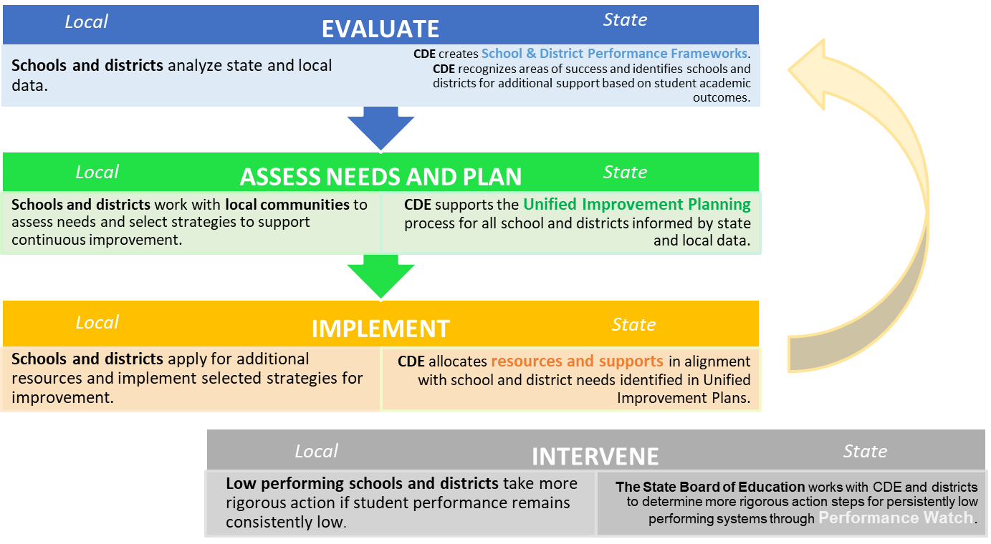
Accountability Theory of Action
See the Legislative Declaration in your handouts
Accreditation

Slide 6
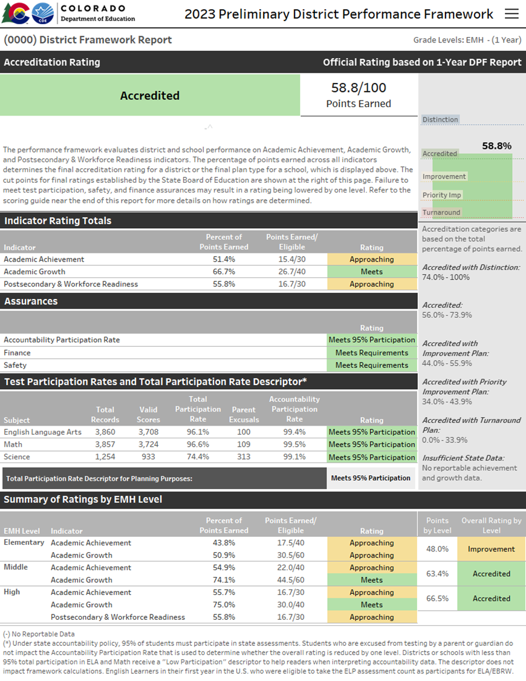
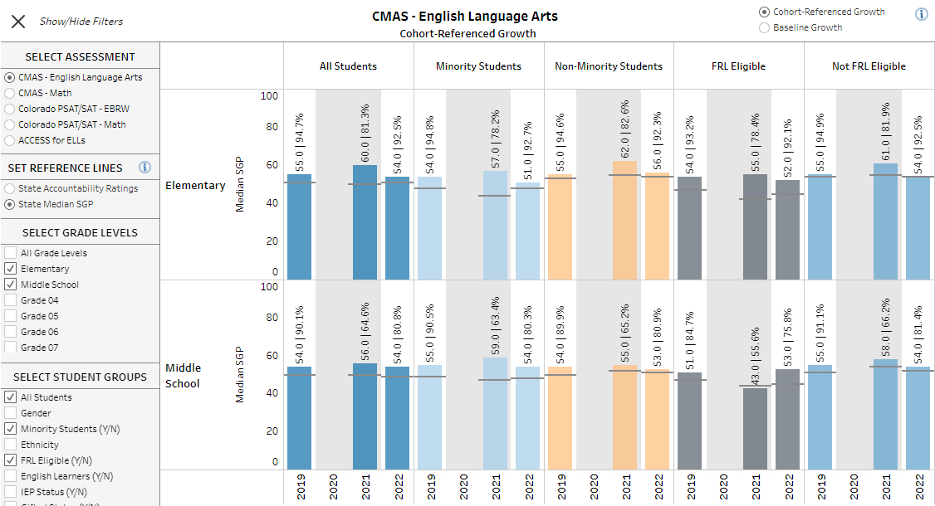
Elements of the Current State Accountability System
Frameworks | Public Reporting
Improvement Planning | Public Engagement
Supports and Interventions | Accreditation
Awards | Anything else?

Slide 7
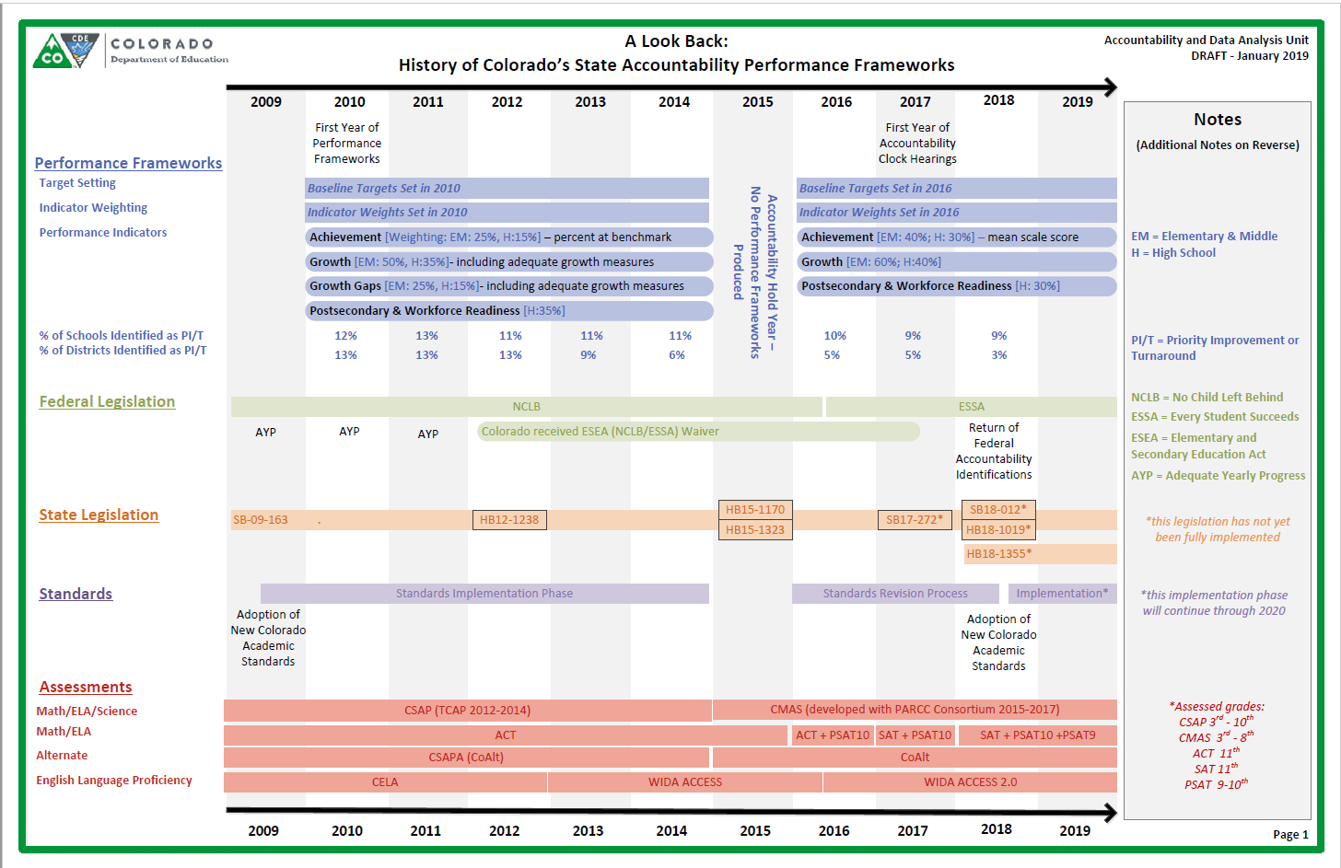
An Historical Review of Colorado’s Accountability System
Look in your folders for an updated version of this resource.

Slide 8
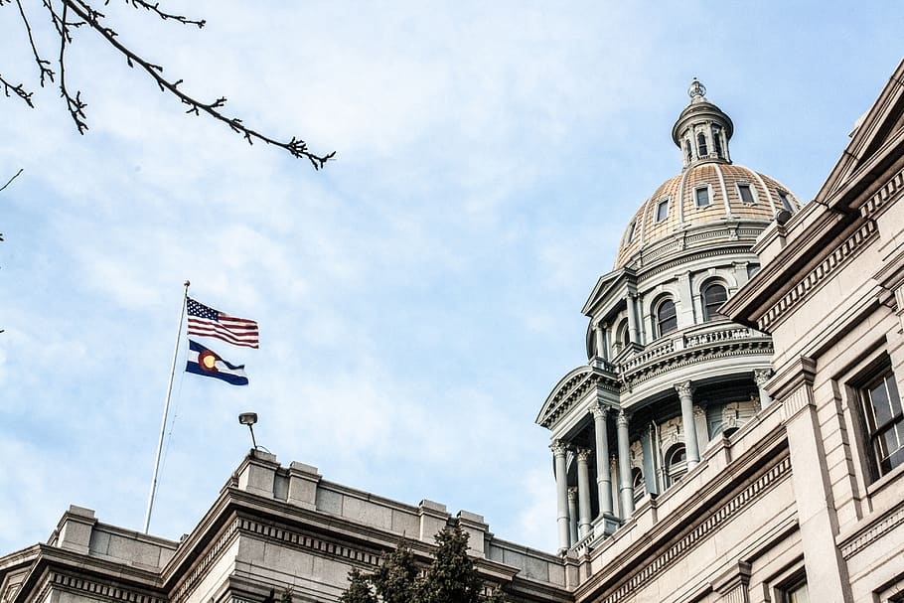
What do we mean by “policy?”
Policy Development Structures | General Description | Examples in Accountability Processes
State Legislature & Governor | Legislature passes statute and Governor signs into law. | SB 09-163 and HB 18-1355: Outlines our current state accountability system
State Board of Education | Board provides additional detail on statute through rule process. | State Board: Sets framework cut scores, adopts plan types, Creates rules (e.g., request to reconsider process, UIP process)
Expert Panels and Stakeholder Groups | Groups are convened to provide advice at different parts of the policy making and implementation. | 1241 Task Force Technical Advisory Panel (TAP) Accountability Work Group (AWG)
CDE Documentation and Guidance | Department provides documentation, logistics and parameters for implementation. Guidance includes requirements and recommendations. | Documentation: Frameworks Calculation Guidebook Guidance: Request to Reconsider Guidance, UIP Handbook

Slide 9
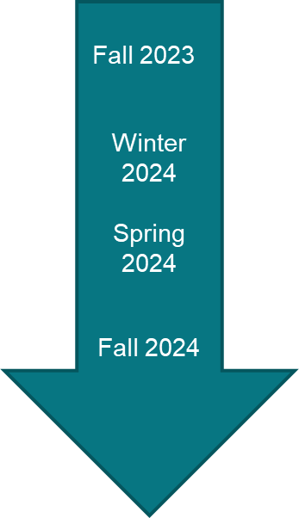
Overarching Accountability Timeline
2023 Frameworks Released
1241 Task Force Begins
2023 Supplemental Framework Report
Interim Report Due
2024 Framework with New Measures for Points
Final Report Due

Slide 10
Elements of the Current State Accountability System
Frameworks
Public Reporting
Improvement Planning
Public Engagement
Supports and Interventions
Accreditation
Awards

Slide 11
Performance Frameworks | Purpose
See your handouts for a copy of the annotated framework
Provides a statewide evaluation of student performance that highlights areas of success and areas for improvement.
Identify those districts and schools whose students are lowest-performing based on academic achievement, growth and postsecondary workforce readiness data, and direct state support and intervention appropriately.
Identify those districts and schools whose students are the highest-performing based on academic achievement, growth and postsecondary and workforce readiness data, recognize them and learn from their practices.

Slide 12
Performance Frameworks | Performance Indicators
Note: SBE is currently reviewing the re-introduction on On Track Growth as a 4th performance indicator.
Performance Indicator | Performance Data
Academic Achievement | Mean scale score English language arts, math, and science assessments Overall and for disaggregated groups
Academic Growth | Median student growth percentile English language arts, mathematics and English language proficiency assessments English language proficiency On Track metric Overall and for disaggregated groups
Postsecondary and Workforce Readiness | SAT – Evidence-Based Reading & Writing and Mathematics Graduation Rate Dropout Rate Matriculation Rate (includes military enlistment) Industry credentials, included in Career and Technical Education and overall matriculation rates calculations Overall and for disaggregated groups (except for Matriculation rate)

Slide 13
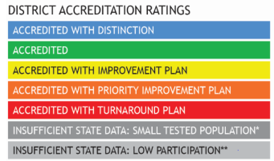
School and District Performance Framework Ratings
Elementary & Middle Schools
Performance Indicator | Weight
Academic Achievement | 40% Elementary & Middle Schools 30% High Schools & Districts
Academic Growth | 60% Elementary & Middle Schools 40% High Schools & Districts
Postsecondary and Workforce Readiness | 30% High Schools & Districts
Ratings
High Schools & Districts

Slide 14
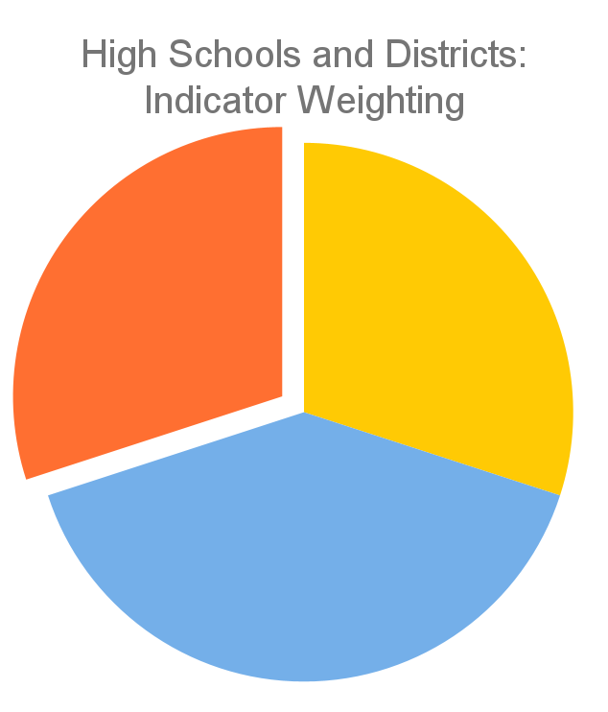
PWR Indicator | Inclusion in the Framework
Only available for high schools and districts
Contributes 30% of the points in determining overall high school or district plan types
Currently consists of five sub-indicators:
SAT Evidence-Based Reading/Writing
SAT Math
Dropout Rates
Matriculation Rates
Graduation Rates
PWR 30%
Achievement
30%
Growth
40%
Current PWR Indicator: Points by Sub-Indicator & Level
SAT EBRW (8 points): Mean Scale Score [All Students (4) & Disaggregated (1 each)]
SAT Math (8 points): Mean Scale Score [All Students (4) & Disaggregated (1 each)]
Dropout (16 points): Rate [All Students (8) & Disaggregated (2 each)]
Matriculation (4 points): Rate [All Students (4)]
Graduation (16 points): Rate [All Students (8) & Disaggregated (2 each)]
Note: SBE is currently reviewing the inclusion of new higher bar sub-indicators

Slide 15
Frameworks Performance Levels and Scoring
https://www.cde.state.co.us/accountability/frameworkscoringguide2023
Performance Level Ratings: Does Not Meet, Approach, Meets, Exceeds,
Sub-indicator cut scores: 15th, 50th and 85th percentiles
Cut scores for rating plan types vary between districts and schools
State board approves annual targets and methodology for new measures

Slide 16
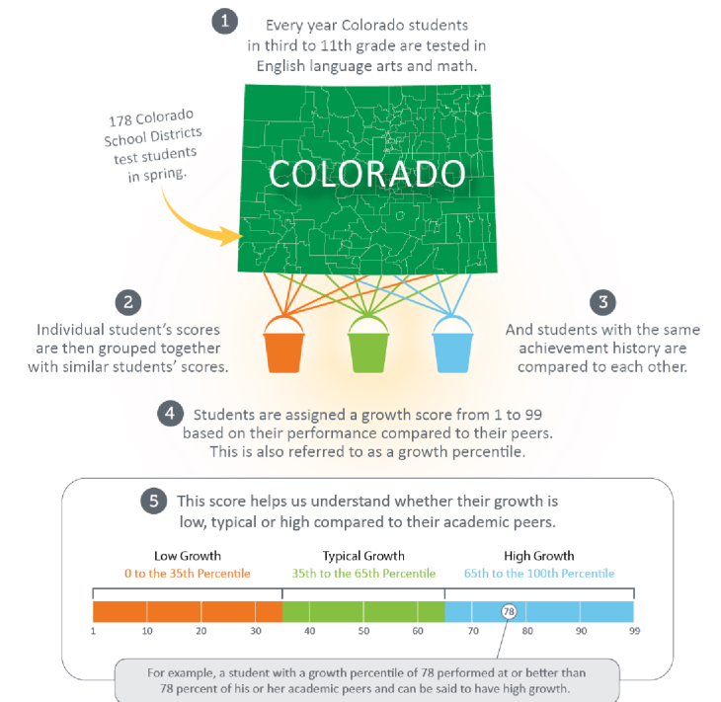
Overview of Colorado’s Growth Model
Visit our Colorado Growth Model webpage
View a pre-recorded walkthrough of the growth model
Parent friendly and technical user resources are available
Let us know what specific questions you have

Slide 17
How CDE Currently Handles Data for Smaller Systems
Current Practices
For publicly reportable data
N of 16 for achievement has been the historical threshold for reporting achievement data.
N of 20 for Growth was based on observed data and what TAP determined to be minimum threshold for reliability with best balance for inclusion.
Calculate a multi-year framework (typically 3 years) to aggregate data over time to generate reports for as many sites as possible.
Created the Insufficient State Data assignment for sites that do not have reportable data for all performance indicators
No tested grades
Small tested population
Limited tested population (e.g., high % of parent excusals)
Related Solutions in Other Parts of Accountability System
Created Secure Data Explorer Tool for districts to analyze state data down to an N of 1.
Created improvement planning guidance on how to still engage in continuous improvement without reporting Personally Identifiable Information.

Slide 18
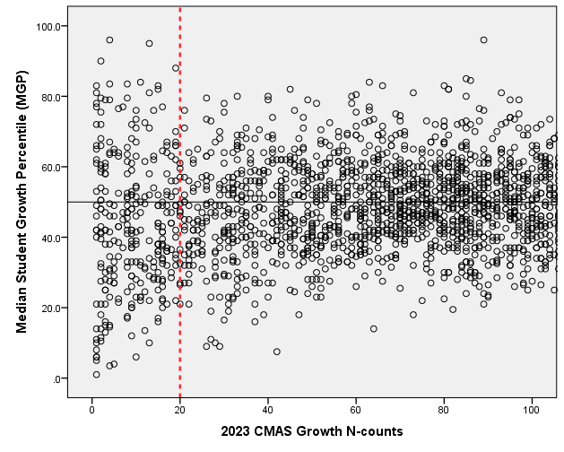
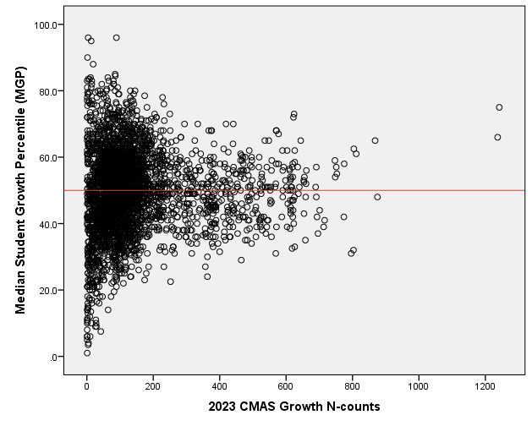
Relationship between 2023 CMAS N-Counts and MGPs
Summary: Minimum N of 20 excludes the extreme high/low values while ensuring most systems will have reportable data.
The n-size used in most state systems varies from as low as 5 to as high as 30. The decision is often influenced by at least three factors: privacy, reliability, and inclusion. The truth is, there isn’t a single right number for any system.
- Chris Domaleski from blog Guidance for Addressing N-size in school accountability and reporting systems

Slide 19
Additional Study on Small N-Counts in Colorado’s Accountability System
Revisiting N Size: Evaluating Outcomes on the School and District Performance Frameworks Relative to N Size (Elena Diaz-Bilello, Center for Assessment, 2012)
Concern was that overall ratings on the frameworks are “biased” against large districts and schools.
Findings illustrate a statistical phenomena that exists as an artifact of n-size, not any form of intentional and/or systemic “bias”
To address concerns related to the observed “funnel” patterns, CDE adopted two mechanisms to help ensure “fairness” related to accreditation ratings:
1. Data is pooled to minimize the increased variability that is associated with smaller systems
2. The Request to Reconsider process allows for additional data to be used for the appeal of low ratings. Similarly, districts reserve the right to have school ratings reduced based on their own professional judgment.

Slide 20
Performance Frameworks | Exploration of a Combined Subgroup
In spring 2016, districts raised concerns that students were being double-counted in multiple disaggregated group sub-indicators
CDE investigated possibilities for changing to use a combined subgroup for framework calculations, but continue to publicly report disaggregated group information
Advocacy and civil rights groups expressed concerns about changing over to a combined subgroup approach
CDE convened a stakeholder meeting to discuss fairness of potential disaggregated group reporting approaches

Slide 21
Performance Frameworks | Description of Combined Group v. Disaggregated Groups
Combined Group | Disaggregated Group
- Students only count once - Addresses perceived “penalty” for serving high need students - Educators care about outcomes for all students, regardless of points | Groups of students have different types of needs Individual groups should be seen Direct attention (people pay attention to the points) Aligns with funding

Slide 22
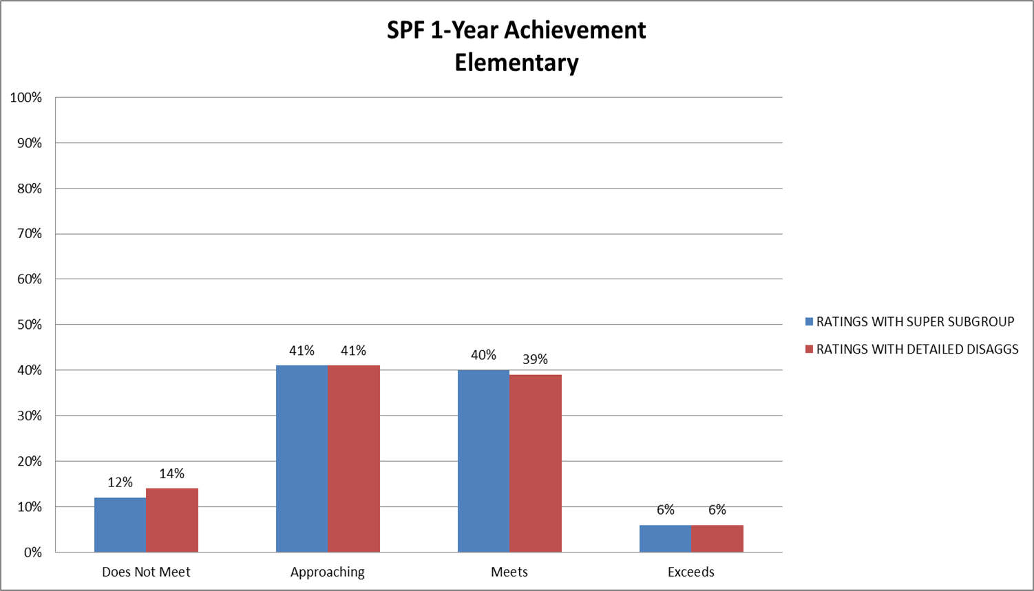
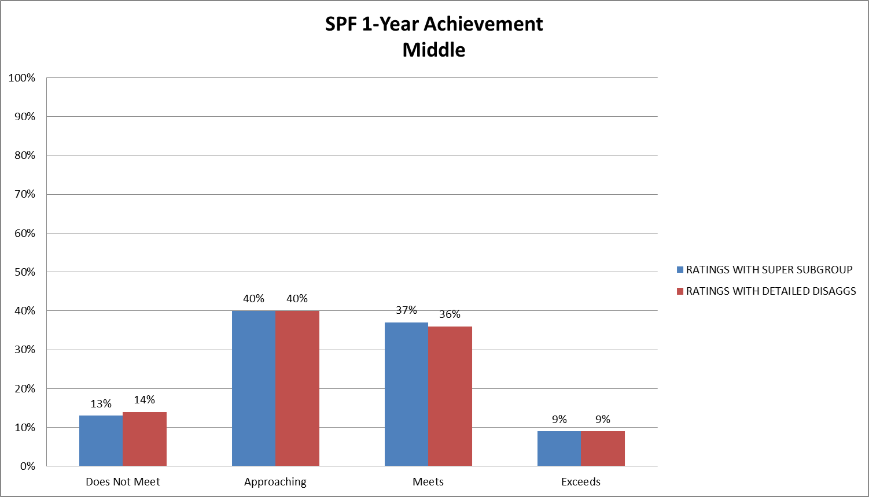
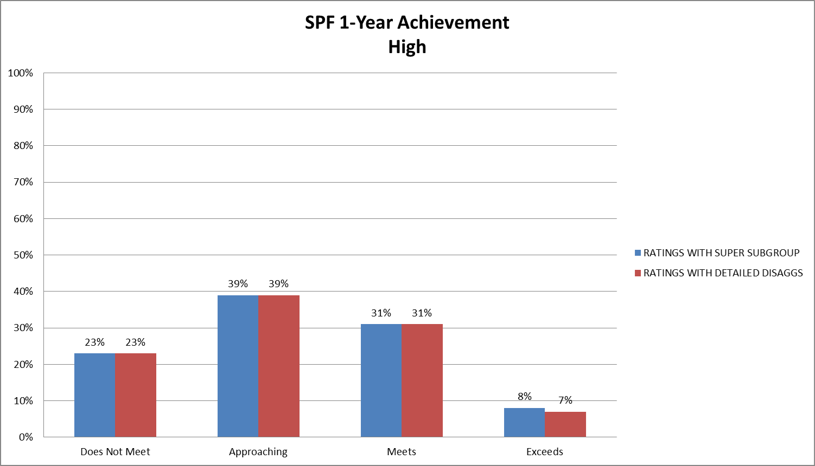
Performance Frameworks | Impact Analysis for Combined Group
Increases the number of schools that meet the minimum n-count required to be held accountable for disaggregated student groups.
Minimal change in achievement indicator ratings compared to individual subgroups.
Maximum 1-2% shifts across all grade levels

Slide 23
Performance Frameworks | Outcomes of the Combined Group Discussion
In June 2016, the state board voted to keep existing disaggregated group structure and not transition to a combined subgroup
Also of note: The U.S. Department of Education would not allow the state to move toward a “combined group” approach. The state was required to keep the disaggregated groups separate in the frameworks and in public reporting. At the time, the state accountability system acted as the federal identification system.

Slide 24
Elements of the Current State Accountability System
Frameworks
Public Reporting
Improvement Planning
Public Engagement
Supports and Interventions
Accreditation
Awards

Slide 25
Performance Tools and Visualizations
Online Frameworks
CDE has launched an interactive version of the frameworks aimed at the public. Users see high levels reports initially and then can dig into accountability data more deeply. There are links to the framework PDF reports, the site’s UIP and the district’s accreditation contract.

Slide 26
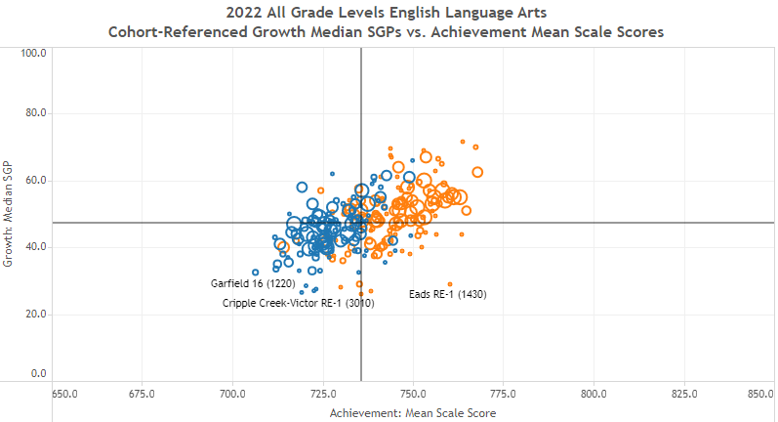
Performance Tools and Visualizations
District and School Dashboard
Data Explorer Tool
Includes updated enrollment, demographics, achievement, growth, and postsecondary visualizations to support improvement planning efforts.
Includes updated achievement, growth, and postsecondary metrics that can also be downloaded into Excel files for additional analysis. Secure tool is located here for smaller systems.

Slide 27
Elements of the Current State Accountability System
Frameworks
Public Reporting
Improvement Planning
Public Engagement
Supports and Interventions
Accreditation
Awards

Slide 28
Multiple Purposes for Improvement Planning
CDE has developed both a process and template to support schools and districts in their performance management efforts.
A mechanism for triggering additional supports through CDE (especially for schools on the accountability clock.
A system to align improvement planning requirements for local, state, and federal accountability into a single plan.
Alignment
Support
Best Practice
Documentation
A common format for schools and districts to document improvement planning efforts. Schools/districts on the accountability clock must demonstrate a coherent plan for dramatic change and adjustments over time. Reviews conducted by CDE and State Review Panel.
A statewide strategy to promote improvement planning based on best practice, including use of state and local data and engagement in a continuous improvement cycle.
Transparency
A process for including multiple voices, including staff, families and community representatives. Plans are posted publicly.

Slide 29
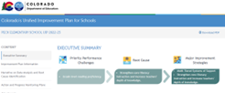
Making Accountability Meaningful
Unified Improvement Planning (UIP)
All schools and districts are expected to engage in improvement planning and submit plans in UIP Online System for public posting.
CDE has coordinated state, federal and grant improvement planning requirements into one place.
UIP process includes:
Identifying and prioritizing needs based upon data
Matching research-based strategies to meet needs
Progress monitoring and adjusting practices
Engaging stakeholders
Focus on universal and targeted supports. Offer resources, virtual and field-based trainings and onsite technical assistance.

Slide 30
Elements of the Current State Accountability System
Frameworks
Public Reporting
Improvement Planning
Public Engagement
Supports and Interventions
Accreditation
Awards

Slide 31
Accountability Committees
All schools and districts are required to have accountability committees. Small districts may combine requirements.
Parents are expected to have the most representation.
Accountability committees are advisory to principals and local boards. They provide recommendations.
Activities include reviewing improvement plans and progress monitoring, reviewing budgets, providing input on various policies (e.g., parent engagement), and other jointly identified areas.

Slide 32
Elements of the Current State Accountability System
Frameworks
Public Reporting
Improvement Planning
Public Engagement
Supports and Interventions
Accreditation
Awards

Slide 33
CDE Support Structure
CDE staff support
Support Leads
Transformation Support Managers
UIP Contacts
ESEA Regional Contacts
EASI Grant
Exploration Support (inc external diagnostic reviews, planning support and stakeholder engagement support)
District Designed and Led
Accountability Pathways Implementation
Turnaround Leadership
Transformation Network
Tailored support for Alternative Education Campuses and Local School Boards that have identified schools
Highlights of State Support System
Driven by state needs assessment
Use Four Domains as organizing structure
District participation is encouraged but voluntary
Distribute supports through tiers (universal, targeted, intensive)
Notes:
LDJ

Slide 34
State Accountability Clock Process
Level of State Intervention
Year 1
Year 4
Year 5
And Beyond
Local Accountability and Transparency
Improvement Planning and Review
Grants and Supports
State Review Panel
State Board Hearing and Order
Ongoing Progress Monitoring

Slide 35
Performance Watch | Overview
PERFORMANCE WATCH
ACCOUNTABILITY CLOCK
On Watch
Priority Improvement or Turnaround
Year 1+
Performance/ Improvement
Year 2+
Sites with State Board Action
Year 5+ and Early Action

Slide 36
Performance Watch | Expectations by Category
N | Criteria | Implications
On Clock | Earned a 2023 Priority Improvement or Turnaround plan type | Communication expectations Additional planning requirements and plan review by CDE Hearing with State Board after five years or progress monitoring if already received state board directed action Eligible for supports and school improvement funds (EASI)
On Watch | Earned a 2023 Improvement or Performance plan type Previously on accountability clock for at least two consecutive years | Plan review by CDE Eligible for supports and school improvement funds (EASI)
On Hold | Received an Insufficient State Data in 2023 Last available plan type was on clock | Communication expectations Additional planning requirements and plan review by CDE Eligible for supports and school improvement funds (EASI)

Slide 37
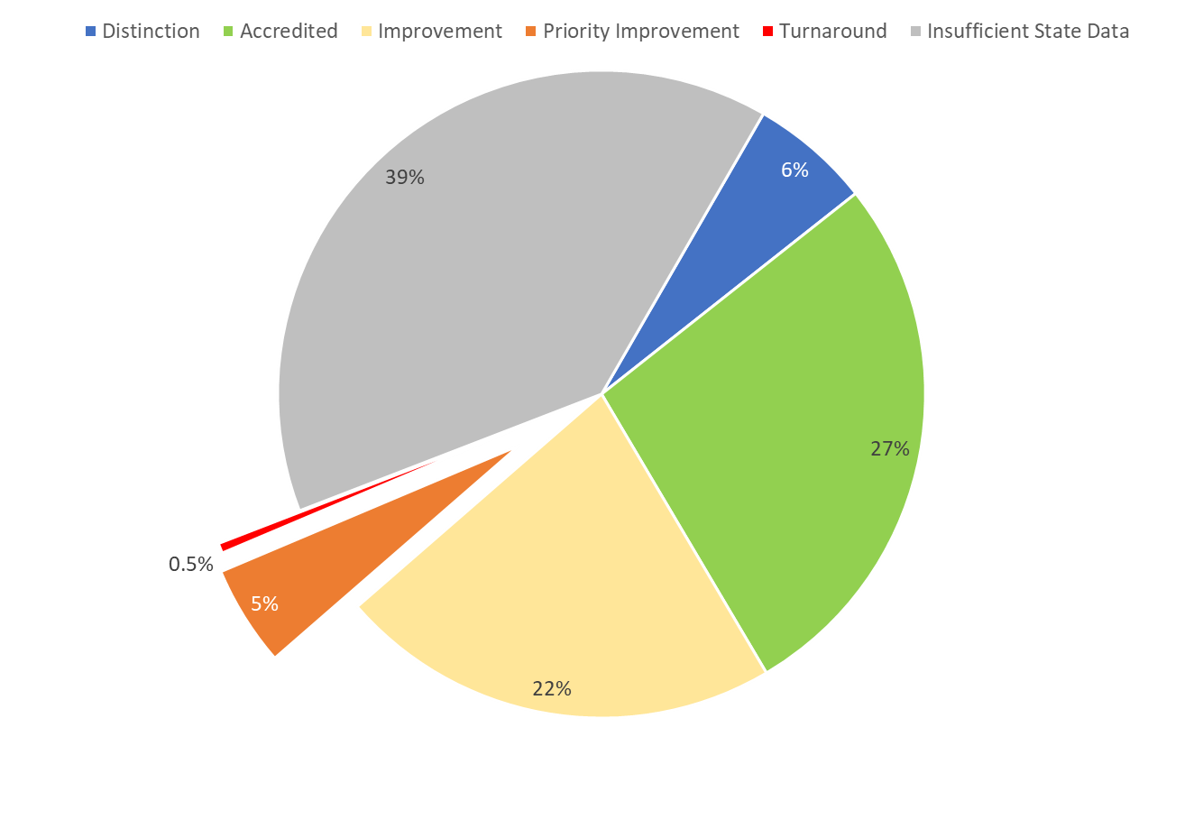
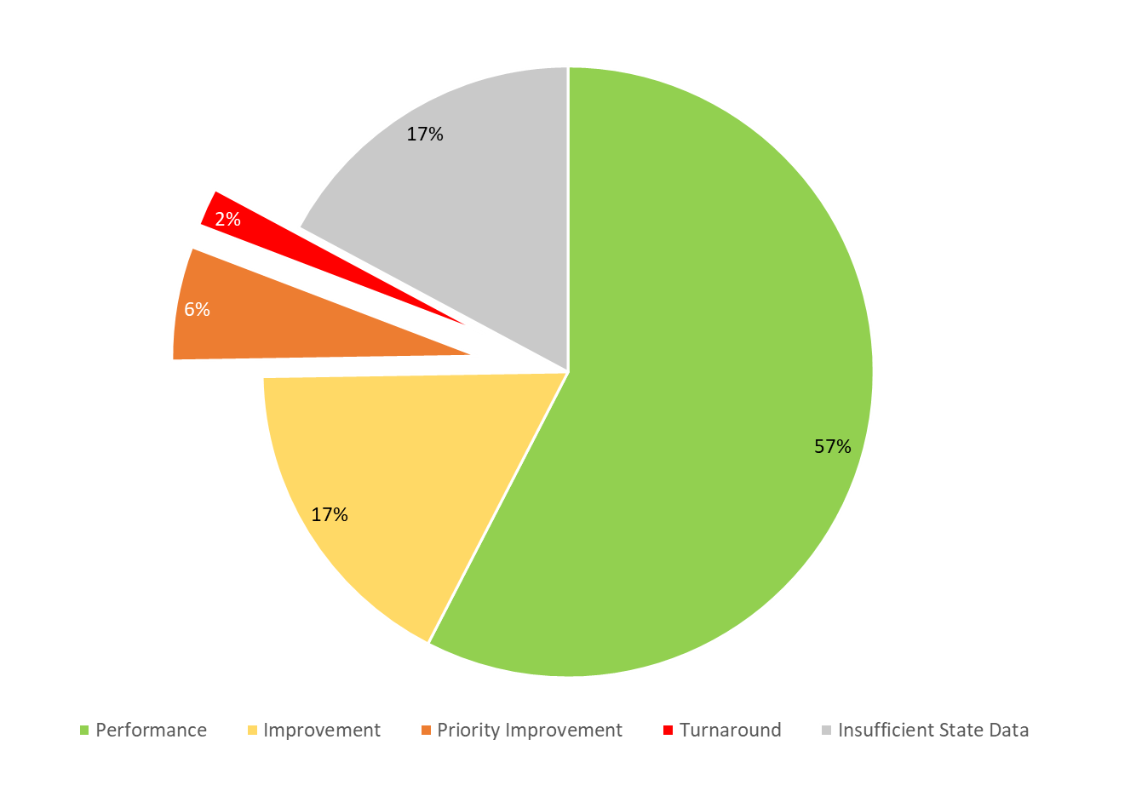
Districts and Schools on Performance Watch in 2022
 | Districts | Schools
# on Performance Watch | 13 | 244
# on Clock (PI, Turnaround) | 11 | 175 (+30 Insufficient State Data)
Year 0 | 7 | 114
Years 1-3 | 3 | 50 (+27 ISD)
Years 4-5 | n/a | 6 (+3 ISD)
Years 6+ | 1 (+ 1 ISD) | 5
# on Watch | 1 | 39 (+6 ISD)
# with an SBE Order (incl. Early Action and On Watch) | 1* | 11
Districts
Schools
* Aguilar (incl. Aguilar Jr./Sr.) does not have an active order but is Year 8 On Watch. Adams 14 is the only school district with an active SBE order.
Notes:
LDJ

Slide 38
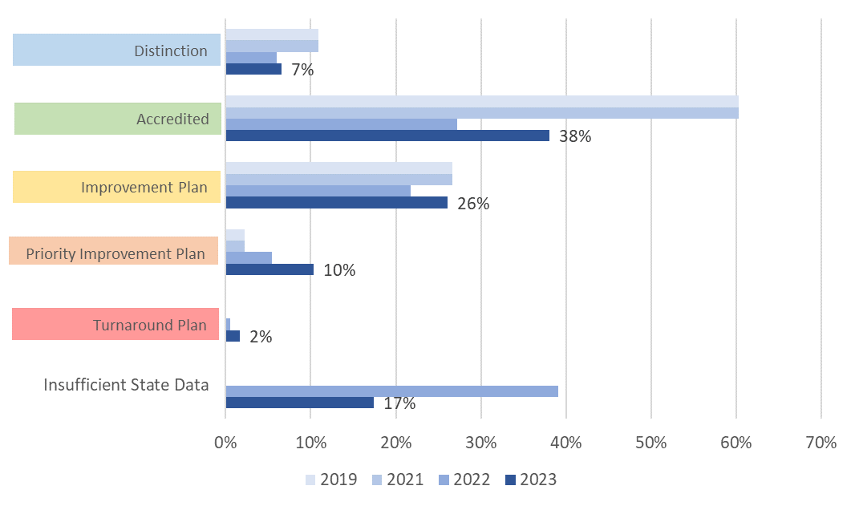
Preliminary District Ratings | Rating Trends Over Time (2019-2023)
Summary: The sharp decrease in ISD ratings compared to 2022 enabled more districts to earn ratings in 2023. More districts at Improvement or higher than in 2022, but not as high as 2019. Higher % on clock deserves further examination.
NOTE: Includes preliminary ratings for 2023 and final ratings for historical data. Frameworks were not calculated in 2020 and 2021; ratings were rolled over from 2019.

Slide 39
Preliminary District Ratings | Performance Watch Comparison Over Time (2019-2023)
Summary: Increase in number of districts on Performance Watch. Most are Year 1 and were decreased due to participation.
Notes:
2020 & 2021 not included because of framework pause
2022 was a transitional year. Year 0 & Year 1 are included in the newly identified.
2019 and 2022 data are based upon final plan types v. 2023 based upon preliminary plan types.
In 2023, 13 of the 19 districts in Y1 were decreased due to participation.

Slide 40
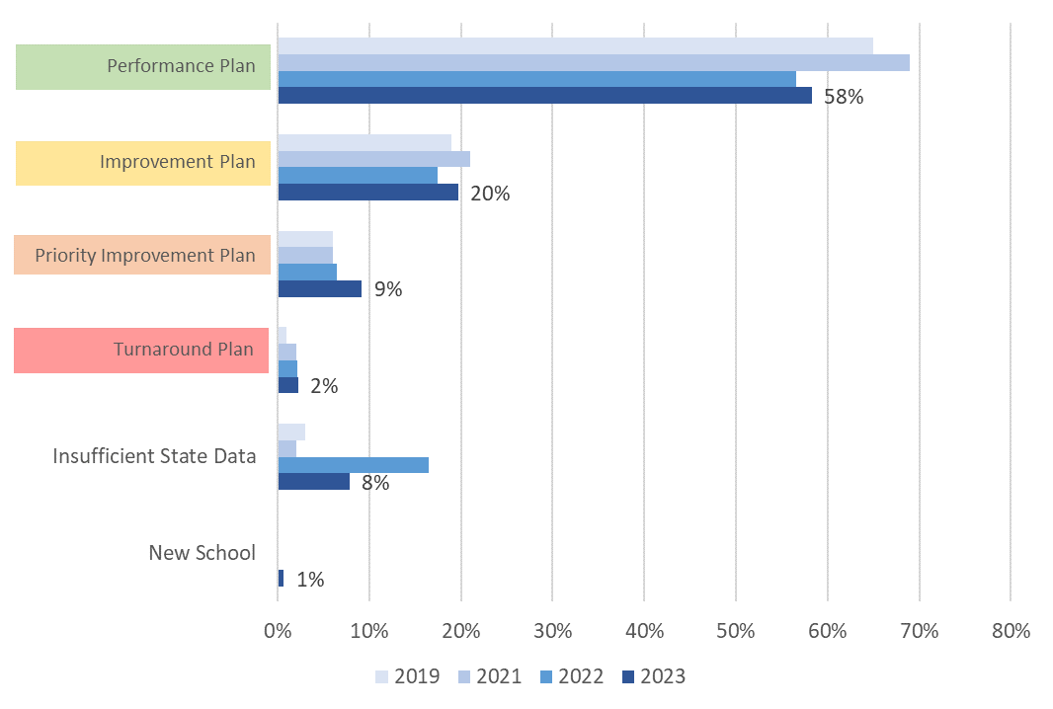
Preliminary School Plan Types | Distribution of Plans Over Time (2019-2023)
Summary: Similar trends as with districts. Decrease in ISD meant more schools earned plan types. Greater % earned Improvement or higher than in 2022 but not as higher as 2019. Higher number on accountability clock.
NOTE: Includes preliminary ratings for 2023 (excludes AECs) and final ratings for historical data. Frameworks were not calculated in 2020 and 2021; ratings were rolled over from 2019.

Slide 41
Preliminary School Plan Types | Performance Watch Over Time (2019-2023)
Summary: Decrease in number of schools on Performance Watch since 2022, but higher than 2019. Greatest number are Year 1 (157). Historically, about 60% of sites in Year 1 exit the clock within a year.
Notes:
2020 & 2021 not included because of framework pause
2022 was a transitional year. Year 0 & Year 1 are included in the newly identified.
2019 and 2022 data are based upon final plan types v. 2023 based upon preliminary plan types.
2023 Data does not yet include 94 AECs.
In 2023, 46 schools on Performance Watch were decreased due to participation; 39 are high schools.

Slide 42
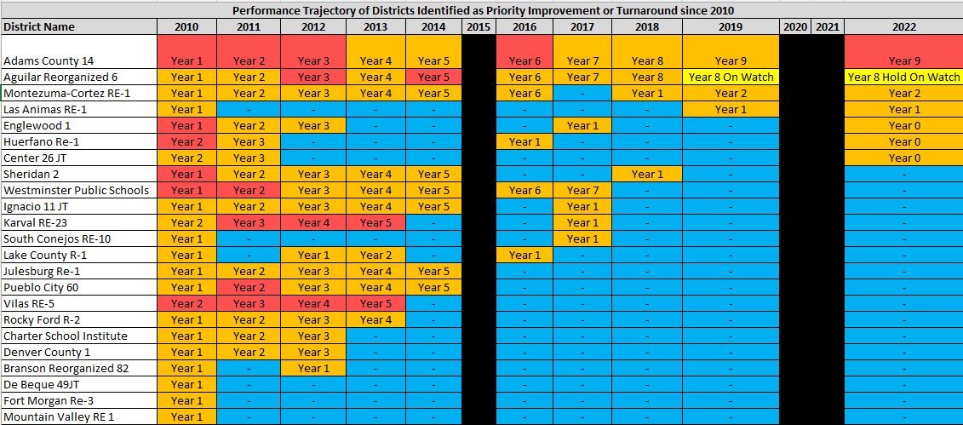
Reviewing Ratings Over Time for Sites on Performance Watch
Between 2010 and 2019, 59% of schools in Year 1 exited the clock within a year.
When looking at Year 1 sites, about 10% of them advance to Year 5.
These graphics are included in your google folder for closer study.

Slide 43
Elements of the Current State Accountability System
Frameworks
Public Reporting
Improvement Planning
Public Engagement
Supports and Interventions
Accreditation
Awards

Slide 44
School & District Accreditation Process
State Accredits Districts
August/September
CDE annually reviews performance through school and district performance frameworks
Districts Sign Accreditation Contracts
Districts Accredit their Schools
Districts officially sign off on final district accreditation ratings
Districts can submit a request to reconsider school plan types and district ratings
By December 31st
September/October

Slide 45
Accreditation Contract Process
Highlights of current system:
One-year contract between state board and local boards on the accreditation system and an agreement to implement applicable laws and policies.
District plan type and state board action determine timeline and additional expectations included in agreement
State Board accredits districts; Local boards accredit schools
Contract includes
Attainment on performance indicators
Adoption and implementation of the district plan
Accreditation and implementation of plans for schools, including online schools
Good faith effort on implementing statute, regulations and policy
Consequences for non-compliance and monitoring
All District Accreditation Contracts available at: https://www.cde.state.co.us/accountability/districtaccreditation
Notes:
Lisa

Slide 46
Elements of the Current State Accountability System
Frameworks
Public Reporting
Improvement Planning
Public Engagement
Supports and Interventions
Accreditation
Awards

Slide 47
Summary of School and District Awards
Blue Ribbon Schools
Centers of Excellence
Colorado School Awards program
Governor’s Distinguished Improvement Award
Green Ribbon Schools
High School Academic Growth Award
John Irwin Schools of Excellence
National ESEA Distinguished Schools
For Description of criteria and recent recipients: https://www.cde.state.co.us/cdeawards/awards

Slide 48
Thank you!
Lisa Medler
Executive Director, Accountability & Continuous Improvement
Medler_l@cde.state.co.us
Marie Huchton
Accountability Analytics Supervisor, Accountability & Continuous Improvement
huchton_m@cde.state.co.us
Accountability Website: www.cde.state.co.us/accountability
General Email: accountability@cde.state.co.us

Slide 49
Resources and Other Bonus Content

Slide 50
Upcoming Accountability Events
Timeframe | Description
Mid-August | Districts receive CMAS and P/SAT growth data, performance framework source data files through Syncplicity. Data Dashboards available through Online UIP. CMAS and P/SAT growth data released publicly 3 days later.
Late August | CDE releases preliminary frameworks to districts. Framework data released publicly 3 days later.
Mid-September | AEC Performance Frameworks released
September 22 | Accreditation forms submissions due through accreditation portal
October 16 | UIPs due for public posting and review for applicable schools/districts. Final request to reconsider materials due, if participating.
November 8-9 (SBE meeting) | District Accreditation Ratings and School Plan Types finalized if not participating in request to reconsider
December 13-14 (SBE meeting) | District Accreditation Ratings and School Plan Types finalized if participating in request to reconsider
December 31 | District Accreditation Contracts due
Late January | Informational reports released to districts with new measures. New measures are expected to be included in 2024 frameworks for points.

Slide 51
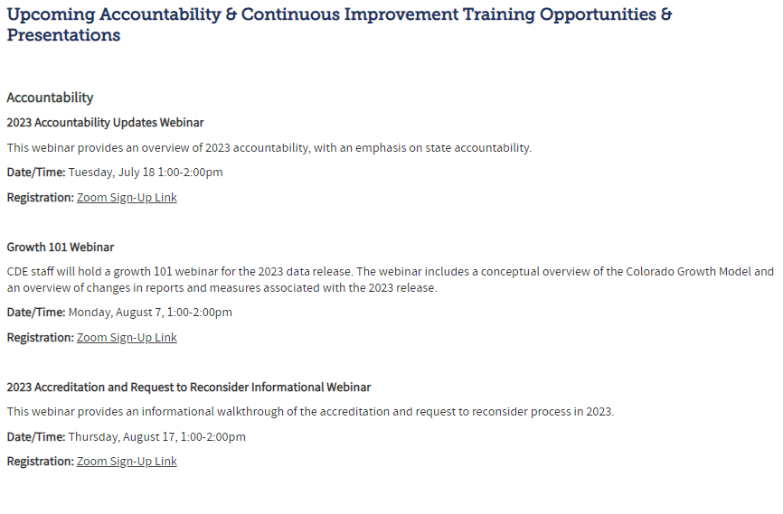
Training Opportunities
Previously recorded:
2023 Accountability Update
Growth 101
Accountability 101
Accreditation and Request to Reconsider
Upcoming:
Sign up for Performance Framework Data Consultation Sessions
For more, go to: https://www.cde.state.co.us/accountability/accountabilitytrainingtechnicalassistance

Slide 52
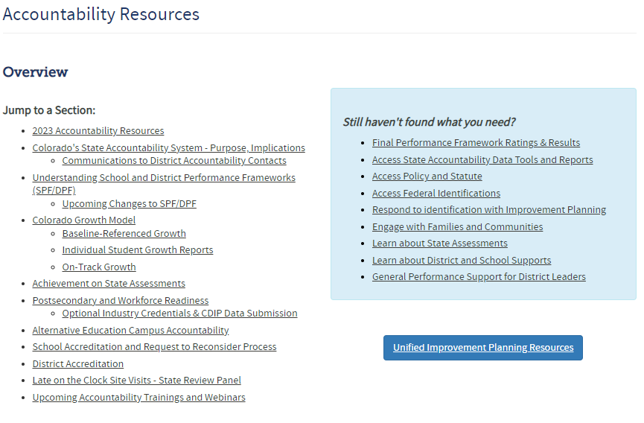
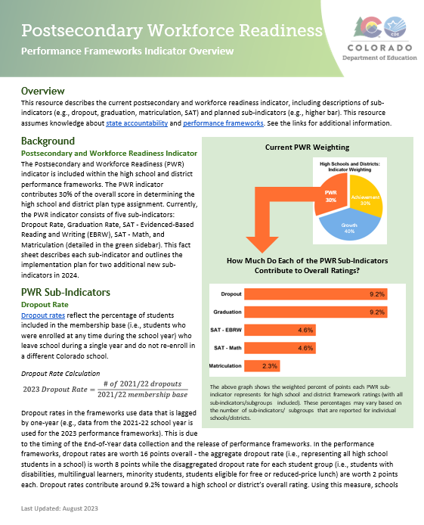
Resources
2023 Framework Scoring Guide
Higher Bar Fact Sheet
NEW: Matriculation Fact Sheet
NEW: PWR Fact Sheet
For more, go to: https://www.cde.state.co.us/accountability/accountability-resources

Slide 53
2023 Informational Results for Schools and Districts
The official 2023 school and district performance frameworks are planned for release in fall 2023, and will include the same indicators and sub-indicators as published in 2022.
A supplemental set of framework results will be released for informational purposes in January 2024, which include:
On-Track Growth indicator
Higher Bar sub-indicators
CMAS Science achievement and participation
2023
2024
Informational Release
Likely Included for Points
All: The On-Track Growth indicator, Higher Bar sub-indicators, and CMAS Science results will be shared for informational purposes following the release of official 2023 performance frameworks, likely in January 2024.
Elementary and middle schools: On-Track Growth will represent 10% of points on the frameworks.
High schools and districts: Higher Bar measures will count for points on the PWR indicator.
All: CMAS Science achievement and participation results will be factored into overall ratings.

Slide 54
Deeper Dive on the PWR Indicator

Slide 55
PWR Indicator | Background and Overview
PWR indicator reflects how well schools are preparing their students for college and the workforce
For state accountability purposes, PWR is one of three performance indicators used for determining accreditation and school plan type ratings
PWR 30%
Achievement
30%
Growth
40%

Slide 56
PWR Indicator | Inclusion in the Framework
Only available for high schools and districts
Contributes 30% of the points in determining overall high school or district plan types
Currently consists of five sub-indicators:
SAT Evidence-Based Reading/Writing
SAT Math
Dropout Rates
Matriculation Rates
Graduation Rates
PWR 30%
Achievement
30%
Growth
40%
Current PWR Indicator: Points by Sub-Indicator & Level
SAT EBRW (8 points): Mean Scale Score [All Students (4) & Disaggregated (1 each)]
SAT Math (8 points): Mean Scale Score [All Students (4) & Disaggregated (1 each)]
Dropout (16 points): Rate [All Students (8) & Disaggregated (2 each)]
Matriculation (4 points): Rate [All Students (4)]
Graduation (16 points): Rate [All Students (8) & Disaggregated (2 each)]

Slide 57
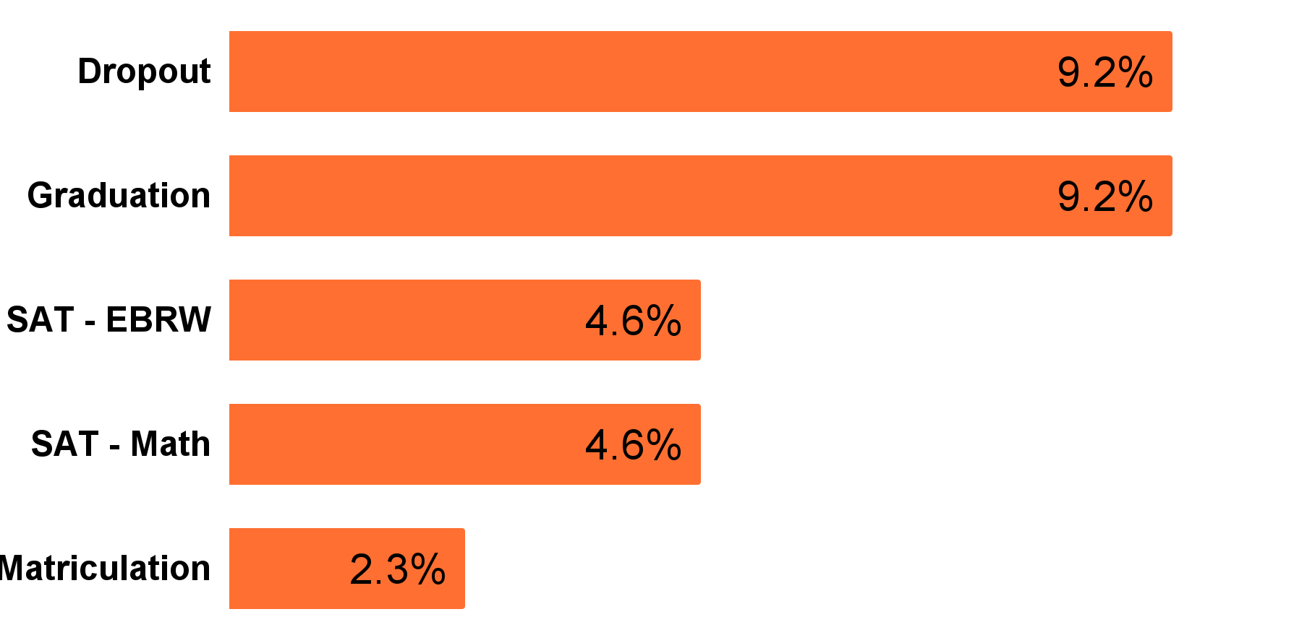
PWR Indicator | Sub-Indicator Weight in the Frameworks
Overall, graduation rates, dropout rates, and SAT (combined) represent the highest percent of points towards overall ratings (around 9% each).
Matriculation rates are weighted the lowest and make up around 2% of overall high school and district framework ratings.
How Much Do Each of the PWR Sub-Indicators Contribute to Overall Ratings?
These percentages vary based on the number of sub-indicators/subgroups that are reported for individual schools/districts.

Slide 58
Dropout Rate Sub-Indicator | Inclusion in the Framework
Reflects the percent of high school students who leave school during a single year and do not re-enroll in a different Colorado school.
Used to demonstrate success at preventing students from dropping out of high school.
Reported as an aggregate (i.e., all students) and disaggregated for each student group (i.e., students with disabilities - SPED, multilingual learners - ML, minority students, students eligible for free or reduced-price lunch - FRL).
How Much Do Each of the PWR Sub-Indicators Contribute to Overall Ratings?
These percentages vary based on the number of sub-indicators/subgroups that are reported for individual schools/districts.
How are 2023 Dropout Rates Scored?

Slide 59
Dropout Rate Sub-Indicator | Calculation
2023 Dropout Rate Calculation:
# of 2021-22 dropouts
2021-22 membership base
Data is lagged by one-year due to the timing of data release (i.e., data for 2023 frameworks represent students from the 2021-22 school year).
High school students who re-enroll at a different Colorado school during the school year are not counted as a dropout.
Only includes high school dropouts (not middle school).
The aggregate rate is worth 8 points while the disaggregated rate for each student group is worth 2 points each (16 points overall).

Slide 60
Graduation Rate Sub-Indicator | Inclusion in the Framework
Reflects 4-year, 5-year, 6-year, and 7-year graduation rates, with each rate referring to the number of years that elapse between a student entering ninth grade and graduating.
Used to demonstrate success at graduating students from high school.
Reported as an aggregate (i.e., all students) and disaggregated for each student group (i.e., SPED, ML, minority, FRL).
How Much Do Each of the PWR Sub-Indicators Contribute to Overall Ratings?
These percentages vary based on the number of sub-indicators/subgroups that are reported for individual schools/districts.
How are 2023 Graduation Rates Scored?

Slide 61
Graduation Rate Sub-Indicator | Calculation
2023 4-Year Graduation Rate Calculation:
# of students from anticipated 2021-22 cohort receiving regular diploma in 4 years
(# of students entering from 9th grade) + (transfers in – transfers out)
Uses the Best-Of Rate to calculate points (i.e., uses the highest of the 4-Year, 5-Year, 6-Year, & 7-Year rates).
Data is lagged by one-year due to the timing of data release (i.e., data for 2023 frameworks represent students from the 2021-22 school year).
The aggregate rate is worth 8 points while the disaggregated rate for each student group is worth 2 points each (16 points overall).

Slide 62
CO SAT Sub-Indicators | Inclusion in the Framework
Represents the extent to which students have met the learning objectives described in the relevant academic content standards for a given content area and grade level.
Since SAT is a college entrance exam, scores can demonstrate students are college-ready in reading/writing and math.
Reported as an aggregate (i.e., all students) and disaggregated for each student group (i.e., SPED, ML, minority, FRL).
How Much Do Each of the PWR Sub-Indicators Contribute to Overall Ratings?
When combined, CO SAT results contribute the equivalent amount of points as graduation and dropout rates.
These percentages vary based on the number of sub-indicators/subgroups that are reported for individual schools/districts.

Slide 63
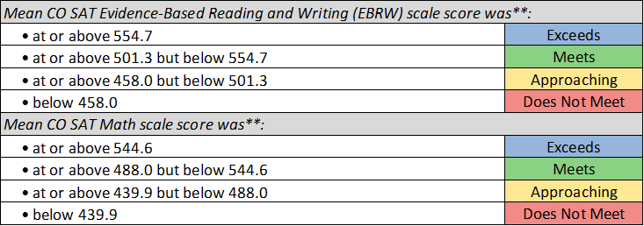
CO SAT Sub-Indicators | Calculation
How are 2023 SAT Results Scored?
Data is not lagged (i.e., data for 2023 frameworks represent students from the 2022-23 school year).
SAT - EBRW and SAT - Math are worth 8 points each (16 points overall).
The aggregate mean scale score is worth 4 points each while the disaggregated dropout rate for each student group are worth 1 point each.

Slide 64
Matriculation Rate Sub-Indicator | Inclusion in the Framework
Reflects the percent of high school graduates who either enlisted, received a credential/diploma (during high school), or enrolled (after high school) in a Career and Technical Education (CTE), 2-year, 4-year, or military option.
Used to demonstrate success of high school students matriculating into postsecondary or workforce options.
Reported as an aggregate (i.e., all students). Disaggregated by matriculation option (i.e., CTE, 2-Year, 4-Year, military) for informational purposes only - not for points.
How Much Do Each of the PWR Sub-Indicators Contribute to Overall Ratings?
These percentages vary based on the number of sub-indicators/subgroups that are reported for individual schools/districts.
How are 2023 Matriculation Rates Scored?

Slide 65
Matriculation Rate Sub-Indicator | Calculation
2023 Matriculation Rate Calculation:
# of 2021-22 high school graduates with qualifying credential or enrollment status
[Includes the number of graduates during high school or those after high school. A student is counted once in the numerator even if that student has multiple pathways]
# of 2021-22 high school graduates
Data is lagged by one-year due to the timing of data release (i.e., data for 2023 frameworks represent students from the 2021-22 school year).
Other industry credentials are also incorporated into the rates based on data submitted by districts on an optional basis.
The aggregate matriculation rate is worth 4 points while disaggregated rates for CTE, 2-Year, 4-Year, and military are worth 0 points each (4 points overall).

Slide 66
Higher Bar Sub-Indicators | Inclusion in the Framework
Currently, the postsecondary workforce readiness indicator consists of five sub-indicators
TAP and CDE are working on developing points for two Higher Bar sub-indicators:
Higher Bar for English Language Arts (ELA) and Math (S.B. 17-272): Measures the proportion of graduating students attaining a higher level of achievement (as defined by the state board) in both ELA and math on certain graduation guidelines measures
Higher Bar for Non-ELA and Non-Math (H.B. 18-1019): Measures the proportion of graduating students attaining similar high expectations in AP, IB, and/or CE non-ELA and non-math courses.
Data is collected from Grad Guidelines, Department of Higher Education, and vendor data sources
Tentative: Data is calculated and reported in high school and district frameworks
2022
2024
2023
Informational data is shared in late January 2024 for high schools and districts

Slide 67
Higher Bar Sub-Indicators | Calculation
Future Higher Bar Calculation:
# of current graduates meeting HB on at least one course/exam
# of current year graduates identified by the school/district
Students who meet the higher bar requirement in one or more exams or courses at any point during grades 9 through 12 are counted as a success.
The total number of framework points eligible for each Higher Bar measure is still to be determined. Must be approved by the State Board of Education.
The inclusion of these measures is unlikely to change the overall weighting of the PWR indicator (30%).
Likely will include All Student group results for points and include informational disaggregated group results to schools and districts similar to the matriculation sub-indicator.

Slide 68
2023 Preliminary Framework Results

Slide 69
Preliminary District Ratings | Distribution of 2023 Ratings
 | Number of Districts | Percent of Districts
Distinction | 12 | 7%
Accredited | 70 | 38%
Improvement Plan | 48 | 26%
Priority Improvement Plan | 19 | 10%
Turnaround Plan | 3 | 2%
Insufficient State Data | 32 | 17%
Total | 184

Slide 70
Preliminary District Ratings | Participation Trends Over Time
Summary: More district plan types were decreased due to participation in 2023. Greater total participation in 2023 compared to 2022, but lower than 2019.
Accountability Participation
Parent excusals removed from numerator and denominator. If below 95% participation in two content areas, then plan type decreased one level.
Participation Descriptor | 2019 | 2020 & 2021 | 2022 | 2023
Decreased Due to Participation | 3% | N/A | N/A | 10%
Total Participation
Parent excusals remain in numerator and denominator. If below 95% total participation in two content areas, then plan is listed as "low participation." This is just for informational purposes and does not impact calculation of frameworks.
Participation Descriptor | 2019 | 2020 & 2021 | 2022 | 2023
Low Participation | 34% | N/A | 64% | 56%
Meets 95% Total Participation | 63% | N/A | 19% | 34%
Note: Percentages based on the total number of districts receiving a participation descriptor

Slide 71
Preliminary District Ratings | Performance Watch by Year
Preliminary Results | Number of Districts | Percent of Districts
Not on Performance Watch | 161 | 88%
Year 2 – On Watch | 1 | >1%
Year 1 – On Clock | 19 | 10%
Year 2 – On Clock | 1 | >1%
Year 4 – On Clock | 1 | >1%
Year 10 – On Clock | 1 | >1%
Total | 184 | --

Slide 72
Preliminary School Plan Types | Distribution of Plan Types
 | Number of Schools | Percent of Schools
Performance Plan | 1035 | 58%
Improvement Plan | 350 | 20%
Priority Improvement Plan | 163 | 9%
Turnaround Plan | 40 | 2%
Insufficient State Data | 139 | 8%
New School | 12 | 1%
School Closed | 35 | 2%
Total | 1774 | --
Note that 94 AECs are not included in these counts as ratings are still pending

Slide 73
Preliminary School Plan Types | Participation Trends Over Time
Summary: More school plan types were decreased due to participation in 2023, especially high schools. Slightly greater total participation in 2023 compared to 2022, but lower than 2019.
Accountability Participation
Parent excusals removed from numerator and denominator. If below 95% participation in two content areas, then plan type decreased one level.
Participation Descriptor | 2019 | 2020 & 2021 | 2022 | 2023
Decreased Due to Participation | 1% | N/A | N/A | 6%
Total Participation
Parent excusals remain in numerator and denominator. If below 95% total participation in two content areas, then plan is listed as "low participation." This is just for informational purposes and does not impact calculation of frameworks.
Participation Descriptor | 2019 | 2020 & 2021 | 2022 | 2023
Low Participation | 24% | N/A | 51% | 45%
Meets 95% Total Participation | 74% | N/A | 48% | 50%
Note: Percentages based on the total number of schools receiving a participation descriptor

Slide 74
Preliminary School Plan Types | Performance Watch by Year
Preliminary Results | Number of Schools | Percent of Schools | Total
Not on Performance Watch | 1551 | 87%
Year 2 – On Watch | 11 | 0.6% | On Watch 14
Year 3 – On Watch | 1 | 0.1%
Year 4 – On Watch | 2 | 0.1%
NOTE: AECs are not currently included for 2023

Slide 75
Preliminary School Plan Types | Performance Watch by Year (cont.)
Preliminary Results | Number of Schools | Percent of Schools | Total
Year 1 – On Clock | 157 | 9% | On Clock 209
Year 2 – On Clock | 21 | 1.2%
Year 3 – On Clock | 12 | 0.7%
Year 4 – On Clock | 8 | 0.5%
Year 5 – On Clock | 3 | 0.2%
Year 6 – On Clock | 3 | 0.2%
Year 7 – On Clock | 1 | 0.1%
Year 8 – On Clock | 1 | 0.1%
Year 9 – On Clock | 1 | 0.1%
Year 10 – On Clock | 2 | 0.1%
Total | 1774 | --
NOTE: AECs are not currently included for 2023

Slide 76
And now the real work begins...
Districts and Schools are...
Analyzing their state and local data and finalizing their improvement plans Implementing their school improvement efforts with students and engaging with their communities right now Verifying their accreditation assignments and some are investigating request to reconsider
CDE is...
Answering questions on frameworks and helping sites analyze their data Supporting the request to reconsider process and accreditation portal Hosting webinars and in-person trainings across the state on data analysis and school improvement efforts Reaching out to sites on Performance Watch for more targeted and intensive supports (e.g., EASI application, Turnaround Network)

Slide 77
Preliminary Frameworks | Request to Reconsider Process
Districts may engage in the request to reconsider process if a different accreditation rating or plan type assignment better describes the site’s performance.
The Department will consider the request and review it based on criteria outlined in policy. CDE will make recommendations to the state board in December for plan type finalization.
All formally reviewed requests are public documents.
Request to Reconsider Homepage: http://www.cde.state.co.us/accountability/requesttoreconsider

