Slide 1
Celebrate Farm to
School Month
Masterclass Specialized
Notes:
Welcome to our On the Menu call – today we are talking about ways you can celebrate farm to school month. National farm to school month is in October so we’re giving you lots of ideas on how you can demonstrate your commitment to local food all month long.
Our training team is adding today’s PowerPoint slides along with a very IMPORTANT and RESOURCES FILLED handout to the chat. The handout contains all of the links included in this presentation so you can easily follow up with anything that is of interest to you.

Slide 2
Mute/
Unmute
Video
On/Off
Chat
Closed Captions
Closed Caption
Notes:
Okay, so some quick Zoom housekeeping items before we jump into the content….
All of you are muted right now, but please feel free to unmute yourself at any time to make comments or ask questions. Next to the microphone is a camera icon…It is completely optional to turn on your camera today, but it would be great you see your faces!
If you keep moving across the bottom portion of your screen you will see a chat icon in the middle. I want everyone to take a moment to bring up the chat and enter your name and district or organization and favorite fall activity. Also, if you have any questions today, please type them into the chat—I will most likely try to answer them along the way. To the right of the chat icon, is an icon for closed captioning, so just click that button if you need it.
Lastly there is a button for reactions which allows you to communicate with me…so feel free to give me a thumbs up or heart reaction when you feel called!

Slide 3
CDE School Nutrition
Vision
Mission
Nourish young bodies and minds. End childhood hunger.
We support the child nutrition community through innovation, training, and partnerships to ensure all youth have access to healthy meals.
Notes:
We have spent time updating our vision and mission.

Slide 4
Non-Discrimination Statement
In accordance with federal civil rights law and U.S. Department of Agriculture (USDA) civil rights regulations and policies, this institution is prohibited from discriminating on the basis of race, color, national origin, sex (including gender identity and sexual orientation), disability, age, or reprisal or retaliation for prior civil rights activity.
Program information may be made available in languages other than English. Persons with disabilities who require alternative means of communication to obtain program information (e.g., Braille, large print, audiotape, American Sign Language), should contact the responsible state or local agency that administers the program or USDA’s TARGET Center at (202) 720-2600 (voice and TTY) or contact USDA through the Federal Relay Service at (800) 877-8339.
To file a program discrimination complaint, a Complainant should complete a Form AD-3027, USDA Program Discrimination Complaint Form which can be obtained online at: https://www.usda.gov/sites/default/files/documents/USDA-OASCR%20P-Complaint-Form-0508-0002-508-11-28-17Fax2Mail.pdf, from any USDA office, by calling (866) 632-9992, or by writing a letter addressed to USDA. The letter must contain the complainant’s name, address, telephone number, and a written description of the alleged discriminatory action in sufficient detail to inform the Assistant Secretary for Civil Rights (ASCR) about the nature and date of an alleged civil rights violation. The completed AD-3027 form or letter must be submitted to USDA by:
1. mail:
U.S. Department of Agriculture
Office of the Assistant Secretary for Civil Rights
1400 Independence Avenue, SW
Washington, D.C. 20250-9410; or
2. fax:
(833) 256-1655 or (202) 690-7442; or
3. email:
program.intake@usda.gov.
This institution is an equal opportunity provider.
Notes:
We include the nondiscrimination statement in our trainings as a reminder of our responsibilities to ensure all eligible people may participate in our child nutrition programs. As equal opportunity providers, we prohibit discrimination in our programs and provide fair and equitable treatment to every participant.

Slide 5
Learning Objectives
Name one action to incorporate local foods into school menus
Explain nutrition education best practices
Identify at least one strategy to improve school meal quality
Professional Standards
1130, 1200
Notes:
By the end of this training, you will be able to: Name at least one (but hopefully A LOT) of strategies to incorporate local foods into a school menu. The next is to be able to explain nutrition education best practices for students, and lastly, I would love for you to be able to identify at least one strategy to improve school meal quality, but we will be covering so much more.
You will receive 1 hour of training credit today. And the professional standards are 1130 and 1200.

Slide 6
Agenda
Celebrating Farm to School Month
Procuring Local Food
School Gardens and Nutrition Education
Meal Quality
Notes:
We are going to start off by thinking of ways to Celebrating Farm to School Month—which begins next week! We will also talk about strategies to procuring local food, starting a school garden, and offering nutrition education. We will end the session by discussing Meal Quality. My colleague Kristi is going to drop a handout in the chat that hyperlinks ALL of the amazing resources I will be going over today. I’ll be referencing it a lot, so make sure you get it downloaded and saved to your computer.

Slide 7
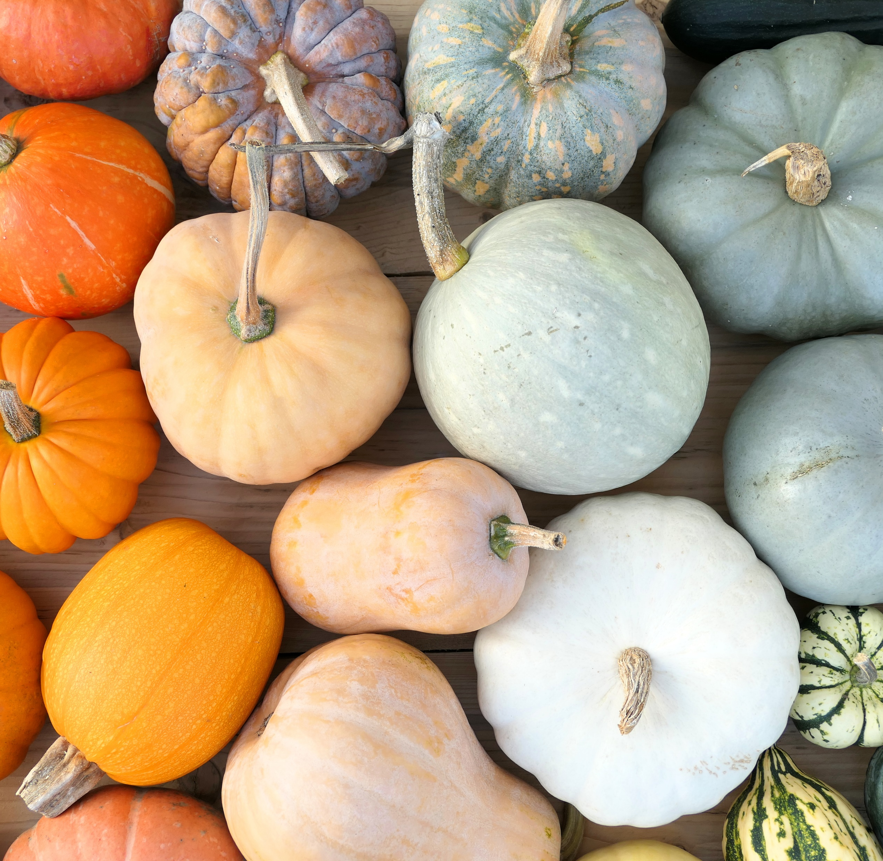
How have you celebrated Farm to School Month in the past?
Notes:
POLL QUESTION
Answers (select all that apply):
Incorporated multiple local items into the menu over the month
Incorporated a couple of local items into the menu over the month
Invited farmers or other local food experts to speak
Engaged students in a school garden
Provided local food nutrition education
None of the above

Slide 8
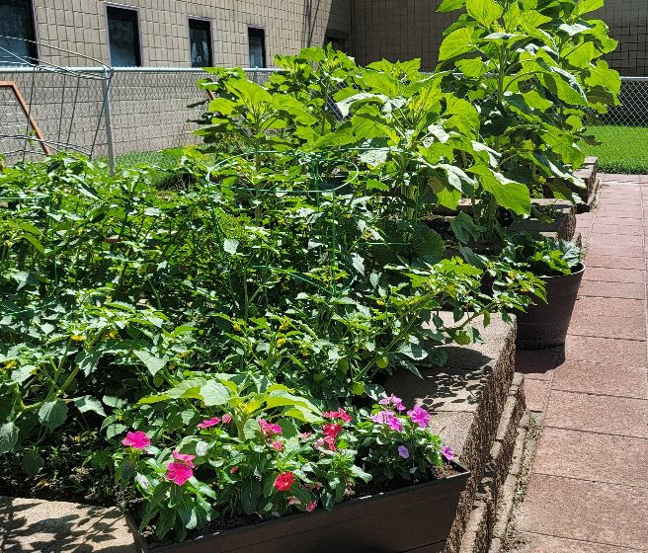
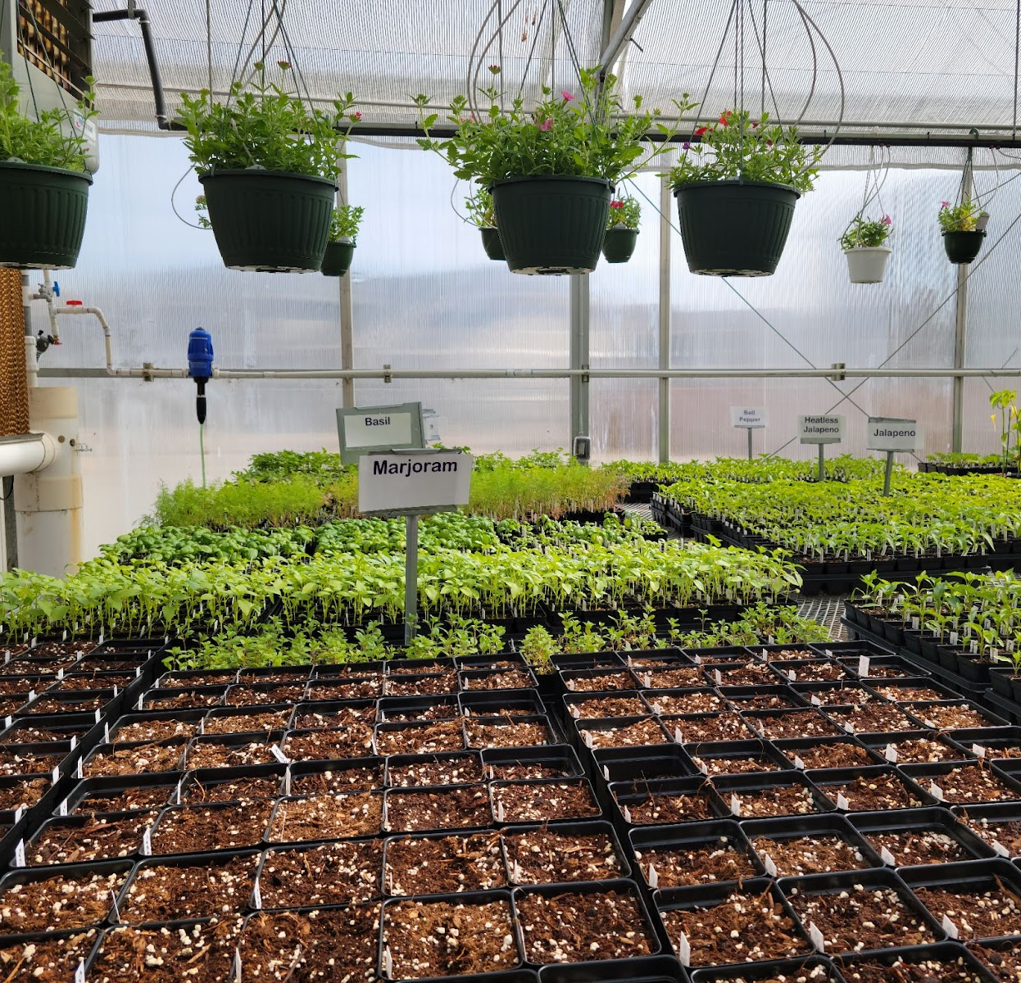
Farm to School Grantees
DYS Garden
Boulder Valley School District: Experiential learning in greenhouses + teacher engagement
Cripple Creek-Victor School District: Hydroponic system + local procurement + nutrition education
Division of Youth Services: School gardens + salad bars + experiential education
Durango 9-R, The Juniper School: School garden + nutrition education
St. Vrain Garden
Notes:
Since we’re talking about celebrating farm to school month, I wanted to take a minute to celebrate the work of the farm to school grantees from last year. School Nutrition received a USDA Farm to School Grant and we subawarded 9 school districts funding to begin or expand their farm to school programming. You’ll hear stories from a few of the grantees throughout the webinar but I wanted to highlight all of them here.
As you can see, they all had slightly different projects and they all incorporated more than one element of farm to school in their grant projects.

Slide 9
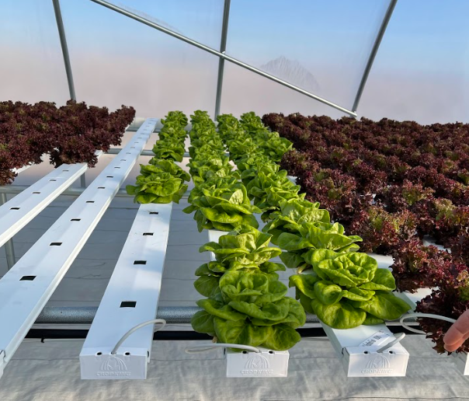
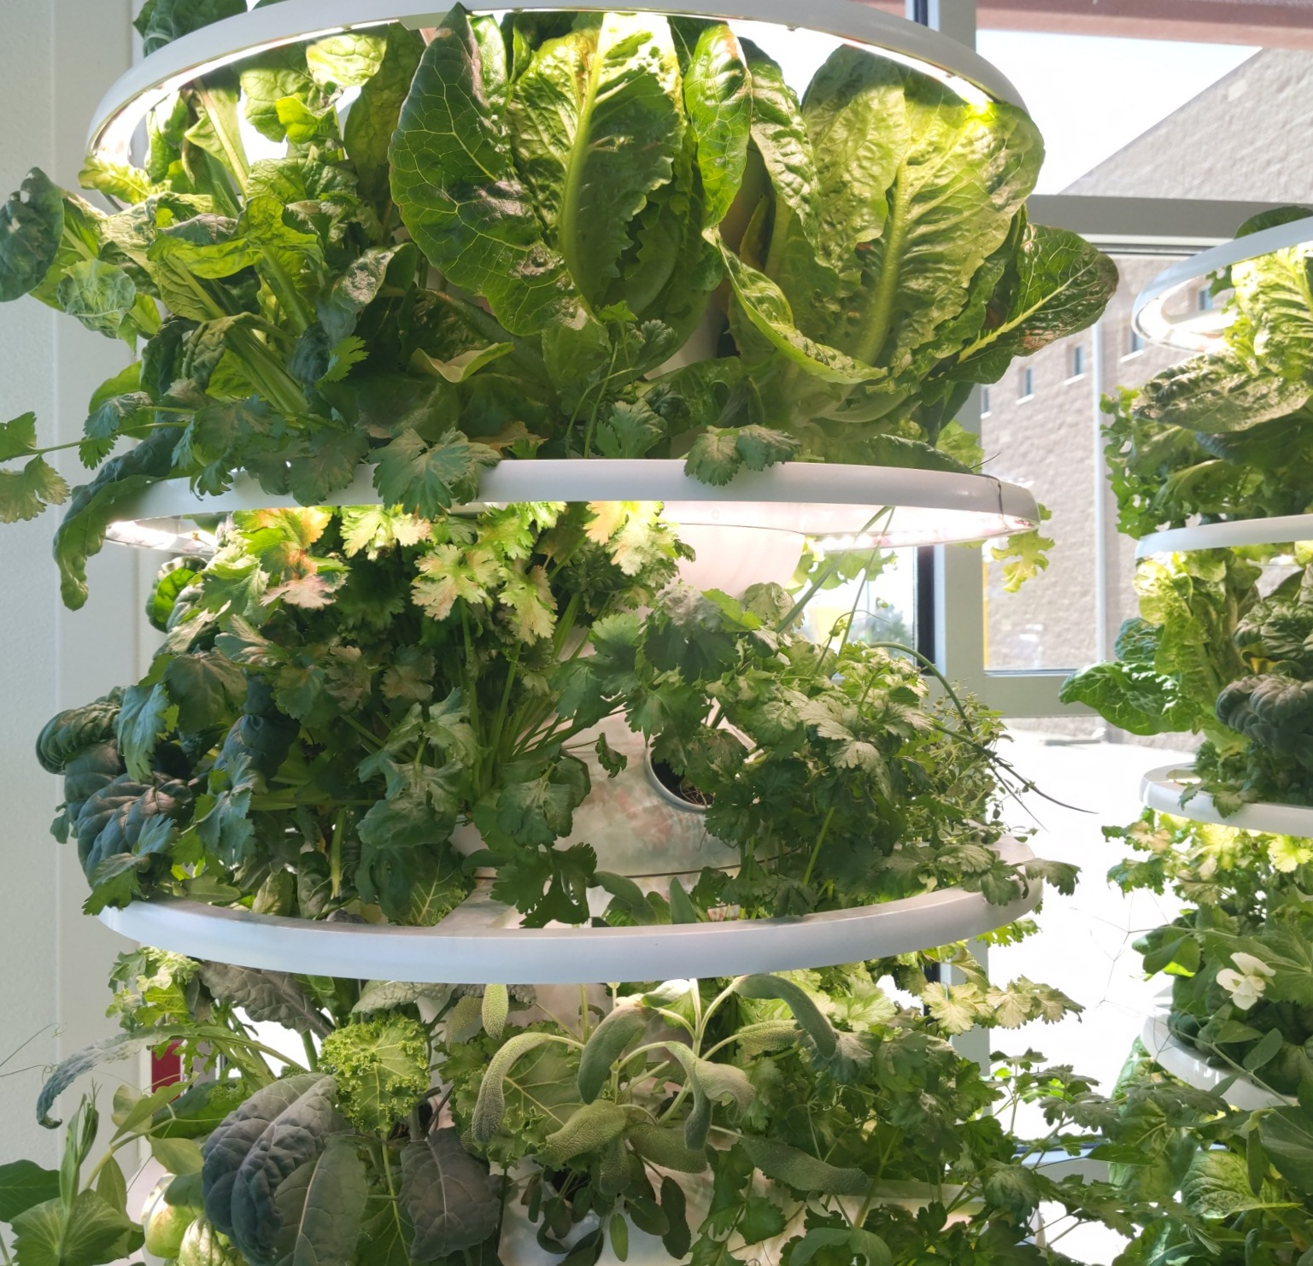
Farm to School Grantees
Swink
Hydroponic Garden
North Conejos School District: HVAC to grow local + nutrition education
Pueblo City School District 60: Tower gardens + nutrition education
St. Vrain Valley School District: Growing local + nutrition education + local procurement
Swink School District: Local procurement + nutrition education
Vilas School District: Equipment + food production + LoProCO
Pueblo 60 Tower Garden

Slide 10
Farm to School Grantees
$95,405 on farm to school activities
Student Engagement
Collaborated with 44 elementary schools and 30 high schools
Reached 200 Early Childhood Education students
19,071 elementary students
7,905 high school students
Collaboration is key
Agriculture teachers, 4H, local farmers, students, community
Notes:
Here are a few more highlights from the evaluation the grantees completed. Our grantees spent a total of $95,405 on their farm to school activities. Student and community engagement were the big themes. Grantees reported collaborating with over 27,000 students with their work!
Collaboration is the key to success with farm to school. Grantees involved agriculture teachers, 4H programs, local farmers, students, their community, non-profits, and many others to get their projects going. For folks just beginning farm to school this is an essential first step to creating a culture of farm to school in your district.
I just want to say congratulations to all the grantees, we were thrilled to be able to support your work.

Slide 11
National Farm to School Month
National celebration of students and local food
National Farm to School Network outreach materials
Register for the Mountain Plains Crunch Off – October 17-21
Notes:
National farm to school month is exactly what it sounds like – a celebration of students and local food. There are a lot of ways you can celebrate throughout October – we’ll focus on serving local food and providing nutrition education in today’s webinar. It’s also important to promote the great things you’re doing to support local food and farmers in your programs – your community can’t get involved in your program if they don’t know what you’re doing!
Visit the National Farm to School Network website to access lots of free outreach materials – there are posters, logos, stickers, and even a celebration toolkit that gives you plenty of ideas on how you can serve more local food on your menus in October and how you can engage students, teachers, and your community to take the celebration to the next level.
Another amazing way you can celebrate the season is by registering for the Mountain Plains Crunch Off October 17-21. This is a competition with other states in our region to see which state can get the most people to register and crunch into a locally grown item during that week. You can register your school district, school, or even send out to your community for other folks to register. When you register, you’ll receive a Crunch Off toolkit with ideas on how to celebrate and where to source local products. The registration link is included in the slides and the handout you received. There might be a misconception that there is nothing growing in Colorado—but think about the cold storage crops like carrots or apples!

Slide 12
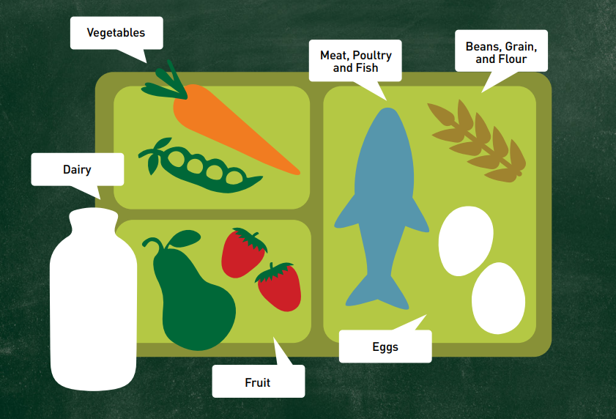
What is local food?
Defined by you!
Definition can change
Local foods can span the food tray
USDA Planning Toolkit
What are you trying to accomplish?
Notes:
There is no federal definition of local. Unless you are purchasing food with funding from a specific program, like Colorado’s Local Food Program, you as the school district define local. This can be within a county, part of the state, the entire state, or even a region. The definition of local can also change depending on what season it is and what you are trying to purchase. Local foods can also be incorporated into all aspects of a school meal program and can span the entire tray. Many school districts find it easier to begin with purchasing local fruits and vegetables, but you can include local grains, meat and poultry, and even value-added products like cheese and bread. Most of you are already purchasing local milk—by the nature of the product!
Ultimately the definition of local should be based on the goals you want to achieve. For example, if your goal is to get as much local product into the school cafeteria as possible, you might develop a broad definition of local that includes surrounding states in the region. If livestock products from local sources are abundant in your region, like cattle or bison, but local fruits and vegetables are scarce, consider different definitions of local for different product types. How a school defines local can frame who it purchases products from, how those products are grown and where the school’s funds are going. The USDA Farm to School Planning Toolkit linked in the handout will give you questions to ask you and your team when starting a farm to school program.
Type into the chat: For those of you already operating F2S, what are you trying to accomplish with your program? If you are just starting, what do you want to accomplish?

Slide 13
How to procure local foods
Procurement Methods:
Source local foods:
Micro-purchase
Spread the wealth
Small purchase
Formal purchase
Geographic preference
Forecasting
Directly from a producer
Through a food hub
From a farmers’ market
Through a distributor
From a school garden
Notes:
As with all child nutrition programs, you must adhere to all procurement policies and have procurement procedures in place. If you’re just getting started with farm to school or want to purchase a specific product for farm to school month, you may find it easiest to use the micro-purchase method. Most sponsors have a micro-purchase threshold of $10,000—so any transaction under this amount does not need to go through a formal procurement or bidding process. It is just best to spread the wealth among qualified vendors.
When ready to source your local products, there are a lot of options. You can purchase directly from an individual producer, through a food hub, farmers’ market, through your mainline distributor, and even from a school garden!
The resources listed on this slide can help you make those initial connections if you don’t know where to start. Use the Colorado producer list to find producers who want to sell products and can deliver to your region. You can also connect with producer associations and your local CSU Extension office to get connected to producers. If you aren’t sure which products even grow in Colorado, check out the produce calendar from the CO Dept of Ag to find out what’s in season. You’ll find links to find all these awesome links in the handout that was posted in the chat earlier.

Slide 14
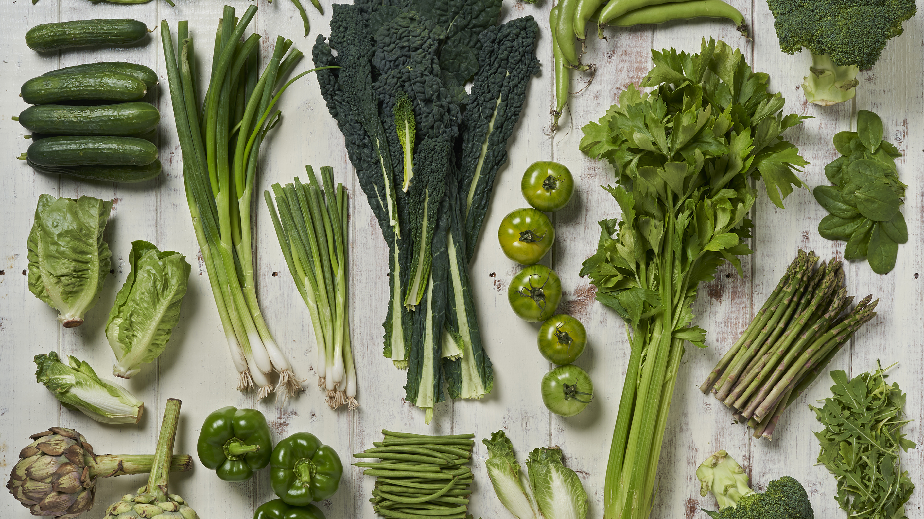
Menu planning with local food
Identify
what’s already local on the menu
Substitute
ingredients
Serve
local products on the salad bar
Start
a “harvest of the month” program
Develop
new recipes
Notes:
There are a lot of ways to incorporate local products into your menus, this is not an all-inclusive list. Start by looking through current products to see what is already local that you offer. Chances are some products from your distributor or DoD Fresh are local products. Once you identify those already local products, be sure to let your students and community know! You could include a sign on a salad bar or create an icon for your menus to indicate local ingredients. You could use the CO Proud Logo if it meets this designation.
Use resources to identify which items are available locally and compare that to your cycle menus. What’s an ingredient you commonly use, such as potatoes or carrots, that you might be able to purchase from a local vendor? Did you know that the San Luis Valley is the second largest potato growing region in the US?? We all know the fruit that comes from the western slope- peaches, or corn from Olathe, or melons from Rocky Ford. The products are there, we just have to think differently about their preparation and menuing.
Another easy way to incorporate local items is to start small and focus on a salad bar. This is especially true for fruits and vegetables, but you could also include a local quinoa salad, or corn and bean dish on your salad bar. You could even create a list of local vegetables categorized by vegetable subgroup so you could easily swap different veggies in depending on the season and still meet your weekly vegetable subgroup requirements.
Starting a Harvest of the Month program is an excellent way to show your community that you’re stepping up your local food game. A harvest of the month program features a new local ingredient every month. You might serve that item just once or you could prepare it different ways throughout the month to display how it can be used in various forms. Remember – local foods can span the entire tray. We know Colorado has a shorter growing season so you could feature local dairy products, grains, beans, or meats during the winter months.
Finally, when you’re ready to take on a new challenge you can develop new recipes that intentionally feature your harvest of the month or other local items you want to consistently incorporate. This is a great opportunity to involve students in your meal program – ask them the types of local items they might want to see and have them taste test new recipes. Some sponsors have worked with their culinary arts program if there is one in the district! Recipe development resources can be found again linked to that magic F2S handout.

Slide 15
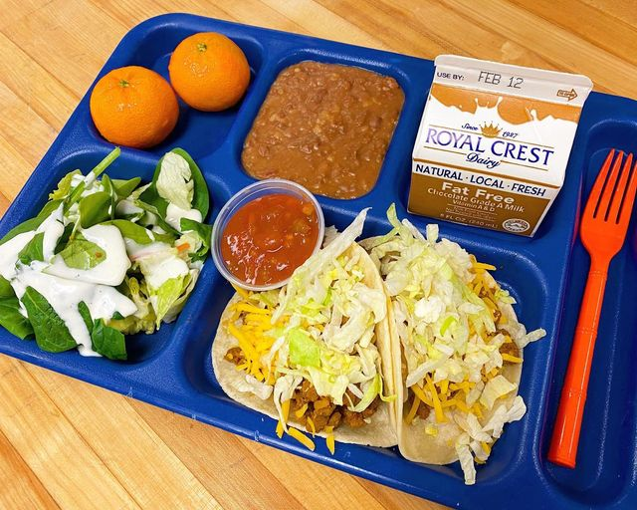
Stories from the field – St. Vrain
Engage students with local food taste tests
Highlight your farm to school efforts
Consider student preferences, cost, and current menu when adding new items
Notes:
Over the past several years, St. Vrain Valley School District has been dedicated to incorporating farm to school in their child nutrition programs by creating school gardens, serving local produce on salad bars, focusing on agricultural education and participating in Colorado Proud School Meal Day. Examples of innovative strategies they’ve implemented include:
Working closely with their Agriscience Department. Last year, students cared for and raised two pigs at the student farm. The pigs were processed and then showcased in the cafeteria.
Creating a farm to school mentorship program where older students teach younger students nutrition and agricultural education including animal husbandry, crop production and farm food safety.
Showcasing local products on their menu and taste testing student raised livestock. This year, student raised lamb will be added to their “walking Gyro” meal.
To start or expand your own farm to school programming, check out these tips from St. Vrain Valley School District:
Conduct taste tests and add local items to the menu. Produce from school gardens is added straight to the salad bar to make sampling easy.
Highlight your efforts. New items are promoted in the cafeteria and staff encourage students to try something new. Be sure to message local products to students, teachers, and families.
Consider cost, nutritional value, staff labor and student preference when adding new items to the menu.
Small changes make a big impact. Start with simple swaps, like salad bar items. Research and consider using local products, like refried beans and tortillas, that are already on your cycle menu.

Slide 16
Inspiring Local Recipes- Boulder Valley
Spanish Summer Gazpacho
For the recipe, email: Stephen.Menyhart@bvsd.com

Slide 17
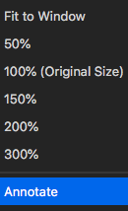
Activity
1
2
3
Notes:
So we are going to use the Annotate Tool for an activity. Click the view options button at the top of the screen where Zoom says you’re viewing my screen. At the bottom of that drop-down, click Annotate. When the Annotate toolbar pops up, click the T for text so you can type directly onto the screen. We are also going to use the stamp button!
Activity:
Provide a link to the CO Produce Calendar as a resource: https://ag.colorado.gov/sites/ag/files/documents/ColoradoProduceCalendar_0.pdf

Slide 18
What’s in season in October?
Produce (fruits & veg)
Non-produce (meat, grain, value-added)
Notes:
So, here we are going to use the annotate text---create a new text box and think of all the fresh fruit and vegetables that are in season right now. In the other section, list items that are not product but are also locally available (grain, dairy products, meat, processed products).
After we have a long list, we are going to use the annotate stamp. Place a stamp next to the local items you would like to try this fall!
Produce:
Apples
Turnips
Radishes
Beets
Bell Peppers
Broccoli
Cauliflower
Carrots
Celery
Kale
Cucumbers

Slide 19
Local food funding
USDA Local Food for Schools Cooperative Grant
Supply Chain Assistance Funds
Colorado Local Food Program (apply Spring 2023)
USDA Equipment Grants
USDA Farm to School Grant
Notes:
We know this work can take a lot of time and resources so wanted to quickly highlight opportunities to support local procurement. We just got word last week that that School Nutrition received the Local Food for Schools Cooperative grant from the USDA, which gives us little over 2 million dollars that we will then reimburse districts for the purchase of local foods. Districts are also receiving another round of Supply Chain Assistance Funds that can be used to procure products. This year, 20 districts were awarded funding for the Colorado Local Food Program, which also reimburses sponsors for Colorado grown, raised, and processed products. You can always apply for USDA equipment grants and the farm to school grant to support this type of work.
There is A LOT of funding flowing into Farm to School efforts—from the national and federal level, down to the state level. Keep you eye out for information as we start distributing these funds!

Slide 20
School Gardens and Nutrition Education
Notes:
School Gardens and Nutrition Education are the other components of farm to school. Farm to school month is a great time to incorporate local food and nutrition education into the cafeteria, a school garden, or even in classrooms.

Slide 21
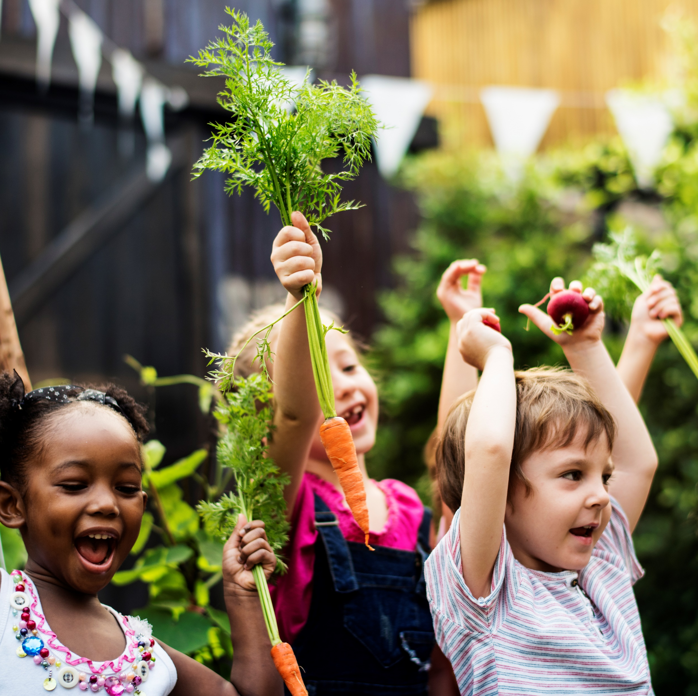
School Gardens
Starting and Maintaining a School Garden
Collaborate
Identify food safety practices, goals, and design
Secure funding and resources
Plant
Maintain
Notes:
School gardens are an integral part of a farm to school program and offer a way for students to engage in hands-on learning. Teachers can incorporate garden education into their curriculum, and school gardens represent a tangible way for parents and the community to be involve. School gardens can take many forms depending on the space you have at your schools – you could do a traditional raised garden bed, use a greenhouse, or even purchase tower gardens to grow food indoors.
If you have access to a school garden, consider collaborating with an agriculture, science, or math teacher to provide a nutrition education lesson for farm to school month. Students can learn more about where their food comes from and might be more willing to try new things in the cafeteria if they have been exposed to them in a garden. One thing to consider is food safety—food grown in a school garden is not inherently more risky than any other produce brought in by a distributor. But you will want to consider what food safety practices you will put into place.
For those of you who don’t yet have a school garden, the National Farm to School Network has a great, succinct resource to help you get started. From garden design and planting, to food safety checklists, there are resources out there already created.

Slide 22
Nutrition and agriculture education
Why is this type of education valuable to students?
Encourage healthy choices
Help them understand food systems
Learn about new food cultures
Engage students
Notes:
Ask: Why do you think this type of education is valuable? (participants can unmute or type into the chat)
Click to show answers
Helps students make positive choices for their health and well-being. Kitchen staff, teachers, and other school leaders can help shape children’s understanding of food and how it impacts their overall health.
Help students develop an understanding of how food is grown, where it comes from, who grows it, and how food impacts the environment.
Food connects us all. Children who try new foods and foods from different cultures can understand more about their own food culture and the food cultures of their peers.
Engage students in your meal program and hopefully increases participation!

Slide 23
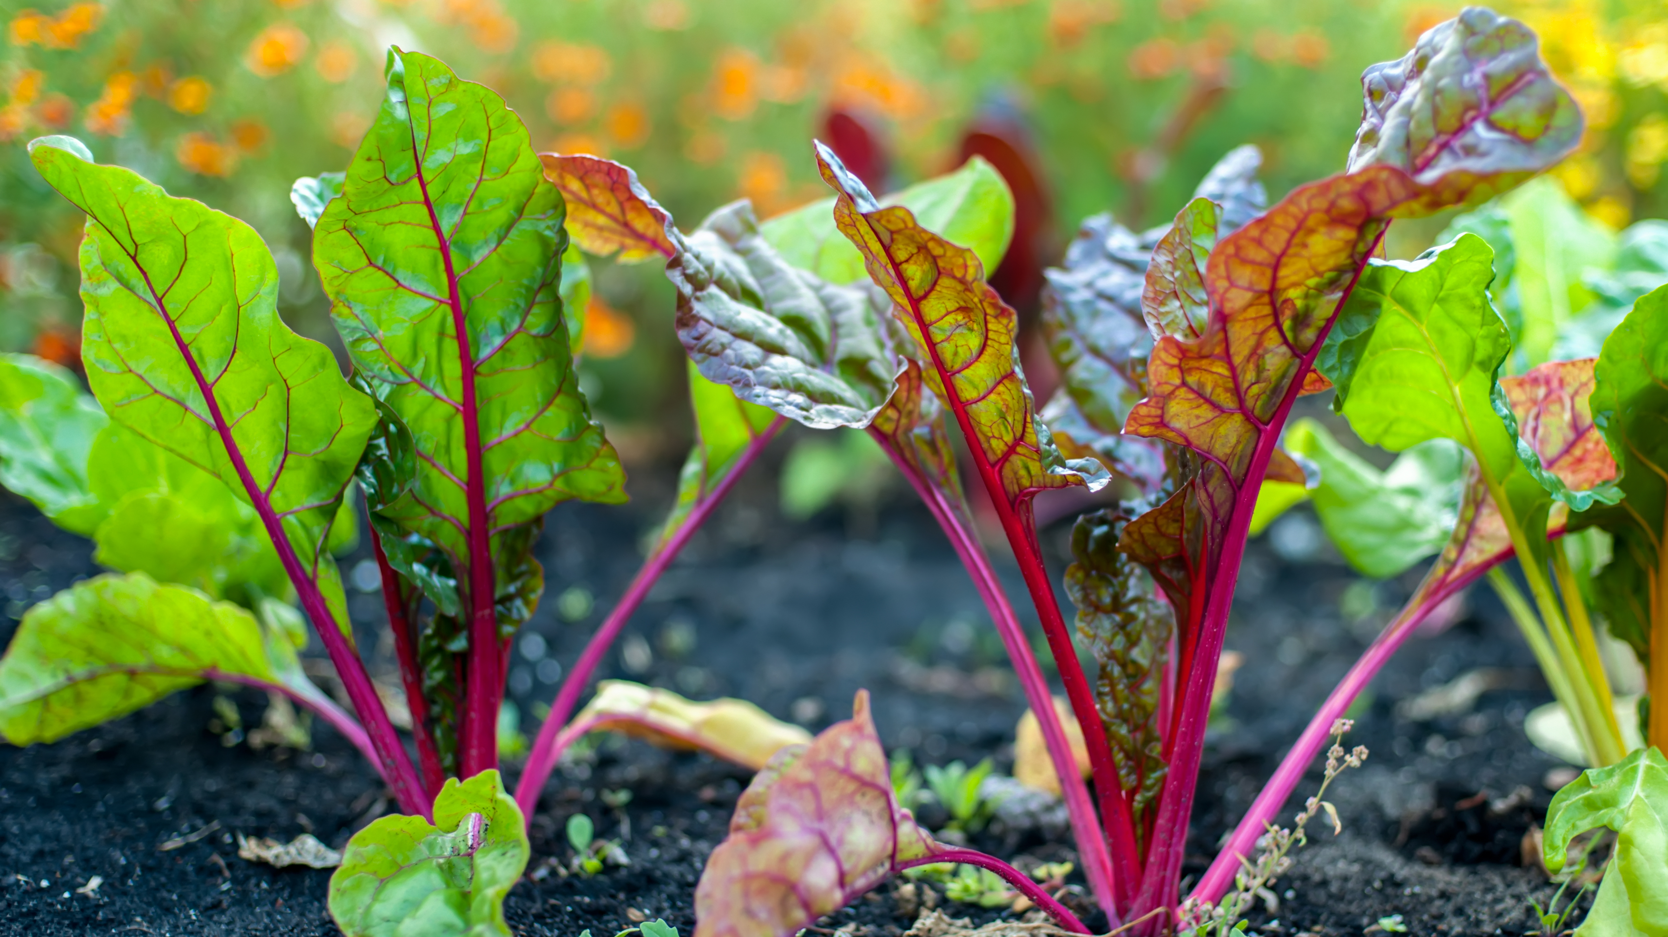
Providing nutrition education
Engage
the broader school community
Connect
with existing programs/groups
Cafeteria
Lessons while in line
Classroom
Guest speaker
Community
Garden Party
Notes:
Let’s talk about how you can start to provide nutrition education for your students. First you should start by explaining the benefits of high meal quality and farm to school to your school administrators. Benefits could include financial (increased participation and increased revenue), social, student health, and community benefits. Parents can be a source of education or might even be some of the local producers in your area! Consider attending PTA meetings, health fairs, and back to school nights to build relationships and providing education about the district’s nutrition department, meal quality, and farm to school goals.
Think about teachers or staff that you might already have connections with, or someone that you’d like connect with? Is there a 4H, Agriculture, or other teacher that could be a natural ally in this work? Farm to school is all about building relationships – you don’t have to do this alone. Other groups who care about student wellness can be great allies, like a Wellness Committee, culinary teacher, science teacher, or school nurse. Another tip is to address meal quality and farm to school goals in your local Wellness Policy. This can help institutionalize these tenets into the school culture. For example, you could add requirements for nutrition education or experiential learning opportunities through school gardens into the policy.
Education can happen anywhere – there are numerous opportunities to host a short nutrition lesson as students wait in the cafeteria line, or have a farmer or wellness leader give a short lesson in a classroom. You can even invite community to attend a harvest party in a school garden and have students teach the community what they have learned about growing food. Refer to the handout for these resources!

Slide 24
Meal Quality
Notes:
Now I want to spend a little time talking about how you can improve school meal quality using local foods.

Slide 25
Using local food to improve meal quality
More nutrient-dense and tastier
Students more likely to consume fruits and vegetables
Learn about gardening, agriculture, healthy food
Can boost meal participation
Notes:
There are a lot of ways to improve the quality of your school meals – through scratch cooking, creating culturally inclusive menus, and serving more fresh, local foods to name a few. You can also demonstrate your values through the food you serve – serving local food shows that you value supporting the local economy. Adding local food goals to your school wellness policy demonstrates your values to student health. Local food tends to be more nutrient-dense, since it has traveled a shorter distance from harvest to plate and is picked at peak freshness. Local produce also tastes better since it was picked when ripe, encouraging students to make healthier choices.
Research from the National Farm to School Network shows that students consume more fruits and vegetables and are more willing to try new and healthy foods through farm to school. When local food is paired with nutrition education, students learn more about gardening, agriculture and healthy food. Serving local food and higher quality meals can also improve meal participation, which allows food service operations to invest more in meal quality improvements.
As you can see, there are a lot of ways that serving local food can help improve your school meal quality.
https://assets.website-files.com/5c469df2395cd53c3d913b2d/611027419232d281ad2f51ff_BenefitsFactSheet.pdf

Slide 26
resources
CDE Meal Quality Videos
Taste of Colorado
Processed to Scratch
Nutritional Nudging
CDE and Nourish Meal Quality Trainings
Strategies to improve Meal quality
Notes:
Here are some meal quality resources that can get you started on improving your school meal quality. These are great training resources for you and your staff. The MQ videos are in both English and Spanish and we worked closely with the staff at Aurora Public Schools and Boulder Valley School District to make these videos come to life!

Slide 27
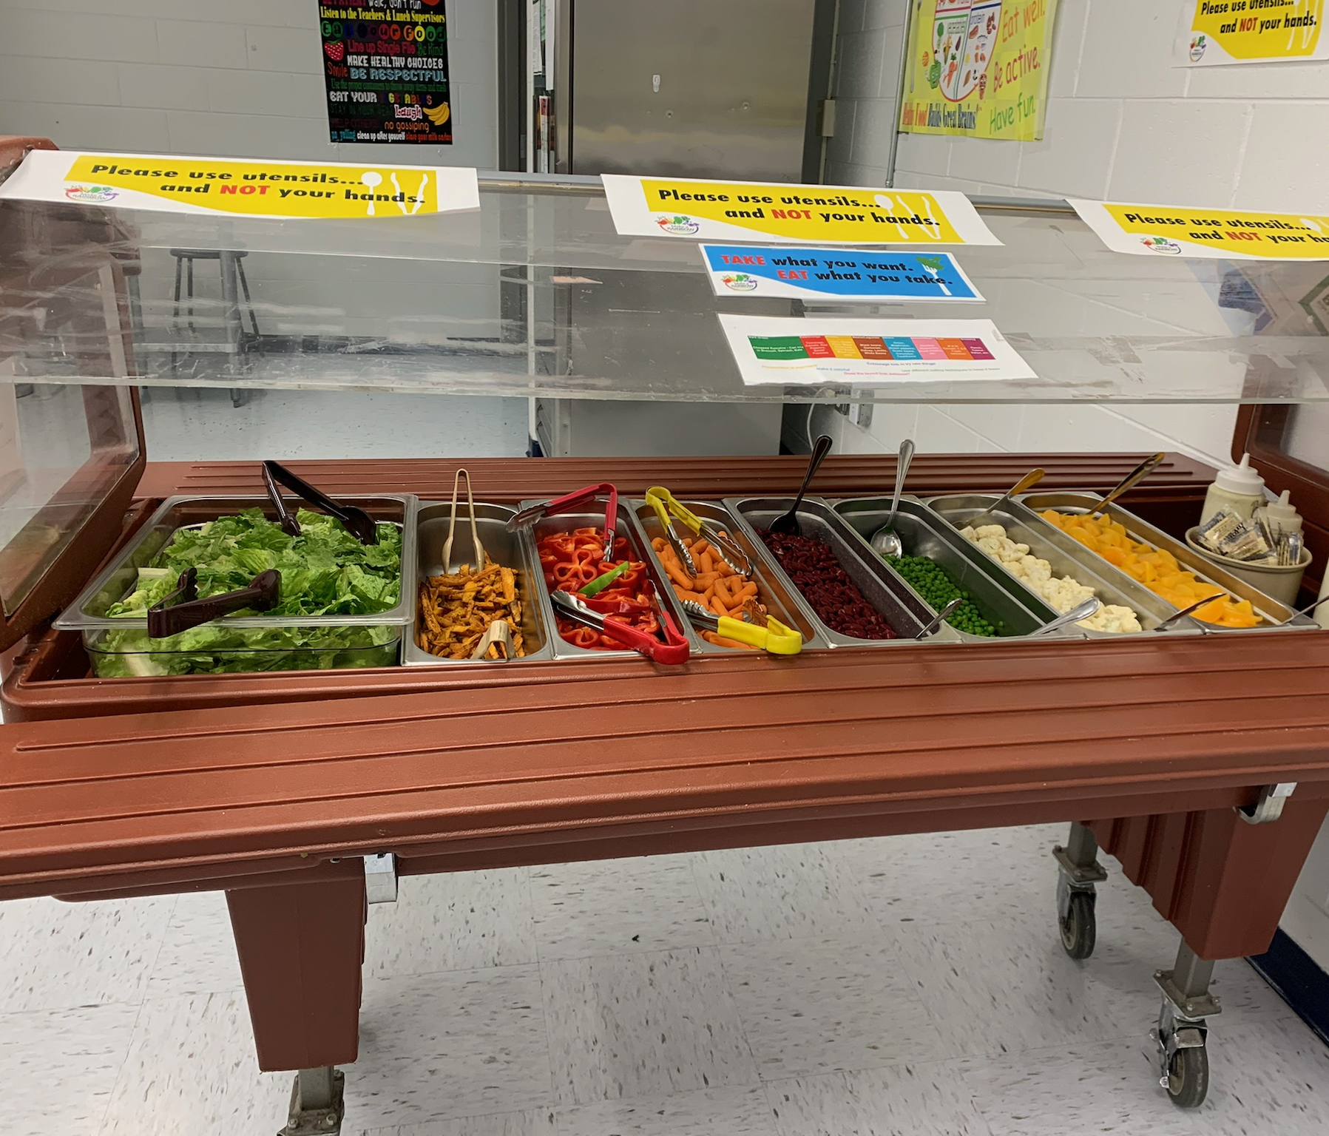
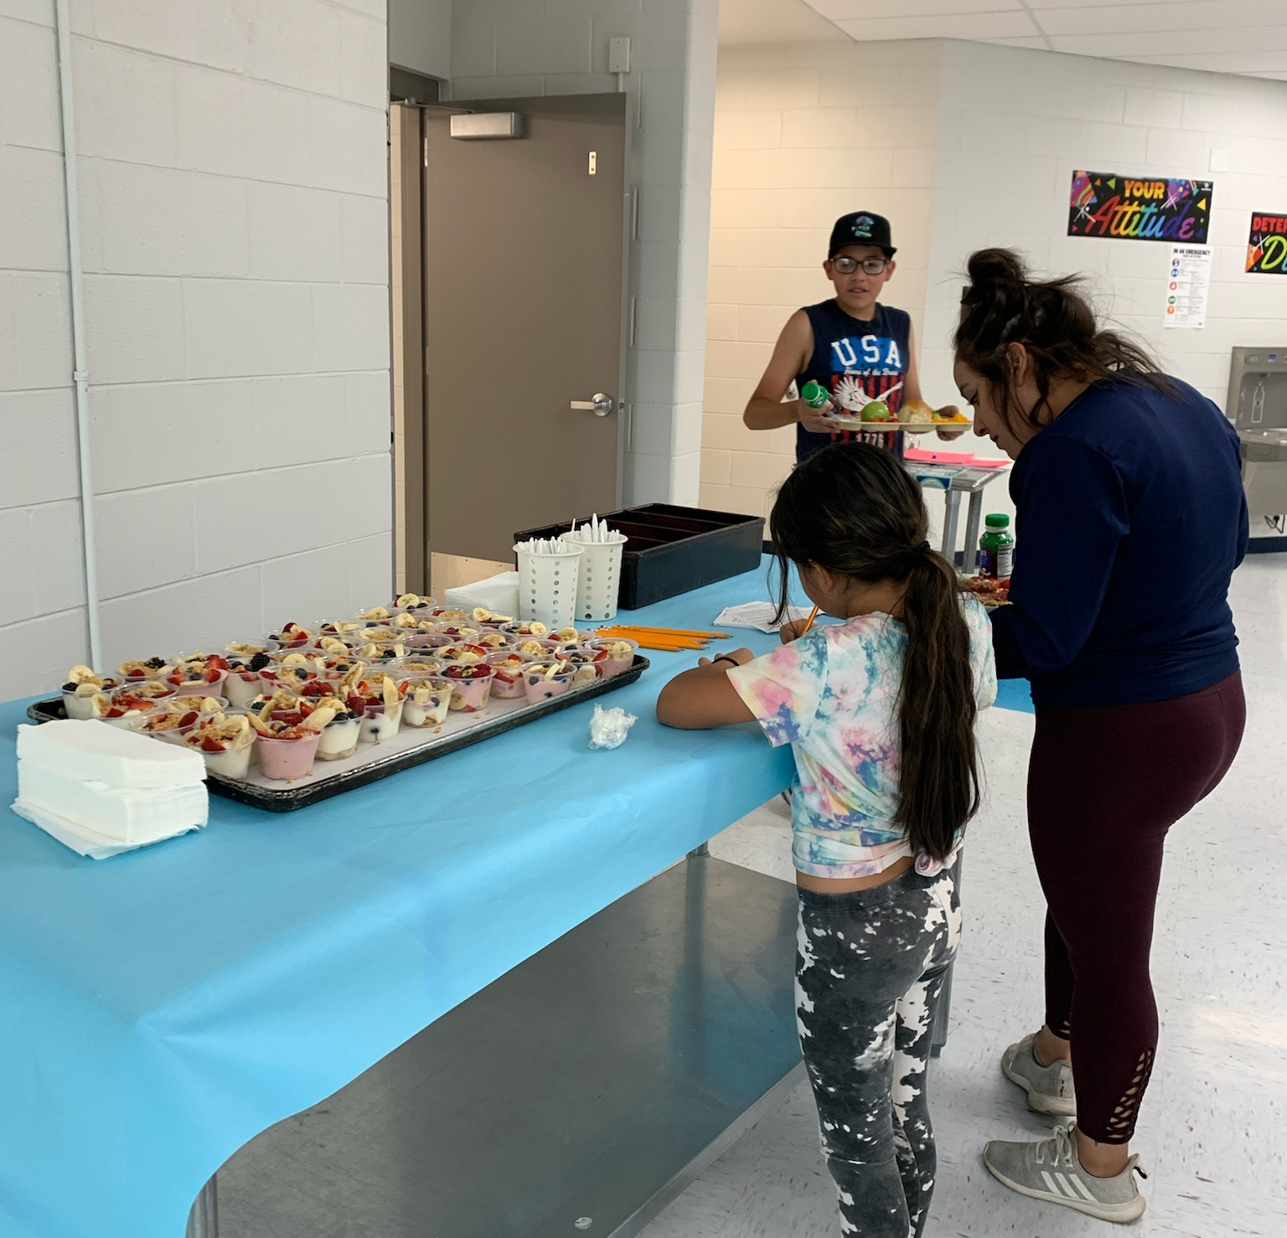
Stories from the field - Trinidad
Nourish Local Procurement Colorado and School Garden Summit
Student survey
Menu recommendations
Taste tests
Bringing local items onto salad bars
Farm field trip
Notes:
Kathy and her team in Trinidad have been working hard to improve school meal quality! Through a Blueprint mini-grant she was able to attend the Nourish Local Procurement Colorado training – a 3 part training series to connect school districts and other institutional buyers to local producers. Kathy will attend the second class this fall. They also attended the school garden summit in Denver to learn how to use school gardens as educational tools to improve school meal quality.
With the help of Nourish, Kathy developed a quick student survey to assess their attitudes of the meal program and asked them to indicate their favorite items. As you can see in the picture, they also conducted taste tests in their summer meal program to get student feedback. Getting student feedback is an essential step in improving meal quality – in order to improve meals you need to know what your students want!
Kathy was also able to bring a salad bar into her summer meals program and her customers were thrilled – not many people offer a fresh salad bar in a summer meals program! Salad bars are an easy way to begin incorporating local produce into your menus. She’s planning to host a farm field trip this fall so students can see what the fall harvest entails.
Thanks for all of your work to improve school meal quality, Kathy!

Slide 28
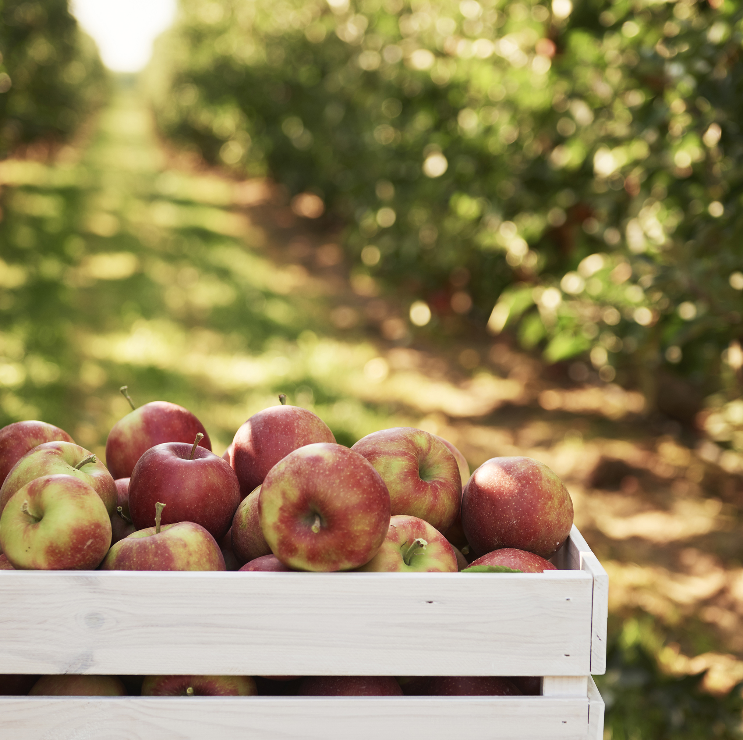
Call to Action
What is one thing you can do to celebrate farm to school month?
Connect
Promote
Procure
Anything else!
Notes:
We’ve discussed a lot of ways you can celebrate farm to school month today – you can buy local food, provide nutrition education, improve meal quality, and always remember to promote the great things you’re doing! We hope this webinar was an inspiration for you to start serving more local food in your program. Farm to school is not a one size fits all approach. There are many ways you can celebrate farm to school month that work best for your school district. Whatever you decide, we hope you have a great farm to school month. And don’t forget to send us pictures and stories from your celebrations! We’re always looking to feature school districts in our upcoming trainings and publications.
Before you leave, take a moment to think about an action you might be able to take in your district to celebrate farm to school month. If you’re just starting out, this could mean talking to an agriculture teacher or student group about how to begin a farm to school program. You could also commit to using some of the free resources provided today to promote the local items you’re already serving. Maybe you’re ready for something more challenging and want to apply for funding or make connections with a local producer to incorporate local items into your menus. Whatever you’re ready for you can always contact us to help you develop a plan or make those initial connections.
If you feel like sharing, please share in the chat how you are planning to celebrate F2S month in October?

Slide 29
Masterclass Foundations
What?
Who?
When?
Virtual, one hour training series to learn skills to boost program participation
Sound financial practices
Data-driven improvement
Community engagement
Peer-to-peer learning, sharing, and networking
All food service professionals who want to learn foundational skills needed to effectively implement child nutrition programs
November 2022 -
March 2023
Complete the Masterclass Foundations sign-up form and indicate the dates you would like to participate
Questions? Contact McKenna at pullen_m@cde.state.co.us or 720-644-7259
Notes:
Before we leave today, I wanted to promote another training opportunity. School nutrition staff of all levels can register for Masterclass Foundations. This is a series of virtual trainings that give participants skills to boost program participation. Each course will be offered 3 times in each month, so register for the time that works best for you. You’ll learn about financial management, using data to make decisions about your program, and how to engage students and community in your programs. For questions, please contact McKenna.

Slide 30
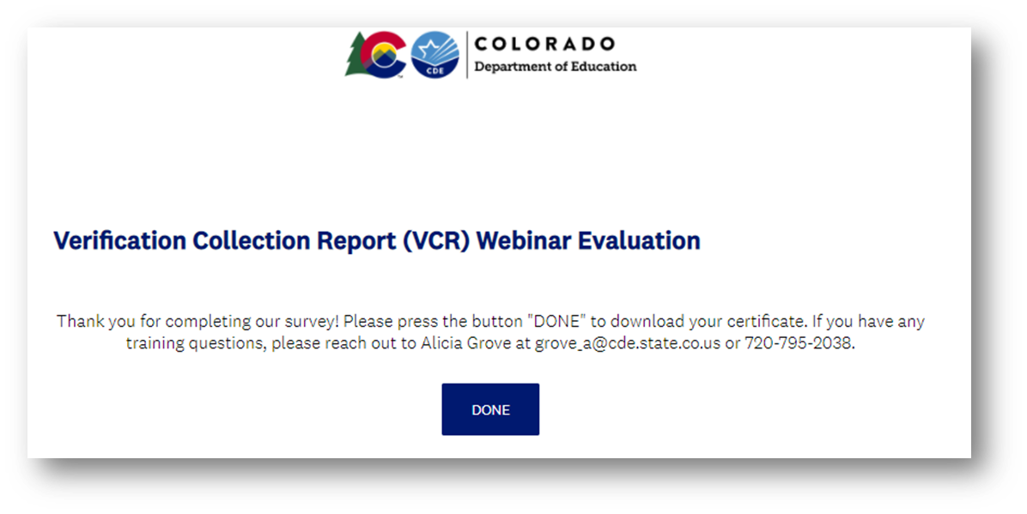
Training Evaluation & Certificate
Click this link to complete a quick training evaluation
https://www.surveymonkey.com/r/SGKCMWM
When you submit the evaluation click “DONE” on the survey thank you page to download your certificate
On the Menu Farm to School Webinar Evaluation
Notes:
This link will be emailed out to all training attendees and once you complete it, you will receive a certificate for your professional standards records.
Thank you so much for your feedback - we are always looking for ways to improve our trainings to better support you.

Slide 31
Thank you!
Becca Boone
McKenna Pullen
Boone_R@cde.state.co.us
Pullen_M@cde.state.co.us
https://www.cde.state.co.us/nutrition/nutrifarmtoschool
Notes:
I’ll open it up to any last questions that I might have missed…..Contact either of us with Farm to School or MQ questions!

