Slide 1
Pandemic EBT Data Collection
July 27, 2022
Presenter: Christian Francisco
Notes:
This session is being recorded and the slide deck will be shared.

Slide 2
Mute/
Unmute
Video
On/Off
Chat
Closed Caption
Notes:
First, I will cover some quick Zoom housekeeping items before we jump into the content.
All attendees will enter muted. You will know that you are muted if the microphone button in the lower left corner has a slash across it. Next to the microphone is a camera icon. Click the camera icon to turn it on which will remove the slash across the icon. It is completely optional to turn on your camera today.
If you keep moving across the bottom portion of your screen you will see a chat icon in the middle. If you have any questions today, please insert them into the chat-we will monitor the chat and compile a list of questions to address at the end of the webinar if we have time.
We will insert the PowerPoint slides for today with speaker notes into the chat for you to download.
To the right of the chat icon, is an icon for closed captioning if you needed it. Go ahead and click this button for subtitles.

Slide 3
CDE School Nutrition
Vision
Mission
Nourish young bodies and minds. End childhood hunger.
We support the child nutrition community through innovation, training, and partnerships to ensure all youth have access to healthy meals.
Notes:
We have spent time updating our vision and mission.

Slide 4
Non-Discrimination Statement
In accordance with federal civil rights law and U.S. Department of Agriculture (USDA) civil rights regulations and policies, this institution is prohibited from discriminating on the basis of race, color, national origin, sex (including gender identity and sexual orientation), disability, age, or reprisal or retaliation for prior civil rights activity.
Program information may be made available in languages other than English. Persons with disabilities who require alternative means of communication to obtain program information (e.g., Braille, large print, audiotape, American Sign Language), should contact the responsible state or local agency that administers the program or USDA’s TARGET Center at (202) 720-2600 (voice and TTY) or contact USDA through the Federal Relay Service at (800) 877-8339.
To file a program discrimination complaint, a Complainant should complete a Form AD-3027, USDA Program Discrimination Complaint Form which can be obtained online at: https://www.usda.gov/sites/default/files/documents/USDA-OASCR%20P-Complaint-Form-0508-0002-508-11-28-17Fax2Mail.pdf, from any USDA office, by calling (866) 632-9992, or by writing a letter addressed to USDA. The letter must contain the complainant’s name, address, telephone number, and a written description of the alleged discriminatory action in sufficient detail to inform the Assistant Secretary for Civil Rights (ASCR) about the nature and date of an alleged civil rights violation. The completed AD-3027 form or letter must be submitted to USDA by:
1. mail:
U.S. Department of Agriculture
Office of the Assistant Secretary for Civil Rights
1400 Independence Avenue, SW
Washington, D.C. 20250-9410; or
2. fax:
(833) 256-1655 or (202) 690-7442; or
3. email:
program.intake@usda.gov.
This institution is an equal opportunity provider.
Notes:
We include the nondiscrimination statement in our trainings as a reminder of our responsibilities to ensure all eligible people may participate in our child nutrition programs. As equal opportunity providers, we prohibit discrimination in our programs and provide fair and equitable treatment to every participant. For the full disclosure statement, visit the School Nutrition civil rights webpage.

Slide 5
Conditions for Success
Be present + engaged
Actively listen, be curious and ask questions
Engage in respectful discussion and feedback
Notes:
Here are some other conditions for success to make our time together today as meaningful as possible include.
Are there any other conditions that would help ensure a successful session that you would like to add today?

Slide 6
Learning Objectives
By the end of this training, sponsors will be able to:
Define the changes in file layout and submission requirements for school year corrections and/or students found newly eligible for free or reduced-price meals (FRPL)
Identify how to accurately submit student data for the upcoming collections
Utilize resources to amend errors
Professional Standards
Administration 3000
Free and Reduced-Price Meal Benefits 3100
Notes:
By the end of this training you will be able to:
You will receive 1 hours of training today in and Reduced-Price Meal Benefits, and Administration.

Slide 7
Agenda
What is P-EBT
Data Requirements for SY Corrections and Summer
Practical Scenarios
Questions
Resources
Notes:
You will have the opportunity to ask questions at the end. If you have questions during the presentation please put them in the chat we have some wizards in the background that will answer those. If your question is very specific we may save it til the end to give it the attention it deserves or we will answer it in depth in our follow up email and FAQ depending on time constraints

Slide 8
What is the Pandemic Electronic Benefits Transfer (P-EBT) Program?
Notes:
We do have some new data respondants so we’ll do a quick overview of the program

Slide 9
P-EBT
Families First Coronavirus Response Act (FFCRA) created P-EBT to assist families who lost access to free or reduced-price school meals due to school closures in response to COVID-19.
Notes:
The families first coronavirus response act created the P_EBT program to assist families who lost access to free and reduced price school meals because of school closures in response to COVID19.
P-EBT is a cash like benefit families use to purchase groceries
CO was approved to provide benefits for SY2021-2022 and Summer of 2022

Slide 10
Eligibility for P-EBT
When is a Student Eligible?
The child is eligible for free or reduced-price meals and attends a school that operates the National School Lunch Program (NSLP), or attends a school that operates a provisional program
The child has not received meals at school because:
The school was operating on a hybrid or remote schedule for at least 5 consecutive days; or
The child has opted-in to fully remote learning/hybrid learning; or
The student was absent due to a COVID-19 outbreak.
and

Slide 11
Data Requirements for School Year Corrections and Summer

Slide 12
P-EBT Data Collection in Data Pipeline
There will be TWO separate Correction and Summer collections
Fall Semester 2021 (Collected Aug 8-31)
August 2021 through December 2021 corrections
Any students who were omitted
Newly eligible FRPL students up to June 30, 2022
Spring Semester 2022 (Collected Sept 6-29)
January 2022 through May 2022 corrections
Any students who were omitted
Newly eligible FRPL students from July 1 up to August 26, 2022
Notes:
There will be TWO separate correction and summer collections one for Fall Semester and one for Spring Semester

Slide 13
P-EBT Data Collection in Data Pipeline
Students submitted in either corrections collection or in original school year collections will be considered for Summer P-EBT benefit
Students must be submitted in at least one of the collections to be considered for summer benefits (April, May, August or September)
Notes:
STUDENTS MUST BE SUBMITTED IN AT LEAST ONE OF THE
COLLECTIONS (in April, in May, in August and/or in
September TO BE CONSIDERED FOR SUMMER BENEFITS)

Slide 14
(e) RELEASE OF INFORMATION.—Notwithstanding any other provision of law, the Secretary of Agriculture may authorize State educational agencies and school food authorities administering a school lunch program under the Richard B. Russell National School Lunch Act (42 U.S.C. 1751 et seq.) to release to appropriate officials administering the supplemental nutrition assistance program such information as may be necessary to carry out this section.
Privacy and Data Sharing Reminder
Notes:
The same privacy and data sharing assurances from last school year continue to be in place.
P-EBT legislation allows districts to share data with CDE without parental consent.

Slide 15
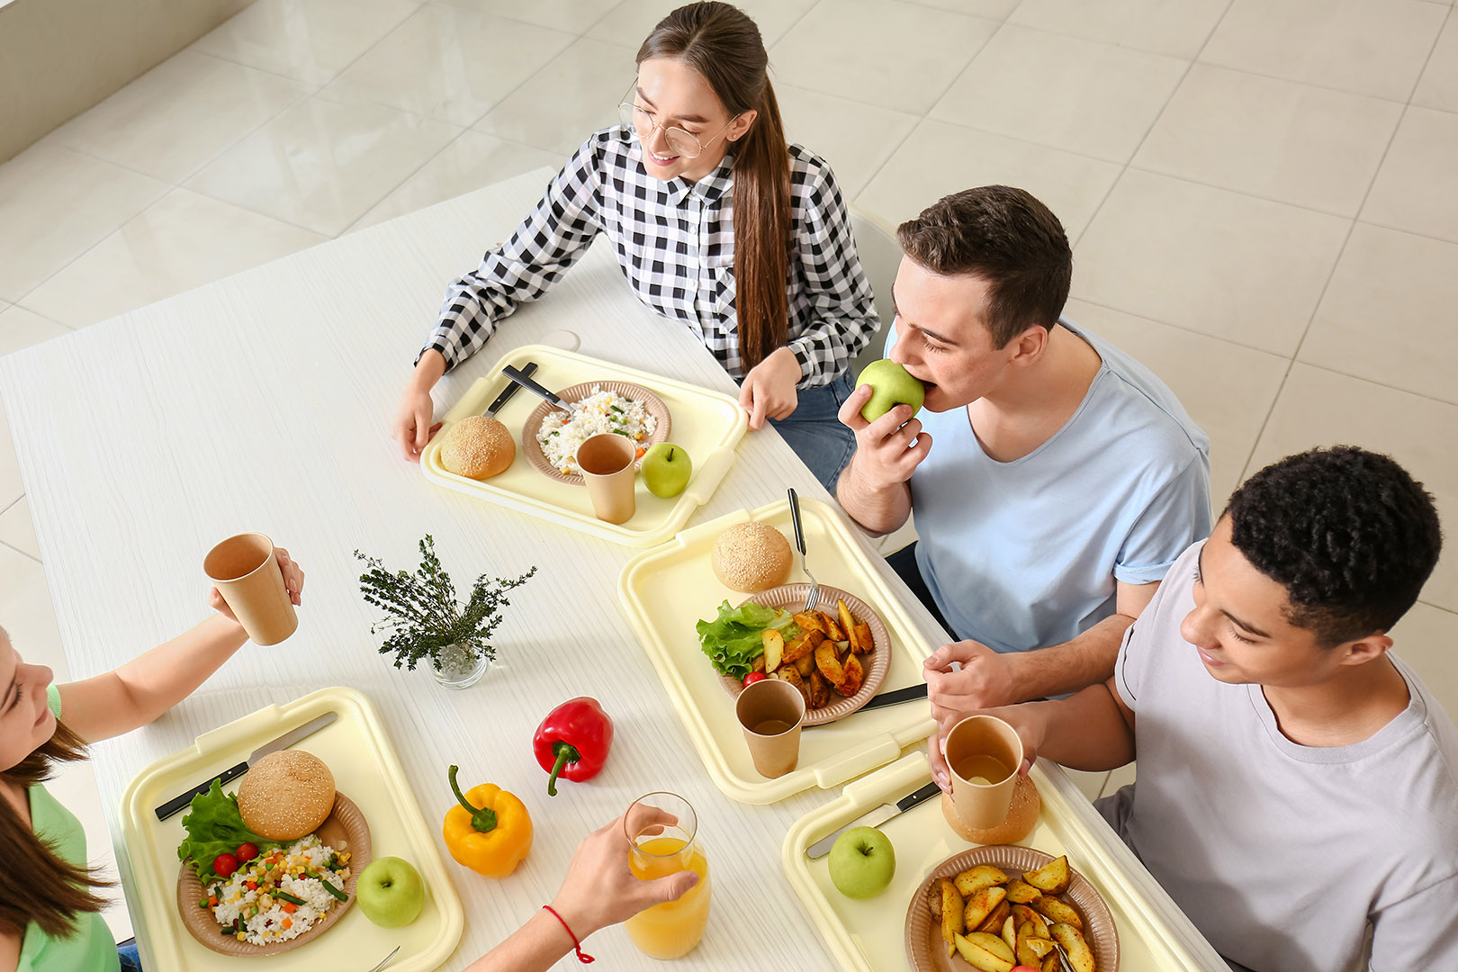
Differences with this Corrections & Summer Period
Same general layout as previous two collections
For the Spring Corrections Collection a new learning modality for newly eligible students on or after July 1, 2022
Students submitted in both collections will be assessed for summer benefits automatically
Notes:
For the Spring Corrections Collection a new learning modality option “5-Newly FRPL Elig-Summer PEBT Only” has been added for students that are newly eligible on or after July 1 2022
Column 25

Slide 16
Tips for the P-EBT Uploads
Provide FULL universe of students enrolled during the current School Year
District can submit multiple records for the same student
Notes:
Provide FULL universe of students enrolled during the current SY
BENEFITS TO PROVIDING FULL UNIVERSE
Able to use historical October Count data
Able to use CDPHE COVID Outbreak data
District can submit multiple records for the same student
Different school enrollments
Different learning modalities throughout the semester Data

Slide 17
Guiding Principles for this Corrections & Summer Period
Students found newly eligible on or before June 30 should be submitted in BOTH Fall (August) and Spring (September) corrections collections.
Student found FRPL Eligible before July 1 will be considered retroactively for SY21-22 benefits
Attendance data and Learning Modality and Timeframe data is required for the students to be considered for school year benefits
Students found newly eligible on or after July 1 should ONLY be submitted in the September Spring Collection with a learning modality of “5 - Newly FRPL Elig-Summer PEBT Only”
For students that were eligible on or after July 1, absence data or learning modality time frame data will not be required

Slide 18
Practical Scenarios

Slide 19
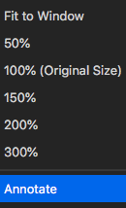
1
CDE PEBT Teams
2
3
Notes:
We’ve listened to your feedback last time of difficulties with Jamboard so we’ll use the built in zoom Annotate Tool. Click the view options button at the top of the screen where Zoom says you’re viewing my screen. At the bottom of that drop-down, click Annotate. When the Annotate toolbar pops up, click the T for text so you can type directly onto my screen. Do not worry if your post overlaps others I will rearrange them as everyone types.
Lets practice now. Everyone use the annotate text to tell me what the newest food, dish, or restaurant you tried was and what you would rate it out of 10 bonus points for people who rate something a 10 and give me the recipe or directions to the restaurant

Slide 20
Scenario 1
Petyr Parker was found eligible for Free Lunch on April 30 and he did not get included in our submissions for the 2021-2022 School Year.

Slide 21
Petyr Parker was found eligible for Free Lunch on April 30 and he did not get included in our submissions for the 2021-2022 School Year.
Submission?
Attendance Data?
Modality Data?
Notes:
Which submission(s) should Petyr be included in?
Does attendance data need to be submitted in submission(s) for Petyr?
Does Learning Modality data need to be submitted in the submission(s) for Petyr?

Slide 22
Petyr Parker was found eligible for Free Lunch on April 30 and he did not get included in our submissions for the 2021-2022 School Year.
Submission?
Attendance Data?
Modality Data?
Both Fall 2021 Corrections in August and Spring 2022 Corrections in September | Yes, Petyr Needs to have attendance data submitted for BOTH semesters | Yes, Petyr needs Learning Modality Data for BOTH semesters
Notes:
Petyr Parker could potentially be eligible for benefits for both the Fall 2021 and the Spring 2022 retroactively.
Petyr should be submitted in both collections:
Fall 2021 Corrections collection in August AND
Spring 2022 Corrections in September
If a student is submitted in either correction collections they will be assessed for Summer 2022 benefits as well
The formatting for Petyr will be the same as our previous collections.
Attendance data is required for both semesters
Learning Modality data is required for both semesters
Learning Modality timeframe data is required if the student was a Remote or Hybrid learning during either semester

Slide 23
Scenario 2
Thor was found eligible for Free Lunch on June 3 (after the end of the school year).

Slide 24
Thor was found eligible for Free Lunch on June 3 (after the end of the school year).
Submission?
Attendance Data?
Modality Data?
Notes:
Which submission(s) should Thor be included in?
Does attendance data need to be submitted in submission(s) for Thor?
Does Learning Modality data need to be submitted in the submission(s) for Thor?

Slide 25
Thor was found eligible for Free Lunch on June 3 (after the end of the school year).
Submission?
Attendance Data?
Modality Data?
Both Fall 2021 Corrections in August and Spring 2022 Corrections in September | Yes, for both semesters | Yes, for both semesters
Notes:
Thor could potentially be eligible for benefits for both the Fall 2021 and the Spring 2022 retroactively.
Thor should be submitted in both collections:
Fall 2021 Corrections collection in August AND
Spring 2022 Corrections in September
The formatting for Thor will be the same as our previous collections.
Attendance data is required for both semesters
Learning Modality data is required for both semesters
Learning Modality timeframe data is required if the student was a Remote or Hybrid learning during either semester

Slide 26
Scenario 3
Spruce Wayne was found eligible for Free or Reduced Price Lunch on July 6, 2022.

Slide 27
Spruce Wayne was found eligible for Free or Reduced Price Lunch on July 6, 2022.
Submission?
Attendance Data?
Modality Data?
Notes:
Which submission(s) should Spruce be included in?
Does attendance data need to be submitted in submission(s) for Spruce?
Does Learning Modality data need to be submitted in the submission(s) for Spruce?

Slide 28
Spruce Wayne was found eligible for Free or Reduced Price Lunch on July 6, 2022.
Submission?
Attendance Data?
Modality Data?
Only in Spring 2022 Corrections in September | Not Required | Learning Modality is required using the new value of “5-Newly FRPL Elig-Summer PEBT Only” Modality timeframe not required
Notes:
Because Spruce Wayne was found eligible for Free or Reduced Price Lunch on or after the july 1st cut off, he is NOT eligible for benefits for the 2021-2022 school year. Spruce is ONLY eligible for consideration for Summer 2022 benefits.
Spruce should be submitted in ONLY:
Spring 2022 Corrections in September
There will be differences in the file layout for Spruce:
Attendance data is NOT REQUIRED
Learning Modality data is required but the new value of “5-Newly FRPL Elig-Summer PEBT Only” should be selected
Learning Modality timeframe data is NOT REQUIRED

Slide 29
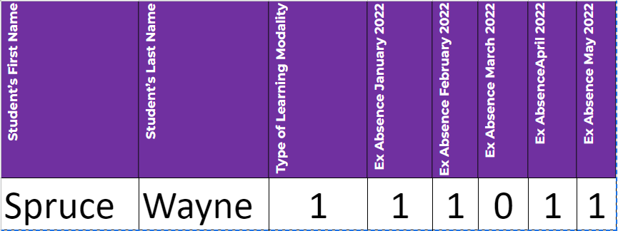
Can you spot what is wrong?

Slide 30
Can you spot what is wrong?
Notes:
1) Regardless of the SY Modality Spruce had, because he was newly eligible after July 1st you only need to list him as Learning Modality 5
2) Because Spruce is only eligible for summer you do not need to fill out any modality time frame or excused absence data
3) Bonus point. Anytime you report an absence data it should be two digits. We lost leading zeros. Always make sure to look at the file layout to ensure the correct amount of digits are present

Slide 31
Scenario 4
Diana Prynce was submitted in the previous collections as an In-Person learner. After reviewing the data more closely, we came to realize the Diana was a remote learning from 10/5/21 - 3/23/22.

Slide 32
Diana Prynce was submitted in the previous collections as an In-Person learner. After reviewing the data more closely, we came to realize the Diana was a remote learning from 10/5/21 - 3/23/22.
Submission?
Attendance Data?
Modality Data?
Notes:
Which submission(s) should Diana be included in?
Does attendance data need to be submitted in submission(s) for Diana?
Does Learning Modality data need to be submitted in the submission(s) for Diana?

Slide 33
Diana Prynce was submitted in the previous collections as an In-Person learner. After reviewing the data more closely, we came to realize the Diana was a remote learning from 10/5/21 - 3/23/22.
Submission?
Attendance Data?
Modality Data?
Both | Yes, for both semesters | Yes, for both semesters AND Learning modality timeframe will be required
Notes:
The correction for Diana could potentially impact her eligibility for benefits for both the Fall 2021 and the Spring 2022.
Diana should be submitted in both collections:
Fall 2021 Corrections collection in August AND
Spring 2022 Corrections in September
The formatting for Diana will be the same as our previous collections.
Attendance data is required for both semesters
Learning Modality data is required for both semesters
Learning Modality timeframe data is required since Diana was identified as being a Remote learning during both semesters

Slide 34
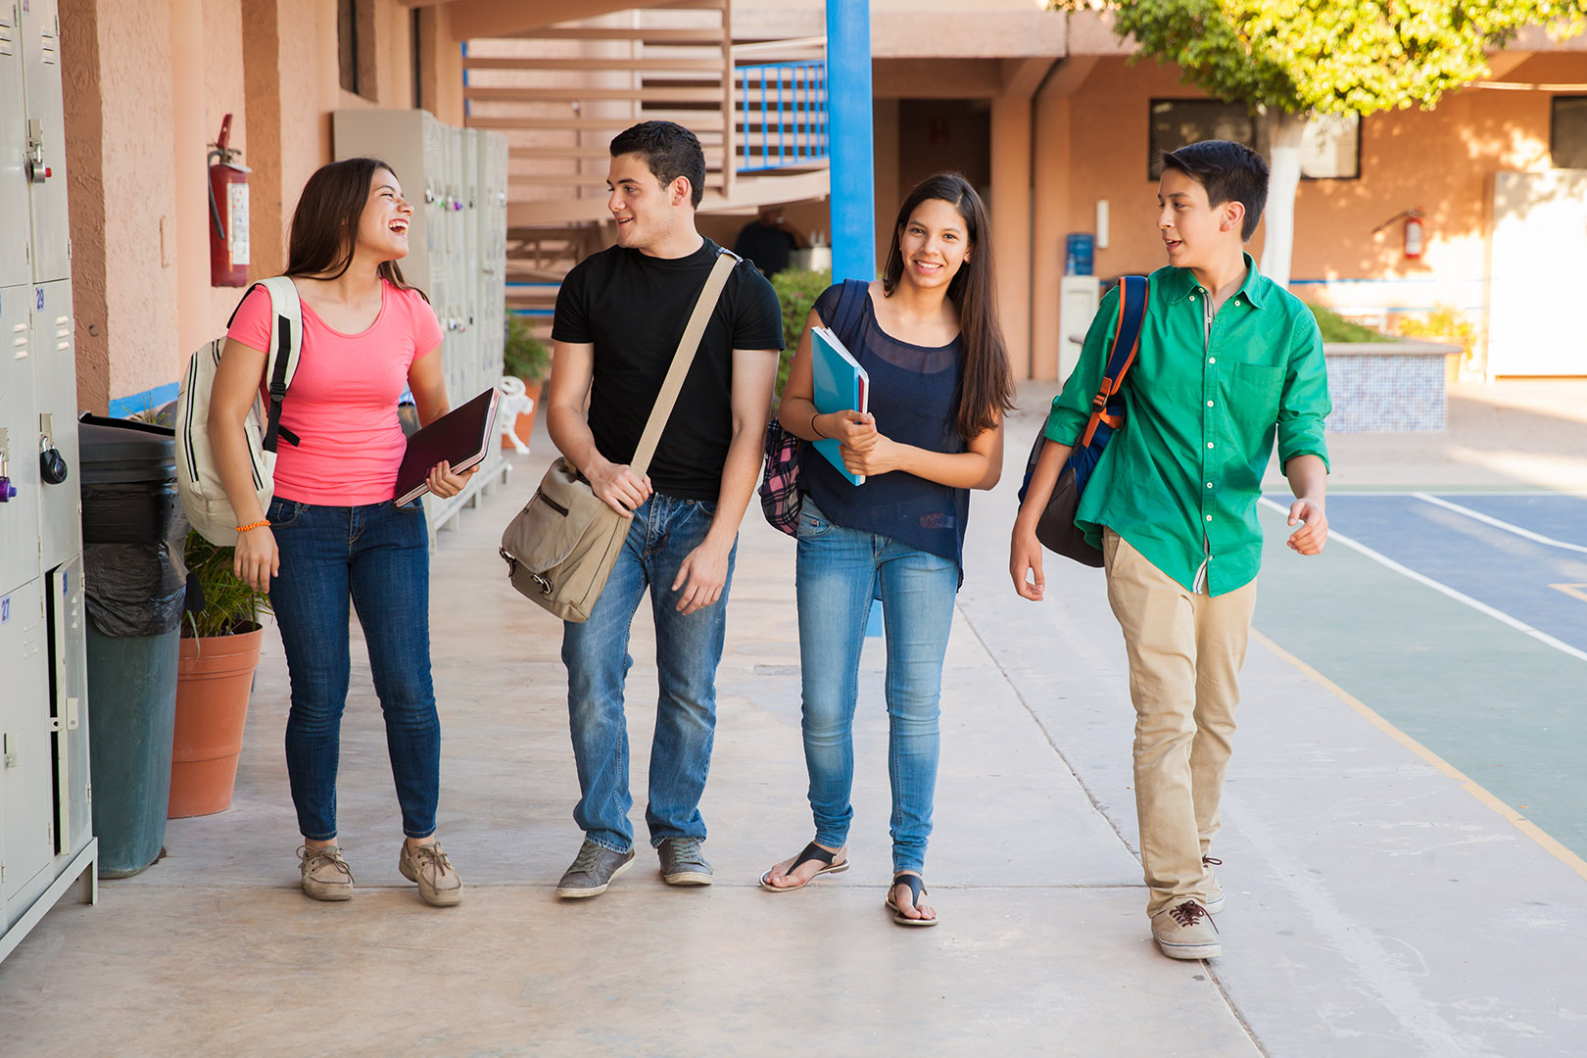
Scenario 5
Peeka Chu was found eligible for Free Lunch on January 20 and was submitted in the Spring 2022 collection in May. He was NOT included in the Fall 2021 collection in April since he had not been found eligible at that time.

Slide 35
Peeka Chu was found eligible for Free Lunch on January 20 and was submitted in the Spring 2022 collection in May. He was NOT included in the Fall 2021 collection in April since he had not been found eligible at that time.
Submission?
Attendance Data?
Modality Data?
Notes:
Which submission(s) should Peeka be included in?
Does attendance data need to be submitted in submission(s) for Peeka?
Does Learning Modality data need to be submitted in the submission(s) for Peeka?

Slide 36
Peeka Chu was found eligible for Free Lunch on January 20 and was submitted in the Spring 2022 collection in May. He was NOT included in the Fall 2021 collection in April since he had not been found eligible at that time.
Submission?
Attendance Data?
Modality Data?
Only the Fall 2021 Corrections Collection in August | Yes for Fall | Yes, for Fall
Notes:
Peeka was already considered for benefits for the Spring 2022 semester but was NOT yet considered for benefits for the Fall 2021 semester. Because TBD was found FRPL eligible prior to July 1st, Peeka could be eligible for benefits for Fall 2021.
Peeka should be submitted in ONLY:
Fall 2021 Corrections collection in August AND
The formatting for Peeka will be the same as our previous collections.
Attendance data is required
Learning Modality data is required Learning Modality timeframe data is required if Peeka was identified as being a Remote or Hybrid learner during the Fall 2021 semester

Slide 37
Questions
Are there any other scenarios we haven’t covered that you would like addressed? Please place them in the chat.
Notes:
We tried our best to think of as many permutations of scenarios as possible. Are there any other scenarios we haven’t covered that you would like addressed?

Slide 38
A reminder of common errors
Leading Zeros: https://www.cde.state.co.us/datapipeline/convertcsvtoexcel
Non-Program School Code
Filling out the correct months for the respective collection
Notes:
Please Visit the Following Links to help troubleshoot when you lose leading zeros:
Please remember to fill out the non program school code
Please ensure you are only filling out Fall months for modality and excused absence data for the Fall collection and Spring months for the spring collection. Fall is categorized as Aug 2021- Dec 2021 and Spring is categorized as Jan 2022 thru May 2022

Slide 39
Resources
Ensure relevant staff are aware of training and available support
1:1 support ->
P-EBT.datapipeline.support@cde.state.co.us
P-EBT Data Collection Website: https://www.cde.state.co.us/datapipeline/p-ebtdatacollection
Business Rules: Unchanged for the Fall Collection here: https://www.cde.state.co.us/datapipeline/2021-2022pebtfinalfilelayout

Slide 40
Office Hours Return
Office Hours are returning on Mondays and Wednesdays starting August 10.
Register for your slot here: https://www.signupgenius.com/go/10C0E4FABAA2CABF5C07-pebt

Slide 41
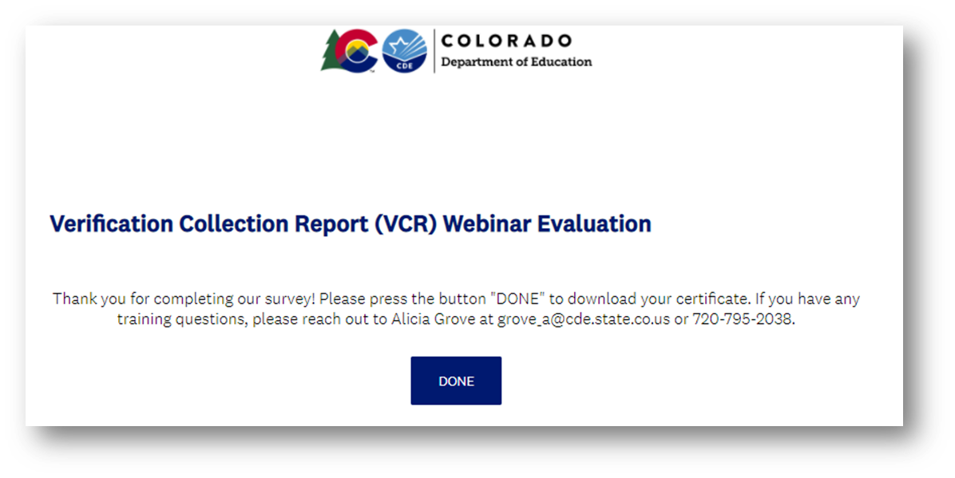
Training Evaluation & Certificate
Ctrl + Click this link to complete a quick training evaluation
Survey
When you submit the evaluation click “DONE” on the survey thank you page to download your certificate
Notes:
This link will be emailed out to all training attendees. This information is included for those watching this training at a later date as a recording.
Thank you so much for your feedback - we are always looking for ways to improve our trainings to better support you.

Slide 42
Thank you!
Christian Francisco
P-EBT.datapipeline.support@cde.state.co.us
https://www.cde.state.co.us/nutrition

