Slide 1
Summer Food Service Program Sponsor Training
March 2022
School Nutrition Unit
Notes:
Good afternoon, and welcome to the program year 2022 Summer Food Service Program Sponsor training. I am Megan Johnson, the Nutrition Programs Manager for the CDE School Nutrition Unit.
I may not be new to child nutrition programs, but I am newer to this role of overseeing the SFSP for the school nutrition unit. This is my first larger training in a while, but I’m excited to be with you today to talk about summer!

Slide 2
Mute/
Unmute
Video
On/Off
Chat
Closed Caption
Notes:
First, I will cover some quick Zoom housekeeping items before we jump into the content.
All attendees will enter muted. You will know that you are muted if the microphone button in the lower left corner has a slash across it. Next to the microphone is a camera icon. Click the camera icon to turn it on which will remove the slash across the icon. It is completely optional to turn on your camera today.
If you keep moving across the bottom portion of your screen you will see a chat icon in the middle. If you have any questions today, please insert them into the chat-we will monitor the chat and compile a list of questions to address at the end of the webinar if we have time.
We will insert the PowerPoint slides for today with speaker notes into the chat for you to download.
To the right of the chat icon, is an icon for closed captioning if you needed it. Go ahead and click this button for subtitles.
2

Slide 3
CDE School Nutrition
Vision
Mission
Nourish young bodies and minds. End childhood hunger.
We support the child nutrition community through innovation, training, and partnerships to ensure all youth have access to healthy meals.
Notes:
Here are the CDE School Nutrition Unit’s Vision and Mission. We have spent time updating our vision and mission to reflect our team’s desire to support our child nutrition community and end childhood hunger in Colorado.
3

Slide 4
Non-Discrimination Statement
In accordance with Federal civil rights law and U.S. Department of Agriculture (USDA) civil rights regulations and policies, the USDA, its Agencies, offices, and employees, and institutions participating in or administering USDA programs are prohibited from discriminating based on race, color, national origin, sex, disability, age, or reprisal or retaliation for prior civil rights activity in any program or activity conducted or funded by USDA. Persons with disabilities who require alternative means of communication for program information (e.g. Braille, large print, audiotape, American Sign Language, etc.), should contact the Agency (State or local) where they applied for benefits. Individuals who are deaf, hard of hearing or have speech disabilities may contact USDA through the Federal Relay Service at (800) 877-8339. Additionally, program information may be made available in languages other than English.
To file a program complaint of discrimination, complete the USDA Program Discrimination Complaint Form, (AD-3027) found online at: https://www.usda.gov/oascr/how-to-file-a-program-discrimination-complaint, and at any USDA office, or write a letter addressed to USDA and provide in the letter all of the information requested in the form.
To request a copy of the complaint form, call (866) 632-9992. Submit your completed form or letter to USDA by: (1) mail: U.S. Department of Agriculture Office of the Assistant Secretary for Civil Rights; 1400 Independence Avenue, SW Washington, D.C. 20250-9410; (2) fax: (202) 690-7442; or (3) email: program.intake@usda.gov.
This institution is an equal opportunity provider.
Notes:
We include the nondiscrimination statement in our trainings as a reminder of our responsibilities to ensure all eligible people may participate in our child nutrition programs. As equal opportunity providers, we prohibit discrimination in our programs and provide fair and equitable treatment to every participant. For the full disclosure statement, visit the School Nutrition civil rights webpage.
4

Slide 5
Be present and engaged
Participate in discussion
Mute your microphone when you’re not talking
Bring a positive attitude and be ready to share
Be respectful, inclusive and open minded
Conditions for Success
Notes:
Here are some other conditions for success to make our time together today as meaningful as possible.
Are there any other conditions that would help ensure a successful session that you would like to add today?

Slide 6
Learning Objectives
By the end of this training, you will be able to:
Identify which requirements are no longer waived
Locate training and resources for the SFSP
Describe SFSP program requirements as it relates to your operations
Professional Standards
1.5 hours in Operations (2000), Administration (3000), and Communications and Marketing (4000)
Notes:
By the end of this training, you will be able to:
Identify which requirements are no longer waived
Locate training and resources for the SFSP
Describe SFSP program requirements as it relates to your operations
You will also receive 1.5 hours of training that can be applied to professional standards requirements. The areas covered by this training are operations, administration, and communications and marketing.
6

Slide 7
2022 Updates
Program Operations
Financial Management
Application Training & Resources
Reviews
Marketing & Outreach
Agenda
Notes:
Here is the agenda for today’s training. We have a lot to cover, and I want to make sure to get to any additional questions you may have. Thank you to those who sent your questions ahead of time. I have tried to incorporate answers to your questions into this training.
If questions come up during the training, please feel free to type them in the chat and we will have time for questions throughout the training and at the end.
I also want to note that resources are linked on the slides throughout this presentation. You won’t be able to click on your screen for the links, but you can download the slides and access the links that way. There is also a handout linked in the chat with all of the links in one place.

Slide 8
Summer 2022 Updates
Notes:
We’re going to start this training with a topic that I know is on all of our minds, which is what we currently know about waivers for this year.

Slide 9
Waiver Updates
Covid-19 related waivers have not been extended for summer 2022
Notes:
For the past couple of years, the USDA has been able to grant nationwide waivers related to the covid-19 pandemic that have provided a tremendous amount of flexibility around SFSP program requirements. Unfortunately, the USDA no longer has the authority to extend these waivers. Once the school year ends, covid-19 related waivers do not apply and all of the traditional SFSP requirements will be in place again.
However, I also want to share that the USDA is continuing to look for ways to extend flexibilities where they do have the authority to do so. This may allow the School Nutrition Unit to request state-wide waivers for specific requirements. At this time we do not know what USDA will be able to allow. Today we will talk about what we currently know, and we will actively communicate any changes or additional flexibilities as new information becomes available.
On the next couple of slides we will go over some of the program areas that will be affected by the loss of these waivers, as well as the waivers that we have already requested for this year.

Slide 10
Waiver Updates
Seamless Summer Option
SSO waivers are not available once the regular school year is over
Notes:
Let’s start with the Seamless Summer Option. SSO waivers expire on June 30th, but please keep in mind that SSO waivers only relate to the regular school year. This means that the waivers are not available during the summer break, even if it begins before June 30th.
In other words, once your regular school year is over, SSO waivers do not apply.
During summer break, you are able to transition to the SFSP. Please reach out to myself or your point of contact if you have questions about which programs can be used during the summer months.

Slide 11
Area Eligibility
Sites must meet eligibility requirements
Waiver Updates
Notes:
Now let’s move into the SFSP.
Area Eligibility requirements have been waived as part of the covid-19 related waivers, which has allowed sites to participate in the SFSP when they would not traditionally be eligible to serve meals.
Currently, there is no waiver for this requirement, which means that all sites that participate in the SFSP must meet site eligibility requirements.
We will go over site eligibility and resources for selecting sites when we talk about program operations.

Slide 12
Congregate feeding
Kids must stay on-site to eat meals
Parents cannot pick up meals for their kids
Waiver Updates
Notes:
Congregate feeding is another one of the requirements that has been waived over the past couple of years. Congregate feeding requires kids to stay on-site and eat meals in order for those meals to be claimed for reimbursement. With congregate feeding requirements, kids must be present to receive a meal and their parents cannot pick up a meal for them.
As of today, there are not any waivers that allow for non-congregate feeding or parent pick up. However, this is an area that we may see flexibility for this summer.

Slide 13
Poll #1
Scenario:
My regular school year ends on May 30th, but there is a summer school taking place in June. Can I continue to operate the SSO through June 30th?
Notes:
Here is a quick poll question to make sure we all have the same understanding around expiring waivers.
Poll Question 1- Scenario:
My regular school year ends on May 30th, but there is a summer school taking place in June. Can I continue to operate the SSO through June 30th?
Yes
No
I Don’t Know
Answer: No, you cannot use the current waivers to operate the SSO through June 30th if your regular school year ends before that date. You could transition to SFSP if the school site is eligible.

Slide 14
Waiver Questions?
Notes:
I know that this is a big transition from how programs have been operating for the last couple of years, and I want to make sure I answer any questions specific to the waivers. Are there any questions you can think of at this time? Please feel free to type in the chat or un-mute yourself.
Open up to other waiver questions- limit to 10 min

Slide 15
Program Operations
Notes:
Thank you for bringing up your questions around the waivers. If you think of any other questions, feel free to put them in the chat and we can answer them at the end of this training.
Now we’re going to dig in to some more detailed information on program operations.

Slide 16
Program Operations
Training Requirements
Site Eligibility
Meal Patterns
Civil Rights
Procurement
Financial Management
Notes:
In this section, we will cover training requirements, site eligibility, meal patterns, civil rights, procurement, and financial management.
As I will share in the next slide, we have new trainings available for many of these topics that dig even deeper into the requirements. Today we are going to cover important updates and reminders for this upcoming summer.

Slide 17
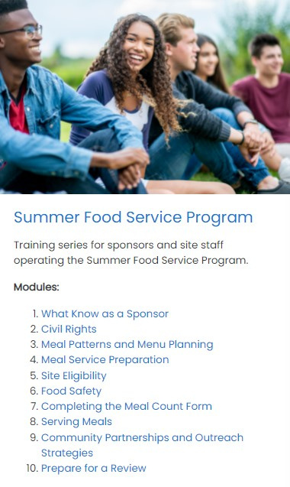
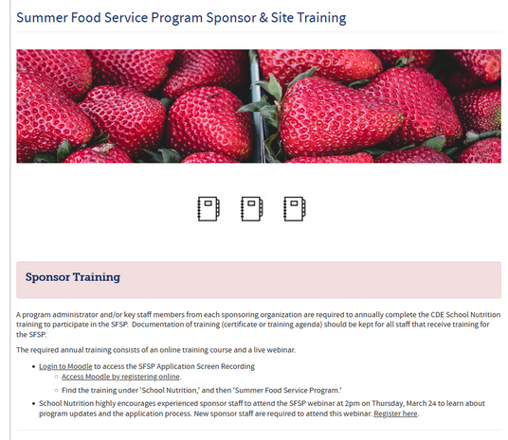
Training Requirements: Sponsors
SFSP Training Page
Notes:
I am excited to share with you that our team has recently worked with a contractor to create a new sponsor training video series. This series features ten videos that cover SFSP operations at the sponsor level. There are five videos that are required for all new and returning sponsors, and five videos that are highly encouraged for new and returning sponsors.
New sponsors are also required to attend this webinar (live or recorded).
To access the videos, visit our summer training web page. You will need to log in to our new training platform called Moodle to access the videos, and if you don’t have a Moodle account you can fill out a quick form that is also linked on the training page to create a new account.

Slide 18
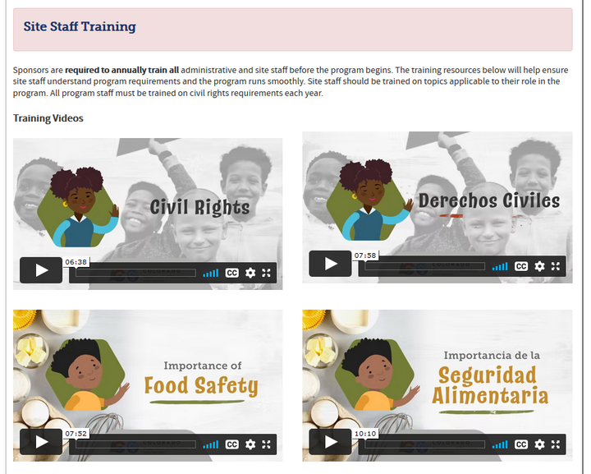
Training Requirements:
Site Staff
Notes:
The School Nutrition Unit also worked with a contractor to create site-level training videos that are linked directly to our summer training web page. As a reminder, all staff/volunteers are required to be trained before program operations begin, and should be trained on areas applicable to their role. Civil rights training is also required for all staff and volunteers.
In addition, please keep documentation of training for all staff and volunteers using training certificates or training agendas.

Slide 19
Site Eligibility
Notes:
With the area-eligibility waiver no longer in place, all sites must meet site eligibility requirements.
For open and closed enrolled sites, area eligibility may be used. When we talk about area eligibility it means that the site is in a location where at least 50% of the kids in the area qualify for free or reduced-price meals. To determine area eligibility you can use either school or census data.
If school data is used, you must use the pk-12 Oct. 1 count. If another month during the school year qualifies the school, you can use that month but must specify the month in the site application.
Please note that the school data used must be from a school in the attendance area of the site, so the school used could be the elementary, middle or high school within the attendance area.
If you use census data, the most recent census data must be used. You can utilize the USDA’s area eligibility map to determine which locations qualify using census data.
School or census data qualifies a site as eligible for 5 years– so you do not need to determine eligibility every year.

Slide 20
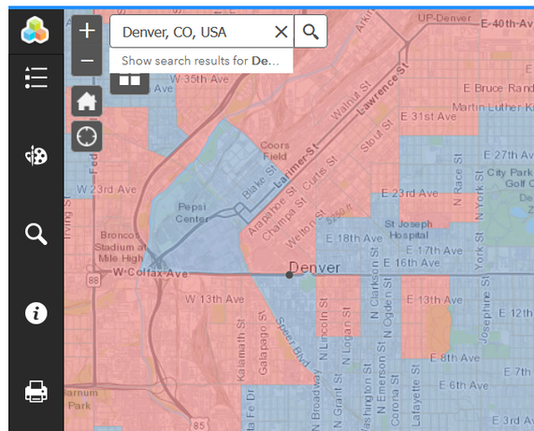
Site Eligibility Resources
How To Determine Site Eligibility Resource
USDA Area Eligibility Map:
census data- red is eligible
CDE Pupil Membership
must use the pk-12 Oct. 1 school count
CO School District Maps
USDA Capacity Builder Map
Tool to help with identifying potential site locations
Can layer different data to visualize gaps in service
Notes:
Linked on this page are several tools that can help identify whether or not a site is eligible and potential site locations.
The How To Determine Site Eligibility Resource covers all of the requirements that I went over in the last slide, and is your go-to resource for site eligibility information.
The USDA area eligibility map is pictured on this slide. The mapping tool allows you to type in any address and easily see if the location is eligible based on census data. If the site is in a red area, then it is eligible.
The CDE pupil membership pk-12 October 1 school count has all of the current school free and reduced lunch eligibility data. In order to find out if the site is within the attendance area of a certain school, you can reference the school district map to find the correct district, and then look on the district’s web page for more detailed information on school attendance areas.
If you have a site that was participating under the area eligibility waiver last year, you can always check to see if the site is area eligible in another way. For example, if the site is not eligible based on census data, you could look to see if there are any nearby schools. If the site is in the attendance area of an eligible school, then the site could still be eligible to participate.
The USDA Capacity Builder map is not used to establish site eligibility, but it is a helpful tool to in identifying new sites or gaps in your community. You can layer different data to see previous feeding sites, school locations, public libraries, and more.
If time, demo of area eligibility/capacity builder maps

Slide 21
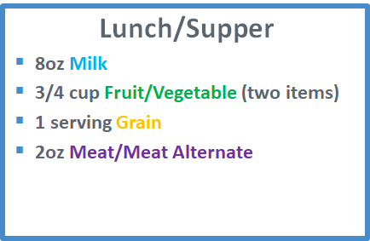
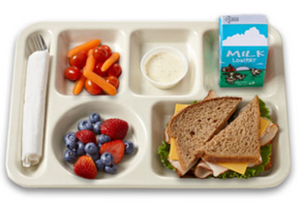
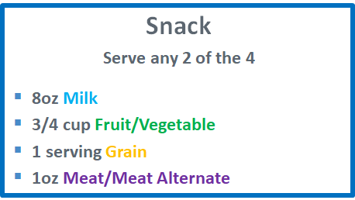
Meal Patterns
SFSP Meal Pattern Requirements
Notes:
This slide outlines the meal pattern requirements. All meals served need to meet these requirements in order to be reimbursed, and there are currently not waivers in place for meal pattern flexibility.
The breakfast meal pattern requires that 3 food components are served in the required portion sizes. These components and portion sizes are 8oz milk, ½ cup fruit/vegetable, and 1 serving of grain. A 1oz meat/meat alternate component is optional at breakfast.
The lunch/supper meal pattern requires that 4 food components in the required portion sizes are served. These components and portion sizes are 8oz milk, ¾ cup fruit/vegetable (consisting of two different fruit or veggie items), 1 serving of grain, and 2oz meat/meat alternate.
The snack meal pattern requires that any 2 of the 4 food components in the required portion sizes are served. The snack must be comprised of two different components.
A more in-depth training on meal patterns and menu planning is available as part of our sponsor training video series.

Slide 22
Civil Rights
Requirement to train all staff annually
Collect Racial/Ethnic Data Form
Visual Identification is no longer allowed
New! Civil Rights Self-Assessment
Available on the civil rights web page
Notes:
As I mentioned earlier in this training, all staff are required to be trained in civil rights on an annual basis. Our new training video series offers civil rights training both in the Moodle course and on our summer training web page.
All sponsors who participate in federal child nutrition programs must have a system to collect racial and ethnic data of program applicants and participants on an annual basis.
Sponsors of residential camps must collect and maintain this information separate for each session of camp. For all other sites, the sponsor must count the participating children at least once during the site's operation.
The data collected is used to determine how effectively your program is reaching potentially eligible children and where outreach may be needed. Please note that visual identification of race or ethnicity by the sponsor is not allowed in the SFSP. Sponsors should collect this information using data from other sources where the respondent has self-identified, such as school or program enrollment data, census data, or CDE data if possible. Alternatively, the linked racial and ethnic data form may be used as long as the information is not collected by visual observation.
The School Nutrition Unit also has a new civil rights self-assessment that can be used to determine if your program is compliant with civil rights requirements.

Slide 23
Procurement
Resources:
Procurement Decision Tree
Procurement Procedures Template
Notes:
Procurement is the process of purchasing goods or services. This process can be longer or shorter depending on what will be purchased and how much money will be spent.
Sponsors are required to have written procurement procedures that are used to guide purchasing decisions. Use the procurement procedures template to develop written procurement procedures that meet federal and local requirements. In addition, the Procurement Decision Tree is another helpful resource that can help guide you through purchasing decisions.
As a reminder, Non-competitive Procurement can still be used if experiencing supply chain issues.

Slide 24
Vended Meals
Purchase Meals from a Meal Vendor
Purchase meals from a school district
Notes:
If you do not have capacity to prepare meals at your site or a central kitchen location, you can purchase meals from a meal vendor or from your local school district.
If you are planning to purchase meals from a meal vendor, be sure to visit our Food Service Management Company and vended meals web page linked here. All vended meals and Food Service Management Company Contracts must meet additional procurement requirements and CDE’s templates for procuring these types of contracts must be used.
Purchasing meals from a local school district does not require any additional procurement steps. Linked in the handout is an agreement template that can be used to agree to the terms such as price and delivery of meals.
Providing meals for another summer sponsor can also be a win for the school district. If you are already preparing meals for the SFSP, then making extra meals to sell to another sponsor could be a great option to increase your reach and bring in some extra revenue.

Slide 25
Poll #2
For SFAs, would you be willing to sell meals for the SFSP to another sponsor?
Notes:
We are looking for school district sponsors who would be willing to sell meals for the SFSP. If you are a school district sponsor and are interested, please complete this quick poll question and we can connect interested sponsors with you.
Poll question: For SFAs, would you be willing to sell meals for the SFSP to another sponsor? If yes, enter in district name

Slide 26
Local Procurement
Use the Local Producer List
USDA Farm to Summer Fact Sheet
Tips and resources all summer in The Dish
Notes:
Summer is a great time to take advantage of the local produce grown throughout Colorado. Sourcing local products and scratch cooking meals when possible can help alleviate supply chain issues as you can pivot more easily to create a nutritious meal based on what you have instead of waiting for a shipment of a specific product. Use the Local Producer list to find producers nearby who want to sell to your program. Sponsors can even shop at farmers markets or the grocery store to find local products. Additionally, consider adding local value added products to your menu such as tamales, tortillas, dairy products, and more.
Each edition of The Dish this summer will feature a farm to summer tip - whether that’s a specific item that’s in peak season, a recipe, or even a farm to summer site activity. Be sure to read each edition so you don’t miss out on a great way to incorporate farm to summer at your own meal sites.

Slide 27
Financial Management: Allowable Costs
Operating Costs
Administrative Costs
Labor
Food & supplies
Facilities
Maintenance & repair
Utilities
Transportation
Planning & Organizing
Site monitoring
Applying for the program
Submitting Claims
Marketing & Outreach
Notes:
Now let’s dig into financial management of the program, starting with allowable costs.
Summer Food Service Program reimbursement may only be used to cover allowable operating costs. These costs include the cost of food, labor, non-food supplies, and space for the food service.
Reimbursement may also be used to cover allowable administrative costs for activities related to planning, organizing, and administering the program.
You also want to be sure that all costs are necessary and reasonable for proper and efficient administration of the program, and be authorized under state or local laws.

Slide 28
Financial Management: Unallowable Costs
Excess meals ordered
Non-compliant meals
Non-program adult meals
Site Activities
Fundraising
Capital expenditures
Assessing Costs in the SFSP
Notes:
Unallowable costs are costs for which program reimbursement cannot be used. They include, but are not limited to:
•Costs for excess meals ordered or prepared but not served to eligible children
•Meals served in violation of program requirements
•The cost of food for use outside of the SFSP (i.e. non-creditable foods)
•Cost of meals served to administrative adult personnel or other adults that are not in the operation of the food service
•Entertainment and fundraising costs (i.e. site activities)
•Direct capital expenditures, including vehicles
Use the Assessing Costs in the SFSP resource linked on this page to see a more inclusive list of allowable and unallowable program costs.

Slide 29
Financial Documentation
Operating Costs
Purchasing invoices, receipts
Receiving reports, delivery slips
Inventory records
Administrative Costs
Time sheets
Receipts
Funds accruing to the program
Deposit records
Receipts
Voucher stubs
Notes:
Another piece in financial management is documenting all program costs and income. Documentation allows you to easily ensure and show that all Summer Food Service Program reimbursements are being used solely for conducting nonprofit food service operations.
Records to support operating costs include:
Purchasing invoices/receipts
Receiving reports and/or delivery slips that record the amount of food received from the vendor
Or inventory records that show a beginning and ending inventory
Records to support administrative costs include:
Time sheets or attendance records
Or other receipts
In addition to documenting your costs to operate the program, you must also document your program income, or funds accruing to the program. Funds accrued include all payments or reimbursement received from Federal, State, local, and other sources designated specifically for the SFSP. Records reflecting income may include: deposit records, voucher stubs, or receipts.
We have a financial tracking tool on our summer financial management web page that I highly encouraged you to use. If you do not use this tool, you will need to use a comparable tracking document to account for all program costs and funds.
If the you have excess funds remaining after the end of the program year, the funds must be used to improve SFSP food service in the following year. You are not able to transfer excess funds to operations that are not related to the Child Nutrition Programs. If you participate in the National School Lunch Program/School Breakfast Program or the Child and Adult Care Food Program, excess SFSP funds may be used to support the food service of those Child Nutrition Programs.

Slide 30
Breakouts
What’s something that you’re excited about for this summer?
What questions do you still have about program operations?
Notes:
I realize that was a lot of information, so now we are going to spend a little bit of time discussing program operations in breakout groups. During these groups, we would like you to discuss the following questions:
Questions:
What’s something that you’re excited about for this summer?
What questions do you still have about program operations?
We will get into these breakout rooms shortly, and you will have 8 minutes for discussion before we return to the larger group and finish up the training.
For CDE staff that are here today, we ask that once you are in your breakout room, you leave the room and return back to the main room.
8 minutes
Any questions that came up during the breakout that we can address at the end of the session? Add to chat or Jamboard

Slide 31
Applications & Claims
Notes:
Now we are going to cover application and claim updates.

Slide 32
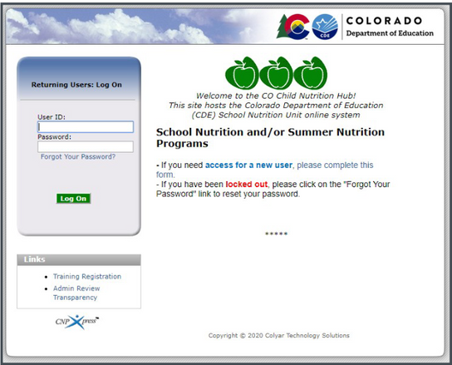
Application Training & Deadlines
Training available on the How to Apply web page
CDE Point Person
Notes:
The online application to participate in the SFSP is now open.Applications for new sponsors are due on April 15th, and Applications for returning sponsors are due on May 1st.
There are detailed instructions and a screen recording on how to complete and submit your program application, and both of these resources are available on our How to Apply web page.
If you need help filling out or submitting your application, feel free to contact your CDE point person for assistance. The list of point person assignments are also linked on this page and in the handout.

Slide 33
Update or inactivate sites
Update contact information
Average Daily Meals
Application Reminders
Notes:
I would also like to go over a few important application reminders. First, we ask that you please work with your CDE point person if you need to inactivate any sites that are no longer eligible or participating. Any sites that were not area eligible last year will either need to be inactivated or the site eligibility section will need to be updated to qualify this summer. For data accuracy, it’s important that we inactivate any sites that are not in use so we can have a complete and accurate picture of participating sites across the state.
We also ask that contact information be updated if there have been any staffing changes last year. If possible, the sponsoring official contact should not be the same person as the program contact. Having the correct sponsor and site contacts is important because it helps us easily reach the right person when needed.
In addition, you will need to enter in the Average Daily Meals served for that particular meal type and site. I know firsthand how difficult it can be to correctly estimate the ADM, especially in the first few weeks of summer, but it is important to enter in your best estimation of the ADM. This is because the AMD from the site application ties directly to how many meals you will be able to claim. To help make this process easier, the claim will now allow 10% more meals than the ADM without having to revise the application.

Slide 34
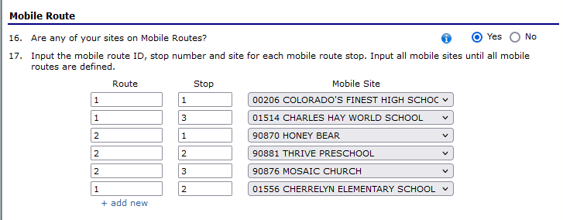
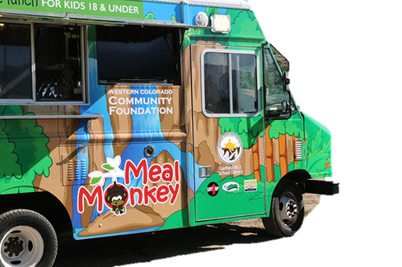
Mobile Sites
Notes:
I’m excited to share that our application process for mobile sites has recently been upgraded.
If you have one or more mobile routes, you can now map out each route and the site stop along that route within the sponsor application. If you are going to be adding new sites for a mobile route, make sure to work with your point of contact to add new sites before you fill out the mobile route section.
The mobile route information from the sponsor application will also display in your site application. To make your site applications for mobile sites easier, you can also copy site data from the first stop in the mobile route. All you need to do is complete the site application for your first stop first, and then click the ‘copy site data’ button for each additional stop along the route.

Slide 35
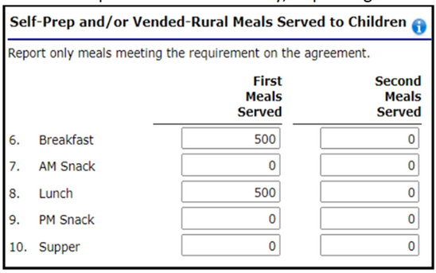
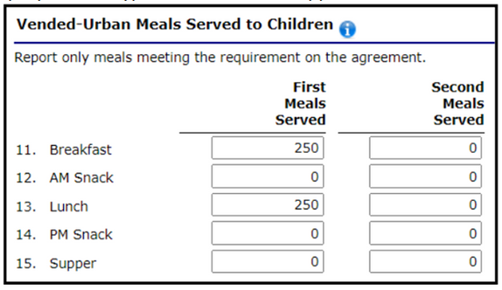
Claiming
Claim meals that meet SFSP requirements
Cannot claim adult meals
Supported by daily meal count forms
Notes:
When claiming meals, remember that only meals that meet the SFSP requirements can be claimed; adult meals cannot be claimed for reimbursement. The signed daily meal count forms must support the claims for reimbursement.
In addition, the total number of second meals claimed cannot exceed two percent of the number of first meals for each type of meal served during the claiming period.
Claims should be submitted as soon as possible. Claims will not be paid if they are submitted more than 60 days after the last day of the month covered by the claim. Any revisions to the original claim must also be submitted within 60 days, unless the revision is a downward adjustment. So if you’re going through documentation and realize the June claim should include 50 more breakfasts, you will need to revise the claim within 60 days of the last day of the claim month.
Visit the claiming instructions linked on this page for more detailed claiming information.

Slide 36
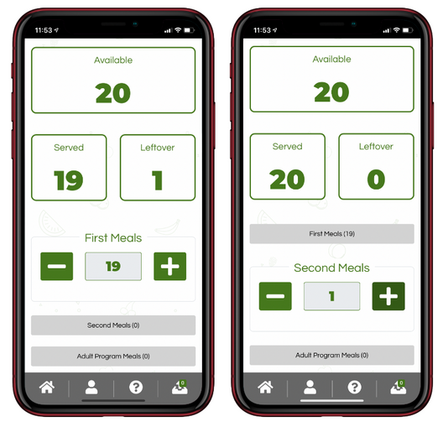
New! Cartewheel Meal Counter App
Meal Counter Resource
How to Apply webpage
Notes:
Another new and exciting feature is the new Cartewheel Meal Counter App. This app allows you to seamlessly count and claim meals for multiple summer sites, and can be used on a web browser or downloaded app. There is also an offline option available if internet service is an issue.
By using the meal counter app, your sites could cut down on paper and count and claim meals more accurately. Meal counts are consolidated by the app, and can be uploaded directly to your claim.
We have linked available training videos and a quick start guide on the new Meal Counter Resource. Please note that if you would like to use this app, you will need to indicate the app is your method of meal counting in the site application. This information is also included in the sponsor application instructions.

Slide 37
Program Payments
SFSP Reimbursement Rates 2022
Notes:
I would also like to share that the SFSP reimbursement rates were updated in January of this year. Shown here are the combined reimbursement rates by site and meal type, which include both operating and administrative reimbursement.

Slide 38
Request advance payments 30 days before:
June 1
July 15
August 15
Advanced Payments
Notes:
Sponsors may request advance payments for their operating costs or for their administrative cost, if necessary. The request must be submitted in the claim system at least 30 days prior to June 1, July 15, and August 15.
Advance payments are based on reimbursement earned during the same month of the previous year or a percentage of anticipated costs. If you have excess program funds from the previous year, the excess funds will be deducted from the advance payment.

Slide 39
SFSP Reviews
Notes:
Now that we have covered program operations, applications, and claims, let’s talk about summer reviews.

Slide 40
SFSP Reviews
Reviews conducted on-site in 2022
2022 Review schedule coming soon!
Visit the SFSP Review Web Page for resources
Notes:
As with other federal programs, reviews of the SFSP are conducted to ensure that the program is operating according to regulations. Reviews are also an opportunity for our staff to come on-site and provide technical assistance as needed.
Reviews are conducted every three years, and we are currently planning to come on-site for reviews this year. Our review schedule will be posted soon and announced in the Dish Newsletter.
In order to prepare, we highly encourage you to watch the new training video on how to be prepare for a review. This is one of the videos in our new sponsor training series that I mentioned earlier.
You can also visit our SFSP review web page for additional resources, including a list of the off-site review questions that are asked.

Slide 41
Marketing & Outreach
Notes:
For the last section of this training, we will cover marketing and outreach strategies to help increase participation in your programs

Slide 42
Importance of a Brand
Makes a memorable impression
Helps users identify and recognize your programs
Allows users to know what to expect
Builds relationships with your users
Provides employees with direction and motivation
Notes:
In 2019, we did a needs assessment as part of our Blueprint to End Hunger grant. One of the recommendations was to create a comprehensive communication and education strategy to bridge the gap between CNPs and stakeholders like parents, community members, and school administration to increase positive perceptions and knowledge around the benefits of child nutrition programs.
To realize this strategy, we have worked to create new branding for marketing and outreach materials. Branding is important because it helps your community be able to recognize your program and know what to expect from you.
You may notice that we have started to incorporate the new branding into our materials, including the web page, resources, and trainings. On the next slide I will share the new resources that are available for you to use as well.

Slide 43
Outreach Materials
Outreach Materials
Marketing Webinar
Notes:
Here are a few examples of the new outreach materials we have available for you to use. Ready to print materials include postcards, banners, yard signs, posters, and magnets.
We also have materials that you can customize to your program, including summer menus and digital materials such as social media graphics and sample messages, web banners and email signature graphics.
To learn more about how to access and use the new marketing materials, check out our marketing webinar that is linked on the training page under the recorded webinars section.

Slide 44
Wrap Up & Questions!
Notes:
We’re at the end of this training, so let’s wrap up and get to your questions.

Slide 45
Training Evaluation & Certificate
Click this link to complete a quick training evaluation:
https://www.surveymonkey.com/r/2ZX3G5J
When you submit the evaluation, click “DONE” on the survey thank you page to download your certificate
Notes:
Linked on this page is an evaluation survey that you can take to access your training certificate for today.
This link will also be emailed out to all training attendees. The information on this slide is included for those watching this training at a later date as a recording.
Thank you so much for your feedback - we are always looking for ways to improve our trainings to better support you.
43

Slide 46
Megan Johnson
Thank you!
Johnson_m@cde.state.co.us
www.cde.state.co.us/nutrition/summerfoodserviceprogram
Notes:
Here is my contact information in case you would like to follow up with any questions that are specific to your program.

Slide 47
Questions?
Notes:
With the time we have left, I would like to answer some of your remaining questions.
If you have additional questions, please continue to add them to the chat.
If we do not have time to get to all of the questions, I will follow up via email to answer the questions that we aren't able to get to today.
45

