Slide 1
Back to School Planning for School Year 2021-22
Kerri Link & Erin Opgenorth
CDE School Nutrition Unit
Notes:
Kerri
This session is being recorded and ppt slides will be shared.

Slide 2
Group Introductions
Jamboard: https://jamboard.google.com/d/1G8xqfh8dGBgFH40WHrI0uYI7eVl_n_9bU38z6O1Td5U/edit?usp=sharing
Name, District, Item of beauty within your view
Think about…
What is something you learned this past year that you plan to utilize during the upcoming school year?
Notes:
Fill in chart: name, district, Item of beauty within your view
What is something you learned this past year that you plan to utilize during the upcoming school year?
– chat blast or speak up.

Slide 3
CDE School Nutrition Unit Vision
Nourish young bodies and minds. End childhood hunger.
CDE School Nutrition Unit Mission
We support the child nutrition community through innovation, training, and partnerships to ensure all youth have access to healthy meals.
3
Notes:
We have spent time updating our vision and mission.

Slide 4
Non-Discrimination Statement
In accordance with Federal civil rights law and U.S. Department of Agriculture (USDA) civil rights regulations and policies, the USDA, its Agencies, offices, and employees, and institutions participating in or administering USDA programs are prohibited from discriminating based on race, color, national origin, sex, disability, age, or reprisal or retaliation for prior civil rights activity in any program or activity conducted or funded by USDA. Persons with disabilities who require alternative means of communication for program information (e.g. Braille, large print, audiotape, American Sign Language, etc.), should contact the Agency (State or local) where they applied for benefits. Individuals who are deaf, hard of hearing or have speech disabilities may contact USDA through the Federal Relay Service at (800) 877-8339. Additionally, program information may be made available in languages other than English.
To file a program complaint of discrimination, complete the USDA Program Discrimination Complaint Form, (AD-3027) found online at: https://www.usda.gov/oascr/how-to-file-a-program-discrimination-complaint, and at any USDA office, or write a letter addressed to USDA and provide in the letter all of the information requested in the form.
To request a copy of the complaint form, call (866) 632-9992. Submit your completed form or letter to USDA by: (1) mail: U.S. Department of Agriculture Office of the Assistant Secretary for Civil Rights; 1400 Independence Avenue, SW Washington, D.C. 20250-9410;
(2) fax: (202) 690-7442; or (3) email: program.intake@usda.gov.
This institution is an equal opportunity provider.
Notes:
This slide features the non-discrimination statement again something you are likely all familiar with.

Slide 5
Conditions for Success
Be present and engaged
Put your cell phone out of arms reach
Close out email or other tabs
Avoid multi-tasking or doing other work
Participate in discussion
Actively listen
Mute your microphone when you’re not talking
Bring a positive attitude and be ready to share
Be respectful, inclusive, and open minded
Notes:
Here are some other conditions for success to make our time together today as meaningful as possible include.
Are there any other conditions that would help ensure a successful session that you would like to add today?

Slide 6
Learning Objectives
By the end of this training, sponsors will be able to:
Demonstrate understanding of USDA waivers and program requirements for school year 2021-22.
Access available resources, including CDE School Nutrition staff, to ensure successful implementation of school year 2021-22 operations.
Express confidence in implementing the Seamless Summer Option for school year 2021-22.
Feel appreciated.
Professional Standards
2 hours of training
Key Area/s and Learning Codes: 1100, 3100, 3200, 4000
Notes:
By the end of this training you will be able to:
You will receive 2 hours of training today in Menu Planning, Free and Reduced-Price Meal Benefits, Program Management, and Communications and Marketing.
We will be going through lots of content over the next two hours but I have built in some breaks and activities. As mentioned in the conditions for success, please be present and I will be sure you get breaks. Additionally, feel free to type questions into the chat throughout the presentation. We will address the questions at two different times throughout the presentations.

Slide 7
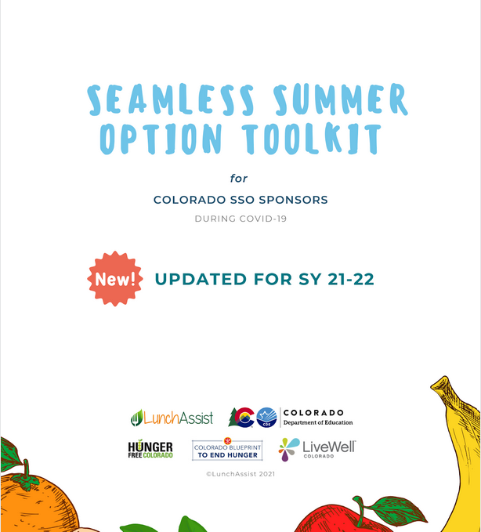
Training Guides
Toolkit
Pg. 1
FAQ
Pg. 1
Notes:
Today’s training will follow directly along with content in the SSO toolkit and our FAQ document.
The SSO toolkit is still being finalized and will be published to our website soon; but is very similar to the SFSP toolkit from this past year. Keep an eye out in the DISH and on our website for this.
The FAQ is linked in the presentation and is on our website. The information has been included in the content and we will also cover specific questions submitted– the page numbers may change in the future as we add/update the document weekly. When updates are made, they are highlighted in yellow to make it easier for you to read and locate new information. You can also “control f” in both of these documents to search specific words you are looking for in the resource.

Slide 8
Nationwide Waiver Overview Effective July 1, 2021 through June 30, 2022, unless otherwise noted https://app.smartsheet.com/b/publish?EQBCT=2fbcc0b15a604b2fb461289e54d80f71
Notes:
Now we will start going through the waivers and guidance released by the USDA that allow flexibility to school meal programs for the 2021-22 school year. Our office has opted into all waivers on your behalf. The only waiver that a sponsor has to apply for is related to meal patterns, which we will go in to more detail on later.
These waivers apply to the National School Lunch Program (NSLP), School Breakfast Program (SBP), Seamless Summer Option (SSO), and the Child and Adult Care Food Program (CACFP).
The link in this slide takes you to a summary of all of the waivers – past, present, CO specific and pending – with links to the full memo of each. This is a great reference if you need a deeper dive into any of the content; however, the tool kit and FAQ are meant to be a summary for you.

Slide 9
Seamless Summer Option (SSO) OR National School Lunch Program (NSLP)
 | SSO | NSLP/SBP
Allowable Meals | Up to 2 meals each day: Breakfast, Lunch, Snack (AM or PM), and/or Supper | Breakfast, Lunch, Afterschool snacks
Reimbursement Rates | SFSP reimbursement rate | NSLP/SBP reimbursement rates
Meal Claiming | All meals are free | Claim meals by student income eligibility (free/reduced/paid)
Meal Pattern | NSLP/SBP meal patterns | NSLP/SBP meal patterns
Applications | Child Nutrition Portal | Child Nutrition Portal
FFVP | May apply and serve if awarded | May apply and serve if awarded
ASP | May apply and serve – waiver for area eligibility applicable | May apply and serve – waiver for area eligibility applicable
Notes:
This slide provides a high level overview of the main differences in program operations.
The benefits of operating the SSO include being able to provide all meals to children for free, and receiving a higher reimbursement rate for meals served. Because of these benefits, today’s presentation will focus on how to implement SSO and the requirements.

Slide 10
Before we dive into content, let’s get an idea of your plans. Which meal program doyou plan to serve under?
Poll Question:
Which meal program do you plan to serve under?
SSO
NSLP / SBP
Still Deciding
In the Chat:
If you’re still deciding, what additional information do you need to inform your decision?
Notes:
Which meal program do you plan to serve under?
SSO
NSLP/SBP
Still deciding
For those of you still deciding, what additional information do you need to inform your decision?

Slide 11
SSO Overview and Implementation
Notes:
The Seamless Summer Option (SSO) is a component of the National School Lunch Program (NSLP) and combines features of the NSLP, School Breakfast Program and the Summer Food Service Program. Under the SSO, sponsors will follow the NSLP and SBP meal pattern requirements and are able to provide free meals to all students and claim the meals at the free rate.

Slide 12
Area Eligibility
Allows sponsors to operate the SSO at any site, regardless of its location.
Sponsors have flexibility to serve meals at school and non-school sites; however, USDA encourages sponsors to operate the SSO at school sites when possible.
Toolkit
Pg. 5
FAQ
Pg. 2-3
Notes:
If you are following along with the toolkit and/or the FAQ, which I highly recommend, the page numbers are listed on the bottom left corner of the ppt slides.
The area eligibility waiver allows sponsors to operate the SSO at any site, regardless of its location. This ensures all children in all areas across the state can receive free meals during the school year.
Sponsors have flexibility to serve meals at school and non-school sites. However, USDA Food and Nutrition Services encourages sponsors to operate the SSO at school sites when possible. As schools transition back to in-person learning, sponsors may choose to offer meals only at their school sites.

Slide 13
Area Eligibility ctd
Meals may be provided to children that are not enrolled in the district, but this is not required.
USDA is encouraging sponsors to operate as close to normal operations as possible.
Toolkit
Pg. 5
FAQ
Pg. 2-3
Notes:
If an SFA chooses to they may operate an open site that serves all children, regardless of enrollment. FNS is encouraging SFAs to operate as close to normal NSLP as possible, but this is allowed. Please let me know if you have any further questions.

Slide 14
Allowable Meals
Sponsors may serve up to two meals a day at sites.
Allowable meal types : breakfast, AM snack, lunch, PM snack, and supper (this does not include snacks served under ASP). For example, a sponsor may serve breakfast and lunch under SSO and a snack under ASP.
Unallowable meal type combinations: serving lunch and supper to the same children on the same day.
Toolkit
Pg. 7
FAQ
Pg. 7-9
Notes:
Up to two meals, per child, per day, in any combination except lunch and supper, may be reimbursed through the SSO.
Allowable meal types include : breakfast, AM snack, lunch, PM snack, and supper (this does not include snacks served under ASP). For example, a sponsor may serve breakfast and lunch under SSO and a snack under ASP.

Slide 15
Allowable Meals ctd.
Sponsors may not provide weekend or holiday meals through the SSO or NSLP/SBP.
Weekend or holiday meals may be provided through the Child and Adult Care Food Program (CACFP) At-Risk Afterschool Meals Program.
Sponsors are encouraged to participate in CACFP At-Risk Afterschool Meals during the 2021-22 school year. Contact CDPHE for more information:
Toolkit
Pg. 7
FAQ
Pg. 7-9
Notes:
We know this has been a pending question since the guidance to operate under SSO came out and USDA released guidance last week that sponsors may not provide weekend or holiday meals through the SSO or NSLP/SBP when school is in session during the regular school year in 2021-22. This would only be allowable during an unanticipated school closure; however, sponsors are allowed and encouraged to provide weekend and/or holiday meals through the Child and Adult Care Food Program at-risk afterschool meals program if needed.

Slide 16
Meal Counting and Claiming
Under SSO, all reimbursable meals served are free.
Sponsors do not need to track meals based on the student’s eligibility status, however:
Must establish a point of service and record meals as they are served.
May use a paper form or electronic point of service system to record meals by meal type each serving day
Toolkit
Pg. 8
FAQ
Pg. 6-7
Notes:
Sponsors must ensure that meals are accurately counted and claimed, and the integrity of the program is upheld for all service model types (e.g. grab and go, parent pick up, in the cafeteria, etc.)
All reimbursable meals served are free. Sponsors do not need to track meals based on the student’s eligibility status. Sponsors can count meals on the day they are distributed for each meal type served. Sponsors are not required to have separate meal count forms for the days meals are intended to be eaten. For example, if 3 days’ worth of meals are served, a sponsor will have one breakfast meal count form and one lunch meal count form that shows 3 days’ worth of meals distributed at that site.

Slide 17
Reimbursement Rates
Meals served under the SSO will be reimbursed at the higher Summer Food Service Program (SFSP) rate:
http://www.cde.state.co.us/node/55492
Toolkit
Pg. 5
FAQ
Pg. 2-3,7
Notes:
Meals served under the SSO will be reimbursed at the higher Summer Food Service Program (SFSP) rate established for rural or self-prep sites, regardless of location. SFSP reimbursement rates are adjusted annually for inflationary changes and become effective January 1 of each year. Therefore, rates paid for SSO meals will change in January 2022.
Current rates can be found on our website linked on this slide.

Slide 18
Free & Reduced-Price Meal Applications
Sponsors operating the SSO may continue to collect and process free and reduced-price meal applications to establish eligibility for Pandemic-EBT (P-EBT) only.
Sponsors operating SSO but not participating in P-EBT cannot collect free and reduced-price applications, however, may use the Family Economic Data Survey (FEDS Form).
All disclosure requirements for release of student eligibility for non-P-EBT or non-program needs will apply.
Toolkit
Pg. 7
FAQ
Pg. 12-13
Notes:
Sponsors operating the SSO may continue to collect and process free and reduced-price meal applications to establish eligibility for Pandemic-EBT (P-EBT) only. Sponsors must provide new students, such as kindergarteners, and newly eligible children an opportunity to establish their eligibility, specifically for P-EBT. Paper copies of the free and reduced-price application must be made available at the district office.
Sponsors operating SSO but not participating in P-EBT cannot collect free and reduced-price applications. Sponsors may use the Family Economic Data Survey (FEDS Form) for data collection; however, food service funds (Fund 21) cannot be used in the processing of FEDS Forms.
All disclosure requirements for release of student eligibility for non-P-EBT or non-program needs will apply.
Sponsors operating the National School Lunch Program may continue to collect and process free and reduced-price meal applications as part of normal operations.
-

Slide 19
Free & Reduced-Price Meal Applications ctd.
Sponsors that collect household applications in school year 2021-22 are required to conduct verification and complete direct certification uploads.
The free and reduced-price school meal application and supporting materials are available on the School Meal Eligibility webpage.
For questions, contact free&reducedpriceschoolmeals@cde.state.co.us
Notes:
Sponsors that collect household applications in school year 2021-22 are required to conduct verification, regardless of the reason the applications were collected and/or the child nutrition program they are operating.
The sample size used to conduct verification activities must be based on the number of approved applications on file as of October 1, 2021.
Additionally, sponsors must continue to conduct direct certification uploads.

Slide 20
Meal Service Times
Allows sponsors to set meal service times that work best for their school and community needs.
Toolkit
Pg. 4
FAQ
Pg. 2,
8-9
Notes:
The meal service time restrictions waiver allows sponsors to set meal service times that work best for their school and community needs. There are no restrictions on time between meals or length of service; however, you should keep these in mind to best meet the needs of your students.
In conjunction with the non-congregate feeding waiver (which we will go in to next), this also allows sponsors to distribute meals for multiple instruction days at one time.

Slide 21
Non-Congregate Feeding
Meals and snacks may be taken and consumed off-site.
Options:
Grab and go
Home delivery
Parent pick up
Toolkit
Pg. 4
FAQ
Pg. 2,8
Notes:
To ensure appropriate safety measures and support social distancing, meals and snacks may be taken and consumed off-site. This allows schools the opportunity to provide meal pick-up options for students learning virtually and facilitates grab-and-go meals for students in school.

Slide 22
Parent Meal Pick Up
Children are not required to be present while their parents/guardians pick up the meals; however, program accountability must be maintained.
The USDA Best Practices for Parent Pick-Up of Meals and Snacks provides helpful information.
Toolkit
Pg. 4, 7-8
FAQ
Pg. 2,5
Notes:
The combination of the non-congregate, meal service times, and this parent pick-up waiver allows schools to utilize meal distribution methods that work best for their students such as, home delivery, grab and go, curbside pick-up, multiple meal distribution, bulk meals, and parent-pick up.
Children are not required to be present while their parents/guardians pick up the meals; however, program accountability must be maintained in order to prevent duplicate meals or meals being served to adults without eligible children. The “USDA Best Practices for Parent Pick-Up of Meals and Snacks” is a great resource provides helpful information for understanding Parent Meal Pick Up.
Again, Sponsors must have plans in place to ensure the integrity of the program.

Slide 23
Renewal Application
Opening soon! More details are forthcoming.
Sponsors participating in the Seamless Summer Option must first apply in school year 2020-21.
Once the 2020-21 application is approved, sponsors will re-apply in school year 2021-22. This ensures important application data will roll over and less data input is required in the 2021-22 application.
Notes:
School Nutrition Program applications will open in the Colorado Nutrition Portal soon. We are working closely with our technology vendor to ensure system functionality allows for a smooth application process. Application resources and training will be available on the How to Apply webpage and announced in the Dish shortly.
Keep in mind: Sponsors participating in the Seamless Summer Option must first apply in school year 2020-21.
Once the 2020-21 application is approved, sponsors will re-apply in school year 2021-22. This ensures important application data will roll over and less data input is required in the 2021-22 application.

Slide 24
What have you connected with from the presentation so far? Any “ah ha’s”?
What is hard to wrap your head around still?
https://jamboard.google.com/d/1G8xqfh8dGBgFH40WHrI0uYI7eVl_n_9bU38z6O1Td5U/edit?usp=sharing
Notes:
Jam board then Q&A.

Slide 25
Break
Notes:
5 min break – refill your water, go to the bathroom, stretch, etc.

Slide 26
Program Requirements
Meal Patterns
Civil Rights/Special Dietary Needs
Food Safety
Smart Snacks & Competitive Foods
Local Wellness Policy
Professional Standards
Monitoring

Slide 27
Meal Pattern Overview
All meals offered must meet the NSLP/SBP meal pattern component and quantity requirements and dietary specifications
Meal patterns emphasize fruits and vegetables, whole grains, and age-appropriate nutrition
USDA recognized the potential challenges of returning to NSLP/SBP meal patterns and is allowing flexibilities
Menu Planning webpage
Notes:
All meals offered next school year must meet the NSLP and SBP meal pattern requirements. As we know, these meal patterns emphasize fruits and vegetables, whole grains, and age-appropriate nutrition through the quantity requirements and dietary specifications. Receiving high-quality, nutritious meals will help our students succeed in the classroom.
With that being said, USDA also recognized that there will be challenges in returning to these more complex meal patterns and is allowing flexibilities through the meal pattern waivers.
I will briefly cover the meal pattern waivers – additional meal pattern training will be available during another session.

Slide 28
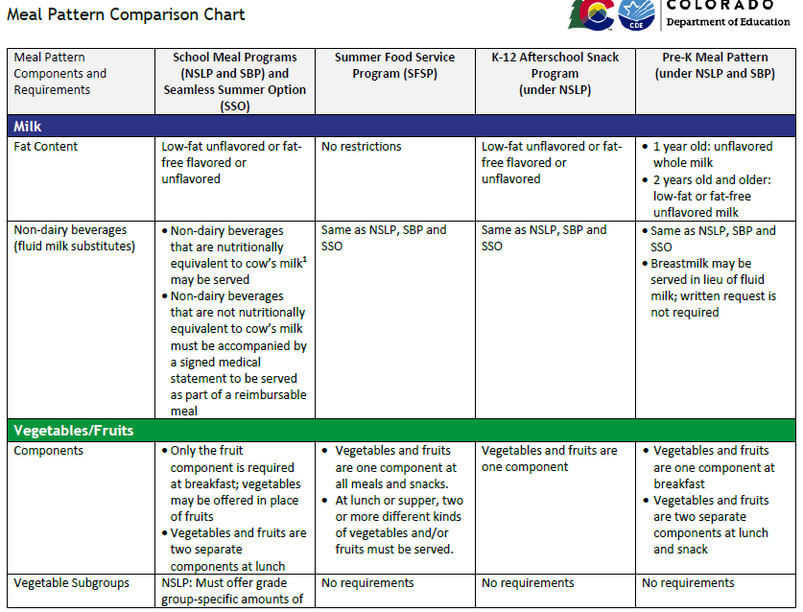
Meal Pattern Comparison Chart
Notes:
We have created a new resource to help you and your staff remember the details of the various meal patterns. This resource is linked here and is available on our menu planning pages. This compares the NSLP/SBP/SSO meal pattern with the SFSP meal pattern, Afterschool Snack meal pattern, and the pre-K meal pattern. It covers the details of the components, as well as the age/grade groupings, and offer versus serve. This is a great resource to help you compare requirements across the child nutrition programs and can be used in tandem with the meal pattern tables.

Slide 29
Meal Pattern Waivers
USDA is allowing meal pattern waiver requests for the following:
Sodium requirements
Whole grain-rich requirements
Vegetable subgroup requirements
Milk variety requirements
Low-fat flavored milk
Age/grade group (K-12)
Sponsors may apply for these flexibilities using the Meal Pattern Waiver Request form
For questions, contact Erin Opgenorth at Opgenorth_e@cde.state.co.us or 720-822-1883.
Notes:
As I mentioned, USDA is allowing sponsors to request specific meal pattern flexibilities for next school year to help ensure a safe meal service, listed here.
All sponsors who apply for the sodium waiver will be approved to remain at sodium Target 1 levels for the 2021-22 school year. The other waiver requests will be approved based on specific situations and justification. As I mentioned, we are waiting on guidance from USDA on whether pre-K students that are not comingled with older students can be included in the age/grade group waiver.
I will review all waiver requests and may contact you for additional information if needed.
Please note that the whole grain-rich waiver is specific to this school year and must be related to needs due to COVID. This is not the same waiver that has been in place in previous school years to allow flexibility based on student acceptability.

Slide 30
Examples of Appropriate Waiver Justifications
Age/grade group waiver for grab and go service based on the age/grade group of most participants. Meals will be planned to meet the K-8 lunch meal pattern.
Whole grain-rich waiver for tortillas and pasta. These items do not hold up in quality for meals in the classroom.
Vegetable subgroup waiver for the beans and peas (legumes) and starchy subgroups. District is serving cold meals in the classroom and menu items to meet these subgroup requirements are limited.
Low-fat flavored milk waiver requested; vendor is projecting fat-free flavored milk shortages but can deliver low-fat flavored milk during shortages.
Notes:
When completing the meal pattern waiver requests it is important to provide as much information and detail as needed to support your request. USDA has emphasized that waivers are in place to support sponsors in providing safe meals while we may still be experiencing the need for alternate meal service styles, increased social distancing, or other safety measures due to the pandemic.
Here are a few examples of what we are looking for to support your waiver requests. These are all specific – they include information on what is being requested, why, and how it ties to alterations in service due to COVID.
USDA did not provide minimum requirements to meet, such the percent of whole grain-rich foods you must serve over the week, so requests will be approved based on justification.

Slide 31
Examples of Unallowable Waiver Justifications
Age/grade group waiver to make it easier for staff to plan and serve meals.
Whole grain-rich waiver for tortillas, pasta, and buns due to lack of student acceptability.
Vegetable subgroup waiver since we will not be using salad bars.
Milk variety waiver requested; students prefer 2% chocolate milk.
Notes:
We are not able to be accepted waiver requests that are not related to COVID, including justifications based on ease of service, student preference, or requests to serve unallowable foods. We understand that sponsors may continue to face challenges next school year, so feel free to contact me to discuss your needs and if a waiver request would be appropriate.

Slide 32
Civil Rights & Special Dietary Needs
Complete annual Civil Rights training for all frontline staff
Includes teachers involved with serving or counting meals in the classroom
Ensure a current Civil Rights complaint procedure is in place
Include the non-discrimination statement on your website and all program materials
Post “And Justice For All” posters
Special Dietary Needs: continue to accommodate special dietary needs when supported with the appropriate documentation
Toolkit
Pg. 9
FAQ
Pg. 6
Notes:
Transitioning to other program requirements:
Plan to complete annual Civil Rights training for all frontline staff and document training. This includes training for teachers who are involved with serving or counting meals in the classroom. Training materials, including the Teacher Training memo are posted on our Civil Rights webpage.
Ensure a current Civil Rights complaint procedure is in place. Additional information on this is also on our Civil Rights webpage.
Include the non-discrimination statement on your website and all program materials
Post “And Justice For All” posters
Special Dietary Needs: continue to accommodate special dietary needs when supported with the appropriate documentation and your special dietary needs policy.
Toolkit page 9, FAQ page 6

Slide 33
Food Safety
Your local public health agency is the ultimate authority on food safety related questions.
A plan for providing meals to students will be school district and, in some cases, building centric.
For state-level guidance, consult Troy Huffman at 303-692-3664
View the food safety webpage for more resources
Toolkit
Pg. 6
FAQ
Pg. 10
Notes:
It is up to you, your district and the local public health agency to determine a plan/meet the needs of your sites for food safety, including implementing salad bars.
For state level guidance, please contact Troy Huffman with CDPHE.
We also have a lot of trainings and resources outlined on our website.

Slide 34
Smart Snacks and Competitive Foods
Requirements are the same as if operating under NSLP.
You may serve a la carte/smart snacks with any service model.
View the smart snacks and competitive foods webpage for more resources.
Notes:
This is a friendly reminder that smart snacks and competitive foods requirements remain the same as if you are operating under NSLP and you can to continue to sell a la carte/smart snacks. We know operationally it may be more challenging depending on your service model, so please reach out to our office if you need any support.
Additionally, resources and requirements can be found on our website.

Slide 35
Local Wellness Policy
Sponsors should continue to implement the goals and standards included in their local wellness policy and comply with all requirements of the final rule.
USDA extended the deadline to complete the triennial assessment to June 30, 2022, under a nationwide waiver.
View the wellness policies webpage for additional resources.
FAQ
Pg. 11
Notes:
Sponsors should continue to implement the goals and standards included in their local wellness policy and comply with all requirements of the final rule.
USDA just announced another extension of the deadline to complete the triennial assessment to June 30, 2022, under a nationwide waiver. We do have a report tool on our webpage to help you summarize your assessment results.
View the wellness policies webpage for additional resources.

Slide 36
Professional Standards
School Nutrition allows the sponsor flexibility to complete annual training requirements over a two-year period.
All training must be tracked on a training tracker with the key area and learning objective codes.
Staff must complete the annual civil rights training and any other training applicable to their day-to-day job duties.
View the professional standards webpage for more information.
FAQ
Pg. 11
Notes:
Professional standards, aka training requirements and record keeping, also remain the same during SSO. We do allow flexibility to meet the training requirements over a two year period. Civil rights training is the only training that is required of all staff on an annual basis. Other training should be prioritized based on each staff members job responsibilities.
Please visit our website for a variety of training options for you and your team, as well as a refresher of the professional standards requirements and how to track your hours.
This training will count as two hours towards your requirements!

Slide 37
Sponsor Monitoring
Sponsors may complete monitoring requirements through an off-site desk audit.
Each meal site must be reviewed at least once during the year.
Utilize the SSO review form.
FAQ
Pg. 10-11
Toolkit
Pg. 4,9
Notes:
USDA waivers allow sponsors to complete monitoring requirements through an off-site desk audit. Sponsors must review each meal site at least once during each site’s operation and can use this SSO review form, or a district specific form that meets all of the requirements in this template.

Slide 38
SY 2021-22 Administrative Reviews
CDE School Nutrition will maintain it's planned review schedule.
Review and technical assistance schedule can be found on the review webpage.
Additional information on how to prepare, time frame, reviewer and if the review will be on or off-site is forthcoming.
FAQ
Pg. 11
Notes:
USDA waivers allow those up for review and operating SSO, for the SSO review to take place of the NSLP review therefore, CDE School Nutrition is able to keep our planned review schedule.
Any sponsor that was scheduled for a NSLP Administrative Review in school year 20-21 was pushed back a year, and subsequently, all sponsors were pushed back one school year. Reviews that took place last school year under the summer food service program do not take the place of the NSLP/SSO review.
The review schedule can be found on the review webpage. Additional information on how to prepare, time frame, reviewer and if the review will be on or off-site is forthcoming.

Slide 39
Time to Test Your Knowledge! On your computer or phone go to https://www.menti.com/w2fcv2187v
Notes:
Kerri
T/F: Under SSO, sponsors will claim students by their eligibility (e.g. F/R/P)
False. All students are claimed at the Free rate.
During SY 21-22, meals may be served:
In the cafeteria
In the classroom
To parents on behalf of their student
Multiple meals at once
All of the above
T/F: Per the USDA waiver, all monitoring at the sponsor and state level are waived for SY 21-22
False. The on-site requirement of monitoring and reviews is waived; however, they must still take place.
T/F: Sponsors may request a meal pattern waivers based on student acceptance of foods.
False. Waiver requests for flexibilities other than sodium must be related to COVID safety.
All of the following must complete annual Civil Rights training except:
Food Service Directors
Cooks
Point of Sale Operators
Claim Preparers
Cafeteria Monitors
Answer: cafeteria monitors, unless they are involved in serving or counting and claiming.

Slide 40
Fresh Fruit & Vegetable Program Afterschool Snack Program
Additional Programs:
Notes:
Kerri

Slide 41
Afterschool Snack Program (ASP)
Based on the Area Eligibility for Afterschool Programs nationwide waiver, all schools, regardless of their location, can provide and claim all afterschool snacks at the free rate.
ASP can operate at sites providing breakfast and lunch under SSO
Toolkit
Pg. 5
FAQ
Pg. 3,8
Notes:
Based on the Area Eligibility for Afterschool Programs nationwide waiver, all schools, regardless of their location, can provide and claim all afterschool snacks at the free rate. For example, a sponsor may serve breakfast and lunch under SSO and a snack under ASP.
Sponsors will complete an application in the portal – more information is forthcoming.

Slide 42
Fresh Fruit and Vegetable Program (FFVP)
The FFVP can operate at sites providing meals under the SSO during school year 2021-22.
CDE School Nutrition will be going for additional waivers to allow for parent pick up and alternate site pick up – stay tuned!
Apply for FFVP in the Colorado Nutrition Portal by Saturday, July 31.
FAQ
Pg. 3
Notes:
Operates the same as it would under NSLP with the same qualifying criteria:
Be an elementary school
Begin FFVP operations at the start of the school year
Have at least 50% of its students eligible for free or reduced price school meals based on the 2020-2021 PK-12 free and reduced-price data.
- Operate the same as last school year hopefully with these waivers
sponsors must complete the FFVP application packet in the Colorado Nutrition Portal by Saturday, July 31; you can reference the application instructions for more information
At this time, sponsors should not make any updates to the National School Lunch Program or Seamless Summer Option applications. Ensure you are in the correct school year by selecting ‘Year’ in the top right hand corner of the portal upon logging in.
For questions, contact Erica Boyd at boyd_e@cde.state.co.us or 720-693-3232.

Slide 43
CDE Support
Notes:
Kerri

Slide 44
Notes:
Well we’ve made it through the bulk of the content! You can continue to put questions in the chat but CDE School Nutrition wanted to take a couple minutes to update you on what we’ve been working on this last year, in addition to just getting through the pandemic like you all.
In light of all the changes and unique operations over the last year, our unit has continued to work on ways to improve and support you, our customers, to best serve Colorado children.
Before we do that, we wanted to “re-introduce” ourselves and put a face to our names; and let you know how much you are appreciated!

Slide 45
CDE Updates: Strategic Plan
Positions and unit teams with more defined and dedicated areas of work such as policy, grants, training and communications.
Revisioning small teams that provide support for specific program areas such as school meal eligibility, meal quality, procurement, and financial management.
Notes:
In light of all the changes and unique operations over the last year, our unit as continued to work on ways to improve and support you, our customers, to best serve Colorado children.
After a lot of work, use of data, and resources such as contractors and you all, we are excited to implement some of these improvements.
- over the past year we have taken steps to focus on our unit strategic plan. To meet our goals and improve our strategy, changes to our structure will take place over the next year to accommodate our growing team.
Examples of some of the changes include:
Positions and unit teams with more defined and dedicated areas of work such as policy, grants, training, and communications.
Revisioning small teams that provide support for specific program areas such as school meal eligibility, meal quality, procurement, and financial management.
Additionally, starting this summer, School Nutrition will move to a point person model to provide more individualized customer service. Sponsors can contact the person assigned to their application in the Colorado Nutrition Portal for program related questions and support with applications, reviews, and training and technical assistance needs. Sponsors operating SFSP can continue to contact the person assigned to their SFSP application. Once sponsors transition to planning for next school year, you can contact the person assigned to your SNP (SSO) application. This person will be your point of contact moving forward for program related questions and support with applications, reviews, and training and technical assistance needs.

Slide 46
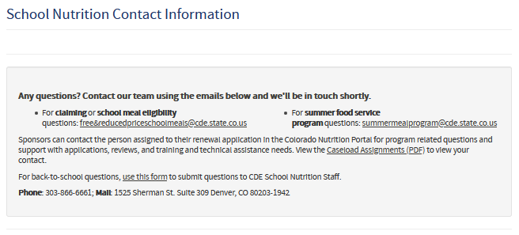
CDE Updates: Caseload Model
Model to provide more individualized customer service.
Program related questions and support with applications, reviews, and training and technical assistance needs.
A list with your point person and their contact information can be found here:
Notes:
Sponsors can contact the person assigned to their application in the Colorado Nutrition Portal for program related questions and support with applications, reviews, and training and technical assistance needs. You can also find your contact person on our contact us webpage.

Slide 47
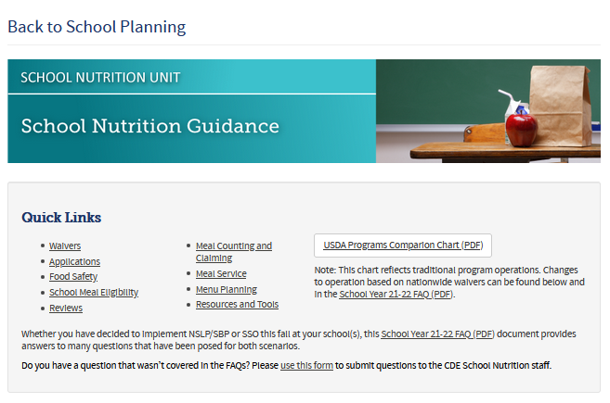
CDE Website
Notes:
Back to School Webpage
Waivers
FAQ

Slide 48
CDE Website ctd.

Slide 49
Resources
Colorado Department of Education Back to School Guidance: http://www.cde.state.co.us/node/52637
USDA Waivers and Guidance (Colorado): https://app.smartsheet.com/b/publish?EQBCT=2fbcc0b15a604b2fb461289e54d80f71
School year 2021-22 FAQs: http://www.cde.state.co.us/nutrition/backtoschoolfaqs

Slide 50
Parent / Guardian Survey: Perceptions of School Meals https://surveys.coronainsights.com/s3/partner1 Please share broadly with your network of families
Notes:
We need your help to spread the word! We are looking to survey parents/guardians of school-age students on what they think about meals at school. This survey will help us create fresh, new marketing materials including videos and tools to help promote participation in school meals. The more input we receive from families, the better!
Our quick online survey will also help Child Nutrition Programs respond to the tastes and needs of families across the state.
We ask that you share this broadly with your networks of families and partners. We will follow up this session with an email that includes a promotional write up that you can simply forward. It will also be in this week’s DISH and promoted on social media.

Slide 51
Questions? Submit via form at any time: https://app.smartsheet.com/b/form/0614096b88c046cbbb6ddda19d96ceb8
Notes:
Q&A – go to jamboard

