Slide 1
Creating a Layered Continuum of Evidence-Based Practices to Support Behavioral Health and Emotional Wellness.
September 2017
Office of Learning Supports

Slide 2
Objectives
The Participant will:
Review of PBIS Logic
Investigate the evidence based practice used when teaching social skills
Gain an understanding Trauma Sensitive Schools
Consider an integrative approach to Behavioral Health and Emotional Wellness
Understand the importance of measuring implementation and impact at the school-wide and student level
Notes:
Go over slide. Will not cover how to use a specific intervention. This is not a training on any particular intervention

Slide 3
Who is in the room?
Notes:
Who’s here?
Reg education teachers
SPED teachers
School psychs, counselors, social workers?
Principals or assistant principals?
District-level personnel? Directors, coordinators…
Other?

Slide 4
Think, Write, Share
1. Paraphrase PBIS in your own words
2. Turn to an elbow partner and share

Slide 5
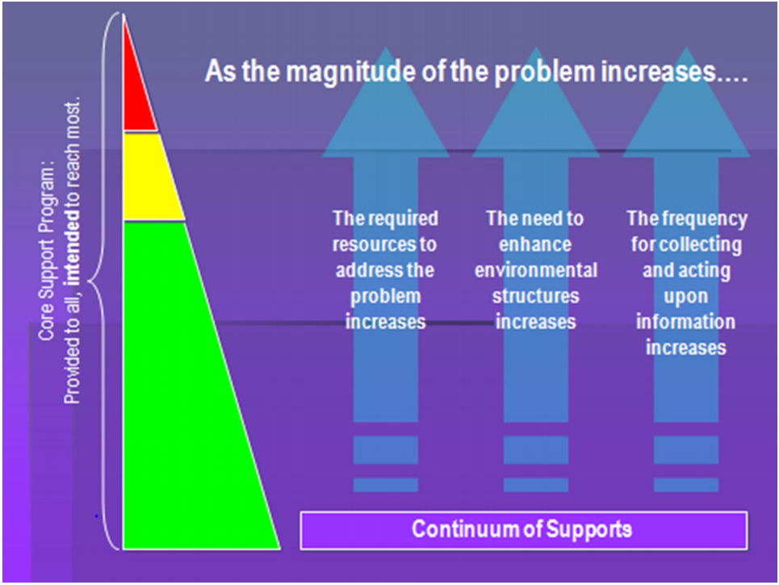

Slide 6
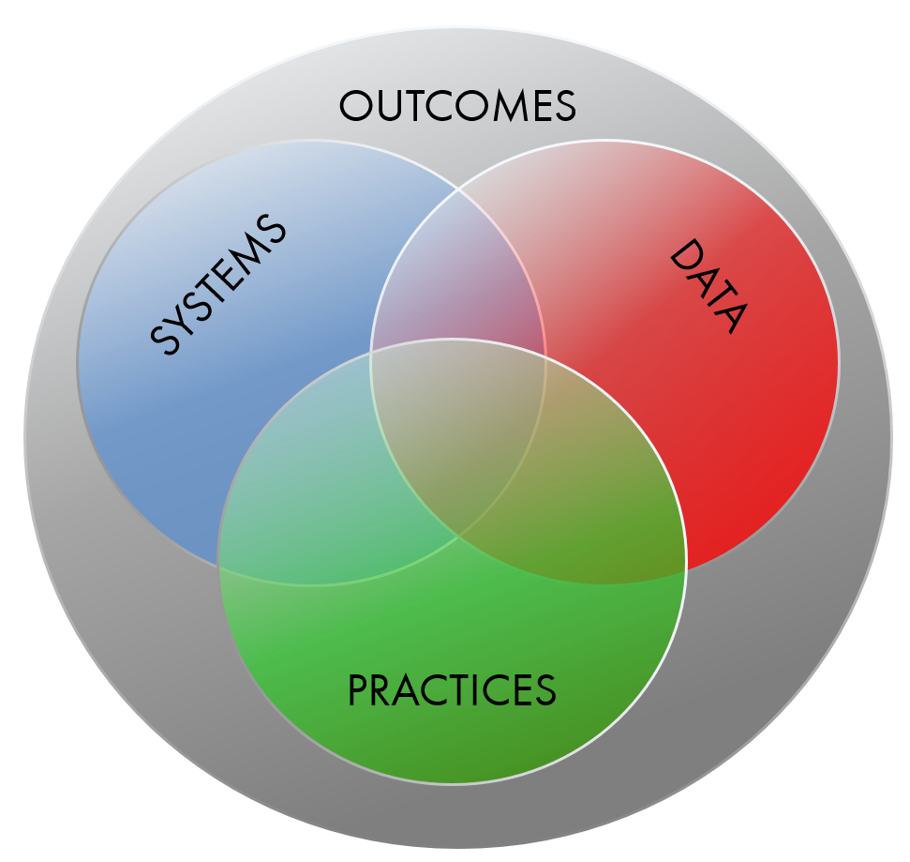
PBIS Logic
Supporting Social Competence & Academic Achievement
Supporting Staff Behavior
Supporting Decision Making
Supporting Student Behavior
Notes:
When we think of implementing a practice in a school, we want to consider 4 key elements. Let’s start with outcomes. What do we want to achieve by using PBIS, for example? These are valued by staff, community and they support social competence and academic achievement. Then we have Data. What data will we use to inform that outcome? Then practices…what will we ask staff to do to reach the outcomes? Then…what systems will we put in place to support staff behavior and allow them to implement the practices and gather the data needed? This is the key piece…we tend to be really good at behavior rand data…and maybe we have a general idea of outcomes…but systems is the issue.
This is how you get sustainability. This is MTSS

Slide 7
Tier 1/Universal PBIS
Outcomes: At least 80% successful with Tier 1 practices alone
Practices: Identify and Teach Expectations, Ack System, Discipline Procedures, Classroom Mang
Data: Office Discipline Referrals, Attendance, Truancy, Grades
Systems: Team-based, Process for teaching expectations to students and adults, Data system and use, etc
Notes:
Practices: Here are the broad practices. You may have differentiation by grade level or for individual kids.

Slide 8
Tier 2/Targeted PBIS
Outcomes: Use with 10-15% of students; At least 80% of students in Tier 2 are successful
Practices: Efficient interventions for small groups of students (not always delivered in a group, however)
Data: ODRs, Daily Point Cards, Screening tools, etc
Systems: Team-based, Process for identifying students and providing support, Data system and use, etc

Slide 9
Outcomes: Use with 3-5% of students; Students reach individual goals
Practices: Individualized interventions, Wrap-Around supports
Tier 3/Intensive PBIS
Data: Rating Scales, ODRs, Daily Point Cards, progress from Tier 2, Results of Complex FBA, etc
Systems: Team-based, Process for identifying students and providing support, Data system and use, etc

Slide 10
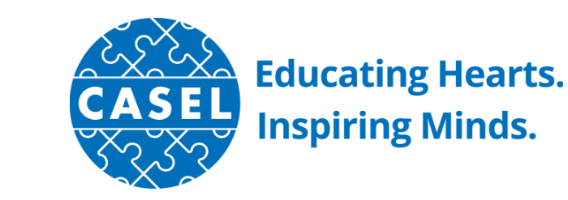
What is Social Emotional Learning
“Social and emotional learning (SEL) is the process through which children and adults acquire and effectively apply the knowledge, attitudes, and skills necessary to understand and manage emotions, set and achieve positive goals, feel and show empathy for others, establish and maintain positive relationships, and make responsible decisions.”
CASEL Collaborative for Academic, Social, and Emotional Learning

Slide 11
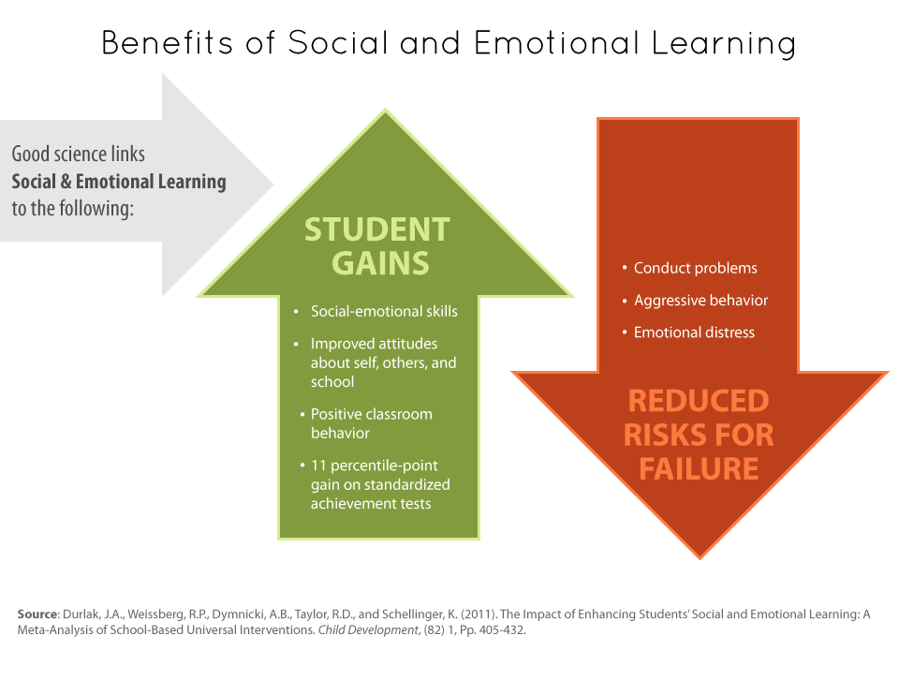
Social Emotional Learning
Notes:
Social and emotional learning (SEL) is the process through which children and adults acquire and effectively apply the knowledge, attitudes, and skills necessary to understand and manage emotions, set and achieve positive goals, feel and show empathy for others, establish and maintain positive relationships, and make responsible decisions.
This research demonstrates that educators cannot just hope that students arrive to school competent in recognizing and managing their emotions, setting and achieving goals, appreciating the perspectives of others, establishing and maintaining healthy relationships, making responsible decisions, and in managing conflict. We must teach, model, and provide consistent reinforcement of these skills throughout the school day in order to create an environment where students feel safe, belong, connect, and are engaged in their learning. This is recognized in our Colorado Academic Standards as well- ESW standard in the Comprehensive Physical Health and Education content area provides the developmentally appropriate framework and language for teaching students these competencies.

Slide 12
Levels of School-wide SEL and 5 Domains of SEL
FAMILY, & COMMUNITY PARTNERSHIPS
FAMILY & COMMUNITY PARTNERSHIPS
SEL CURRICULUM & INSTRUCTION
SCHOOLWIDE PRACTICES & POLICIES
SEL CURRICULUM & INSTRUCTION
SELF-MANAGEMENT
SELF-AWARENESS
SOCIAL AWARENESS
Social and
Emotional
Learning
(SEL)
RESPONSIBLE DECISION-MAKING
SEL CURRICULUM & INSTRUCTION
RELATIONSHIP SKILLS
SCHOOLWIDE PRACTICES & POLICIES
http://www.casel.org/
Notes:
Collaborative for Academic, Social, and Emotional Learning. “For a growing number of schools and districts, SEL has become a coordinating framework for how educators, families, and communities partner to promote students’ social, emotional, and academic learning.
SEL is embedded in their strategic plans, staffing, professional learning, and budgets. It guides their curriculum choices and classroom instruction — both direct practice in SEL as well as integrated instruction with reading, math, history, and other core subjects.
It drives many of their schoolwide practices and policies. It informs how adults and students relate with each other at all levels of the system, creating a welcoming, participatory, and caring climate for learning.
It shapes their partnerships with families and community members, highlighting engagement, trust, and collaboration.”
“Our partner districts are developing tools to help districts conduct needs assessments, align resources, select programs, assess progress, and more.”

Slide 13
Building Bridges to Language
Social Emotional Learning…
Bullying Prevention
Positive youth development
Character ed
21st century skills
Soft skills
Essential Skills
Self-regulation
Self-monitoring
Mindfulness
Bullying prevention
Whole child approach
Brainwise
Restorative practices
Problem solving training
Empathy training
Compassion training
Optimism training
Positive culture and climate

Slide 14
Think, Write, Share
Turn to an elbow partner and discuss other educational language used to describe SEL

Slide 15
Traditional Representation of each Approach
PBIS
• Management of behavior
• Context/setting specific behaviors
• Data and progress monitoring
• Emphasis on structures and systems to enable system level change
• prescriptive 5:1 positive interactions
Context specific implementation
SEL
• Self-discipline
• Focus on building competence
• Specific teaching tools
• Emphasis on classroom practices
Emphasis on student relationships (student-student; student-teacher; teacher-teacher)
• Clearly articulated scope and sequence
Sara A. Whitcomb, Ph.D. Sarah A. Fefer, Ph.D. BCBA University of Massachusetts, Amherst College of Education School Psychology Program
New England PBIS Forum 2014

Slide 16
EBP for Social Skills
Can just use your expectations…define the expectation more explicitly
Discrete steps;
what it is/is not
Teaching of Skill
Controlled and Applied Settings
Model, Practice and Reinforcement of Skill
All Settings
Generalization and Maintenance
Monitor and Evaluation
Notes:
Teaching: modeling; discrete skills and steps. Application to real life: Emphasize the “what if you do” what if you don’t in real life examples
Forecast considerations for system. Making it effective as Tier 2 system

Slide 17
Connecting to PBIS
In order to be successful with either PBIS and SEL, we need an integrated approach…without it, it is very difficult to get down to the teacher-student interaction and sustainability is challenging if not impossible
Notes:
Some have characterized PBIS as the structure and SEL as the support within the umbrella of positive school climate
Same have said that PBIS is an evidence-based PBIS program. SEL coordinators do not know how to do the work effectively. Must be taught like you would teach any skill

Slide 18
But how do we integrate supports?
What
How
Where
Effective Interventions
Effective Implementation Methods
Enabling Contexts
Academic, Behavior,
Family, Staff Supports, etc.
Implementation Science
Supportive Infrastructure
Why
Socially Significant Outcomes
Adapted from 2012 Dean Fixen and Karen Blasé, National Implementation Research Network
Notes:
We are considering implementation science and infrastructure as systems design. Talking about both in this section

Slide 19
Questions Teams Asks:
 | Schoolwide | Student
Implementation | Systems-Implementation: Who is on each team? When/where do the teams meet? What interventions are available? What training and support is provided to staff? Fidelity of interventions overall is at least 90%? | Student-Implementation: How does a student receive Tier 2/3 services and supports? What is the process? What paperwork is needed? Who completes it?
Impact | Systems-Impact: At least 80% of students are successful at Tier 1? 10-15% of student population need Tier 2/3? At least 80% of students in Tier 2/3 are successful? | Student-Impact: Which students needs interventions? What intervention does a given student need? What is the progress of a given student? Is a given group of students successful with level of support?
Can’t just live here. Must address all other tasks/cells.
Notes:
When you consider systems and student along with implementation and impact, it creates a matrix. Questions that you ask/data to gather for each cell.

Slide 20
Feature | Description
Explicit instruction of expectations/skills | Teach the student exactly what is expected using examples and non-examples to illustrate desired behaviors (consider avoidance of “appropriateness”). Typically: Define behaviors, role play, and cite feedback for initial and ongoing implementation.
Structured prompts for behaviors | This might include reminders of expected behaviors, visuals, or cues on a point card.
Opportunities to practice the skills | Skill practice should be embedded throughout the school day and across [relevant] environments (and not just in an isolated instructional/skills group setting).
Frequent feedback to the student | Students should receive positive and corrective feedback at regular intervals throughout the school day on the expectations or skills being targeted (usually at least once per period or subject area). Feedback should be consistent and specific and focus on positive interactions.
Mechanism to fade support | This often involves reducing the number of times the student is prompted or receives feedback about a skill. It can also involve increasing the interval between delivery of acknowledgements (“positive referrals”) associated with success.
Communication with students’ families | Outreach to parents/families (e.g., brief notes home , daily or weekly ; phone calls, emails, post card mailers or other quick, culturally-relevant communication forms). Considerations: Content & Confidentiality & Two-way options
Adapted from CDE PBIS presentations
Notes:
The features are the salient things you’d see ... What does it look like?

Slide 21
Think, Write, Share
1. Think about your current Tiered systems. What are some areas to consider?
2. What are areas that you feel are being addressed? What should be improved?

Slide 22
What exactly IS a trauma-sensitive school?
All staff understand the prevalence and impact of trauma of their students and themselves.
School strives for physical, emotional, social, academic safety for all.
The school addresses holistic student needs.
The school is inclusive and connects students to the community instead of excluding them.
The school staff work collaboratively to support students.
School leaders adapt services and supports based on contemporary needs of students.
Notes:
The focus of Trauma Informed Care is in the recognition, understanding, and responsiveness to trauma with explicit efforts made in restoring emotional safety, building healthy relationships, and creating positive opportunities where students can practice self-regulation strategies and prosocial skills.

Slide 23
Linking Trauma Informed Approaches with PBIS
Both emphasize the recognition, understanding, and responsiveness to student needs using a preventive, positive, and instructional lens.
Both recognize the necessity of building the collective capacity of school personal to create safe, predictable, and engaging learning environments for all students.
Both make explicit efforts to build healthy, trusting relationships, emphasize choice and empowerment through skill building.
Both intentionally create positive opportunities where students can practice self-regulation strategies and prosocial skills.
Both view collaborative partnerships between school, home, and community as essential for creating culturally relevant outcomes and sustained benefits for students.
Notes:
The focus of Trauma Informed Care is in the recognition, understanding, and responsiveness to trauma with explicit efforts made in restoring emotional safety, building healthy relationships, and creating positive opportunities where students can practice self-regulation strategies and prosocial skills. Both FBA and TIC assume that if we learn more about precipitating factors associated with behavior, gain a better understanding of the need that the behavior serves, and identify critical features surrounding motivation or intent, we are better equipped to select strategies that will target lagging skills, teach new, pro-social behaviors that serve the same function or need, create environments where students feel safe to practices those skills, and promote self-regulation.

Slide 24
Becoming even more Trauma Sensitive…
Raise staff awareness of the prevalence and impact of trauma.
Recognize that problem behaviors might be a response/adaptation trauma.
Pay attention to students emotional responses in addition to behavioral ones.
Establish a discipline system that is sensitive, predictable and respectful.
For students impacted by trauma, work with them to identify and reduce school triggers.
Infuse youth development and cultural sensitivity into curricula, student activities, staff professional development and family/community events.

Slide 25
Think, Write, Share
Discuss current efforts to be more trauma informed as a Tiered approach

