Slide 1
Understanding Response to Intervention Within the Colorado Multi-tiered System of Supports Framework: Essential Concepts for Educators

Slide 2

Introductions
In the chat, please add your:
Name
Roll
Who we are:
Christina Kirchhof and Evan Daldegan – COMTSS Implementation Specialists in the Office of Learning Supports and members of the Response to Intervention (RtI) team.
This series is presented in collaboration with the Office of Special Education, Office of Gifted Education, and the Office of Standards and Instructional Support.

Slide 3
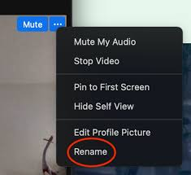
Session Norms
Right click on your photo to rename yourself if needed. Select the three dots in the upper right corner and then rename.
  Please include your first and last name for attendance
Be as virtually present as possible
Communicate any needs or questions through zoom chat – we have allotted time to answer questions at the end.

Slide 4

Objectives and Agenda
Participants will be able to describe how RtI functions within the COMTSS Framework.
Participants will enhance their understanding of the key features of RtI and the function of each.
1. Content
2. Resources
3. Q&A

Slide 5

Why Now?

Slide 6
Future RtI Trainings
Using Assessments in Response to Intervention
October 9, 2025 – 8:30-9:30am
Data Literacy for Response to Intervention
November 20, 2025 – 8:30-9:30am

Slide 7
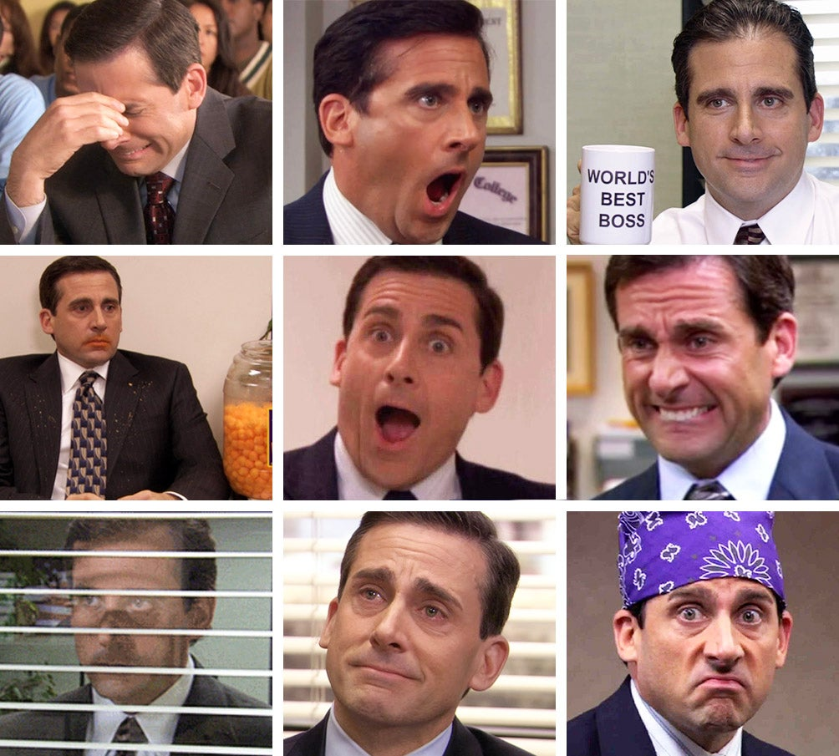
Which version of Michael Scott best matches your feelings about Response to Intervention?
1
2
3
4
5
6
7
8
9

Slide 8
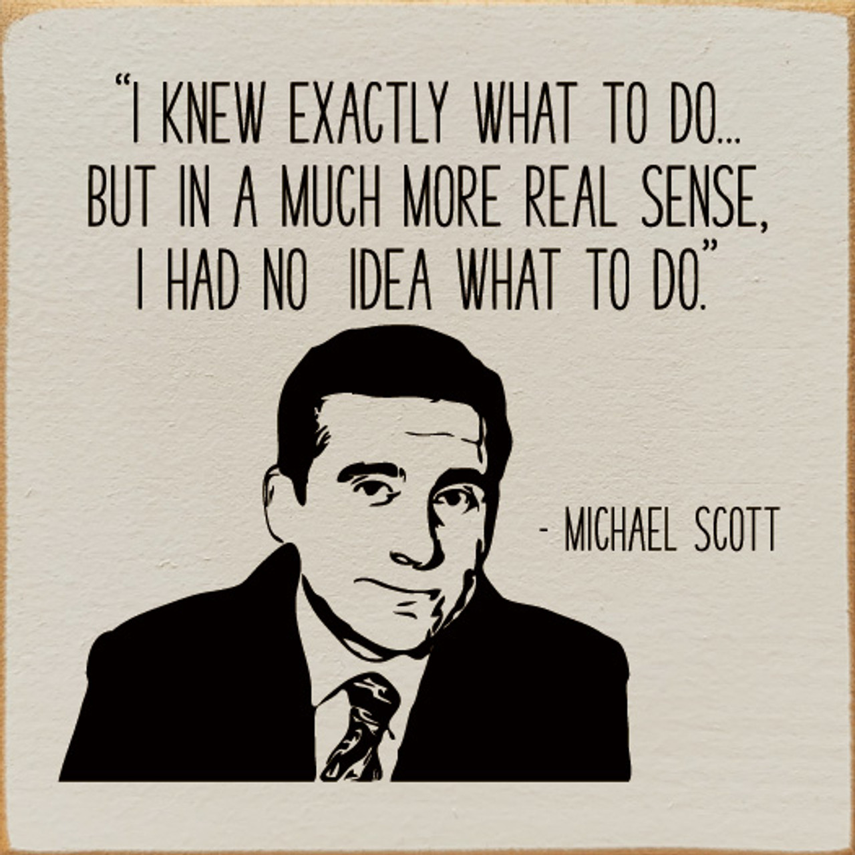
Michael Scott quote

Slide 9
Colorado Multi-Tiered System of Supports and
Response to Intervention

Slide 10
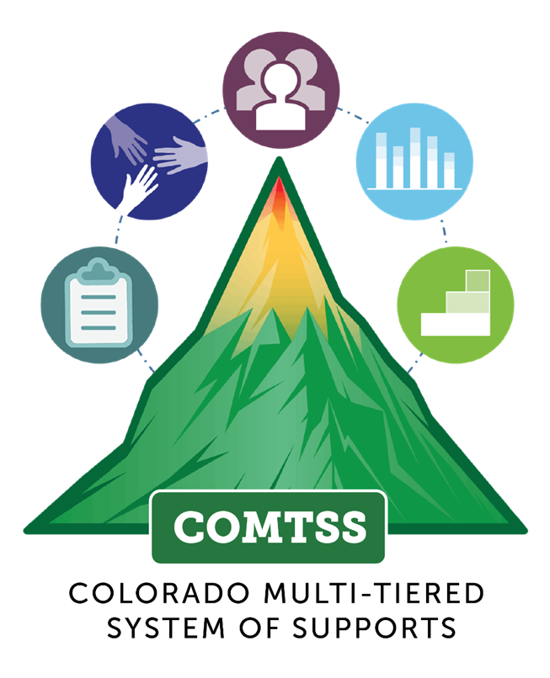
Colorado Multi-tiered System of Supports
COMTSS is a prevention-based framework using team-driven leadership and data-based problem solving to improve the outcomes of every student through family, school, and community partnerships, comprehensive assessment, and a layered continuum of supports.

Slide 11
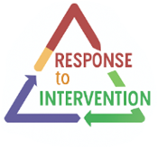
Response to Intervention
RtI targets implementation at the school- level creating structures and supports that focus on giving all students high-quality instruction and individualized tiered support based on their academic, social-emotional, and behavioral needs.

Slide 12

The Key Features of Response to Intervention
A collaborative team focused on student-level problem solving.
A problem-solving model focused on individual student needs.
A standardized process to select and implement evidence-based practices.
A comprehensive data collection and analysis process is used consistently to target identified student needs.
Capacity building for all partners to understand and implement interventions.
Consistent, meaningful collaboration with families.

Slide 13
The Framework Supports the initiative
COMTSS is the framework that outlines how the work is done, using five core components. It serves as an implementation guide to ensure all necessary elements are in place.
RtI is an initiative that operates within the COMTSS framework, using its implementation practices to determine what work is done to support students.

Slide 14



Aligned Framework
= initiative
COMTSS is the integration of several multi-tiered initiatives (including RtI) into one clear aligned framework used to address multiple domains in education.
(McIntosh & Goodman, 2016)

Slide 15
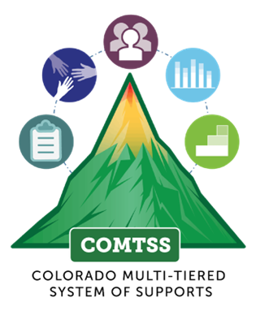

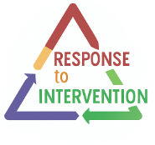


COMTSS supporting implementation
Framework
Initiatives
Practices
Students

Slide 16
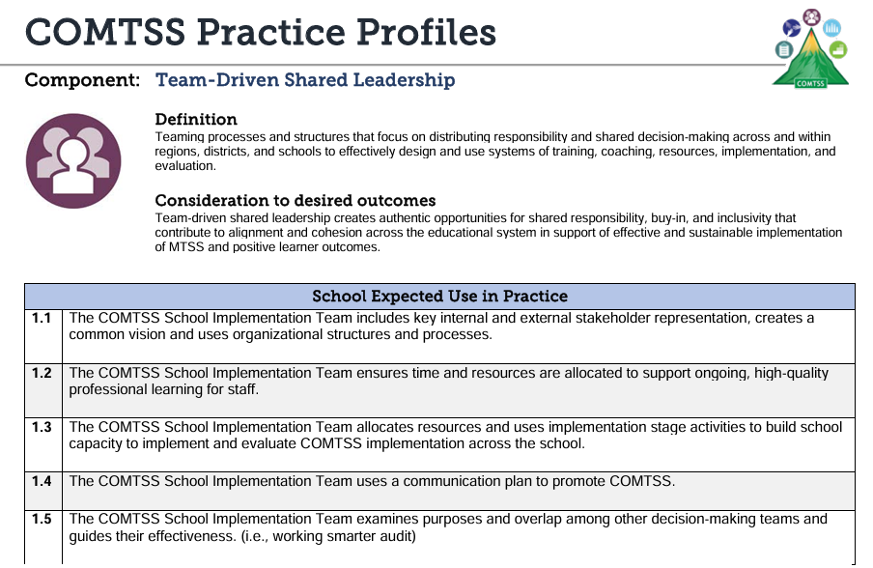
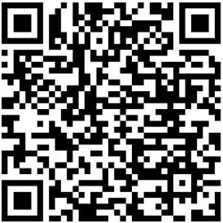
Practice Profiles
COMTSS Practice Profiles Link

Slide 17
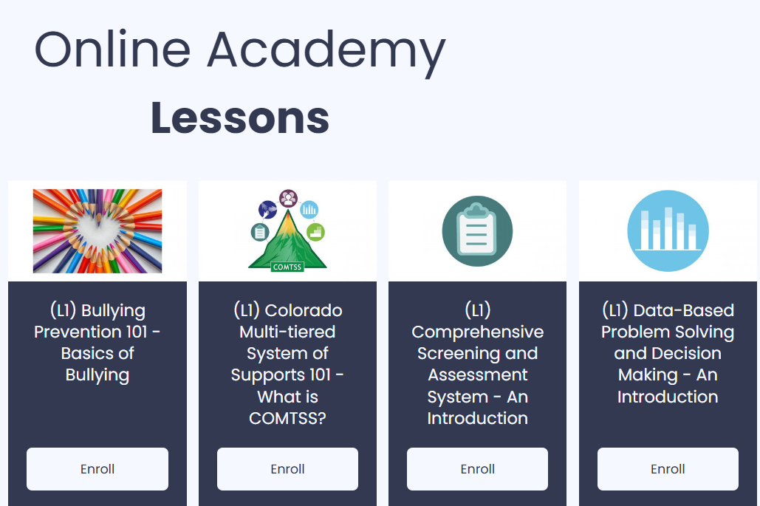
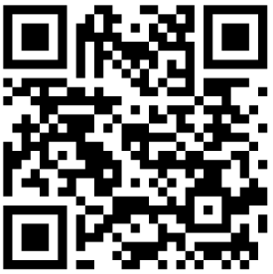
Online Academy
Online Academy Link

Slide 18
How does having an implementation framework (COMTSS) directly support the initiative? (RtI)

Slide 19
COMTSS and RtI
Working Together
COMTSS
Examples of the COMTSS Component used to support the implementation and sustainability of RtI
RtI
An initiative that includes Tier 1, Tier 2, Tier 3 practices, protocols, and procedures that support student needs
RtI
STUDENT LEVEL
WHOLE SCHOOL LEVEL

Slide 20

Team-Driven Shared Leadership
COMTSS
RtI
School leadership team helps build the RtI team, sets a consistent meeting schedule, defines team roles, and trains all members on data protocols and procedures
Student problem-solving team spends less time organizing themselves and more time analyzing student needs and planning interventions.

Slide 21

Response to Intervention: Key Feature
A collaborative team focused on student-level
problem solving.
Each school maintains a diverse, collaborative team to address academic, behavioral, and/or social emotional needs of students at risk or not making adequate progress.
    Representation should be diverse. Members may include teachers, specialists, administrators, families, and, when appropriate, the student.
Teams meet regularly to implement and monitor problem-solving processes.

Slide 22

Data-Based Problem Solving and Decision Making
COMTSS
RtI
Use multiple sources of data to evaluate student progress and make adjustments to individual student interventions if needed.
Collect and use implementation and student outcome data to make decisions about how well each tier is functioning.

Slide 23
Response to Intervention: Key Feature
A problem-solving model focused on individual student needs.
Follows a structured Four-Step Process:
          Problem identification, Problem Analysis, Plan Monitoring, and Plan Evaluation.
Uses comprehensive data, both formal and informal, for all decision-making.
Ensures interventions are selected efficiently and matched to the student’s needs.

Slide 24

Comprehensive Screening and Assessment System
COMTSS
RtI
The student problem solving team will be able to take full advantage of an assortment of data that directly helps to guide specific services for specific students
Aligns school-wide assessment tools, creates an assessment calendar, and ensures that teams have access to all data collected

Slide 25
Response to Intervention: Key Feature
A comprehensive data collection and analysis process is used consistently to target identified student needs
Decision rules are established based on a comprehensive review of all available data and are evaluated at regular intervals.
Decision rules clearly distinguish between system-level (COMTSS) and student-level (RtI) considerations.
Decision rules are applied equitably and consistently when reviewing student-level data.

Slide 26
Response to Intervention: Key Feature
Standardized Process to Select and Implement
Evidence-Based Practices
Identify culturally responsive, developmentally appropriate evidence-based interventions (EBIs).
Evaluate EBIs for contextual fit with the school’s values, needs, skills, and resources.
Assess in three areas:
                Strength: Clearly defined and supported by high-quality research.
      Fit: Addresses identified needs and aligns with staff skills.
      Capacity: Leadership support, resources, and time available for implementation.

Slide 27

Family, School, and Community Partnerships
COMTSS
RtI
Include parents in student RtI meetings and use two-way communication with families about individual student needs, strengths, and progress through a culturally responsive approach to problem solving- “parents as partners”
Establishes trusting relationships using school-wide family engagement strategies and collects feedback to improve processes.

Slide 28
Response to Intervention: Key Feature
Consistent, meaningful collaboration with families
• Families play a crucial role in the RtI model and problem-solving process. Their partnership is essential, and their input should be included when developing intervention plans.
• The RtI team ensures that the whole of the RtI process is accommodating to the needs of the family, ensuring that they can engage meaningfully.
• Families and school staff maintain regular, two-way, and meaningful communication to support student learning.

Slide 29
Response to Intervention: Key Feature (Cont.)
Capacity building for all partners to understand and implement interventions
• The RtI team ensures that capacity building opportunities and experiences are available to all partners and include activities or resources that provide information or feedback about the RtI process.
• Barriers to RtI implementation can include anything that interferes with the implementation of the "solutions" that were decided upon by the RtI team. These barriers are reviewed at regular intervals.

Slide 30

Layered Continuum of Supports
COMTSS
RtI
Creates and maintains a central “menu” of Tier 1, Tier 2, and Tier 3 interventions to ensure alignment and avoid duplication or gaps.
Teams can quickly match students to interventions instead of reinventing the wheel or debating untested ideas.

Slide 31

RtI Layered Continuum of Support
5-10%
10-15%
80%
Prevention/Promotion throughout the tiers
Few students also receive intensive supports
Some students also receive targeted supports
All students receive universal supports

Slide 32

Ingredients for the Tiers
Outcome:
  The goal or target for each tier
  Student growth, performance, success-
  “What we specifically want to achieve”
Data:
The evidence used to drive decision making at system and student levels-
“What information are we using?”
Practices:
Instructional, behavioral, or support strategies implemented at each tier
“What we do.”
Systems:
Practices, Protocols, Procedures and mutli-disciplinary teaming to support RtI
“What structures make it work effectively and sustainably?”

Slide 33
Tier 1: Universal Systems
High Quality Tier 1 Instruction
Outcomes: 80% of students are successful with Tier 1 strategies/practices alone
Practices: High Quality Instructional Practices
Best, First Instruction
Data: Office Discipline Referrals, Attendance, universal screening, engagement, grades, assessments, implementation
Systems: team-based learning opportunities for all staff, data collection system, implementation supports

Slide 34
Tier 2: Targeted/Supplemental Systems
Outcomes: Use with 10-15% of students; At least 70% of students in Tier 2 are successful –Close the skill gap
Practices: Efficient interventions for small groups of students in and/or outside of the classroom
Systems: Team-based process for identifying needs and matching support, progress monitoring, data system, coaching support
Data: Student discipline, academic growth, progress monitoring intervention data, implementation data

Slide 35
Tier 3: Intensive
Outcomes: Use with 3-5% of students; Students make meaningful progress toward individual goals
Practices: Individualized interventions and supports, “wrap-around” supports
Data: Outlined in behavior support plans, individualized progress monitoring data in area(s) of need
Systems: Use a Process for identifying needs and matching supports, ongoing coaching and support for teachers

Slide 36
Objectives Revisited
Participants will be able to describe how RtI functions within the Colorado Multi-Tiered System of Supports (COMTSS) Framework.
Participants will enhance their understanding of the key features of RtI and the function of each.

Slide 37
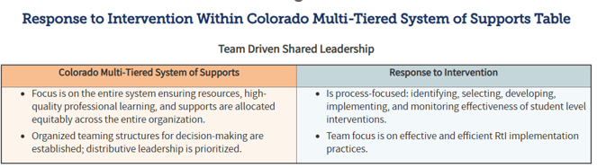
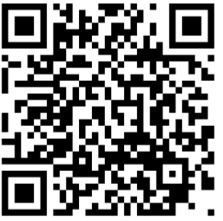
RtI Within COMTSS Crosswalk
This table shows how RtI aligns with each of the five COMTSS components at the school level.
Link to the Crosswalk

Slide 38
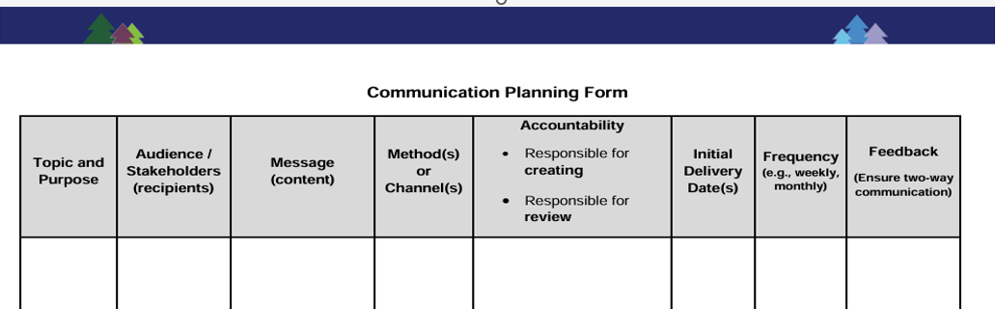
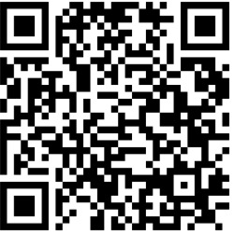
Committee Audit Protocol
This protocol identifies each team or committee in a setting and define its functions and
intended outcomes.
Committee Audit Link

Slide 39
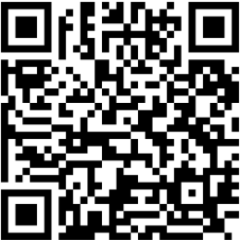
Communication Plan
This tool gives teams a structured way to plan communication with both internal
and external stakeholders.
Communication Plan Link

Slide 40
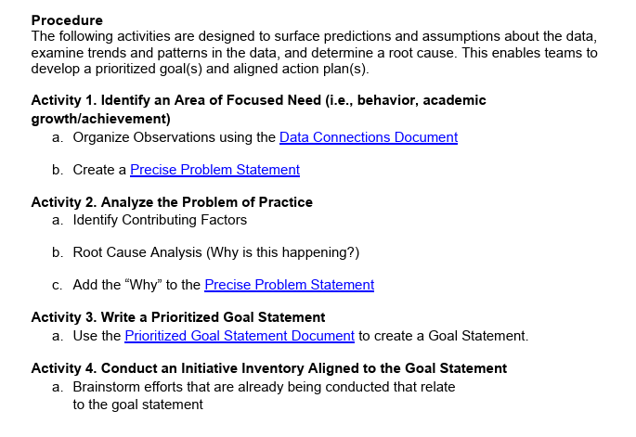
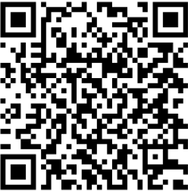
Decision-Making Protocol
The Data-Based Decision-Making protocol is designed to guide the four-step problem-solving process.
Decision Making Protocol Link

Slide 41
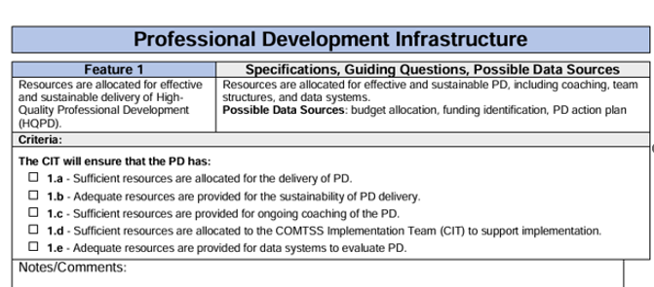
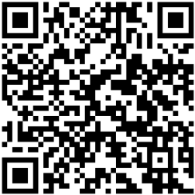
Professional Development Plan
The professional development plan gives direction and focus to staff learning.
Professional Development Plan Link

Slide 42

Questions and Answers
1. How might COMTSS support adult education and family literacy in a way that aligns with the Colorado two-generation strategies?
2. How can we be more efficient with COMTSS and RTI?
3. How can special education and general education teams work together to make this process better/more effective?
3.1. How can RTI be used most effectively prior to making program adjustments?
4. What does the RtI process look like for behavior interventions?
5. What might RtI look like at the secondary level?
6.What considerations are there for students and families of Faith Communities?

Slide 43
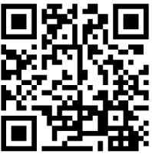
Resources and October 9th Session
https://www.cde.state.co.us/mtss/resources

Slide 44
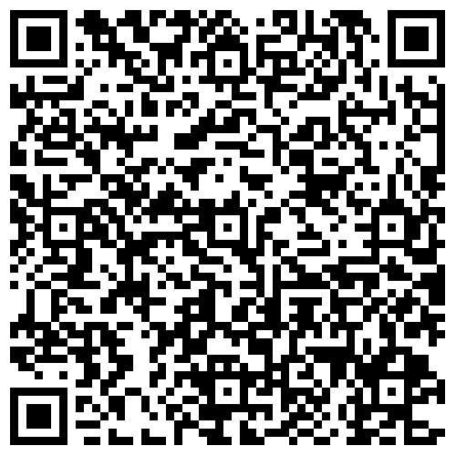
The Gift of Feedback
RtI September 5th Feedback Survey
Registration for the October 9th training

Slide 45




School Mental Health Support Program
Implemented by Kempe Center for the Prevention and Treatment of Child Abuse and Neglect at University of Colorado Anschutz Medical Campus and Butler Institute at University of Denver
Established by HB24-124, funded by Colorado Behavioral Health Administration (BHA)
Training, consultation, implementation support, and resources on: mental health, resiliency, trauma-informed practices, cultural responsiveness, mindfulness and cognitive-behavioral skills, resources for managing suicide risk, educator wellness and addressing work-related stress
Aligned with Multi-Tiered System of Supports (MTSS)
Virtual learning sessions on many topics, more coming soon

Slide 46


For questions or more information please visit: www.cde.state.co.us/mtss
Or email us at:
Response to Intervention Mailbox
RTI@cde.state.co.us

