Slide 1
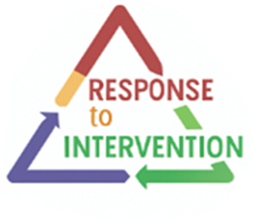
Integrating Universal Design for Learning within
Response to Intervention
January 15, 2026

Slide 2

Welcome!
In the chat, please add your:
Name
Roll
Who we are:
Katherine Freeman – Colorado Multi-Tiered System of Supports (COMTSS) Regional Specialist
Milcah Hawk – COMTSS Regional Specialist
This series is presented in collaboration with the Office of Special Education, Office of Gifted Education, and the Office of Standards and Instructional Support.

Slide 3

Session Norms
Be as virtually present as possible
Communicate any needs or questions through zoom chat – we have allotted time to answer questions at the end.

Slide 4




Previous Sessions
Recordings and slide decks can be found at the bottom of the RtI training page
September – Response to Intervention (RTI) within the COMTSS Framework
October - Using Assessments in Response to Intervention
November - Data Literacy in Response to Intervention

Slide 5

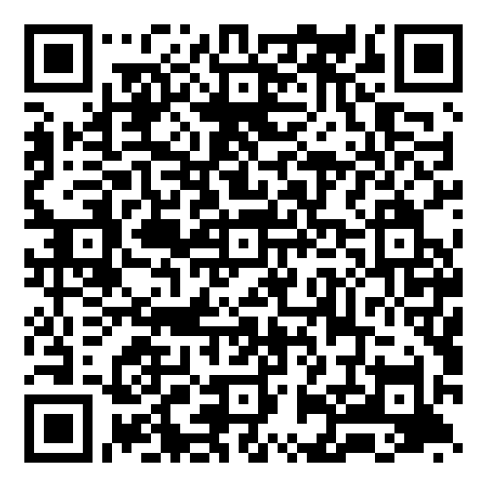
Response to Intervention to Support a Continuum of Learners
February 19th, 2026 – 8:30-9:30
Participants will:
Apply assessment practices to support an array of learner abilities.
Use data literacy to drive collaborative approaches.
Explore their systems and student-centered decisions to ensure support for all levels.
Register for February 19th here

Slide 6

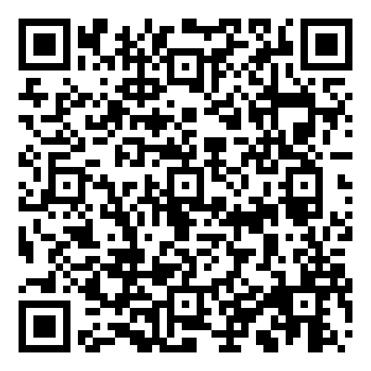
Response to Intervention to Support Multilingual Learners
March 12th, 2026 – 8:30-9:30
Participants will:
Participants will be able to apply Like-Peer comparative data to inform equitable instructional, intervention, and referral decisions across Colorado Multi-Tiered System of Supports (COMTSS) tiers for multilingual learners.
Participants will be able to explain how Like-Peer comparative data strengthens COMTSS decision-making for multilingual learners by contextualizing performance within linguistically and culturally comparable groups.
Register for March 12th here

Slide 7
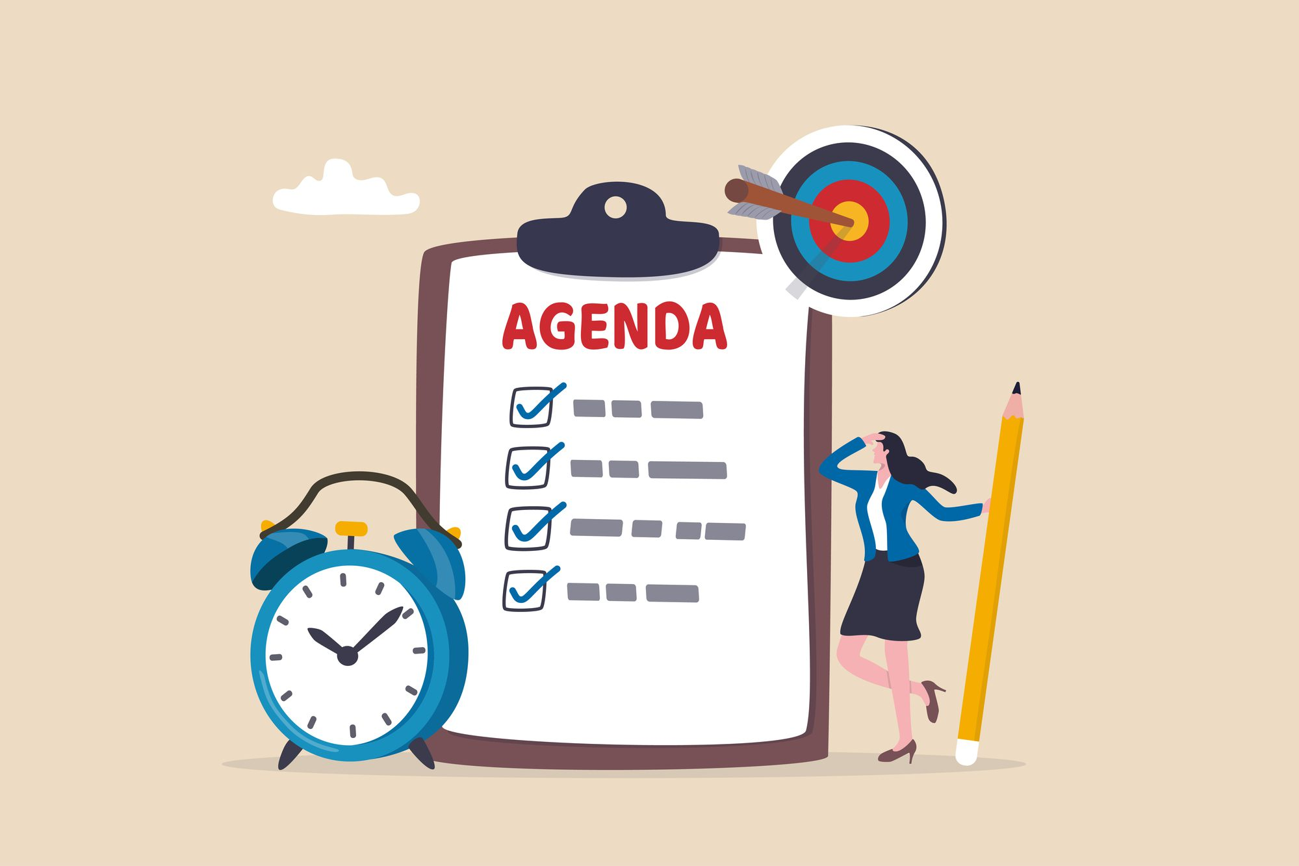
Objectives and Agenda
Participants will explore how Universal Design for Learning (UDL) Guiding Principles strengthen RtI by improving access, equity, and effectiveness across all tiers of support.
Participants will identify ways to embed UDL strategies in core instruction to reduce barriers and support all learners.
Participants will demonstrate how UDL can inform targeted and intensive interventions, ensuring flexibility and accessibility for diverse learners.
1. Content
2. Application
3. Q&A

Slide 8
Universal Design for Learning
UDL is a framework to guide the design of learning environments that are accessible, inclusive, and challenging for every learner. Ultimately, the goal of UDL is to support learner agency, the capacity to actively participate in making choices in service of learning goals.
Center for Applied Technology (CAST) UDL Evidence and Benefits

Slide 9

Learner Variability

Slide 10


Physical Variability and The Myth of Average
Height
Shoulders
Chest
Waist
Hips
Legs
Reach
Torso
Neck
Thigh
Rose, T. (2016). The End of Average: How to Succeed in a World
that Values Sameness. San Francisco, CA: HarperOne.

Slide 11
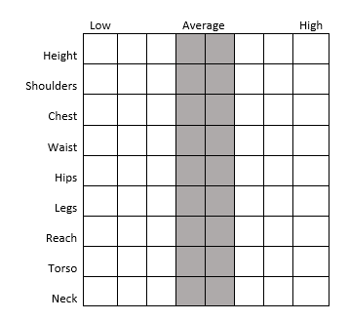
Physical Variability:
Variability is the Norm
Student 2
Student 1
Rose, T. (2016). The End of Average: How to Succeed in a World
that Values Sameness. San Francisco, CA: HarperOne.

Slide 12
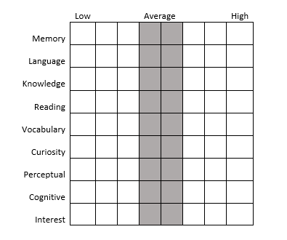
Learner Variability:
Variability is the Norm
Student 2
Student 1
Rose, T. (2016). The End of Average: How to Succeed in a World
that Values Sameness. San Francisco, CA: HarperOne.

Slide 13
The Goal of Universal Design for Learning: Learner Agency
The UDL Guidelines inform the design of learning environments to support learner agency that is:
Purposeful - internalized self-efficacy, acting in ways that are personally and socially meaningful.
Reflective - self-awareness and metacognition to identify internal motivations and external influences that support learning and make adjustments when necessary.
Resourceful - understanding and applying assets, strengths, resources, and linguistic and cultural capital.
Authentic - increasing comprehension and deepening understanding in ways that are genuine.
Strategic - setting goals and monitoring learning with intentionality and planfulness.
Action-oriented - self-directed and collective action in pursuit of learning goals.

Slide 14
Learner Agency Benefits All Learners
Improved access to content
Reduced language load without reducing rigor
Intentional vocabulary and language development
Early access and prevention
Multiple pathways to understanding
Flexible ways to participate and respond
Opportunities for depth, complexity, and challenge
Reduced reliance on pull-out or add-on enrichment
Flexible demonstration of learning

Slide 15
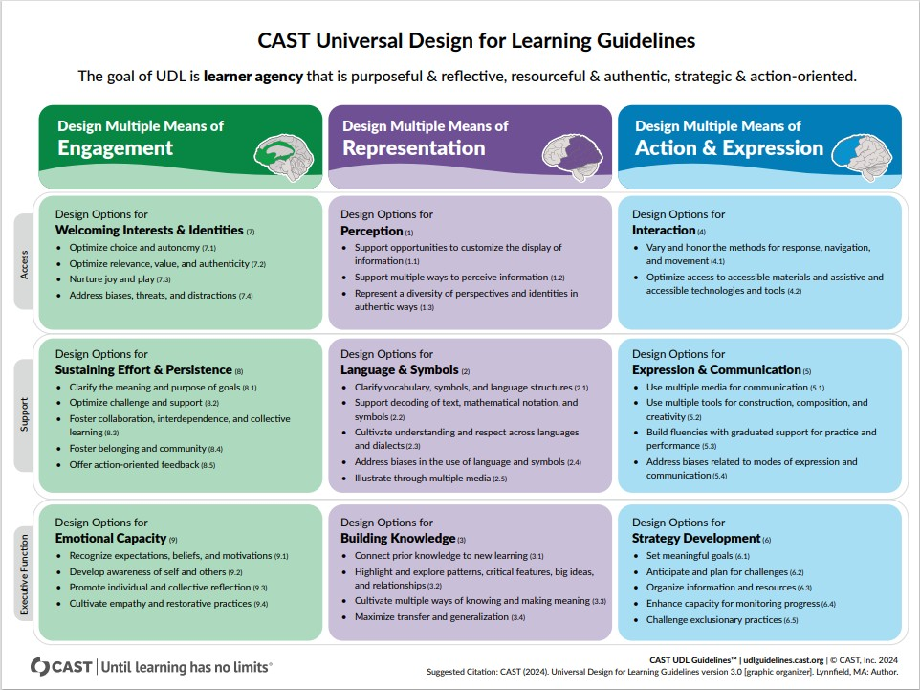
CAST Universal Design for Learning Guidelines visual
Universal Design for Learning Guidelines

Slide 16
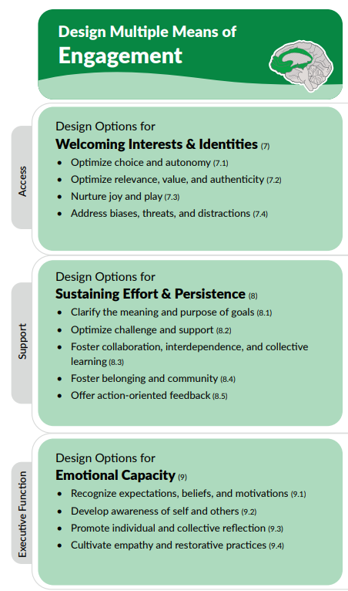
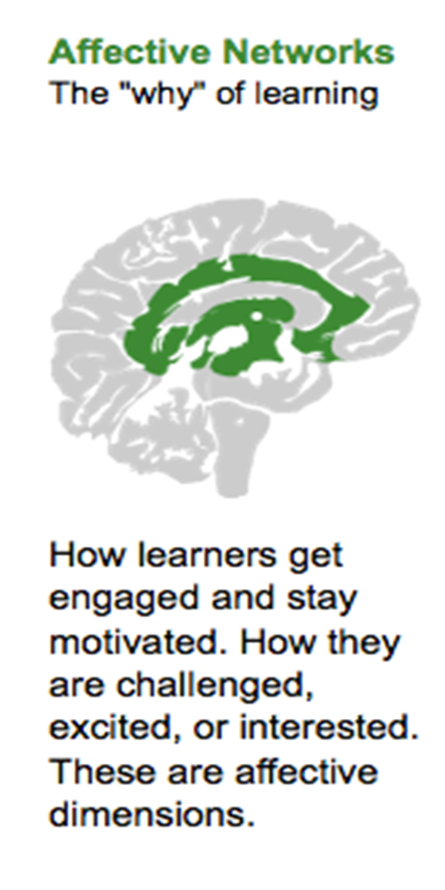
Engagement
The Limbic System is a group of brain structures that includes the amygdala, hippocampus, and hypothalamus. These parts help control emotions and memory. The limbic system is also responsible for our “fight or flight” response, which is how the body reacts to danger or stress.

Slide 17
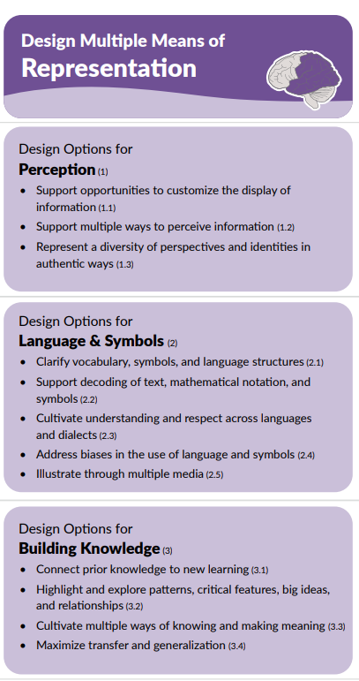
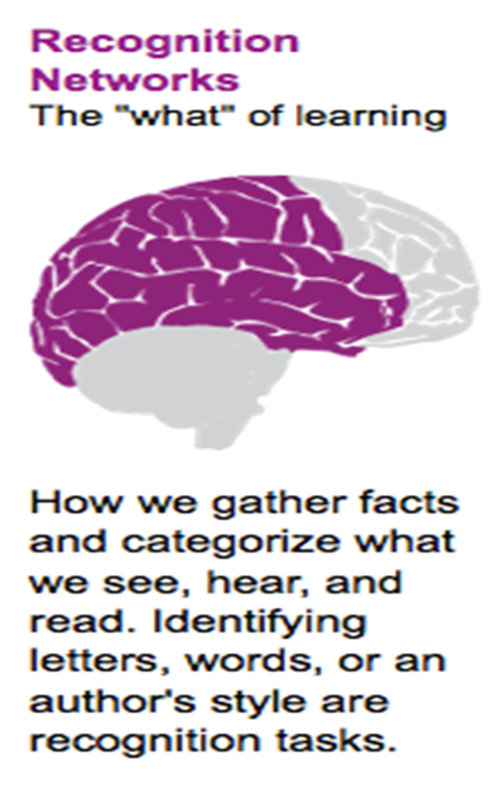
Representation
Access
The Temporal Lobe is an important part of the brain that handles many key functions. It helps us recognize things, understand language, form memories, and respond emotionally. This lobe is also involved in processing what we hear, see, and smell. In addition, it plays a big role in both short-term and long-term memory. Overall, the temporal lobe is essential for perception, communication, and memory.
Support
Executive Function

Slide 18
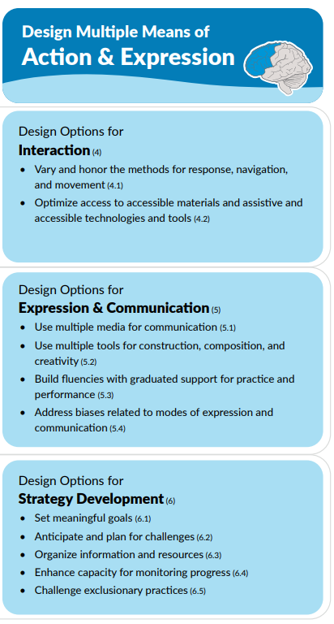
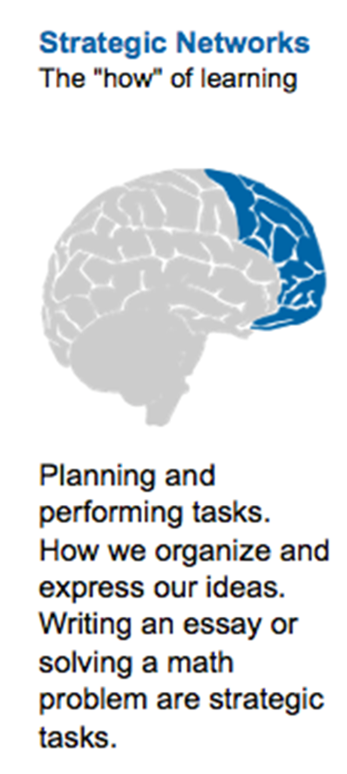
Action and expression
The Frontal Lobes are the largest part of the brain’s cerebral cortex. They play a big role in what we call “higher-level” thinking. These lobes help with important skills like making decisions, planning, solving problems, and thinking through ideas. They also control voluntary movements, attention, language understanding, and overall intelligence. In short, the frontal lobes are key for many functions that help us learn, communicate, and make choices every day.
Access
Support
Executive Function

Slide 19

How does technology support Universal Design for Learning?
What are some examples from your own life in how technology removes barriers?
Waterfall in the chat

Slide 20
A Tier 1 Lesson Without Universal Design for Learning Principles: Context
Context: 6th grade language arts, 25 students; diverse group including students from various cultural backgrounds, 3 ML students, 4 students with IEPs, 2 students with ALPs
Instructional Environment:
Traditional rows of desks facing the front
Walls display posters with literary terms and grammar rules
Single projector used for presentations
Minimal flexible seating
Learning resources on table at back of the room

Slide 21
A Tier 1 Lesson Without Universal Design for Learning Principles: Standards and Goals
Standards:
CCSS.RL.6.3: Describe how a particular story's or drama's plot unfolds in a series of episodes as well as how the characters respond or change as the plot moves toward a resolution.
CCSS.RL.6.1: Cite textual evidence to support analysis of what the text says explicitly as well as inferences drawn from the text.
Learning Goals:
Students will be able to:
Define character development
Write a paragraph with examples of how a character develops or changes in a novel

Slide 22
A Tier 1 Lesson Without Universal Design for Learning Principles: Lesson Outline
Introduction (15 min)
  Define character development
  Ask students to share characters they know and briefly discuss their development.
Reading activity (30 min)
  Assign a chapter from Holes by Louis Sachar for students to read silently
Class discussion (20 min)
  Whole group discussion about character traits, asking open-ended questions that require students to recall details from the chapter
Written assignment (15 min)
  Students write a paragraph describing how a character developed over the events of the chapter.

Slide 23
A Tier 1 Lesson Without Universal Design for Learning Principles: Outcomes
1. Introduction
  3 students raised their hands to share in the discussion
  Teacher shared several examples
2. Reading activity
  Teacher had to redirect the whole class to stop talking 4 times
  2 office discipline referrals were written for disruption, and 1 students was sent to work in the hallway
  1 student fell asleep
  Unclear how many students completed the readinG
3. Class discussion
  The same 3 students raised their hands to share in the discussion
  Teacher called on 2 more students, but they couldn’t provide details from the chapter

Slide 24
A Tier 1 Lesson Without Universal Design for Learning Principles: Assessment Outcomes
Written assignment
  Students write a paragraph describing how a character developed over the events of the chapter.
 | Exceeded expectations | Met expectations | Partially met expectations | Did not meet expectations | Absent
Number of students | 1 | 3 | 9 | 10 | 2

Slide 25
Lesson Reflection: Curriculum Components
Goals
Does the learning goal allow for multiple means of representation and/or action and expression?
Methods
Do students have a choice for how they build knowledge and access resources?
Materials
Do students have a choice in the materials they will use?
Assessments
Are there opportunities for diagnostic, formative, and summative assessments?

Slide 26
Lesson without Universal Design for Learning Principles reflection: What were the discussion barriers?
Barrier: Students are unprepared to contribute to the discussion (i.e. lack of content knowledge)
Provide options/choice for students to
Complete anticipation guides
Review possible prompts before the discussion
Write questions as they review class resources so they have pre-prepared low-risk opportunities to speak (Stengel et al, 2019)
Barrier: Students lack language skills to participate effectively
Provide a word bank with content-specific vocabulary
Provide the option to use sentence stems or frames
Resource: UDL Considerations for Minimizing Classroom Discussion Barriers from Novak Education

Slide 27
A Tier 1 Lesson With Universal Design for Learning Principles: Context and Environment
Context: 6th grade language arts, 25 students; diverse group including students from various cultural backgrounds, 3 ML students, 4 students with IEPs, 2 students with ALPs
Instructional Environment:
Classroom designed to be flexible and welcoming, with a range of seating options (traditional and standing desks, floor cushions, etc.) - 4.1, 4.2, 8.3, 7.1
Learning centers with resources and a technology corner with tablets – 4.1, 4.2, 1.1. 1.3
Walls feature student work, culturally relevant materials, and charts with language learning strategies – 2.1, 2.2, 2.3, 2.4, 7.2, 8.3

Slide 28
A Tier 1 Lesson With Universal Design for Learning Principles: Standards and Goals
Standards:
CCSS.RL.6.3: Describe how a particular story's or drama's plot unfolds in a series of episodes as well as how the characters respond or change as the plot moves toward a resolution.
CCSS.RL.6.1: Cite textual evidence to support analysis of what the text says explicitly as well as inferences drawn from the text.
Learning Goals:
Students will be able to:
Define character development
Describe how a character changes over the events of the novel, citing evidence from the text.

Slide 29
A Tier 1 Lesson With Universal Design for Learning Principles:
Lesson Outline, Introduction
Introduction (15 min)
  Show a video clip showing character development in popular media (movies, cartoons) - 2.5
  Provide sentence stems for students to discuss with a partner about how the characters changed and what caused the changes – 5.3, 8.1
  Call on pairs of students to share what they discussed with the class – 8.3

Slide 30
A Tier 1 Lesson With Universal Design for Learning Principles:
Lesson Outline, Reading Activity
Reading activity (30 min)
  Distribute graphic organizers to help students track character traits and changes throughout the story – 6.3, 3.2
  Students read the assigned chapter from their chosen literature circle novel, with the option of reading silently, reading along with the audiobook, or reading with partner – 1.1, 1.2, 7.1

Slide 31
A Tier 1 Lesson With Universal Design for Learning Principles:
Lesson Outline, Group Discussion
Group discussion (20 min)
  Students meet with their literature circle groups to discuss their observations using their graphic organizers, allowing for peer learning and exchange of ideas – 8.3, 9.3

Slide 32
A Tier 1 Lesson With Universal Design for Learning Principles:
Lesson Outline, Assessment Option
Assessment option (15 min)
  Students choose to demonstrate understanding with a choice - 7.1, 5.1, 6.1
    Creative project – multimedia poster that represents a character's journey and development in the story, using evidence from the text
    Socratic seminar – preparation and guided discussion, using evidence from the text to support arguments
    Written reflection – students describe how a character changed, using evidence from the text and providing personal insights

Slide 33
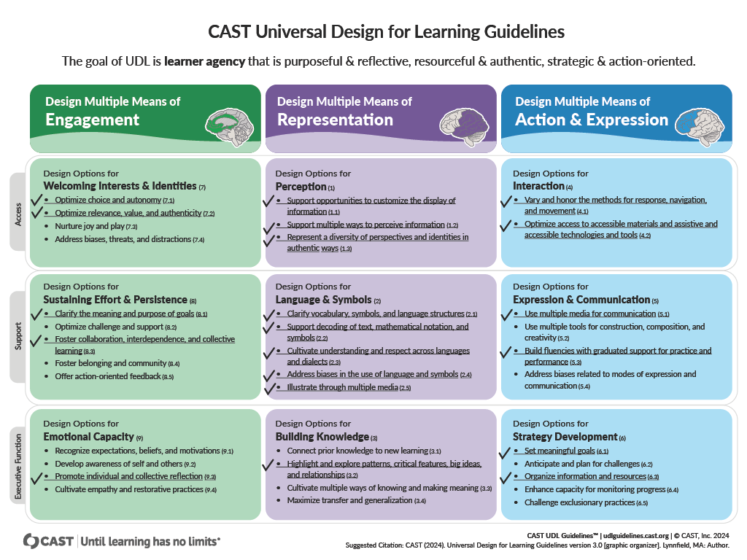
CAST Universal Design for Learning Guidelines Used in the Sample Lesson
Universal Design for Learning Guidelines

Slide 34
A Tier 1 Lesson With Universal Design for Learning Principles: Outcomes
1. Introduction
  All students participated in peer discussions
  6 pairs of students shared their ideas with the class
2. Reading activity
  Teacher had to redirect one group of students once
  All but 4 students finished the reading
3. Class discussion
  All students participated in group discussions
  Teacher monitored groups, redirected 2 of them, and prompted 3 students to participate

Slide 35
A Tier 1 Lesson With Universal Design for Learning Principles: Assessment Outcomes
4. Assessment options
Creative project
Socratic seminar
Written reflection
 | Exceeded expectations | Met expectations | Partially met expectations | Did not meet expectations | Absent
Without UDL | 1 | 3 | 9 | 10 | 2
With UDL | 4 | 9 | 7 | 3 | 2

Slide 36
How Universal Design for Learning Strengthens Response to Intervention as a System
UDL is not an add-on to RtI—it is the design approach that makes RtI more preventive, equitable, and sustainable.
UDL improves Tier 1 quality, which is the foundation of RtI
Fewer students need intensive support when barriers are removed proactively
RtI data become more reliable because instruction is designed for variability
Problem-solving conversations shift from student deficits to instructional design

Slide 37
The Difference between Universal Design for Learning and Differentiated Instruction
UDL
Differentiated Instruction
The goal is to remove barriers to learning, supporting strong understanding and learner agency.
Proactively designs instruction so all learners have accessible options including multiple means of engagement, representation, and action and expression for all students.
Emphasizes designing flexible goals, methods, materials, and assessments with diverse learner needs in mind from the start.
Students are encouraged to make choices and self-differentiate, selecting pathways that best support their learning.
The goal is to create a responsive and effective learning environment for individual students or groups of learners.
Responsive practice in which instructional adjustments are made based on individual student needs.
Differentiation often occurs after data are reviewed and patterns or trends are identified.
Relies on targeted, teacher-directed strategies, with educators determining which supports and approaches students receive.

Slide 38
Integrating Universal Design for Learning and Response to Intervention
"Educators in MTSS need to be both proactive and responsive to accelerate student learning." (Novak 2022)
UDL proactively designs lessons to anticipate and eliminate barriers to learning.
RtI responds to student needs by providing additional targeted and/or intensive support.
Novak, K. (2022). UDL Now! A Teacher's Guide to Applying Universal Design for Learning. CAST Professional Publishing.

Slide 39
Breakout Groups
Self-select based on your experience with UDL
Group 1: Beginner
Group 2: Intermediate
Group 3: Administrators and experts

Slide 40
More Universal Design for Learning Resources
CAST.org
CAST UDL Guidelines 3.0
Downloads, resources, and more information about UDL
Novakeducation.com
Blog, resources, downloads
AI for UDL: A Review of the AI Tool LUDIA
LUDIA

Slide 41


For questions or more information please visit: www.cde.state.co.us/mtss
Or email us at:
Response to Intervention Mailbox
RTI@cde.state.co.us

