Slide 1
Using Assessments in Response to Intervention
October 9th, 2025

Slide 2

Introductions
In the chat, please add your:
Name
Roll
Do you support elementary, secondary, or district wide (all levels)?
Who we are:
Evan Daldegan – Colorado Multi-Tiered System of Support (COMTSS) Implementation Specialist
Heather Baskin – Assistant Director of Gifted Education
Christina Kirchhof – COMTSS Implementation Specialist
This series is presented in collaboration with the Office of Special Education, Office of Gifted Education, and the Office of Standards and Instructional Support.

Slide 3

Session Norms
Be as virtually present as possible
Communicate any needs or questions through zoom chat – we have allotted time to answer questions at the end.

Slide 4

Objectives and Agenda
Participants will learn the purpose and types of assessments used within a tiered system, including universal screening, diagnostic assessments, formative, and summative assessments.
Participants will understand how to adjust supports according to assessment data.
1. Content/Resources-20 minutes
2. Breakout Rooms- 25 minutes
3. Q&A- 15 minutes

Slide 5

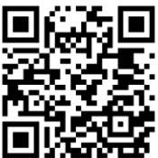
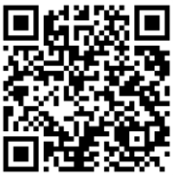
Previous Sessions
Recording - Response to Intervention (RtI) within the Colorado Multi-Tiered System of Supports Framework
The Slide Deck can be found at the bottom of the RtI training page.

Slide 6

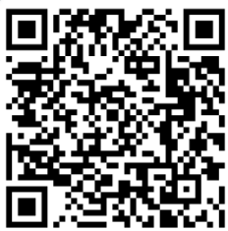
Data Literacy for Response to Intervention
November 20, 2025 – 8:30-9:30am
Participants will learn how to collect, analyze, and use data to identify student needs, monitor progress, and make informed instructional and intervention decisions.
Participants will learn strategies for using assessment data collaboratively in problem-solving teams to make timely, student-centered decisions across all tiers.
Register for November 20th here

Slide 7

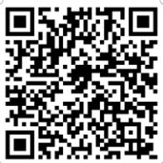
Integrating Universal Design for Learning within
Response to Intervention
January 15th, 2026 – 8:30-9:30
Participants will:
Describe how Universal Design for Learning (UDL) principles strengthen Response to Intervention (RtI) by improving access, equity, and effectiveness across all tiers of support.
Identify ways to embed UDL strategies in core instruction to reduce barriers and support all learners.
Demonstrate how UDL can inform targeted and intensive interventions, ensuring flexibility and accessibility for diverse learners.
Register for January 15th here

Slide 8
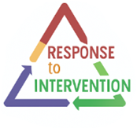
Response to Intervention: Key Feature
A problem-solving model focused on individual student needs.
Follows a structured Four-Step Process:
          Problem identification, Problem Analysis, Plan Monitoring, and Plan Evaluation.
Uses comprehensive data, both formal and informal, for all decision-making.
Ensures interventions are selected efficiently and matched to the student’s needs.

Slide 9


Assessment Disclaimers
Please be sure to reference your district, school, and/or Board of Cooperative Educational Services (BOCES) policies and procedures around obtaining parent/guardian consent for assessments.
The presence of a particular assessment in this presentation does not constitute endorsement and should not be viewed as a recommendation.
Some assessments can have multiple purposes based on reports they can generate and how they are being used

Slide 10
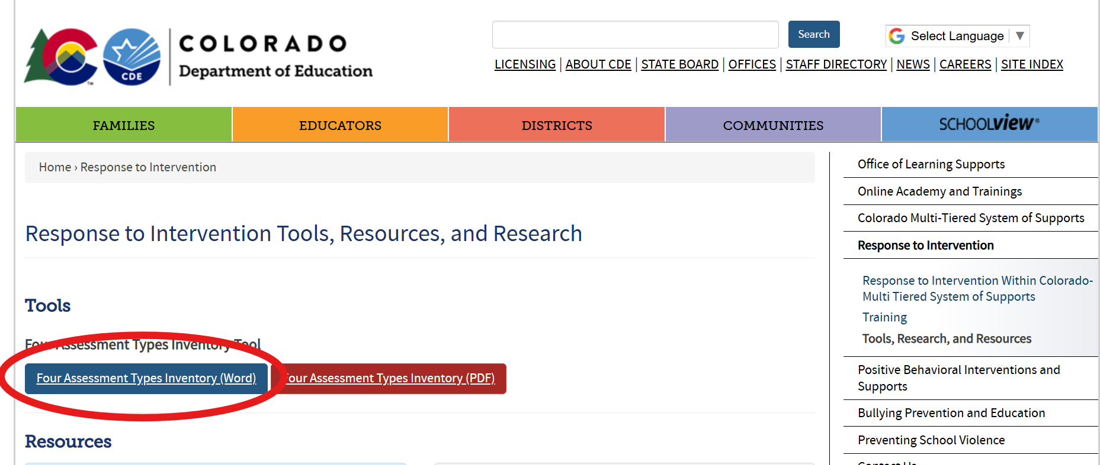
Four Assessment Types Inventory Tool
RtI Tools, Resources, and Research Webpage

Slide 11
The Four Assessment Types
Diagnostic Assessments
Universal Screening Assessments
Summative
Assessments
Formative Assessments

Slide 12


What, why, when, and how
What?
Why?
When?
How?
W
W
W
H

Slide 13

Universal Screening
What: Brief assessments given to all students in math, literacy, behavior, social/emotional competencies, etc.
Why: To analyze overall student(s) needs and/or to identify those who may need intervention or enrichment opportunities- “Who needs ______?”
When: Fall, Winter, Spring
How: What you have available, your system and student needs, staff capacity, and resources

Slide 14
Common Universal Screening Assessment Examples
Math | Reading
Northwest Evaluation Association (NWEA) Measure of Academic Progress (MAP) Growth Math Assessment | Dynamic Indicators of Basic Early Literacy Skills (DIBELS)
Renaissance STAR Math Assessment | Renaissance STAR Reading and STAR Early Literacy
Iowa Assessments (K-12) | i-Ready Assessment for Reading
Acadience Math | Acadience Reading K-6 (including Rapid Automatized Naming (RAN), Spelling, and Word Use Fluency-Revised)
CDE Mathematics Resource Bank
CDE READ Act Approved Screeners (Interim)

Slide 15
Common Universal Screening Assessment Example:-Behavior/Social Emotional
Behavioral and Emotional Screening Systems
Behavioral and Emotional Screening System (BASC-3 BESS)
Behavior Intervention Monitoring Assessment System (BIMAS-2)
Devereux Student Strengths Assessment (DESSA)
Preschool and Kindergarten Behavior Scales (PKBS-2)
Cognitive Ability Screener
The Cognitive Abilities Test (CogAT)

Slide 16
Diagnostic (Skill Gap Identification)
What: pinpoint student’s precise skill deficits to guide individualized intervention planning
Why: Identification of specific skills, helps us better match targeted intervention to student needs-guides what skills to work on.
When: Administered after a student(s) are flagged by a screener or before instruction begins
How: Individually or in small group setting

Slide 17
Common Diagnostic Assessment Examples
Math | Reading
Renaissance STAR Math Assessment (student report) | Renaissance STAR Reading Assessment (student report)
i-Ready Math Diagnostic | mCLASS with DIBELS 8th Edition, 2018
EasyCBM Math (with error analysis) | i-Ready Assessment for Reading
Exact Path Diagnostic Assessment Math (3-8) | Star Early Learning (English and Spanish)*
CDE Math Resource Database
CDE Reading Diagnostic Assessments

Slide 18
Informal Diagnostic Assessment Examples
Math | Behavior or Social-emotional | Literacy
Error analysis | Observation logs | Error analysis of reading passages
Math interviews or think-alouds | ABC (Antecedent-Behavior-Consequence) charts | Writing samples with rubrics
Informal diagnostics are:
Flexible – created or adapted by educators.
Targeted – focus on one specific skill or concept.
Actionable – results can be used immediately to adjust instruction.

Slide 19
Formative Assessments
What: Formative assessments are ongoing checks for understanding.
Why: To provide immediate feedback to guide teaching and support student learning in real time.
When: Used directly before, after, or during instruction.
How: quizzes, class discussions, exit tickets, or observations

Slide 20
Formative Assessment: Progress Monitoring
What: Used to assess if a student is making adequate academic or behavioral progress.
Why: Evaluates the effectiveness of instruction or interventions. Helps educators make informed decisions about continuing, modifying, or intensifying support.
When: Involves regularly collecting and analyzing data
How: Requires previous determination of current state and specific future goals

Slide 21
Common Progress Monitoring Examples
Math | Reading
aimswebPlus Math | Acadience Reading K-6 (aka DIBELS Next®)
i-Ready Diagnostic and Growth Monitoring (Math) | aimswebPlus Reading
Istation | i-Ready Diagnostic and Growth Monitoring (Reading)
Renaissance STAR Math Assessment (Student Progress Monitoring Report) | Renaissance STAR Reading Assessment (Student Progress Monitoring Report)
CDE Math Resource Database

Slide 22


Summative Assessments
What: Summative assessments evaluate total student learning.
Why: They help determine whether learning goals have been met.
When: End of an instructional period, such as a unit, semester, or school year
How: These include final exams, standardized tests, or end-of-unit projects.

Slide 23
Four Assessment Types Summary
Universal Screeners = who might need help?
Diagnostics = what exactly do they need?
Formative = how are they doing in the moment?
Progress Monitoring = is the intervention working?
Summative = did they reach the end goals?

Slide 24
Resources
CDE RtI One-Pagers
READ Act Approved Assessments
CDE’s Mathematics Resource Bank
National Center on Intensive Intervention (NCII)
Academic Screening Tools Chart
RtI Tools, Four Assessment Types Inventory Tool

Slide 25

Collaborative Learning
Assign a note taker
Assign someone to share out
What assessment types does your system already have in place? What gaps exist?
How do your teams determine whether an assessment is giving actionable data?
Who is looking at the data in your schools? Who should be there that is not present?
Are you routinely using the data you gather?

Slide 26

Questions & Answers
How do we align the four assessment types so they work together instead of feeling separate?
How do we communicate assessment purposes and results clearly to families?
How do we ensure assessments are culturally and linguistically responsive?
How can we make progress monitoring efficient without overwhelming staff?

Slide 27

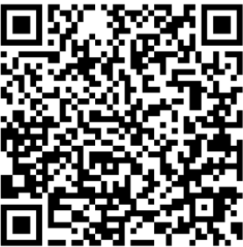
Feedback
October 9th Feedback Form

Slide 28


For questions or more information please visit: www.cde.state.co.us/mtss
Or email us at:
Response to Intervention Mailbox
RTI@cde.state.co.us

