Slide 1
Data-based Individualization: What is it and How to Start?
Materials here:
tinyurl.com/DBIWebinarMay132020
May 13, 2020, 3pm MT
Office of Learning Supports
National Center on Intensive Intervention

Slide 2
We will be recording this webinar. Please access materials here.
tinyurl.com/DBIWebinarMay132020
Notes:
tinyurl.com/DBIWebinarMay132020
Welcome everyone, we’re thrilled to have this webinar on data-based individualization or DBI.

Slide 3
Housekeeping
Webinar will be recorded and posted online at: cde.state.co.us/mtss
Certificate of completion available (linked to evaluation survey).
Use the chat room for asking questions.
Because of the size of session, your microphone is off and not used.
We will answer any questions we don’t get to will be answered afterwards in a document.
Turn your camera off (it helps reduce bandwidth usage).

Slide 4
In the chat, please share your name, title, and favorite summer treat.

Slide 5
Webinar Panel
Jason Harlacher, MTSS Specialist, CDE
Veronica Fiedler, SLD Specialist, CDE
Sarah Benz, Researcher, American Institutes for Research
Lindsey Hayes, Senior Researcher, American Institutes for Research
Steve Goodman, Director, MiBLSI
Notes:
Read the list. We can chat into the chat our treat

Slide 6
NCII Project: TA Plan
Variation in language and problem solving processes used with students with intensive needs.
Increase alignment of DBI across CDE
Provide support on use of DBI to stakeholders
Aligning offices and department on resources, language, and content around DBI
Guidance on alignment with other problem solving models or processes
Webinar (May 13)
Online modules on DBI (May 18)
cde.state.co.us/mtss/resources
Online Academy (Sept)
Training Series (20/21 year)
Notes:
There were various problem solving models used at CDE (5 different ones), so we’re aligning language and use when it comes to support students with intensive needs. To that end, we are aligning at CDE. Then offering training and support. This webinar is our introduction to share DBI and begin supporting stakeholders.

Slide 7
www.cde.state.co.us/mtss/resources
Notes:
Mtss website

Slide 8
Objectives: Understand steps of DBI
Identify critical pieces for readiness for implementation

Slide 9
Overview of DBI (30 mins)
-Veronica Fiedler
-Quiz; Jason Harlacher
Readiness for DBI (45 mins)
-Steve Goodman
-Introduction by Sarah Benz
Questions and Answers (15 mins)
-Facilitated by Lindsey Hayes

Slide 10
Overview of DBI Veronica Fiedler

Slide 11
What is Intensive Intervention?
Intensive intervention addresses severe and persistent learning and behavioral difficulties.
Characterized by increased intensity and individualization
Driven by data
Notes:
Intensive intervention addresses severe and persistent learning and behavioral difficulties. It is intended for a small percentage of students with severe and persistent learning and behavioral needs, including those who:
Are not making adequate progress in their current intervention program (often, a Tier 2, evidence-based intervention)
Are not meeting individualized education program (IEP) goals
Have persistently low academic achievement
Have high-intensity/frequency behavior
Intensive intervention is driven by data and characterized by increased intensify and individualization.

Slide 12
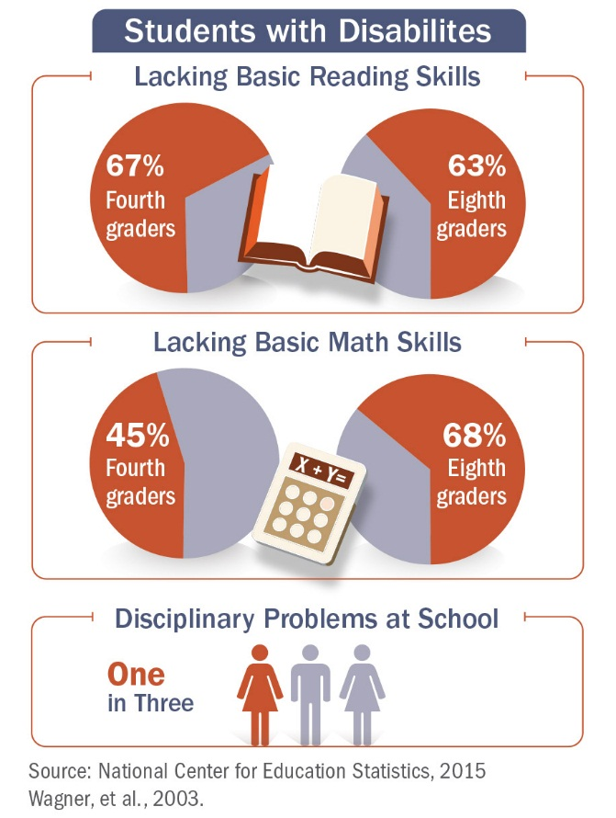
Why Intensive Intervention?
Too many students, especially those with disabilities, lack basic skills for reading and mathematics or have serious discipline problems in school
Notes:
While there is a growing body of evidence-based practices, we know that validated programs are not universally effective. Even after implementing them with fidelity, 3 to 5% of students will need more help. Those students with intensive needs often require upwards of 10 to 30 times as much practice as their peers when they are learning new information.
Note: while the previous slide highlighted poor outcomes for students with disabilities, not all students with intensive needs have an identified disability. For example, the practice guide by Gersten et al. (2008) reflects data that include students without disabilities.

Slide 13
Who needs Intensive Intervention?
Students with disabilities who are not making adequate progress in their current instructional program
Students who present with very low academic achievement and/or high-intensity or high-frequency behavior problems (typically those with disabilities)
Students in a tiered intervention system who have not responded to secondary intervention programs delivered with fidelity
Notes:
Review slide.
The decision to move a student directly to an intensive intervention should be made on an individual and case-by-case basis. In most cases, data should be collected over time to help demonstrate that the student’s low achievement/behavior challenges are both significant AND persistent.

Slide 14
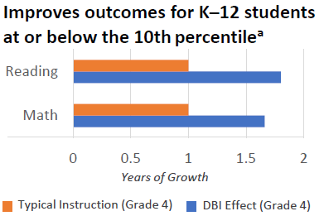
Benefits of Intensive Intervention
In one year, 78% of students receiving intervention reached ambitious growth goals set using national norms. Thirty percent of students were exited from any kind of intervention.
—Bristol Warren Regional School District, Rhode Island
Jung, McMaster, Kunkel, Shin, Stecker, 2018; Scammacca, Fall, Roberts, 2015.
Notes:
Review slide data.
Additional research and articles focused on intensive intervention are available at (ADD CITATION LIST)
Jung, P. G., McMaster, K. L., Kunkel, A. K., Shin, J., & Stecker, P. M. (2018). Effects of data‐based individualization for students with intensive learning needs: A meta‐analysis. Learning Disabilities Research & Practice, 33(3), 144–155 and growth benchmark from Scammacca, N. K., Fall, A. M., & Roberts, G. (2015). Benchmarks for expected annual academic growth for students in the bottom quartile of the normative distribution. Journal of Research on Educational Effectiveness, 8(3), 366–379

Slide 15
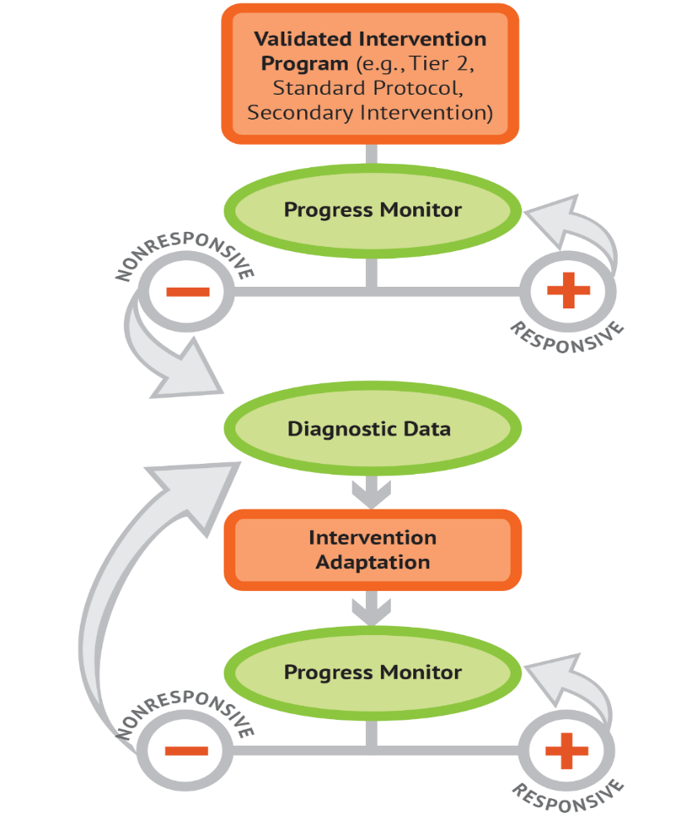
What is Data-Based Individualization (DBI)?
DBI Process
Data-based individualization (DBI) is a research-based process for individualizing and intensifying interventions for students with severe and persistent learning and behavioral needs.
The process integrates evidence-based intervention, assessment, and strategies.
Notes:
DBI is a systematic method for using data to determine when and how to individualize and intensify intervention for students with severe and persistent learning and behavioral needs. It is grounded in research conducted by Deno and Mirkin at the University of Minnesota and expanded upon by others (Capizzi & Fuchs, 2005; Fuchs, Deno, & Mirkin, 1984; Fuchs, Fuchs, & Hamlett, 1989). The DBI process integrates evidence-based intervention, assessment, and strategies.
In reality, DBI is the technical term for what many good teachers do naturally through the problem-solving process: frequently review student data and make changes to their teaching based on what works for students. DBI, however, makes this process systematic, explicit, and tailored to meet the needs of individual students through a multi-step process that gradually intensifies instruction and support.

Slide 16
What is DBI?
Is…
A process
Individualized based on student needs
More intense, often with substantively different content AND pedagogy
Involves more frequent and precise progress monitoring
An approach that integrates academic and behavioral supports
Is Not…
A one-time fix
A single approach
A manual
A preset program
More of the same Tier 1 instruction
More of the same Tier 2 instruction
Notes:
Briefly review slide and reinforce that DBI is a process not a one time fix, single approach or preset program.

Slide 17
Five DBI Steps
Validated intervention program, delivered with fidelity
Progress monitoring
Diagnostic data used to develop a hypothesis
Adaptation to validated intervention
Continued progress monitoring, with adaptations occurring whenever needed to ensure adequate progress
Notes:
The DBI process includes 5 iterative steps:
Step 1: The DBI process builds on validated intervention program delivered with fidelity. The validated intervention program is typically an evidence-based standard-protocol intervention.
Step 2: Regular progress monitoring data are collected to determine whether the student is responding or not responding to the intervention. If the student is responsive, the teacher continues to provide the validated intervention program and monitors student progress until the student reaches expectations. If the data suggest that the student is not responding while other students who have received the intervention have responded, then the teacher moves to the next step of the process.
Step 3: To determine why the student is not responding, diagnostic data are collected and reviewed to identify specific skill deficits or behavior concerns that are affecting the student’s progress. This may include data from informal and formal academic and behavior measures. These data are used to develop a hypotheses about why the student is not responding.
Step 4: The hypothesis along with educators’ expertise are used to develop an individual student plan for modifying or adapting the intervention to better meet the student’s individualized needs.
Step 5: While implementing the intervention adaptations, the teacher continues to collect progress monitoring data at regular intervals to determine responsiveness. Students whose data indicate responsiveness continue with the adapted intervention. Students whose data indicate nonresponse return to Step 3, where the teacher will analyze additional data and consider additional adaptations.

Slide 18
Validated Intervention Program (e.g., Tier 2)
DBI Process
Use of a standard approach here to maximize efficiency
Standard = intervention that has common procedures and focus used for all students identified for support (focused on group needs, not individualized needs yet)
70-80% of students respond with a standard intervention at Tier 2 (Vaughn et al., 2010)

Slide 19
Adjustments to Match Student’s Individual Needs (Tier 3)
DBI Process
Use of diagnostic data to modify supports to meet student’s specific needs
Use RIOT/ICEL framework to organize data collection
Handout on RIOT/ICEL
Develop a hypothesis that guides adjustment of supports

Slide 20
DBI is an ongoing process based on student responsiveness to the intervention.
Notes:
(Click for animation) Review slide.

Slide 21
Readiness for DBI Steve Goodman, PhD

Slide 22
Questions and Answer -Facilitated by Lindsey Hayes

Slide 23
Thank you for attending! Please complete the evaluation survey at: www.surveymonkey.com/r/DBIwebinar2020
You can provide your email for a chance to win the book: Essentials of Intensive Interventions!

Slide 24
References
Beck, I.L., McKeown, M.G. & Kucan, L. (2002). Bringing Words to Life: Robust Vocabulary Instruction. New York: The Guilford Press.
Blevins, J. (2006). New perspectives on English sound patterns: ‘Natural’ and ‘Unnatural’ in Evolutionary Phonology. Journal of English Linguistics. 34, 6–25.
Chall, J.S. (1996). American reading achievement: Should we worry? Research in the Teaching of English, 30, 303-310.
Fuchs, L. S., Fuchs, D., & Malone A. S. (2017). The taxonomy of intervention intensity. Teaching Exceptional Children, 50(1), 35–43.
Kame'enui, E. J., Simmons, D. C., Baker, S., Chard, D. J., Dickson, S. V., Gunn, B., Smith, S. B., Sprick, M., & Lin, S. J. (1997). Effective strategies for teaching beginning reading. In E. J. Kame'enui, & D. W. Carnine (Eds.), Effective Teaching Strategies That Accommodate Diverse Learners. Columbus, OH: Merrill.

Slide 25
References
Kamil, M. L., Borman, G. D., Dole, J., Kral, C. C., Salinger, T., and Torgesen, J. (2008). Improving adolescent literacy: Effective classroom and intervention practices: A Practice Guide (NCEE #2008-4027). Washington, DC: National Center for Education Evaluation and Regional Assistance, Institute of Education Sciences, U.S. Department of Education. Retrieved from http://ies.ed.gov/ncee/wwc.
Mol, S. E., Bus, A. G., & De Jong, M. T. (2009). Interactive book reading in early education: A tool to stimulate print knowledge as well as oral language. Review of Educational Research, 79, 979-1007. Doi: 10.3102/0034654309332561
National Center on Intensive Intervention. (2013). Data-based individualization: A framework for intensive intervention. Washington, DC: American Institutes for Research. Retrieved from https://files.eric.ed.gov/fulltext/ED575656.pdf

