Slide 1
Effective Family, School, and Community Partnering (FSCP)
September 18, 2017

Slide 2
MTSS and Essential Components
Team-Driven Shared Leadership
Family, School, and
Community Partnering
Data-Based
Problem Solving and Decision-Making
Layered Continuum
of Supports
Evidence-Based
Practices
Notes:
Definition of the whole framework:
CO-MTSS is a prevention-based framework of team-driven, data-based problem solving for improving the outcomes of every student through family, school, and community partnering and a layered continuum of evidence-based practices applied at the classroom, school, district, region, and state level.

Slide 3
What is happening for you?
PROMPTS:
In general, what is your viewpoint of the basic issues families have in your district?
What are your experiences in observing how the school systems interact with families?
Who is in the room?
“Voices” are heard
Our MTSS FSCP Definition:
Family, School, and Community Partnering - The collaboration of families, schools and communities as active partners in improving learner, classroom, school, district, and state outcomes.

Slide 4
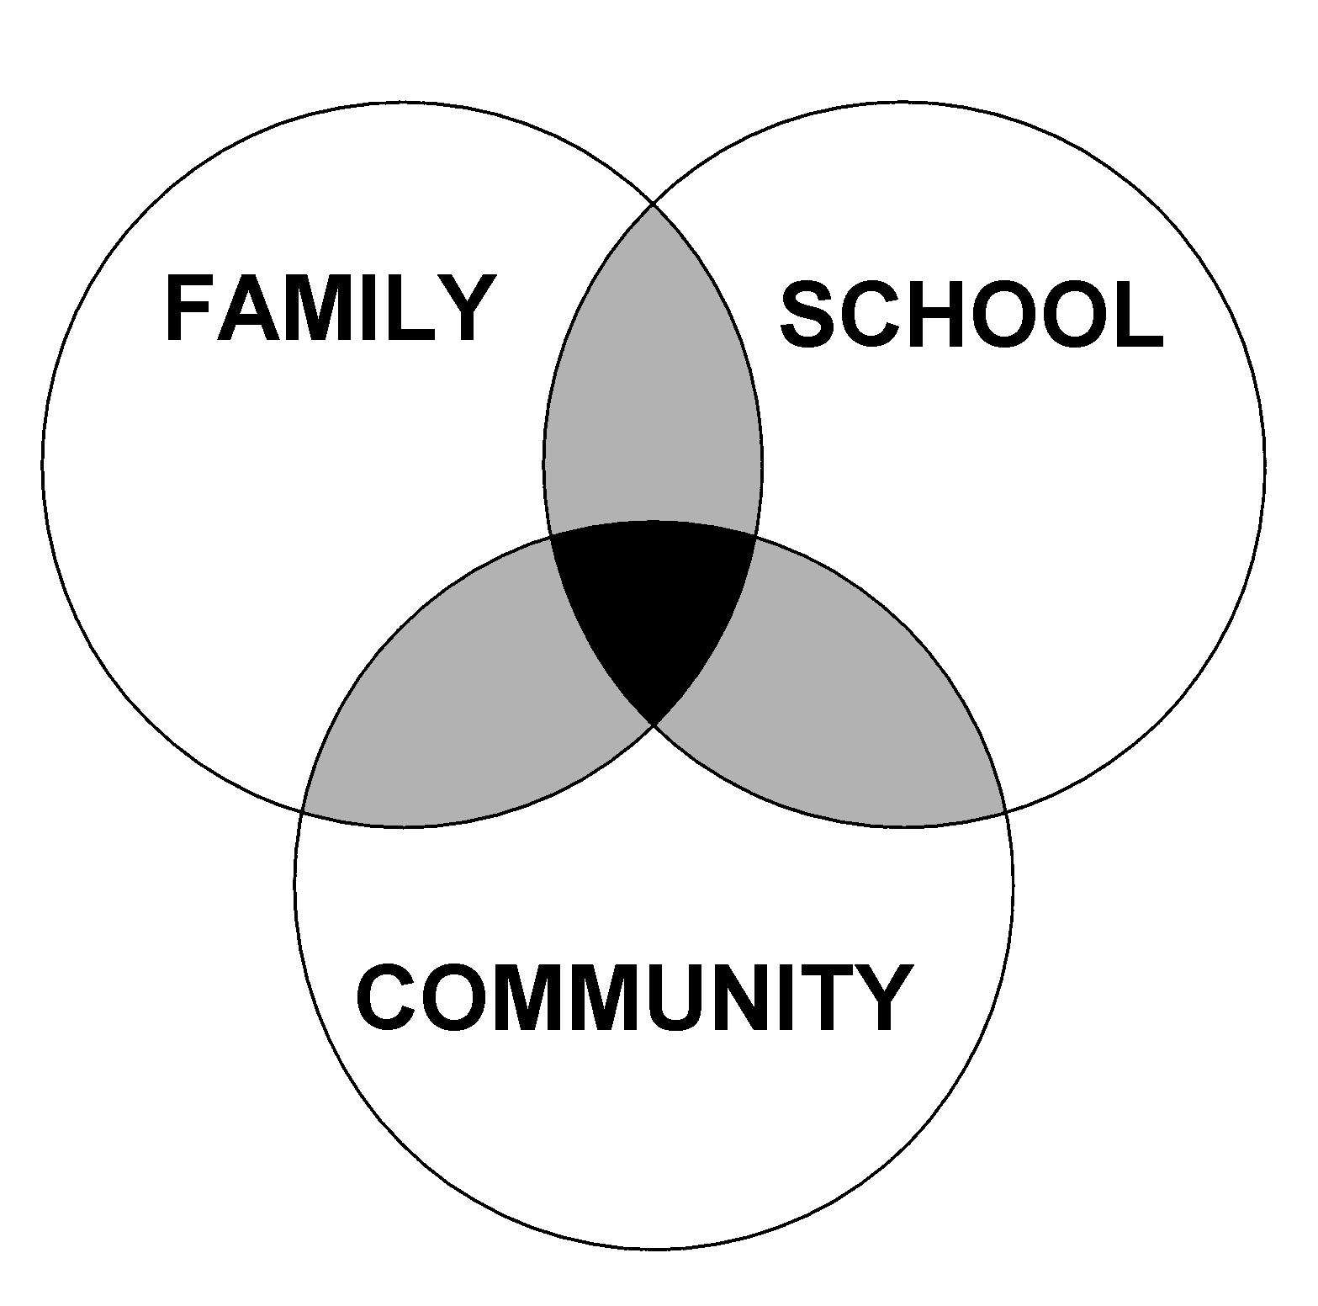
OVERLAPPING SPHERES OF INFLUENCE
Theoretical Model
Factors Influencing
Effective Partnering
Experiences,
Beliefs,
Practices
Notes:
This is a theoretical model for how school, family, and community interaction effects children’s learning. It was developed by Dr. Joyce Epstein based decades of research from schools primarily located in Baltimore City. You will see that three entities are represented: Family, School, and Community. Community can include businesses, school alumni, neighbors, parents with children not yet at school age. Each group does some things for students separately, and others together.
What are some sole responsibilities for families? Schools? The Community?
Depending on the extend of collaboration, the spheres either move closer together or farther apart. This model is NOT a Venn diagram. It is a dynamic model that is different for every student and school and can change over time. If the school’s beliefs and values differ greatly from those of the family, the circles will move away from each other. Likewise, if families, schools, and the community unite for a shared goal/vision, the circles will move closer together.
Just think about the answer to this question, you don’t need to vocalize it, but if you were to draw the Overlapping Spheres of Influence Model for you school, families, and community, how do you think it would look?

Slide 5
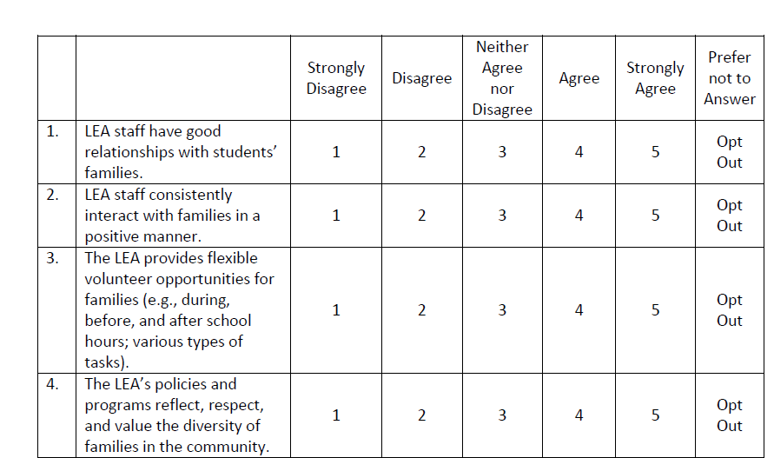
FSCP Survey
http://www.cde.state.co.us/mtss/fscpdistricteoyresponseformmay2017

Slide 6
End of Year Average (N=22, some “opt out” on items)

Slide 7
How do you know it’s working?
What are your evaluation methods for FSCP?
What are you trying to measure? What is of value?
What tool(s) have you used? What would you like to try?

Slide 8
Chart Paper Activity
Celebrations
Challenges

Slide 9
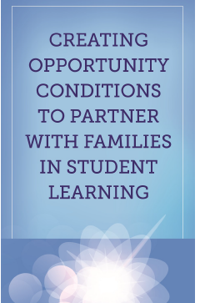
Brochures
http://www.cde.state.co.us/uip/familyengagement

Slide 10
What are you “ready” to impact?
Multi-Tiered FSCP: What would you like to see “in place”? What is the desired outcome?
Universal FSCP
Targeted FSCP
Intensive FSCP

Slide 11
Why do people conflict?
Conflict is a signal or message that something is not working and needs to be different.
-Talk Through Conflict Using Interests-Based Problem Solving, Education Service Center Region 4. (2011).
Miscommunication
Misperceptions
Perceived threat
Past issues and relationships
Cultural differences
Different interests or goals
Different processing styles
Different values
Lack of information or misinformation
Ambiguity
Emotions
Unmet psychological needs
Limited resources or unequal control

Slide 12
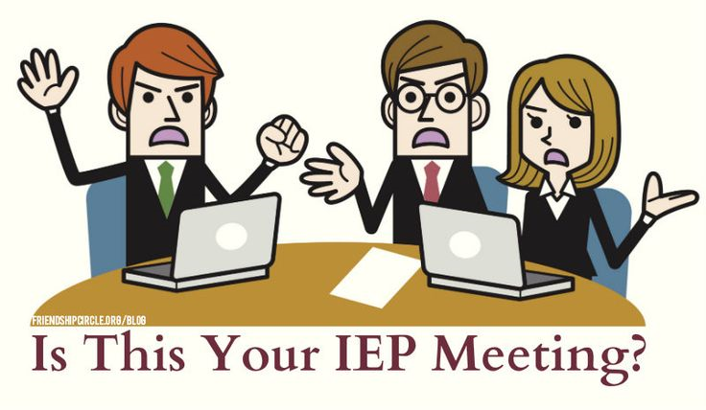
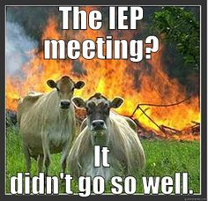
The Challenge
Most special education conflict centers on the development of the IEP.
A natural imbalance of power exists that results in parents feeling undervalued in the IEP process.
School staff members, administrators, and families often become focused on disagreement and engaged in a relationship strained by unresolved conflict.
School districts are spending over $90 million per year on conflict resolution.
Notes:
Timing-> 2 minutes
Next-> Colorado’s Dispute Resolution Statistics

Slide 13
How do we build the capacity of our partners?
Multi-Tiered FSCP: What are ideas for stakeholders?
The “What”, the “Why”, and the “How”
Staff learn: FSCP
Families learn: FSCP
Community learn: FSCP

Slide 14
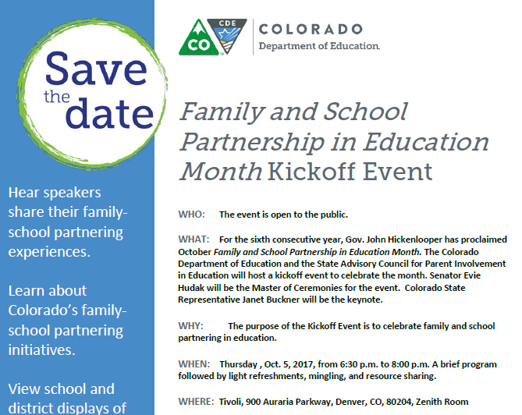
http://www.cde.state.co.us/mtss/familyschoolpartnershipineducationmonthoct2017flyer

Slide 15
What are you “planning” to impact? (individually)
What would you like to see “in place”? What is the desired outcome?
Note if it is a PERSONAL action step or a SYSTEM action step.
30 Days
60 Days
90 Days
Notes:
(variation as handout)

Slide 16
Additional Resources
Family/Parent Resources: http://www.cde.state.co.us/resourcesforparents
Multi-Tiered FSCP: http://www.cde.state.co.us/mtss/fscp
Training Resources: http://www.cde.state.co.us/uip/trainingmaterials
Research Briefs: http://www.cde.state.co.us/uip/familyengagement
Promising Partnership Practices: http://www.cde.state.co.us/uip/promising
Survey: http://www.cde.state.co.us/uip/school_family_community_partnership_survey
Colorado Academic Standards Parent Guides: https://www.cde.state.co.us/standardsandinstruction/guidestostandards

Slide 17
“…No matter how skilled professionals are, nor how loving families are, each cannot achieve alone, what the parties, working hand-in-hand, can accomplish together.” (Adapted from Peterson and Cooper as cited in 2007)

Slide 18
This CDE guidance document is meant for clarification, is not legally binding, and is not to be confused with legal advice. This guidance reflects CDE’s recommendations, but Local Education Agencies (LEAs) and Administrative Units (AUs) may have developed their own policies or procedures that differ from those described herein. Be sure to refer to your local AU’s policies and procedures through local leadership (e.g., Directors of Special Education, Title I Coordinators, superintendents). If you are seeking legal advice, please contact your legal counsel.
Note that the contents of this presentation and corresponding handouts were developed under a grant from the U.S. Department of Education. However, the content does not necessarily represent the policy of the U.S. Department of Education, and you should not assume endorsement by the federal government.
Notes:
Key Points:
This slide notes the funding source for this work.

