Slide 1
Data Literacy for Response to Intervention
November 20th, 2025

Slide 2

Introductions
In the chat, please add your:
Name
Roll
Who we are:
Christina Kirchhof – COMTSS Implementation Specialist
Emily Ottinger – Specific Learning Disabilities Specialist
This series is presented in collaboration with the Office of Special Education, Office of Gifted Education, and the Office of Standards and Instructional Support.

Slide 3

Session Norms
Be as virtually present as possible
Communicate any needs or questions through zoom chat – we have allotted time to answer questions at the end.

Slide 4
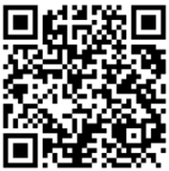


Previous Sessions
Recordings and slide decks can be found at the bottom of the RtI training page
September – Response to Intervention within the Colorado Multi-Tiered System of Supports Framework
October - Using Assessments in Response to Intervention

Slide 5

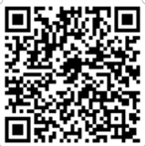
Integrating Universal Design for Learning (UDL) within
Response to Intervention (RtI)
January 15th, 2026 – 8:30-9:30
Participants will:
Describe how Universal Design for Learning (UDL) principles strengthen Response to Intervention (RtI) by improving access, equity, and effectiveness across all tiers of support.
Identify ways to embed UDL strategies in core instruction to reduce barriers and support all learners.
Demonstrate how UDL can inform targeted and intensive interventions, ensuring flexibility and accessibility for diverse learners.
Register for January 15th here

Slide 6

Objectives and Agenda
Participants will learn how to collect, analyze, and use data to identify student needs, monitor progress, and make informed instructional and intervention decisions.
Participants will learn strategies for using assessment data collaboratively in problem-solving teams to make timely, student-centered decisions across all tiers.
1. Content
2. Resources
3. Q&A

Slide 7

In October….
We learned about types of assessments used in RtI
We learned the What, When, Why, and How about the four assessment types
  Screening → Who may be at risk?
  Diagnostic → Why might they be struggling?
  Progress monitoring → Is intervention working?
  Summative → How effective was the intervention in meeting the goal?
We reviewed the Four Assessment Types Inventory Tool

Slide 8

Response to Intervention: Key Feature
A comprehensive data collection and analysis process is used consistently to target identified student needs
Decision rules are established based on a comprehensive review of all available data and are evaluated at regular intervals
Decision rules clearly distinguish between system-level (COMTSS) and student-level (RtI) considerations.
Decision rules are applied equitably and consistently when reviewing student-level data.

Slide 9
Data Quote
“The data people use may differ. The interpretations may differ. Even the same data may mean different things to different people. Data, in and of themselves, are meaningless. They are simply numbers. Data gain meaning through context.”​
Mandinach, E. B. (2012). A perfect time for data use: Using data-driven decision making to inform practice. Educational Psychologist, 47(2), 71-85.

Slide 10
Fidelity Before Outcomes
Implementation fidelity data measures how closely a program is delivered according to its original plan.
Outcome data is information that measures the impact or results of a program, intervention, or process

Slide 11

Decision Rules
Clear, predetermined guidelines or criteria that teams use to determine when a student requires additional support, when to adjust existing interventions, or when to consider reducing or discontinuing support. These rules ensure decisions are consistent, data-driven, and equitable.

Slide 12

Behavior Intervention Decision Rules Example
Michael Scott’s School for Tots
564 students enrolled
100 4th grade students
Suburban

Slide 13
Aggregated Universal Screener Data
Reading Screener Results
Above 50th percentile:
82 students
21st–50th percentile:
12 students
Below 20th percentile:
6 students
Average Score: 205 (national average ~200)
Math Screener Results
Above 50th percentile:
76 students
21st–50th percentile:
16 students
Below 20th percentile:
8 students
Average Score: 203 (national average ~201)
Behavior Screener Results
Low Risk (0-3):
86 students
Moderate Risk (4-8):
10 students
High Risk (9-15):
4 students

Slide 14

Aggregated Universal Screener Data – First Glance
Reading Screener Results
Above 50th percentile:
82 students
21st–50th percentile:
12 students
Below 20th percentile:
6 students
Math Screener Results
Above 50th percentile:
76 students
21st–50th percentile:
16 students
Below 20th percentile:
8 students
Behavior Screener Results
Low Risk (0-3):
86 students
Moderate Risk (4-8):
10 students
High Risk (9-15):
4 students
18% of students
24% of students
14% of students

Slide 15
Aggregated Office Discipline Referrals and Attendance Data
Total ODRs (Last 30 Days): 20
Frequent Behavior Issues (5+ ODRs):
3 students
Moderate Behavior Issues (2-4 ODRs):
7 students
One-time Incidents:
10 students
Top Reasons for Referral:
Disruptive behavior:
8 cases
Physical aggression:
5 cases
Defiance/non-compliance: 4 cases
Other (bullying, vandalism, etc.):
3 cases
Attendance Data (Last 30 Days)
Average Attendance Rate: 92%
Number of students with chronic absenteeism (less than 90% attendance):
15
Number of students with perfect attendance:
25

Slide 16

Aggregated Office Discipline Referrals and Attendance Data – First Glance
Total ODRs: 20
Frequent Behavior Issues (5+ ODRs):
3 students
Moderate Behavior Issues (2-4 ODRs):
7 students
One-time Incidents:
10 students
10% of students
Top Reasons for Referral:
Disruptive behavior:
8 cases
Physical aggression:
5 cases
Defiance/non-compliance: 4 cases
Other (bullying, vandalism, etc.):
3 cases
Attendance Data
Average Attendance Rate: 92%
Number of students with chronic absenteeism (less than 90% attendance):
15
Number of students with perfect attendance:
25
15% of students

Slide 17
Making Decision Rules
Student considered for more intensive supports if ANY of the following apply
Score of 4 or above (moderate or high) on the Behavior Screener
2 or more ODRs in the past 30 days
Teacher concerns about behavior that impact academic engagement
Below 90% attendance
Combination of academic struggles and behavior risk

Slide 18
Identifying Students Using Decision Rules from Assessment Data
 | Attendance | Behavior | Math | Reading | ODR | Teacher Feedback
A | 88% | High | Low | Low | 6 | Off-task, peer conflicts
B | 95% | Low | Below Avg. | Below Avg. | 1 | Difficulty focusing
C | 78% | Low | On-track | On-track | 1 | Low engagement
D | 92% | Low | Below avg. | On-track | 0 | Positive peer leader
E | 85% | Moderate | Low | Low | 3 | Avoids work, withdrawn
F | 97% | Low | On-track | On-track | 1 | Engaged, disruptive
G | 90% | Moderate | Below Avg. | Low | 4 | Poor emotional regulation
H | 93% | Low | On-track | On-track | 1 | Struggles with transitions
I | 89% | Low | On-track | On-track | 0 | Strong academic focus
J | 80% | High | Low | Low | 7 | Frequent outbursts
Students A, C, E, and J from the assessment data table are identified as needing further evaluation

Slide 19
Modifying Decision Rules
Student considered for more intensive supports if ANY TWO of the following apply
Score of 4 or above (moderate or high) on the Behavior Screener
2 or more ODRs in the past 30 days
Do not include: Teacher concerns about behavior that impact academic engagement
Below 90% attendance
Combination of academic struggles and behavior risk

Slide 20
Re-evaluating Students After Decision Rule Changes
 | Attendance | Behavior | Math | Reading | ODR | Teacher Feedback
A | 88% | High | Low | Low | 6 | Off-task, peer conflicts
B | 95% | Low | Below Avg. | Below Avg. | 1 | Difficulty focusing
C | 78% | Low | On-track | On-track | 1 | Low engagement
D | 92% | Low | Below avg. | On-track | 0 | Positive peer leader
E | 85% | Moderate | Low | Low | 3 | Avoids work, withdrawn
F | 97% | Low | On-track | On-track | 1 | Engaged, disruptive
G | 90% | Moderate | Below Avg. | Low | 4 | Poor emotional regulation
H | 93% | Low | On-track | On-track | 1 | Struggles with transitions
I | 100% | Low | On-track | On-track | 0 | Strong academic focus
J | 80% | High | Low | Low | 7 | Frequent outbursts
Students from the original data table (slide 18) have been removed from consideration for additional evaluation after the Decision Rules were changed

Slide 21
Final Students Identified for Evaluation Using Decision Rules
 | Attendance | Behavior | Math | Reading | ODR | Teacher Feedback
A | 88% | High | Low | Low | 6 | Off-task, peer conflicts
E | 85% | Moderate | Low | Low | 3 | Avoids work, withdrawn
G | 90% | Moderate | Below Avg. | Low | 4 | Poor emotional regulation
J | 80% | High | Low | Low | 7 | Frequent outbursts

Slide 22
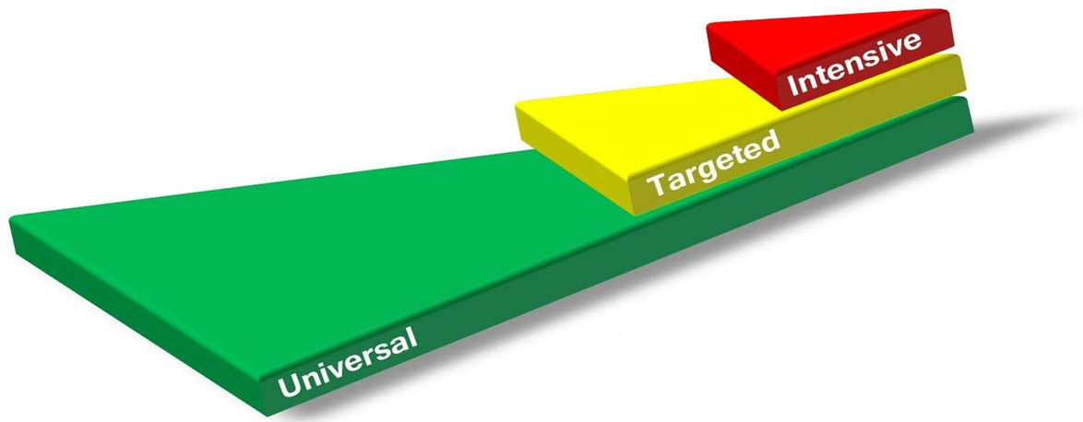
The 10/10 Rule
The 10/10 rule helps you decide which type of solution to implement:
10 students = Group-based solution
10% = System-based solution
A school has 500 students enrolled.
40 students are chronically absent – group-based solution (8%)
100 students are chronically absent – System-based solution (22%)
McIntosh, K., et al. (2021). Ensuring Equity in Multi-Tiered Systems of Support. Journal of Positive Behavior Interventions, 23(4), 195-208.

Slide 23
Local Context Matters
Population | 2+ ODRs (10) | Behavior mod+high (14) | Chronic absent (15) | Reading <20 (6) | Math <20 (8)
100 (current example) | 10.0% | 14.0% | 15.0% | 6.0% | 8.0%
564 (whole school) | 1.77% | 2.48% | 2.66% | 1.06% | 1.42%
45 (small school) | 22.22% | 31.11% | 33.33% | 13.33% | 17.78%
75 | 13.33% | 18.67% | 20.00% | 8.00% | 10.67%
120 | 8.33% | 11.67% | 12.50% | 5.00% | 6.67%

Slide 24
Elementary Research-Based Decision Rules
Researchers examined 581,775 referrals across 2500 elementary schools.
For elementary schoolers, 50% of students who received 6 or more total referrals over the year already had 2 or more referrals by the end of October; 79% had 2 or more referrals by the end of December.
McIntosh, K., Frank, J., & Spaulding, S. A. (2010). Establishing research-based trajectories of office discipline referrals for individual students. School Psychology Review, 39, 380-394.

Slide 25
Secondary Research-Based Decision Rules
Researchers examined 403,172 referrals across almost 600 middle schools to answer the same question: When is the earliest time we can intervene and change the trajectory for students who might benefit from additional support?
While October and November are still good times to look for students with two or more referrals, there’s an even better predictor at the middle school level. For middle school students who receive six or more referrals by the end of the year, 91% had at least one referral in September for defiance.
Predy, L., McIntosh, K., & Frank, J. (2014). Utility of number and type of office discipline referrals in predicting chronic problem behavior in middle schools. School Psychology Review, 43(4), 472-489.

Slide 26
Matching Interventions to Student Skill Gaps
Interventions are most effective when they directly address the specific skill a student is missing.
General or unrelated interventions = wasted time and student frustration.
Data ➡️ Skill Gap ➡️ Targeted Intervention ➡️ Progress Monitoring ➡️ Adjustment

Slide 27
Key Steps in Effective Intervention
Start with data: What skill is missing?
Pinpoint the exact gap: Accuracy? Fluency? Comprehension? Application?
Select an intervention: Choose one that targets that skill.
Monitor and adjust: If no progress, recheck the gap or intensity.
The right match speeds up learning. The wrong match stalls it.

Slide 28
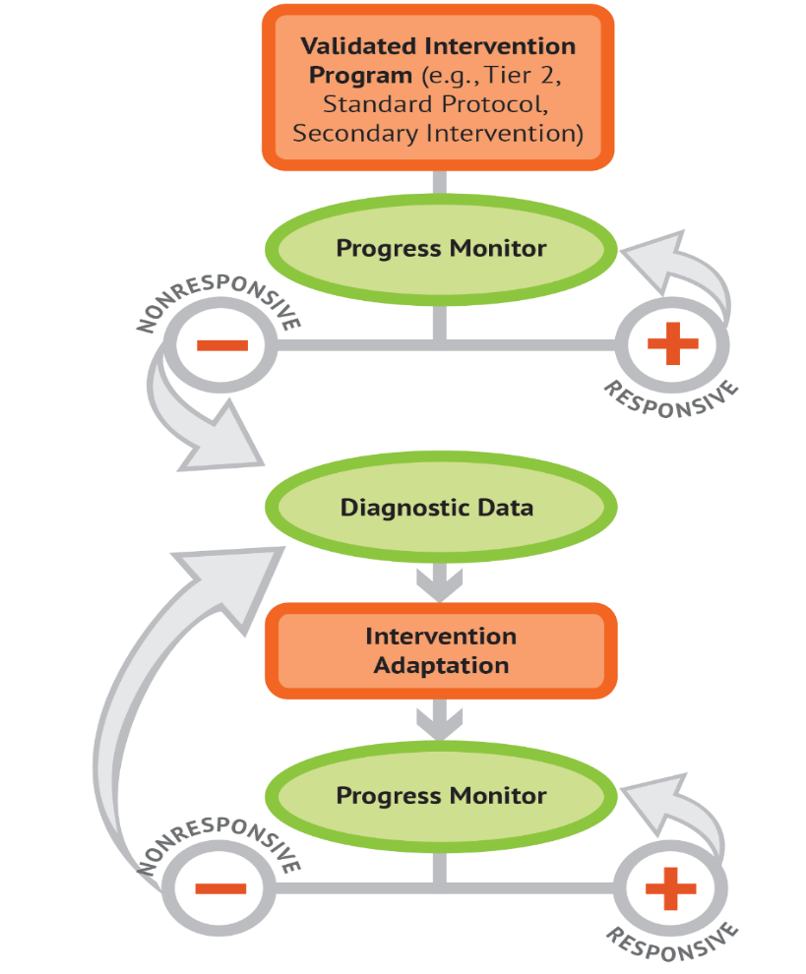
Approach – Step 1
DBI is a research-based process for individualizing and intensifying interventions for student with severe and persistent learning and behavioral needs.
The process integrates evidence-based intervention, assessment, and strategies.

Slide 29
Progress Monitoring
Progress monitoring is important for understanding student responsiveness and determining when changes are needed.
Valid and reliable tools, standardized delivery
Frequency depends on intensity of instruction
Requires ongoing graphed data and a goal for valid interpretation
Curriculum-Based Measures, General Outcome Measures

Slide 30
Does the Intervention Work?
At this step, staff regularly collect and analyze progress monitoring data to determine if the student is responding to the validated intervention.
Were data collected regularly and with a consistent approach?
Were progress data graphed?
Was the goal set using a validated approach?
Was the intervention effective for most students?

Slide 31
Approach – Step 2

Slide 32

Why Do Students Experience Challenges?

Slide 33
Relevant and Alterable Variables
Curriculum
  Scope and Sequence
  Level of Difficulty
  Match to learner
  High Quality Materials
Instruction
  Explicit Instruction
  Pacing
  Corrective Feedback
  Engagement Strategies
Environment
  Clear Expectations
  Positive Reinforcement
  Positive Interactions
  Positive Feedback

Slide 34
Why Didn’t the Intervention Work?
Staff use diagnostic data to develop a hypothesis about why the student is struggling.
Do multiple data sources confirm slow progress?
Have both academic and behavioral explanations been considered?
What do these data suggest about what needs to be changed?

Slide 35
Informal Diagnostic Data
Analysis of student errors in work samples and progress monitoring data (curriculum)
Classroom observations (instruction, environment)
Interviews with student or family
Intervention-specific assessments (curriculum)

Slide 36
What Change is Needed?
The hypothesis, along with educator expertise, is used to develop an individual student plan for modifying or adapting the intervention to better meet the student’s individual needs.
Does the adaptation address the hypothesis?
Does the plan address both academic and behavioral concerns when needed?
Are procedures in place for implementing and monitoring the adapted intervention?
Are only a few adaptations made at one time?

Slide 37
Did the Change Work?
Continue to collect, graph, and analyze progress monitoring data to determine if the student is responding to the adapted intervention.
Are data collected according to the plan?
Does the graph indicate when adaptations were made?

Slide 38
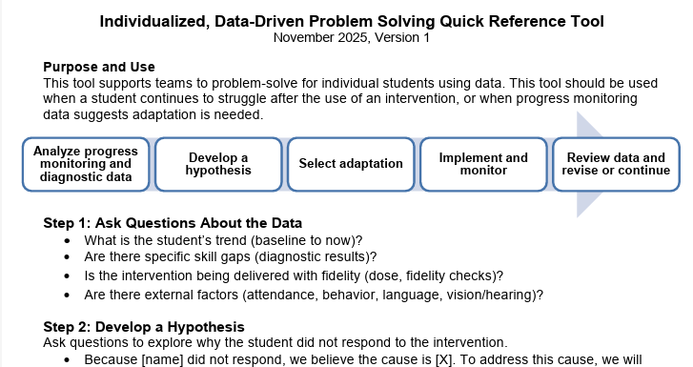
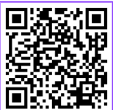
New Resource!
Individualized, Data-Driven Problem-Solving Quick Reference Tool

Slide 39

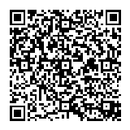
Feedback
November 20, 2025 Feeback Survey

Slide 40




The School Mental Health Support Program
Implemented by Kempe Center for the Prevention and Treatment of Child Abuse and Neglect at University of Colorado Anschutz Medical Campus and Butler Institute at University of Denver
Established by HB24-124, funded by Colorado Behavioral Health Administration (BHA)
Training, consultation, implementation support, and resources on: mental health, resiliency, trauma-informed practices, cultural responsiveness, mindfulness and cognitive-behavioral skills, resources for managing suicide risk, educator wellness and addressing work-related stress
Aligned with Multi-Tiered System of Supports (MTSS)
Virtual learning sessions on many topics, more coming soon

Slide 41
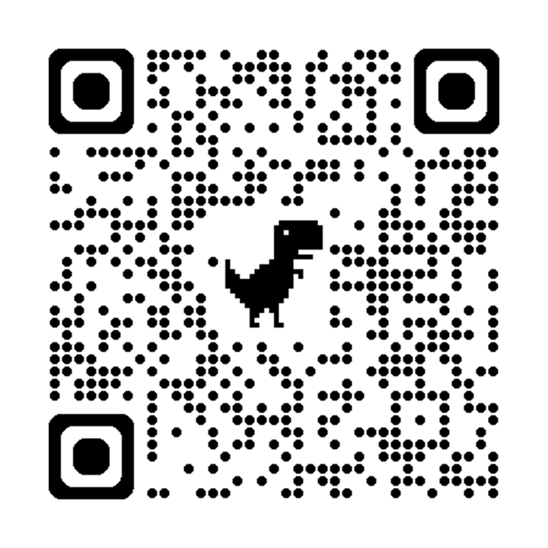
Application to Practice session:
Wed Dec. 3rd at 8:30am
Dig deeper
Ask follow-up questions
Discuss implementation opportunities
Problem-solve with other school
professionals across Colorado
Register for Application to Practice Session: Data Literacy for RtI

Slide 42


Questions and Answers

Slide 43


Contact Us
For questions or more information please visit:
www.ed.cde.state.co.us/mtss
Or email us at:
Response to Intervention Mailbox
RTI@cde.state.co.us

