Slide 1

Preventing School Violence
From Conflict to Connection: Restorative Strategies for Safer Schools
September 11, 2025
This training is funded by the National Bureau of Justice
STOP School Violence Grant

Slide 2
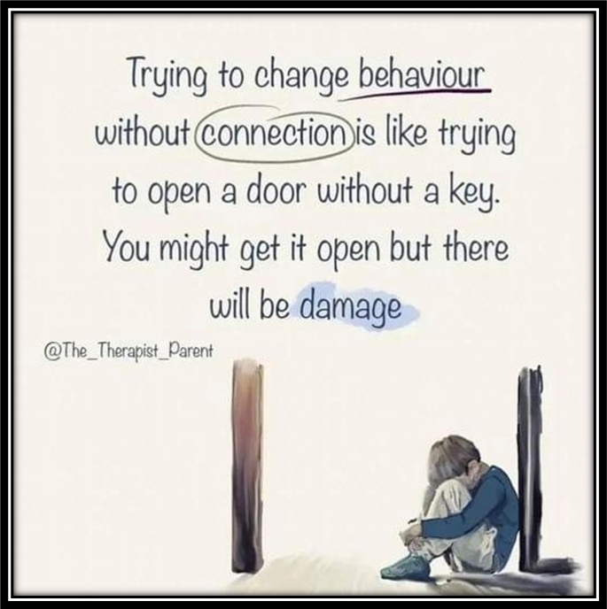
Thank you For Being Here

Slide 3
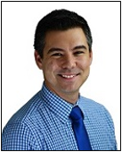
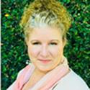
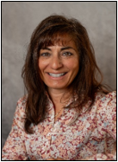
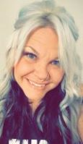
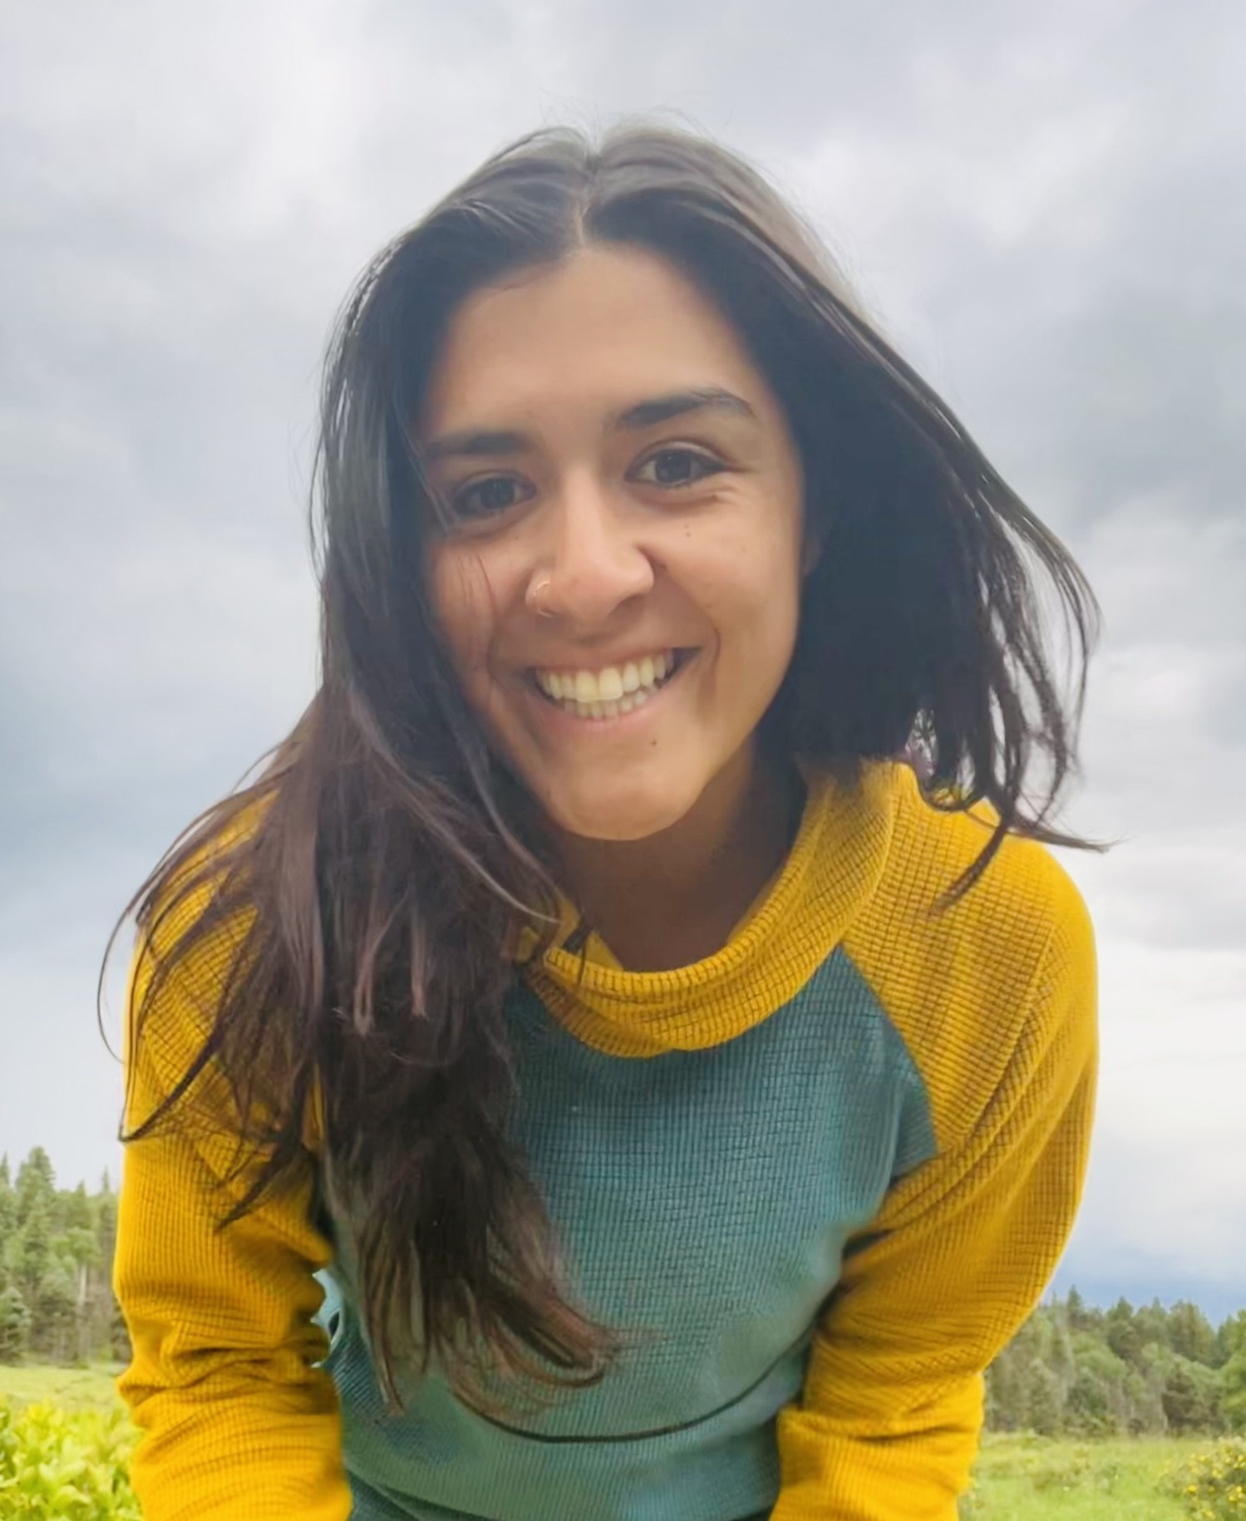

Prevent School Violence Team
Kristen Brown
Director, Office of Learning Supports​​​
Adam Collins
Statewide Bullying Prevention Manager​
Office of Learning Supports​
Lynne DeSousa
COMTSS Specialist/RTI and PBIS​ Integration Coordinator​
Office of Learning Supports​
Jessica Booth-Snider
Preventing School Violence Implementation Coordinator
Office of Learning Supports​​
Nicole Herrera
Dropout Prevention Specialist
Dropout Prevention & Student Re‑engagement

Slide 4

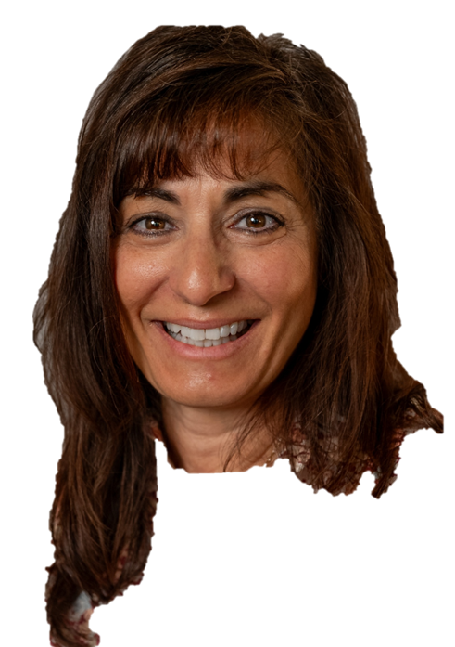
Who Are You…
Who is in the Virtual Room
    In the Chat:
    Introduce yourself: Work location, and job title?
    In the CHAT, please put the number that corresponds to your level of experience with restorative practices in schools:
I am a novice or learner
I am an implementer
I could teach or train

Slide 5

Housekeeping
Materials and recording will be posted on our website
Participation Hours will be distributed
Please use the chat to capture:
  Thoughts,
  Ideas, and
  Positive, on-topic Comments
  Questions for the presenter
At the conclusion of each presenter, we will have a brief Q & A session
Preventing School Violence Training webpage

Slide 6
Why Are We Here?
Restorative Practices

Slide 7
Restorative Practices Prevent School Violence
Why It Works:
Builds trust, belonging, and open communication.
Teaches conflict resolution, empathy, and accountability.
Replaces zero-tolerance discipline with relationship repair.
Key Takeaway:
Rooted in science: students are more inclined to demonstrate positive behavior when the school climate and relationships inspire feelings of trust, belonging, and safety

Slide 8
How Does it Support School Safety Efforts?
What the Research Shows:
  87% fewer suspensions (Oakland USD).
  Fewer fights & behavior incidents (Denver Public Schools).
  Better student-teacher relationships & school climate (RAND, 2018).
Key Takeaway:
Schools using restorative practices report less violence, stronger relationships, and safer learning environments.

Slide 9
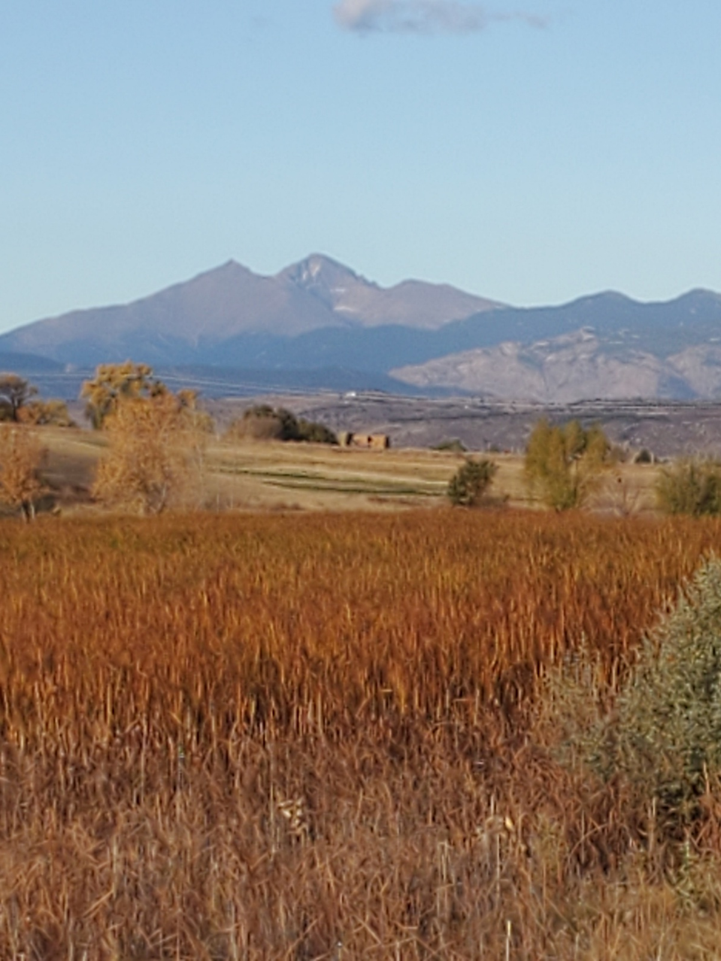
Objectives
Building Positive Connections Within Schools and Throughout the Community
Communication Strategies That Supports Problem Solving over Violence
Systems and Structures to Identify Needs, Resolve Conflicts Peacefully, and Repair Relationships with Dignity

Slide 10
Restorative Practice Foundation

Slide 11

7 Core Assumptions
The true self in everyone is good, wise, and powerful.
The world is profoundly interconnected.
All human beings have a deep desire to be in a good relationship/
All human beings have gifts and everyone is needed for what they bring.
Everything we need to make positive change is already here.
Human beings are holistic.
We need practices to build habits of living from the core self.

Slide 12

History and Language
Restorative practices are not new innovations - they are rooted in indigenous wisdom traditions centered on community, healing, and collective care
Indigenous Peacemaking Circles (North America)
Maori Justice Peace Practices (Aotearoa/ New Zealand)
Ubuntu Philosophy (Southern Africa)
Modern Restorative Justice

Slide 13
Defining Restorative Practices
Restorative Practice is a mindset, not a curriculum or program, that focuses on building positive relationships and providing opportunities for community members to take responsibility for their behavior and their lives.
At the heart of restorative practices is the belief that we are all in this together and that we are a community

Slide 14
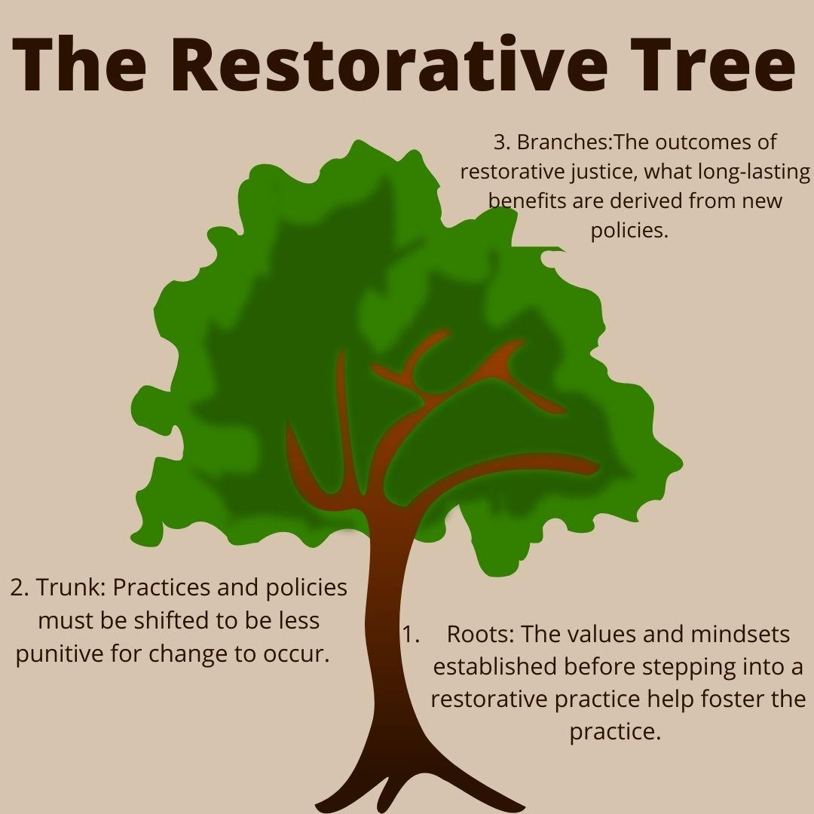
The Aim of RP
Build a community to restore back to
Manage conflict and tensions by repairing harm
Shifting from punishment → accountability and healing

Slide 15

Restorative Practices - What It Is NOT
Public Shaming
Lecturing responsible parties
Rigid process or system
Program
Fixing
Lack of consequences
Sympathizing
Overly focused on the person who caused harm. Losing focus on the person who was harmed.
Forced apologies
Adults deciding consequences
Quick

Slide 16
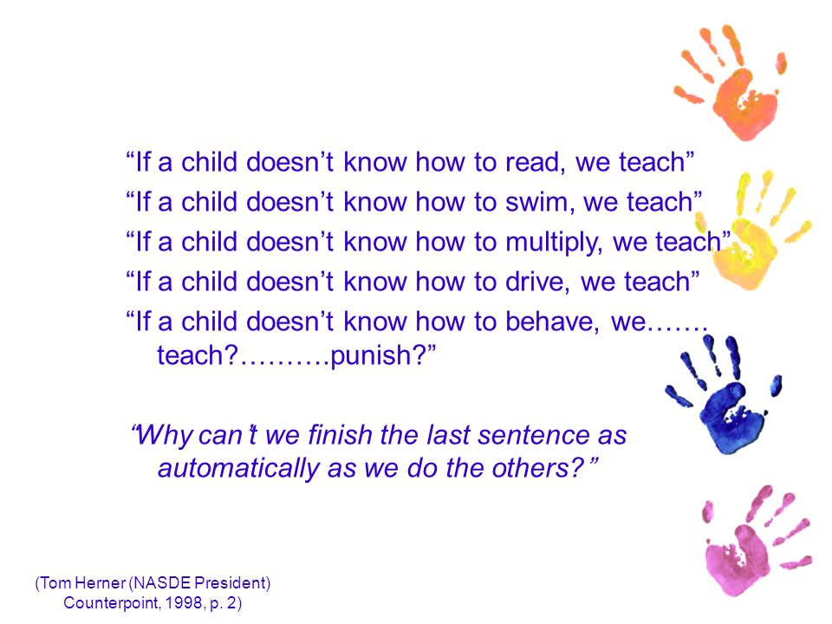
Behavior Quote

Slide 17

5 R’s of Restorative Practices
Relationship
Respect
Responsibility
Repair
Reintegration
5 R’s are from Beverly Title’s work and Resolutionaries Inc

Slide 18
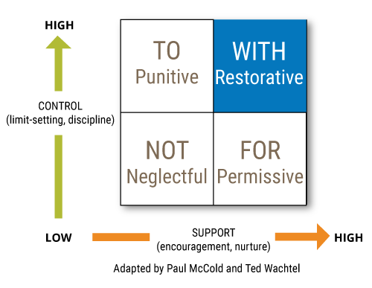
Social Engagement Window
Paul McCold and Ted Wachtel

Slide 19
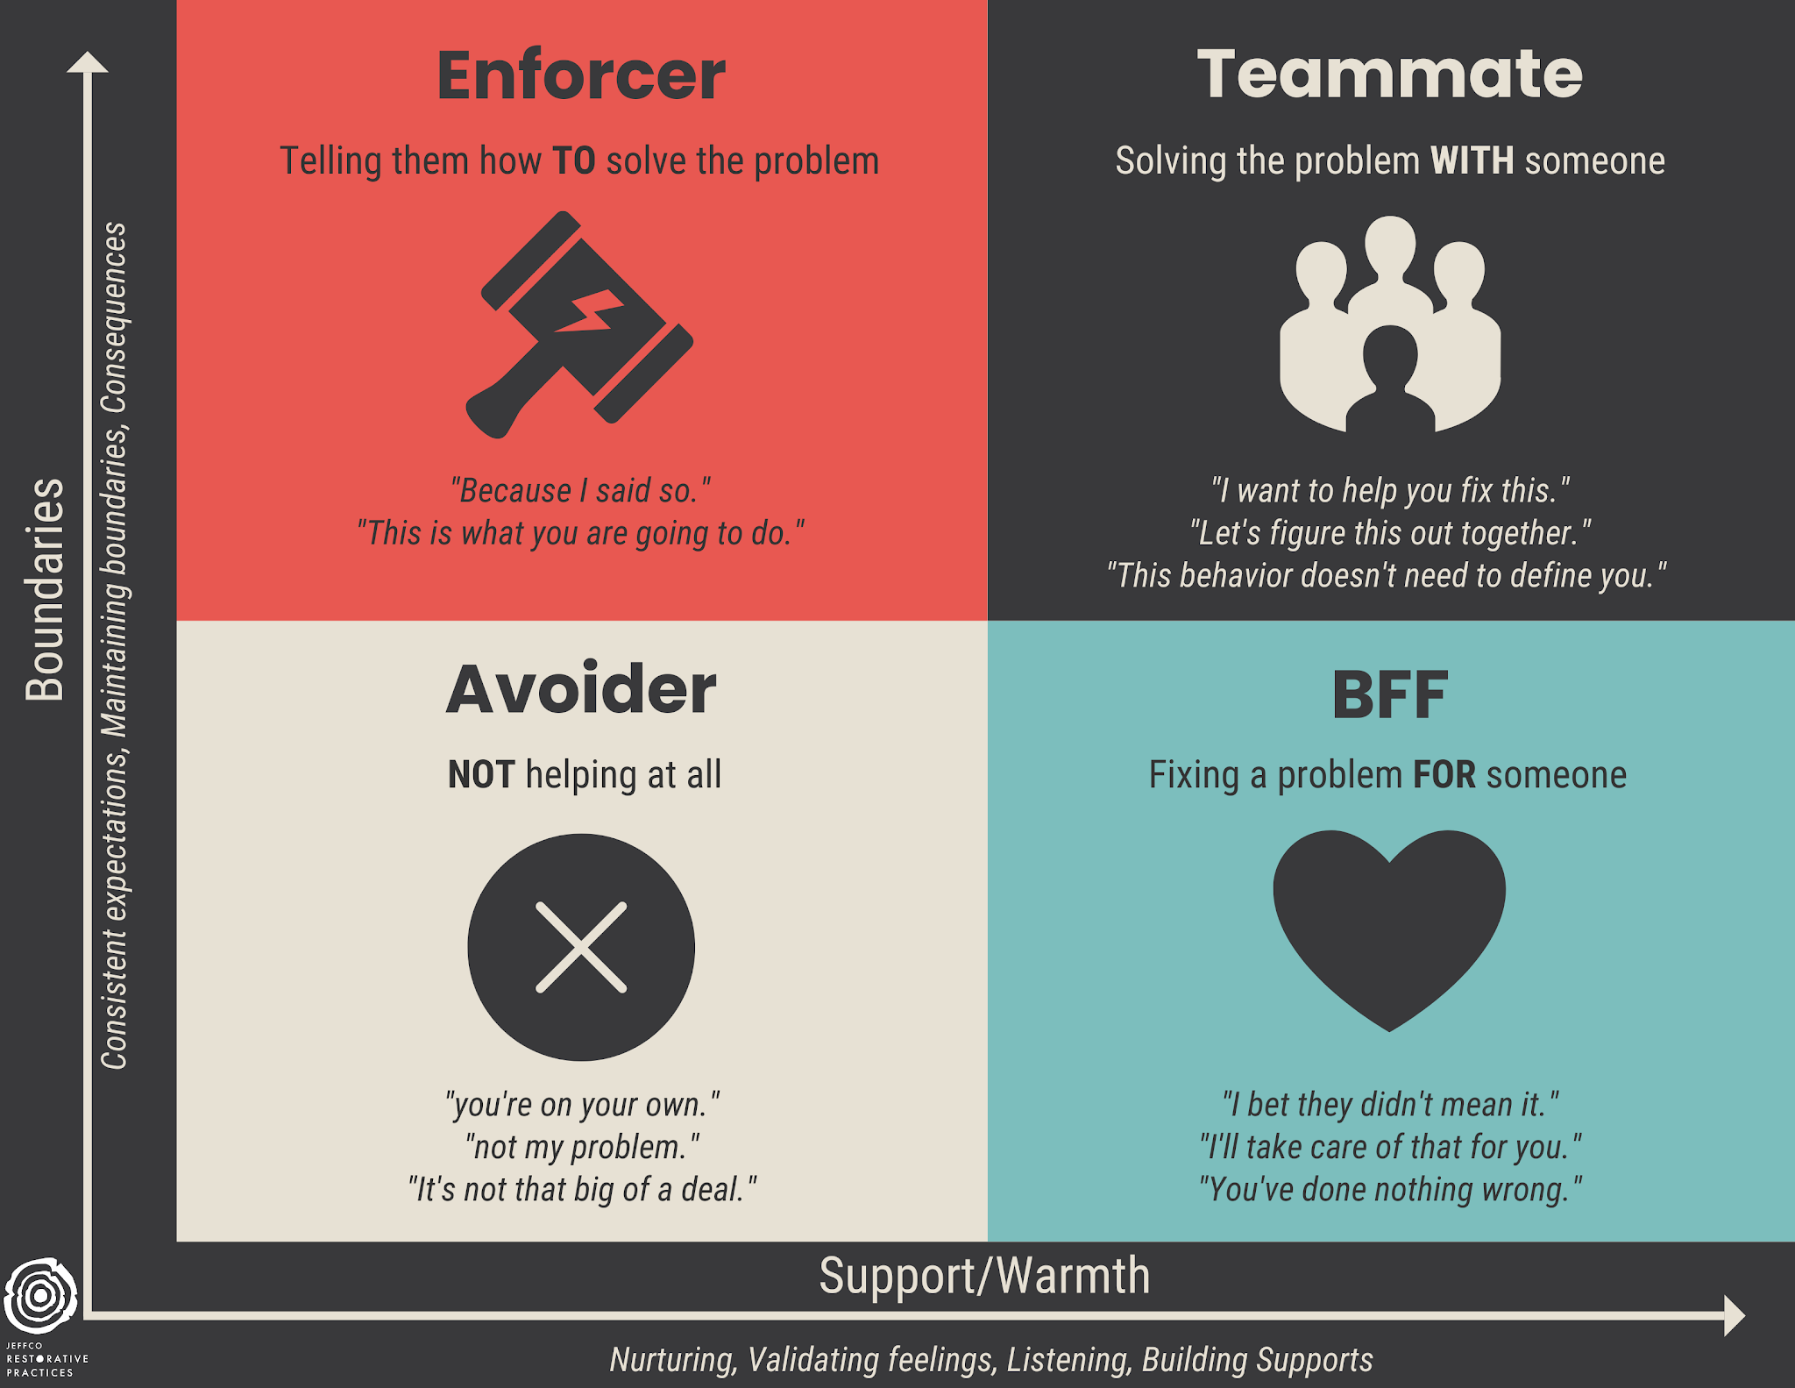
How do we best engage people

Slide 20
Restorative Practices Across Tiered Supports
Tier Three: REINTEGRATE (5%)
Formal Conferencing
Higher-level Responsive Circles
Tier Two: REPAIR (15%)
Restorative Conversations (Informal Conferencing)
Low-level Responsive Circles
Tier One: RELATE (80%)
Proactive Circles
Relationships
Climate Culture Practices
REINTEGRATION
REPAIR
RESPONSIBILITY
RESPECT
RELATIONSHIP

Slide 21

Personal Reflection
What has resonated most with you up to this point?

Slide 22
Leadership

Slide 23

What is Restorative Leadership?
Focuses on the power of
Collective responsibility
Open dialogue
Empathy
Growth mindset
Mutual respect

Slide 24
Characteristics of Restorative Leadership
Characteristics
Reflective | Relational | Responsive
Models self-awareness and vulnerability | Listens actively and validates staff | Addresses harm with compassion and clarity
Seeks feedback and growth | Builds trust through consistency | Holds high expectations while supporting through change
Owns mistakes publicly | Centered in shared power | Navigates conflict restoratively

Slide 25

Questions to Ask Self
What are the top three values that you hold most dear?
What do you feel you have healed through in your life that you now share as wisdom with others?
What do you want to model for those around you or the next generation?
What communities do you impact? Remember that your own family, kin, or friendship relationships are communities too.

Slide 26

Characteristics of a Resilient Teams
Collaboration and mutual respect
Open communication (trust)
Flexibility and adaptability
Problem-solving mindset
Group Reflection and learning

Slide 27

Staff Culture Is School Culture
How we lead each other is how we lead students
How does your staff navigate conflict?
Is feedback welcomed/feared/seen as a waste of time?
Are staff meetings inclusive or performative?
Are adult relationships marked by trust and transparency?

Slide 28
Implementation Fails Without Adult Alignment
Teachers/staff mirror what they experience
Circles and reintegration plans require shared norms
Staff will struggle to hold space for student reflection if they aren’t given the same grace
Leadership Culture
Staff Culture
Student Experience

Slide 29

Build Relational Infrastructure Among Adults
Open meetings with check-ins or circles
Normalize adult affective statements and feedback
Address conflict with staff, not around staff - Nothing about us, without us
Invite reflection over compliance

Slide 30
Personal Reflection
“The eagle is the leader of the birds. It says that this is what it means to be a good leader. To have vision. To be generous. It reminds the whole community that leadership is not rooted in power and authority but in service and wisdom.”
~ Robin Wall Kimmerer, Braiding Sweetgrass
Which element of this section feels most significant for you to carry forward?

Slide 31

Questions and Answers
Thank you, Nicole!

Slide 32
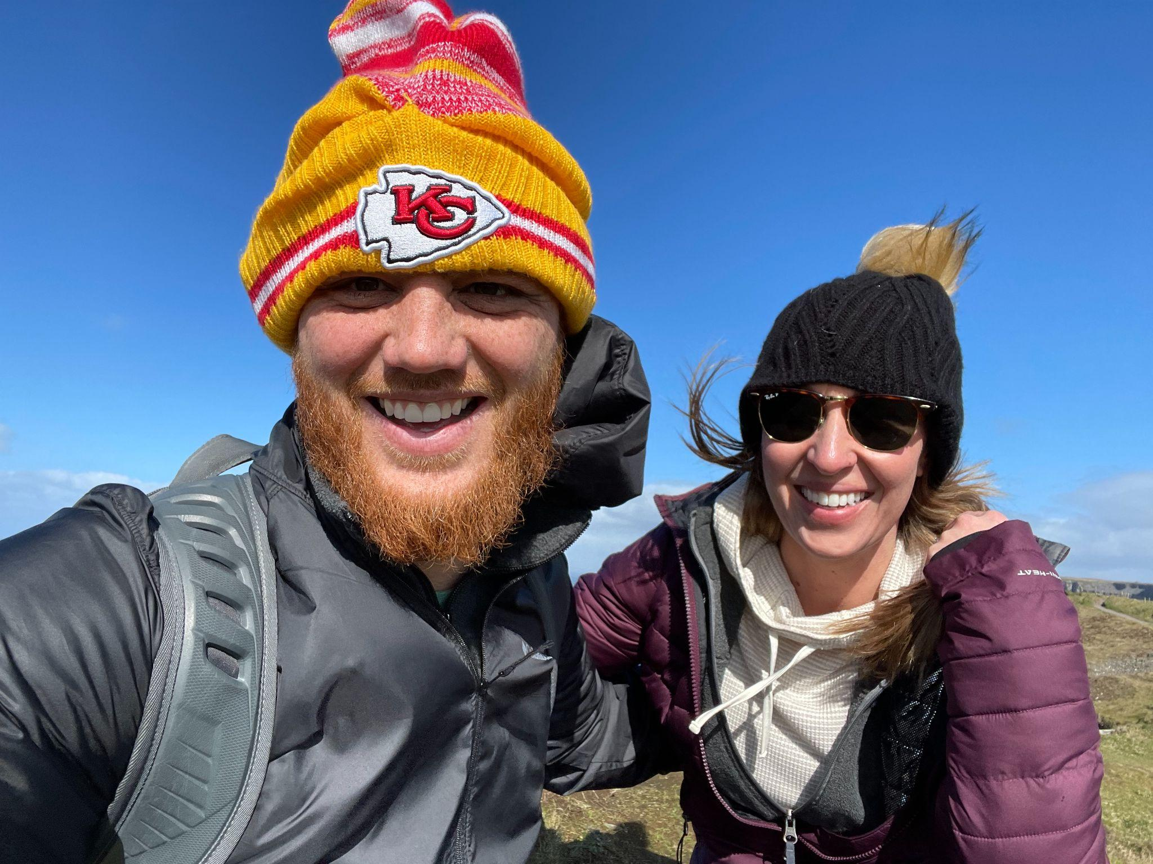
Introduction of Speaker
Reid Heller, PhD
Assistant Principal, Smoky Hill High School, Cherry Creek School District
Reid is originally from Kansas City (Go Kelce), and a proud husband and father of two daughters. For 9 years he taught Physical Education and Health across all grade levels. He has been a dean, restorative coordinator, and assistant principal. Most importantly, in a school setting Reid enjoys and thrives on being different. He earned a Doctoral degree from the University of Colorado Denver.

Slide 33
Trust
“To the victim, there is only one story: the story of atrocity. And there are only a limited number of roles: one can be a perpetrator, bystander, ally or supporter. Every new or old relationship is approached with the implicit question: Which category are you? The victims greatest contempt if not for the perpetrator but the bystander”.
Trauma and Recovery: By Judith Herman

Slide 34
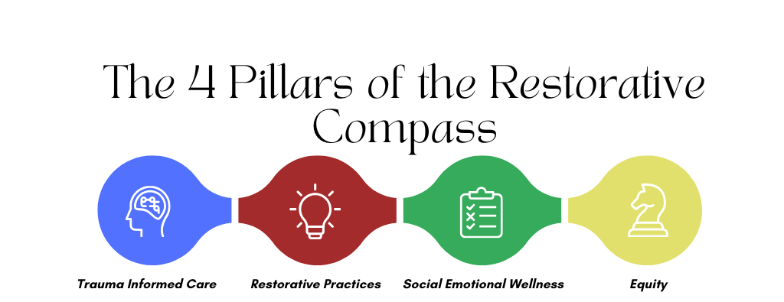
The 4 Pillars of The Restorative Compass

Slide 35
Data from 24-25 School Year
Disobedient Defiant – Reduced incidents by 12%
Suspensions by 16.7%
Suspension Average – Shortest length of time in past 7 years. Average 1.13
Escorts / Focused Day – Completed over 100 for the 24-25 school year.
Over Representation – 2 or more Race is 1.5%
Native/Pacific .8%
Hispanic 1.3%
Black 7.9%
Expulsion – Reduced by 44%

Slide 36
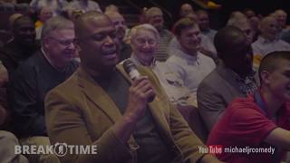
Break Time YouTube Video

Slide 37
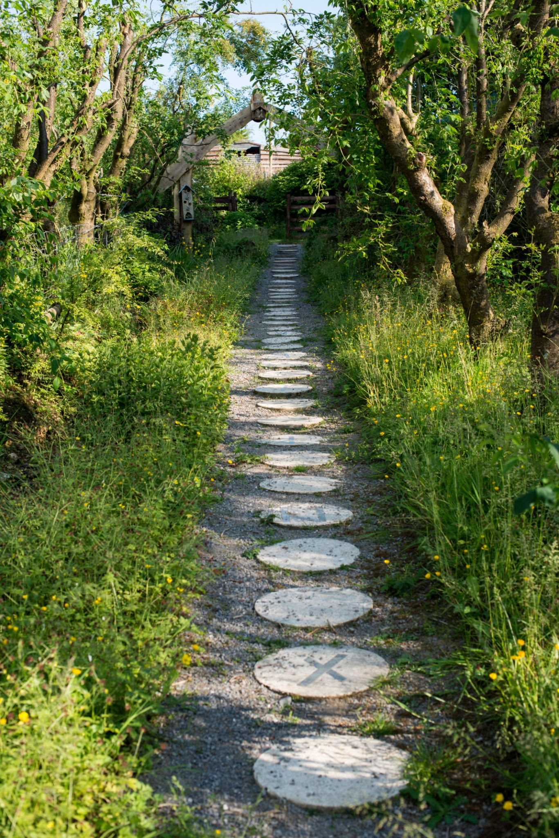
Building Capacity
Have manageable goals
Start with a small team
Review beliefs and align
Train EVERYONE
Review and share data
Review policy / process
Review goals

Slide 38
How we did it…
4 year process
In house training system with outside resources as needed
Created a team
Monthly email update
Parent nights
Utilized your in building resources
Share data good and bad with community
Scaffold
Apply for grants
Communicate, Model, Communicate, Model

Slide 39
Personal Reflect
What's a practice you have in your setting that you would like to change?
What's the first step you can take to initiate change?
When you hit a roadblock or negativity what do you do?

Slide 40
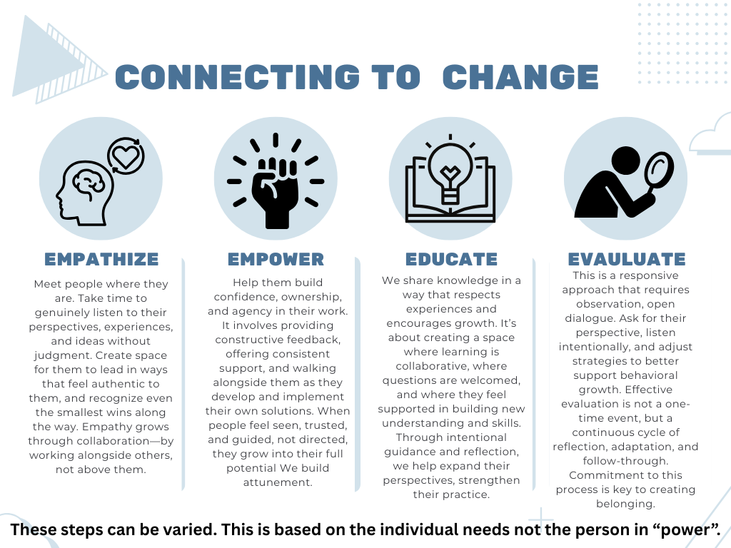
Connecting to Change

Slide 41
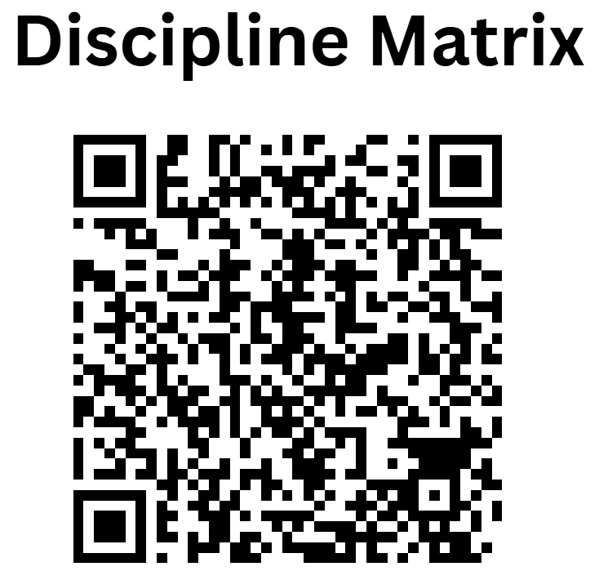
Discipline Matrix
Link for the Discipline Matrix

Slide 42
Personal Reflection
Importance:
  80 - 20
  Keeping the Power
How does this compare to your Consequence Guide at the school or district level?
What do you need to adapt to this change?

Slide 43
Alternatives to Suspension
Guardian Escorts - Designed to build community between guardian and the school while supporting the student.
Contract
Emails
Provide the Why
Focused Day - Designed for the school to support the student.
Keep the student focus on academics and engagement
Build community between students and adults
Show the student you will show up for them

Slide 44
Personal Reflection: Team Conversations
Use Guardian Escorts?
Use Focused Day?
Get your administrative team/district team engaged in conversations to change the status quo.

Slide 45
Personal Reflection: Outside the Box
Are you thinking outside the box if the box was never there?

Slide 46
Reid - Questions and Answers
Thank you, Reid!

Slide 47
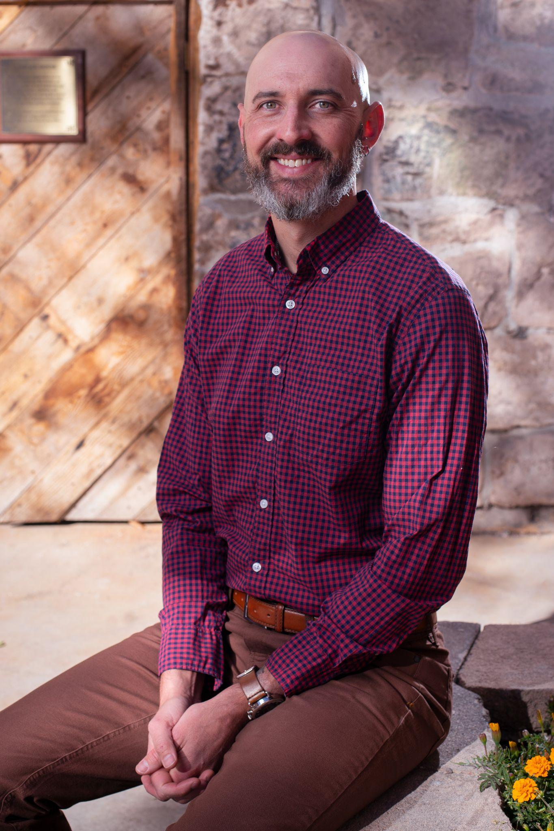
Luke Yoder Introduction
Luke Yoder
Executive Director , Center for Restorative Programs
Luke Yoder has been the Executive Director of the San Luis Valley based, youth- and family-serving Restorative Justice non-profit Center for Restorative Programs (CRP) since 2010 after receiving Master’s Degrees in Conflict Resolution and Business Administration from the University of Denver. CRP provides RJ services within the 6 counties of the 12th Judicial District, and to the 14 school districts of the San Luis Valley. Luke has actively worked with community partners to establish Restorative Practices as an accepted practice for diversion, school culture building, and community intervention.

Slide 48
What capacity is needed?
RP/School Culture Team to oversee implementation effort
Professional Development: Training, Modeling, Mentoring/Coaching
Data collection/Culture Assessment
Policy/Procedure/Protocol
5-7 Year Implementation Window for meaningful culture change (Implementation Science approach)
Expertise in RP approaches!

Slide 49
What capacity exists?
Rural
  Often have limited staff for oversight of RP; staff wearing many hats
  May have 4 day schedule, which presents challenges and opportunities for PD
  Less likely to have in house or district level expertise
Urban
  May have dedicated staff to oversee RP efforts
  May have access to expanded Professional Development options
  May have access to district level resources and expertise

Slide 50
Increasing Capacity Through Partnerships
External partners can increase school building/district capacity
Can be more cost effective to partner with outside expertise to build internal bandwidth over time
There are opportunities and challenges in partnering with external experts

Slide 51

Case Study – SLV
  14 school districts across the 6-county region
  Many districts are quite small, 100-200 students total
  All districts on 4-day school week
  Existing RP expertise through the Center for Restorative Programs

Slide 52
Personal Reflection: Systems
What is the internal building/district capacity to do the work?
Does the building/district have internal capacity? If not, are there external partners with whom to work?
  Local nonprofit? Consultant? What would that look like?
    Help with: Planning? Training? Coaching?

Slide 53
Luke - Questions and Answers
Thank you, Luke!

Slide 54

COLORADO OFFICE OF SCHOOL SAFETY
Colorado Department of Education
September 11, 2025
Christine Harms, MS, Director
Colorado Office of School Safety
Colorado Department of Public Safety

Slide 55
Office of School Safety – SB23-241
Office of School Safety
CDPS
Chris Harms, Director
(4)
CSSRC
Margaret Ochoa, Manager
(9)
Crisis Response Unit
Kati Garner, Manager
(4)
Grants Unit
Charli Pringle-North, Manager
(2)

Slide 56
School Safety Resource Center (CSSRC) – 9 FTE
    Margaret Ochoa – Manager
          Metro (3 staff)
          Statewide:
            NE - Sterling
            SE – La Junta/Cheyenne Wells
            SC – TBD
            SW - Bayfield
            NW - Basalt

Slide 57
CSSRC
Provides training, resources, consultation and technical assistance
Pre-K through higher education
Staff includes - mental health professionals, former law enforcement professional and school administrators
Regional training consultants in the SE, E, NE, SW, NW
Training on both physical and psychological safety topics, such as:
      Emergency operations planning, tabletop exercises, threat assessment, suicide assessment, bullying prevention, child sexual abuse prevention and a host of others

Slide 58
Grants Unit – 2 FTE
Charli Pringle-North, Manager
Manages Grants and Researches Grant Opportunities
        School Security Disbursement Grant ($16M in 2024, $100K in 2025)
              For “improving security”
              Much broader than SAFER
        School Access for Emergency Services (SAFER) Grant (~ $5M/year thru 6/30/28)
              School/community interoperability grant
              RFP is usually posted in March/April for June award

Slide 59
Crisis Response Unit – 4 FTE+
Kati Garner M.Ed., Manager
Three Crisis Response Specialists across the state, plus a grant-funded new hire
        Train in PREPaRE and other response models as well as trauma
        Respond, on a limited basis, to any school with a critical incident

Slide 60
Ongoing Initiatives
School Safety Working Group (SSWG) SB20-023 and HB22-1274
Created guidelines for building site and physical safety recommendations. Those can be found on the OSS website.
SSWG ongoing committee with six state agencies met monthly, now ad hoc.
OSS website takes school personnel to all the state agency resources available for schools
https://oss.colorado.gov/news-article/state-agencies-collaborate-on-new-school-safety-resource-guide

Slide 61


Educator Safety Task Force (HB24-1320)
Office of School Safety was required to facilitate a task force looking at educator safety
The task force operated with four subcommittees that met monthly
A survey was completed by over 1,100 school employees.
A report was submitted to the legislature this summer.

Slide 62
Upcoming Events
  October 15 - Student Staff Summit at Yuma High School
  October 23rd - Safe Schools Summit at Adams 12 Five Star Schools
  November 13th - Youth Suicide Prevention, Intervention and Postvention Symposium at Lowry Conference Center
  More to come after the first of the year
  Ongoing each month: Networking groups for crisis response, suicide and threat assessment, and managing youth with problematic sexual behaviors

Slide 63
Thank you!
Christine.Harms@state.co.us
303-912-6915
OSS.Colorado.gov

