Slide 1
Effective Multi-Tiered
Family, School, and Community
Partnering (FSCP)

Slide 2

Outcomes
Attendees will…
define Family, School, and Community Partnering (FSCP) within the CO-MTSS framework,
engage with the National Standards for
Family-School Partnering (PTA, 2008),
consider state- and local-level applications,
review selected available tools and resources,
reflect on current practices, and
explore examples (case studies).

Slide 3
Self-Identification
My role is:
Teacher
Coach
Specialist
Administrator
Parent &/or Family Member
Community Partner
Advocate or Liaison
Professor
Researcher
Other???
My community is:
Rural
Suburban
Urban
College-Town
Mountain-Town
Other???
My primary connection to education is at the _______ grade/age level:
Preschool
Elementary
Middle School
High School
Post-Secondary
Adult Educ.
Multiple
(e.g., K-8;
P-12)
My connection to education is to:
Program-level
School-level
District-level
Regional-level
State-level

Slide 4
Adult Learning Principles
Introduction
Illustration
Mastery
Practicing
Reflection
Evaluation
Adapted from:
Trivette, 2012 (http://www.signetwork.org/file_attachments/123/download)

Slide 5
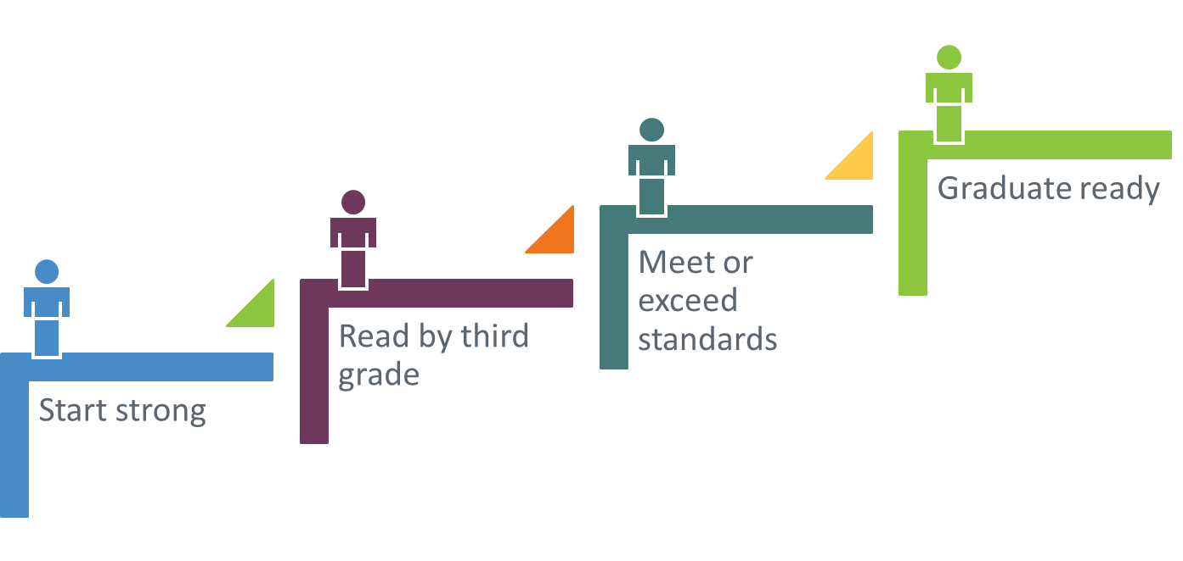
CDE Strategic Goals
Family
Every Student Every Step of the Way

Slide 6
Colorado Definition: Multi-Tiered System of Supports
CO-MTSS is a prevention-based framework
of team-driven data-based problem solving for improving the outcomes of every student
through family, school, and community partnering and a layered continuum of
evidence-based practices applied at the classroom, school, district, region, and state level.
Notes:
“updated” definition (as of 2016)

Slide 7
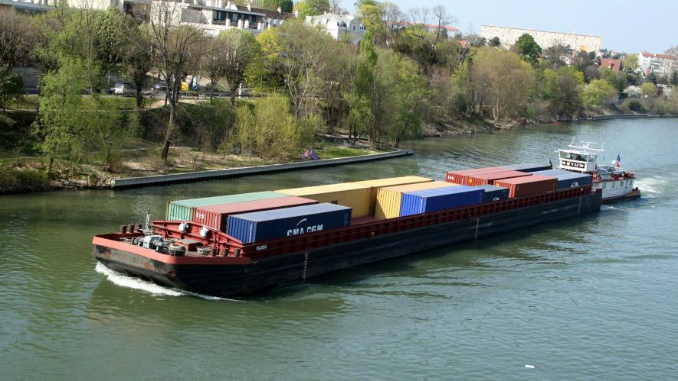
Consider this barge…How “easy” is it to move?
Substantive systems change is a process.
Notes:
This is an image of a barge…
Implementation is not “a quick shift” or a “quick change” or a “quick turn”

Slide 8







MTSS and
Essential Components
Team-Driven Shared Leadership
Family, School, and
Community Partnering
Data-Based
Problem Solving and
Decision-Making
Layered Continuum
of Supports
Evidence-Based
Practices
Notes:
CO-MTSS is a prevention-based framework of team-driven, data-based problem solving for improving the outcomes of every student through family, school, and community partnering and a layered continuum of evidence-based practices applied at the classroom, school, district, region, and state level.
Note that FSCP is Multi-Tiered

Slide 9
Family, School, and Community Partnering
  Definition:
  The collaboration of families, schools, and communities as active partners in improving learner, classroom, school, district, and state outcomes.
Partnering is….
______________________________________
Notes:
On a piece of paper/notecatcher/index card/post-it note, Fill in the blank…
“Partnering is…” ___
Then, in looking at our definition, think: what gels/what differs?
Also…aloud for all:
Think of a partner in your life. What attributes (adjectives/descriptors) would you use to describe the relationship you have with that individual?

Slide 10
Supporting Research for FSCP
School-initiated, specific family
participation programs –
such as shared reading,
homework checking,
and teamed two-way communication
– are significantly and positively
related to academic achievement
for students at all levels.
(Jeynes, 2012)
Notes:
Over 50 years of research supports impl. FSCP effectively.
Key Points:
It is important for all stakeholders understand the rationale for partnering – there is a strong research base as to its effectiveness in improving student achievement
Federal and state laws have been created based on the strong research base.
Because of the research and laws, there is a national shift for educator and families.

Slide 11

Partnering Principles
The focus is always on
student success
It is about ongoing, sustainable,
intentional relationships
Differences are directly addressed, so that:
  students see their worlds working together
  a forum is created for understanding the culture of the family and the culture of the school (cultural sharing).
  -Coll & Chatman, 2005
Notes:
Key Points:
Families & teachers work together right away when student is struggling; all try to understand the problems.
This keeps students engaged in the learning process.
Easier to overcome differences when focusing on big picture & what really counts - students.
Relationships, relationships, relationships…
Students see adults in their lives caring and sharing.

Slide 12
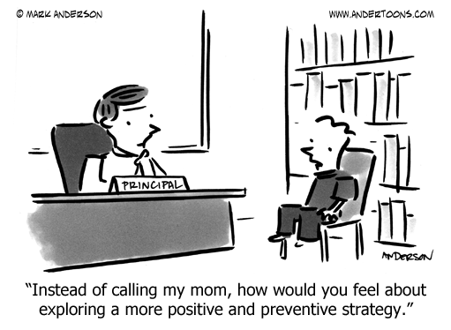

Slide 13
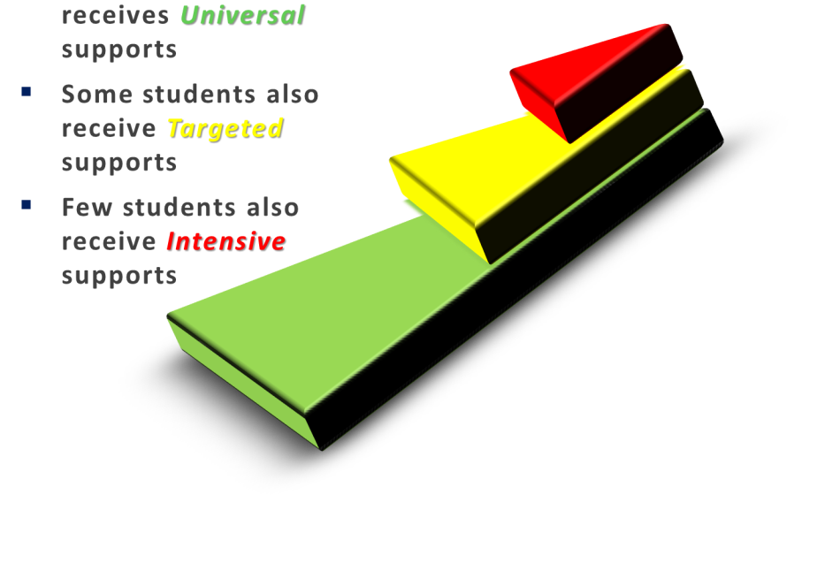
Support Matched to Stakeholders’ Needs
Few = Universal + Targeted + Intensive
Some = Universal ALSO Targeted
Every = Universal
Intensive
Targeted
Universal
“The Layered Continuum of Supports”
(Note: Visual graphic
Representation
adapted from multiple sources)
Notes:
“We layer supports on…(matching to need)…students do not ‘move through tiers’ (as if it were a “maze” for them to navigate).”
“layered continuum” = having a strong ‘core’ isn’t enough; having ‘quality interventions’ isn’t enough; all has to be equally supportive
Notes:
High quality instruction is provided to all students.
Some students benefit from additional instruction, progress monitoring and support to ensure educational gaps are eliminated.
Also, a few students benefit from more precise and explicit support to ensure their persistent academic or behavioral needs are met.

Slide 14
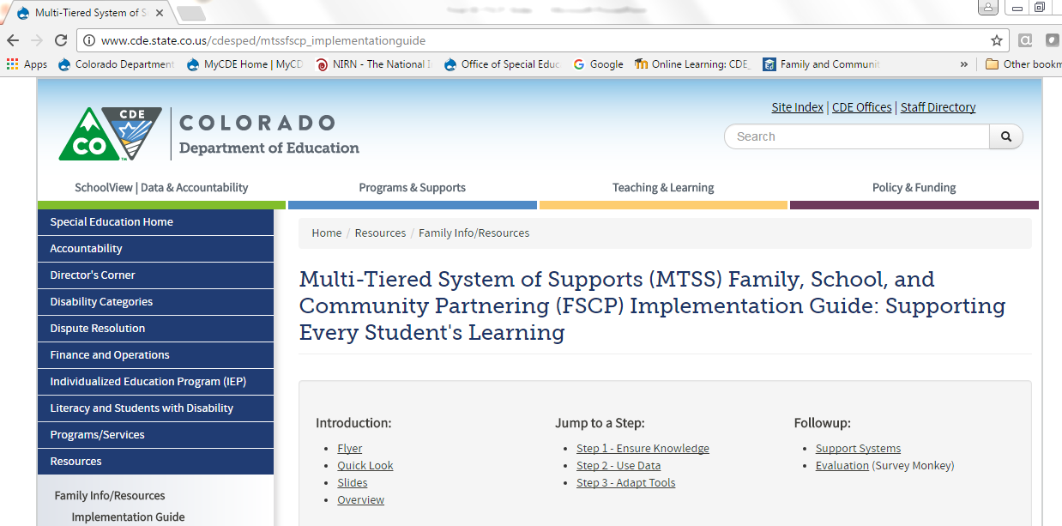
Implementation Guide
http://www.cde.state.co.us/cdesped/mtssfscp_implementationguide

Slide 15
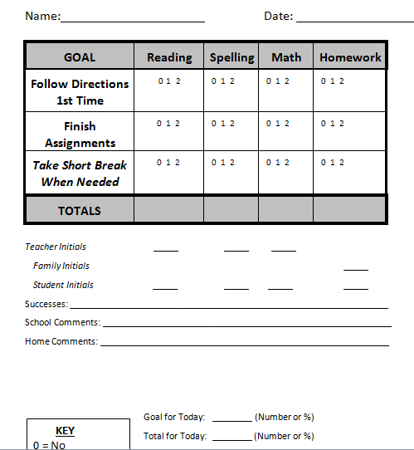
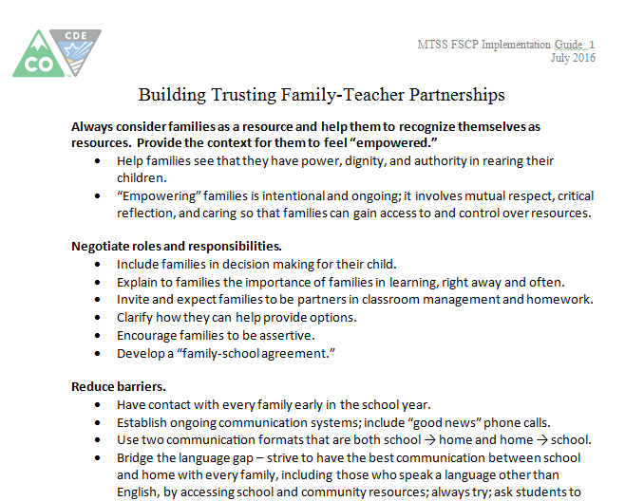
Tiered Tools within the Guide
Reminder: Label Supports, not Stakeholders
Notes:
These are screenshots of tools in the Guide.
This slide: Referencing the “triangle” (tiered logic)
-anecdote if time-permitting

Slide 16
Common Language & Common Understanding
Language reveals belief;
belief informs action;
action is visible in the behavior of adults
…which is what we are trying to
change or shape to support students.
Notes:
By “we” think “we” the “system”; it is the global/universal/collective “we”; the “MTSS-rs”…
We = collective PN
We = “partners in progress”

Slide 17
Partnering Vocabulary
Examples
Words | “WE”, “OUR”, “US”
Goals | What do we want to achieve together?
Roles | How can we partner around that?
Data | How will we know it is working?
Input | What does the family or school or community partner think, feel, know?
Decisions | We ALL are “at the table” & “on the team”.
Responsibilities | What are we each doing?
Students | What is best for our student(s)?
http://www.cde.state.co.us/cdesped/mtssfscp_implementationguide
Notes:
Think of the language you use…consider the partnering.
Connections to other MTSS components.
Connections to Impleme. Sci.

Slide 18
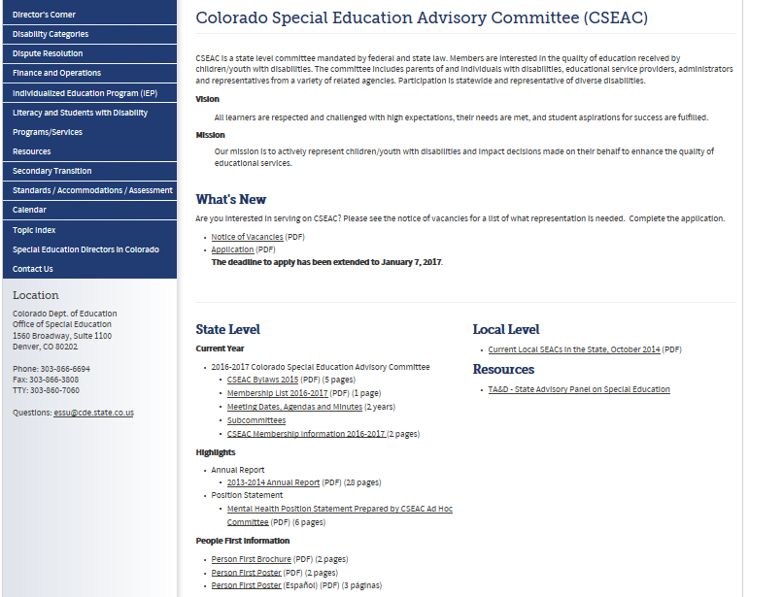

Slide 19

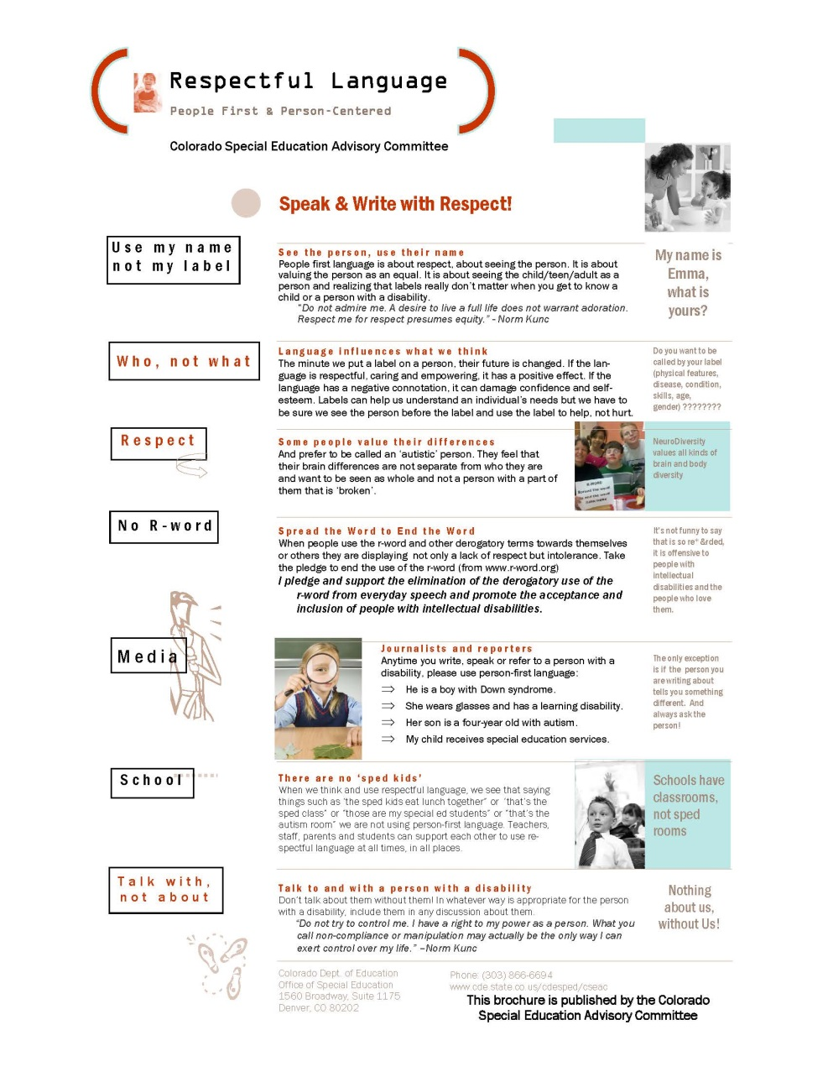
Person-First Handout (ref CSEAC)

Slide 20
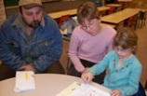
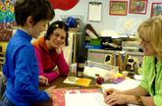
Dual Capacity-Building Framework
Families & Educators Both Need…
Capabilities (skills & knowledge)
Connections (networks)
Cognition (beliefs, values)
Confidence (self-efficacy)
U.S. Dept. of Ed. Dual Capacity-Building Framework (2013)
http://www.ed.gov/family-and-community-engagement

Slide 21
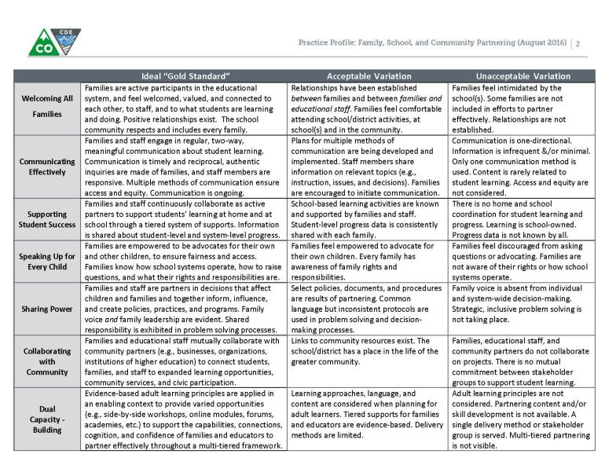
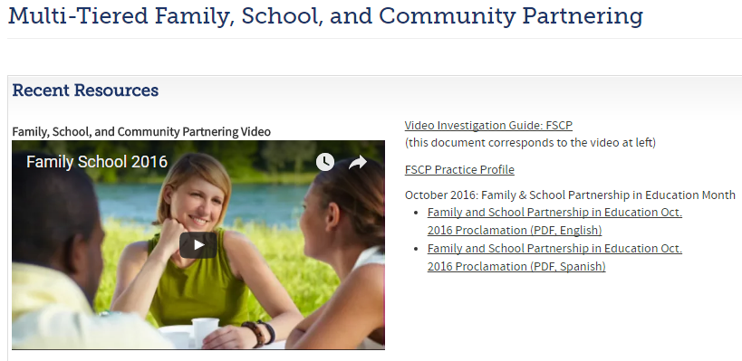
Application: Example Tools
http://www.cde.state.co.us/mtss/fscp
Notes:
Tools/resources on MTSS FSCP page.
[Animate slide.]
Including screenshot of Practice Profile (see full handout).

Slide 22
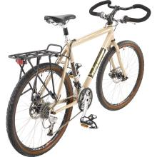
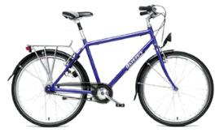
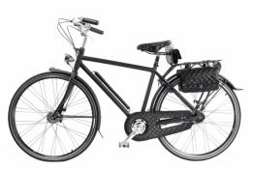
Bike Analogy: Which bike do you like?
Adapted from: U.S. Department of Education
Notes:
Everyone take a look and make a choice.
Then…(speaker) Link standards to elems. of bike.

Slide 23

“…No matter how skilled professionals are, nor how loving families are,
each cannot achieve alone, what the parties, working hand-in-hand,
can accomplish together.”
(Adapted from Peterson & Cooper,
as cited in 2007)

Slide 24

Enabling Change
System-wide;
every stakeholder
    Create readiness:
    Culture of commitment
Ongoing Support;
capacity-building
    Personnel Development
“For every increment of performance I demand of you, I have an equal responsibility to provide you with the capacity to meet that expectation.”
(Elmore, 2002)

Slide 25
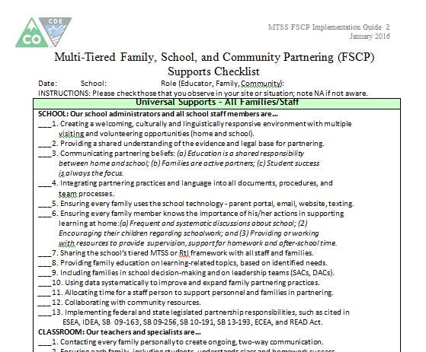
Multi-Tiered Partnering Checklist

Slide 26

Seeking Balance
Infrastructure
Culture

Slide 27
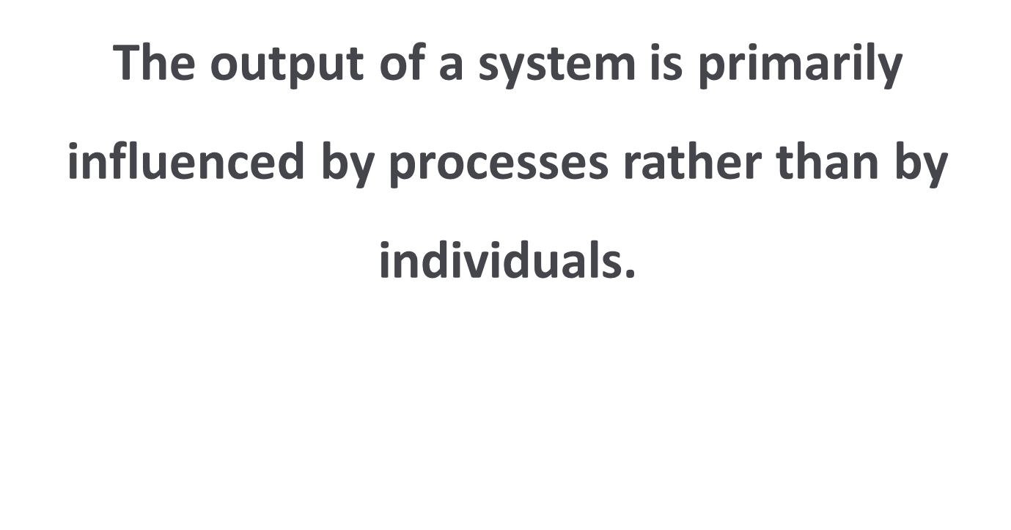
Systems Thinking
Notes:
This quotation leads to some of the “how”. We always like to say that this work is not “person-specific” (or individual dependent); MTSS implementation demands certain elements, but it should be more than a solo project or a siloed activity. It is not “about the individual” –it’s not even about the individual STUDENT…it’s about every student. It IS about the processes and the drivers that ensure your system functions effectively to reach desired outcomes.
Systems change is about implementation and sustainability of: processes, protocols, procedures, and practices. “It’s not about the people” (as those can/should/do change). The system ‘sustains’.
It is not “a person” who implements systems change.
(as in it’s not = ex: “Kim, the interventionist, does MTSS at our school.”)

Slide 28
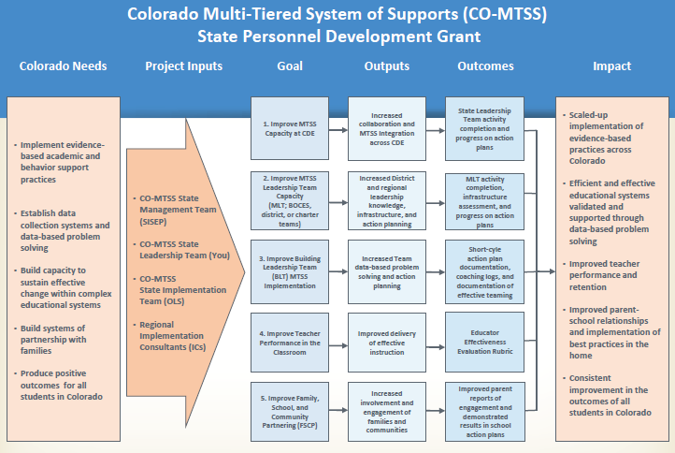
(Drafted Example, 2016)

Slide 29
FSCP Logic Model Draft Example
Your School – Family School Community Partnering Initiative
INPUTS
OUTPUTS
OUTCOMES
Program Investments
Activities
Participation
Short Term
Intermediate
Long Term
LEARNING
ACTION
CONDITIONS
Develop district FSCP vision, mission, & policy
FSCP training for all staff
Family FSCP Workshops
FSCP Action Plans by DAC & all SACs
Activities for
reaching hard to reach
families
Data from families
collected & analyzed;
used to inform practices
Teams
Admin team
School Board
DAC
SACs
PTA
MTSS Team
Action Team (ATP)
Individuals
Building Admins
District staff
Families
Students
Community
liaisons
District-wide FSCP policy
adopted
FSCP Guiding Questions used at all meetings
Systematic FSCP data
collection and
analysis
All staff and
families have
knowledge of
best practices
for FSCP.
District-wide
mission and
vision for FSCP
articulated
Higher levels
of satisfaction
expressed
by families.
Increased
engagement
with
“hard to reach”
families
District MTSS Program
Supt.’s district
innovation fund
Administrators & School
Board trained in FSCP
using CDE resources
DAC trained and has
commitment to FSCP
Other?
Project Objectives
Process Measures
Team checklist
Other?
Outcome Measures
FSCP Survey results
Climate survey data
Other ?
Adapted from Jennifer Coffey,
U.S. Department of Education
http://signetwork.org/event_
calendar/events/1030
Notes:
Collaboratively constructed by CDE (SEA) & PEAK (PTI): used within FSCP CoP
What is a Logic Model?
Illustrates the connection between what an
organization does (e.g. its activities)
and what it hopes to achieve
(e.g. its goals and outcomes).
Harvard Family Research Project, November 2009
http://www.hfrp.org/publications-resources/browse-our-publications/how-to-develop-a-logic-model-for-districtwide-family-engagement-strategies
How to Develop a Logic Model for District-Wide Family Engagement Strategies
Define the Goals That Will Shape Your Strategy
Identify You District’s Inputs
Specify Which Activities Your District Will Implement
Define the Desired outcomes of Your District’s Activities
Select Performance Measures to Track Progress
Harvard Family Research Project, November 2009
http://www.hfrp.org/publications-resources/browse-our-publications/
how-to-develop-a-logic-model-for-districtwide-family-engagement-strategies

Slide 30
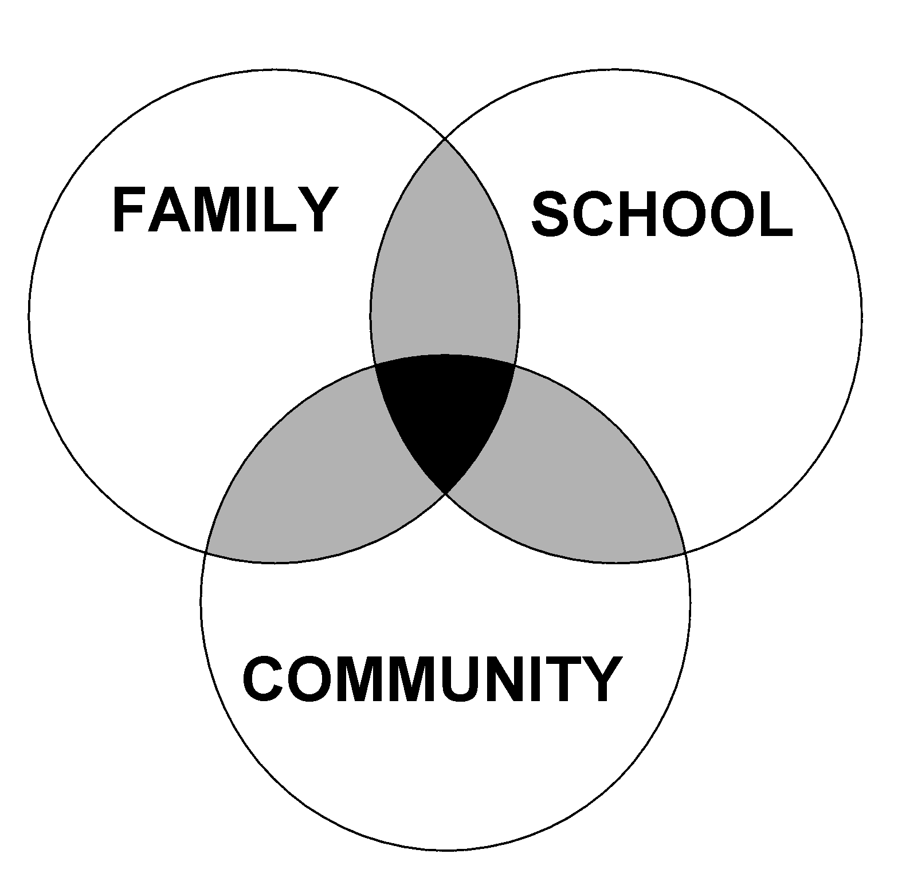
Theoretical Model
OVERLAPPING SPHERES OF INFLUENCE OF
FAMILY, SCHOOL, AND COMMUNITY ON
CHILDREN’S LEARNING
Force C
Experience,
Philosophy,
Practices
of School
Force B
Experience,
Philosophy,
Practices
of Family
Force D
Experience,
Philosophy,
Practices
of Community
Force A
Time/Age/Grade Level
Notes:
This is a theoretical model for how school, family, and community interaction effects children’s learning. It was developed by Dr. Joyce Epstein based decades of research from schools primarily located in Baltimore City. You will see that three entities are represented: Family, School, and Community. Community can include businesses, school alumni, neighbors, parents with children not yet at school age. Each group does some things for students separately, and others together.
What are some sole responsibilities for families? Schools? The Community?
Depending on the extend of collaboration, the spheres either move closer together or farther apart. This model is NOT a Venn diagram. It is a dynamic model that is different for every student and school and can change over time. If the school’s beliefs and values differ greatly from those of the family, the circles will move away from each other. Likewise, if families, schools, and the community unite for a shared goal/vision, the circles will move closer together.
Just think about the answer to this question, you don’t need to vocalize it, but if you were to draw the Overlapping Spheres of Influence Model for you school, families, and community, how do you think it would look? Keep that question in mind as we move throughout the day.

Slide 31
Four Core Beliefs
All parents have dreams for their children and want the best for them.
All parents have the capacity to support their children’s learning.
Parents and school staff should be equal partners.
The responsibility for building partnerships between school and home rests primarily with school staff and especially school leaders.
Henderson, A.T. et al. (2007) Beyond the bake sale: The essential guide to family-school partnerships.
Notes:
Reflection/discussion (brief)
Connections to READINESS!!! NOTE: “parents” here > within our language, “families”
Prompt idea(s):
What beliefs do you have/hold for FSCP? How are these aligned/challenging?
Consider the following four core beliefs to determine schools/districts are ready to partner with families.
Notes:
Dr. Joyce Epstein’s Theoretical Model, The Overlapping Spheres of Influence, states that stakeholders’ philosophies, experiences, and practices impact the extent to which families, schools, and communities collaborate.

Slide 32
Colorado Data
On the Colorado TELL Survey, the teaching condition with the strongest connection to high student achievement and growth is:
Community Support and Involvement
Parents/guardians in the community are engaged, influential, and supportive of teachers and schools
Across all school levels
In each year: 2009, 2011, 2013, and 2015
(New Teacher Center, 2015)
Notes:
COLO data (connect to UIP)

Slide 33
Three-Pronged Support Structure
Family, School, and
Community Partnering for Student Learning
CDE-
193
CDE FSCP CoP
SACPIE

Slide 34

FSCP CoP Active CDE Units, Offices, and Programs
Adult Education and Family Literacy
Colorado State Library
District and School Performance
Dropout Prevention and Student Engagement
Early Learning and School Readiness
Exceptional Student Services
Federal Programs
Health and Wellness
Improvement Planning
Learning Supports
Migrant Education
Standards and Instructional Support

Slide 35
SACPIE Strives To Achieve an Overarching Goal
To partner with Colorado’s families in maximizing the potential of
every student by:
  Reducing dropout rates.
  Reducing gaps in academic achievement
  and growth among student groups.
  Increasing the number of students who continue into higher education.

Slide 36
S.B. 13-193
Increasing Parent Engagement in Public Schools
Solicit parent participation on
school and district accountability committees
(SACs and DACs), including parents
that represent the student population.
Incorporate strategies on the Unified Improvement Plan to increase parent engagement in schools.
Each school district board of education shall adopt a district policy for increasing and supporting parent engagement in the public and charter schools of the district.
Districts shall identify a Family Partnership Liaison as the point of contact for family engagement training
and resources.

Slide 37

Comprehensive, Sustainable Structure
Implementing the Framework of:
National Standards for Family-School Partnerships
    Welcoming All Families into the School Community
    Communicating Effectively
    Supporting Student Success
    Speaking Up for Every Child
    Sharing Power
    Collaborating with the Community
Sharing Leadership
Action Planning
Evaluating
http://www.cde.state.co.us/sacpie/nationalstandardsgoalsandindicators2l
Notes:
Based on current education research, SACPIE recommends that schools and districts in Colorado move away from “random acts of partnership” to instead implement and comprehensive and sustainable partnership structure linked to student learning. Over the past three years, hundreds of schools and districts in Colorado have attended trainings about this comprehensive structure. The four components of this comprehensive structure include:
Implementing the Framework of the National Standards for Family-School Partnerships
Sharing Leadership
Action Planning
Evaluating
Based on Senate Bill 09-90, Colorado aligns its FSCP work with the National Standards for Family-School Partnerships. These standards are a framework for schools and districts to consider when organizing their outreach and partnerships with families. More information on the National Standards for Family-School Partnerships is located on the CDE website, which is at the bottom of the slide.
Sharing leadership is important to include different voices and perspectives on various topics. Sharing leadership may occur in committees already established in schools and districts, such as the accountability committee or parent-teacher groups (PTA or PTO).
It is also important to include FSCP within the Unified Improvement Plan. Family partnerships may be a major improvement strategy of its own but more likely will be embedded within the action plan to accomplish the school’s or district’s goals.
Finally, evaluating individual initiatives and the partnership structure as a whole is critical to sustaining effective and intentional FSCP.

Slide 38
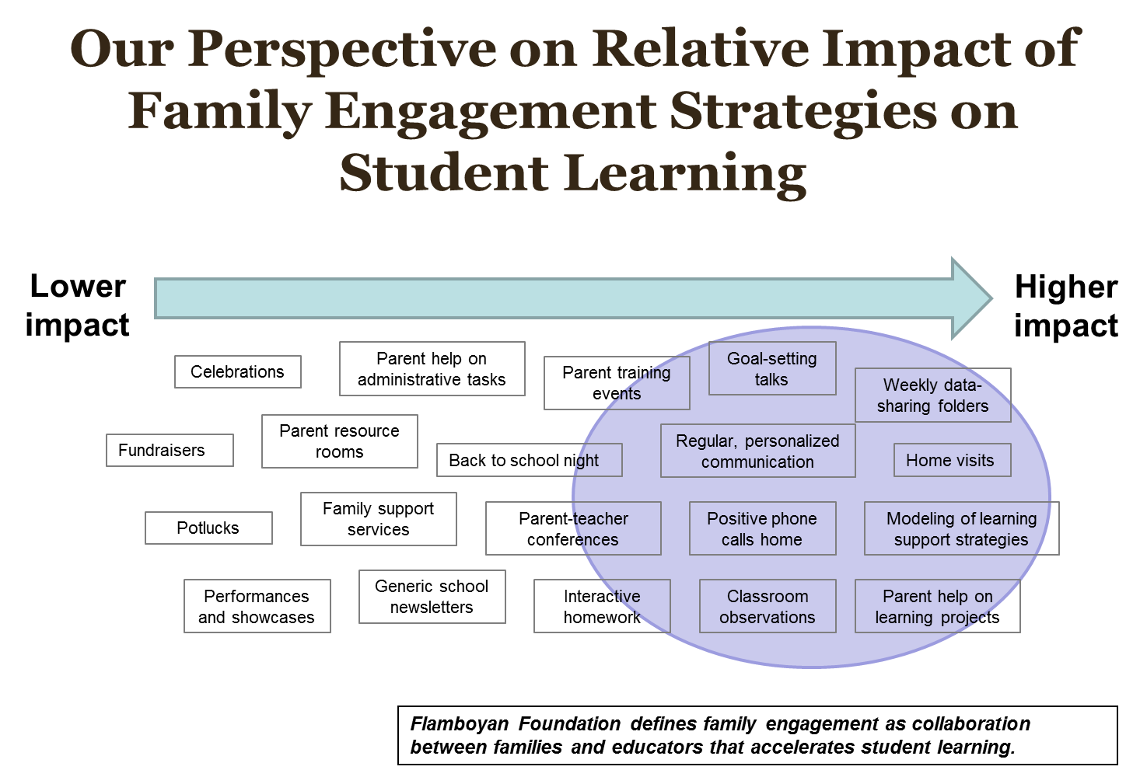
Notes:
Flamboyan Foundation, located in Washington DC, conducted a meta analysis linking FSCP to student learning. This slide shows which activities have a low vs. high impact on student achievement. It’s important to note that the low impact activities are not bad activities to implement. These activities—celebrations, potlucks, performances—are often great first steps to create a welcoming climate of partnership. However, schools and districts should work toward prioritizing the high impact strategies to have the highest impact on student learning.

Slide 39
What is important to know about school, family, and community partnerships?
Not only THAT partnerships contribute
to good schools and
successful students.
But also WHAT is needed in an excellent
partnership program.
and… HOW to organize and sustain
high-quality and effective
programs of family and
community involvement.
We must think in new ways about leadership
for partnerships at all policy levels.

Slide 40

Promising Practices within a
Multi-Tiered System of Supports
Crisis Intervention Team
Public Information Officer
Parent Resource Night
Parent Liaison
Math Night/ Literacy Night
4th of July Fun Run
PenPal Service Project
Poverty Simulator
Parent Classes
Professional Development
YMCA Bus
Intensive
Targeted
Universal
Notes:
Building a Foundation of Relationship and Community to rely on when more
support is needed.

Slide 41






Case Studies

Slide 42
Reaching Results
Standard 1:
Welcoming All Families
Standard 6:
Collaborating With The Community
Standard 2:
Communicating Effectively
Promising Practices
Standard 5:
Sharing Power
Standard 3:
Supporting Student Success
Standard 4:
Speaking Up For Every Child

Slide 43
CDE Resources
  Family/Parent Resources: http://www.cde.state.co.us/resourcesforparents
  Training Resources: http://www.cde.state.co.us/uip/familyengagement
  Promising Partnership Practices: http://www.cde.state.co.us/uip/promising
  Survey: http://www.cde.state.co.us/uip/school_family_community_partnership_survey
  Colorado Academic Standards Parent Guides: https://www.cde.state.co.us/standardsandinstruction/guidestostandards
  Teachers Involve Parents in Schoolwork (TIPS)
  Interactive Homework: http://www.cde.state.co.us/uip/tips_interactive_homework
Notes:
Many of the CDE offices have developed resources to support FSCP. Some of the most general resources are available on the links here.

Slide 44
National Resources
Dual Capacity Framework: http://www.sedl.org/pubs/framework/
National Association of Family, School, and Community Engagement (NAFSCE): http://nafsce.org/
National Network of Partnership Schools at Johns Hopkins University: http://nnps.jhucsos.com/
Harvard Family Research Project: http://www.hfrp.org/
Flamboyan Foundation: http://flamboyanfoundation.org/
Henderson, A.T. et al. (2007) Beyond the bake sale: The essential guide to family-school partnerships.

Slide 45
Action Steps
How might this learning affect/impact
your thinking?
What might you consider for changing your practice or your system?
What resources/supports might you need for your next steps?

Slide 46

Thank you!
Contact | Phone | Email
Darcy Hutchins Colorado Dept. of Education Family Partnership Director | 303-866-5921 | hutchins_d@ cde.state.co.us
Michelle Nay Lewis-Palmer School District Parent Liaison | 719-433-5672 | mnay@ lewispalmer.org
Kim Watchorn Colorado Dept. of Education MTSS Specialist | 303-866-6262 | watchorn_k@ cde.state.co.us

Slide 47

This CDE guidance document is meant for clarification, is not legally binding, and is not to be confused with legal advice. This guidance reflects CDE’s recommendations, but Administrative Units (AUs) may have developed their own policies or procedures that differ from those described herein. Be sure to refer to your local AU’s policies and procedures through your Director of Special Education. If you are seeking legal advice, please contact your legal counsel.
The contents of this handout were developed under a grant from the U.S. Department of Education. However, the content does not necessarily represent the policy of the U.S. Department of Education, and you should not assume endorsement by the federal government.

