Slide 1
GAINS Colorado Department of Education LEA Fund Requests Training Module

Slide 2
Fund Request Entry Page
Access from Left Nav: Fund Requests >> Fund Requests
Choose FY and Funding Application
Available Budget: Lesser of Approved Budget and Pending Allocation
Total Available Amount: Factors in Funding % of Allocation Sources
Net Available Amount = Total Available – Received Amount
Pending Fund Requests shows an amount when there is a request in progress or ‘None’ when no pending request

Slide 3
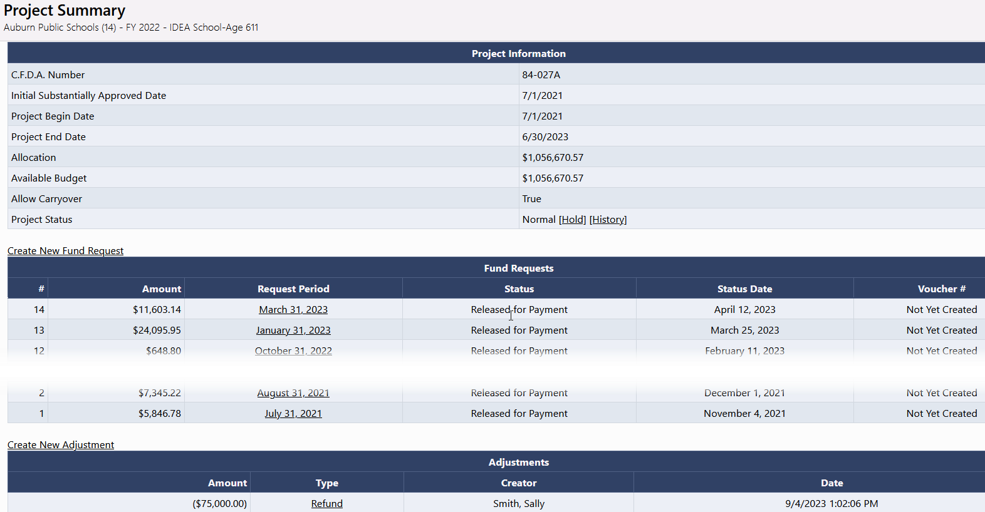
Project Summary / Fund Request List
Displays general grant information
List of Requests for this grant
List of Adjustments for this grant
Project Hold Administration

Slide 4
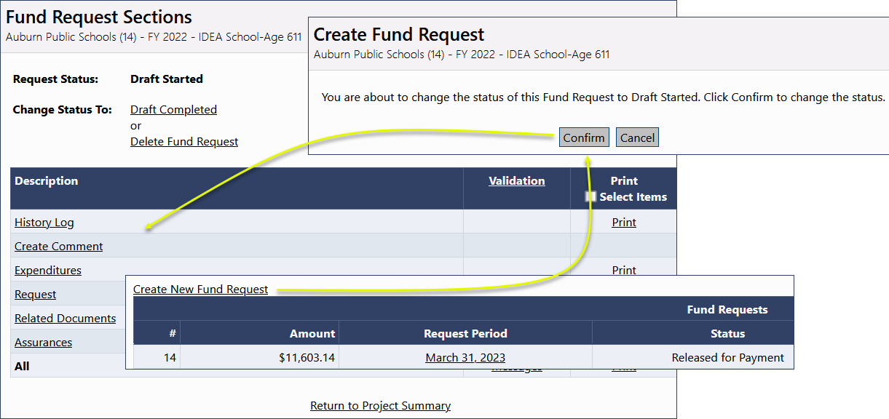
Creating and Completing Fund Requests
Fund Requests cannot be created until the grant budget is approved
One active Fund Request per LEA/Grant/FY combination
General Framework consistent with Funding Application
Sections - History Log and Communication - Validation - Workflow
Fund Requests for state grants will automatically generate upon application approval

Slide 5
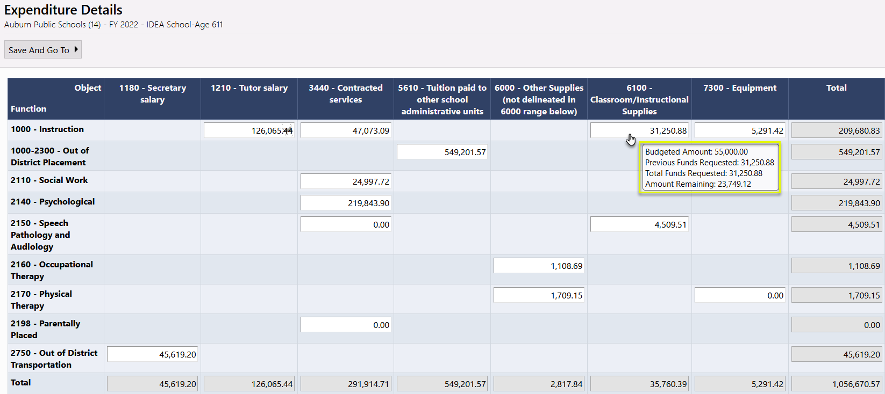
Expenditure Details Page
Report year-to-date Expenditures by Object and Function Item
Only displays rows and columns that contain approved budget amounts
GAINS validates expenditures against approved budget
Hover on cell to see approved budget amount
Disabled cells where no approved budget exists
Automatically populates expenditures from previous request
Just update cells that have changed

Slide 6
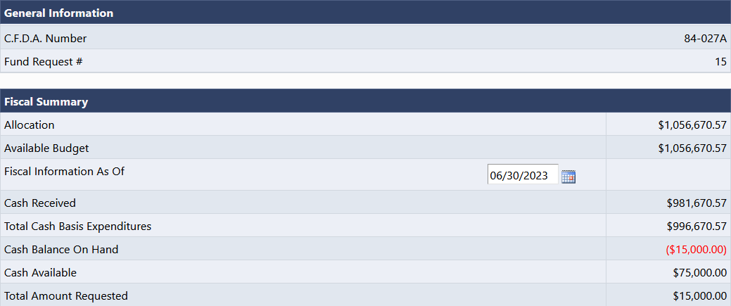
Request Page – Fiscal Summary
System knows and automatically populates most fields
Total Cash Basis Expenditures comes from Expenditure Details page
Calculates amount of the request automatically using total expenditures minus cash received

Slide 7
Related Documents Page
LEA may be asked by CDE to upload backup documentation detailing their expenditures
Document types allowed include PDF, Word, Excel, PowerPoint

Slide 8
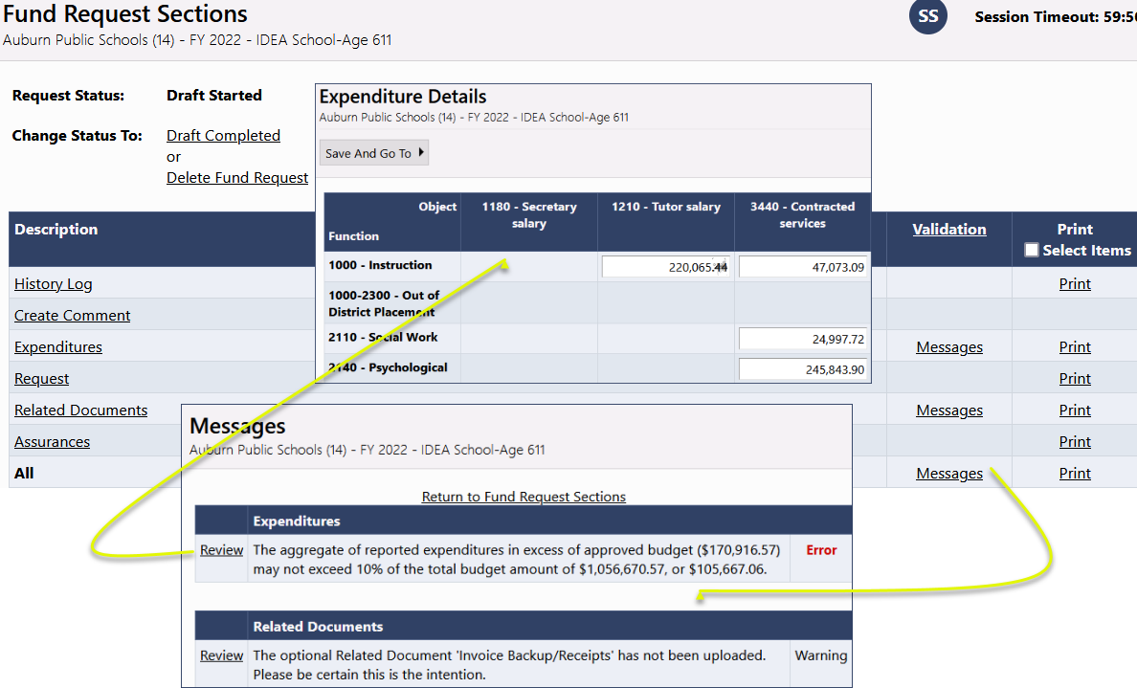
Validation
System automatically validates Fund Requests as they are completed
Errors will prevent submission; warnings will be called out but allow submission

Slide 9
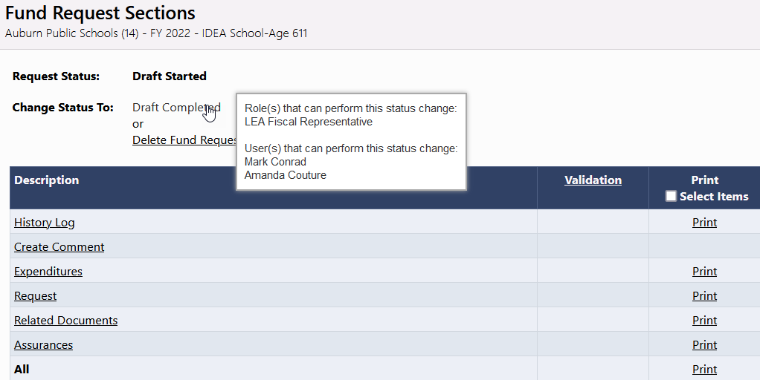
Submission and Review
Once a request passes validation, the LEA Fiscal Representative may move it to Draft Completed
Request is then sent to CDE for review

Slide 10
Fund Request Approval Steps
Status | Role Needed
Draft Started | LEA Fiscal Representative
Draft Completed | LEA Fiscal Representative
Fiscal Analyst Approved | SEA Fiscal Analyst
Grants Fiscal Management Approved | SEA Grants Fiscal Manager
Released for Payment | SEA Fiscal Payment Batch Approver

Slide 11
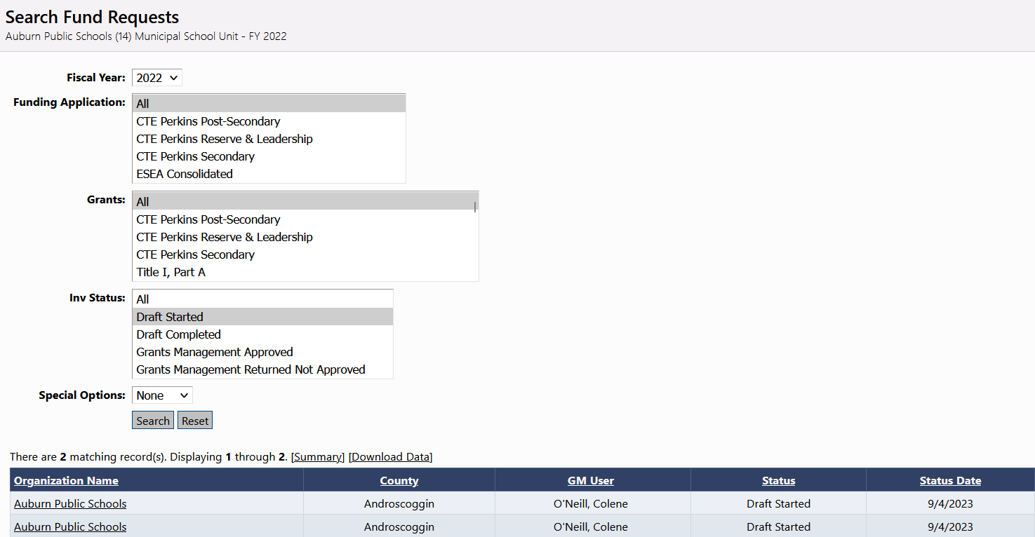
Search Fund Requests
LEAs have a search tool that will allow them to quickly find Fund Requests
From left navigation: Fund Requests >> Search Fund Requests

Slide 12
Demonstration

