Slide 1
GAINS Colorado Department of Education LEA Funding Application Training Module

Slide 2
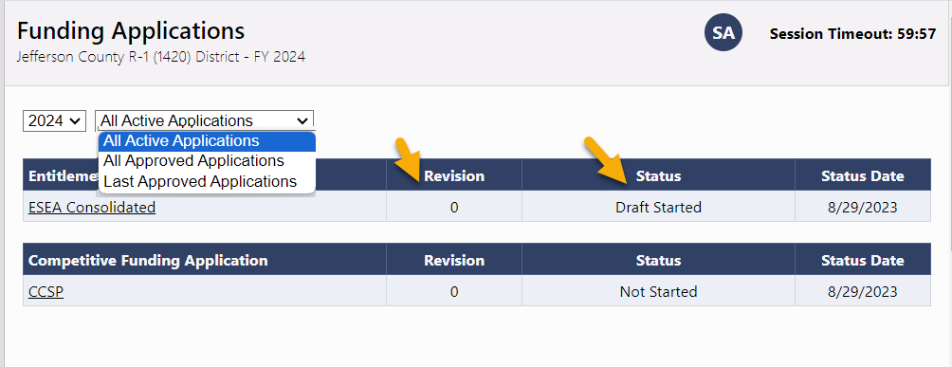
Funding Applications Page
Funding Application: contains one or more grants that go through workflow together
Grant: has a single budget and possible associated detail pages
Funding Applications page is access point for all current and past funding applications for the organization
Organized by Entitlement and Competitive types
Displays revision number and status of each
2

Slide 3
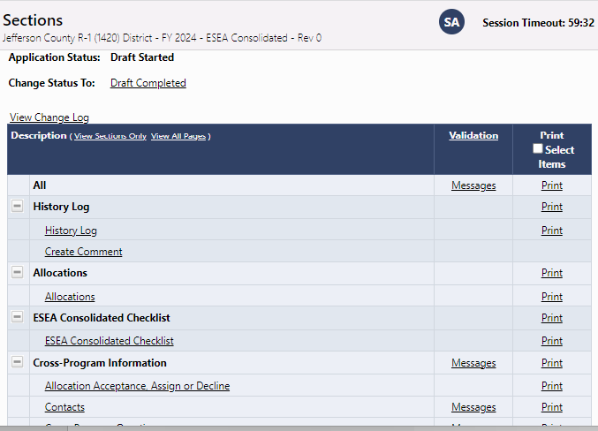
Sections Page
Common to ALL components
Change statuses
History Log, Comments
Change Log
Grant and General Sections
Links to application pages
Print
“Messages” show warnings and errors
Sections can be collapsed or expanded
Checklist (for SEA review)

Slide 4
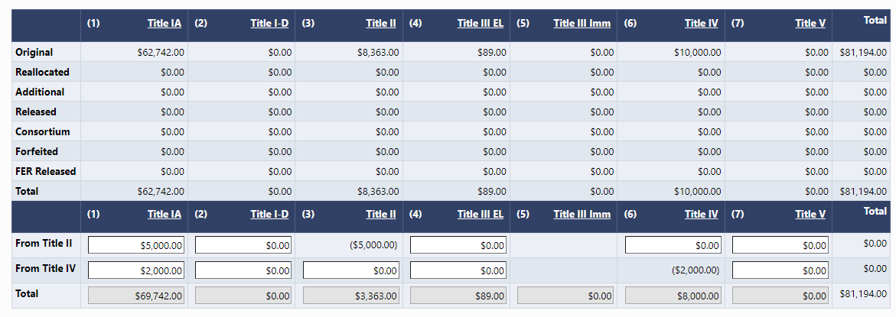
Allocations Page
Read-only page (except for Consolidated) showing allocations
Competitive grants display $0 until grant is approved
Users can make allowable transfers between grants in Consolidated application
Consortium line reflects movement of funds in a consortium

Slide 5
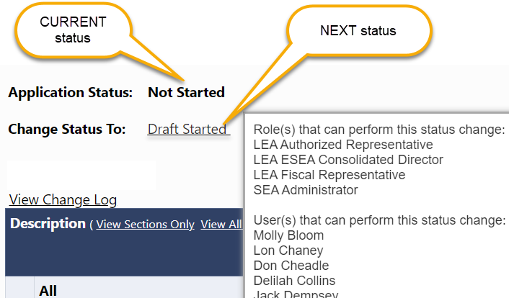
Statuses
Hovering over Change Status To displays users who can change status
Only applications in Started or Returned to LEA allow editing
Tip: Funding Application must be moved into Draft Started status before it can be edited
Statuses
Not Started
Draft Started/ Revision Started
Draft Completed/ Revision Completed
LEA Fiscal Representative Approved or Returned
LEA Authorized Representative Approved or Returned
SEA (Funding Application) Consultant Approved or Returned
SEA (Funding Application) Director Approved or Returned

Slide 6
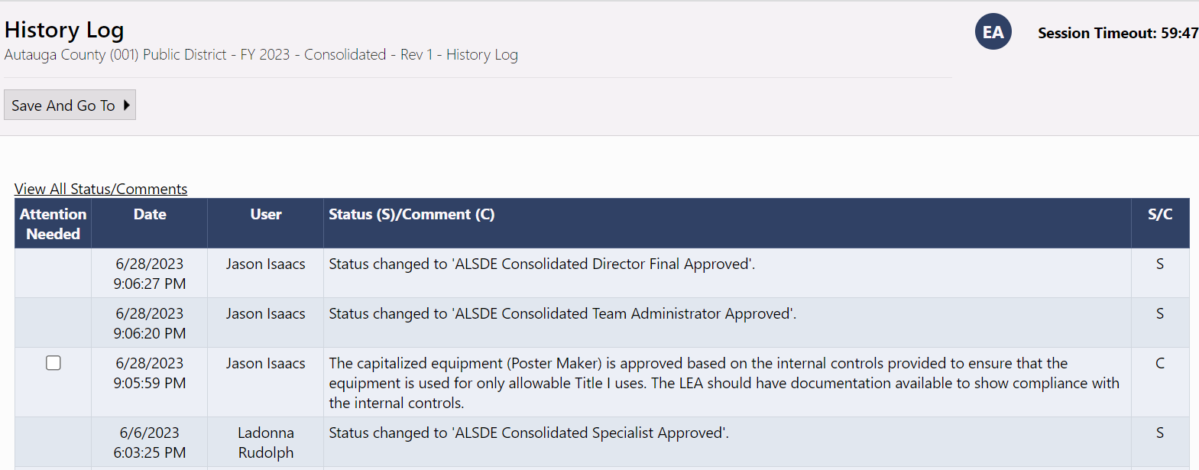
History Log
History log lists all status changes and comments related to the funding application by user and time stamp
864-216-4338

Slide 7
Comments
Comments are ongoing notes and discussion between SEA and the LEA related to a funding application
Comments can be made by anyone with access to the application at any time, regardless of status
Can be emailed to intended recipients
Comments are saved within the funding application
Not visible to public users

Slide 8
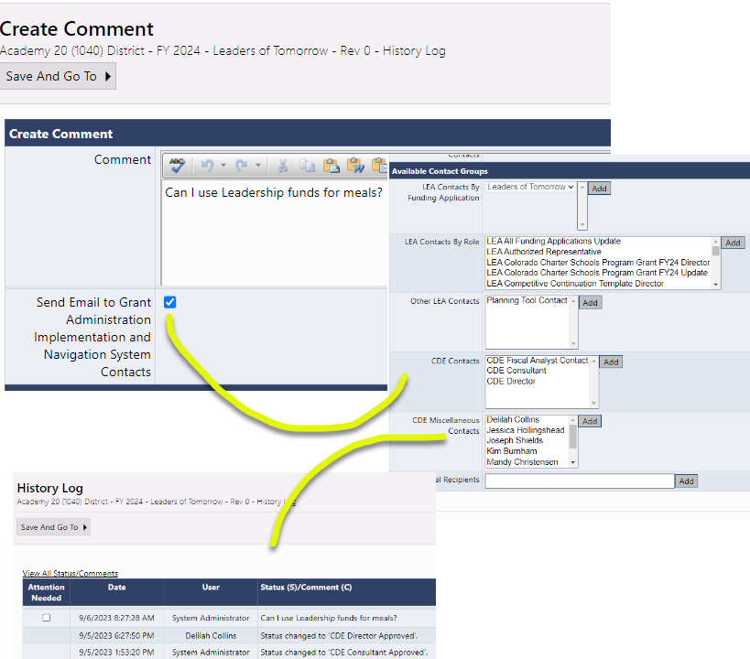
Comments

Slide 9
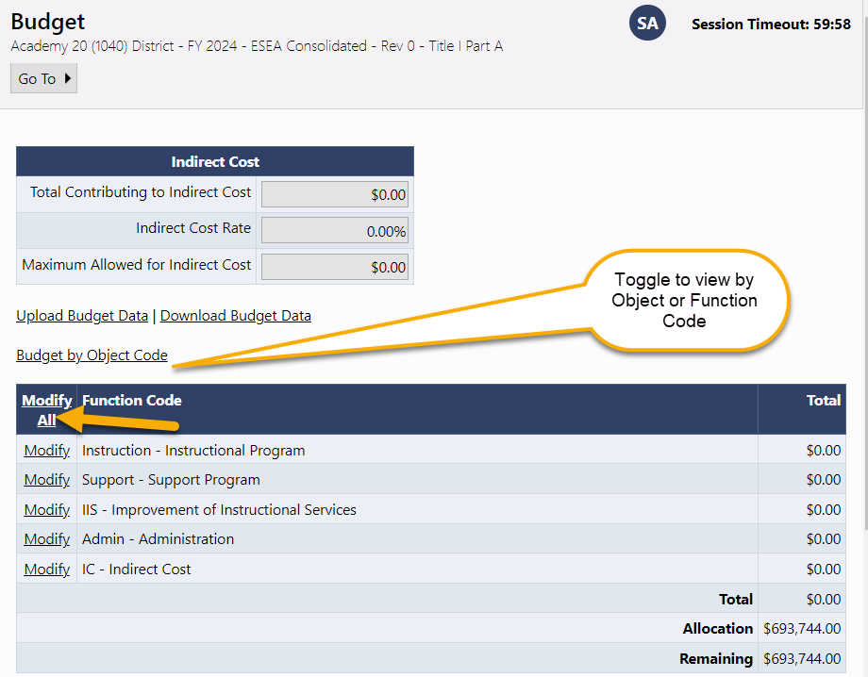
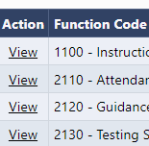
Budget Page
Summary of budget by Object or Function
Access Budget Detail page by clicking on Modify All
If the Action shows View, line items can be seen but are not editable
Upload/Download Budget details used by districts with large number of budget details to view and modify at one time

Slide 10
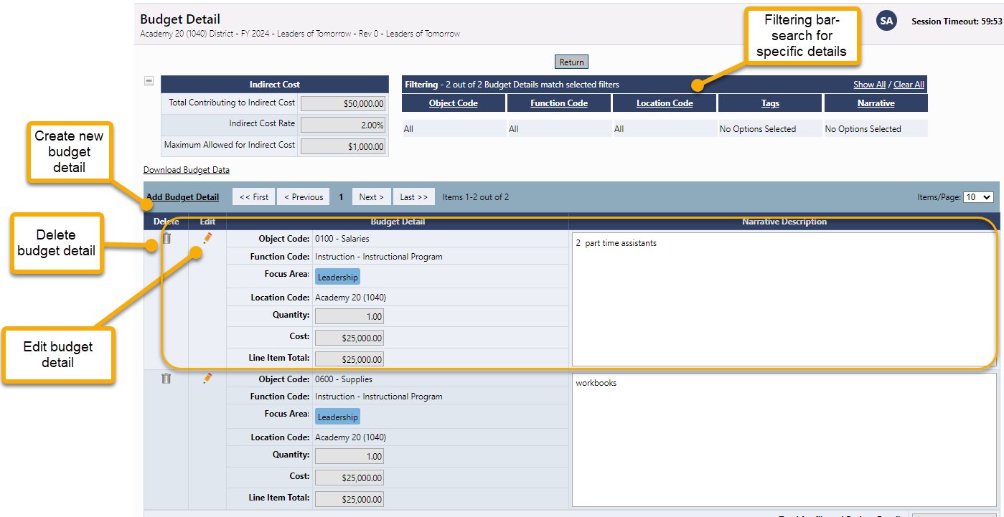
Budget Detail Page
Click the Add Budget Detail link to create a new entry.
Edit or delete existing budget details
Filtering bar for finding a group of or a specific detail

Slide 11
Creating a Budget Detail
Select Function Code from drop-down
Select Object Code from drop-down
Tags (Varies by grant, may not be an option) – identifies additional attributes of a budget detail, used for filtering and reports
Location (optional) – default is district level, lists all schools
Quantity multiplies the cost field and is usually left at 1.
Enter Cost. (Total cost if quantity is left at 1.)
Enter narrative description - required
Click Create. (Update for editing)

Slide 12
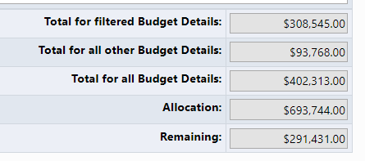
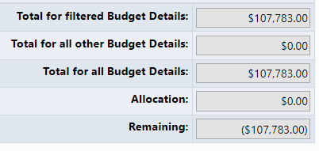
Completing the Budget
Continue creating Line Items until the Total for all Budget Line Items equals the Adjusted Allocation.
Total for filtered Budget Details displays the total for details if a filter is applied
Total for all Budget Details is the current total of the budget
“Remaining” reflects the amount of the Allocation still to be budgeted.
Competitive Grant initial application will not have an allocation and "Remaining" will be a negative number.
Grant will allocation
Competitive Grant initial application

Slide 13
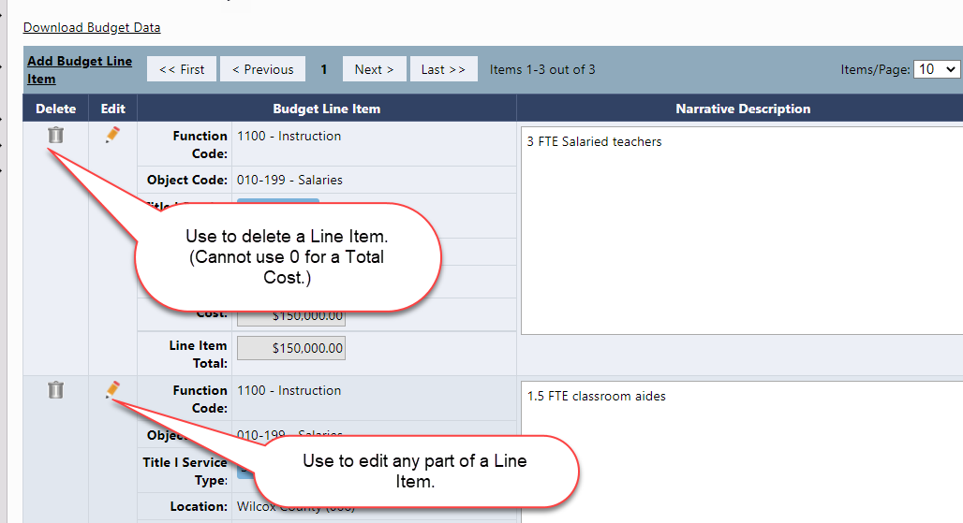
Edit Budget Details
To edit any part of a budget detail , click on the Pencil Icon in the Edit column, make changes and click Update
To delete a budget detail, click on the Trash Can icon in the Delete column.

Slide 14
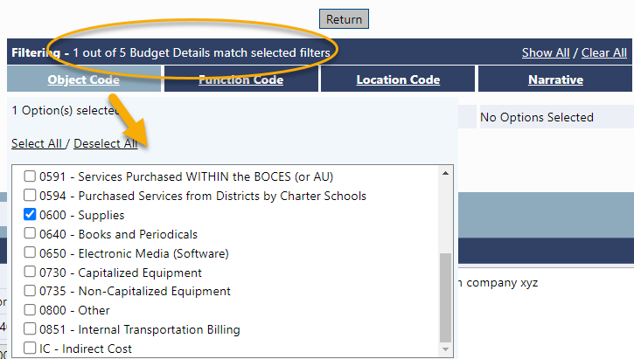
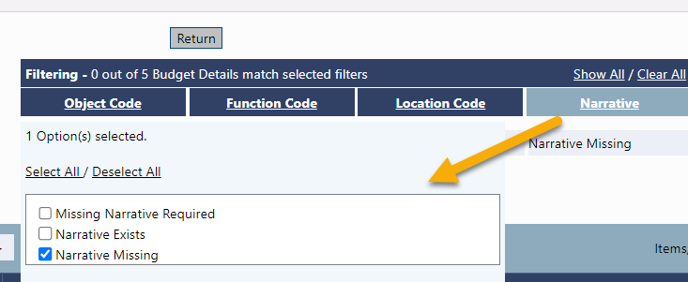
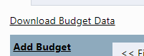
Filtering Budget Details
Use filtering bar to see specific groups of details, e.g. total of all supplies, find missing narratives
Click a filter heading to see/select options
Click on Show All to see all line items.
Header shows how many line items are shown and exist
Download Budget Data downloads visible details, useful for filtering
Notes:
Title IV wilcox

Slide 15
Budget Overview
Non-editable grid view of budgeted code subtotals
Can be filtered by locations
Can show all possible category/object code combinations by selecting Show Unbudgeted Categories

Slide 16
Budget Overview Plus/Minus
Read-only page that appears in revisions only
Shows any budget changes in category/object code from previous revision
Red number indicates the amount of reduction
Green number indicates amount of increase

Slide 17
Demonstration

Slide 18
Break

Slide 19
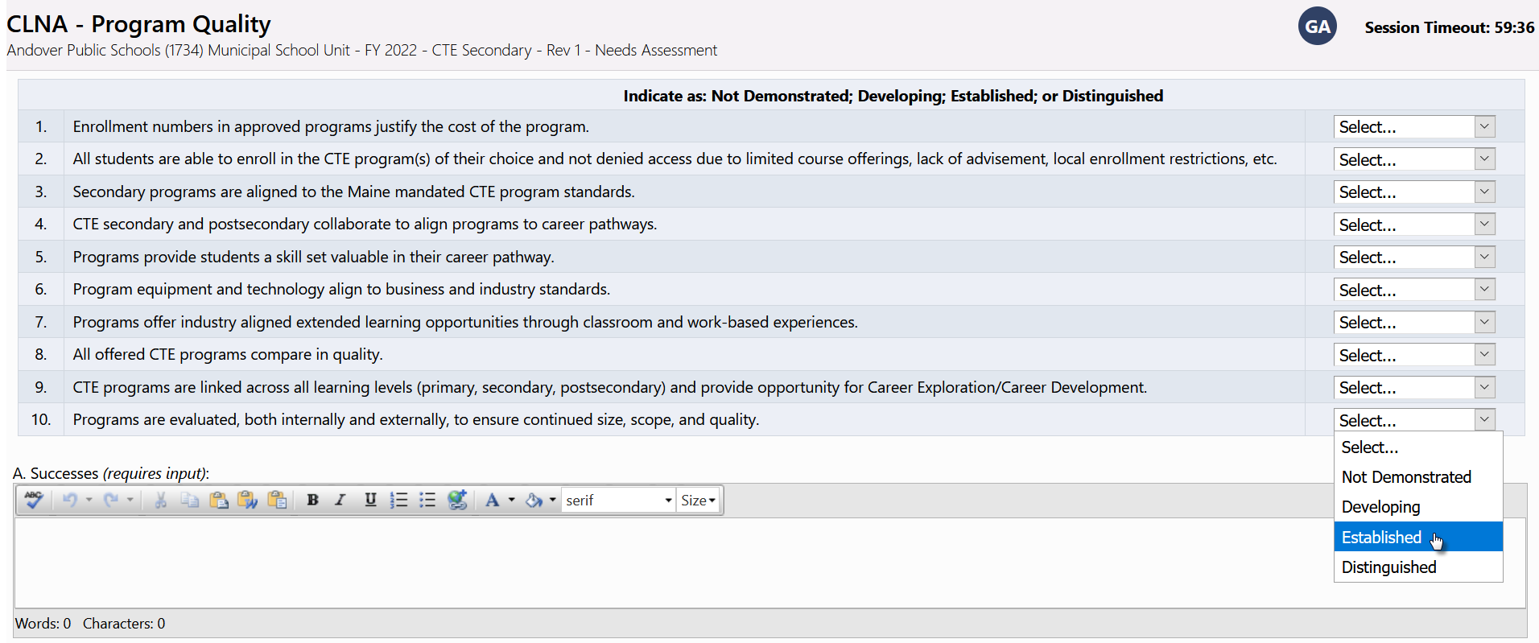
Program Detail Pages
Additional information about an LEA’s application beyond what is captured in budget
Some applications have multiple Program Details pages with a different page title for each
Entered directly into GAINS by LEA users
If item has an * next to it, it is required and a response must be entered

Slide 20
Program Detail Pages
Common Types of Data
Numeric
Short Text response
Narrative – Rich or Plain Text
Dropdown List / Radio Buttons
Checkboxes
Checkboxes that enable or disable a subsequent range of questions
Date Picker
Grids allowing multiple responses (“Add a Row”)
Document Uploads
Read-only fields calculating amounts based on entries in other fields
Read-only LEA-specific values populated by CDE

Slide 21
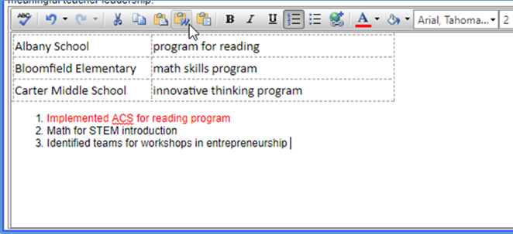
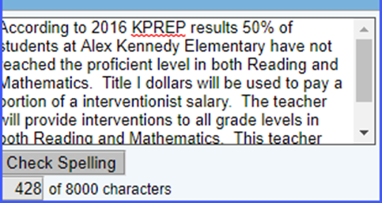
Text Boxes
Rich text
Plain text
Format Text from toolbar
Copy and Paste formatted text
Spell Check
Large amounts of text
Copy and Paste text only
Spell check
Limited to # of characters
21

Slide 22
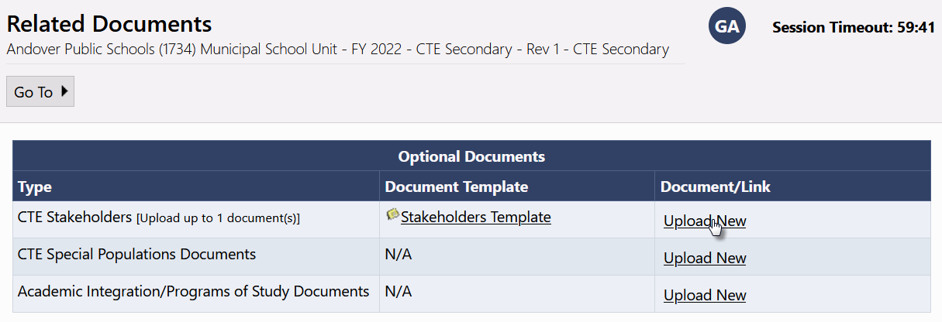
Related Documents
CDE may request that LEAs attach additional documentation to funding application
CDE can provide document template
Documents may be required or optional
Clicked links will open in new browser window

Slide 23
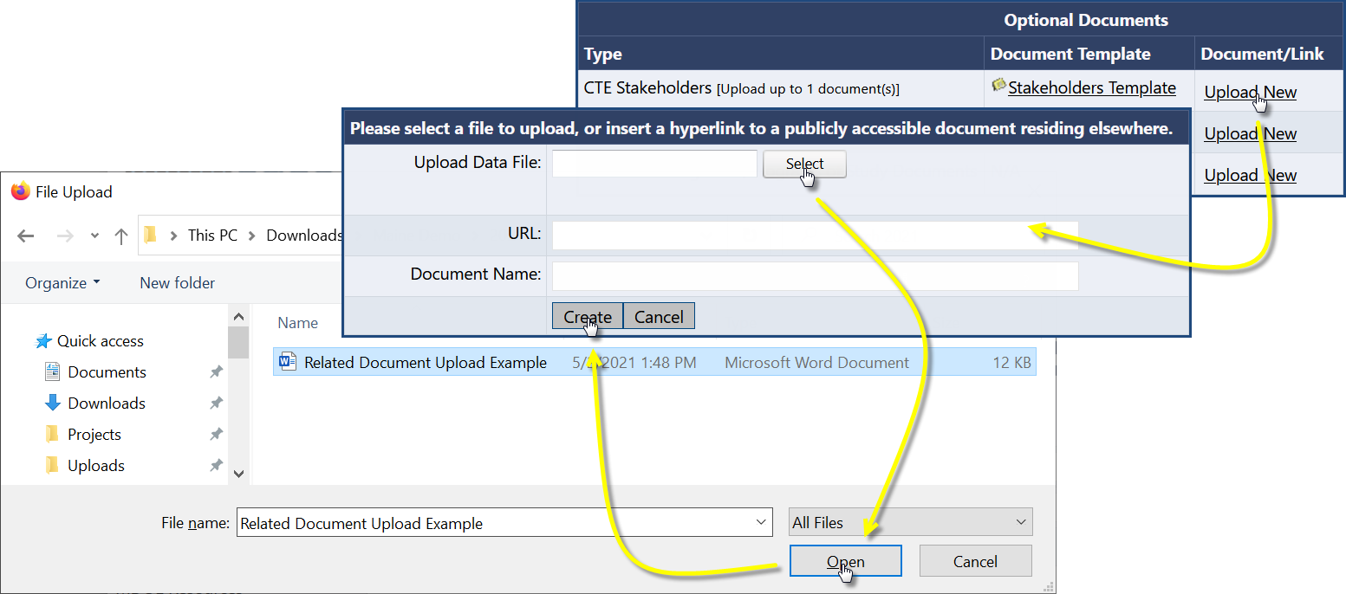
Adding a Related Document
Browse for file to upload, or enter a URL
Make sure URL is for a publicly accessible web page
Optionally enter a Document Name

Slide 24
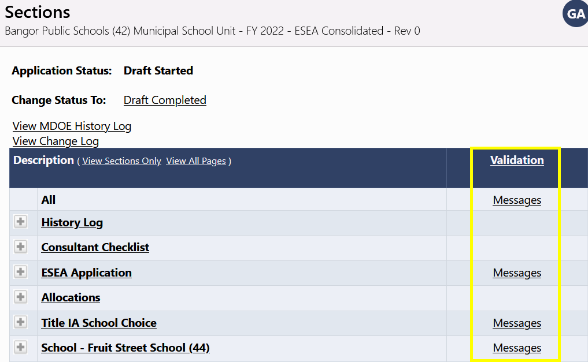
Validation
Business rule checks put in place to ensure quality of data being submitted by district
System automatically runs validation as application is completed
Presence of validation issues indicated on the Sections page, under the Validation column
Messages do not appear on the page as user fills out data
System does not prevent saving of “invalid” data; prevents submission of invalid data
Validation checks can span pages
“Invalid” data can become valid based on subsequent input

Slide 25
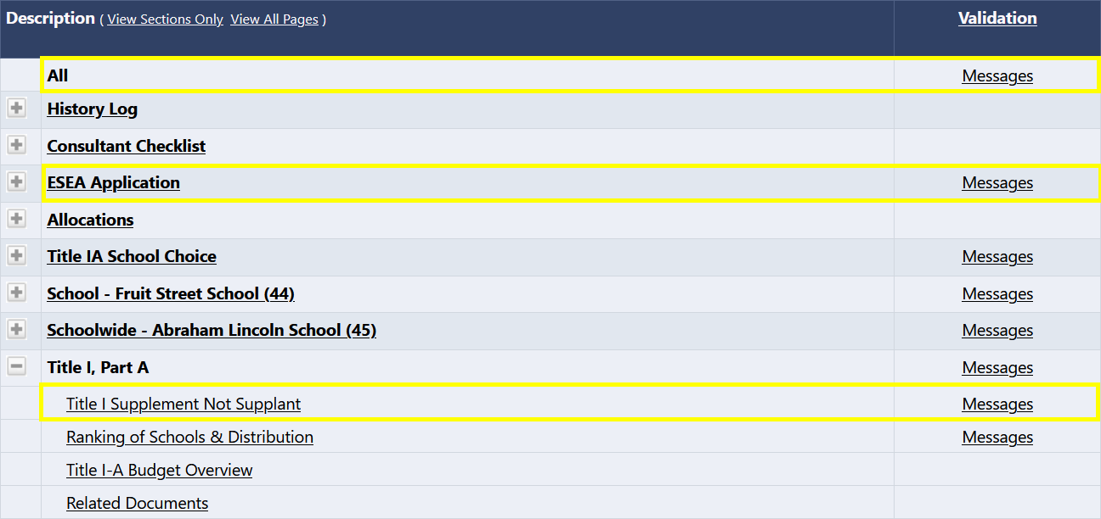
Validation…continued
Two types of validation messages
Errors: Prevent submission of application
Warnings: Point out potential issues but allow submission
Filtering Messages
All: Show every message
Section: Show all messages for pages in that section
Page: Show all messages for that page

Slide 26
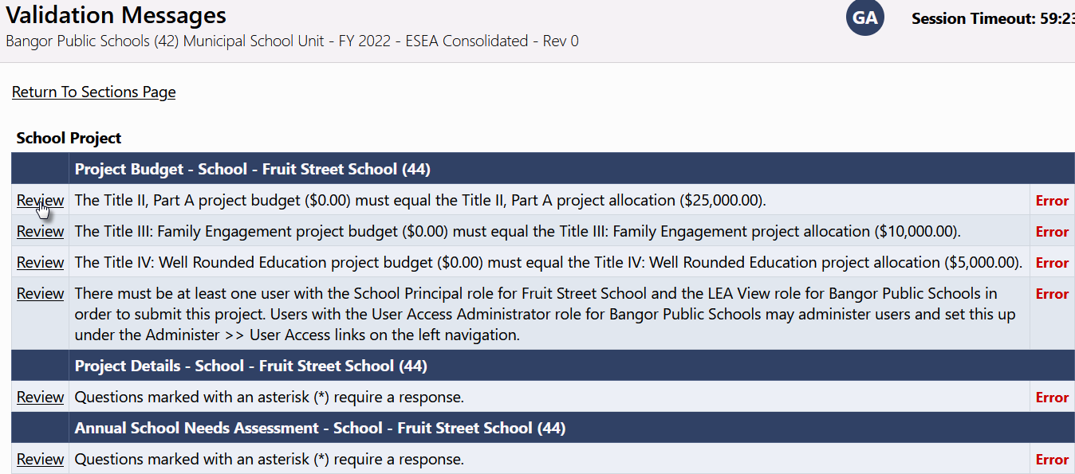
Validation…continued
Each message contains a clickable “Review” link
Clicking link will take user to the screen on which the issue occurred

Slide 27
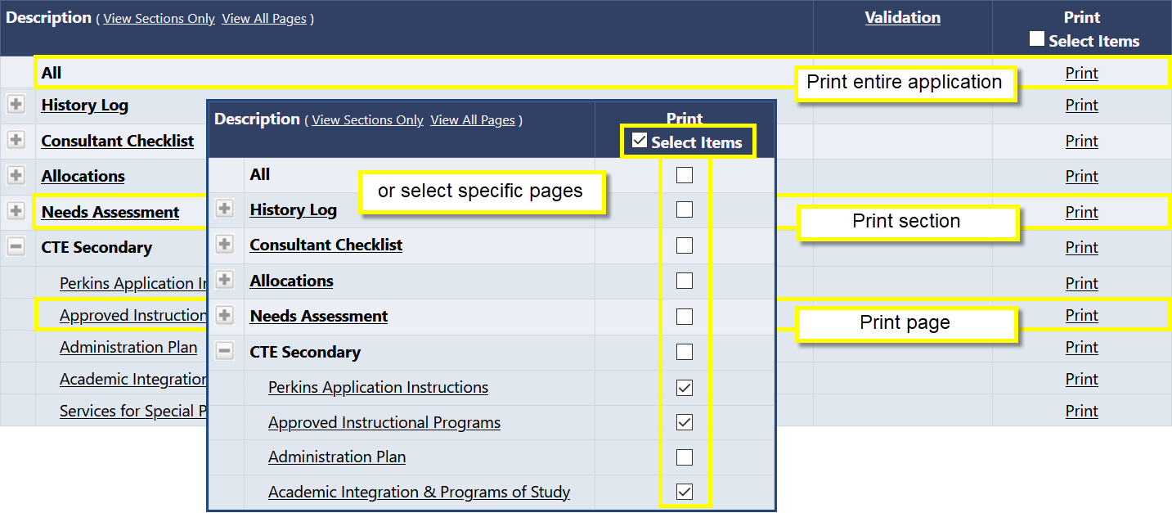
Print – Sections Page
Print from Sections page generates a PDF
Print Levels: All, single section, single page, or multiple individual pages
Click in Print checkbox to select multiple individual pages
Make sure pop-up blocker is turned off for GAINS

Slide 28
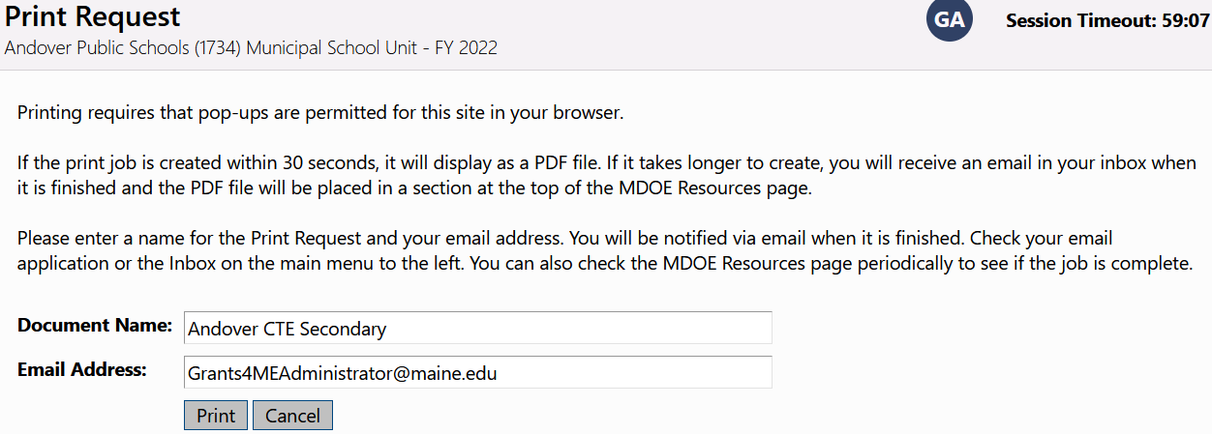
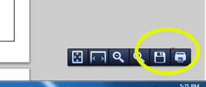
Printing
Small print jobs will be returned and displayed immediately
Larger print jobs (longer than 30 seconds to generate) will send an email when complete
Large print jobs will be available in CDE Resources for the user
Print job displays as PDF
Print or download from PDF

Slide 29
Editing, Submitting, and Reviewing
Role Name | Actions
LEA [Application Name] Director | Move to Draft Started Move to Draft Completed Move to Draft Edits Completed Move to Revision Started Move to Revision Completed
LEA [Application Name] Update | Edit application contents
LEA Fiscal Representative | Edit application contents Move to LEA Fiscal Representative Approved/Returned Not Approved
LEA Authorized Representative | Edit application contents Move to LEA Authorized Representative Approved/Returned Not Approved

Slide 30
Editing, Submitting, and Reviewing
Once application is finished, LEA Funding Application Director should move application to Draft Completed.
LEA Fiscal Representative, then LEA Authorized Representative must review and approve.
Either one can return the application, which will open it for edits.
If CDE returns application to LEA for modification, make requested changes and then move to “Draft Completed” (entitlement grants) or “Draft Edits Completed” (competitive grants)

Slide 31
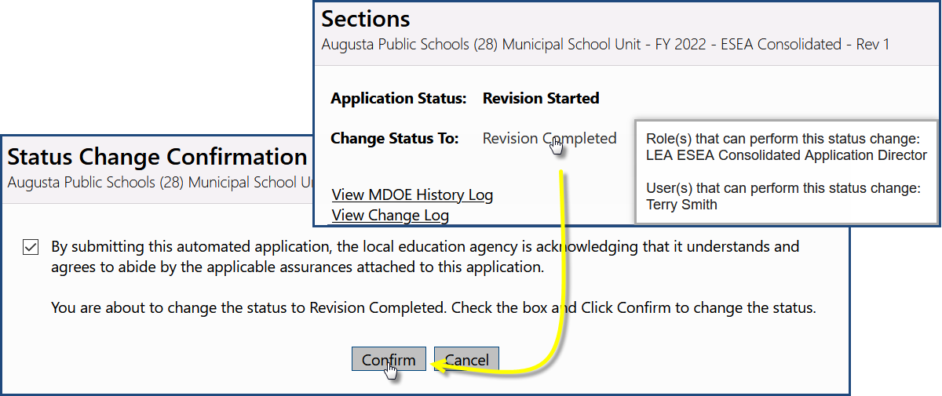
Submission and Review Workflow
Prerequisite checks
Does user have permission?
Does time frame allow for this status change?
Is application valid? (may not run depending on status)
Certain approval steps require that an “Agree To” box be checked, which adds a comment to the History Log

Slide 32
Status Change Outcomes
Entry added to History Log documenting the change
Next person in submission workflow notified by email that application now requires their attention
Application may be locked down or unlocked
Application may become publicly accessible
Application revision may be created

Slide 33
Consultant Checklist
Goes above and beyond system validation to identify qualitative issues with a submitted application
Helps enhance and simplify communication between CDE and district
Allows district to better understand, from the start, what is expected from a quality application
Allows CDE reviewers to provide feedback on common issues without entering extensive narrative describing them
Allows district to easily identify what portions of a returned application require attention

Slide 34
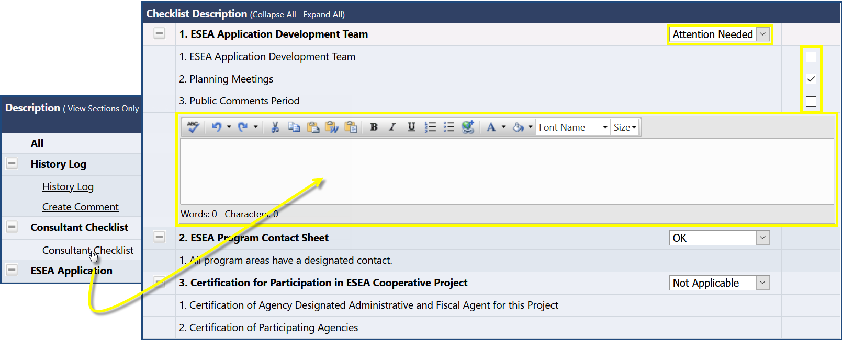
Checklist
Way for CDE to provide feedback to LEA when returning application for updates
Section may be marked OK, Attention Needed, or Not Applicable by CDE
If section is marked Not Approved, CDE Application Consultants can check boxes to call out common issues, or enter narrative describing the issue(s)
If CDE returns application to LEA Not Approved, LEA users should go to Checklist page to identify what issues requires attention, fix them, and resubmit application

Slide 35
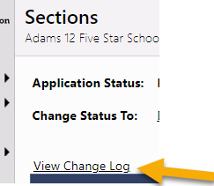
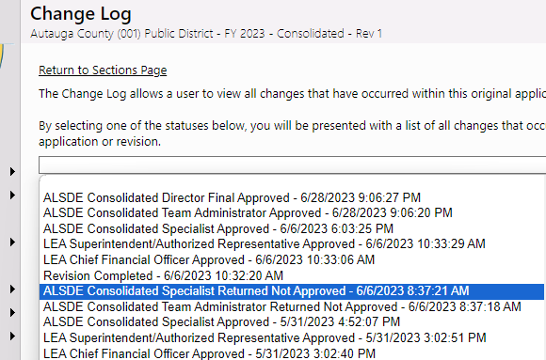
Change Log
View all changes to an application created since a selected status change
Useful to see that all necessary changes are made
Useful for reviewers to identify all changes that need to be approved

Slide 36
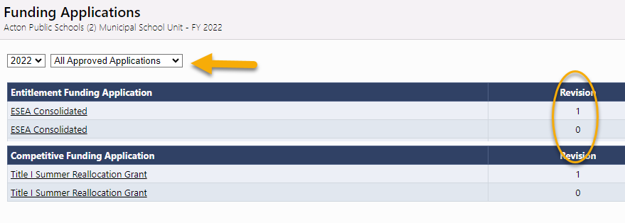
Revisions
Final approval of original submission (Rev 0) locks the data
Changes/amendments occur by starting a revision
Revisions copy the previous version data for editing
Revisions go through an approval process and lock the date when approved.
Each revision saved separately and accessible from the Funding Applications page by selecting All Approved Applications

Slide 37
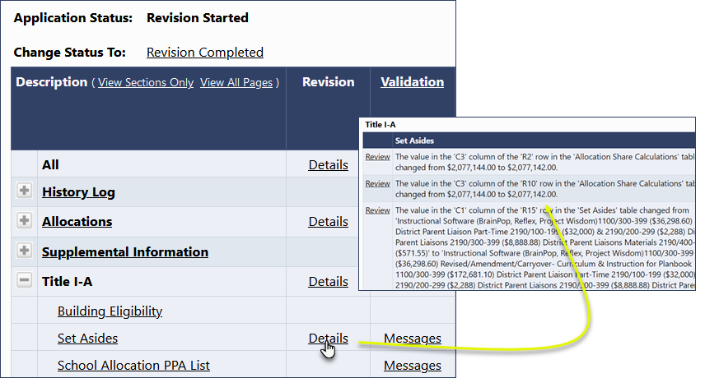
Revisions
Details column on revision Sections page lists changes to page from previous version
No need to review entire application revision
Look at Revision Details

Slide 38
Demonstration

