Slide 1
Alabama State Department of Education GAINS eGrants Management Application
GAINS Colorado Department of Education Basic Site Navigation Training Module

Slide 2
Agenda
Review GAINS format and basic navigation
Menu Items
Review Users and User Roles

Slide 3
Accessing GAINS
For live site - https://colorado.egrantsmanagement.com/
Home page has announcements and reminders
Sign In button
Public Access to some menu items

Slide 4
Help Resources
Help Resources can be accessed without logging in
CDE Resources
Library of resource documents: guidance and training documentation
Help for Current Page
Guidance for the page you are viewing (optional)
Contact CDE
Browser requirements and resources
Send help request to CDE

Slide 5
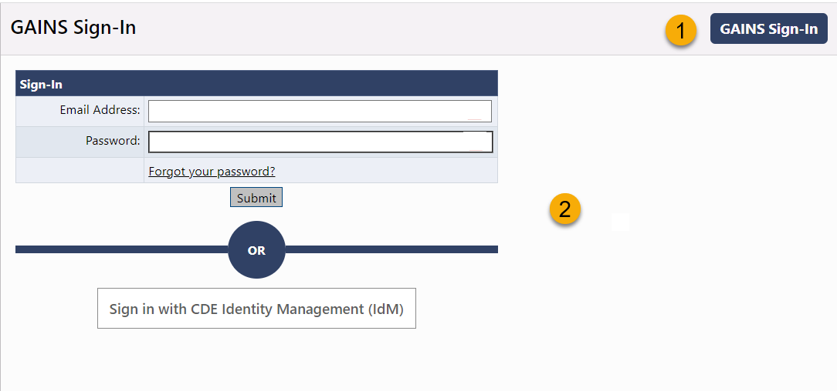
Logging in
Users must have a valid email address and password or an IdM account
For users who are not using IdM
Click the GAINS Sign-in button,
enter Email Address and password
Click Forgot Your Password? to reset password
For users who are using IdM
Click “Sign in with CDE Identity Management (IdM)”
Follow IdM sign-in process then redirect back to GAINS

Slide 6
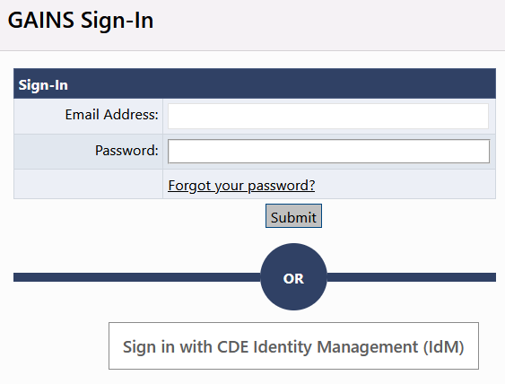
Logging in
District users should use CDE IdM
Community Organizations/those without CDE IdM access should use GAINS’ native authentication
District LAMs will act as User Access Administrators for their districts
CDE will provide additional training to LAMs in first half of October

Slide 7
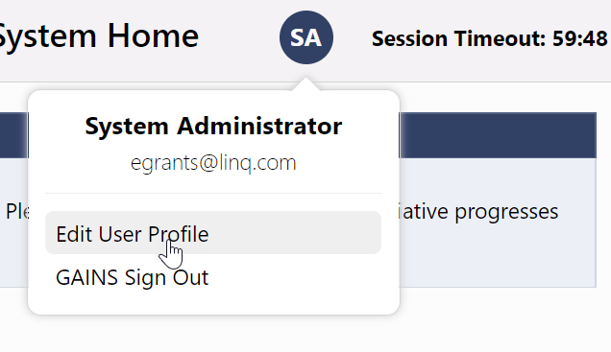
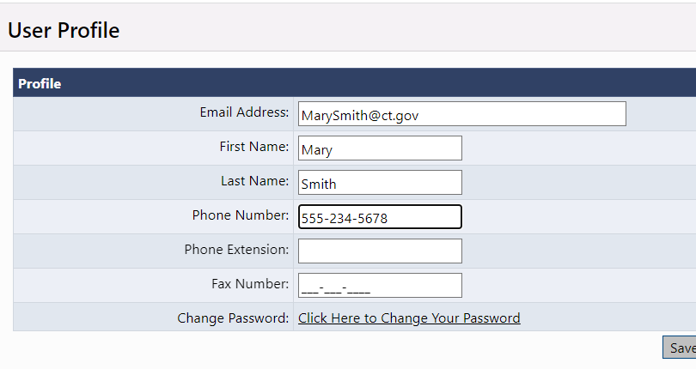
Update name, phone, email
Click on Edit User Profile
Users can update their own name, email and phone information
For users authenticating with IdM, name and email will not be editable

Slide 8
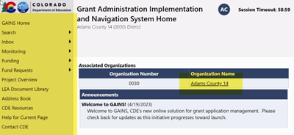
GAINS Navigation Menu
LEA users are automatically entered into their organization unless they have permissions in more than one organization
Left menu for navigation between components
Hover over menu items with arrows to view sub menu

Slide 9
Menu Item Descriptions
GAINS Home – Messages, Login
Administer – (User Access Administrators only)
Search – Search for other organizations and approved applications in other organization
Inbox – Record of system emails to and from user
Monitoring – Access to monitoring instruments
Funding – Access to grant applications
Fund Requests – Access to fund request processes
Project Overview– Overview/details of LEA’s grants
LEA Document Library – LEA-specific location for uploading documents not associated with an application
Address Book – District specific list of users with LEA and SEA roles for an LEA
CDE Resources – Library of training, program guidance, forms
Help for Current Page – Page specific help; number indicates number of help items
Contact CDE– Submit Feedback form to GPA

Slide 10
Roles
A role grants a set of permissions
A user can have more than one role
A role can be assigned to more than one user
A user can have roles in multiple organizations
A user cannot have both an LEA role AND an SEA role
Every LEA organization MUST have an LEA Fiscal Representative and LEA Authorized Representative to submit applications and create fund requests

Slide 11
Roles in GAINS
LEA (Component Name) Director Creates and completes named grant or component
LEA (Component Name) Update Can edit but cannot change statuses
LEA All Funding Applications Update Can edit any funding application but cannot change statuses
LEA Fiscal Representative approves grants or components/ creates fund requests
LEA Authorized Representative final LEA approval, Superintendent or CEO type role
LEA Data View Can view all district content but no editing or status changes
User Access Administrator Manages LEA user roles
SEA (Component Name) Consultant First state level approval
SEA (Component Name) Director Second state level approval

Slide 12
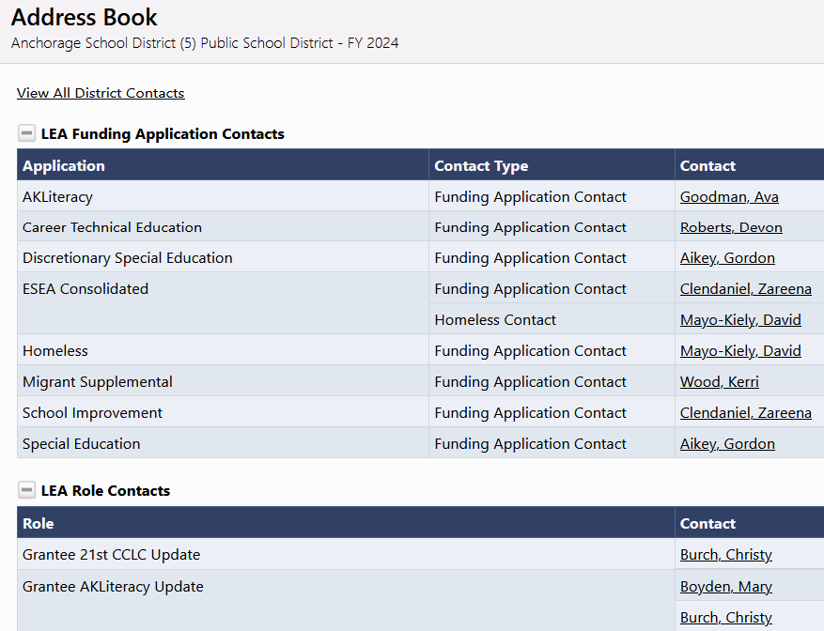
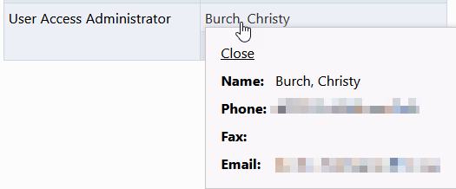
Menu Item: Address Book
Use to identify LEA and SEA roles and contacts in an organization
Can view contact information and launch email
Find User Access Administrator
Selecting the name brings up the email address where an email can be sent
12

Slide 13
Demonstration

Slide 14
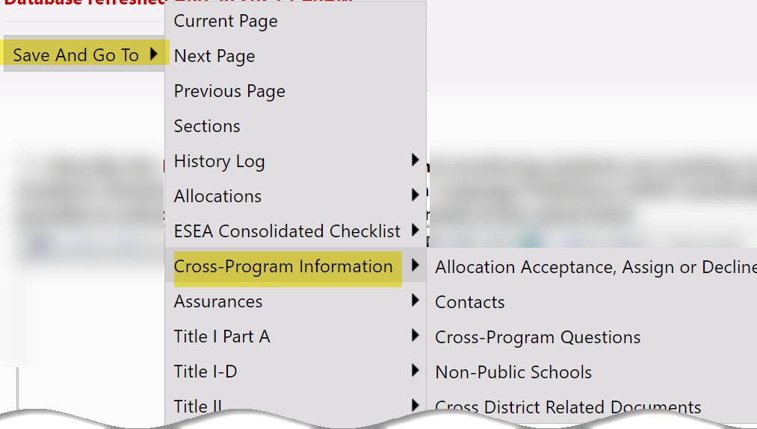
Navigation
DO NOT USE your browser’s back/forward buttons; use GAINS menus and links to navigate
On data pages, use “Save and Go To” or “Go To” buttons
Primary navigation menu on many pages
Saves data on current page; moves to selected page
14

Slide 15
Saving
60-minute session time-out between saves
Using Save and Go To button automatically saves and resets to 60 minutes
Time-out clock shows time remaining before a save is needed.
Save and Go To: Current Page saves, resets time-out clock and allows continued work on a page
Work on current page is lost if browser buttons are used or after 60 minutes without saving

Slide 16
Multiple Users and Page Locking
Multiple people can work in an application at the same time, but multiple users cannot edit the same page simultaneously
User will see message indicating the user that has the page locked
Lock released after that user leaves the page or their session times out

Slide 17
Menu item: Search
Used to find address book and approved applications in other districts
Used by public for access to approved applications
Do not use to find applications in your district; use appropriate left navigation menu item (Funding >> Funding Applications)

Slide 18
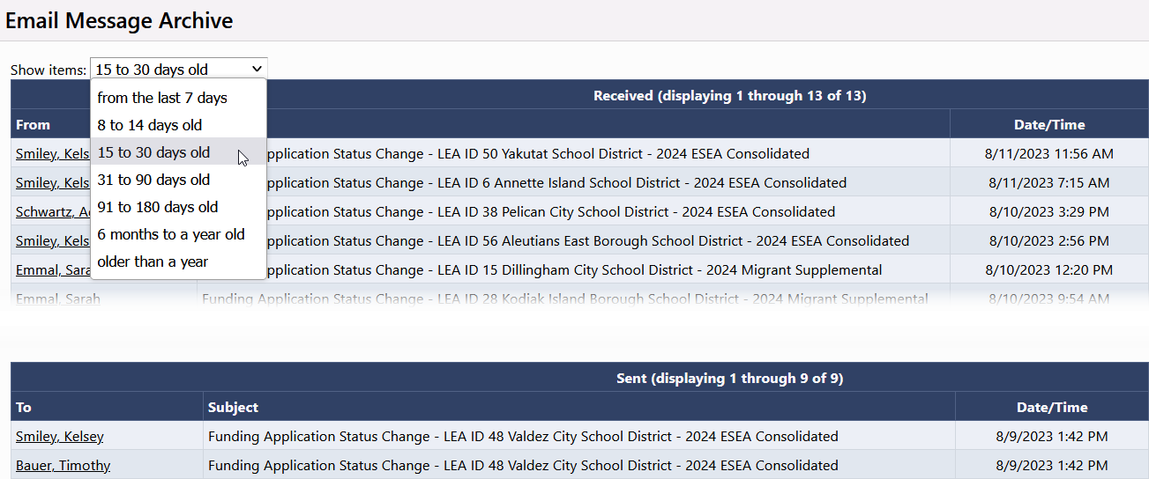
Menu Item: Inbox
Email Message Archive displays all emails generated within GAINS to/from user
Use drop down to select time frame
Find system emails if lost in email client (Outlook, Mail)

Slide 19
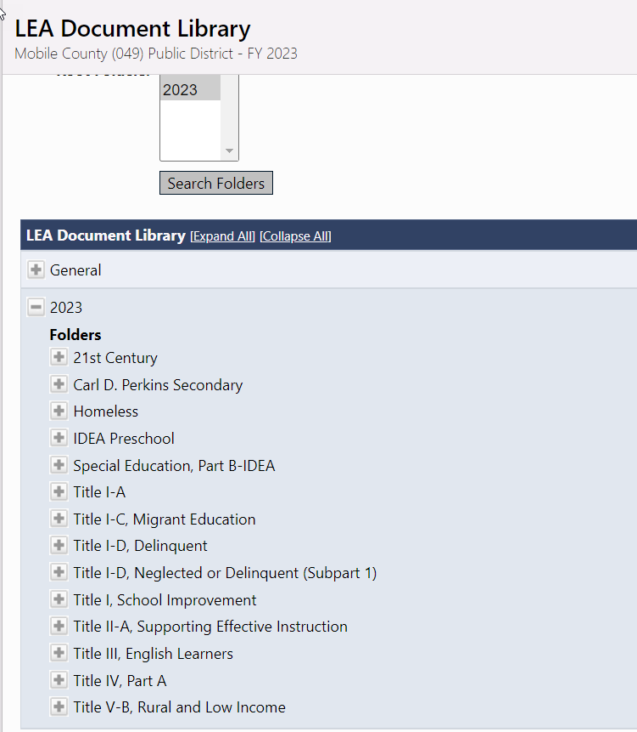
Menu Item: LEA Document Library
District-Specific
Only visible to SEA and users in the district
For upload of documents outside a funding application –exp. Quarterly reports, CCEIS
Only documents applicable to the district are visible

Slide 20
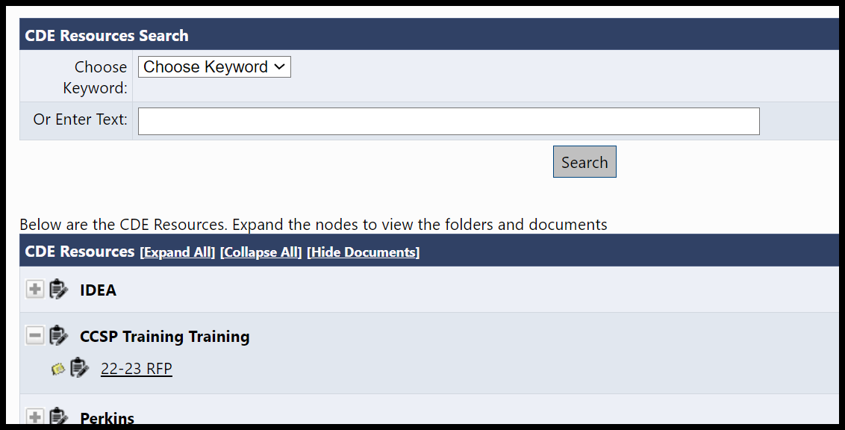
Menu Item: CDE Resources
Resource library of documents, links, forms, guidance, training
Always visible; accessible to public

Slide 21
Demonstration

Slide 22
User Access Administrators
LEA Users with this role can add, modify and remove users from their organization
Users must have a valid email address and password or IdM account log in
DIstrict LAMs will serve as User Access Administrators

Slide 23
User Access: GAINS Native Authentication vs Colorado IdM
GAINS allows User Access Administrators to
CREATE new user accounts in GAINS or
Assign roles to users whose account data has come over from IdM
If using IdM, a user will not be available for role assignment in GAINS until they have logged into IdM and accessed GAINS
The first time an IdM-authenticating user accesses GAINS, they will have no roles assigned to them and therefore will function as a public user
A user created natively in GAINS can be co-opted by IdM
Create sally.smith@denverschools.edu in GAINS
sally.smith@denverschools.edu logs into IdM and accesses GAINS
She must now use IdM to authenticate into GAINS going forward

Slide 24
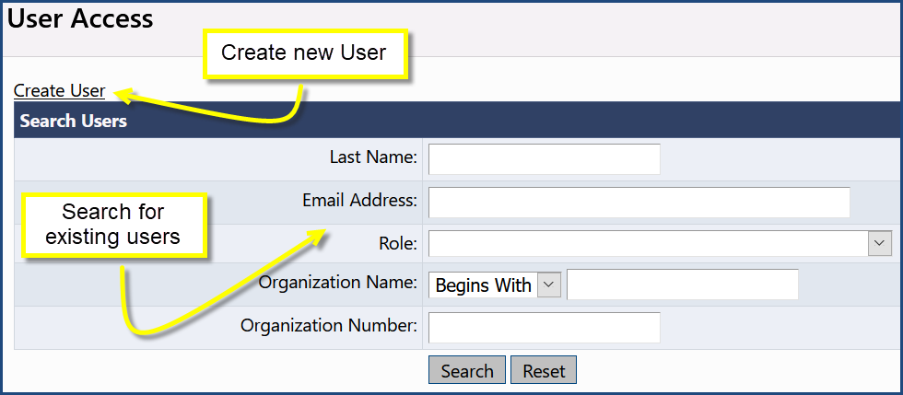
Creating Users
User Access screen
Accessible to User Access Administrators via left nav
Administer >> User Access
Search for existing users
Link to Create New User

Slide 25
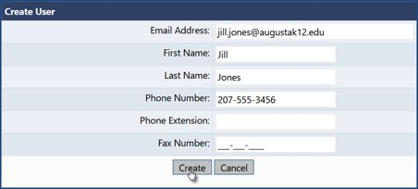
Create User
Enter Email Address, First Name and Last Name
Other fields optional; user can set up themselves after signing in
System sends email to new user when “Create” is clicked

Slide 26
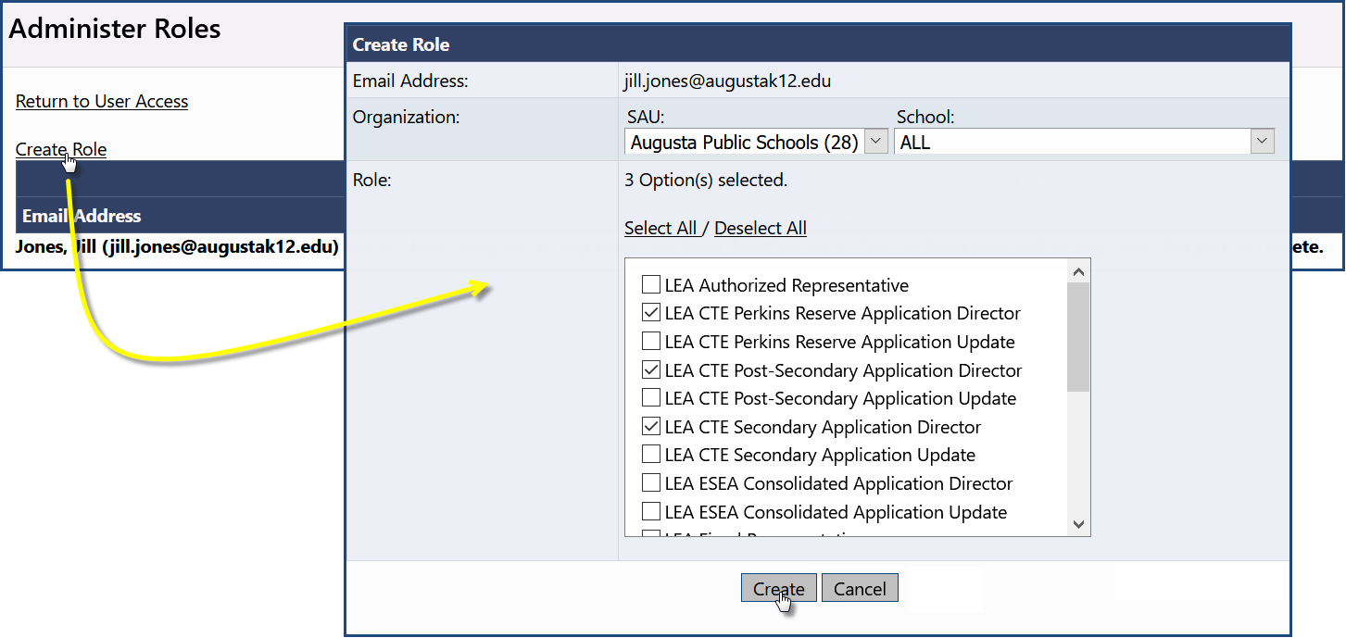
Add Roles
Click on Create Role
Leave School at ALL
Check the box(es) for the appropriate role(s)
Click “Create”

Slide 27
Removing Users
Users cannot be deleted from the system, but all their roles can be deleted, which makes them function as an unauthenticated user
Click the Delete All Roles icon for the desired user
Confirm Deletion
User’s account remains in the system but has no specific authorizations
User now functions as a “public” user

Slide 28
Demonstration

