Slide 1
Completing Funding Applications in GAINS

Slide 2
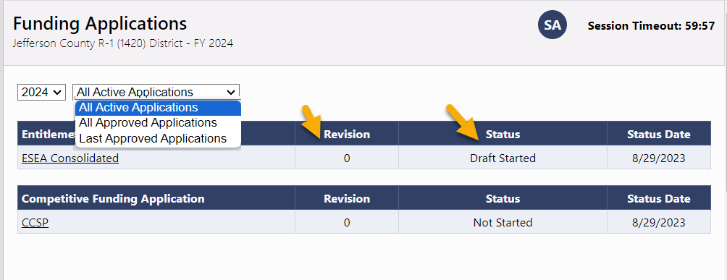
Funding Applications
Funding Application: A Funding Application contains one or more Grants that go through the workflow together.
Grant: A Grant has a single budget and possible associated narrative or program detail pages.
The Consolidated Application is an example of a funding application with multiple grants.
The Funding Applications page is the access point for all current and past funding applications for your organization.
The first section displays entitlement or formula grant applications, and the second section is competitive grant applications.
Each application will display the revision number and status of each grant.

Slide 3
Sections Page

Slide 4
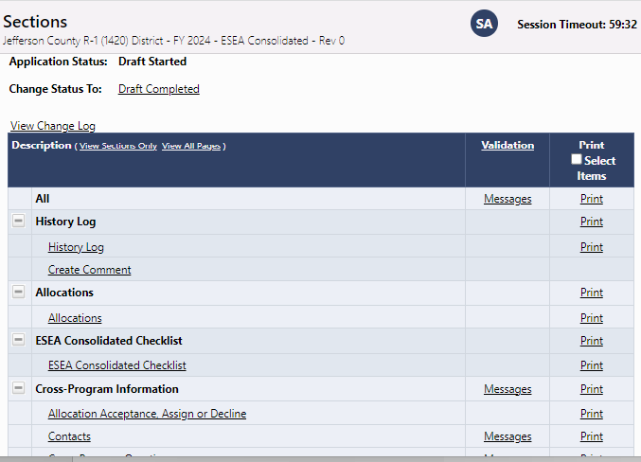
Sections Page
Once you select a grant application from the list, you’ll be taken to the Sections Page.
The Sections Page is common to ALL grants in GAINS.
Here you can change the status of an application; view the History Log, Comments, and Change Log.
Depending on your permission level, users can view and/or edit the grant application and associated sections.
You can also print the application in full or in part.
In the validation column, “Messages” indicate warnings or errors present in the current version of the application.

Slide 5
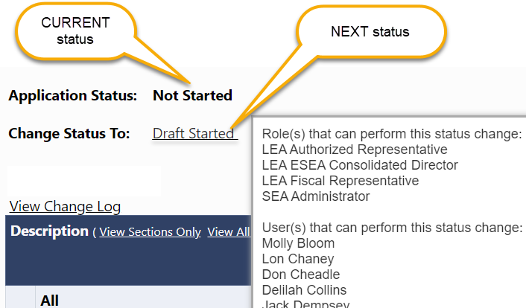
Statuses
On the Sections Page, users can hover over “Change Status To” to display personnel who can change the status of the application.
Only applications in Draft/Revision Started or Returned to LEA can be edited.
To start an application, the status must be changed to Draft Started status before it can be edited.

Slide 6
Different Statuses
An application can display several different statuses:
Not Started indicates that the application has not been opened by the applicant and it is not editable.
Draft Started / Revision Started – the application is open for edits.
Draft Completed / Revision Completed – the application is awaiting approval from the LEA Fiscal Representative.
LEA Fiscal Representative Approved – the application is awaiting approval from the LEA Authorized Representative.
LEA Authorized Representative Approved – the application has been submitted to CDE and enters the review workflow.
LEA Fiscal Representative or LEA Authorized Representative Returned – the application requires revision and is once again open for edits. After edits are completed, the approval workflow begins again.
SEA [Name of Grant] Consultant Approved – the application is awaiting approval from the assigned CDE Director.
SEA [Name of Grant] Director Approved – the application has received final approval from CDE.
SEA Consultant or SEA Director Returned – the application requires revision and is reopened for the applicant to make changes.

Slide 7
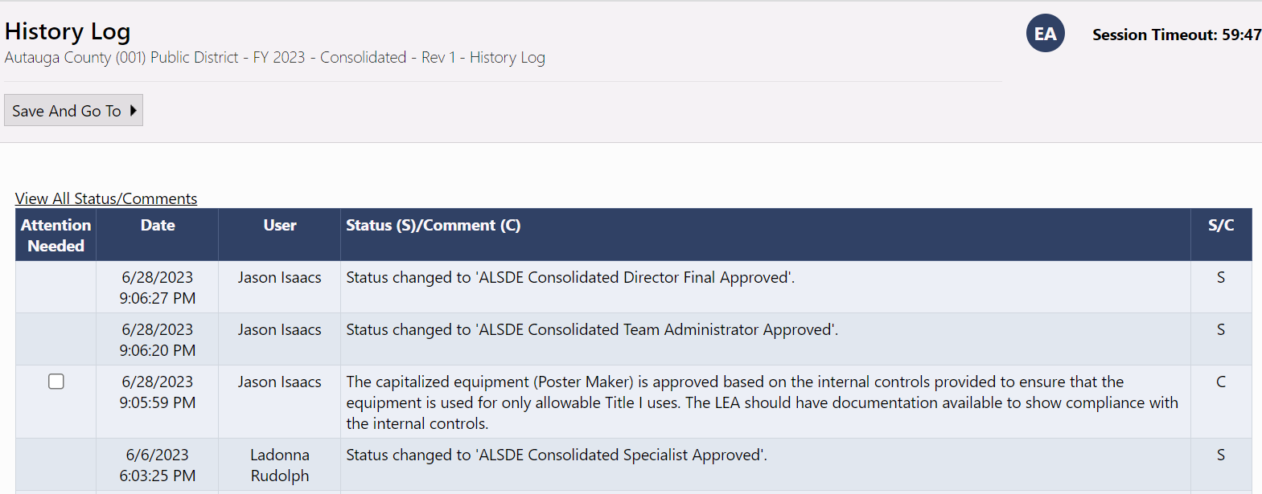
History Log
Also, on the Sections Page, users can access the History Log for the funding application. The History Log lists all status changes and comments related to the application, including details on who made the change and when.

Slide 8
Comments
Comments are ongoing notes and discussion between your organization and CDE related to a funding application.
Comments can be made by anyone with access to the application at any time, regardless of the application’s status.
Comments can be emailed to intended recipients if you’d like to distribute a comment outside of the system.
Comments are saved within the funding application and can be referenced at any point. They will remain a part of the permanent record for the application.
Comments are not visible to public users.

Slide 9
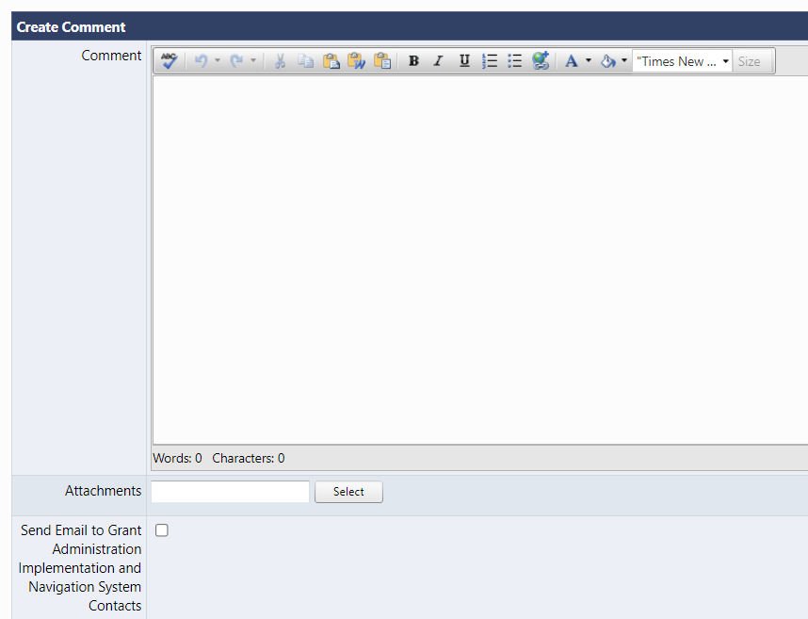
View of Comments
When you select “Create Comment” on the Sections Page, you’ll be taken to this screen.
Compose your message.
Provide any attachments (optional).
If you like to send this comment in an e-mail as well, you can select the applicable contacts after checking the “Send Email” box.

Slide 10
Completing the Grant Budget

Slide 11
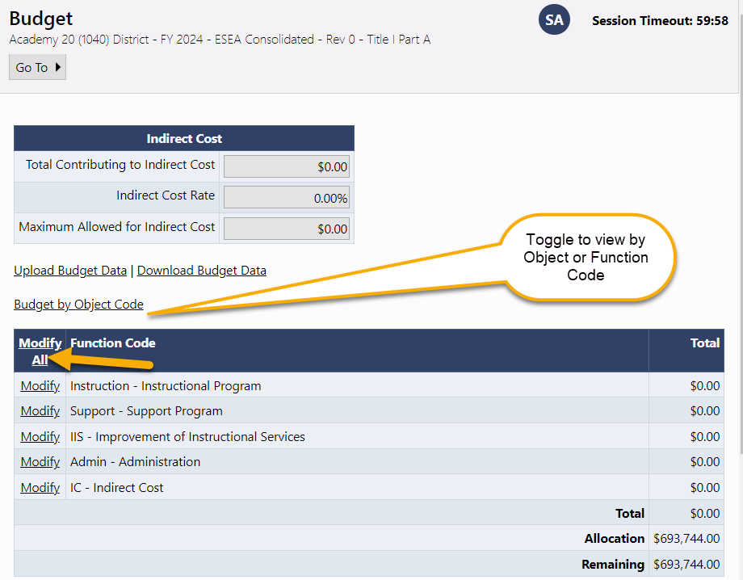
Budget Page
On the Sections Page, select “Budget” to edit the grant budget. The initial budget page will show a summary of your budget by Object or Program code.
Access the Budget Detail page to add or edit budget items by clicking Modify All.
If the action column says View instead of Modify All, your budget line items can be seen but are not editable.
The Upload/Download Budget Data functions can be used by applicants with many budget lines to enter. Budgets can be completed in an Excel document and uploaded to the system rather than adding line by line.

Slide 12
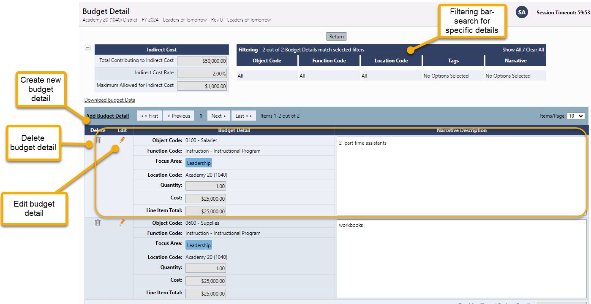
Budget Detail Page
Click the Add Budget Detail link to create a new budget line entry.
On this screen, you can also edit or delete existing budget details.
Use the filtering bar at the top of the page to find a group of expenditures or a specific detail.

Slide 13
Creating a Budget Detail Entry
Select the applicable Object Code from drop-down.
Select applicable Program Code from drop-down.
Tags can identify additional attributes of a budget detail item and are used for filtering and reporting. Tags vary by grant and may not be an option in certain applications.
Location Code is an optional selection. The default location is at the organization or district level, but applicable individual schools will be in the dropdown if costs must be broken out at the school level.
Entering a number in the quantity field multiplies the cost field (but is usually left at 1.00).
Enter the Cost. (If the quantity is 1.00, enter the total cost.)
Enter the narrative description for the item providing any necessary context for the budget line. This is a required element.
Click Create when finished adding the item or click Update if you are editing the item.

Slide 14
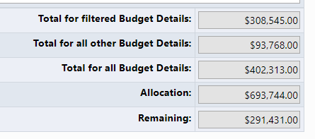
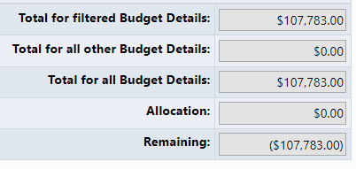
Completing the Budget
Continue creating Line Items until the “Total for all Budget Details” equals the Allocation. Note that in an initial application for a Competitive Grant there will not be an allocation and "Remaining" will be a negative number.
The “Total for filtered Budget Details” field displays the total for details if a filter is applied.
The “Total for all Budget Details” field shows the current total of the budget.
The “Remaining” field reflects the amount of the Allocation still to be budgeted. Again, for initial competitive funding application, “Remaining” will be a negative number.
Grant with initial allocation
Competitive Grant initial application

Slide 15
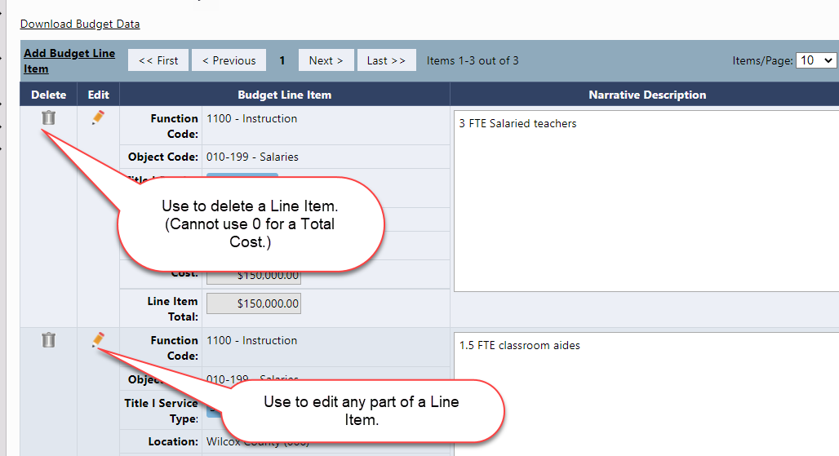
Edit Budget Details
Back on the Budget Detail page, to edit any part of a budget detail, click on the Pencil Icon in the Edit column, make your changes, and click Update.
To delete a budget detail, click on the Trash Can icon in the Delete column.

Slide 16
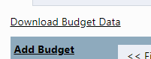
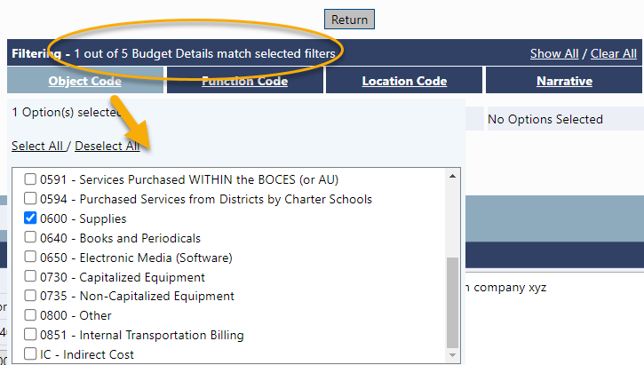
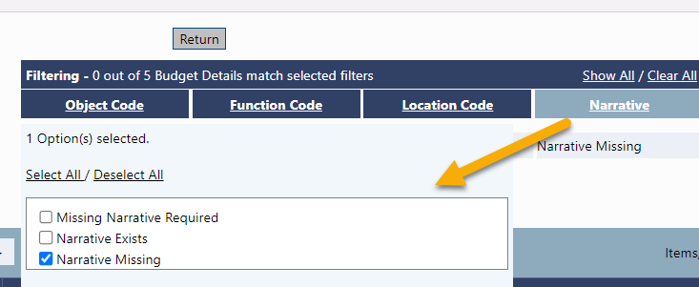
Filtering Budget Details
Also on the Budget Detail page, use the filtering bar to see specific groups of details; for example: the total of all supplies, finding missing narratives, seeing totals by location, etc.
Click a filter heading to see and select the available options.
Click on Show All to return to the view with all line items.
The header also indicates how many line items are present in the budget.
The Download Budget Data button will export your budget details.

Slide 17
Budget Overview
The Budget Overview page is a non-editable grid view of the budgeted subtotals.
The overview can be filtered by locations and can show all possible category/object code combinations by selecting Show Unbudgeted Categories.

Slide 18
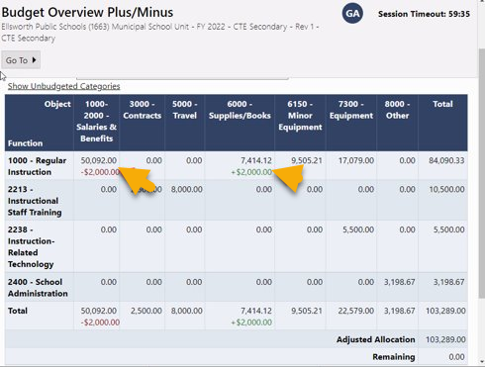
Budget Overview Plus/Minus
The Budget Overview Plus/Minus page is a read-only page that appears in revisions only.
It shows any budget changes from the previous revision broken down by category/object code.
A Red number indicates a reduction.
A Green number indicates an increase.

Slide 19
Additional Application Components

Slide 20
Other Application Pages
Applicants will typically be required to complete other pages in the application in addition to their budget.
These pages may collect additional applicant information, narrative responses, document uploads, and more.
If item has an “ * ” next to it, a response is required for the application to be complete.

Slide 21
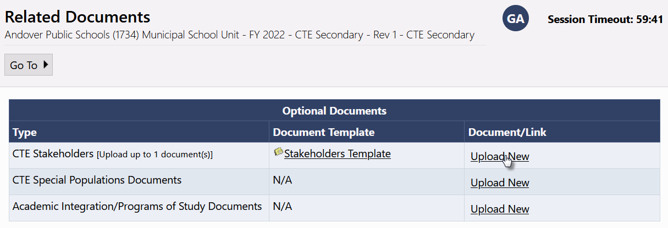
Related Documents
CDE may request that applicants attach additional documentation to complete a funding application.
Documents will be designated as required or optional.

Slide 22
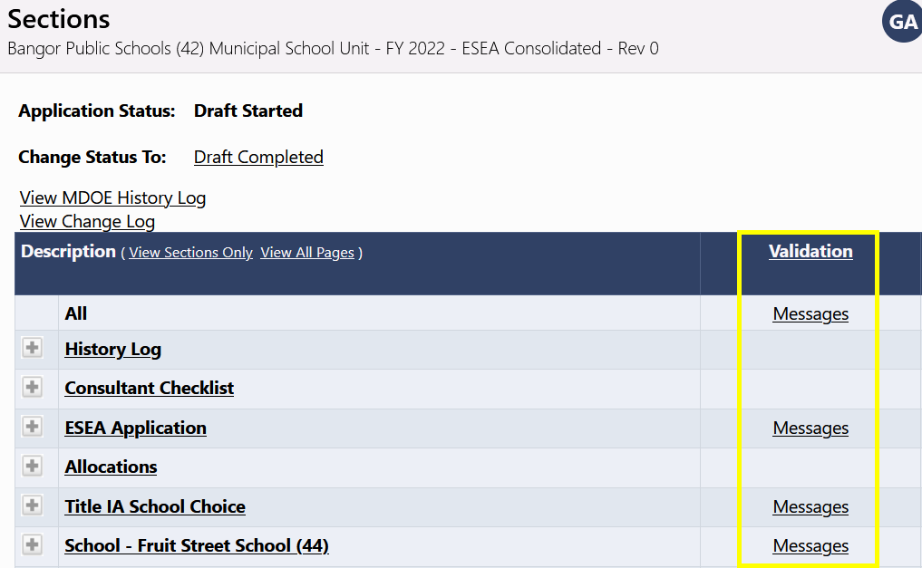
Application Validation
Prior to submitting an application, all validation rules must be met.
GAINS automatically runs validation as you complete your application.
You can view any validation issues on the Sections Page. If it says “Messages” in the Validation column, that page of the application has a warning and/or error.
Note, messages to not appear on the page as you fill out the application. Messages are only present after you save your work and navigate back to the Sections Page.
The validation check does not evaluate the quality of your data, only that data exists.

Slide 23
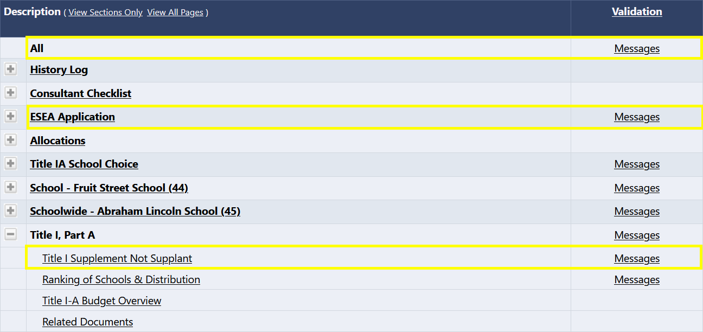
Application Validation (cont.)
There are two types of validation messages.
Errors: Prevent submission of application. (For example, a required response was not provided.)
Warnings: Point out potential issues but allow submission. (For example, an optional document was not uploaded.)
You can view all Messages for the whole application, or view Messages by specific page.

Slide 24
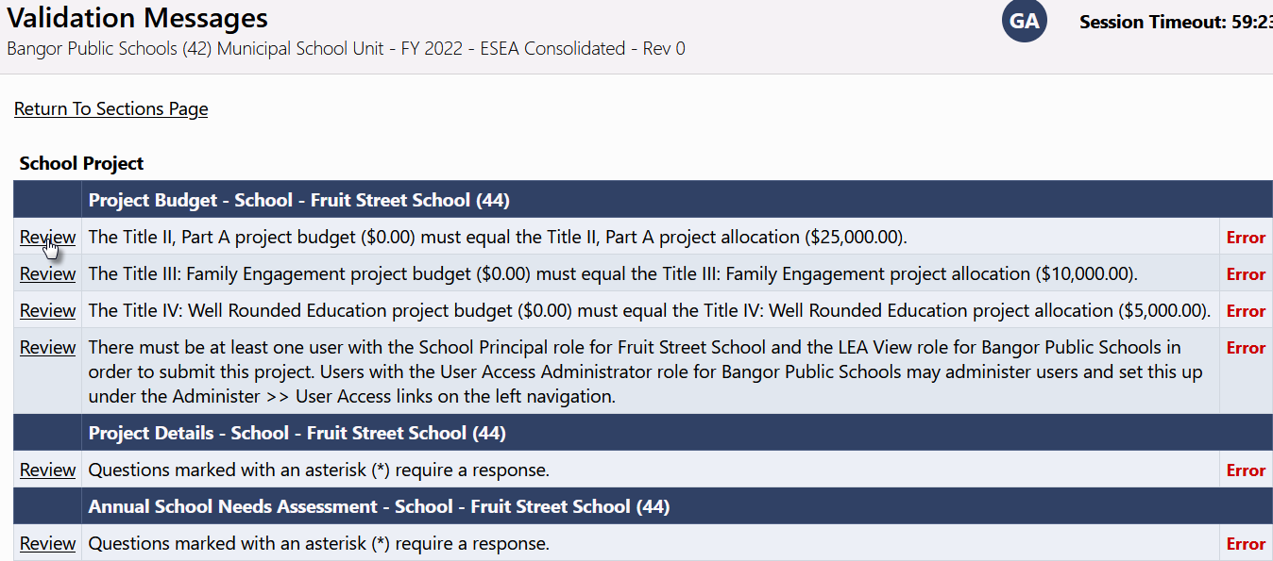
Application Validation (part 3)
Each message contains a clickable “Review” link.
Clicking the link will take user to the screen on which the issue occurred.

Slide 25
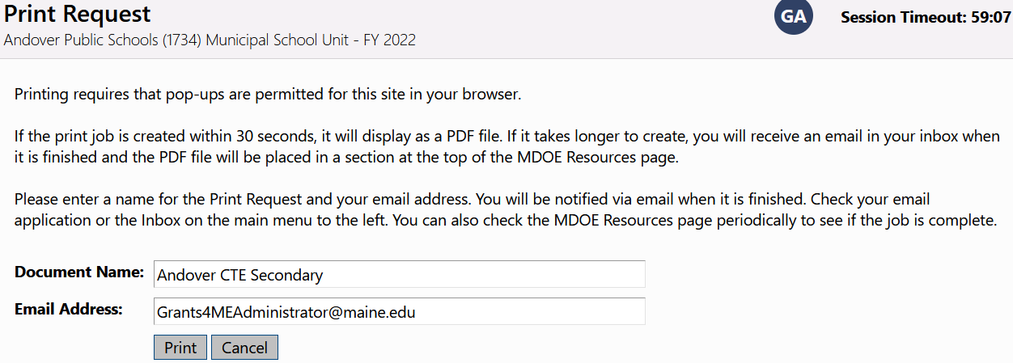
Printing
Small print jobs will be returned and displayed in your browser immediately. Ensure that popups are enabled if your print job does not appear.
Larger print jobs will send an email when complete and can be accessed in CDE Resources.
Print jobs display as a PDF, and you will be able to print or download the resulting document.

Slide 26
System Roles and Workflow

Slide 27
Roles in GAINS
What are the roles and permissions in GAINS?
Roles | Access
LEA Data View | Has the authority view all district content but no editing or status changes.
LEA Fiscal Representative | The Fiscal Representative is authorized to approve grants, complete and submit requests for funds, and will receive fiscal related communication regarding the application. Usually the district Fiscal Manager, but other personnel can also have this role in your budgeting office.
LEA Authorized Representative | The Authorized Representative is the individual authorized to provide final LEA approval and submit the application to CDE on behalf of the LEA. This individual will receive the Grant Award Letter (GAL). Can be a superintendent and/or anyone else at the district who has authority to approve an application.
User Access Administrator | Has the authority to manage LEA user roles. The district LAM(s) has this role by default, but it can be assigned to others in the organization.
LEA All Funding Applications Update | Has the authority to edit any funding application but cannot change statuses/approve. Could be a district grant manager or grant writer.
LEA [Funding Application Name] Director | Authorized to create and complete named grant. The specific person managing the grant if this is not a centralized role for your district.
LEA [Funding Application Name] Update | Authorized to edit but cannot change statuses. Could be a school-based staff member who will need to assist in creating a grant application but would not have authority to submit on the district’s behalf.

Slide 28
Application Submission Workflow
All competitive applications in GAINS will follow the same workflow:
Draft Started
Draft Completed
LEA Fiscal Representative Approved (or Returned)
LEA Authorized Representative Approved (or Returned)
Not Started
Which status is submitted to CDE? LEA Authorized Representative Approved!
If it is in any other status, you have NOT submitted the application to CDE.

Slide 29
Application Submission Workflow (cont.)
Specific roles in the system can complete the various steps:
If either the LEA Fiscal Representative or the LEA Authorized Representative selects “LEA Fiscal/Authorized Representative Not Approved”, the application will return to “Draft Started” for additional edits and the workflow begins over.
Once the LEA Authorized Representative has approved the application, it enters CDE’s workflow.
Draft Started
LEA Fiscal Representative Approved (or Returned)
LEA Authorized Representative Approved (or Returned)
LEA [Program Name] Director
Draft Completed
LEA [Program Name] Director
LEA Fiscal Representative
LEA Authorized Representative
LEA Fiscal Representative
LEA Authorized Representative
LEA Fiscal Representative
LEA Authorized Representative

Slide 30
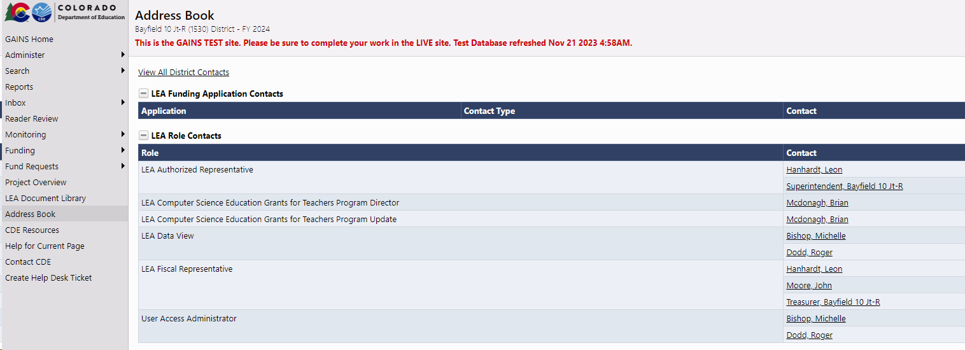
Application Submission Workflow (part 3)
If you need to double check who can next complete an action in the workflow, you can go to your Address Book in the left navigation bar and see which individuals within your organization have which roles.

Slide 31
Status Change Outcomes
Once the status of an application has been changed, the following actions occur in GAINS:
An entry is added to the application’s History Log documenting the change.
The next person in the workflow is notified by email that application now requires their attention.

Slide 32
Consultant Checklist
Some grants might also utilize the Consultant Checklist.
The checklist is used by CDE staff to evaluate the quality of responses in an application.
The checklist helps enhance and simplify communication between CDE and the applicant.
Allows the applicant to better understand, from the start, what is expected from a quality application.
Allows CDE reviewers to provide feedback on common issues without entering extensive narrative describing them.
Allows the applicant to easily identify what portions of a returned application require attention.
If an application will utilize the Consultant Checklist, you’ll find it in the Sections Page along with the other application elements.

Slide 33
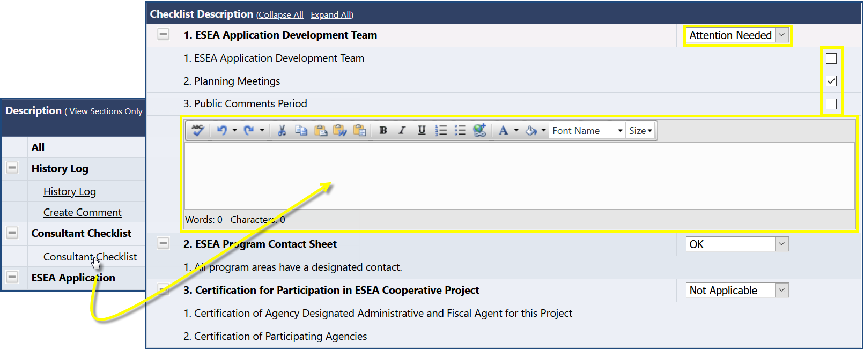
Consultant Checklist (cont.)
In the Checklist, a section may be marked OK, Attention Needed, or Not Applicable by CDE.
If section is marked Not Approved, CDE Application Consultants can check boxes to call out common issues or enter narrative describing the issue(s).
If CDE returns application to applicant as Not Approved, users should go to Checklist page to identify what issues requires attention, fix them, and resubmit application.

Slide 34
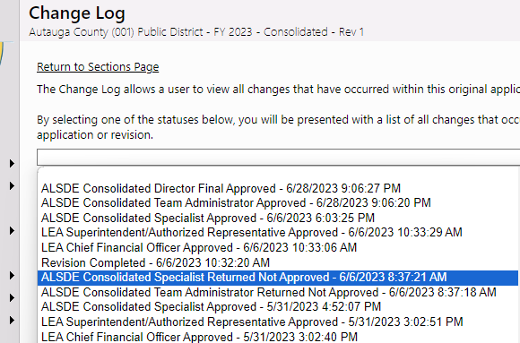
Change Log
Once an application has been approved and opened for revisions, the Change Log comes into play.
Using the Change Log, an awardee can view all changes to an application created since a selected status change
This can be useful for an awardee to see that all necessary changes are made, as well as for reviewers to identify all changes that need to be approved.

Slide 35
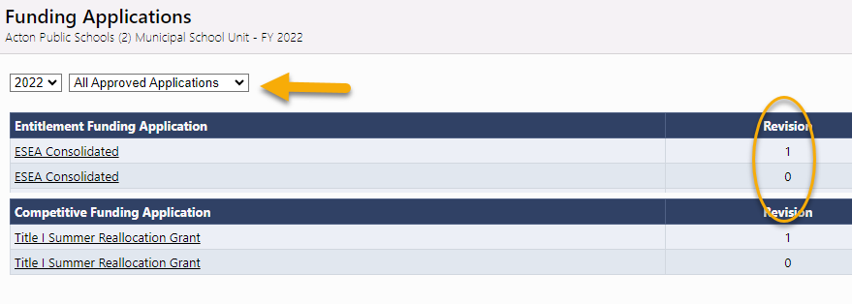
Revisions
Once an application receives final approval from the applicable CDE Director, the original application is locked and is designated “Rev 0”.
Changes/amendments to the application can be made to the application by starting a revision.
Revisions will copy the previous version data for editing. For example, if an awardee is starting a revision to their original application, the data from Rev 0 will transfer in full to Rev 1 for editing.
Like applications, revisions go through an approval process workflow.
Each application revision is saved separately and is accessible from the Funding Applications page by selecting All Approved Applications.

Slide 36
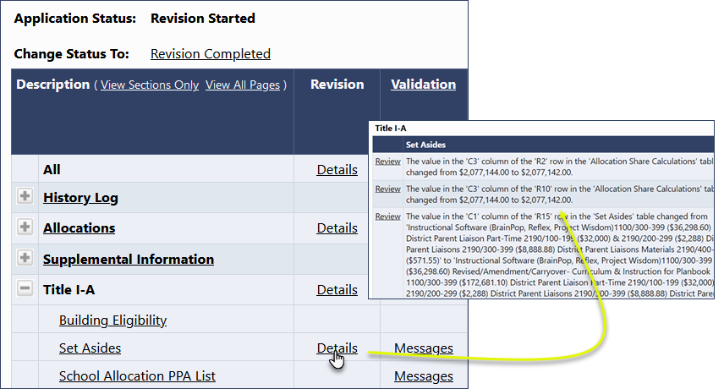
Revisions (cont.)
The Details link in the Revision column on the Sections Page lists changes specific to each page from the previous version.
By highlighting those changes, there is no need to review the entire application revision as GAINS will direct users to any new/revised data in the application.

Slide 37
Questions?

Slide 38
GAINS Walkthrough

